Slide 1

2025 Final Summary / 2026 Plans
Subproject: SP F Wall conditioning and boronization physics
Project Meeting
Plasma-Wall Interactions and Exhaust
Andrei Goriaev
LPP-ERM/KMS
Affiliation
S. Brezinsek (PL), J.W. Coenen, A. Hakola, K. Schmid, A. Kirschner, J. Likonen, I. Classen, A. Goriaev, and D. Douai (DPL)

Slide 2
2025 Final Summary of SP F:
SP F.1: Review of boronization physics and procedure
SP F.2: Mimic boronization and develop analysis techniques
SP F.3: Activities at TOMAS with test of ITER conditions and needs

Slide 3
Status 2025 Tasks and Deliverables SP F.1
Review of boronization physics and procedure
PWIE-SP F.1.T-T002-D001 Boronization procedures, experimental settings, and efficiency of boronization in toroidal devices (WEST) reviewed. Input for new ITER boronization strategy provided (CEA)
PWIE-SP F.1.T-T002-D002 Efficiency and properties of boron layer formation in toroidal and laboratory devices reviewed. Input for new ITER boronization strategy provided (FZJ, LPP-ERM-KMS)
PWIE-SP F.1.T-T002-D003 Boronization procedures, experimental settings, and efficiency of boronization in toroidal devices (ASDEX Upgrade) reviewed. Input for new ITER boronization strategy provided (MPG)
All corresponding deliverables achieved and reported

Slide 4
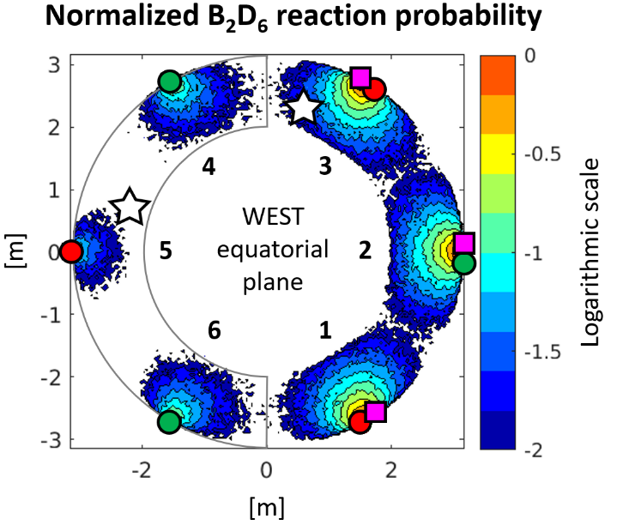
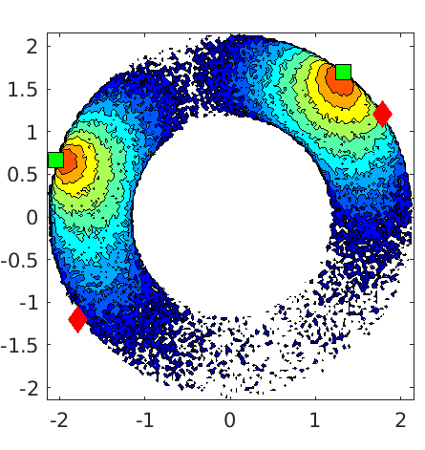
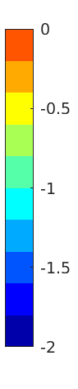
Example of Activity SP F.1
Characterization of a non-uniform boronization setups on AUG and WEST
Non-uniform boronization with half-torus B₂D₆ injection (WEST)
boron layer thickness variations of up to 2 orders of magnitude, exceeding modelling predictions
NRA of tungsten and stainless-steel samples in boron-depleted regions revealed
  reduced boron areal density
  lower D/B ratios
  increased oxygen content
Non-uniform boronization with half (2) anodes (AUG)
boronization resulted in lower overall deposition
experimentally observed non-uniformity was 2–3 times smaller than predicted
  likely due to overestimation of the boron sticking coefficient
spatial variations in boron deposition driven by geometric and shielding effects
D2H6 injected at
[A. Gallo PFMC 2025]
Reaction density of B₂H₆ (log)
AUG
2 active
anodes
[T. Wauters, 35th ITPA DivSOL]
B2H6 injected at ◊, Anodes located at ■

Slide 5
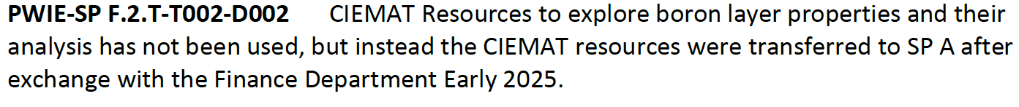
Status of 2025 Tasks and Deliverables SP F.2
Mimic boronization and develop analysis techniques
PWIE-SP F.2.T-T002-D001 CEA Resources to explore boron layer properties and their analysis (CEA)
PWIE-SP F.2.T-T002-D002 CIEMAT Resources to explore boron layer properties and their analysis (CIEMAT)
PWIE-SP F.2.T-T002-D003 Exploratory boron layer production and exposure in PSI-2. Characterization and post-mortem analysis of boron layers. Development of LIBS and LID-QMS for thin boron layers. (FZJ)
PWIE-SP F.2.T-T002-D004 VR Resources to explore boron layer properties and their analysis. NRA analysis of thin boron samples (VR)
PWIE-SP F.2.T-T002-D005 Resources to explore boron layer properties and their analysis (MPG)
PWIE-SP F.2.T-T002-D006 NRA analysis of thin boron samples including support for SP B (RBI)
PWIE-SP F.2.T-T002-D007 NRA analysis of thin boron samples including support for SP B (IST)
PWIE-SP F.2.T-T002-D008 NRA analysis of thin boron samples including support for SP B (NCRSD)
All corresponding deliverables achieved and reported

Slide 6
Example of Activity SP F.2
Laser: Nd:YAG 1064 nm, 29 J, 1.5 ms pulse, 3.6 mm x 3.1 mm spots
Laser-Induced Desorption LID-QMS in PSI-2
Samples used: W substrates with 0.3 µm a-C:D layer and 0.3 µm a-B:D layer
Step
too fast pump-out
D₂
HD
Use the integral of the partial pressure as LID-QMS signal.
Calibration using the integral, too.
→ results in 3 orders of magnitude too low D desorption
  Laser power inhomogeneity at sample position
  Spatial variations of vacuum window transmission due to deposits
The QMS scan takes few seconds. Too strong pumping evacuates the desorbed gases too quickly → The maximum value is missed.
With only 1 pump (the QMS pump), the maximum value is captured.

Slide 7
Status 2025 Tasks and Deliverables SP F.3
Activities at TOMAS with test of ITER conditions and needs
PWIE-SP F.3.T-T002-D001 TOMAS upgraded to support ITER wall conditioning studies by ECWC, ICWC, GDC. Cleaning effectiveness of first round on boron-containing samples performed. (FZJ)
PWIE-SP F.3.T-T002-D002 TOMAS upgraded to support ITER and W7-X wall conditioning studies by ECWC, ICWC, GDC and underlying codes benchmarked. (KIPT)
PWIE-SP F.3.T-T002-D003 TOMAS upgraded to support ITER wall conditioning studies by ECWC, ICWC, GDC and underlying codes benchmarked. Cleaning effectiveness of first round on boron-containing samples performed. (LPP-ERM-KMS)
PWIE-SP F.3.T-T002-D004 Preparation of first round of boron coating samples. The work is rescoped and done in close collaboration with SP B. (FZJ, VR)
All corresponding deliverables achieved and reported

Slide 8
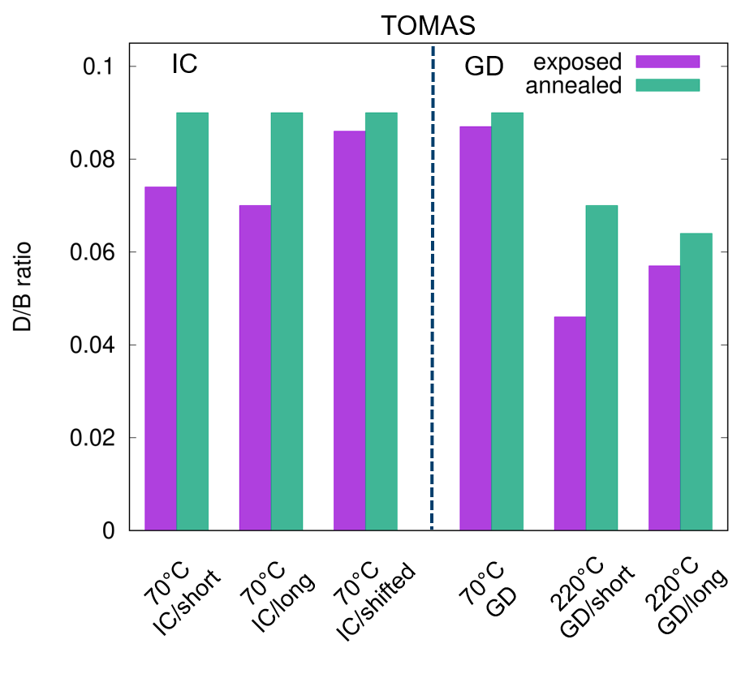
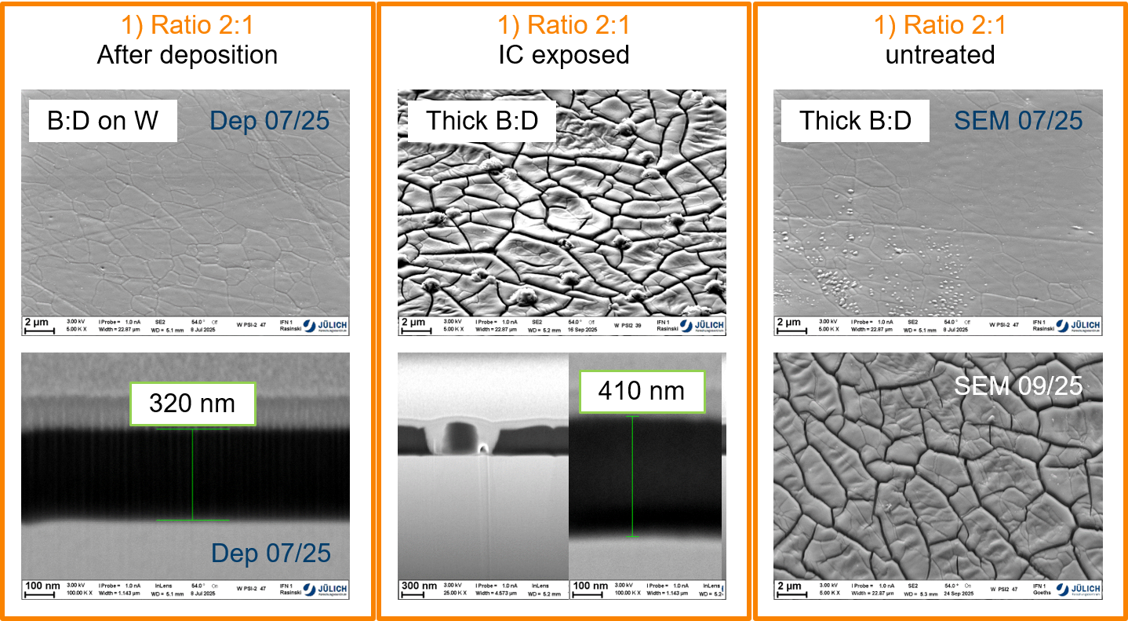
Example of Activity SP F.3
Studies of fuel removal from B:D layers by isotopic exchange on TOMAS
Two types of B:D layers (“thin” ~ 160 nm and thick ~ 320 nm) produced by magnetron sputtering deposition and characterized by FIB/SEM, NRA and TDS
“Thin” B:D layers ~ 160 nm
Exposed to H GDC and ICWC plasmas
Comparison of the D/B ratio of the H plasma exposed and reference samples
Maximum of 18% of the D removed by the 11.3 min H ICWC plasma exposure at 70 ºC
triple ICWC exposure time increases D removal to 22%,
H GDC plasma (117 min) at 70 ºC -> D removal is insignificant.
Increasing sample temperature to 220 ºC leads to the highest D removal of ~ 34%.
Stable and homogenous thick layers are subjected to a layer cracking and layer thickness increase after
plasma exposure and annealing
several weeks without treatment in vacuum

Slide 9
2026 Plans of SP F

Slide 10
PWIE Structure in 2026 and 2027
Project Leader: S. Brezinsek
Deputy Leader: D. Douai
PSO: D. Alyassin / NN
Project | Titel | Leader
SP A | Particle and heat load studies in preparation of the exploitation of ITER and a fusion power plant | J.W. Coenen
SP B | Experiments on erosion, deposition, and material migration | A. Hakola
SP C | Fuel retention and release | K. Schmid
SP D | Plasma-edge and plasma-wall interaction modelling | A. Kirschner
SP E | JET post-mortem analysis, LIBS and associated interpretation | J. Likonen
SP F | Wall conditioning and boronization physics | A. Goriaev
SP X | Plasma characterization and laser-based diagnostic development | I. Classen
In general: Tasks and Deliverables are prepared for 2026 and 2027
IMS entry of tasks and deliverables shall be completed by first week of March

Slide 11
2026 Resources distribution
Distribution of Human Resorurces among selected RU
Distribution of selected Machine time
Facility Resource | Operation Days
PSI-2 | 15
TOMAS | 40
FZJ accelerator | 7
VR accelerator | 5

Slide 12
SP F Description 2026-2027
Provide guidelines for ITER to achieve a reasonably uniform B layer coating of the main chamber plasma facing surfaces with validation on TOMAS by characterized GD.
Review of boronization experience in current W devices and of the extrapolation to ITER from point of view of technical and physical aspects.
Aspects of fuel content and fuel release from boron layers addressed with in-situ experiments using LIBS in PSI-2, BiGYM.
RF-wave absorption and propagation, resulting in desirable ion/CXN fluxes inducing impurity and fuel removal validated and used to benchmark codes for ECWC/ICWC such as TOMATOR-1D in TOMAS.
Cleaning activities on boron co-deposits from laboratory experiments or tokamaks
Laser-based techniques to the TOMAS manipulator used for in-situ analysis without exposure to oxygen (LID-QMS and/or LIBS).
Two major task activities will be carried out:
SP F1: Experimental studies of retention and removal of D by GDC and ICWC from boron mixed layers on tungsten substrates by laboratory experiments. Comparison with tokamak (WEST, ASDEX Upgrade) sample exposure experiments.
SP F2: Detailed physics studies of wall conditioning processes on the TOMAS device: in view of ITER wall conditioning schemes and predictive simulations

Slide 13
2026 Tasks and Deliverables SP F.1
Exposure of samples to non-uniform (half diborane injection points) boronizations in WEST and analysis of the characterization results (CEA)
Exposure of witness samples on Laser-Blow-Off (LBO) manipulator during AUG glow discharge boronization (GDB) and characterization of boron (B) and deuterium (D) retention using ion beam analysis (IBA) (MPG)
Analysis of long-term silicon (Si) samples by ion beam analysis (IBA) to determine the campaign-integrated spatial distribution of boron content and deuterium retention behavior for samples from experimental campaign 2025 (MPG)
Comparison of laboratory B and B-D layers with coatings generated in boronizations in fusion experiments (FZJ)

Slide 14
2026 Tasks SP F.1
Exposure of hydrogen and deuterium doped boron-coated samples in TOMAS wall conditioning plasmas supporting boronization studies for ITER and W7-X (LPP-ERM/KMS)
Optimization of hydrogen-dopped boron-coating production in laboratory devices and supporting coating analysis for TOMAS exposure experiments (FZJ)
Production of B:W:N:O layers with doped deuterium via ion implantation, followed by pre-characterisation and post-mortem analysis after exposure in TOMAS wall conditioning plasmas (VR)

Slide 15
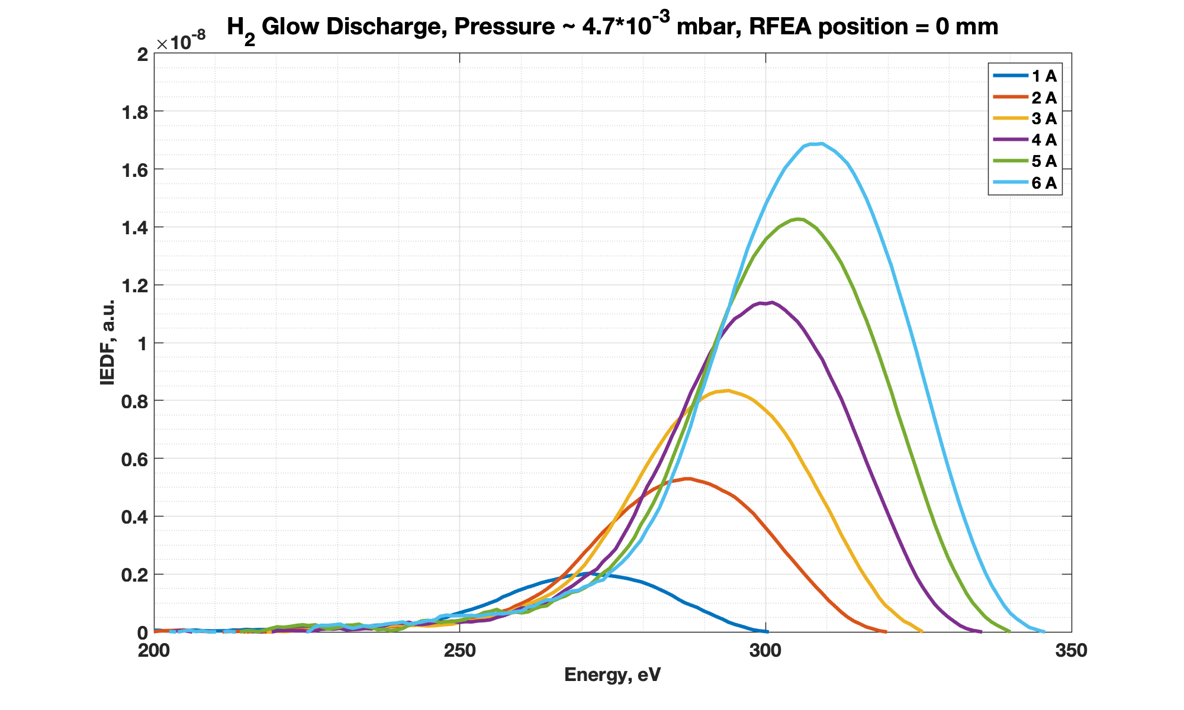
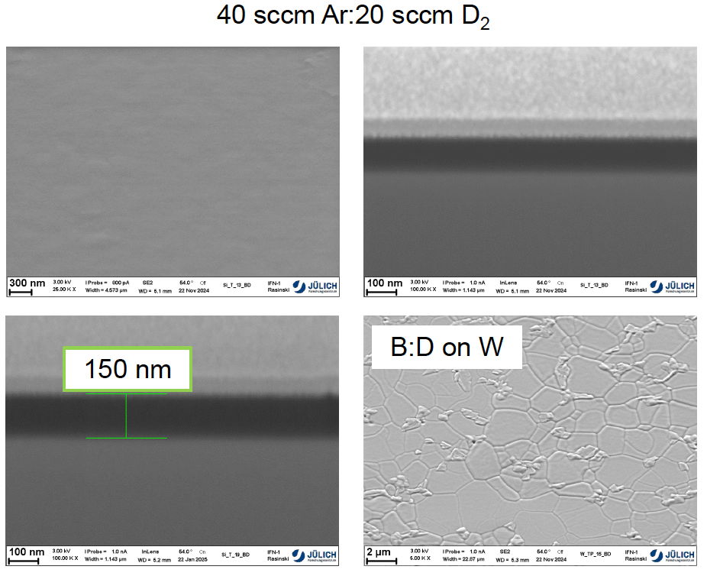
Example of SP F1 Activities
Exposure of H and D doped boron-coated samples in TOMAS wall conditioning plasmas for ITER
Exposure to TOMAS D and H GDC and ICWC plasmas
Plasma characterization by ToF NPA, RFEA, Langmuir probes
Elevated sample temperatures (70 ºC and 220 ºC)
Boron-coated W samples prepared and analysed by
FZJ (hydrogen dopped samples)
VR (B:W:N:O layers with doped deuterium via ion implantation and co-deposition)
Main goal:
Compare isotope exchange effects in different gases
Layer impurity influence on deuterium release
Assess stability of the layers during the exposure procedure and erosion rates by wall conditioning plasmas

Slide 16
2026 Tasks SP F.2
Upgrade of the power deposition module in the TOMATOR-1D code for fundamental and second harmonic EC heating (LPP-ERM/KMS)
Exploration of optimal breakdown conditions and magnetic configurations for Electron Cyclotron Wall Conditioning scenarios for JT-60SA and ITER (LPP-ERM/KMS)
Characterization and analysis of H and D mixed wall conditioning plasmas in TOMAS utilizing the improved data analysis methods for TOMAS plasma diagnostics (LPP-ERM/KMS)
Study of the combined glow + microwave discharges and ICWC wall conditioning scenarios in TOMAS (KIPT)
Development of a thermal desorption probe for TOMAS wall conditions characterization (KIPT)
Adaptation of the multichannel broadband spectrometer for characterization of TOMAS wall conditioning plasmas (FZJ)

Slide 17
2026 Tasks SP F.2
Commissioning of LIBS on the BiGYM and its first tests with boron-coated samples (ENEA)
Design of the LIBS (or LID QMS) integration on the TOMAS device (FZJ)
Further development of in-situ LIBS and LID-QMS techniques for fuel retention characterization on deuterium/hydrogen implanted boron coatings on PSI-2 (FZJ)
Production of boron-coated samples for LIBS and LID-QMS method development in PSI-2 and their comparative surface analysis (FZJ)
Production of boron-coated samples by redeposition of eroded boron in PSI-2 and its in-situ characterization (FZJ)
Production and characterization characterization of W boron-coated samples with different boron thickness and deuterium concentration for LIBS studies in PSI-2 (IAP)

Slide 18
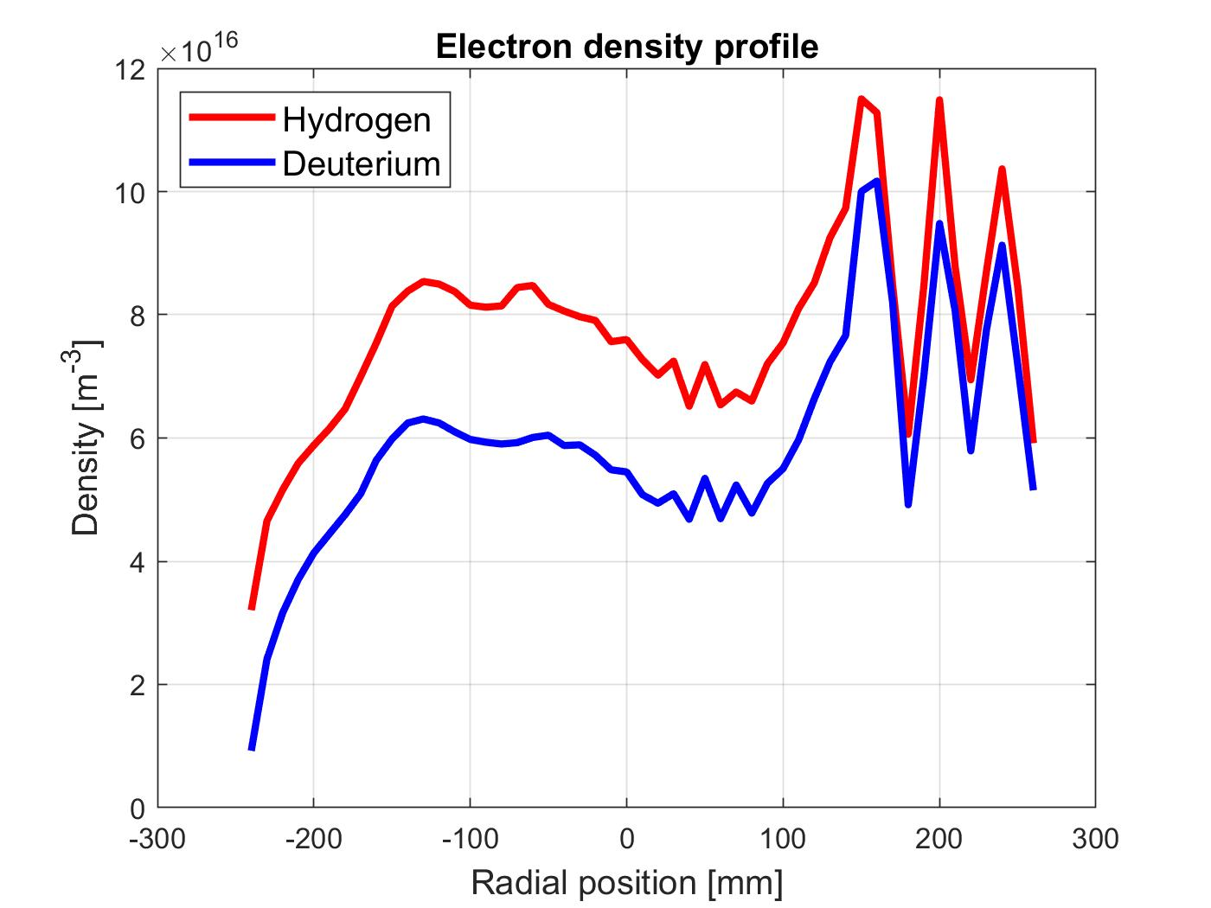
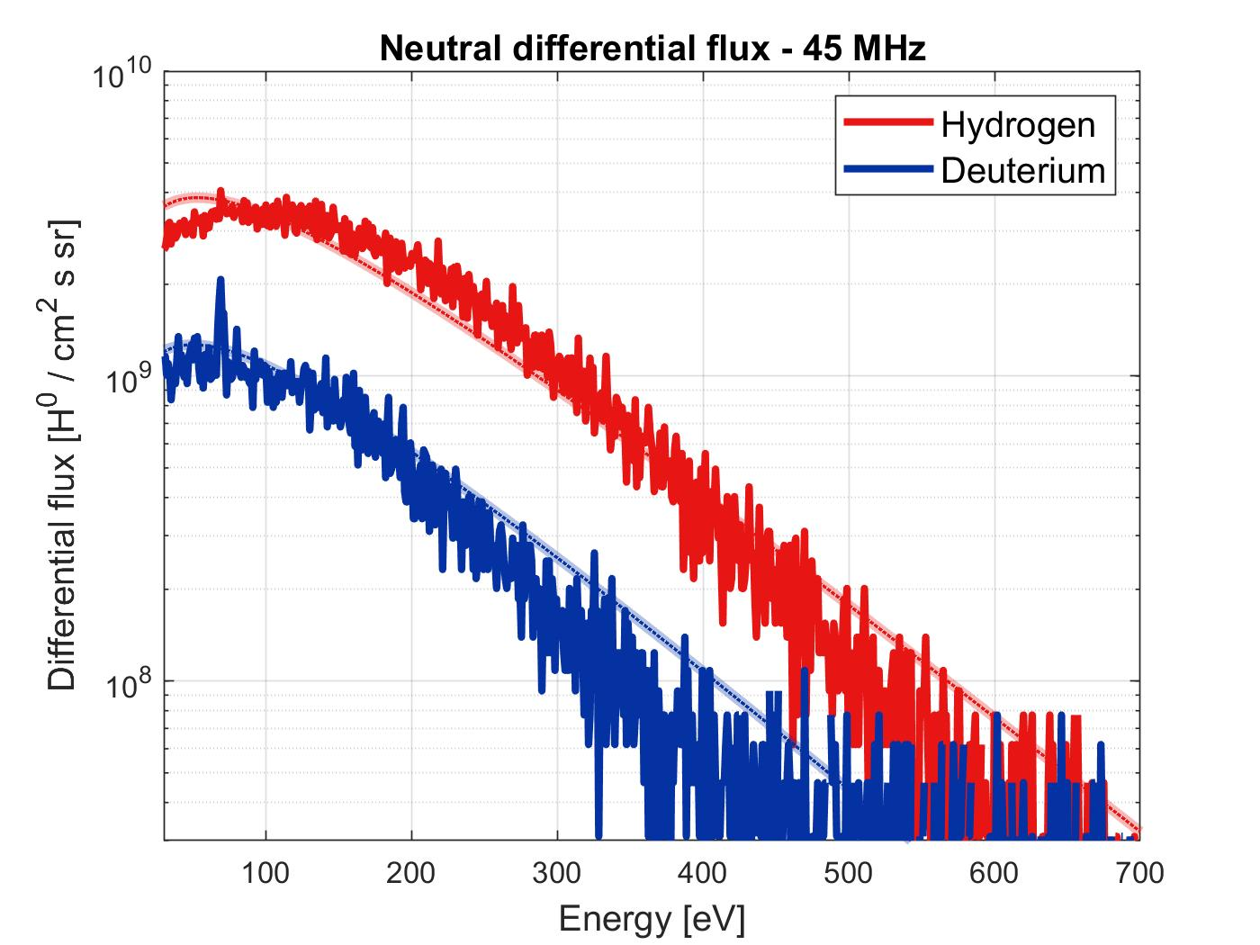
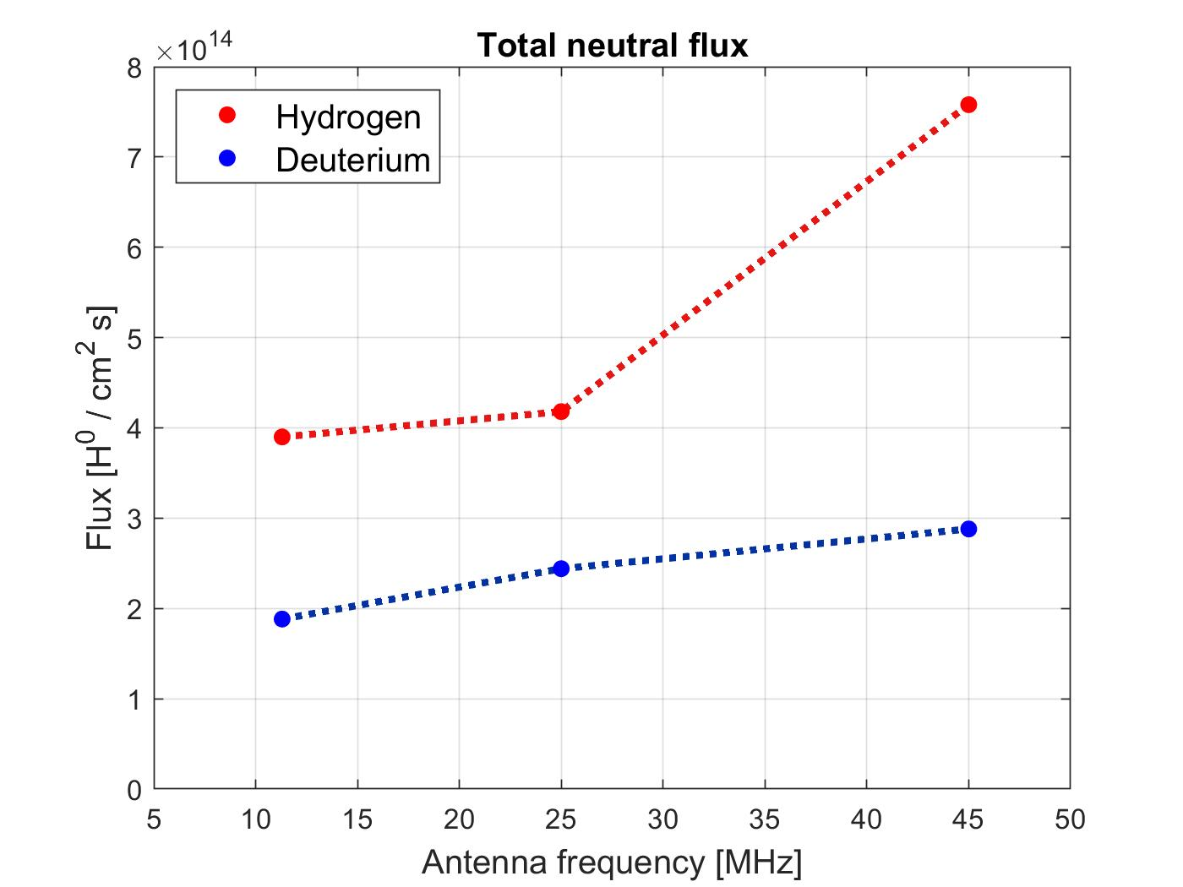
Example of SP F.2 Activities
Characterization and analysis of H and D mixed ICWC plasmas in TOMAS
  Measurement of vertical and radial profiles of electron density and temperature for both gases and their mixtures using Langmuir probes.
  Measurement of neutral particle energies and fluxes for gas mixtures using a Time-of-flight neutral particle analyzer.
  Comparison between the results obtained with the diagnostics for hydrogen and deuterium plasmas and mixed plasmas and study on the dependency on different plasma parameters like ICRH power, antenna frequency, magnetic field strength, and gas pressure.

