Slide 1
Additional proposals for 2027
Project Meeting
Plasma-Wall Interactions and Exhaust
D. Douai
CEA, IRFM
S. Brezinsek (PL), J.W. Coenen, A. Hakola, K. Schmid, A. Kirschner, J. Likonen, I. Classen, A. Goriaev, and D. Douai (DPL)

Slide 2
Context
PMU asks for submission of High Level Topics (HLTs) addressing key questions for ITER and fusion pilot plan to be funded in 2027 and to be evaluated in a competitive manner
Discussion at FSD PB pre-meeting on March 5/6 : identification of budget requirements and discussion on prioritization, including facilities
As input to FSD Project board on March 16/17 for approval in April GA
So far two topics identified (disappeared in AWP2026-2027 due to “budget” cut) :
Tritium studies
Dust

Slide 3
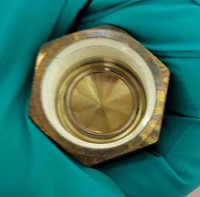
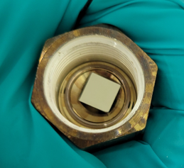
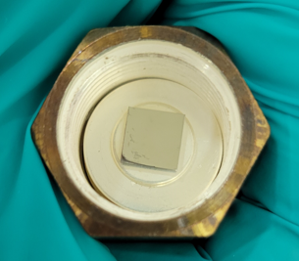


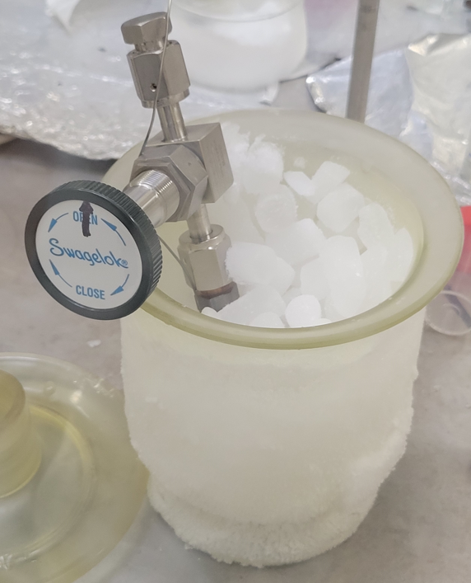
Tritium studies (1): Kinetics of T desorption: comparison in air vs. in water
New device (TETRIS : ThErmal TRItium desorption in materialS) and new protocol:
T₂ loading : both samples are in the same enclosure → exact same loading conditions (T, P, duration)
Quench: after loading, the sample holder is put in dry ice → desorption does not start until the samples are taken out of the dry ice bath
Desorption measurements: one of the sample desorbs in air, the other in water. For the one desorbing in air, tritium is measured either with an ionisation chamber (if the activity is low enough) or with tritium bubblers. The flow goes seamlessly to the ionisation chamber or to the bubbler to allow a continuous recording of desorption:
To the tritium loading rig
Samples
« snubber » gasket: holds the sample, lets T2 through
Empty sample holder
First sample inserted
Second sample inserted
To the ionisation chamber
Inlet flow (air or Ar)
Direct water samplings and liquid scintilliation counting
To the tritium bubblers
Samples held vertically → equal contribution of both sides

Slide 4
2025: First experimental testing: bare vs. Pd-coated Eurofer
Loading conditions :
200°C
50 mbar of T₂
1h
Bare samples:
Most of the desorption in air occurs within the first day
The release in water is instantaneous (slight decrease due to desorption in air)
Pd coated samples:
clear difference in desorption dynamics
Proposed activities in 2027: High-temperature loading / desorption

Slide 5
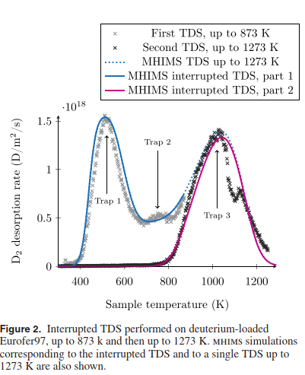
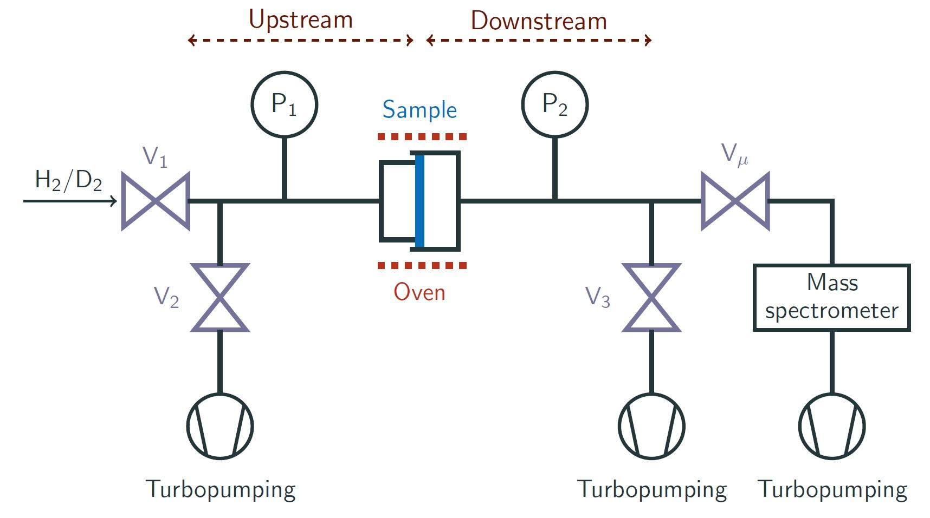
Tritium studies (2) : Copermeation analysis
Several trapping sites identified in Eurofer97
in particular irreversible sites at high energy
Proposed activities in 2027: copermeation studies to allow studying kinetics of trapping/detrapping and isotopic exchange
H/D copermeation experiments on Eurofer using the new version of Hypertomate
Analysis of D/T copermeation through D/T desorption loading experiments performed with Teddi and Tetris
Associated modelling of H/D/T co-permeation and T outgassing permeation with the standard diffusion trapping tools (FESTIM and MHIMS)
F. Montupet-Leblond, NF 2022

Slide 6
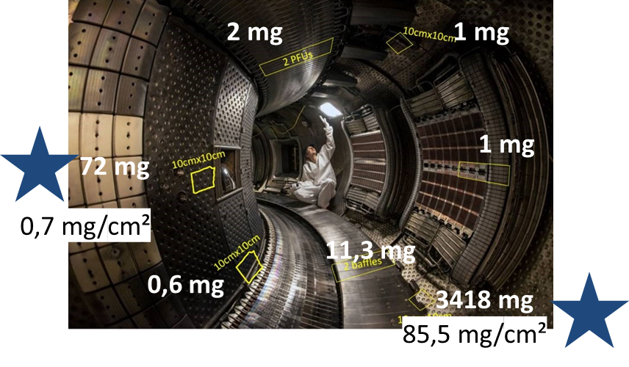
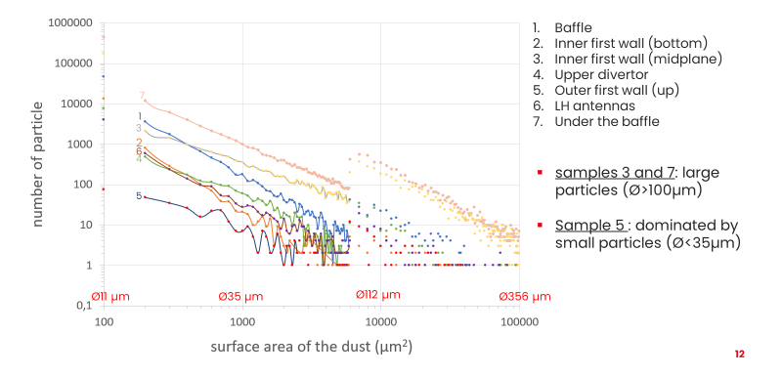
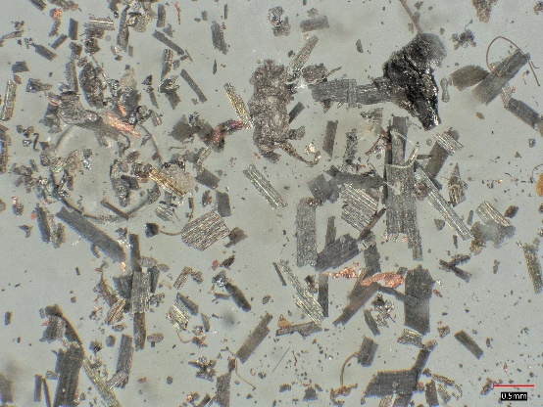
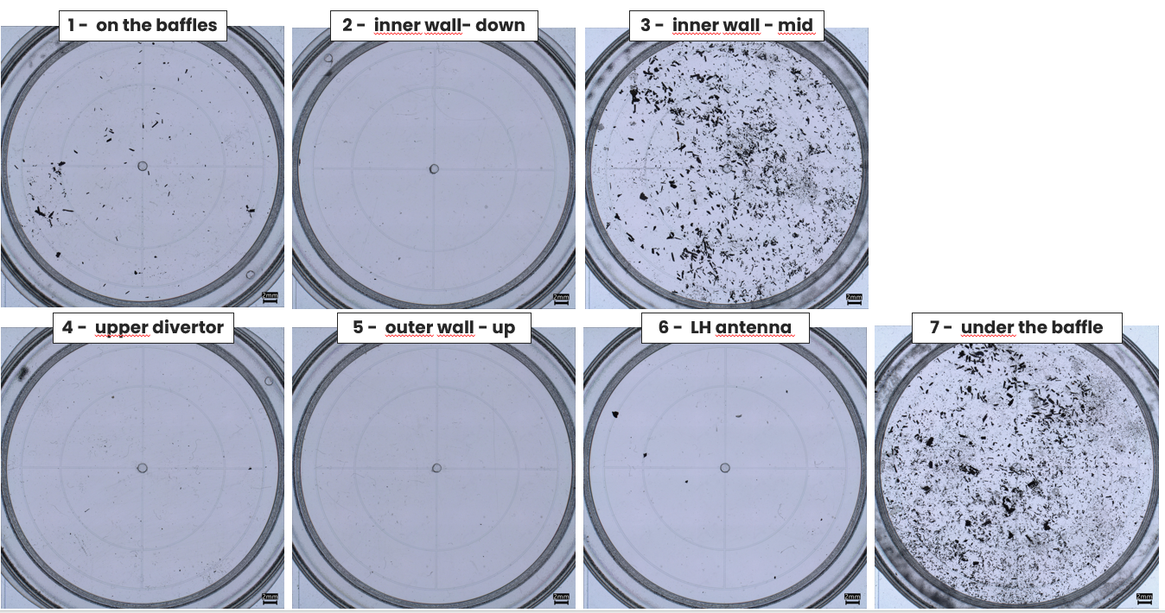
Characterization of dust produced on WEST during Phase 2
Work carried out within SAE and reported in PWIE
2024 (after C8/C9) : collection on 7 points in a poloidal section of WEST
size distribution measured
highest mass under the baffle
SEM/EDX measurements:
Particles of W coating, B, but also Cu, Fe, Cr, Si…
M. Diez, A. Flament, C. Martin, et al.

Slide 7
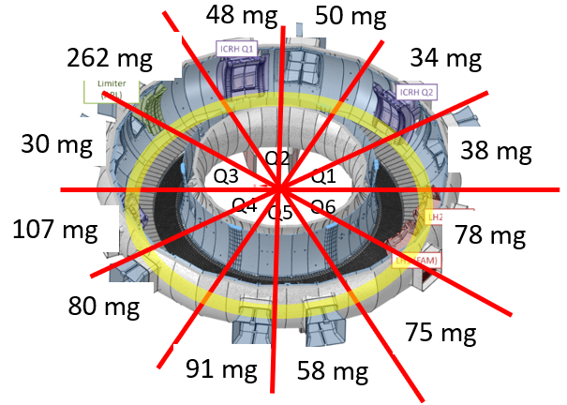
Characterization of dust produced on WEST during Phase 2
2025 (after C11): collection toroidally under the baffle, over the VV
12 dust collections (Q1→Q6)
→ Dust evenly distributed across the 12 sectors but more on poloidal limiter
size distribution : on-going
SEM/EDX analyses : on-going
+ in 2025 : 180g of dust from laser cleaning of the divertor prior to high fluence campaign C12 with XPR…

Slide 8
Proposal/need for 2027 : fuel and composition vs. size, morphology, composition, location…
Composition and fuel content …
Ion-beam analyses (micro-beam techniques)
TDS?
Pyrolysis?
Dust mass and size and shape distributions
Microscopy (SEM, TEM)
Weighing
Statistical analyses
Any other analysis method?
We can compare “normal dust” with dust from laser cleaning
8

Slide 9
Safety issue
Gamma spectrometry performed on dust samples revealed 181W
only qualitative measurement, activity not quantified yet
→ dust samples are considered to be above the thresholds set by CEA: 10⁶ Bq/total and 1 Bq/gr
→ can only be sent to nuclear facilities made aware of the activity
→ work on-going with CEA safety to release constraints
PFUs sent to EU labs for analysis had lower values → we don’t expect levels in dust to be higher than these very low thresholds since WEST
we need labs with nuclear license and post-mortem analysis capabilities
→ call for volunteers!
→ to be discussed today and developed next week
9

