Slide 1
WP TE : proposed budget requests for 2027 for preliminary discussion
Pre PB Meeting
05/03/2026
E. Tsitrone and N. Vianello
For WP TE Task Force leaders

Slide 2
Background : high level objectives for WP TE in 2026-2027
Address urgent R&D issues related to the new ITER baseline / Research Plan (full tungsten wall) : far SOL physics and wall loads; tungsten sources, transport and screening; startup on tungsten limiters; runaways damage of tungsten first wall components and efficiency of boronisation in full tungsten devices
ITER-EUROfusion MoU
Provide a full qualification of the most promising no ELM scenario, focusing on X-point radiator (XPR) and quasi-continuous exhaust (QCE) now considered as a viable option for ITER / DEMO.
Support modelling efforts for interpretation of available data from TE devices, including JET DD and DT last campaigns
integrated modelling for JET high current radiative scenario in view of validating models used for ITER
Prepare the JT-60SA scientific exploitation in the OP2 and OP3 campaigns, pending resources becoming available.

Slide 3
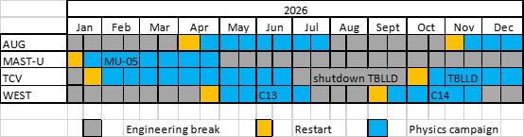
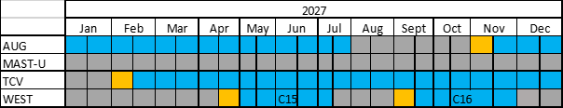
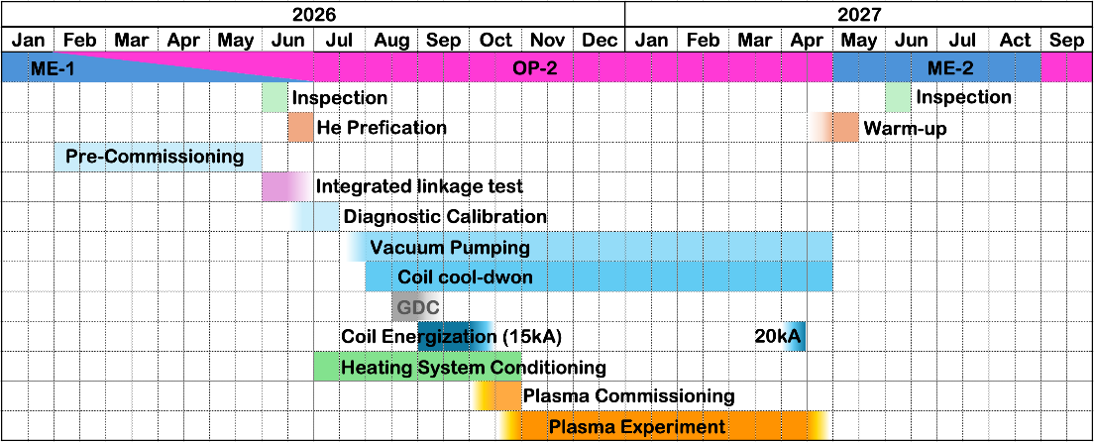
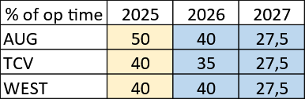
Background : operating WP TE devices in 2026-2027
JT-60SA
K. Takahashi, ETCM-05, Feb 2026
2026
AUG, MAST-U, TCV and WEST in operation : ~25 months of ops
JT-60SA : start of OP2
2027
AUG, TCV and WEST in operation (MAST-U in shutdown) : ~25 months of ops
JT-60SA : OP2 + start of OP3

Slide 4
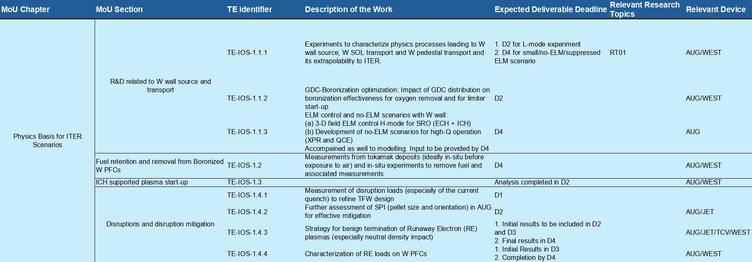
R&D in support of the EUROfusion-ITER MoU requires experimental time, data analysis and modelling
W wall source and transport
Boronisation
Disruption and RE mitigation, RE impact
ELM control and no ELM scenario
ICRH start up
Control workflow …
Experimental time in AUG/WEST/TCV

Slide 5
R&D in support of the EUROfusion-ITER MoU requires experimental time, data analysis and modelling
Development / validation of plasma models + analysis workflow
➔ data analysis / modelling from JET/AUG/TCV/WEST
JET : complete key JET data analysis / modelling before opening to international collaborators
EFPW recommendation : extend effort for integrated core/edge modelling (JET high current radiative scenario) to XPR / QCE

Slide 6
WP TE 2026-2027 budget for scientific exploitation : present situation
Presently for 2026 (« real » ppy) :
~ 100 ppy allocated for TE devices
~ 11 ppy allocated for JT-60SA (data analysis OP-1/preparation OP2 + W phase)
485k CC cost / ~10 ppy left :
3-4 ppy for OP2 call for participation,
6-7 ppy for further data analysis activities, modelling (to be discussed with WTM/TSVV, as presently no extrapolative modelling towards ITER/FPP in TE) (+ transfer for 2027 ?)
ppy TE-2 (@82 k average salary*) | 2025 | 2026 | 2027
Other TE devices | 107* | 92* | 74
JT-60SA | 11* | 13** | 0
-15% for 2026, -30% for 2027
No support for JT-60SA in 2027
* Note that actual ppy are higher as TE effective average salary ~66 k (UK staff + PhD/ERG … covered by other means)
** granted at last GA
Missions (CC cost) | 2025 | 2026 | 2027
Other TE devices |  | 867 | 445
JT-60SA |  | 119** | 0
Total | 986 | 986 | 445
No support for JT-60SA in 2027
Presently for 2026 :
150 k CC cost of missions already allocated
-50% for 2027
** granted at last GA
Secondment for JT-60SA for 2026 : 87.5 k CC cost (granted at last GA)
INCO (EAST, KSTAR, D-IIID) : same level as 2025

Slide 7
Proposed WP TE budget requests for 2026/2027
Scientific exploitation of TE devices
Nominal operation of TE devices at 40% (bare minimum 35%) (note : all P1 experimental proposals could not be accomodated on AUG/WEST)
CC cost missing to be estimated by PMU
2) Increase staffing to manageable level (note : staffing required not linear with % of experimental time)
97.5 ppy / 4.415 Mio CC cost (taking into account UK) required. Available 3.379 Mio ➔ Missing : 636 k CC cost
3) Increase missions accordingly
445 k available ➔ Missing : 309 k CC cost
Scientific exploitation of JT-60SA (2027)
Assumption : 6 months of OP2 + 3 months of OP3
Staffing : 35 ppy / 1.794 Mio CC cost
Missions : 1.160 Mio CC cost
Secondment : 234 k CC cost
Scientific exploitation of JT-60SA (2026)
HMI training needed in 2026 : TRED ? SA ? TE ?

Slide 8
Proposed WP TE budget requests for 2026/2027
Topic | Required resources (PM, hardware, facilities, …) (in average 82 k salary) | Associated CC budget* [k€] | Associated EC budget* [k€] | WP priority (Low, Medium, High) | PSD priority TBD
Scientific exploitation of TE devices : machine operation |  | tbd |  | High/medium
Scientific exploitation of TE devices : staffing (pm) | 149 | 636 |  | high
Scientific exploitation of TE devices : missions |  | 309 |  | High/medium
JT-60SA scientific exploitation : staffing | 420 | 1794 |  | high
JT-60SA scientific exploitation : missions |  | 1160 |  | high
JT-60SA scientific exploitation : secondment |  | 234 |  | high
JT-60SA scientific exploitation : HMI training (2026) |  | tbd |  | high (under SA ?)
Total : 4144 k CC cost w/o machine operation and HMI
(3188 k CC cost for JT-60SA scientific exploitation)

