Slide 1

2027 Plans and beyond
Project Meeting
Plasma-Wall Interactions and Exhaust
Sebastijan Brezinsek and David Douai
FZJ| CEA
S. Brezinsek (PL), J.W. Coenen, A. Hakola, K. Schmid, A. Kirschner, J. Likonen, I. Classen, A. Goriaev, and D. Douai (DPL)

Slide 2
EUROfusion Prolongation 2026-2027
WPPWIE proposed a two-years scientific program as input to the AWP2026-2027
Initial assumption one program with one reporting
Change of the strategy requested by EC – annually reporting required (thus twice the administration!)
Full planning for both years prepared – midterm deliverables included
Task descriptions with resources for both years uploaded in each of the 20 scientific tasks as attachment to 2026
Note, WPPWIE has an about 37% smaller budget in 2026 and 2027 in comparison to 2025
Completion of multiple extra tasks and closure of some activities
Complete skip of activities with T operation by CEA (high cost ) in 2026 and 2027
Complete skip of activities with metallic tokamak dust and safety assessment (mainly WEST) in 2026 and 2027
Note, the JET post-mortem analysis is still delayed and shifted / conversion of some goods required
PL and Subproject Leaders prepared a best as possible program under the given boundary conditions
Program presented on 26th of February to the WPPWIE team in a one-day-project meeting

Slide 3
Focus: PWIE topics of relevance for ITER‘s new baseline with W and B
PWI finally determines the lifetime of first wall components => armour thickness, melting and recrystallisation, heat exhaust capabilities of damaged PFCs (W)
PWI has vital impact on machine and nuclear safety => license limits on fuel retention (B, T) and dust formation (B, W)
PWI can negatively impact confinement and plasma performance => impurity influx and radiation (W, O, seed)
PWI impacts the duty cycle of the device => frequency of boronisations (B, W, O) and fuel removal activities (T, B)
PWI in steady-state conditions (with fluence) and during transient events (with energy and flux) to be controlled
Oxygen impurity
fuel retention
Boron
seed species
Tungsten PFC
dust formation
dust formation
erosion
pollution
erosion
Key areas for ITER to be addressed by experiments, testing, and/or simulations:
Tungsten: Required W PFC armour thickness? Maximal tolerable tungsten influx form W wall for Q=10? High-Z dust?
Boron: Which frequency of boronization and which layer thickness and homogeneity is required? Low-Z dust?
Tritium: How to monitor, quantify, and if required remove it under controlled conditions? Frequency?

Slide 4
WPPWIE Structure 2026-2027
WPPWIE
PL S. Brezinsek [FZJ]
DPL D. Douai [CEA]
SPA
J.W. Coenen [FZJ]
SPC
K. Schmid [MPG]
SPD
A. Kirschner [FZJ]
SPB
A. Hakola [VTT]
SPE
J. Likonen [VTT]
SPF
A. Goriaev [ERM/KMS]
SPX
I. Classen [DIFFER]
SPA: Particle and heat load studies in preparation of the exploitation of ITER and fusion power plant
SPB: Experiments on erosion, deposition, and material migration
SPX: Plasma characterization and laser-based diagnostic development
SPC: Fuel retention and release
SPD: Plasma-edge and plasma-wall interaction modelling
SPE: JET post-mortem analysis, LIBS and associated interpretation
SPF: Wall conditioning and boronization physics
Task: SPA.1, SPA.2, SPA.3
Task: SPB.1, SPB.2, SPB.3
Task: SPC.1, SPC.2, SPC.3
Task: SPD.1, SPD.2, SPD.3
Task: SPE.1, SPE.2
Task: SPF.1, SPF.2
Task: SPX.1, SPX.2

Slide 5
Objectives
Support ITER plasma-facing components (PFC) qualification, performance assessment, and lifetime estimations regarding limiter start-up, L-mode plasmas (SRO) and H-mode burning plasma conditions (DT-1)
Support ITER regarding the usage of boronization, its impact on fuel retention, and explore ways of fuel removal
Support ITER regarding tungsten migration (erosion, transport, deposition, screening) and boron migration (erosion, transport, deposition, mixing)
[All three in strong collaboration with WPTE an WPTM]
Support DEMO (or FPP) plasma-facing material qualification under plasma or combined plasma and heat load
Support DEMO (or FPP) lifetime (erosion and deposition) and safety estimates (tritium retention and dust)
Support of W-based divertor and first wall solutions and their qualifications
[All three in strong collaboration with WPMAT, WPDIV, WPDES, WPBB and WPTE, WPW7X]
Support of tokamak and stellarator experiments in area of PWIE
Provision of surface sputtering data by molecular dynamics simulations and beyond
Completion of JET LIBS and post-mortem analysis (nuclear environment)
Benchmark of collisional-radiative models, atomic and molecular data with novel experiments and diagnostics
Optimization of laser-based surface analysis techniques
Advanced PWIE code development and benchmark experiments for the far-scrape-off layer

Slide 6
Human Resources WPPWIE in AWP 2026-2027
Selection made and human resources balanced in different subprojects and tasks to be carried out
2026-2027 tasks specification completed
IMS entry approval process started (apart from SPB)
Temporary PSO in FZJ: Dyana Alyassin
new PSO from 1.4.2026 : Zarah Chitgar
Only difference between 2026 and 2027 in allocation:
Resources for SP E1: LIBS analysis reduced from 16 to 3PM
assuming completion of work at the time of planning
=> see proposal for additional funding on LIBS
Note:
WPPWIE prepared one program for two years.
But 2027 is still subject to changes and adapations and depends on GA approval.

Slide 7
Facilities WPPWIE in AWP 2026-2027
Selection made by PL and SPLs considering needs for WPPWIE tasks
Machine usage similar to 2024
Machine costs preliminary updated with RUs input in cause of evaluation
LPD resources slightly reduced
Accelerator resources constant
Note:
WPPWIE prepared one program for two years.
But 2027 is still subject to changes and adapations and depends on GA approval.

Slide 8
Preliminary resource allocation: AWP 2027
WBS ID | Manpower [PM] | E&GS (incl. use of facilities) [k€] | Missions (actual) [k€] | CC resources [k€] | Total resources [k€] | Related GD/GM | Involved Beneficiary(ies) / Affiliated Entities
PM | 29.6 | - | 84 | 252.8 | 400 |  | VTT, FZJ, MPG, LPP-ERM-KMS, DIFFER, Not all.
FOp | (112.8) | 48+695 | - | 1082.5 | 1913 |  | VTT, JSI, CEA, ENEA, NCSRD, CIEMAT, FZJ, RBI, IST, KIPT, VR, DIFFER, MPG
SPA | 100 | - | - | 350.8 | 702 |  | LPP-ERM-KMS, CIEMAT, DTU, KIPT, CEA, MPG, VR, FZJ, DIFFER, UKAEA
SPB | 110 | - | - | 429.2 | 858 |  | UT, IPP.CR, CU, CIEMAT, IST, IPPLM, RBI, NCSRD, JSI, OEAW, IAP, VR, VTT, ENEA, DIFFER, CEA, FZJ, MPG, UKAEA
SPC | 84 | - | - | 351.9 | 704 |  | IPPLM, ENEA, VR, OEAW, ISSP-UL, DIFFER, KIT, JSI, FZJ, MPG, CEA, UKAEA
SPD | 91 | - | - | 367.9 | 736 |  | CIEMAT, OEAW, DIFFER, IPPLM, IPP.CR, MPG, CEA, ENEA, VTT, FZJ, UKAEA
SPE | 67 | - | - | 152.3 | 305 |  | IPPLM, NCSRD, VR, IST, IAP, ISSP-UL, VTT, FZJ, UKAEA
SPF | 45 | - | - | 201.4 | 403 |  | KIPT, IAP, VR, ENEA, CEA, MPG, FZJ, LPP-ERM-KMS
SPX | 61 | - | - | 250.1 | 500 |  | ISSP-UL, VTT, ENEA, IPPLM, CU, UT, CEA, MPG, DIFFER, FZJ
2027 Total | 587.6 (+ 112.8 UoF) | 48 (+ 695 UoF) | 84 | 3438.9 | 6521

Slide 9
Other Standard Input
Accompanied Research
Request from IAP obtained and will be fully supported
Request from IPPLM obtained and will be fully supported
UKAEA activities integrated in WPPWIE work program
SPA (including HIVES)
SPC (retention modelling)
SPD (MD simulation)
SPE (JET activities)
EU-related missions
Resources for joint experiments (TOMAS, PSI-2, MAGNUM, etc.) reserved
Resources for another LIBS campaign with JET/T samples in 2027
Resources for two in-person Meetings in 2027
Resources for in-person midterm and progress meetings on request
Other visits on request
International missions
International mission budget for WPPWIE as in 2026 (EAST experiments, DIII-D experiments, Rokasho and Japanese laboratories)
Other visits on request

Slide 10
Request for extra resources in 2027
High Level Topics to be funded in 2027 addressing key questions for ITER (licensing, safety, and damage predictions) and support fusion pilot plan identified
Four topics identified:
Tritium studies (in view of ITER licensing)
Dust (in view of WEST results)
Post-mortem analysis and LIBS interpretation of JET tiles
(in view of massive damage of divertor tiles by downward RE and mass of data)
Integrated modelling (development) of RE-induced PFC Damage
disappeared in AWP2026-2027 due to budget restrictions
Total: ~410 k€ EC

Slide 11
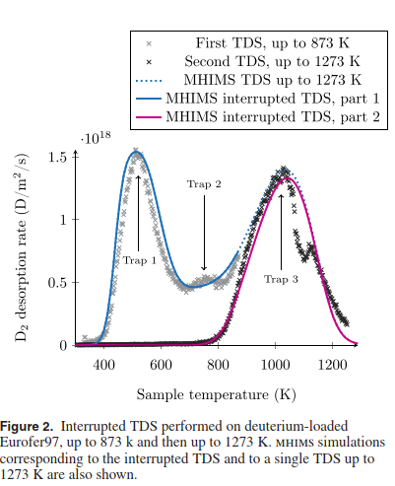
Area 1 : (Real) Tritium studies
Understanding/predicting D/T trapping and permeation in and through the walls of fusion reactors
Transition of different sources of D/T through different
Proposed activities in 2027:
Tritium permeation studies in air vs. in water for EUROFER-97 (CEA) and for 316-LN and P91/92 steels (ISSP-UL)
copermeation studies (H/D then D/T) to allow studying kinetics of trapping/detrapping and isotopic exchange
+ Associated modelling of H/D/T co-permeation and T outgassing (FESTIM and MHIMS)
F. Montupet-Leblond, NF 2022

Slide 12
WPPWIE - 2027 budget requests and priorities
Topic |  | Required resources (PM, hardware, facilities, …) | Associated CC budget* [k€] | Associated EC budget* [k€] | WP priority (Low, Medium, High) | PSD priority TBD
Area 1 Tritium | Study of the kinetics of tritium desorption in air versus in water, for gas-loaded samples with the new TETRIS device (CEA) | 6PM | 25,6 | 28,2 | High
 | H/D and D/T co-permeation studies and associated modelling (CEA) | 11PM HW: 20k€ | PM: 46,97 HW:10 | PM: 51,7 HW:14 | High
 | Tritium permeation studies in 316-LN and P91/92 steels in comparison to EUROFER-97 (ISSP-UL) | 6PM HW: 10 k€ | 25,6 HW: 5 | 28,2 HW: 7 | High
Total: 130.1 k€
*Conversion: 4.27k€ CC/ PM (@average); 4.70k€ EC/PM; HW/facility CC= 0.5*direct cost; HW/facility EC=0.7*direct cost

Slide 13
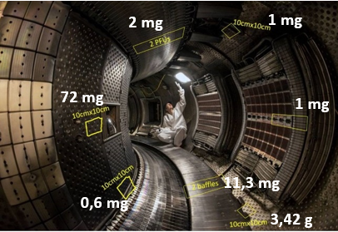
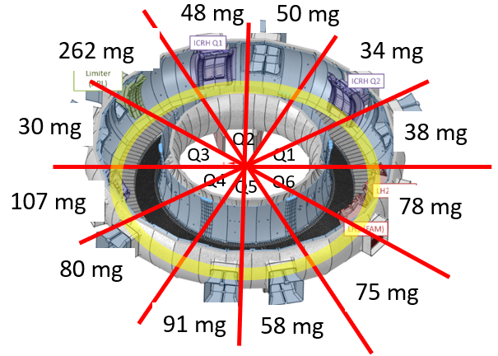
Area 2 : Dust
Proposal : determine the dust conversion factor in W environment
If conversion factor is 100% in ITER (JET C conversion factor 0.5)
Boronized layers of 50 nm create a potential dust source of 86 g of B per boronization
W erosion and deposition (0.16 g/s) associated with Fuel Trapping potential source of W dust
potential
Strategy
Analyse in-situ dust collections in WEST at various poloidal locations (after C8/C9 2024) and toroidal locations (after C11, 2025)
+ in 2027 : collection after C12→C14 campaigns
Need data on:
mass, volume, morphology…
Location, fuel and composition…
dust mobilization/adhesion
Determine conversion by comparing with erosion and deposition inferred from post-mortem analysis after C6-C12
C8/C9
C10/C11

Slide 14
WPPWIE - 2027 budget requests and priorities
Topic |  | Required resources (PM, hardware, facilities, …) | Associated CC budget* [k€] | Associated EC budget* [k€] | WP priority (Low, Medium, High) | PSD priority TBD
Area 2 Dust | Collection / analysis after C14 (CEA) | 4PM | 17,1 | 18,1 | High
 | NRA µ-beam dust analysis (VR, RBI) | 6PM 30 days IBA 3k€/day | PM: 25,6 Fac.: 45 | PM: 28,2 Fac.: 63 | High
 | Dust analysis with TDS, microscopy, µ-LIBS, SEM (FZJ, IPPLM, NN) | 6PM | 25,6 | 28,2 | High
 | Surface properties / release origin / survivability of dust (VR) | 2PM | 8,5 | 9,4 | High
 | Report on dust conversion in W machines (VR, IAP MPG, CEA, UKAEA, VTT, FZJ) | 6PM | 25,6 | 28,2 | High
Total: 175.1 k€
*Conversion: 4.27k€ CC/ PM (@average); 4.70k€ EC/PM; HW/facility CC= 0.5*direct cost; HW/facility EC=0.7*direct cost

Slide 15
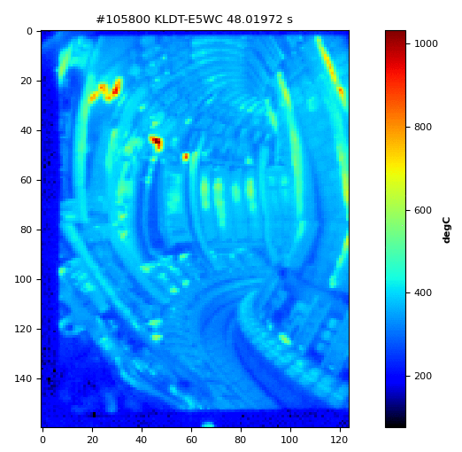
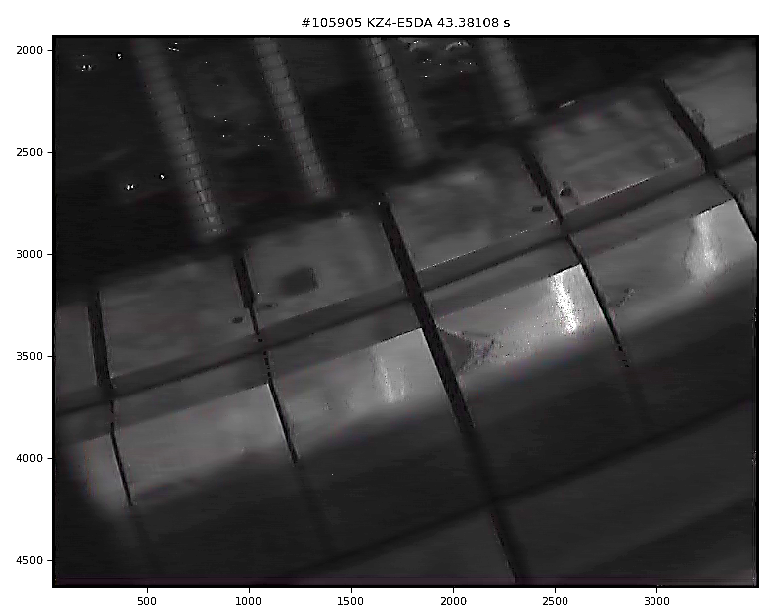
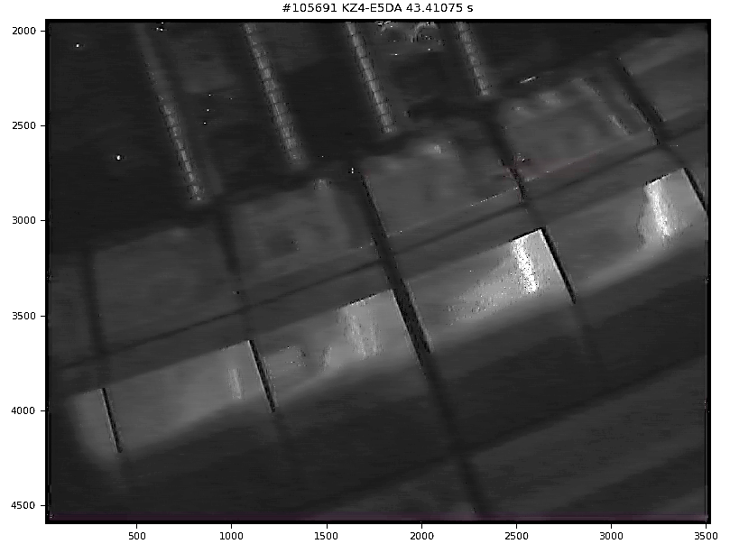
Final JET PFC (Dec 2023) experiment – Divertor RE
Before RE impact
AFTER RE impact
RE impact
After RE impact

Slide 16
Area 3 : Post-mortem analysis and LIBS interpretation of JET tiles
Proposal : full exploitation of last JET experiments with RE-beam impact (etc.)
JET carried out downwards RE at the end of operation (not discussed with WPPWIE)
Critical for ITER divertor: assessment of tile 0 and tile 1 regarding damage (done for Be before)
Impacts conclusion on fuel release and surface stability and dust
Full exploitation of very successful LIBS campaign
LIBS at areas with damages carried out, but not in initial analysis plans
LIBS on steel and Inconel carried out, but not in initial analysis plans
Strategy
1-2 damaged tiles to be added to the list of tiles to studied under SPE
Provide input to RE-damage modelling to divertor PFCs
Complete LIBS studies and include specific locations not in initial plan
(quantitative analysis delayed => calibration in focus 2025)

Slide 17
WPPWIE - 2027 budget requests and priorities
Topic |  | Required resources (PM, hardware, facilities, …) | Associated CC budget* [k€] | Associated EC budget* [k€] | WP priority (Low, Medium, High) | PSD priority TBD
Area 3 JET post-mortem analysis | Conversion of 1 container into PM (VTT has one) [Proposal made 10/25] |  |  |  | High
 | Dedicated analysis of RE impacted divertor tiles :LIBS, LID-QMS, metallography, IBA, microscopy (SP E) | 8 PM Fac. : 20k€ (accelerator) | PM: 34,2 Fac.: 10 | PM: 37,6 Fac.: 14 | High
 | T loading of W samples as proxy for JET tiles and norm for LIBS, LID-QMS (IAP) | 4 PM 5k€ for samples & transport 5k€ exposure | 8,6 Eq/OGS: 5 | 9.4 Eq/OGS: 7 | High
Total: 68 k€ (+conversion)
*Conversion: 4.27k€ CC/ PM (@average); 4.70k€ EC/PM; HW/facility CC= 0.5*direct cost; HW/facility EC=0.7*direct cost

Slide 18
Area 4 : RE-damage modelling development and benchmark
Proposal : Support RE damage modelling development
High priority item for ITER and selected as EEG
VR grantee left to industry => direct transfer not possible
Recover work by senior scientist
Impacts WPTM, WPTE and WPPWIE

Slide 19
WPPWIE - 2027 budget requests and priorities
Topic |  | Required resources (PM, hardware, facilities, …) | Associated CC budget* [k€] | Associated EC budget* [k€] | WP priority (Low, Medium, High) | PSD priority TBD
Area 4 RE-induced PFC damage | Integrated modelling of RE-induced PFC Damage | 8PM | 34,2 | 37,6 | High
Total: 37.6 k€
*Conversion: 4.27k€ CC/ PM (@average); 4.70k€ EC/PM; HW/facility CC= 0.5*direct cost; HW/facility EC=0.7*direct cost

Slide 20
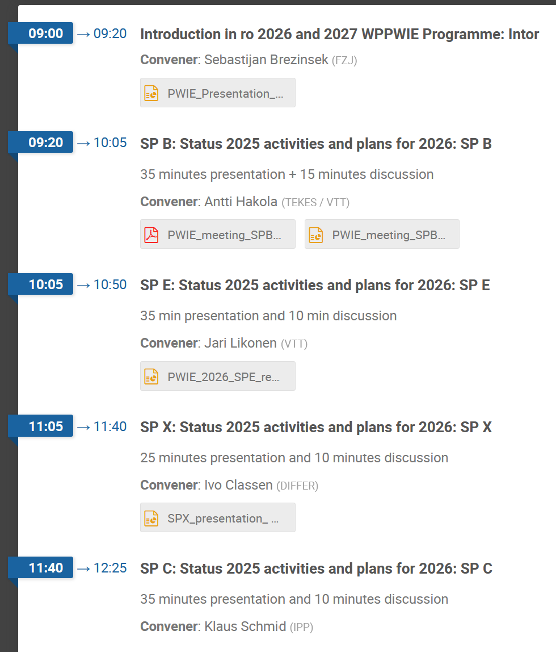
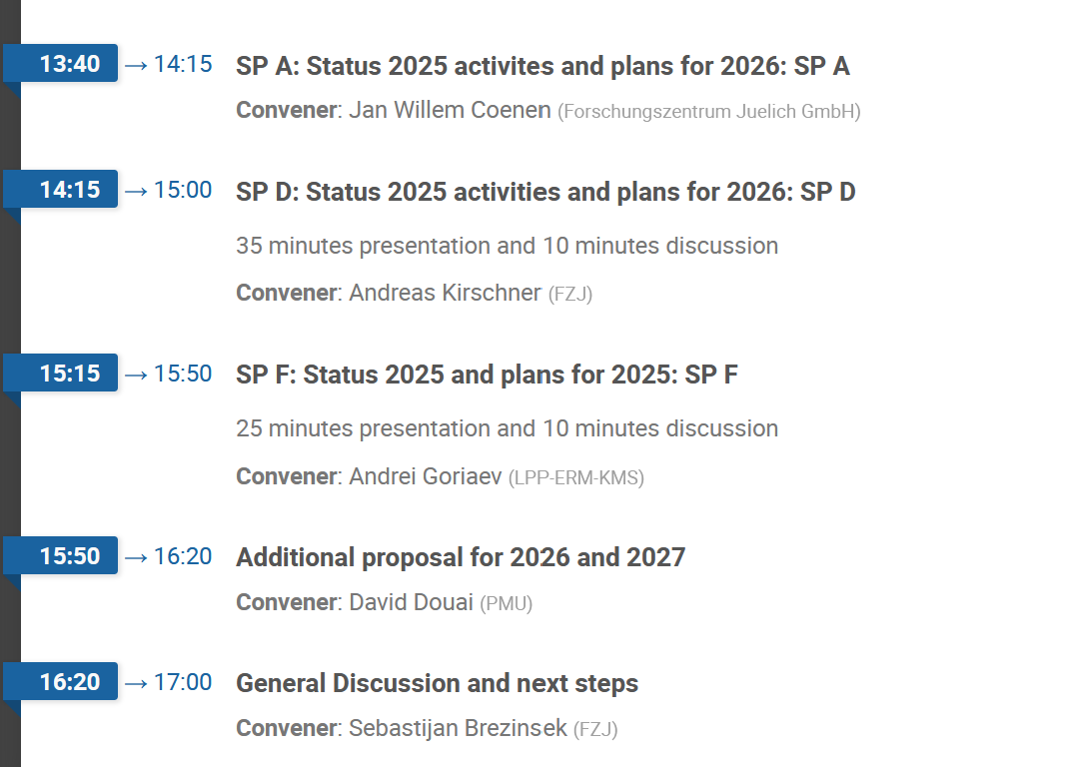
Agenda

Slide 21
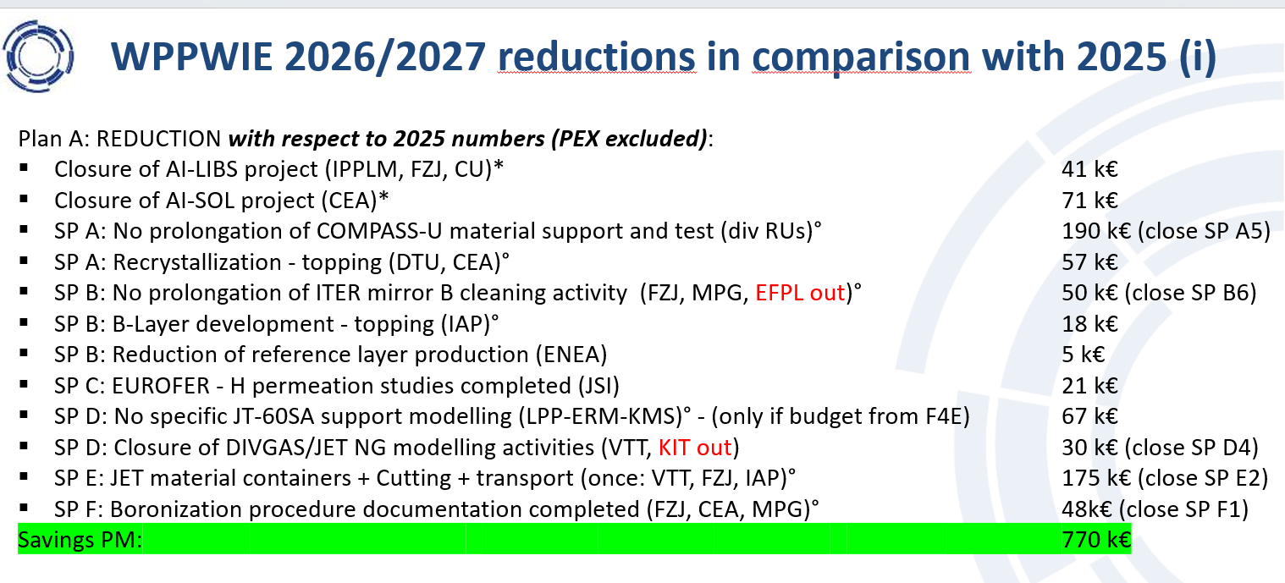
Resources in WPPWIE in AWP 2026-2027
Resources in AWP 2026/2027 for PWIE are reduced by ~40% with respect to the average of 2021-2025
About 33% reduction with respect to 2025 (WPPWIE resource profile and extra tasks in 2024/2025)
Refocus and closure of different activities with extra budget in 2024/2025 for 2026-2027
Remaining reduction by closure/pause of a few physics areas (prioritisation including Program Manager)
Closure or strong reduction of all T-lab studies [risk to lose labs is high]
Closure of dust related studies (tokamak analysis, predictions, modelling) [risk to lose labs is high]
QSPA studies limited [budget to rebuild facilities from other area]

