Slide 1


WPSA: 2027 planning and beyond, additional budget request
EUROfusion FSD PB premeeting
Carlo Sozzi

Slide 2
SA Objectives
2026
complete the installation, systems commissioning and first operation in OP2 of edge TS, div. VUV, MGI
Support first phase of new systems operation (commissioning with plasma)
Support first data production and interpretation, assist the Experiment Team in the data validation
Finalize preparation of installation and commissioning procedures of systems under installation in ME2 (2027): Fast Ion Loss Detector (FILD), Tangential Phase Contrast Imaging (TPCI), Gamma Ray Spectrometer (GRS) (+RE monitor, EC stray detectors TBD)
Support the development and procurement of the sources (extruders) of the Pellet Launching System (PLS)
Finalize design for systems foreseen for the following machine enhancement period (ME3 in 2028): Compact Neutron Spectrometer, Doppler Reflectometry (+Vertical Neutron Camera TBD)
2027
installation and commissioning of FILD, TPCI, and GRS (+ TBD)
Support on- and off-site support for the scientific operation of Edge TS, Divertor VUV and EDICAM diagnostics.
assist procurements for systems foreseen for the machine enhancement period ME3 in 2028

Slide 3
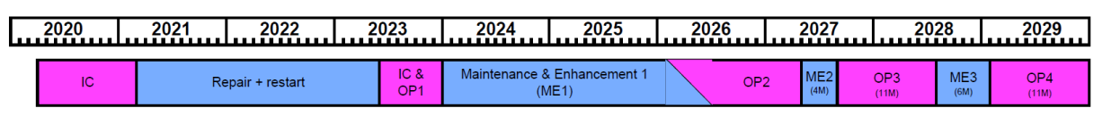
Ongoing projects
OP1: first plasma
OP2: high Ip operation
OP3: H mode development
EC assisted breakdown at low E//
Plasma control with SC coils
Disruption characterization
Extension of the operation domain (high Ip, H mode, Beta, collisionality, …)
Disruptions and Runaway control, Error field
Heat transport L mode with dominant Electron heating
Shine through, Fast ion losses, LH transition, ELMs,
SOL scaling at high IP, Divertor characterization
ITER relevant H-mode and high beta scenarios
High Beta non-inductive steady-state scenarios
NTM, RWM, ST control
Heat transport L mode with dominant Electron heating
Fast ions and turbulence, Alpha particles in D-3He plasma
ELMs regimes, W screening, Seeding
Scope=>
DIAGNOSTICS ENHANCEMENTS
Div.VUV,
Edge TS
TPCI, FILD, LaBr3(Ce) Gamma Sp, CLYC Neut. Sp.
Doppler Refl., VNC,
LaCl3(Ce) Neut. Sp
Systems =>
EDICAM
W-wall
EC Stray?
Edge&SOL diags?
A comprehensive set of feasibility studies has been carried out in 2025
The studies collectively evaluate the feasibility, conceptual design, and integration of a diverse suite of diagnostic for the JT-60SA tokamak, aimed at supporting high-power operation phases and the transition from carbon to tungsten wall.

Slide 4
Clarification of the hand over between SA, F4E and operations
WPSA supports:
proposals for enhancements (mainly diagnostics to achieve the scientific and operational objectives of JT-60SA), until scientific acceptance and until a degree of development such that a PA can be signed (F4E contract).
Development of operational oriented software tools (synthetic diagnostics, control room analysis, control tools). Does not support their exploitation: use for analysis by non-developer
Installation and commissioning until final acceptance of the developed systems
“Regular” operation is at present outside the budget and horizon. Likely might happen for OP3
As part of the preparation for the W transition, additional diagnostics are taken into consideration (a further assessment of the diagnostics plan should be done by TCM-45 – late May 2026) – Call for feasibility studies of “Edge and SOL” diagnostics, 2025.

Slide 5
High-Impact Diagnostics
Real-Time Detachment Control
Usability: High. It reuses existing visible-spectrometer lines of sight (LOS) and proven APDCAM-10G technology, requiring no in-vessel modifications.
Importance: Essential. Protecting the divertor from overloading is essential in a W-wall environment. The system specifically includes a W I line (400.9 nm) for dedicated tungsten monitoring.
Edge VUV Imaging Spectrometer
Usability: Medium. Requires an active cooling system for its golden-coated mirrors during baking.
Importance: Essential. This is the primary tool for determining tungsten transport properties in the Scrape-Off Layer (SOL) and pedestal regions, which is an open issue for ITER.
Quartz Crystal Microbalances (QCMs)
Usability: Medium. In-vessel installation requires robust thermal management and radiation-hardened electronics.
Importance: Essential. QCMs provide the only real-time, in-situ measurement of material erosion and deposition, which is crucial during the transition from carbon to tungsten walls.
MANTIS Multispectral Imaging
Usability: Medium-High. While requiring a custom re-entrant port, it is designed to handle tungsten wall reflections using the CHERAB ray-tracing framework.
Importance: Essential. Provides 2D emissivity maps essential for understanding the volumetric processes of plasma detachment and exhaust physics.

Slide 6
Essential Support Diagnostics
Runaway Electron (RE) Monitor
Usability: Very High. Low cost, external installation, and minimal machine interfaces, can be integrated with the JT-60SA real-time control system.
Importance: High. Essential for machine protection. REs hitting the first wall can cause severe damage to tungsten structures.
High-Resolution Visible Overview Camera Upgrade
Usability: Medium. It identifies off-the-shelf cameras that could reuse existing EDICAM optics. However, their magnetic field tolerance is currently unconfirmed.
Importance: High for robust steady-state monitoring and providing multispectral observation of the entire plasma section.
Neutral Gas Analysis (NGA)
Usability: High. Compatible with existing ports and safe for turbopumps.
Importance: High. Essential for global particle balance and fuel retention studies, which are major research focuses for metallic wall operations.
Thermal Helium Beam (THB)
Usability: Medium. Requires a dedicated gas puffing system, but the principle is fully compatible with both carbon and tungsten walls.
Importance: High. Offers fast measurements (1 kHz) of edge and profiles, which are critical for characterizing the pedestal in W-wall scenarios.
Directional Electron Probe (DEP)
Usability: Medium-High. Dedicated to the SOL measurements, it requires dedicated probe manipulator and tungsten-upgraded tips to survive the high-parameter environment of JT-60SA.
Importance: Medium-High. Provides unique data on parallel electron currents to help resolve edge filament structures

Slide 7
Development of diagnostics for the W phase
9 good new proposals, still to be discussed/accepted by the Experiment Team
Essentially no budget in 2026-27 for their further development
Assuming ∼ 5 can get through, at least 4 ppy more would be required: additional ∼ 330 k€ (see later)

Slide 8
Presently ongoing development
System under procurement or development | Reference person | Proposed Op. | Present status
FILD | Juan Ayllon (U. Sevilla) | OP3 | Ex-vessel design consolidated and the shielding concept validated by neutronics studies. Ready for procurement
TPCI | Stefano Coda (EPFL) | OP3 | Mechanical design for the ME-1 components is complete
Doppler Reflectometry | Elena de la Luna (CIEMAT) | OP4 | Consolidated concept for the DR system that meets spectral resolution requirements. Pending decision on the final instrumentation location
EC Stray detection system | Saul Garavaglia (CNR) + W7-X team | ? | Al2O3+TiO2 as the primary absorbing material for the bolometer system robust bolometer design validated through MISTRAL laboratory tests and W7-X operations sniffer probe design moving into the laboratory testing and calibration
Gamma-ray spectrometer | Massimo Nocente (Unimib) | OP3 | Design phase for the JT-60SA LaBr3(Ce) Gamma-ray Spectrometer complete. Ready for procurement.
EU Neutron diagnostics (Vertical Neutron Camera) | Marco Cecconello (VR)+IPPLM team | ? | conceptual layout and material composition for the VNC collimator and detector units
EU Neutron spectrometer | Davide Rigamonti (CNR) | OP4 | confirmed the feasibility of a LaCl3-based compact spectrometer for 2.5 MeV neutron spectroscopy at JT-60SA
Neutron Spectrum Reconstruction in support of Activation foils (F4E) | Katarzyna Mikszuta-Michalik (IPPLM) | OP2(?) | high-intensity part of the JT-60SA neutron spectrum can be reliably reconstructed from activation measurements with an uncertainty below 25%.

Slide 9
Present 2026-2027 plan (resources)
Role Title | PMs X activity | 2026 | 2027
1.1 Enhancements Area Coordinator | 4 | 2 | 2
1.2 Fast Ion Losses Detector RO | 4 | 2 | 2
1.3 Fast Ion Losses Detector expert | 4 | 4 | 0
1.4 Tangential Phase Contrast Imaging RO | 2 | 1 | 1
1.5 TPCI expert | 4 | 4 | 0
1.6 Gamma Ray Spectrometer RO | 4 | 2 | 2
1.7 GRS expert | 4 | 2 | 2
1.8 Compact Neutron Spectrometer RO | 4 | 2 | 2
1.9 CNS expert | 5 | 2 | 3
1.10 Pellet System RO | 4 | 2 | 2
1.11 Pellet System expert | 9 | 6 | 3
1.12 Diagnostic system expert | 15 | 10 | 5
1.13 Diagnostic system RO | 4 | 3 | 1
1.14 Neutronics expert | 12 | 10 | 2
2.1 Plasma Operations Area Coordinator | 4 | 2 | 2
2.2 Thomson Scattering TRO | 4 | 2 | 2
2.3 Thomson Scattering Expert | 9 | 7 | 2
2.4 Divertor VUV spectroscopy TRO | 3 | 2 | 1
2.5 VUV spectroscopy expert | 6 | 5 | 1
2.6 MGI expert | 4 | 2 | 2
2.7 EDICAM expert | 6 | 3 | 3
2.8 Subsystem operation expert | 4 | 1.5 | 2.5
3.1 Code Management Area Coordinator | 4 | 2 | 2
3.2 Pulse Design Simulator expert | 6 | 4 | 2
3.3 Electron Cyclotron Waves simulation expert | 5 | 2 | 3
3.4 Magnetic control expert | 5 | 3 | 2
3.5 Cryo-magnet system simulation and data analysis expert | 4 | 2 | 2
3.6 Control room monitoring tools/ Synthetic diagnostics expert | 6 | 3 | 3
tot PMs(I) |  | 92.5 | 56.5

Slide 10
Distribution of personnel in Japan (presently allocated budget)
SubSystem |  | 2026 |  |  |  |  |  |  |  |  |  |  |  | 2027
inst./mant. | operation | 1 | 2 | 3 | 4 | 5 | 6 | 7 | 8 | 9 | 10 | 11 | 12 | 1 | 2 | 3 | 4 | 5 | 6 | 7 | 8 | 9 | 10 | 11 | 12
EDICAM | status
 | persons in mission |  |  |  |  |  |  |  |  |  |  | 1 | 1 | 1 | 1 |  |  |  |  |  |  | 1 |  | 1
 | persons in secondment
EdgeTS | status
 | persons in mission |  |  | 3 | 2 |  |  |  |  |  | 1 | 1 | 1 | 1 | 1 | 1 | 1 | 1 | 1 | 1 |  |  | 1 | 1
 | persons in secondment
divVUV | status
 | persons in mission |  |  | 2 | 2 |  |  |  |  |  | 1 | 1 | 1
 | persons in secondment
MGI | status
 | persons in mission |  |  |  |  |  |  | 1 |  |  |  |  |  |  |  |  |  | 1 | 1
 | persons in secondment
TPCI | status
 | persons in mission |  |  |  | 1 |  |  |  |  | 1 | 1 | 0 |  |  |  |  |  |  |  |  | 1 | 1 |  | 1 | 1
 | persons in secondment
FILD | status
 | persons in mission |  |  |  |  |  |  |  |  |  |  |  |  |  |  |  |  |  |  |  | 1 | 1 |  | 1 | 1
 | persons in secondment
GRS | status
 | persons in mission |  |  |  |  |  |  |  |  |  |  |  |  |  |  |  |  |  |  |  | 1 |  |  | 1
 | persons in secondment
REmon | status
 | persons in mission |  |  |  |  |  |  |  |  |  |  |  |  |  |  |  |  |  |  |  | 1 |  |  | 1
 | persons in secondment
PLS | status
 | persons in mission |  |  |  |  |  |  |  |  |  |  |  |  |  |  |  |  |  |  |  | 1 | 1 |  | 1 | 1
 | persons in secondment
other |  |  |  | 1 |  |  |  |  |  |  |  | 1 |  | 1 |  |  |  |  | 1 |  |  |  |  | 1

Slide 11
JT-60SA enhancements and commissioning budget estimation for 2027 (SA)
Assumptions
Coherent with the last timeline
for "large" subsystems under operation or under installation/commissioning: 1 people on site - permanently (Diagnostics RO)+ about 0.5 more on shorter term (for data validation, assistance to installation and commissioning). Scientific exploitation (scientific use of data) under TE afterwards
for "light" diagnostics under operation or under installation/commissioning: 1 people on site - on short term with periods of overposition (1.5 on average). Scientific exploitation (scientific use of data) under TE
2026: installation and commissioning of 2 diagnostics (divVUV, EdgeTS), 1 subsystem (MGI), operation of 1 already installed diagnostics (EDICAM) + 1 months of plasma operation (OP2)
2027: 6 months of plasma operation (OP2) + 4 months machine enhancements (ME2) + 2 months of plasma operation (OP3). During ME2 installation of 4 new diagnostics (FILD, TPCI, GRS, RE monitor) and upgrade of 1 (EDICAM with spectral capabilities)
OP2 : 1 month in 2026 + 6 months in 2027
OP3 : 2 months in 2027
CC cost ppy = 82 kEuros average salary*0,5*1,25
CC cost mission Japan (including travel)= 340/day * 0,7*1,25
CC cost secondment =4.9 k€/month at 100% + 2.8k€ flight/3m
CC cost mission in EU =270/day incl travel= 270/day*0.7*1.25
total costs |  |  | 2027
 |  |  |  | CC cost | EC contrib | Total resources | Actual cost [k€]**
ppy in EU |  |  | 3.166667 | 162.2917 | 178.5208 | 324.5833 | 259.6667
ppy in Japan |  |  | 7 | 358.75 | 394.625 | 717.5 | 574
missions in EU (days) |  |  | 200 | 47.25 | 37.125 | 67.5 | 54
missions in Japan (days) |  |  | 1920 | 571.2 | 448.8 | 816 | 652.8
secondment (months) |  |  | 20 | 116.6667 | 64.16667 | 116.6667 | 116.6667
management (ppy) |  |  | 0.9 | 64.575 | 50.7375 | 92.25 | 73.8
TOT |  |  |  | 1320.733 | 1173.975 | 2134.5 | 1730.933
Presently allocated budget + 6ppy to support commissioning and operations of diagnostics and subsystems

Slide 12
Distribution of personnel in Japan (presently allocated budget + 6ppy)
SubSystem |  | 2026 |  |  |  |  |  |  |  |  |  |  |  | 2027
inst./mant. | operation | 1 | 2 | 3 | 4 | 5 | 6 | 7 | 8 | 9 | 10 | 11 | 12 | 1 | 2 | 3 | 4 | 5 | 6 | 7 | 8 | 9 | 10 | 11 | 12
EDICAM | status
 | persons in mission |  |  |  |  |  |  |  |  |  |  | 2 | 2 | 1 | 2 | 1 | 2 | 1 | 2 |  | 2 | 2 |  | 2 | 1
 | persons in secondment
EdgeTS | status
 | persons in mission |  |  | 2 | 2 |  |  |  |  | 1 | 1 | 1 | 1 | 1 | 1 | 1 | 1 | 1 | 1 | 1 |  |  | 1 | 1
 | persons in secondment |  |  | 1 | 1 | 1 | 1 | 1 | 1 | 1 | 1 | 1 | 1 | 1 | 1 | 1 | 1 | 1 | 1 | 1 |  |  | 1 | 1 | 1
divVUV | status
 | persons in mission |  |  | 2 | 1 |  |  |  |  |  | 1 | 1 | 1 | 1 |  |  |  |  |  | 1 |  |  | 1 | 1 | 1
 | persons in secondment |  |  | 1 | 1 | 1 | 1 | 1 | 1 | 1 | 1 | 1 | 1 | 1 | 1 | 1 | 1 | 1 | 1 | 1 |  |  | 1 | 1 | 1
MGI | status
 | persons in mission |  |  |  |  |  |  | 1 | 1 |  |  |  |  |  |  |  |  | 1 | 1 |  |  |  | 1 | 1 | 1
 | persons in secondment
TPCI | status
 | persons in mission |  |  |  | 1 |  |  |  |  | 1 | 1 | 0 |  |  |  |  |  |  |  |  | 2 | 2 |  | 2 | 1
 | persons in secondment
FILD | status
 | persons in mission |  |  |  |  |  |  |  |  |  |  |  |  |  |  |  |  |  |  |  | 2 | 2 |  | 1 | 1
 | persons in secondment
GRS | status
 | persons in mission |  |  |  |  |  |  |  |  |  |  |  |  |  |  |  |  |  |  |  | 2 | 1 |  | 1
 | persons in secondment
REmon | status
 | persons in mission |  |  |  |  |  |  |  |  |  |  |  |  |  |  |  |  |  |  |  | 1 |  |  | 1
 | persons in secondment
PLS | status
 | persons in mission |  |  |  |  |  |  |  |  |  |  |  |  |  |  |  |  |  |  |  | 2 | 2 |  | 2 | 1
 | persons in secondment
other |  |  |  | 1 |  |  |  |  |  |  |  | 1 |  | 1 |  |  |  |  | 1 |  |  |  |  | 1

Slide 13
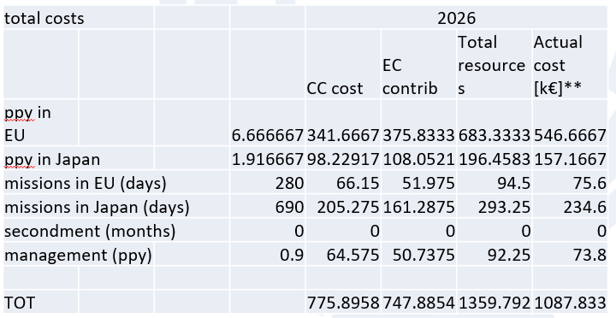
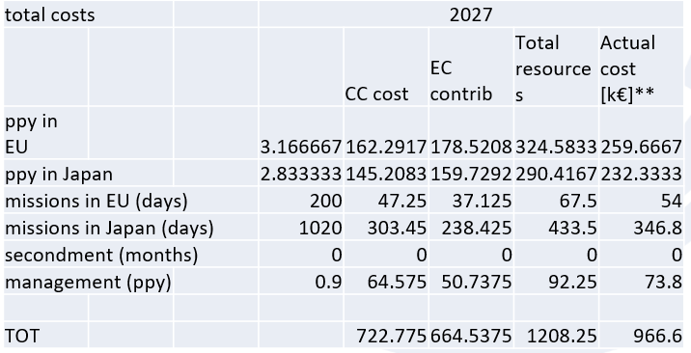
Budget request
Present budget: Present 2026/2027 (reduced to ∼55%) budget only allow for “scientific keep-in-contact” (1-2 PM/y *system) once PA signed
total costs |  |  | 2027
 |  |  |  | CC cost | EC contrib | Total resources | Actual cost [k€]**
ppy in EU |  |  | 3.166667 | 162.2917 | 178.5208 | 324.5833 | 259.6667
ppy in Japan |  |  | 7 | 358.75 | 394.625 | 717.5 | 574
missions in EU (days) |  |  | 200 | 47.25 | 37.125 | 67.5 | 54
missions in Japan (days) |  |  | 1920 | 571.2 | 448.8 | 816 | 652.8
secondment (months) |  |  | 20 | 116.6667 | 64.16667 | 116.6667 | 116.6667
management (ppy) |  |  | 0.9 | 64.575 | 50.7375 | 92.25 | 73.8
TOT |  |  |  | 1320.733 | 1173.975 | 2134.5 | 1730.933
Additional 2027 budget:
+600 k€ to support ongoing projects, including commissioning on plasma (NB can be less if a differently funded secondment scheme can be activated)
+330 k€ to support new diagnostics for the W phase

