Slide 1
18/03/2026 – Turbulence in QCE regime Project news
TSVV-B – Regular advancement meeting
P. Tamain

Slide 2
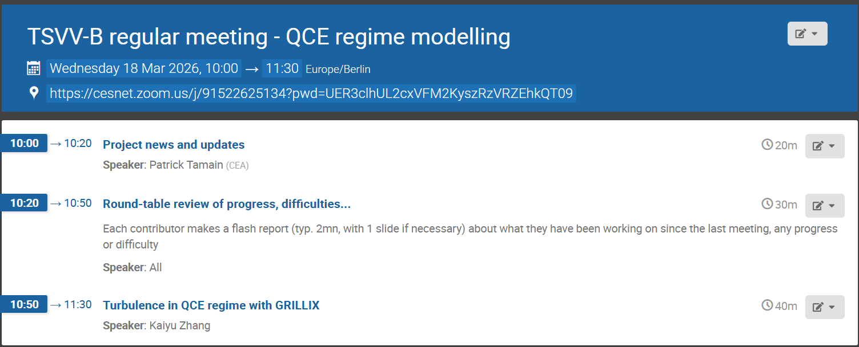
Today’s meeting agenda

Slide 3
ETASC budget issues
Confirmation of -28% budget cut in 2027 if no additional money found
For the moment no obvious path to get extra money => prepare for the worst case scenario
Request from X. Litaudon to:
formalize the deliverables at risk => done!

Slide 4
ETASC budget issues – deliverables
To be checked and polished by e-mail
List of deliverables at risk as sent to Xavier (can still be changed)
D1.1: The modelling of TCV baffled configuration with SOLEDGE3X is planned for the second half of 2026. However, in case of budget reduction, this activity would be cancelled as considered as lower priority than other tasks in our workplan.
D6.2 & D7.1: the coupling of the KINDNESS kinetic neutrals module to other turbulence codes than GBS would have to be postponed, thus limiting the mutualization of tools among European codes. Along the same line, future developments of the KINDNESS code, including its GPU-ization would have to be postponed beyond 2027, limiting the upscaling of GBS simulations to larger machines.
D6.4 & D6.9: the deployment in edge fluid codes of advanced sheath boundary conditions requires large resources as it will likely change significantly the numerical stability of the codes and the way they can be run. Exploring such changes is time-consuming and we will not be able to carry this task in case of additional budget cuts. The implementation in codes of newly derived boundary conditions will be postponed beyond 2027.
D1.2: the contribution of some of the TSVV-B codes to the TCV-X23 reference case analysis (turbulence in high density regimes) will have to be postponed beyond 2027 as priority will be given to validation exercises that have already been started. This is at least the case for the FELTOR and GRILLIX contributions.
D6.8: the extension of reduced turbulence models to advanced SOL regimes (high density, detached…) will likely be limited in scope. This would delay the implementation of these models in SOLPS-ITER and their availability to the rest of the modelling community.
D1.3: the evaluation of the turbulent transport of impurities in the edge plasma, a fully novel topic on which reduced fidelity mean-field models rely on turbulence codes to get an answer, would likely be limited to very first proof-of-principle studies. Simulations of D-T plasma in particular are at risk. This would impact the effort towards reducing the uncertainty in the parameter tuning of mean-field models that are heavily used to determine the operational space of future machines.
D5.1: the investigation of the dependence of the SOL width on key parameters in edge fluid turbulence codes will be drastically reduced in ambition (use of simplified geometry, limited range of scan). This is a very time- and resource-consuming activity as some of the scans (especially the one in toroidal field) are challenging, especially in realistic X-point geometries. This activity however is fundamental to validate the capability of our codes to reproduce experimental scaling laws before applying them to predictive studies for future machines. This is a topic that was identified as critical for ITER’s operation.

Slide 5
ETASC budget issues – resources
Applying 28% compression ~uniformly
Association | Current | Compressed 2027
CCFE | 0,0 | 0
CEA/AMU | 12,5 | 8,9
DTU | 15,0 | 10,8
EPFL | 12,5 | 9
IPP Garching | 10,0 | 7,2
IPP Prague | 2,0 | 1,4
KUL | 8,0 | 5,8
TOTAL scientists | 60 | 43,1

Slide 6
Annual meeting
When?
Mon. 28 Sep. – Wed. 30 Sep.
Wed. 30 Sep. – Fri. 02 Oct.
Where? Marseille, Prague, Garching?
Checking possibility in Marseille or Cadarache (not on CEA site)…
If not fall back to Prague?

Slide 7
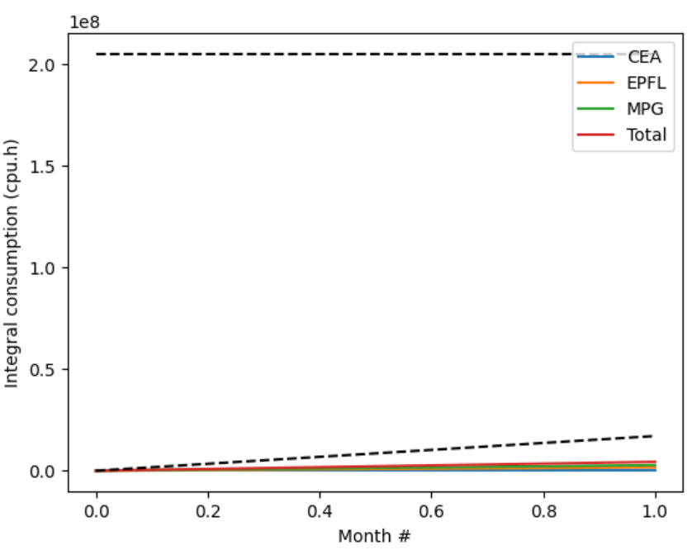
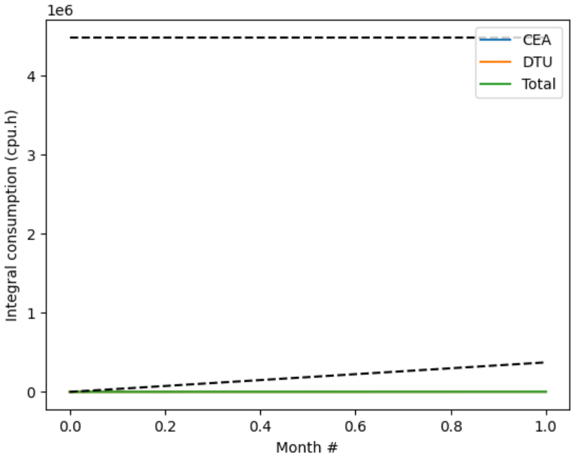
Pitagora usage
New project names: FUPA2_TSVVB (CPU) and FUPB2_TSVVB (GPU)
Please send me updated list of users for each project
CPU
GPU
2.1%
0%

Slide 8
Latest publications
Please use from now on WPTM-TSVV-B-CEA
Turbulence in stellarators (GBS)
Z Tecchiolli et al : 5th March 2026 | DocumentID : 42477
: Validation of global edge plasma turbulence simulation of the optimized HSX stellarator
Journal : Nuclear Fusion, .

Slide 9
Today’s meeting agenda
Please upload materials to https://indico.euro-fusion.org/event/3931/

