Slide 1
CEA deliverables status - 2026
D1.1: Assessment of impact of baffles on turbulence and plasma conditions in high-density regime in TCV (CEA, EPFL)
  Not started, will be dropped if budget compression confirmed
D2.1: Evaluate the role of electromagnetic turbulence from low to high beta conditions (CEA)
  TCV simulations on-going (R. Düll)
D6.1: Implement full Horsten fluid neutrals model, including boundary conditions, in SOLEDGE3X (CEA, KUL)
  Volume model implemented, currently undergoing verification and checks (B. McGibbon)
  Planning work on boundary conditions next -> work trip of Bridget to KUL
D6.2: Couple another edge turbulence code to EIRENE or KINDNES, likely starting with GRILLIX (CEA, DTU, EPFL, MPG)
  STYX2 ported on Pitagora, waiting for check from Nicolas on weird test results (could be the test itself)
  Licencing issue raised with hierarchy, will define a position
  Ready to be taken over by GRILLIX team
D6.1: Python post-treatment routines to export data from all contributing codes in IMAS format using library developed in TSVV-3 (all)
  Waiting for Anna to produce an official list of IDSs needed for synthetic diagnostics, should remind her

Slide 2
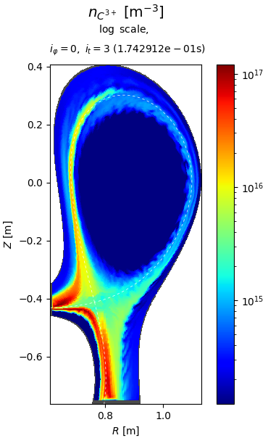
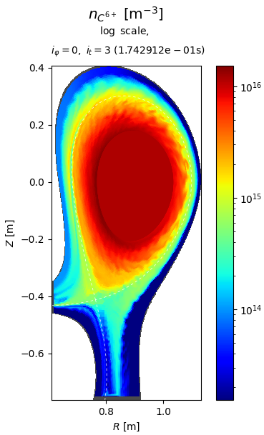
CEA deliverables status – 2027 (1)
D1.2: Analysis of turbulence and transport in detached regime in the frame of the TCV-X23 experiments (CEA, EPFL, MPG, DTU, KUL)
  NF paper of Virginia submitted
  Simulations with EIRENE (2D) on-going preparing oral at PSI (D. Sales)
D1.3: First evaluation light impurity turbulent transport in 3D edge turbulence simulation (CEA, EPFL)
  First simulations based on TCVX21 on-going, some numerical difficulties due to restarting from old code version (P. Tamain)
D1.4: Demonstrate capability to model D-T plasmas both for mean-field and turbulence applications (CEA, DTU)
  Preliminary steps done but still technical issues in STYX
  On-hold as priority is to PSI invited talk polishing (S. Suresh-Kumar)

Slide 3
CEA deliverables status – 2027 (2)
D2.3: Analysis of near SOL transport in L-mode and H-mode conditions in TCV and AUG (CEA, EPFL, MPG)
  Power scan in COMPASS geometry shows signs of formation of ETB with simple ES model (M. Lambresa)
  Under investigation in sight of PSI poster and EPS contribution
D5.1: Investigate the dependence of the SOL width on key parameters in edge turbulence simulations in L-mode (CEA, MPG)
  Main parameter scans (Bp, Bt, R/a…) performed in slab geometry and first tries in toroidal geometry (H. Corvoysier)
  Wrapping up in sight of PSI poster
D6.6: STYX-EIRENE package usable in 3D in turbulence simulations and in time-dependent mode (CEA)
  STYX2’s release if first step (separation of neutrals module from SOLEDGE3X), including generic interpolation procedure
  Next step: generate independent EIRENE mesh and compute interpolation function with external python tool (D. Sales)
D6.7: Couple synthetic emission diagnostics and Doppler back-scattering to TSVV-B codes with IMAS interface (CEA, DTU)
  Not started

Slide 4
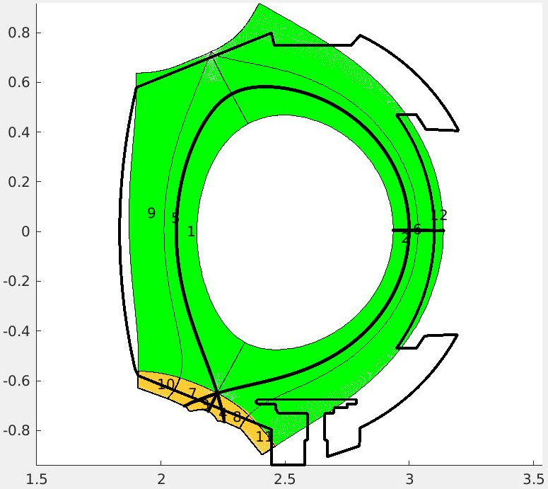
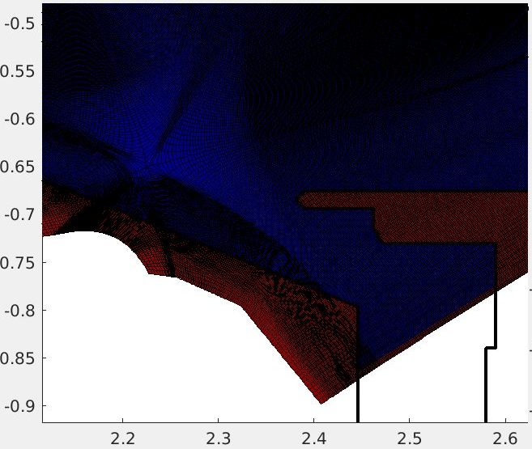
CEA deliverables status – 2027 (3)
D7.3: Port full turbulence model of GRILLIX and SOLEDG3X to GPU (CEA, MPG)
  WEST mesh for full scale turbulence case generated and passed to ACH for first tests on GPU partition (P. Tamain, H. Bufferand + ACH)
D8.2: TSVV-B codes compliant with priority 2 criteria of EUROfusion standard software recommendations (exception: priority 1 criteria for SOLEDGE-HDG) (all)
  Progressively deploying code standard tools in CICD (Fortitude, fprettify)
D8.3: Individual or collective training for new users of TSVV-B codes on request from WPs or individual collaborators (all)
  Thinking of organizing a training session some time in autumn at request of US users, but open to EU participant

