Slide 1

WP Plasma-Wall Interactions and Exhaust Update 2025
8th Physics Department Project Board
Sebastijan Brezinsek (PL)
FZJ
J.W. Coenen (FZJ), A. Hakola (VTT), K. Schmid (MPG),
A. Kirschner (FZJ), A. Goriaev (LPP-ERM/KMS), J. Likonen (VTT), I. Classen (DIFFER), D. Douai (DPL / CEA)

Slide 2
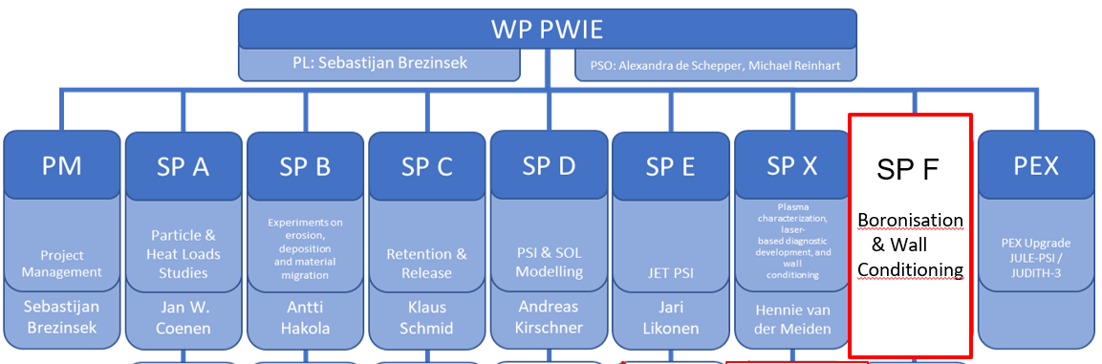
WPPWIE Overview
2025
In general: very successful completion of WPPWIE in FP9 EUROfusion Phase 1 (2021-2025)
26 RUs participated in average in this period of time
In average 7 subprojects per year covering 30+ “level 3” tasks and several hundred of tasks and deliverables within
PEX-HML covering FZJ Hot Material Laboratory activities (JUDITH-3 and Hot Cells)
25 Grant Deliverables within WPPWIE defined in 2020 for the 5-years-period => 23 GD “fulfilled”
20 GD completed and approved/submitted to the EC
3 GD in IMS still in review process PWIE GD 16 (2024), PWIE GD 19 (2025), and PWI GD (2025) => needs polishing
PEX-related PWIE GD 15 (2024) and GD 21 (2025) cancelled (PEX-HML owned by FZJ) and new GD in 2027

Slide 3
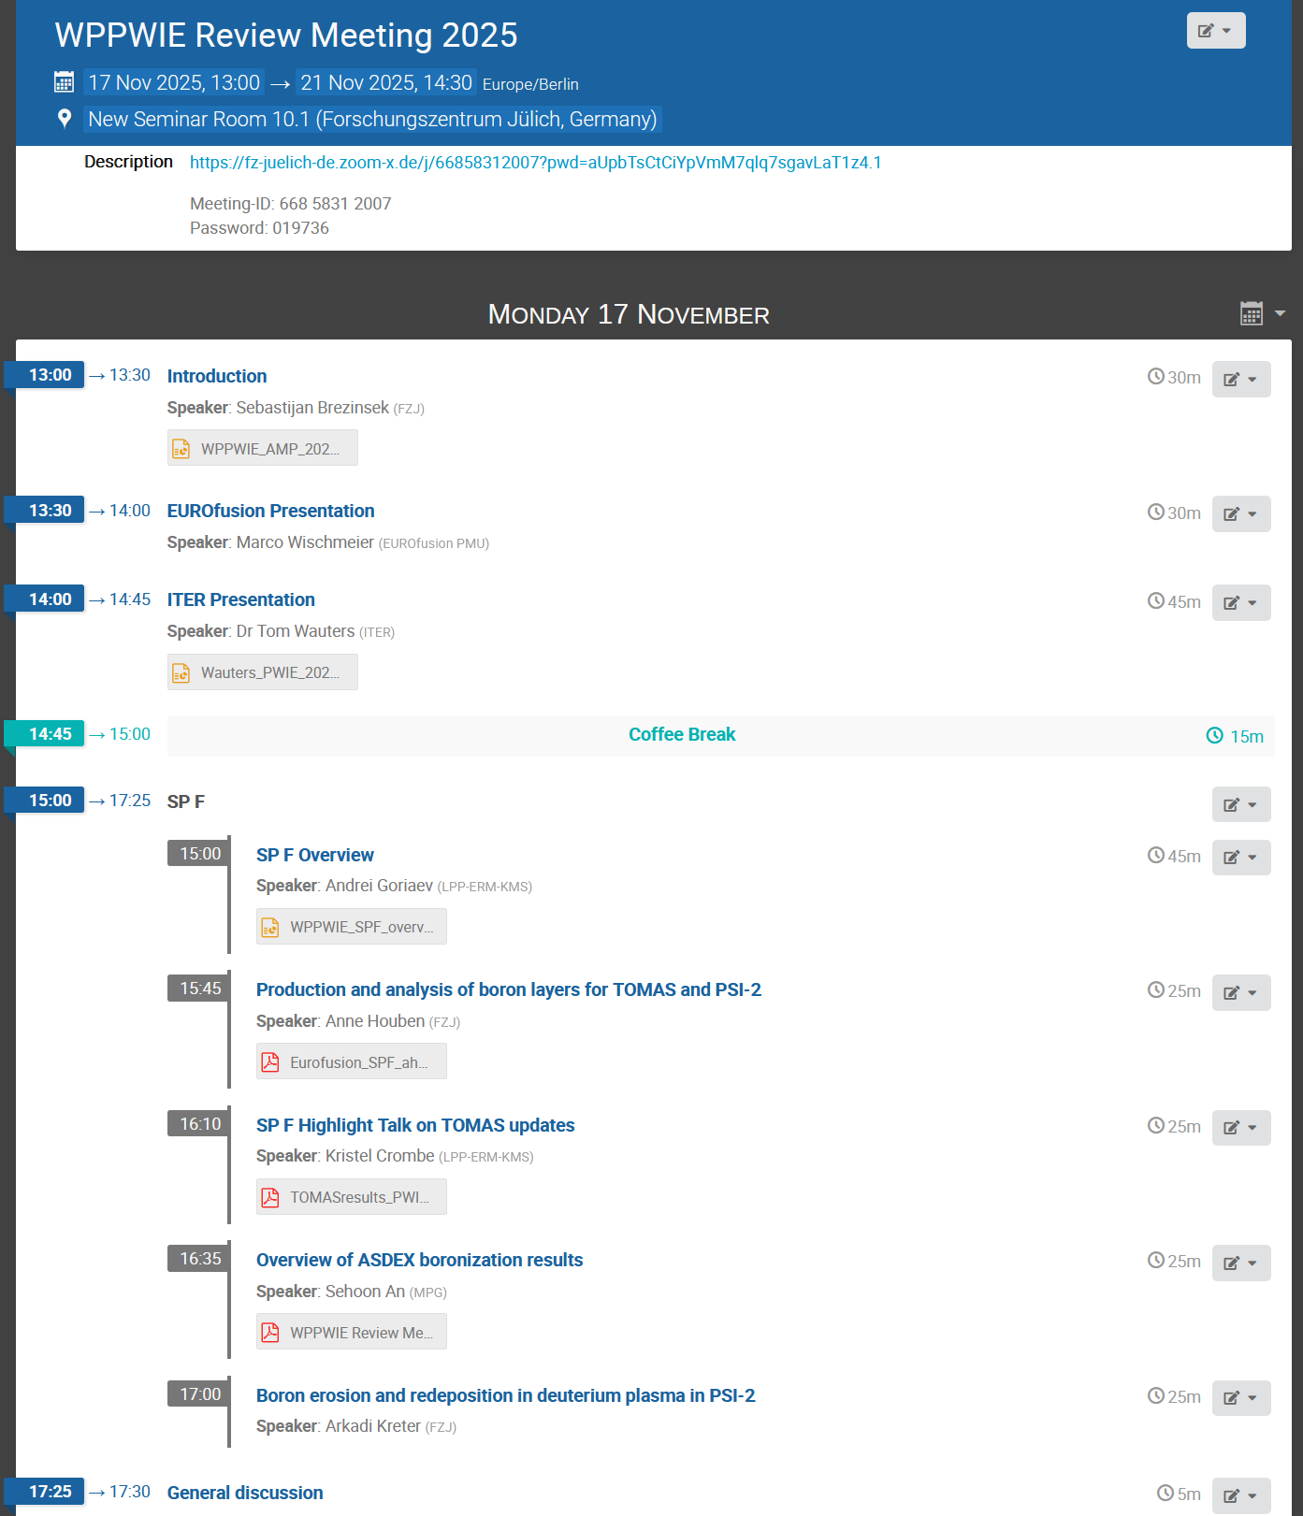
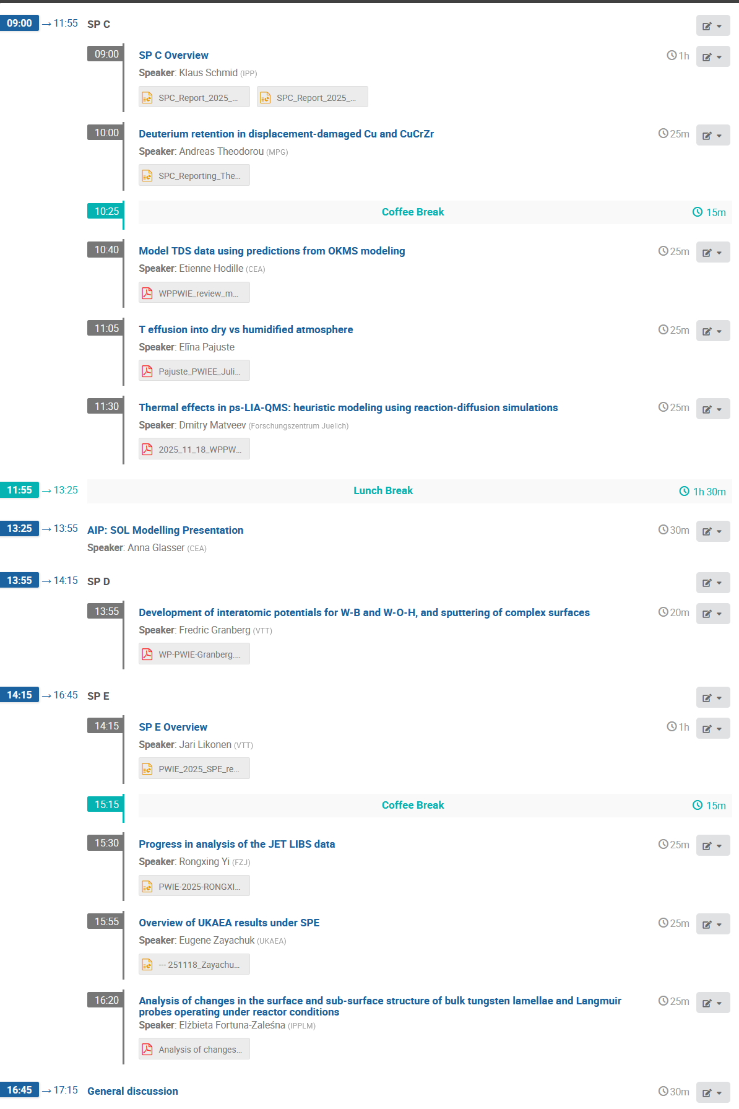
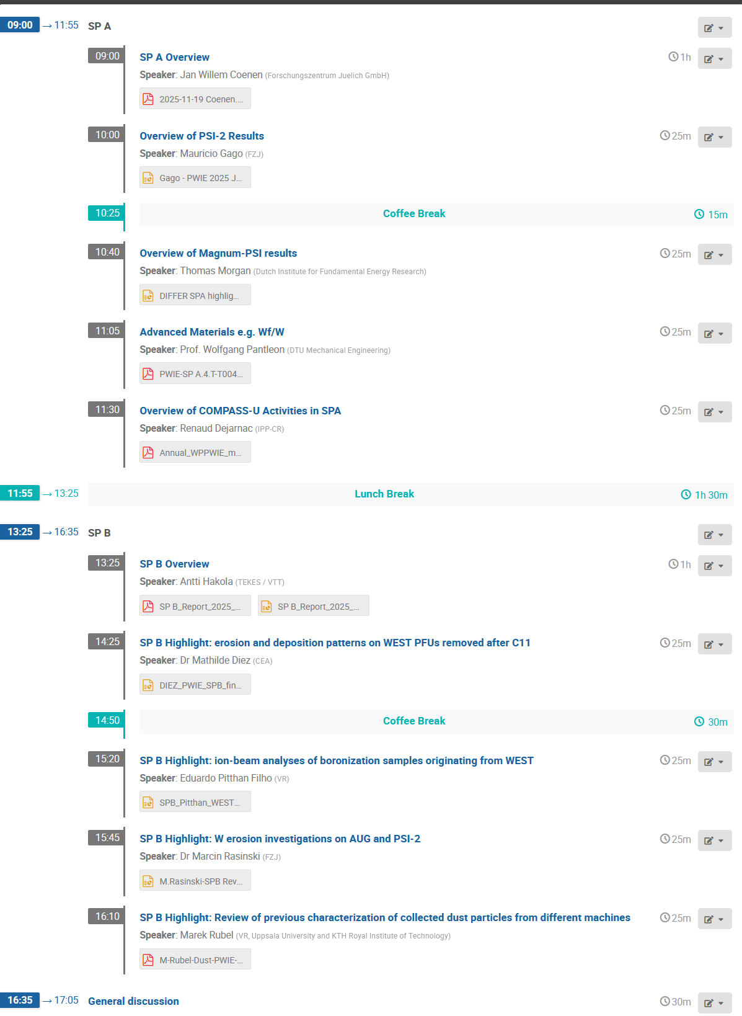
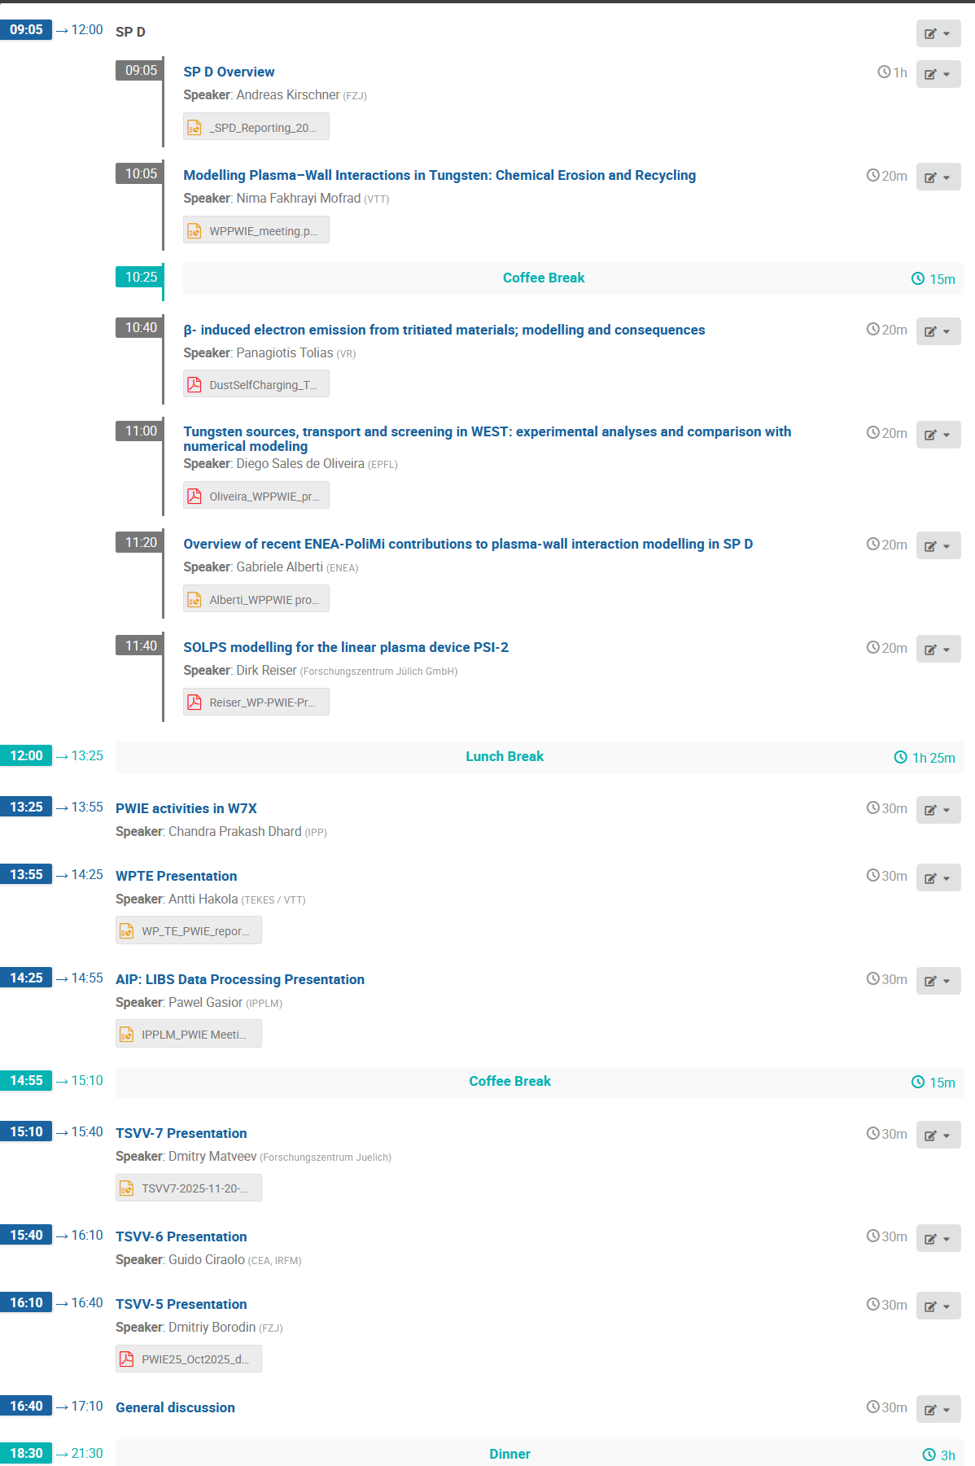
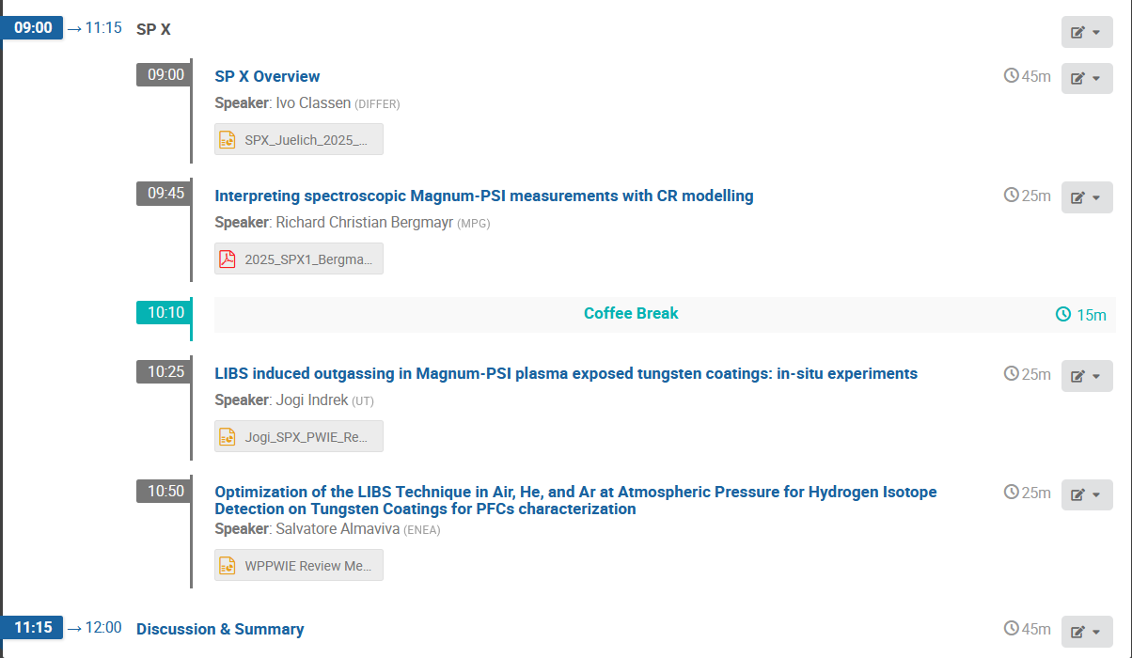
Final WPPWIE Project Meeting of Phase 1 2021-2025 (17.-21.11. in FZJ)
Overview presentations of subproject leaders
AI-accompanied tasks (AI-LIBS, AI-SOL) and associated TSVVs (TSVV-5, TSVV-6, TSVV-7)
Highlight presentations of individual tasks within WPPWIE covering multiple years of research
Presentations of partners (WPTE, WPW7X, IO)
https://indico.euro-fusion.org/event/3671

Slide 4
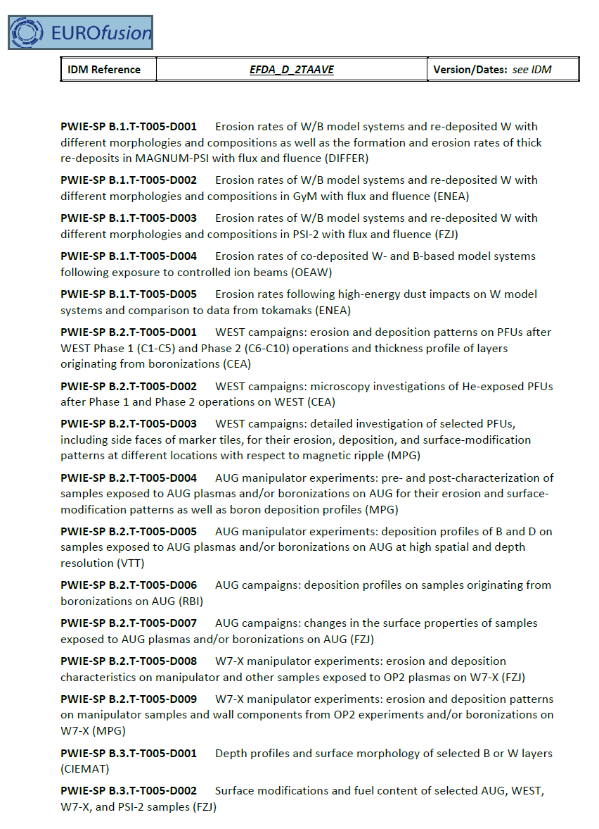
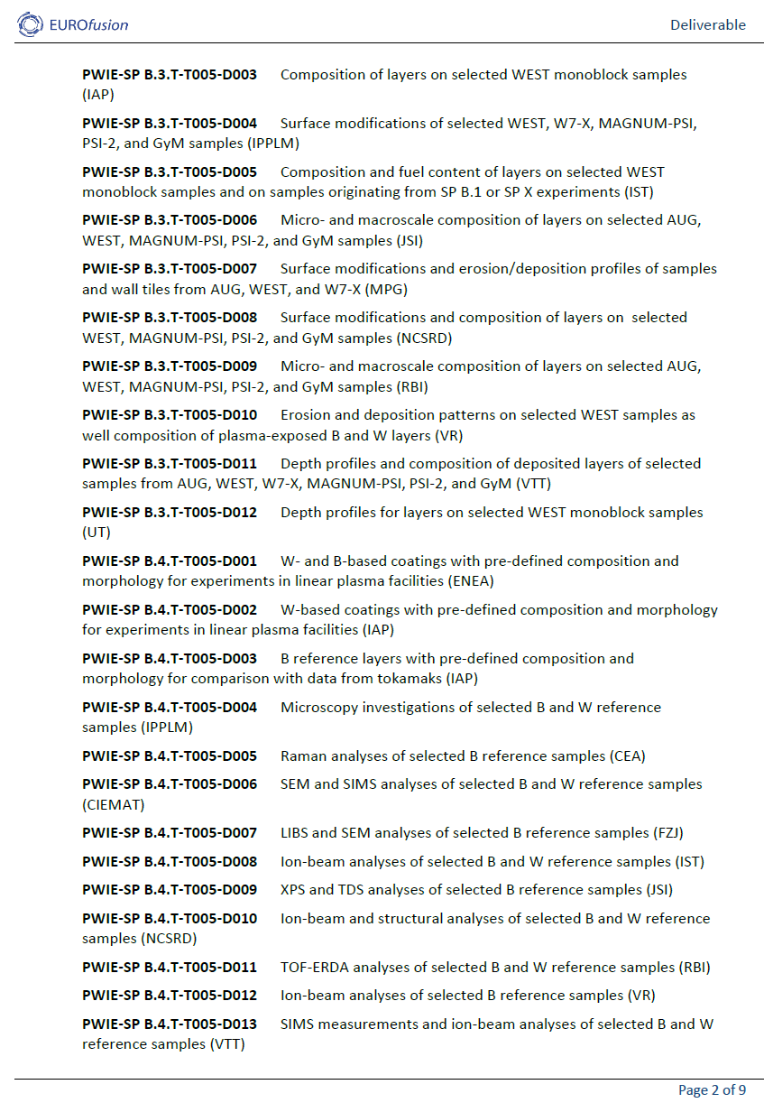
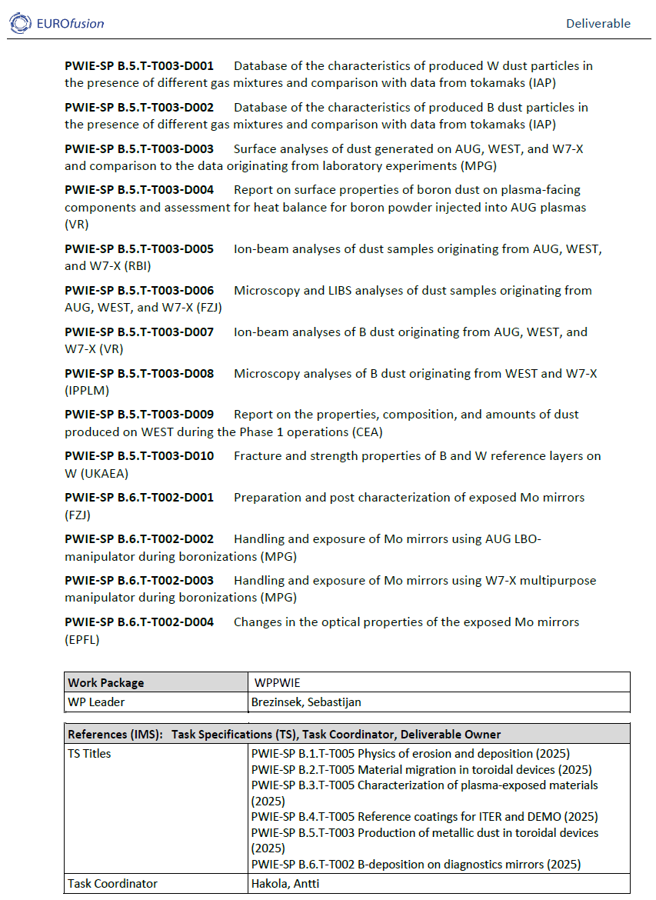
Reporting
Initial report at 7th Project Board
30 “Level-3 task” reporting as subproject reports: https://idm.euro-fusion.org/default.aspx?uid=2SXPHV
WPPWIE Technical Report for 2025 not yet finalised
99% of scientific tasks and deliverables foreseen in 2025 completed/fulfilled
Two scientific tasks delayed and shifted into 2026
SPB.6 T002-D004 related to ITER mirror cleaning from boron layers
Parts of SPE.3 related to JET post-DT ex-situ tile analysis with tritium and activation
Reports on PEX-HML activities for 2025 incomplete as GD delayed
Example: SP B covering
erosion and depostion studies
6 “level-3 tasks”with SPL as Deliverable Owner
SP B.1, SP B.2, SP B.3, SP B.4, SP B.5, SP B.6
Below 54 Tasks and Deliverables (RU-level)
1 Task and deliverable not fully completed and remaining parts shifted into 2026!

Slide 5
Activities within 2025
Supporting ITER re-baselining and addressing critical question in experiments / modelling:
Simulation of first wall W erosion, W deposition, and W screening in limited and diverted plasmas
Boronization and B layers: homogeneity, B layer properties, lifetime, and impact of B on wall conditions
T retention (scaling law), T removal techniques (ICWC, ECWC), T quantification (laser-techniques),
active removal of B layer by erosion, dust formation, dust properties, and dust removal (incl. TOMAS and other facilities)
Advanced modelling of B physical and chemical erosion process as input for PWIE models (MD simulations)
Qualification of ITER TFW design solutions in HHF and plasma devices (inertially cooled PFCs) *
PFC damage predictions under VDE and RE impact in ITER (JET benchmark)
Supporting ITER first mirror performance in the presence of boron (boronization / boronization + plasma)
* experiments started in 2026
Activities coordinated with IO using the ITPA umbrella (DivSOL) and direct communication between IO/PWIE

Slide 6
Activities within 2025 (ii)
Material qualification for “DEMO” and other facilities with plasma and combined load, damage evolution, limits
Support of WEST and ASDEX Upgrade experiments, analysis, and interpretative modelling
(PWIE aspects only e.g. migration, 3D aspects, layer formation, stability)
Address T-retention by trapping/diffusion/permeation in damaged tungsten/Eurofer PFCs
Prompt re-deposition physics of W and properties of re-deposited W (experiments and modelling)
Analysis of JET-LIBS data and prepare/start for post-DT tile analysis
Support of W7-X PWIE in long-pulse operation, wall conditioning, material migration, transfer to W
Properties of cold, recombining plasmas in view of molecular assisted processes in H,D
Development and application of laser-based technologies for in-situ and in-operando studies (W, B)
Support of COMPASS-U and JT-60SA regarding transfer to W by modelling, divertor design, and PFC test
Coordination with WPTE and WPW7X and support of WPSA in specific areas
Note, dedicated experimental time for benchmark experiments which require high fluence limited in 2025
Interaction with FTD where possible, but in general challenging due to re-organisation and change of scope

Slide 7

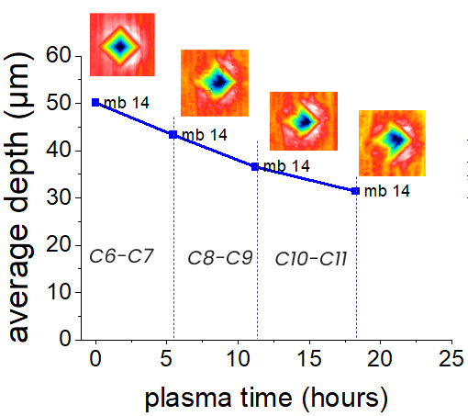
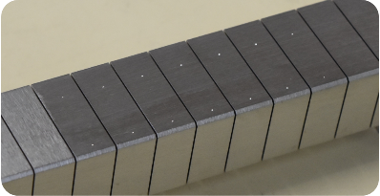
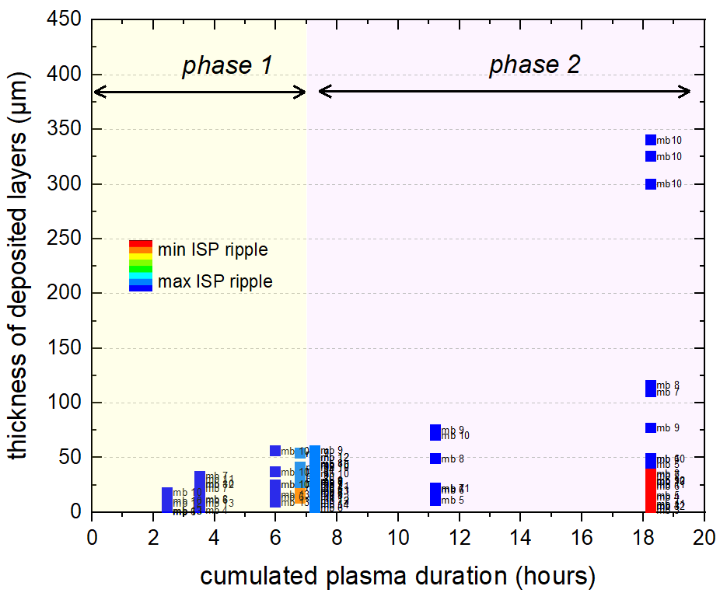
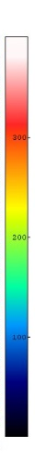
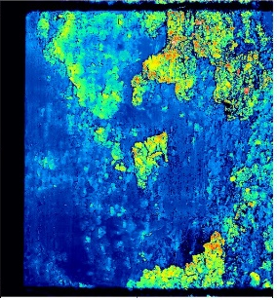
SP B example: WEST erosion and deposition patterns on PFUs
Task and questions to be addressed
Assess erosion of divertor PFUs phase 2
Approach
Fiducials on the surface of 4 PFUs (CEA)
Measurement of their depth using confocal microscopy – monitoring after each campaign (CEA)
FIB analyses of the fiducials (MPG)
Results
Fiducials clearly modified by plasma (change of depth, change of shape)
Erosion might reach 20 µm at ISP after 18h of plasma
M. Diez et al.
Task and questions to be addressed
Evaluate deposition behaviour on PFUs during phase 2
Approach
Confocal microscopy on PFUs after C9 and C11 to determine thickness of deposited layers
Results
Layers > 100 µm during phase 2
Cleaning activities needed
Extreme erosion and deposition values for W
W migration from first wall to divertor needed
to explain deposition (ripple, antenna, operation?)

Slide 8

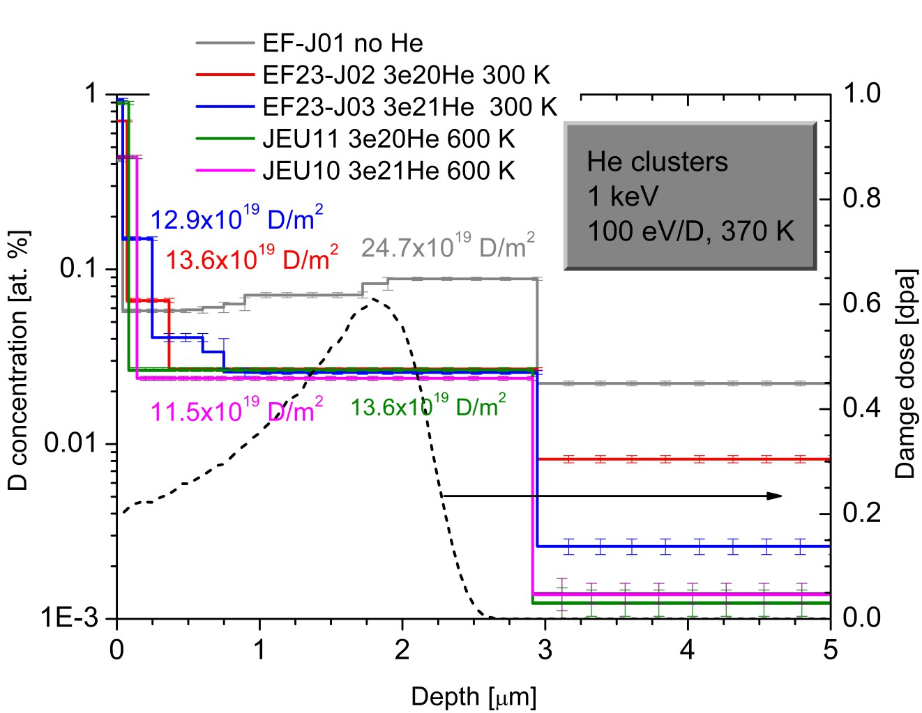
SP C example: Fuel retention in EUROFER w/ and w/o He
Study D uptake and retention in EUROFER as a function of He fluence implanted at elevated temperature
Exposure of Eurofer to 3×10²⁰ and 3×10²¹ He/m² @ 600K; 20 MeV W ion irradiation at 290 K and D ion exposure 100 eV/D ion exposure at 370 K, flux 2x10¹⁷ D/m² for 22h
3He-NRA D depth profiling shows about two times reduced uptake as compared to no-He sample
Lower D retention for higher He fluence
The effect of reduced D uptake at 600K is similar as observed for 300 K He irradiations.
S. Markelj et al.

Slide 9
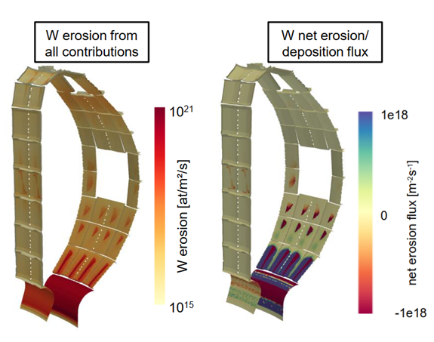
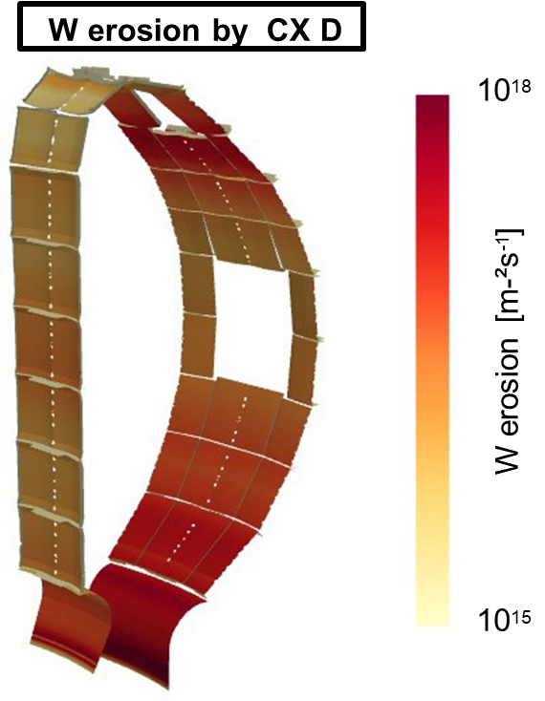
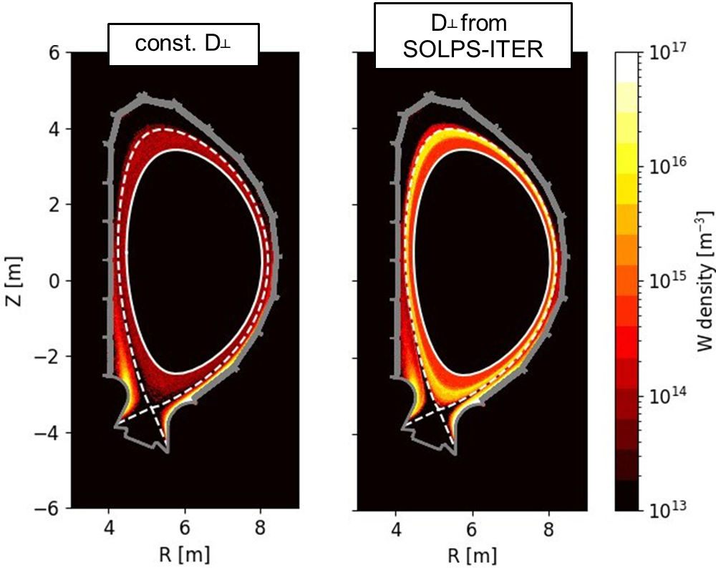
SP D example: Simulation of W first wall erosion for ITER
3D-resolved W erosion flux distribution for reference Q=10 DT plasma
Plasma ions: D, H, seed impurity Ne (from SOLPS-ITER)
Energetic CX neutrals: D (from EIRENE with energy and impact resolution)
3D-resolved W erosion flux distribution for reference Q=10 DT plasma
Plasma ions: D, H, seed impurity Ne (from SOLPS-ITER)
Energetic CX neutrals: D (from EIRENE with energy and impact resolution)
W self-sputtering (from ERO2.0 inclduding diffusion coeffiecients for W)
Dominant in ITER: Ne-induced sputtering followed by W-self sputtering
W erosion resources by RF-sheath effects on top
Benchmark experiment in ASDEX Upgrade performed in 2025 (analysis ongoing)
A. Loarte, T. Wauters*
Presemted at IAEA
* Review EPS2026
Ch. Baumann*
NF submitted
EPS contribution
A. Kirschner
NME 2025
W self sputtering

Slide 10


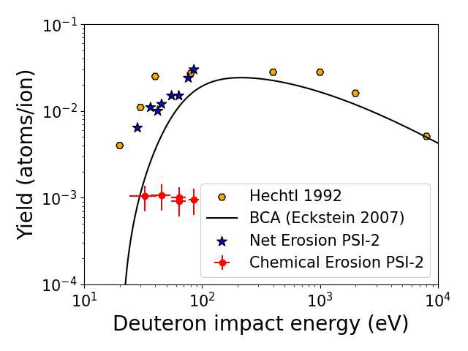
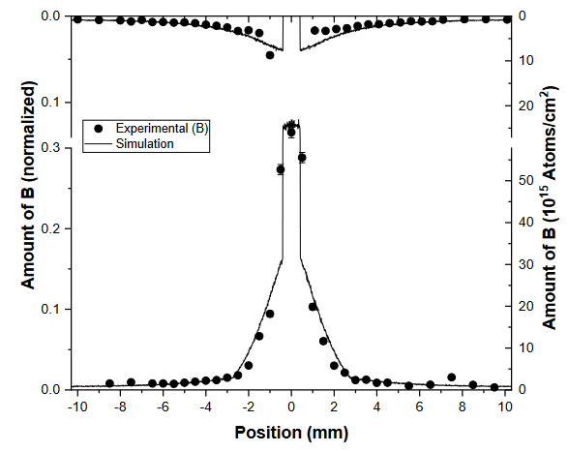
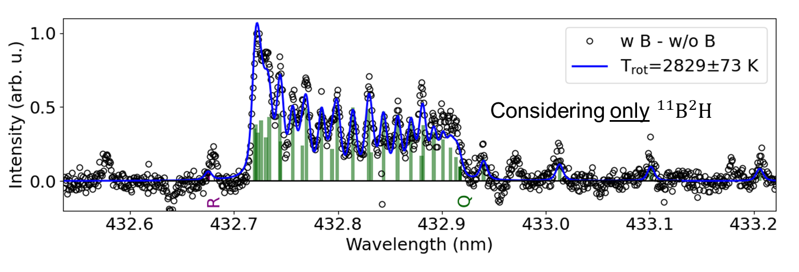
SP F example: Boron sticking coefficients / boron chemistry
Standard boronisation is a glow discharge in He with 10% B₂H₆ carried out and sticking monitors installed
Two sticking species identified
Enhances the homogeneity of the B layer coverage
Feeds into boronization modelling (IO)
Will feeds into WallDYN-3D and ERO2.0
B layer on W substrate exposed to D plasma in PSI-2
Chemical and physical sputtering of boron separated
B layer sputtered by low energy hydrogen atoms/ions
Quantification by sample thickness and spectroscopy
Benchmark of atomic and molecular data in ERO2.0
M. Sackers et al.
NME 2025 and PSI 2026
M. Mayer et al.
NME 2025

Slide 11
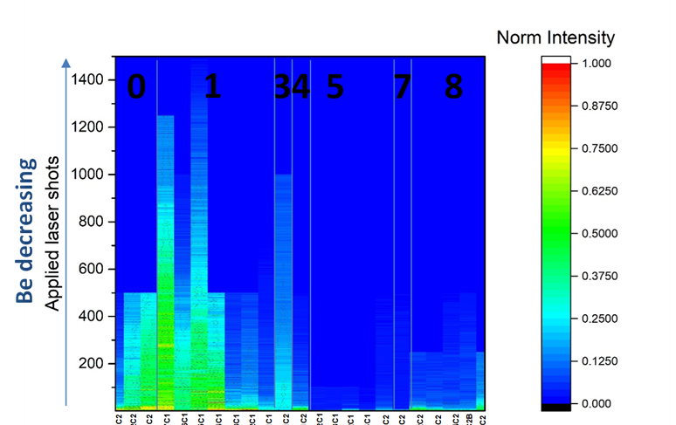
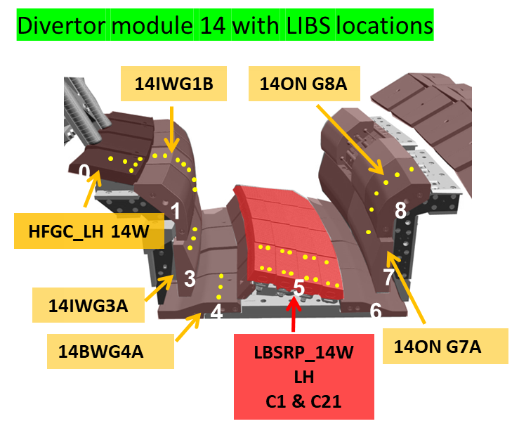
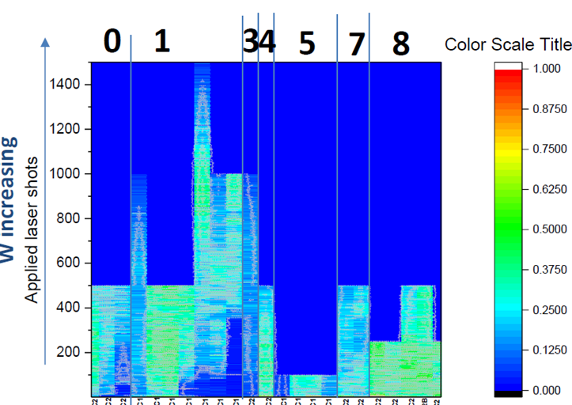
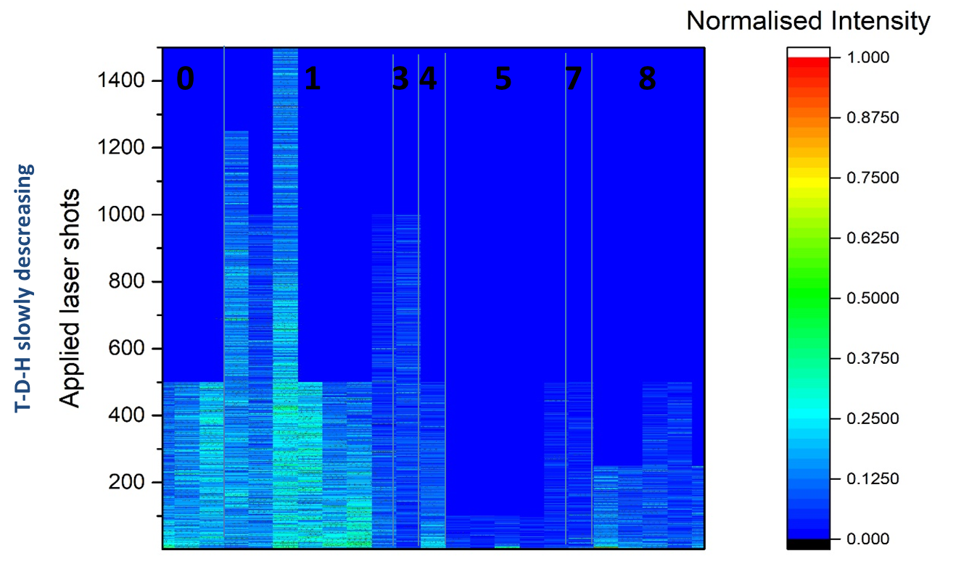
SP E example: In-vessel ps-LIBS system in JET with H in Be codeposits
Beryllium
Erosion and deposition pattern in JET
quantified by ps-LIBS in W divertor
General pattern in agreement with previous post-mortem anaylsis
S. Amaviva et al.
JNE 2026
J. Likonen et al.
NME 2025
R. Yi et al.
NME 2025
Hydrogen Isotopes
Tungsten
Transfer to ITER (diagnostic candidate):
Diagnostic capability shown in JET
Technological capability shown in JET
Laboratory experiments to transfer
from Be to B layers (H. Wu et al. NME2025)

Slide 12

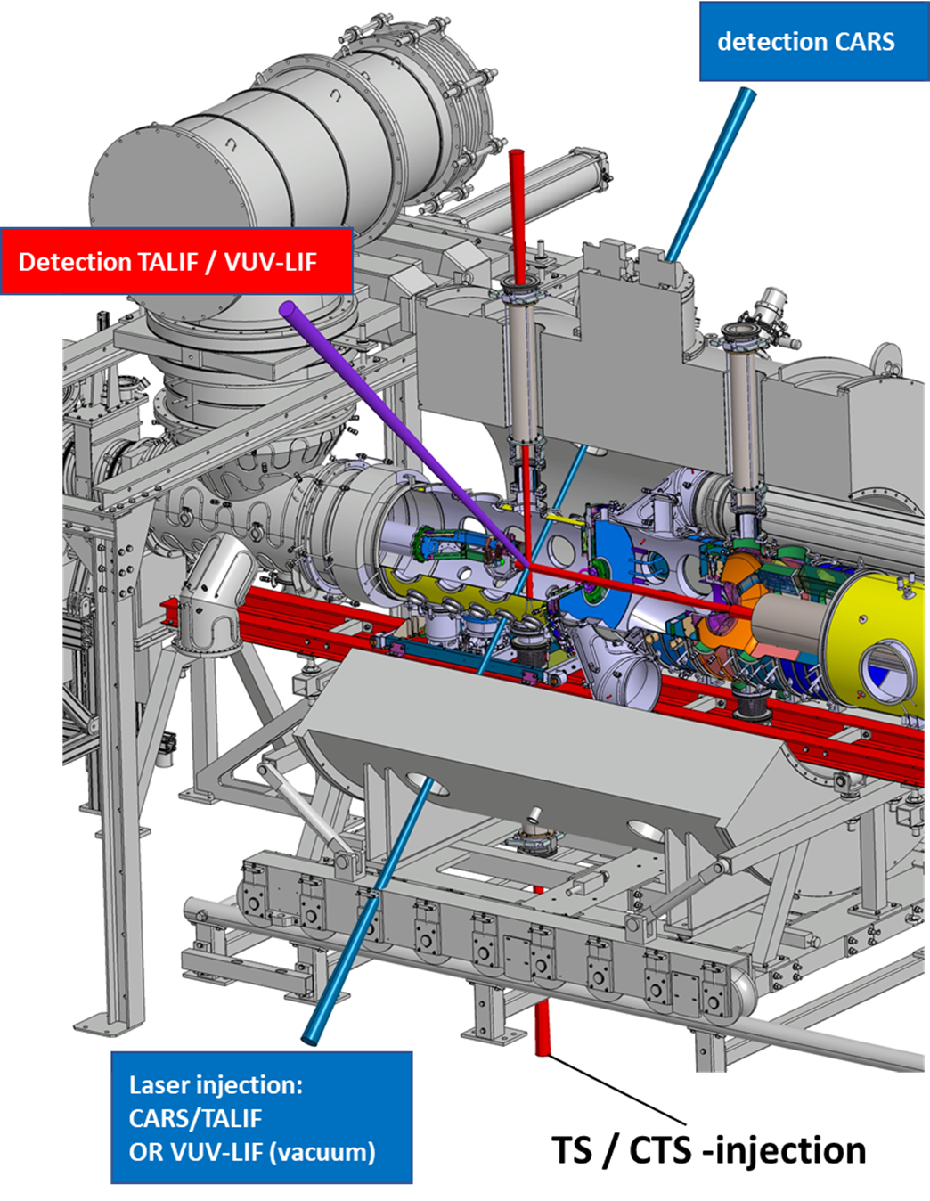
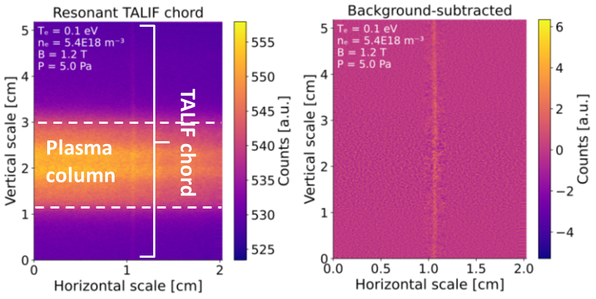
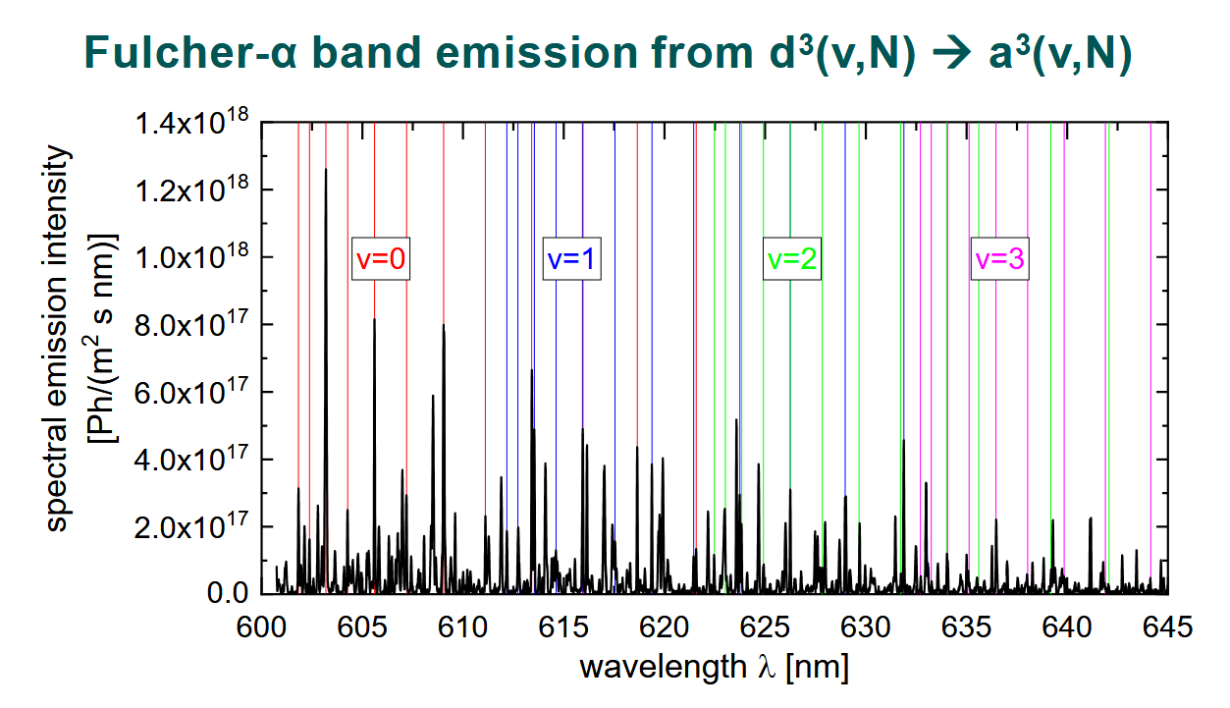
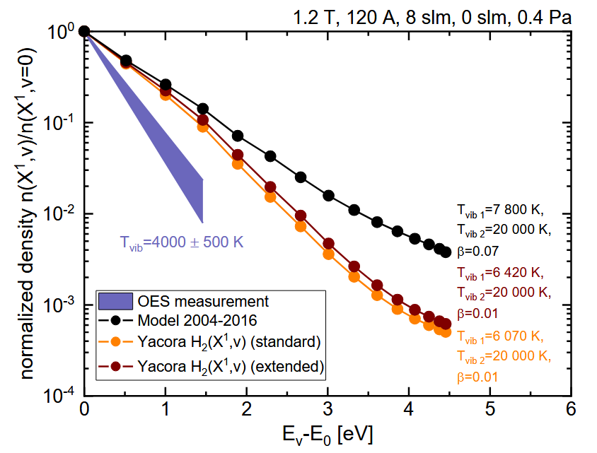
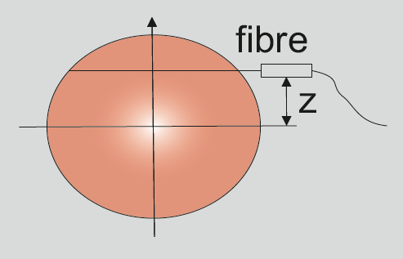
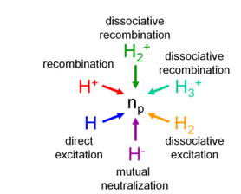
SP X example: active and passive spectroscopy as input to benchmark CRMs for H and D
TALIF, OES on MAGNUM-PSI
Fulcher-band measurements and Yacora CR modelling
VUV/VIS OES on PSI-2

Slide 13
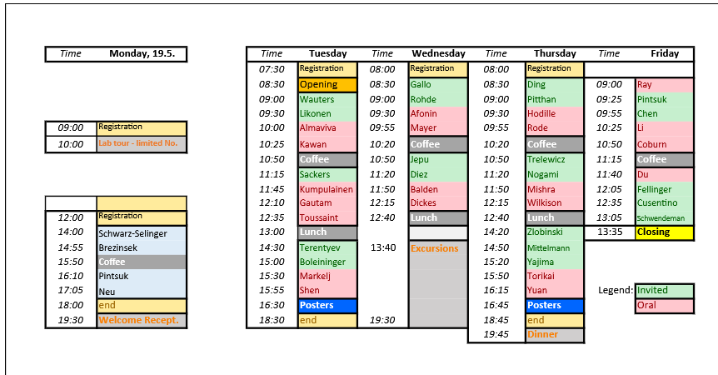
Outreach
Multiple plenary, invited, oral and poster presentations at fusion conferences resulting from PWIE activities
AAPPS DPP, PFMC, IAEA FEC, EPS, ICFRM, PLASMA, PET etc. (pinboard)
Multiple journal publications in peer-review publications (pinboard)
Presentations of WPPWIE members at summer schools or special days at conferences
EUROfusion
is leading
PWIE studies
worldwide
Example
PFMC
Ljublijana
International visits outside of EU in 2025
PISCES in San Diego => Boron
ORNL => linear plasma test stand in nuclear environment
NIFS => 3D modelling with EMC3-EIRENE/ERO2.0 in LHD heliotron
Rokasho => post-mortem analysis with activated samples from JET
Hefei => material studies

Slide 14
Summary WPPWIE 2025
Activities of all Subprojects in 2025 completed, apart from two activities
Key results presented at conferences including PFMC, EPS, AAPPS-DPP, PET, IAEA and ICFRM
Strong emphasis on ITER-related tasks (close collaboration with IO):
to support physics assumptions for new baseline and provide predictions
to support technical solutions for new baseline and help in open design issues
to compare tokamak experiments in support of ITER regarding material migration, retention, and predictions
Support of reactor-related physics questions and PFC qualification with plasma
Annual meeting mid November in FZJ summarising all work and provide input to level-3 reporting
Level-3 reporting completed
WPPWIE technical report not yet completed*
20 out of 23 Grant Deliverables completed. 3 GD in review process to be completed by April.
* Extreme work load in the last six months and level of reporting increased substantially

