Slide 1
Digital Solutions for Fusion Office (DSO) Work Package Advanced Computing (WPAC)
Physics Project Board #08
F. Jenko (DSO Head)
D. Kalupin (DSO Coordination Officer)
EUROfusion PMU

Slide 2
Digital Solutions for Fusion Office (DSO)
The DSO will drive and coordinate EUROfusion digital innovation activities, including the provision and management of computational and data storage resources. It will support the development of research and engineering software, with a focus on integrating computational tools into a common environment. The DSO will provide digital solutions tailored to the specific needs of other WPs and departments.
Digital Twin Environment
Predictive capabilities, real-time control, coupled physics-engineering simulations, and analysis tools for next-generation facilities.
Advanced Computing Hubs
Support for code developers:
High-Performance Computing;
Modelling Frameworks and Standardized Workflows.
Data Management Plan
Unified access to experimental data using FAIR principles. Support further development and maintenance of existing multi-machine databases.
Computing & Data Storage Systems
Management & distribution of dedicated computing resources (PITAGORA HPC system, collaboration with Japan, new Gateway, Long-Term Data Storage Facility).

Slide 3
Key goals and recent activities
Key goals
Build a vibrant, collaborative ecosystem that integrates physics, engineering, and digital technologies
Develop and employ digital twins of fusion systems (helping to save cost and time)
Emphasize development & dissemination of EUROfusion Standard Software (opportunity to build user bases)
Close coordination with various departments and WPs, particularly the newly established WPTM
Collaborations with colleagues in the UK and the USA
Re-establishment of activities for 2026/27
ACHs (down from 5 to 4 due to a ~30% budget reduction w.r.t. 2021-25 values)
DTE projects (replacing the 7 PoC DTE projects, 14 AI projects, and TSVV-15, very strong reduction w.r.t. 2021-25 )
Data projects (DMP + multi-machine DBs)
HPC, EFGW and LTDSF + DevOps (continuation of hardware and software provision, part of 2021-2025 budget)
Distribution of infrastructure and support activities
Allocation of ACH projects for 2026
Allocation of HPC resources for Cycle#10
Meetings
EUROfusion Science Meeting - TSVV Final Reports (2021-2025) – Jan 2026
E-TASC General Meeting #2 (organized by DSO & WPTM, planning of 2026-2027 and beyond) – Feb 2026
DTE Hands-On Workshop (towards ESS) – Summer 2026 – Under consideration (see Change Request)

Slide 4
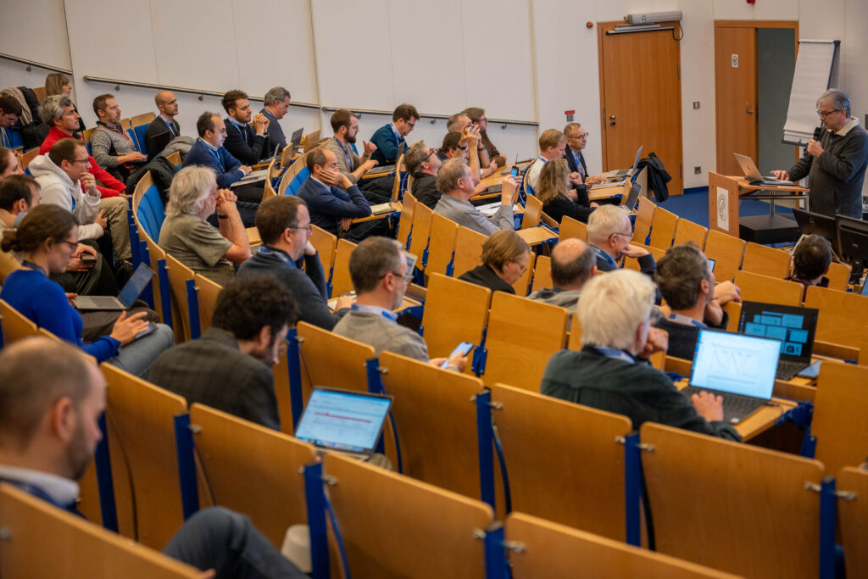
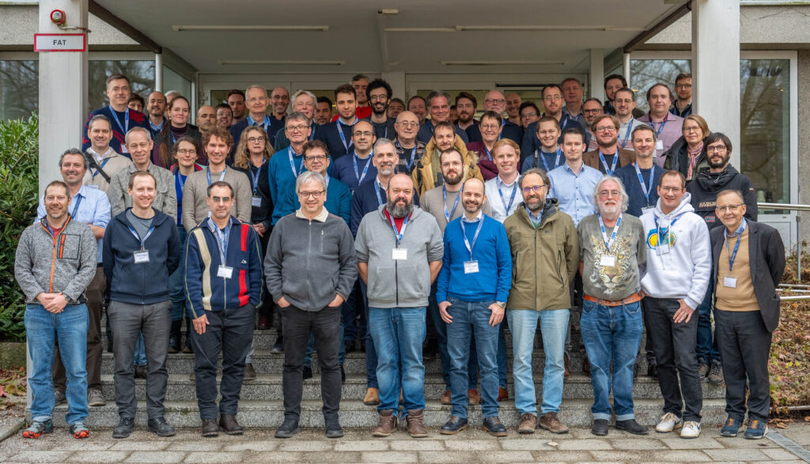
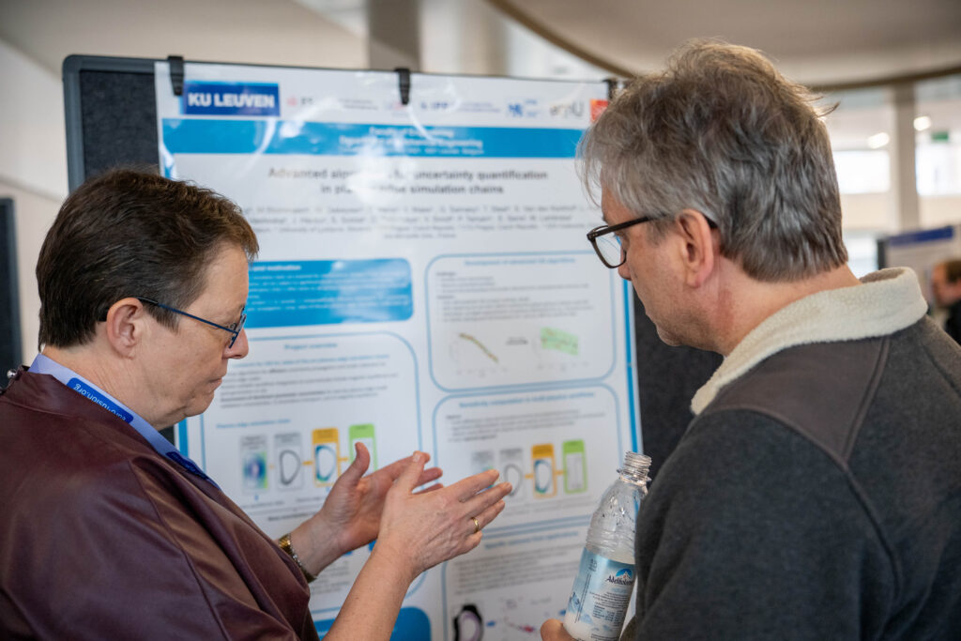
E-TASC General Meeting #2 (Garching, February 9-13, 2026)
70+ on-site participants
100+ total participants
Credit: Tamás Szabolics, EUROfusion

Slide 5
Determining software standards
The quality assurance framework for EUROfusion Standard Software (ESS)
https://idm.euro-fusion.org/?uid=2Q72WQ&version=v2.2
(endorsed by the E-TASC SB on March 12, 2025)
Progress toward the establishment of ESS has been regularly monitored and shows clear advances since 2021. The remaining gaps are expected to be addressed during 2026-2027.
An increasing number of codes are being released as open source, in alignment with IO/EU policies and enabling collaboration with start-ups under appropriate licensing frameworks.
The strategic focus is gradually shifting from software development to software utilization, supported by targeted training for users within the constraints of the mission budget.

Slide 6
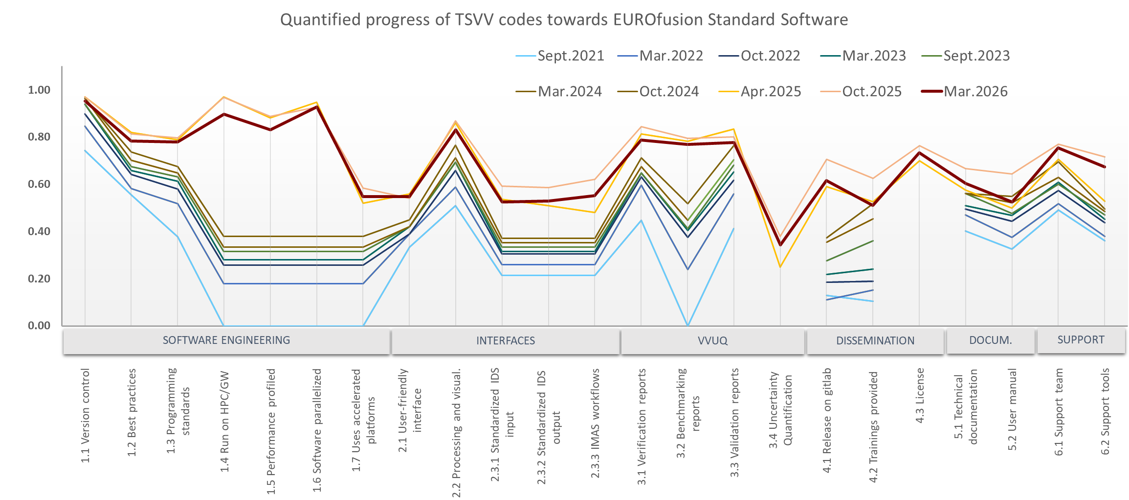
Progress towards EUROfusion Standard Software
March 2026 decrease reflects the addition of DTE activities with no prior ESS exposure.
The proposed DTE-ACH workshop will accelerate DTE onboarding to the ESS ecosystem, guided by ACHs.

Slide 7
Work Package Advanced Computing

Slide 8
Processes and collaborations
WPAC
Infrastructure and Support
WPs
Infrastructure and Support
Facilitate the development and deployment of advanced computational tools across all WPs.
Standardized Data Access (using FAIR principles)
Available for all MST devices as well as JET, ensuring transparency, reproducibility, and interoperability across systems.
Development of a Digital Twin Environment Leverage the latest advancements from relevant TSVVs and WPs, integrating state-of-the-art computing and AI/ML to enhance predictive modeling capabilities.
Liaison to ITER and F4E
Ensure their effective engagement in the planning, implementation, and exploitation of software development activities.
ACH Support
E-TASC Scientific Board
TSVVs
HPC Resources
EnRs
HPC Allocation Committee
HPC OC
HPC PC
GW and LTDSF Resources
Data management (DMP, DBs)
Digital Twin Environment
Physics modules
AI/ML methods, Data curation
IMAS, Simulation Tools
ITER
F4E

Slide 9
WPAC structure: Advanced Computing Hubs
4 ACHs recommended for 2026/27, aiming at broad competence coverage within available resources:
Cat1 (HPC): CIEMAT, EPFL, MPG
Cat2 (MFSW): IPPLM
VTT (AI/ML focus): not funded as standalone activity due to budget constraints, but competences to be integrated under ACH-MPG
Category 1: High Performance Computing (HPC) | Category 2: Modeling Frameworks and Standardized Workflows (MFSW)
Tasks under the category include:
Enabling effective GPU usage of a selected set of codes on EUROfusion's HPC platforms with expanded GPU partitions Selecting and implementing scalable algorithms Assisting with code parallelization and performance optimization Optimizing communication patterns and memory usage Supporting code refactoring efforts Providing targeted support and training for code developers Promoting best practices in software engineering and efficient HPC resource utilization Providing support for the development of AI/ML surrogates for physics models Supporting large-scale model training and inference on EUROfusion infrastructure Supporting the development and application of advanced visualization tools | Supporting the development and maintenance of the Integrated Modelling and Analysis Suite (IMAS) framework to ensure extensibility, maintainability, and usability Offering technical support to code developers in adapting their codes to the IMAS data model to enable integration and validation Assisting with code integration and workflow optimization Contributing to the development of a unified, scalable, and interoperable modelling ecosystem aligned with EUROfusion’s long-term objectives Advancing database infrastructure and evaluating/implementing software solutions for data storage, management, and analysis, as well as authenticated/authorized access control

Slide 10
WPAC structure: Data
Data Management Plan (DMP)
Ensure FAIR access to EUROfusion experimental and simulation data.
Implement Scenario C: traceable data access via Persistent Identifiers (PIDs).
Develop software solutions for: 1) Data storage and management; 2) Analysis and access control; 3) Account provisioning and resource allocation (supported by ACHs)
Promote AI/ML technologies for data validation, analysis, and optimization.
EUROfusion Multi-Machine Databases
Maintain and extend databases: pedestal, disruption, transport, L-H transition
Updates and developments: TCV pedestal database with WPTE data; Develop L-H transition database; Coordinate transport database; Standardize Infrared Imaging Systems database; Update CICLOP long pulse database
AMNS Database
Continued support and maintenance: Align with latest IMAS Data Dictionary (DD) releases; Extend datasets included

Slide 11
WPAC structure: Digital Twin Environment
The notion of a Digital Twin first emerged around 2002 in the context of Product Lifecycle Management. It was later adopted as a conceptual basis in aerospace engineering and many other discipines.
Excellent source: “Foundational Research Gaps and Future Directions for Digital Twins“ (National Academies of Sciences, Engineering, and Medicine, 2024): http://nap.nationalacademies.org/26894
A Digital Twin (DT) is a set of virtual information constructs that mimics the structure, context, and behavior of a natural, engineered, or social system, is dynamically updated with data from its physical twin, has a predictive capability, and informs decisions that realize value.
The key elements that comprise a DT include (1) a virtual representation of a physical counterpart, and (2) a bidirectional interaction between the virtual and the physical. This bidirectional interaction forms a feedback loop that comprises dynamic data-driven model updating (e.g., sensor fusion, inversion, data assimilation) and optimal decision-making (e.g., control, sensor steering).
A DT should be defined at a level of fidelity and resolution that makes it fit for purpose. Important considerations are the required level of fidelity for prediction of the quantities of interest, the available computational resources, and the acceptable cost. This may lead to the DT including high-fidelity, simplified, or surrogate models, as well as a mixture thereof.
A Digital Twin Environment (DTE) is an integrated, multi-domain physics application space for operating on DTs for a variety of purposes (according to Michael Grieves & John Vickers: https://rdcu.be/d1wRu)

Slide 12
WPAC structure: Digital Twin Environment (2)
Pulse Design Tool (PDT) Extension Towards Digital Twin Functionality
Simulator-agnostic DTE integration – towards a consolidated framework with an ITER relevance
Sven Wiesen, DIFFER
Development of generic coupling between transport and free-boundary eq. codes with breakdown modules for PDTs
Stefano Marchioni, IPP.CR
Data Driven Predictive Modeling for Real-Time Feedback
A machine-agnostic DT framework towards fast simulation and real-time plasma prediction and control
Alessandro Pau, EPFL
A novel ML-based DT architecture for real-time monitoring, integration, and control of the breeding blanket
Antonio Cammi, ENEA
Advanced Visualization
Verification-oriented interactive visualisation and decision support for the DTE
Leon Kos, JSI

Slide 13
WPAC structure: Digital Twin Environment (3)
Integrated Physics/Engineering Simulation Framework for Fusion Devices
A highly scalable and flexible DT of FPPs and photorealistic renderer based on physically accurate models
Cristian Sommariva, EPFL
DT platform for integrated design of tokamak components – case studies on EU-DEMO divertor and ITER divertor
Domenico Marzullo, ENEA
Integrated DT framework for breeding blanket systems: Coupling plasma, fuel cycle, and thermal-hydraulics dynamics
Carlos Moreno, CIEMAT
A comprehensive numerical platform for advanced thermal protection of tokamaks
Marie-Helene Aumeunier, CEA
An integrated validation and benchmarking framework for the EUROfusion DTE
Anna Glasser, CEA
Development of a DT framework for fusion
Andrew Davis, UKAEA

Slide 14

WPAC structure: Computational systems
HPC PITAGORA (by CINECA)
Computational resources for large-scale, time-consuming simulations
CPU part.: 17 Pflops, GPU part.: 28.2 Pflops, storage: 16.2 PB (raw disk capacity) and 200 TB for home (backed-up)
10th cycle - Mar.2026-Feb.2027
EUROfusion Gateway (by CINECA)
Central host for code development and releases, computing resources for codes not requiring HPC
14 CPU + 1 GPU, storage: 3.5 PB (raw disk capacity) and 100 TB for home (backed-up)
Long-Term Data Storage Facility (by PSNC)
Long-term (~10 yrs) storage of simulation data
Storage at PSNC (8 PB disks+8 PB tapes) + Fast (SSD) buffer at CINECA to provide fast connection to PITAGORA

Slide 15
Grant deliverables and milestones (2026)
Grant Deliverables
Deliverables Title | Date | Comments
Consolidated report including uptime KPIs, usage statistics, GPU/CPU utilisation, user feedback, and incident logs for HPC, EFGW, and LTDSF | 12.2026 | Produce consolidated report including uptime KPIs, usage statistics, queue times, GPU/CPU utilisation, user feedback, and incident logs for HPC, Gateway, and LTDSF by Dec 2026 [CHW]
Advanced Visualisation Toolkit | 12.2026 | Release version 1.0 of an interactive visualisation toolkit supporting IMAS data and DTE validation, including documentation and 2 demonstrator use cases. [DTE]
Grant Milestones
Milestones Title | Date | Comments
IMAS platform enabled for the use on Pitagora HPC | 12.2026 | Provide a containerised IMAS execution environment enabling the latest two IMAS releases on EUROfusion HPC systems, validated via at least three reference workflows (transport, equilibrium, turbulence). [CHW]
Allocation of HPC resources for Cycle 10 of production runs | 03.2026 | Completed project selection and resource allocation for the use of the EUROfusion HPC during Cycle 10 [CHW]
Achievement of KPIs on availability to users of EUROfusion computational resources | 12.2026 | Availability of HPC, Gateway and LTDSF in support of simulation programme as set by the Key Performance Indicators [CHW]

Slide 16
Links to important materials
2nd E-TASC General Meeting (Feb 9-13, 2026, Garching)
Summary: https://idm.euro-fusion.org/?uid=2TBH6G&action=get_document
Materials: https://indico.euro-fusion.org/event/3723/
1st E-TASC General Meeting (Nov 11-15, 2024, Garching)
Summary: https://idm.euro-fusion.org/?uid=2S53YT&action=get_document
Materials: https://indico.euro-fusion.org/event/3034/
EUROfusion Standard Software
https://idm.euro-fusion.org/?uid=2Q72WQ&version=v2.2
Review of Advanced Computing Hubs (2024)
https://idm.euro-fusion.org/Portal/Pages/ContentView.aspx?uid=2RHUC2
WPAC reporting
https://idm.euro-fusion.org/default.aspx?uid=2PMTS8
DSO/WPAC Wiki
https://wiki.euro-fusion.org/wiki/DSO_wiki_pages

Slide 17
Outlook to FP10

Slide 18
Strategic key objectives for 2026/27 and beyond
Based on discussions at the E-TASC General Meeting #2:
Meeting the needs and opportunities with regard to the interpretation of data from W7-X and TE devices, including JET, and to addressing physics gaps relevant to ITER, JT-60SA, FOAK, and tokamak/stellarator-based fusion pilot plant concepts
Development and dissemination of EUROfusion Standard Software
Facilitating Stellarator Collaborations
Towards Systematic and Reproducible VVUQ
Enabling Data-Driven Fusion Science
From Open Source to Open Data
Promoting the Reproducibility of Published Scientific Results
Taking Advantage of the AI Revolution
For Reference: New Approach of the U.S. Fusion Program

Slide 19
Supporting VVUQ, Open Data & AI in fusion
Enable federated, FAIR, and AI-supported fusion data ecosystems
Accelerate IMASification of experimental and simulation data
Promote open data publication alongside scientific results
Strengthen transparency and reproducibility via citable repositories
Combine AI with physics-based models toward Digital Twins
Above mentioned policies will be encouraged during FP9 and should become mandatory in FP10.

Slide 20
The big picture
EUROfusion’s role may evolve significantly, with implications for DSO strategies:
Support the development of future FOAK/FPP devices
Support of ITER operations remains a central objective
Leverage digital solutions to mitigate risks and reduce costs & timelines
Digital solutions provide moderate-cost, high-impact contributions to Europe’s fusion program
DSO key objectives:
Maintain fundamental theory and simulation as core program components
Integrate plasma physics with fusion engineering and materials science to support FOAK/FPP readiness
Strengthen communication and collaboration between scientific and engineering communities
Prioritize key methodologies – VVUQ, AI, and Digital Twins – as central elements of FP10 objectives
Provide state-of-the-art computational resources dedicated for fusion
Enable ACHs to fully leverage EUROfusion’s HPC investments
Private sector & funding engagement:
Promote coordinated, win–win collaborations with the private sector
Maximize the impact of EC funding by supporting public institutions in ways that also benefit private stakeholders (cmp. INFUSE voucher program in the US)

Slide 21
Change Requests

Slide 22
Urgent Change Request: Mission funds for 2026
CR1: Increase mission funds for 2026 by 28 k€
Justification: Mission funds available to WPAC activities in 2026/27 are extremely limited. Once the costs of the 2nd E-TASC General Meeting and the ACH coordination meeting are taken into account, no funds remain to support further WPAC activities.
Objective: The Digital Twin Environment (DTE) projects are new within the E-TASC framework and, due to the timing of the 2026 planning cycle, were not included in the ACH support allocation. To address this, it is proposed to organize a one-week in-person hands-on meeting (DTE + ACH) to foster early integration and accelerate progress toward the development of Digital Twins.

Slide 23
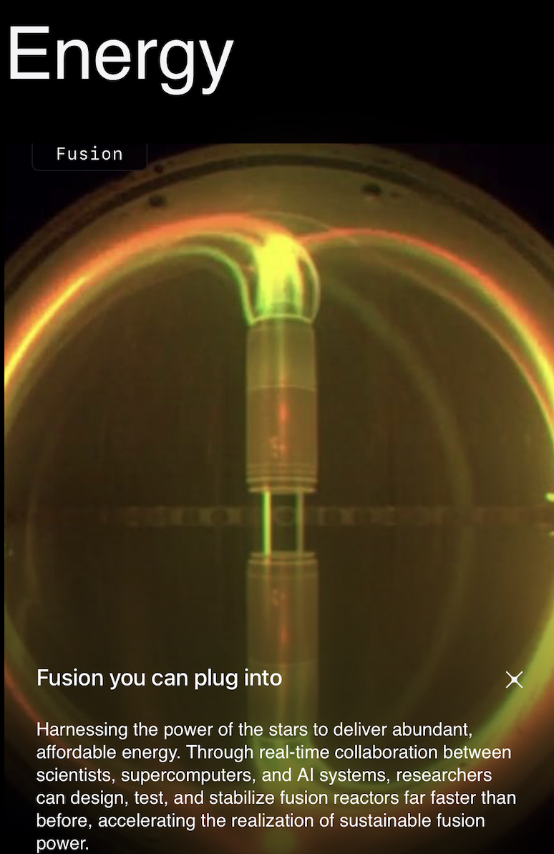
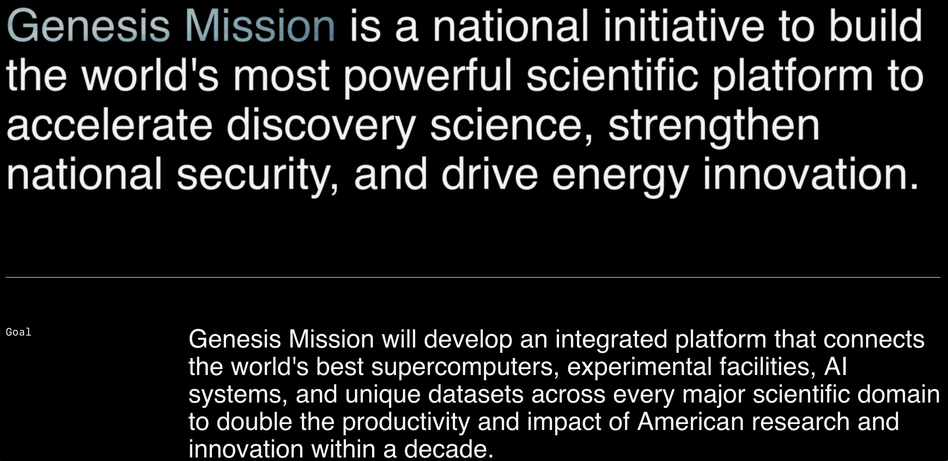
Increased funding for Artificial Intelligence in the U.S.
“Genesis Mission“ was recently announced as DOE-wide AI initiative.
One of the lighthouse challenges is fusion.
https://genesis.energy.gov

Slide 24
Request for increased funding of AI in 2026/27 and beyond
EUROfusion must position itself at the forefront of the AI revolution
Regrettably, due to significant budget cuts during the 2025–2026 transition, the number of active AI projects was reduced from 14 to 2
Should additional funding become available in 2026–2027, the following activities should be prioritized for reinstatement:
Pilot projects on applications of agentic AI models (e.g., AI-assisted IMASification of JET data)
Use of AI techniques for the development of EUROfusion Standard Software (code development, optimization, porting, IMASification, etc.)
Establishment of an updated, AI-ready data ecosystem: accelerating DMP development toward full Scenario C and Scenario D compliance
Integration of stellarator data and simulations
Development of surrogate models for real-time plasma control and Digital Twins

