Slide 1

Work Packages Plans for 2026-27
Project Meeting
Plasma-Wall Interactions and Exhaust
Sebastijan Brezinsek
FZJ
S. Brezinsek (PL), J.W. Coenen, A. Hakola, K. Schmid, A. Kirschner, J. Likonen, I. Classen, A. Goriaev, and D. Douai (DPL)

Slide 2
EUROfusion Prolongation 2026-2027
WPPWIE proposed a two-years scientific program as input to the AWP2026-2027
Initial assumption one program with one full reporting end of 2027 is sufficient
Change of the strategy requested by EC – annually reporting required (double the administrative work)
Full planning for both years prepared within allocated budget given by the PM and approved by the GA
Presentation of scientific activities to the 25 RUs included in WPPWIE in two Project Meetings:
November 2025: https://indico.euro-fusion.org/event/3671
February 2026: https://indico.euro-fusion.org/event/3929
21 activity descriptions for both years completed and uploaded to IDM as additional information:
March 20026: https://idm.euro-fusion.org/?uid=2TDKGN
21 activities or “Level 3” tasks for 2026 implemented into IMS
=> several hundred tasks and associated deliverables to the 25 RUs participating
PMP update for 2026 and 2027 not yet done
Note, WPPWIE has an about 37% smaller budget in 2026 and 2027 in comparison to 2025 (31 activities)
  Completion of multiple extra tasks and closure of some activities
  Complete skip of activities with T operation by CEA (high cost ) in 2026 and 2027
  Complete skip of activities with metallic tokamak dust and safety assessment (mainly WEST) in 2026 and 2027
Note, the JET post-mortem analysis is still delayed and shifted / flexibility required

Slide 3
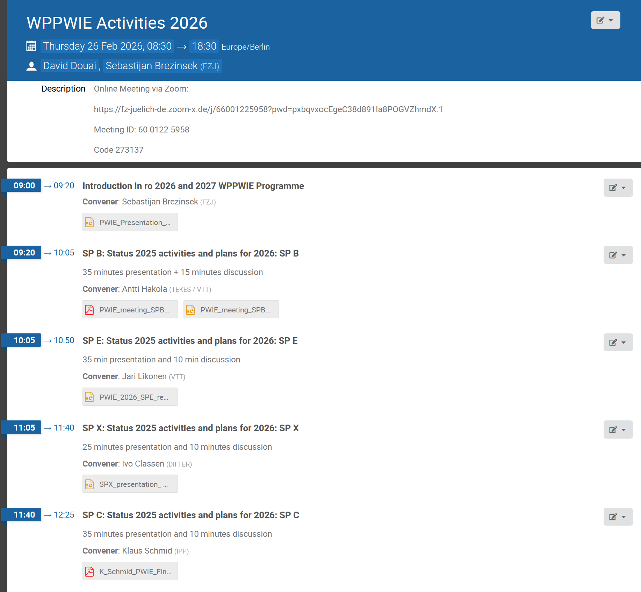
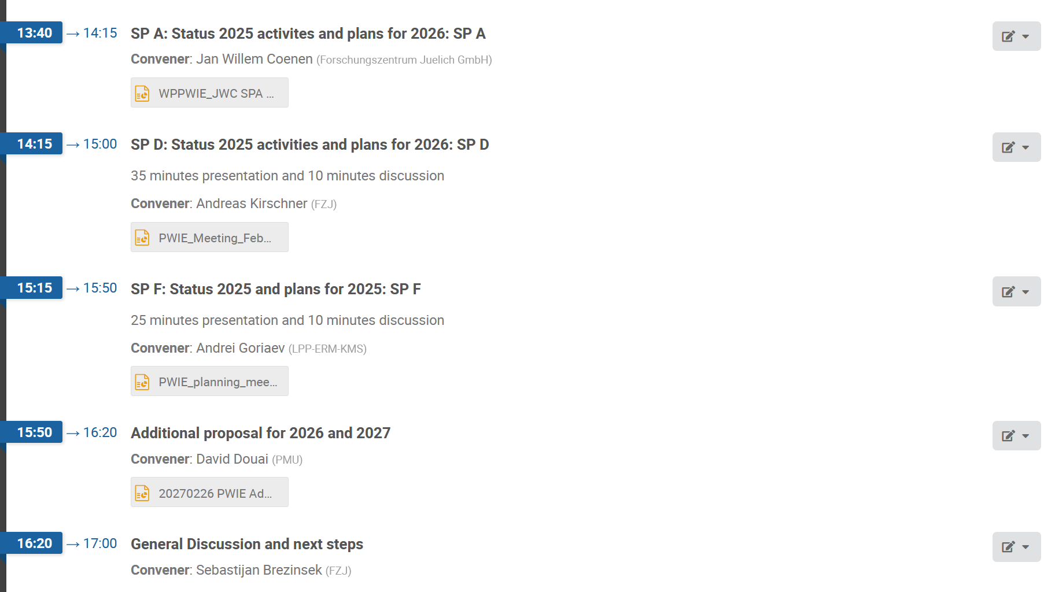
Project Meeting February 2026
120 participants at maximum online
80 participants in average per subproject online
2026: Activities, tasks, deliverables and resources communicated
after iteration with the laboratories considering their capabilities, offered resources, and priorities

Slide 4
Focus: PWIE topics of relevance for ITER‘s new baseline with W and B
PWI finally determines the lifetime of first wall components => armor thickness, melting and recrystallisation, heat exhaust capabilities of damaged PFCs (W)
PWI has vital impact on machine and nuclear safety => license limits on fuel retention (B, T) and dust formation (B, W)
PWI can negatively impact confinement and plasma performance => impurity influx and radiation (W, O, seed)
PWI impacts the duty cycle of the device => frequency of boronization (B, W, O) and fuel removal activities (T, B)
PWI in steady-state conditions (with fluence) and during transient events (with energy and flux) to be controlled
Oxygen impurity
fuel retention
Boron
seed species
Tungsten PFC
dust formation*
dust formation*
erosion
pollution
erosion
Key areas for ITER to be addressed by experiments, testing, and/or simulations:
  Tungsten: Required W PFC armor thickness? Maximal tolerable tungsten influx form W wall for Q=10? High-Z dust?
  Boron: Which frequency of boronization and which layer thickness and homogeneity is required? Low-Z dust?
  Tritium: How to monitor, quantify, and if required remove it under controlled conditions? Frequency?
Activities along the list of topics in IO-EUROfusion collaboration (common phd/post-docs not covered)

Slide 5
Objectives 2026-2027
Support ITER plasma-facing components (PFC) qualification, performance assessment, and lifetime estimations regarding limiter start-up, L-mode plasmas (SRO) and H-mode burning plasma conditions (DT-1)
Support ITER regarding the usage of boronization, its impact on fuel retention, and explore ways of fuel removal
Support ITER regarding tungsten migration (erosion, transport, deposition, screening) and boron migration (erosion, transport, deposition, mixing)
[All three in strong collaboration with WPTE an WPTM]
Support DEMO (or FPP) plasma-facing material qualification under plasma or combined plasma and heat load
Support DEMO (or FPP) lifetime (erosion and deposition) and safety estimates (tritium retention and dust)
Support of W-based divertor and first wall solutions and their qualifications
[All three in strong collaboration with WPMAT, WPDIV, WPDES, WPBB and WPTE, WPW7X]
Support of tokamak and stellarator experiments in area of PWIE
Provision of surface sputtering data by molecular dynamics simulations and beyond
Completion of JET LIBS and post-mortem analysis (nuclear environment)
Benchmark of collisional-radiative models, atomic and molecular data with novel experiments and diagnostics
Optimization of laser-based surface analysis techniques
Advanced PWIE code development and benchmark experiments for the far-scrape-off layer

Slide 6
WPPWIE Structure 2026-2027
WPPWIE
PL S. Brezinsek [FZJ]
DPL D. Douai [CEA]
SPA
J.W. Coenen [FZJ]
SPC
K. Schmid [MPG]
SPD
A. Kirschner [FZJ]
SPB
A. Hakola [VTT]
SPE
J. Likonen [VTT]
SPF
A. Goriaev [ERM/KMS]
SPX
I. Classen [DIFFER]
SPA: Particle and heat load studies in preparation of the exploitation of ITER and fusion power plant
SPB: Experiments on erosion, deposition, and material migration
SPX: Plasma characterization and laser-based diagnostic development
SPC: Fuel retention and release
SPD: Plasma-edge and plasma-wall interaction modelling
SPE: JET post-mortem analysis, LIBS and associated interpretation
SPF: Wall conditioning and boronization physics
Task: SPA.1, SPA.2, SPA.3
Task: SPB.1, SPB.2, SPB.3
Task: SPC.1, SPC.2, SPC.3
Task: SPD.1, SPD.2, SPD.3
Task: SPE.1, SPE.2
Task: SPF.1, SPF.2
Task: SPX.1, SPX.2

Slide 7
First wall mirror cleaning assessment (input ITER mirror strategy)
WPPWIE SPB task (high priority) with transfer of budget into 2026* for completion
Collaboration with IO (diagnostics department) PWIE (FZJ, EFPL, MPG)
First wall mirrors (Mo) bought under PWIE and pre-characterized (FZJ)
Mirrors exposed on manipulators in W7-X (WPW7X) and AUG (WPTE) to boronization (MPG)
Mirrors characterized post-boronization (FZJ)
Mirrors cleaned by plasma torch and post cleaning characterized (EFPL)*
L. Moser
A. Litnovsky
L. Marot
C.P. Dhard
V. Rode
Main Results
Complete removal of boron films confirmed by XPS after plasma cleaning
Recovery of the reflectivity after plasma cleaning. Diffuse reflectivity increases by a few percent after cleaning *

Slide 8
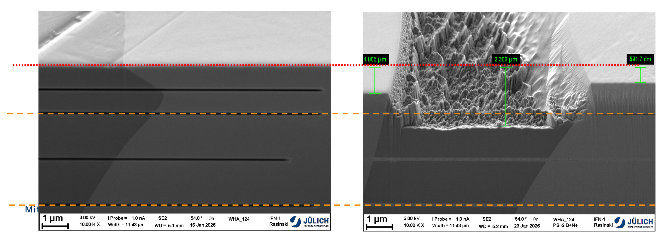
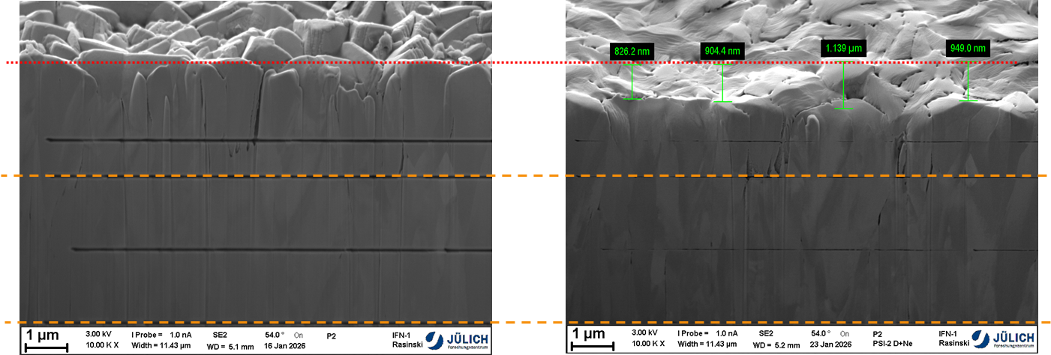
Testing of TFW W materials (input ITER W PFC selection)
WPPWIE SPA/SPB task => testing of ITER W materials under plasma loading
Collaboration with IO (science department) PWIE (experiment 1/2025)
Different sets of potential ITER TFW coatings and W heavy alloy studied (erosion/power handling)
First screening in PSI-2 in D with 5% Ne at impact energy of 150eV (~Te=30eV) / D fluence 2x10²⁵ m⁻²
Comparable performance of all W coatings with ~ 20% variation depending on grain orientation
before
after
WNiFe alloy
Erosion of ~ 600 – 1000 nm in W
Erosion of ~ 2300 nm in NiFe
preferential sputtering
critical for start-up area
Next steps:
Additional exposures
(w/ and w/o Ne)
NRA, Spectroscopy
W 82
P1 - SV-PVD
P2 - UTBM-PVD
P3 - UTBM-VPS
T. Wauters
M. Sackers
M. Rasinski
S. Brezinsek
no sever damage of W coatings
erosion comparable to bulk W

Slide 9
Human Resources WPPWIE in AWP 2026-2027
Selection made and human resources balanced
in different subprojects and tasks to be carried out
2026-2027 tasks specification completed (activity sheets)
IMS entry completed (approval process ongoing)
old PSO left 31.12.2025: Michael Reinhart
new PSO from 1.4.2026 : Zarah Chitgar
=> delays as PL had to cover most PSO activities in this period
Only difference between 2026 and 2027 in current allocation:
Resources for SP E1: LIBS analysis reduced from 16 to 3PM
assuming completion of work at the time of planning,
but JET laser-based analysis is most productive and to be
expanded to RE beam impact studies (proposal)
Note:
WPPWIE prepared one program for two years.
2027 is still subject to changes and adaptations and depends on GA approval.

Slide 10
Facilities WPPWIE in AWP 2026-2027
Selection made by PL and SPLs considering needs for WPPWIE tasks
Machine usage similar to 2024
Machine costs preliminary updated with RUs input in cause of evaluation
LPD resources slightly reduced
Accelerator resources constant
Note:
WPPWIE prepared one program for two years.
2027 is still subject to changes and adaptations and depends on GA approval.

Slide 11
Resource allocation summary: 2026
WBS ID | Manpower [PM] | E&GS (incl. use of facilities) [k€] | Missions (actual) [k€] | CC resources [k€] | Total resources [k€] | Involved Beneficiary(ies) / Affiliated Entities
PM | 35.6 | - | 85 | 280 | 455 | FZJ, VTT, MPG, LPP-ERM-KMS, DIFFER, CEA
FOp | (114.2) | 75+697 | - | 1095.7 | 1946 | FZJ, DIFFER, MPG, KIPT, CIEMAT, ENEA, DIFFER, IST, NCSRD, VR, VTT, RBI, CEA, JSI
SPA | 100 | - | - | 345.6 | 691 | CEA, CIEMAT, DIFFER, DTU, FZJ, KIPT, LPP-ERM-KMS, MPG, VR, UKAEA
SPB | 111 | - | - | 427.6 | 855 | CEA, CIEMAT, CU, DIFFER, ENEA, FZJ, IAP, IPP.CR, IPPLM, IST, JSI, MPG, NCSRD, OEAW, RBI, UT, VR, VTT, UKAEA
SPC | 84 | - | - | 346.7 | 693 | CEA, DIFFER, ENEA, FZJ, IPPLM, ISSP-UL, JSI, KIT, MPG, OEAW, VR, UKAEA
SPD | 91 | - | - | 362.3 | 725 | CEA, CIEMAT, DIFFER, ENEA, FZJ, IPP.CR, IPPLM, MPG, OEAW, VTT, UKAEA
SPE | 83 | - | - | 197.1 | 394 | CU, ENEA, FZJ, IAP, IPPLM, ISSP-UL, IST, NCSRD, UT, VR, VTT, UKAEA
SPF | 45 | - | - | 198.4 | 397 | CEA, ENEA, FZJ, IAP, KIPT, LPP-ERM-KMS, MPG, VR
SPX | 56 | - | - | 231.3 | 463 | CEA, CU, DIFFER, FZJ, IPPLM, ISSP-UL, MPG, UT, VTT
2026 Total | 599.6 (+ 114.2 UoF) | 75 (+ 697 UoF) | 85 | 3484 | 6619

Slide 12
Preliminary resource allocation summary: 2027
WBS ID | Manpower [PM] | E&GS (incl. use of facilities) [k€] | Missions (actual) [k€] | CC resources [k€] | Total resources [k€] | Involved Beneficiary(ies) / Affiliated Entities
PM | 35.6 | - | 84 | 282 | 459 | VTT, FZJ, MPG, LPP-ERM-KMS, DIFFER, CEA
FOp | (112.8) | 48+695 | - | 1082.5 | 1913 | VTT, JSI, CEA, ENEA, NCSRD, CIEMAT, FZJ, RBI, IST, KIPT, VR, DIFFER, MPG
SPA | 100 | - | - | 350.8 | 702 | LPP-ERM-KMS, CIEMAT, DTU, KIPT, CEA, MPG, VR, FZJ, DIFFER, UKAEA
SPB | 110 | - | - | 429.2 | 858 | UT, IPP.CR, CU, CIEMAT, IST, IPPLM, RBI, NCSRD, JSI, OEAW, IAP, VR, VTT, ENEA, DIFFER, CEA, FZJ, MPG, UKAEA
SPC | 84 | - | - | 351.9 | 704 | IPPLM, ENEA, VR, OEAW, ISSP-UL, DIFFER, KIT, JSI, FZJ, MPG, CEA, UKAEA
SPD | 91 | - | - | 367.9 | 736 | CIEMAT, OEAW, DIFFER, IPPLM, IPP.CR, MPG, CEA, ENEA, VTT, FZJ, UKAEA
SPE | 67 | - | - | 152.3 | 305 | IPPLM, NCSRD, VR, IST, IAP, ISSP-UL, VTT, FZJ, UKAEA
SPF | 45 | - | - | 201.4 | 403 | KIPT, IAP, VR, ENEA, CEA, MPG, FZJ, LPP-ERM-KMS
SPX | 61 | - | - | 250.1 | 500 | ISSP-UL, VTT, ENEA, IPPLM, CU, UT, CEA, MPG, DIFFER, FZJ
2027 Total | 587.6 (+ 112.8 UoF) | 48 (+ 695 UoF) | 84 | 3468 | 6579

Slide 13
Accompanied Research, UKAEA, and Missions
Accompanied Research in 2026
Request from IAP obtained and will be fully supported
Request from IPPLM obtained and will be fully supported
UKAEA activities integrated in WPPWIE work program in 2026
SPA (including HIVES)
SPD (MD simulation)
SPE (JET activities)
EU-related missions in 2026 and 2027
Resources for experiment participations at LPD and plasma facilities (TOMAS, PSI-2, MAGNUM, etc.)
Resources for LIBS campaigns with JET/T samples
Resources for two in-person project meetings per year
Resources for in-person midterm and progress meetings on request
Other visits for analysis or focus topics meetings (LIBS analysis) on request
International missions in 2026
International mission budget for WPPWIE
- EAST: CXN simulations, and in-situ laser experiments
- DIIID: plasma boundary and PWIE simulations towards full-W and experiments
- Rokasho: dust and tritium analysis of JET samples
Other visits on request

Slide 14
Grant Deliverables and Milestones
Grant Application neither yet submitted nor approved by the EC: preliminary deliverables and milestones
ID | Deliverable Title | Date
 | Report on scaling the integrated first wall W sources in toroidal devices as function of edge plasma conditions, impurity composition, wall clearance deduced from high fidelity PWIE simulations for AUG, JET, ITER and DEMO (H-mode) | 31.12.26
 | Report on the erosion /deposition pattern and fuel (tritium) retention in Be and W PFCs in JET deduced from post-mortem analysis and laser-based techniques information and PWIE simulations | 31.12.27
 | Report on the efficiency of wall conditioning and fuel removal techniques obtained in TOMAS and toroidal devices with metallic PFCs (w/wo boron) in view of application in tokamaks and stellarators, and recommendations to ITER new baseline | 31.12.27
 | Report on the quantification of fuel retention in self-damaged (or neutron-damaged) W exposed in JULE-PSI (or PSI-2) using in-situ laser-based methods and comparison with post-mortem analysis techniques | 31.12.27
ID | Milestone Title | Date
 | Matrix describing the fuel retention in boron layers as function of flux composition, impact energy, and surface temperature on tungsten and steel substrate available | 31.12.26
 | Execution of high fluence plasma exposure of PFCs solutions for a pilot fusion plan , JT-60SA, W7-X in MAGNUM-PSI and PSI-2 mimicking divertor and first wall conditions covering seeding species composition and thermal cycling completed | 31.12.27

Slide 15
Request for extra resources in 2027
High Level Topics to be funded in 2027 addressing key questions for ITER
(licensing, safety, and damage predictions) and support fusion pilot plan identified
Four topics :
  Tritium studies (in view of ITER licensing)
  Dust (in view of WEST results)
  Post-mortem analysis and LIBS interpretation of JET tiles
  (in view of massive damage of divertor tiles by downward RE and mass of data)
  Integrated modelling (development) of RE-induced PFC Damage
disappeared in AWP2026-2027 due to budget restrictions

Slide 16
Back-up

Slide 17
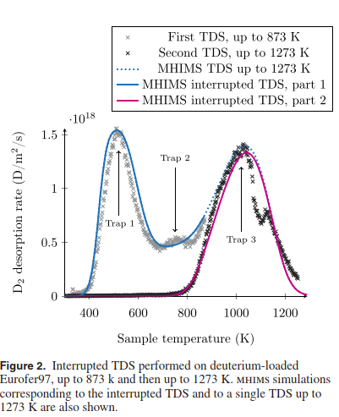
Area 1 : Tritium studies
  Understanding/predicting D/T trapping and permeation in and through the walls of fusion reactors
  Transition of different sources of D/T through different
Proposed activities in 2027:
  Tritium permeation studies in air vs. in water for EUROFER-97 (CEA) and for 316-LN and P91/92 steels (ISSP-UL)
  copermeation studies (H/D then D/T) to allow studying kinetics of trapping/detrapping and isotopic exchange
  + Associated modelling of H/D/T co-permeation and T outgassing (FESTIM and MHIMS)
F. Montupet-Leblond, NF 2022

Slide 18
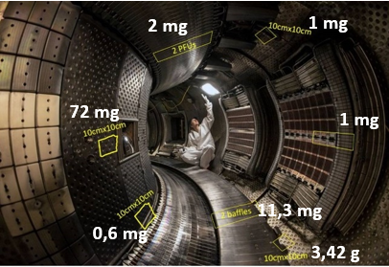
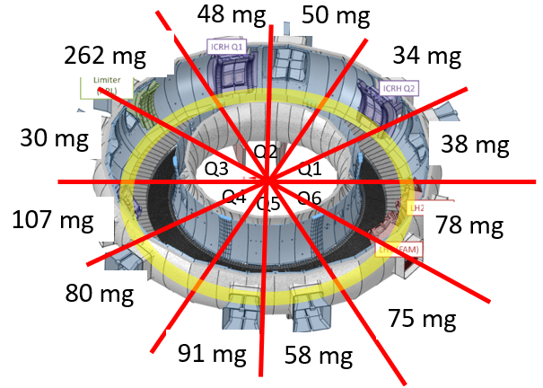
Area 2 : Dust
Proposal : determine the dust conversion factor in W environment
If conversion factor is 100% in ITER (JET C conversion factor 0.5)
  Boronized layers of 50 nm create a potential dust source of 86 g of B per boronization
  W erosion and deposition (0.16 g/s) associated with Fuel Trapping potential source of W dust
potential
Strategy
  Analyse in-situ dust collections in WEST at various poloidal locations (after C8/C9 2024) and toroidal locations (after C11, 2025)
    + in 2027 : collection after C12→C14 campaigns
    Need data on:
      mass, volume, morphology…
      Location, fuel and composition…
      dust mobilization/adhesion
  Determine conversion by comparing with erosion and deposition inferred from post-mortem analysis after C6-C12
C8/C9
C10/C11

Slide 19
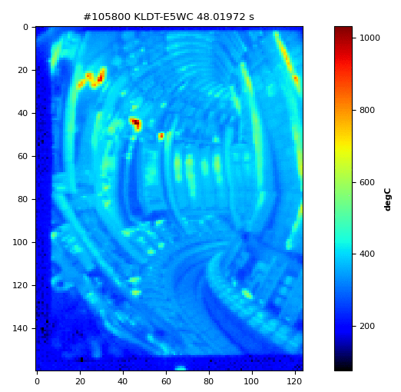
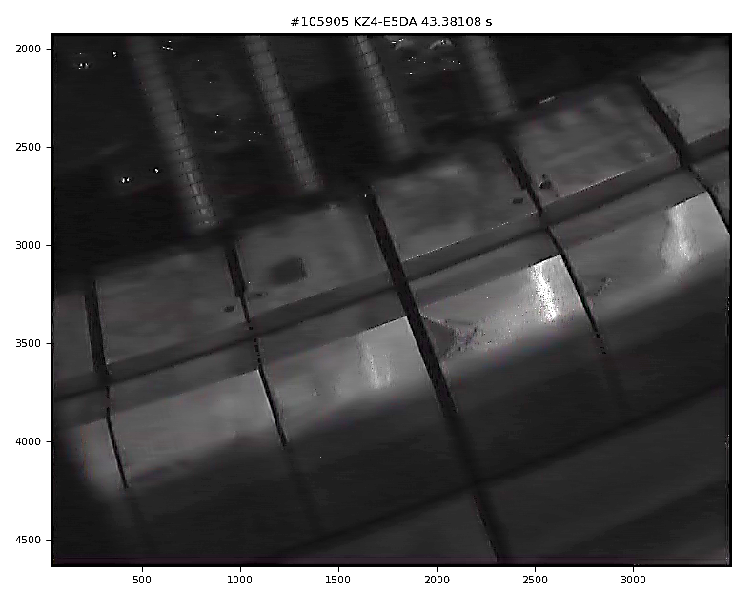
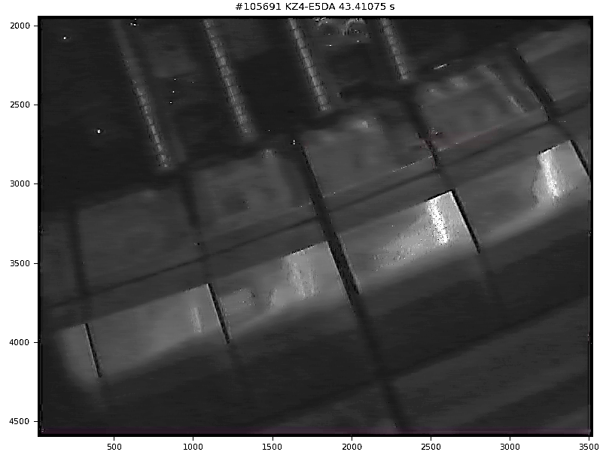
Final JET PFC (Dec 2023) experiment – Divertor RE
Before RE impact
AFTER RE impact
RE impact
After RE impact

Slide 20
Area 3 : Post-mortem analysis and LIBS interpretation of JET tiles
Proposal : full exploitation of last JET experiments with RE-beam impact (etc.)
JET carried out downwards RE at the end of operation (not discussed with WPPWIE)
  Critical for ITER divertor: assessment of tile 0 and tile 1 regarding damage (done for Be before)
  Impacts conclusion on fuel release and surface stability and dust
Full exploitation of very successful LIBS campaign
  LIBS at areas with damages carried out, but not in initial analysis plans
  LIBS on steel and Inconel carried out, but not in initial analysis plans
Strategy
    1-2 damaged tiles to be added to the list of tiles to studied under SPE
    Provide input to RE-damage modelling to divertor PFCs
    Complete LIBS studies and include specific locations not in initial plan
    (quantitative analysis delayed => calibration in focus 2025)

Slide 21
Area 4 : RE-damage modelling development and benchmark
Proposal : Support RE damage modelling development
High priority item for ITER and selected as EEG
VR grantee left to industry => direct transfer not possible
Recover work by senior scientist
Impacts WPTM, WPTE and WPPWIE

