Slide 1
Work-Package Theory and Modelling (WPTM): Plans for 2026-27
Xavier LITAUDON* (Project Leader), Gloria FALCHETTO* (Project Support Officer) on behalf of the TSVV PIs
* Officially nominated Jan. 2026
CEA lead lab. for WPTM
xavier.litaudon@cea.fr

Slide 2
Work-Package Theory and Modelling (WPTM)
A key focus is the sustained development and first (“FOAK”) application of predictive tools that enable reliable extrapolations to unexplored parameter regimes for ITER, FOAK and FPP
  “Emphasis on extrapolability to ITER to support revision of ITER Research Plan” (sic from IO-EUROfusion agreement) “extrapolability” quoted 13 times !
Critical objective due to significant knowledge gaps on the path to ITER and fusion power plant – gaps that cannot be addressed solely through direct experiments
WPTM will Leverage EUROfusion experimental strengths
Enable reliable, simulation-driven preparation of experiments, ITER and future fusion facilities, reducing reliance on empirical approaches / scaling laws
Activities implemented through the set of 11 Theory, Simulation, Verification and Validation (TSVV) projects, focusing on specific topic as outlined in the WP 2026-2027

Slide 3
11 well-elaborated, high-quality, multi-beneficiary proposals !
 | TSVV titles | Principal Investigator | Lead Beneficiary | Other Beneficiaries involved
A | H-Mode and Small/No-ELM Pedestals | Tobias Görler | MPG | CEA, DIFFER, ENEA, EPFL
B | Plasma Particle/Heat Exhaust – Fluid Simulations | Patrick Tamain | CEA | DTU, EPFL, IPP.CR, LPP-ERM-KMS, MPG
C | Plasma Particle/Heat Exhaust – Gyrokinetic Simulations | Daniel Told | MPG | CEA, DIFFER, EPFL, IPP.CR, JSI
D | Plasma-Wall Interactions with Metallic Plasma-Facing Components | Dmitry Matveev | FZJ | CEA, DIFFER, IPP.CR, MPG, VR, VTT
E | Impurity Sources, Transport, and Screening | Guido CIRAOLO | CEA | EPFL, FZJ, IPP.CR, IPPLM, VTT
F | Tokamak Disruptions and Runaway Electrons | Matthias Hoelzl | MPG | CEA, ENEA, EPFL, VR
G | Physics of Burning Plasmas | Oleksiy Mishchenko | MPG | CEA, ENEA, EPFL, KIPT, NCSRD, UKAEA
H | Reliable Prediction of Plasma Performance and Operational Limits in Tokamaks | Michele Marin | EPFL | CEA, DIFFER, ENEA, EPFL, IPP.CR, IST, LPP-ERM-KMS, MPG, UKAEA, VR
I | Stellarator Optimization | Joaquim Loizu | EPFL | CIEMAT, EPFL, MPG, OEAW
J | Stellarator core turbulence | José Manuel García-Regaña | CIEMAT | DIFFER, EPFL, MPG, UKAEA
K | Neutral Particle Models | Dmitriy V. Borodin | FZJ | CEA, DIFFER, ENEA, FZJ, LPP-ERM-KMS, VTT

Slide 4
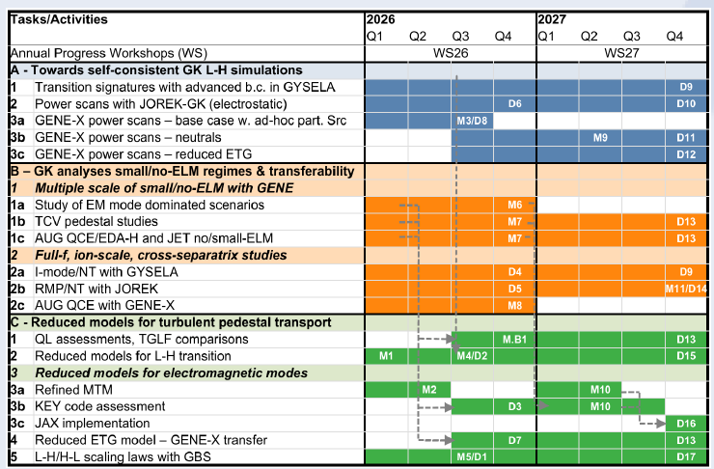
Strong "Project Structure” implemented in all TSVVs
A typical example from one TSVV proposal

Slide 5
 | Key Objectives/Focus of the 2026-2027 Work-Programme per TSVVs at full scale
A | Develop the capability to perform self-consistent, robust, and validated gyrokinetic simulations of L-H transitions, enabling accurate H-mode pedestal profile predictions. Gyrokinetic simulations of small/no-ELM regimes, transferability to future fusion devices, including ITER
B | Turbulent transport in the SOL with physics of neutrals, impurities, isotopes as well as PWI. Generalization to non-axisymmetric geometries
C | Particle/heat exhaust based on gyrokinetic equations under conditions relevant to a semi-collisional edge and SOL, physics of neutrals and impurities. Generalization to non-axisymmetric geometries
D | First-wall erosion, mixed-material formation, dust generation and transport, and fuel inventory as function of neutron damage. Enhanced models to simulate transients
E | W impurity distributions (sources, transport, screening) and impact on performance. Effects of 3D perturbations and ELM suppression on W impurity and seed impurity distributions in ITER
F | Disruptions, in particular in W-devices. model for runaway electron beam generation and losses, dynamics and mitigation to be integrated into modelling tools and nonlinear MHD
G | Mutual interaction of energetic particles, MHD modes, turbulence, and kinetic plasma profiles in tokamak and stellarator
H | Complete scenarios: breakdown to termination including metallic wall conditions (ITER). Model validation as well as code exploitation and deployment
I | Stellarator optimisation codes with enhanced speed and greater scope
J | Gyrokinetic turbulence codes in 3D magnetic and validation. Reduced turbulent transport models
K | Neutrals, first principles to reduced models and integration fluid and gyrokinetic edge turbulence simulation

Slide 6
WPTM leadership roles in the E-TASC ecosystem
Ensure cross-TSVVs dialogue and coordination around key scientific topics, e.g.
  Validation & Uncertainty Quantification
  Reduced model development, etc
Ensure high-level coordination at the interface between experiments and model validation
  With TE, STEL, PWIE on model validation strategy and processes
Ensure high-level coordination with the DSO/WPAC projects
  HPC and ACH support
  Databases
  Reduced models development for Pulse Design Simulator
  Synthetic diagnostics
Ensure that the TSVVs PIs have adequate resources to deliver their objectives

Slide 7
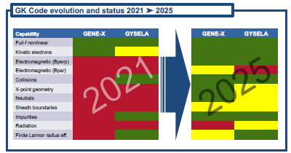
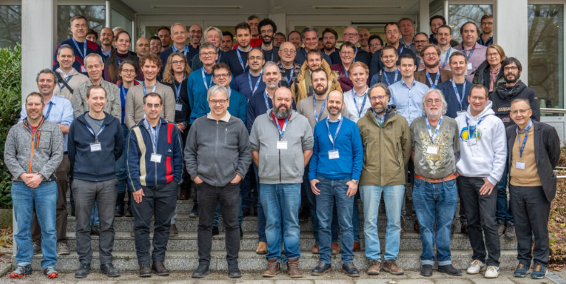
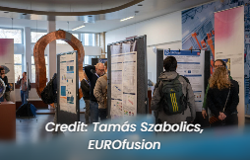
Full swing start in early 2026
EUROfusion Science Meetings – TSVV Final Reports 2021-2025*
  14 & 28 January
  High level take-away:
    Significant progress in code development and physics integration
    Many codes have reached a level of maturity for more systematic multi-machine (tokamak & stellarator) validation
    Exploit the uniqueness of the EU database (metallic wall, size scaling, isotopes H, D, T, DT )
Second E-TASC General Meeting (09 – 13 Feb., IPP-Garching)*
Set-up WPTM regular coordination meetings
  Every two weeks with all the TSVV PIs
  Representatives of the “experimental” WPs are invited
WPTM Wiki and Indico have been set-up to share the information
  https://wiki.euro-fusion.org/wiki/WPTM_wikipages:_Theory_and_Modelling_Work_Package
To be set-up: coordination meetings with TE, STEL, PWIE to jointly agree on model
and/or workflow validation around key scientific topics
*Special thanks to Denis Kalupin and Frank Jenko

Slide 8
Resource considerations
TSVVs call issued with 5-6 PPY/Y for TSVV A-J, 3 PPY/Y for TSVV K for 2026-2027 (30% lower than in 2021-2025)
  Following replies to the call : 45% overbudget
  Within one week TSSV PIs went down to the minimum limit : 5 (3) PPY/Y (without UKAEA)
  PIs revised the deliverables & PPY following recommendations from E-TASC Scientific Board
Issue 1 for PL/PSO: 1 PPY/Y not included in the 2026-2027 budget estimate (activity previously managed by PMU when call issued)
Issue 2 for TSVVs: Calculation with the actual salary/per beneficiary for 2026-27 leads to budget above TM budget ceiling in k€
TM decision to provide PPY as selected in 2026 and to reduce PPY in 2027 by 28 % (uniformly across all TSSVs/beneficiaries) to stay within the budget ceiling (5864k€ in CC)
  Mismatch between deliverables and allocated PPY: 3.6 PPY TSVV A-J and 2.1 PPY TSVV K in 2027
Mission budget: 97k€/year (direct cost) not sufficient to hold at least one in-person meeting per TSVV/Y + E-TASC general meeting and does not include PL/PSO missions (Project Board, E-TASC, HPC Board, FSD ...)
  Request: 130 k€ for 105 participants with one week mission per year

Slide 9
Significant work-force reduction for Theory and Simulation activity
Averaged PPY/Y in 2021-2025 for the TSVVs* | PPY in 2026 | PPY in 2027
77,1 PPY/Y | 53,4 PPY/Y | 38,2 PPY/Y
-30%
-28%
-50%
Equivalent of stopping one TSVV per year: -5.5PPY per year
EUROfusion activitiy that will not be covered by the PPP
Some beneficiaries might leave TSVVs since “effort” will not be sufficiently rewarding
[*EUROFUSION GA (25) 51 - 5.2a - 2021-2025 - Budget Revision v16]

Slide 10
Grant Deliverables and Impact on TSVV Deliverables
Grant Deliverables
Report on code dissemination, model validation, and comparison with experimental data (for both tokamaks and stellarators)
Report on TSVV Research Software Compliance with EUROfusion Standards
=> Expected impact on code dissemination and compliance to standard software
Grant milestones
Formal coordination established with experimental WPs for model validation and requirement capture for data comparison
Formal coordination established with ACHs in support to TSVV Research Software compliance with EUROfusion standards
Consequences on the TSVV deliverables:
Preliminary analysis performed per TSVVs by PIs with programmatic consequences

Slide 11
Few examples of some TSVVs deliverables to be reduced in scope or dropped ?
TSVV-B D6.8: extension of reduced turbulence models to advanced SOL regimes (high density, detached…) => delay the implementation in SOLPS-ITER and availability for modelling community.
TSVV-C M5: Validation of neutrals + sheath models in TCV-X21/X23 case, including the impact on λq.
TSVV-I : SD6.8 and SD6.9 Study of the effect of edge optimization on divertor performance with high-fidelity codes
TSVV-J: D.HEAVY-Z-TRANSP: Comprehensive study of W transport in reactor-relevant W7-X scenarios, stellarator reactor candidates from TSVV-I, and ITER with 3D perturbations.
Examples –
Detailed analysis
to be performed

Slide 12
Ongoing assessment: programmatic consequences on cross-TSVV topics
Topic 1. SOL heat flux decay length, pedestal and L-H transition
Topic 2. Simulation of advanced regimes without ELMs by integrating : neutrals, boundary conditions, sheath coupling, impurities
Topic 3. Core-pedestal-SOL-wall workflow including 3-D effects (e.g. RMPs)
Topic 4. Disruption, RE and impact on the W wall at high current
Topic 5. Simulation of high beta plasmas and fast particle effect on confinement/stability
Topic 6. Stellarator core turbulence and optimization
Topic 7. Development and test of reduced models
Topic 8. Validation & Uncertainty Quantification: Enabling Physics Discovery
An example of the ongoing analysis is provided on Topic 4

Slide 13
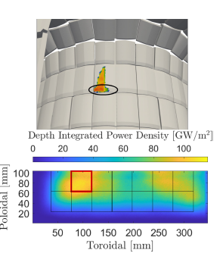
Topic 4. Disruption, RE and impact on the W wall at high current
TSVVs: D, F
Deliverables to be reduced in scope or dropped: on going analysis
JOREK-DREAM coupling and parallelization of DREAM for efficient RE calculation at high current
  Delay in addressing the highest risk for ITER high-current operation
Compliance with EUROfusion standard software (CARIDDI and FIREWALL) that will impact code dissemination and users involvement
RE induced damages on W PFC wall: development of thermo-mechanical model with W (Geant4-MEMENTO-LSDYNA): vaporisation, melting , release of debris
WPs Impacted: TE, PWIE (delay in the validation)
ITER-EUROfusion collaboration impacted :
  “Physics Basis for ITER scenarios” : Disruptions
  disruption mitigation : strategy for benign termination of RE plasmas
  Runaway electron avalanche (RAE) behaviour and predictive model validation

Slide 14
WPTM - 2027 budget request to recover the full scope across topics
Topic | Required resources in PM | Associated CC budget* [k€] | Associated EC budget* [k€] | WP priority (Low, Medium, High) | PSD priority TBD
WPTM Management PL/PSO (12PM CEA 82 k€ CC) + Missions 15 k€ (Actual cost) | 19 | 95 | 100 | H
Topic 1. SOL heat flux decay length, pedestal and L-H transition (TSVVs: A, B, C, H, K) | 28 | 120 | 132 | H
Topic 2. Robust simulation of advanced regimes without ELMs by integrating missing elements (TSVVs A, B, C, H, K ) | 24 | 103 | 113 | H
Topic 3. Core-pedestal-SOL-wall workflow including 3-D effects (TSVVs: D, E, J, K) | 25 | 107 | 118 | H
Topic 4. Disruption, RE and impact on the W wall at high current (TSVVs: D, F) | 21 | 90 | 99 | H
Topic 5. Simulation of high beta plasmas and fast particle effect on confinement/stability (TSVVs: G, H, I , J ) | 21 | 90 | 99 | H
Topic 6. Stellarator core turbulence and optimization: Divertor and alpha losses (TSVVs: G, I, J) | 22 | 94 | 104 | H
Topic 7. Development and test of reduced models for integrated workflows (TSVVs: A, B, C, D, E, F, G, H, J, K ) | 29 | 125 | 138 | H
Topic 8. Validation and UQ (TSVVs: A, B, C, D, E, F, G, H, J ) | 22 | 93 | 103 | H

Slide 15
Conclusion
WPTM started at full swing since January 2026
  TM management tools set-up: Indico, IDM, Wiki, IMS, Pinboard
  All 11 TSVV projects implemented in IMS for 2026
  Regular Coordination meetings established with TSVV PIs
  Coordination with the other WPs ongoing (cf E-TASC General Meeting & FSD meetings) and will be strengthen
11 TSVV PIs have successfully initiated the 2026 activity with their team
However, start disrupted by assessment of the impact of workforce reduction to stay within TM budget
Immediate actions:
  Identify which TSVV deliverables are delayed, reduced in scope or dropped
  Report to E-TASC SB and Autumn Project Board
Request for extra resources (reserve list) to maintain the full TSVV scope and TM team

Slide 17
High-level objectives of WPTM
Focus on first-principle and multi-fidelity modelling, from high-fidelity physics to reduced models for whole-device and future real-time applications
Strong emphasis on:
  Theory, verification, validation, extrapolation and uncertainty quantification as a “continuous cycle”
  Simulations from plasma core to (metallic) wall, from the start to the end
  Systematic validation using advanced diagnostics experimental data and synthetic diagnostics with WPs TE, STEL, PWIE, DSO/AC
Extension of tools to non-axisymmetric geometries: tokamaks & stellarators
Embedded in the E-TASC ecosystem, with:
  Close links to experimental WPs, WP AC (DMP, HPC, Advanced Computing Hubs)
  Collaboration with IO and international partners
Transform research codes into widely used, validated predictive tools
Leverage EUROfusion experimental strengths, e.g.
  Access to multi-machine databases (tokamak & stellarator)
Enable confident, simulation-driven preparation of experiments, ITER and future fusion facilities, reducing reliance on empirical approaches / scaling laws

Slide 18
Topic 1. SOL heat flux decay length, pedestal and L-H transition
Deliverables to be reduced in scope or dropped: on going analysis
TSVVs: A, B, C,H, K
Investigation of the SOL width on key parameters (current, magnetic field, power with realistic X-point geometry) in edge fluid turbulence codes (FELTOR, GBS, GRILLIX, SOLEDGE) & gyro-kinetic codes (GENE-X & GYSELA)
  heat flux decay length scaling to high current and validation against JET at high Ip=3-4 MA
  Delay in Validation neutrals + sheath models in TCV-X21 (GENE-X)
L-H simulation integrating SOL in the simulation domain (GENE-X, GYSELA, JOREK-GKG)
Development/coupling of KINDNESS kinetic neutral codes
Validation TCV-X23 reference case analysis (turbulence in high density regimes)
Evaluation of the turbulent transport of impurities in the edge plasma and simulations of D-T
Code evolution (FELTOR and GRILLIX, GENE-X) to handle 3D geometry (stellarator)
HFPS prediction of the pedestal height (AUG, JET): size, isotope effects and impurity to support ITER prediction
Impacts:
  TE, PWIE, STEL
  ITER-EUROfusion collaboration : “Physics Basis for ITER scenarios”
  ENR MOD/ Developing reduced turbulence transport models for the tokamak scrape-off layer
  ENR-MOD/ Pedestal Inference Engine (PIE)

Slide 19
Topic 2. Simulation of advanced regimes without ELMs by integrating : neutrals, boundary conditions, sheath coupling, impurities
TSVVs: A, B, C,H, K
Deliverables to be reduced in scope or dropped: on going analysis
First principle (GENE-X, GYSELA, JOREK-GK) and integrated modelling on ITER Seeded baseline (no/small ELMs), X-point radiator (XPR) and quasi-continuous exhaust (QCE) regimes
  Multiple-scale characterisation of AUG QCE/EDA-H mode and JET no-/small-ELM pedestals
  Delay in studying the impact of impurities and validity of dilution models
studying coupled turbulence and neutral interaction
  Impact of isotope physics
Involved TSVVs: A, B, C, H, K
Impacts
  WPs : TE, SA
  ITER-EUROfusion collaboration:
    “Physics Basis for ITER scenarios”: ELM control and no ELMS scenarios with W wall
    Validation of HFPS in Neon seeding high performance JET DD and DT plasmas

Slide 20
Topic 3. Core-pedestal-SOL-wall workflow including 3-D effects (e.g. RMPs)
TSVVs: D, E, J, K
Deliverables to be reduced in scope or dropped: on going analysis
Predicting erosion and migration in the ITER plasma in the presence of RMPs (SOLEDGE3X-ERO2.0 and EMC3-EIRENE+ERO2.0)
  W-source (erosion, migration) and transport in W machines, including effect of RMPs and extrapolation to ITER: core W estimate for ITER ?
study of W transport in reactor-relevant W7-X scenarios, stellarator reactor candidates from TSVV-I, and ITER with 3D perturbations
Extension TSVV codes towards 3D stellarator configurations from erosion to migration up to core impact
WPs Impacted: TE, PWIE, STEL
ITER-EUROfusion collaboration impacted: ITER-EUROFusion “Physics Basis for ITER scenarios”: ELM control and no ELMS scenarios with W wall

Slide 21
Topic 4. Disruption, RE and impact on the W wall at high current
TSVVs: D, F
Deliverables to be reduced in scope or dropped: on going analysis
JOREK-DREAM coupling and in the parallelization of DREAM code for efficient RE calculation at high current
  Delay in addressing the highest risk for ITER high-current operation: simulation of the dependency of RE current on the pre-disruption plasma current. Importance of seed generation and losses vs avalanche multiplication effect (high current simulation)
compliance with EUROfusion standard software (CARIDDI and FIREWALL) that will impact code dissemination and users involvement
RE induced damages on W PFC wall: development of thermo-mechanical model with W (Geant4-MEMENTO-LSDYNA): vaporisation, melting , release of debris
WPs Impacted: TE, PWIE (delay in the validation)
ITER-EUROfusion collaboration impacted :
  “Physics Basis for ITER scenarios” : Disruptions
  disruption mitigation : strategy for benign termination of RE plasmas
  Runaway electron avalanche (RAE) behaviour and predictive model validation

Slide 22
Topic 5. Simulation of high beta plasmas and fast particle effect on confinement/stability
TSVVs: G, H, I, J
Deliverables to be reduced in scope or dropped: on going analysis
global gyrokinetic simulations (ORB5/EUTERPE, GENE, GYSELA) of energetic-particle physics in EUROfusion experiments, JT60-SA, ITER, stellarator.
High beta regimes in stellarator plasmas assessing the KBM instability. At risk
integration simulation with realistic burning plasma sources to address the importance of memory effects and nonlinearities when fast particles, profiles and turbulence evolve
WPs Impacted: TE, SA, STEL
ITER-EUROfusion collaboration impacted:
  “HFPS improvements” : development of models for burning plasmas and models validated at high beta (electromagnetic effects)

Slide 23
Topic 6. Stellarator core turbulence and optimization
TSVVs: G, I, J
Deliverables to be reduced in scope or dropped: on going analysis
predicted performance and validation on two experimental W7-X campaigns 2026-27
  “study of tungsten transport in reactor-relevant W7-X scenarios, and ITER with 3D perturbations”
  “Stellarator core turbulence database for W7-X based on flux-tube simulations”
  “Rapid turbulence synthetic diagnostic tool development based on an initial electrostatic turbulent transport database”
study of the effect of edge optimization on divertor performance with high-fidelity codes (EMC3-EIRENE)
coupling of efficient orbit-following codes with stellarator optimization codes
  Delay in the prediction of energetic particle losses on the walls
application of newly developed topological tools
  study and optimization of internal transport barriers in stellarators and validation in W7-X
exploration of piecewise omnigeneous stellarator configurations,
  simpler coil designs without compromising the confinement performance
WPs Impacted: STEL
Impact:
  Support Europe unique position in stellarator experiments , theory and design
  Maintain EU leadership

Slide 24
Topic 7. Development and test of reduced models
TSVVs: A, B, C, D, E, G, H, J, K
Deliverables to be reduced in scope or dropped: on going analysis
reduced models development and validation for integrating the entire chain of processes involving tungsten — from erosion to migration (including pedestal effects) up to the impact on the core plasma
reduced model for Wall sputtering and reflection
reduced models development and validation for L-H transition
development and validation of reduced model to study the impact of impurities on turbulence in arbitrary geometry
reduced model development and validation for fast ion and burning plasmas
  Delay in Coupling and testing of the ATEP workflow in HFPS, to calculate the transport of fast ions
  Delay in Studies of the transients and self-consistent back-reaction of the phase-space transport on fusion power and burn control using reduced-model framework.
WPs Impacted: TE, PWIE, SA, STEL, DSO/WPAC : Digital twins, PDS, real time control applications
ITER-EUROfusion collaboration impacted: “Joint Development of plasma models” : HFPS improvement
Collaboration
  ENR-MOD/ Massive ASCOT simulations for fast ion tomographic reconstructions and surrogate model training
  ENR MOD/ Pedestal Inference Engine (PIE)

Slide 25
Topic 8. Validation & Uncertainty Quantification: Enabling Physics Discovery
TSVVs: A, B, C, D, E, F, G, H, J
Deliverables to be reduced in scope or dropped: on going analysis
validation process across all TSVVs
synthetic diagnostic development and integration for interpretive simulations, e.g. HFPS + TWINTOK
Implementation of as strong validation strategy
  Define specific experiments to validate models
  Develop a dedicated validation pathway for first-principles codes
  Develop common validation metrics for integrated modelling
  Large multi-machine discharge databases or parameter scans around selected reference discharges
WPs Impacted: TE, SA, STEL, WPIE, DSO/AC: synthetic diagnostic, PDS, databases
ITER-EUROfusion collaboration impacted:
  “Joint Development of plasma models”: Analysis workflow for experimental data ; Use and validation models

Slide 26
Summary of 2027 cuts in k€ in CC across TSSV and Topics

