Slide 1
Financial overview
Physics Project Board #08
Garching 16-17 March 2026
P. Haucke, E. Genangeli

Slide 2
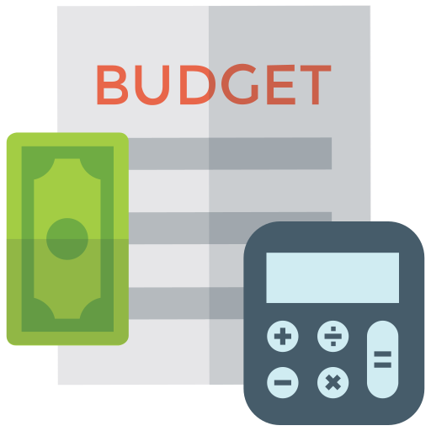
Work Plan 2026-27 Budget
The Work Plan 2026-27 has been approved by the GA at its extraordinary Meeting on 22 January 2026
The proposal for the grant extension has not yet been submitted – waiting for approval of Euratom Work Programme 2026-27
Definition of Task Specifications for 2026 suffer from delays in various WPs
Consolidated 2026 budget not yet available
Budget status presented here is as in Work Plan 2026-27 (January 2026)

Slide 3
EC Guidelines on Work Plan 2026-27 budget
Guidelines from EC on the structure of work plan 2026-27 and allocation of resources to the various activities:
The 145M€ top up can be used ONLY for the new activities in 2026-27
Funds for delayed 2021-25 activities can be transferred to 2026-27 and used only to finance those activities, provided the activities, deliverables and respective resources are indicated in the WP2026-27
Unused funds from 2021-25 CANNOT be transferred to 2026-27 to finance new activities.
[E. Genangeli | 7th Ext. GA | 22 Jan 2026]

Slide 4
Budget composition
In the work plan 2026-27 there are two blocks of activities:
New activities
New tasks to be implemented in 2026-27
169.9M€ (EC)
Activities from 2021-25
Delayed tasks and projects initiated in 2021-25 with budget pre-commitment
72.3M€ (EC)
The work packages’ scope and work is described in the work plan separately for the two blocks
Grant deliverables/milestones have been modified or new ones introduced for a better monitoring
[E. Genangeli | 7th Ext. GA | 22 Jan 2026]

Slide 5
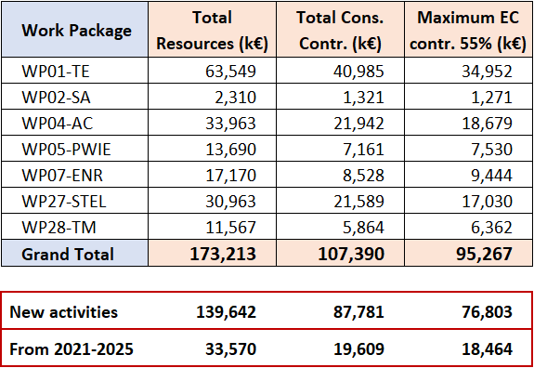
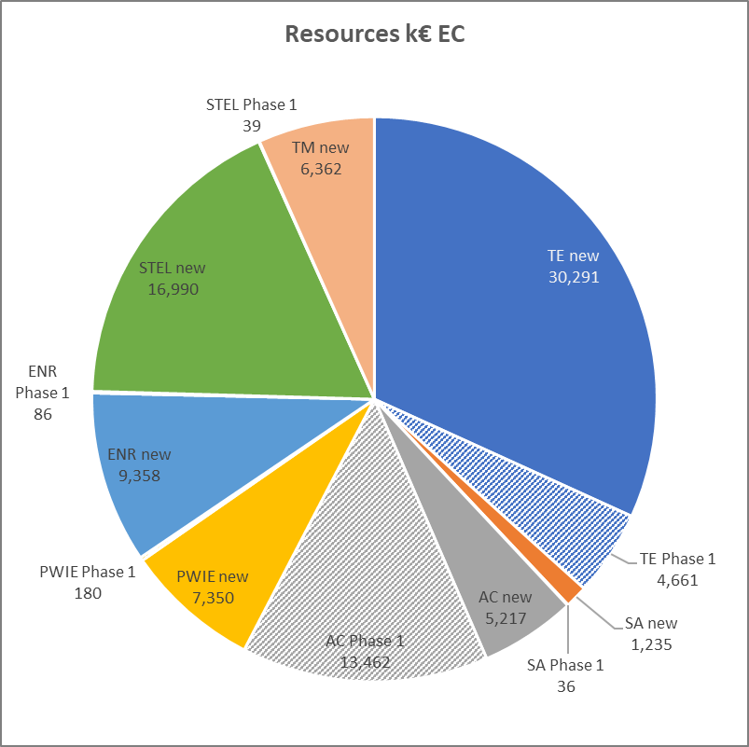
2026-27 budget by WP

Slide 6
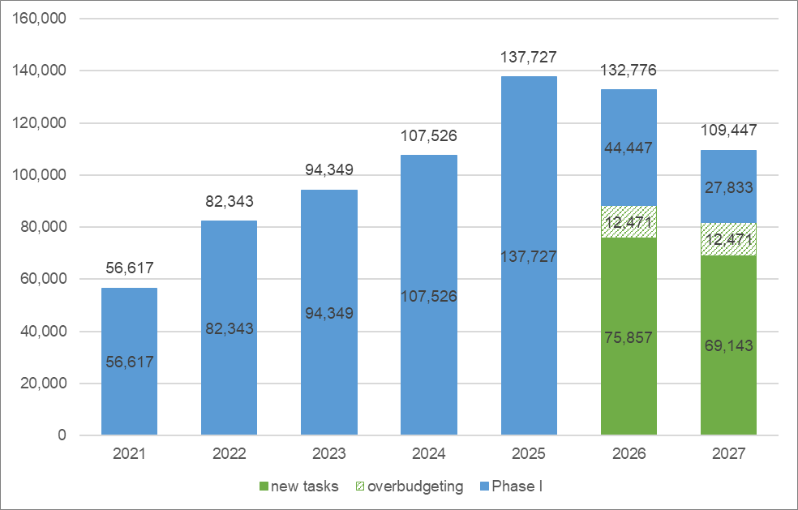


EUROfusion 2021-27 Budget outlook (EC)
549.4M€
145M€
+
Expected total grant amount: 694.4M€
Overbudgeting 2026-27: 24.9M€
[E. Genangeli | 7th Ext. GA | 22 Jan 2026]

Slide 7

Grant extension 2026-27: remaining steps
Grant agreement amendment to work plan 2021-25:
DTT scope, list of equipment new investments, grant deliverables/milestones
Submission of proposal for grant extension:
EC portal not yet open
Evaluation of the proposal
Grant agreement amendment for budget top-up and inclusion of Work Plan 2026-27
After positive evaluation of the proposal by the EC
Revision of annex 1 and annex 2
[E. Genangeli | 7th Ext. GA | 22 Jan 2026]

