Slide 1


A multi-machine study on turbulence suppression by density peaking in stellarators
D. Carralero¹, B. Stefanoska², K. Tanaka³, H. Thienpondt¹, J.M. García-Regaña¹, E. Maragkoudakis⁴, A. González¹ , K. Aleynikova⁴,
A. Alonso¹, A. Cappa¹, T. Estrada¹, A. Knieps⁵, H. Okawada, E. Sánchez¹, J. L. Velasco¹, T. Windisch⁴, W7-X team and LHD team
¹ Laboratorio Nacional de Fusión. CIEMAT, 28040 Madrid, Spain. ²Max-Planck-Institut für Plasmaphysik, 85748, Garching, ³National Institute for Fusion Science. 322-6 Oroshi-cho, Toki, Gifu 509-5292, Japan. ⁴Max-Planck-Institut für Plasmaphysik, D-17491 Greifswald, Germany. ⁵Forschungszentrum Jülich GmbH, 52425 Jülich, Germany
This work has been funded by the Spanish Ministry of Science, Innovation and Universities under grant PID2021-125607NB-I00 and PID2021-123175NB-I00 financed by MICIU/AEI /10.13039/501100011033 and FEDER, UE; and was carried out within the framework of the EUROfusion Consortium, funded by the European Union via the Euratom Research and Training Programme (Grant Agreement No 101052200 - EUROfusion). Views and opinions expressed are however those of the authors only and do not necessarily reflect those of the European Union or the European Commission. Neither the European Union nor the European Commission can be held responsible for them.

Slide 2
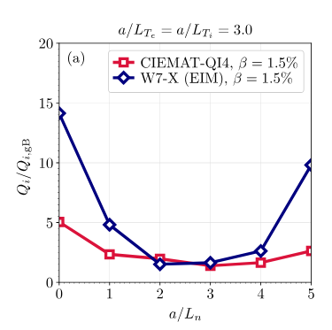
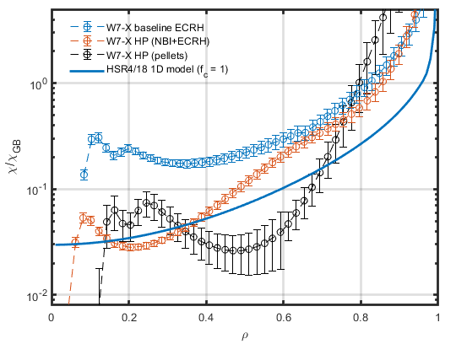
  Model validation is critical for the design of a stellarator reactor
Scaled W7-X reactor
HPI2
A. Alonso NF 2022, D. Carralero PPCF 2022
N. Panadero, see I27 tomorrow
J.M. García-Regaña NF 2025,
see E. Sánchez P2.51 this afternoon
Turbulence suppression is essential for achieving sufficient confinement in a stellarator reactor. BUT:
Density gradient stabilization is not obviously applicable in a reactor scenario.
Turbulence optimization is possible, but as of yet, not validated experimentally.
In order to design a reactor based on this optimization, sufficient validation is required.
Recent works have provided substantial advances towards self-consistent transport simulations (D.L.C. Agapito PoP 2025). However, no experimental validation of the predicted stabilizing role of the density gradient has been carried out yet.
1

Slide 3
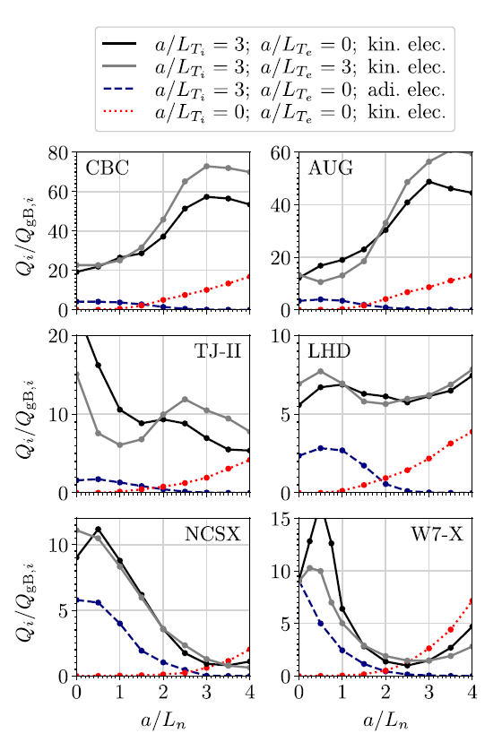
  Validating the effect of the density gradient: an experimental approach
H. Thienpondt et al., NF 2025
From the theory side, this work is already well advanced:
Extensive flux tube, non-linear simulations have been carried out with code stella regarding the effect of a/L_{n} on turbulent transport (H. Thiendpondt et al., NF 25).
These simulations show qualitative differences between different magnetic configurations, which should be outstanding in experimental data.
2

Slide 4
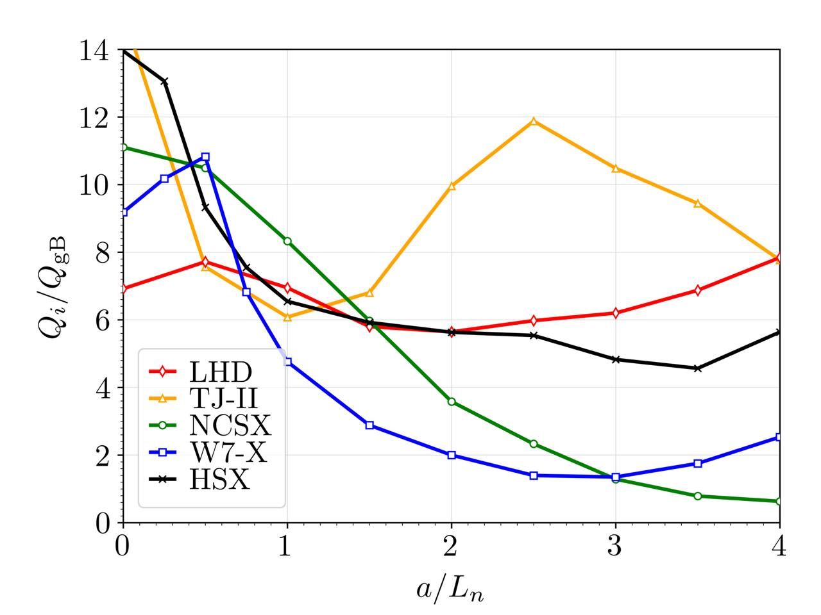
  Validating the effect of the density gradient: an experimental approach
H. Thienpondt et al., NF 2025
From the theory side, this work is already well advanced:
Extensive flux tube, non-linear simulations have been carried out with code stella regarding the effect of a/L_{n} on turbulent transport (H. Thiendpondt et al., NF 25).
These simulations show qualitative differences between different magnetic configurations, which should be outstanding in experimental data.
2

Slide 5
  Validating the effect of the density gradient: an experimental approach
H. Thienpondt et al., NF 2025
From the theory side, this work is already well advanced:
Extensive flux tube, non-linear simulations have been carried out with code stella regarding the effect of a/L_{n} on turbulent transport (H. Thiendpondt et al., NF 25).
These simulations show qualitative differences between different magnetic configurations, which should be outstanding in experimental data.
In this work, we set out to validate experimentally these predictions at two levels:
Verify the quantitative behavior of transport among different configurations
Carry out a quantitative comparison between code predictions and experiments
→ Develop comparable scenarios in W7-X, LHD and TJ-II
→ Carry out a systematic comparison between simulations and power balance observations in these scenarios
2

Slide 6
Outline
Introduction
W7-X results
  Baseline density gradient suppression of turbulence
  A low density scenario
  Transport evaluation
LHD results
    LHD experimental scenarios
    Transport evaluation
Multi-machine comparison and preliminary validation results
Summary

Slide 7
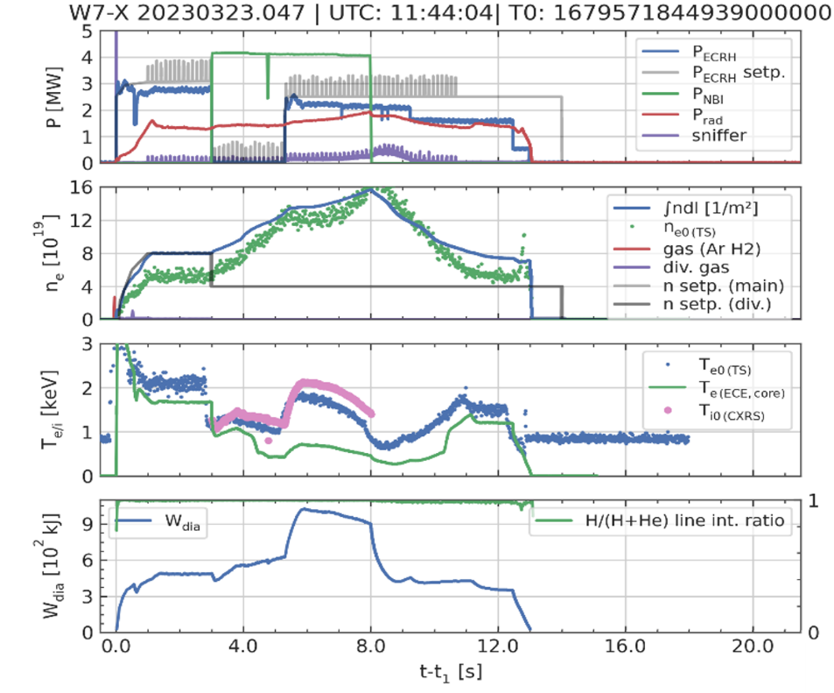
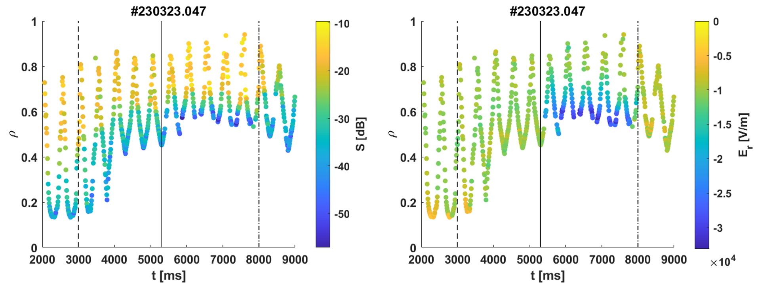
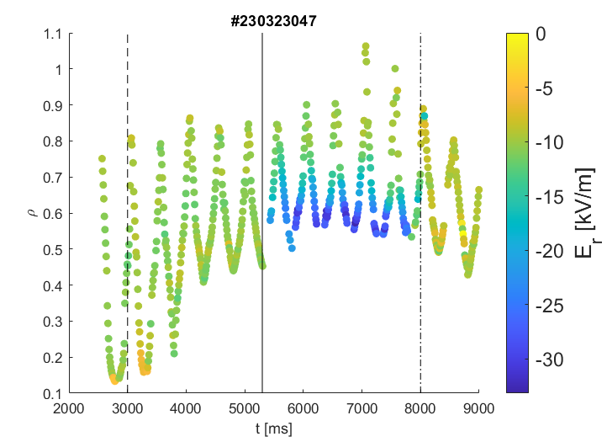
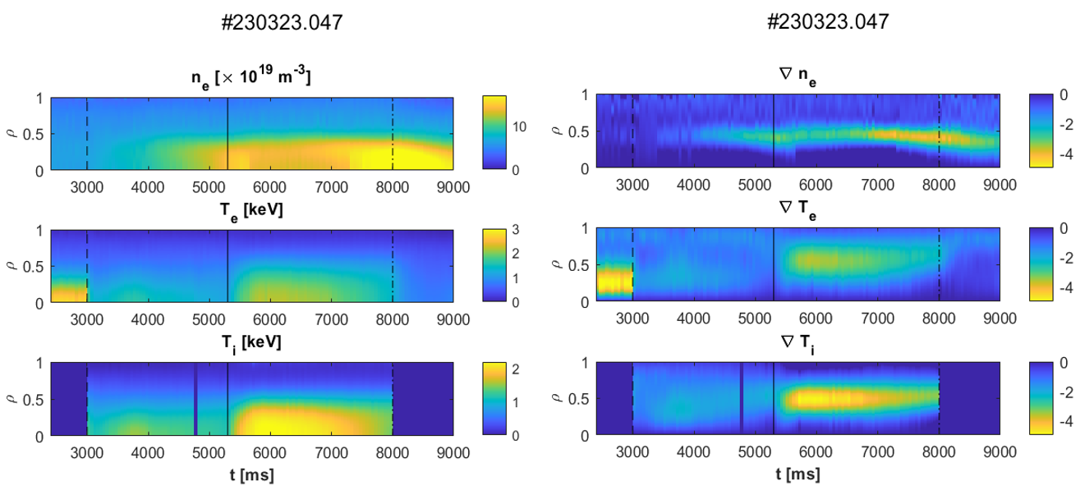
  Turbulence suppression by ∇n – Baseline scenario in W7-X
ECRH
NBI
ECRH
+ NBI
ECRH
B. Stefanoska, in preparation
Baseline turbulence suppression scenarios in W7-X are well documented [1,2,3]:
A ∇n_{e} is created by NBI/pellets, suppressing turbulence and increasing τ_{E}/τ_{ISS04}
Then, additional heating can be used to bring up T_{i,core}, n_{e}T_{i}τ_{E}
With the improved gradients, a strong NC E_{r} appears at the core [4].
n_{e} (10¹⁹ m⁻³)
T_{e} (keV)
T_{i} (keV)
[1] S. Bozhenkov, NF 20 [2] D. Carralero PPCF 22 [3] O. Ford NF 24 [4] T. Estrada, NF, 20
3

Slide 8
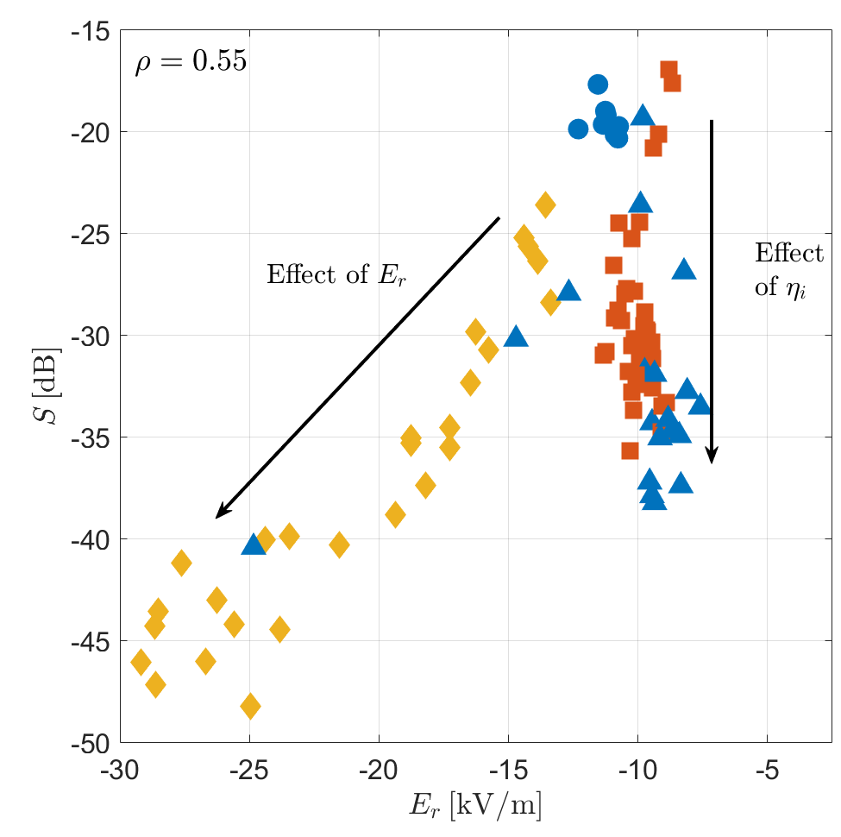
  Turbulence suppression by ∇n – Baseline scenario in W7-X
ECRH
NBI
ECRH
+ NBI
ECRH
B. Stefanoska, in preparation
This scenario presents two problems for code validation:
It introduces a large variation in density along that of ∇n_{e}
Much higher density than in comparable scenarios in LHD
Baseline turbulence suppression scenarios in W7-X are well documented [1,2,3]:
A ∇n_{e} is created by NBI/pellets, suppressing turbulence and increasing τ_{E}/τ_{ISS04}
Then, additional heating can be used to bring up T_{i,core}, n_{e}T_{i}τ_{E}
With the improved gradients, a strong NC E_{r} appears at the core [4].
Recent studies have shown that this E_{r} plays a further role in turbulence suppression. Effects on transport are currently being analyzed.
∇n_{e} (10¹⁹ m⁻⁴)
∇T_{e} (keV/m)
∇T_{i} (keV/m)
[1] S. Bozhenkov, NF 20 [2] D. Carralero PPCF 22 [3] O. Ford NF 24 [4] T. Estrada, NF, 20
3

Slide 9
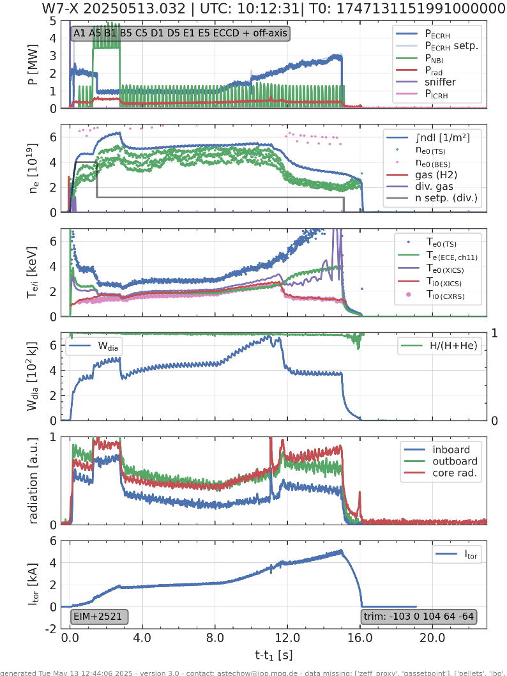
  A low density high performance regime in W7-X
τ_{E}/τ_{ISS04}
A dedicated low density HP scenario was developed in the 2024-2025 campaigns:
During a short NBI pulse, ECRH power is halved
Clean wall, no puff lead to strong ne reduction at the edge
A stable ∇n_{e} emerges at the edge, increasing performance
With additional heating, this scenario yields record confinement levels, with τ_{E}/τ_{ISS04} ~ 1.25
4

Slide 10
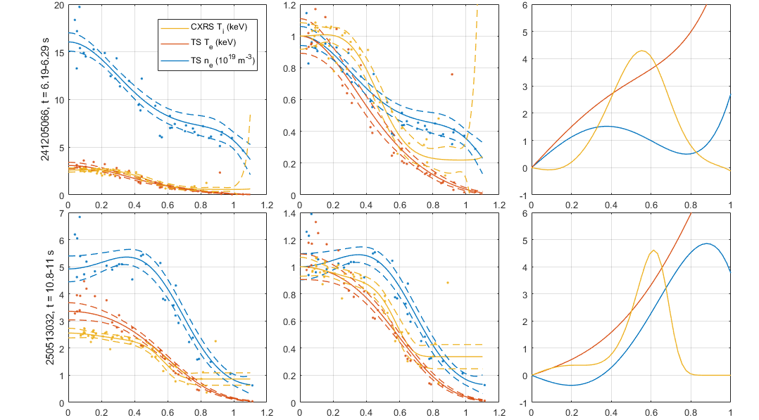
  Low edge density leads to higher performance!
a/L_{ne}, a/L_{Te}, a/L_{Ti}
Rho
Rho
Rho
While the basic turbulence suppression mechanism is the same, there are some relevant differences with baseline scenarios:
Density gradient appears at the edge, rather than at the mid-radius
As a result, T_{i} gradient is also radially displaced, leading to higher “HP volume”, thus improving performance
5

Slide 11

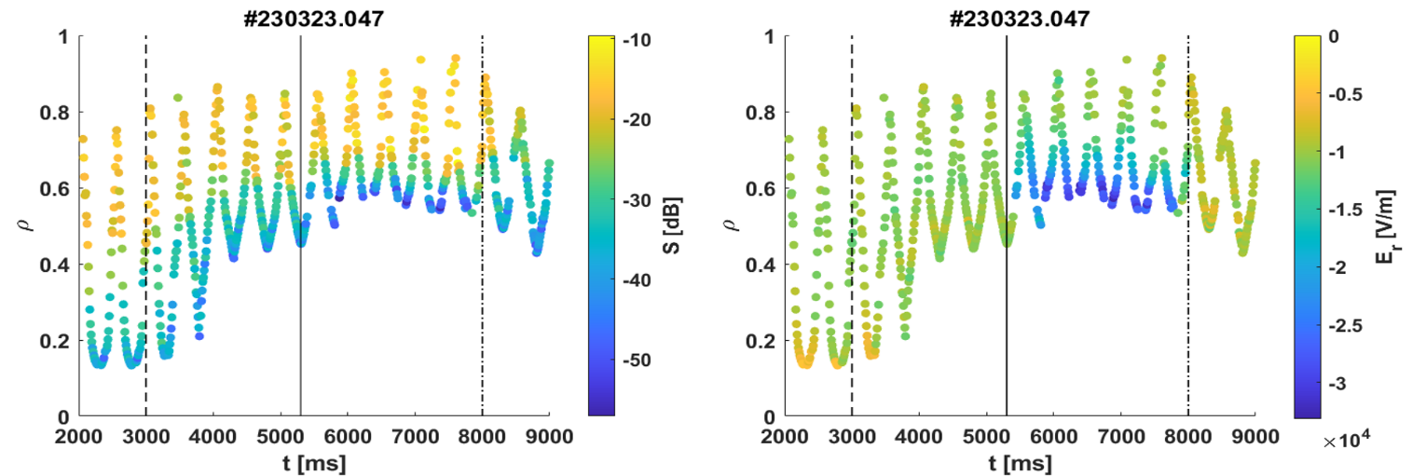
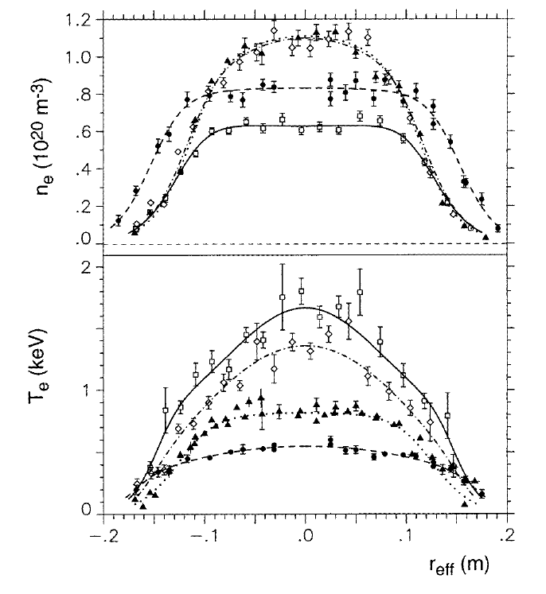
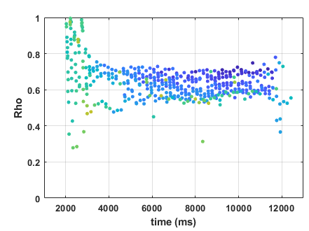
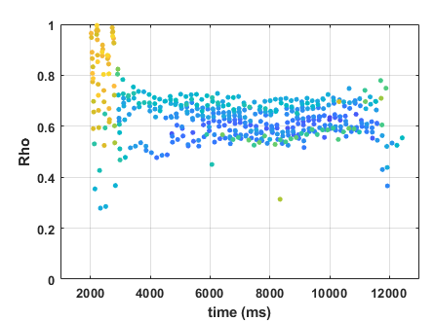
  Low edge density leads to higher performance!
This regime is reminiscent of the “Optimum Confinement” regime in W7-AS, which produced τ_{E}/τ_{ISS95} ~ 2-2.5, record T_{i}, n_{e}T_{i}τ_{E.}
HP phase
HP phase
Rho
While the basic turbulence suppression mechanism is the same, there are some relevant differences with baseline scenarios:
Density gradient appears at the edge, rather than at the mid-radius
As a result, T_{i} gradient is also radially displaced, leading to higher “HP volume”, thus improving performance
Same differences can be observed in DR measurements of E_{r} and fluctuations.
Kick et al., PPCF 1999
5

Slide 12

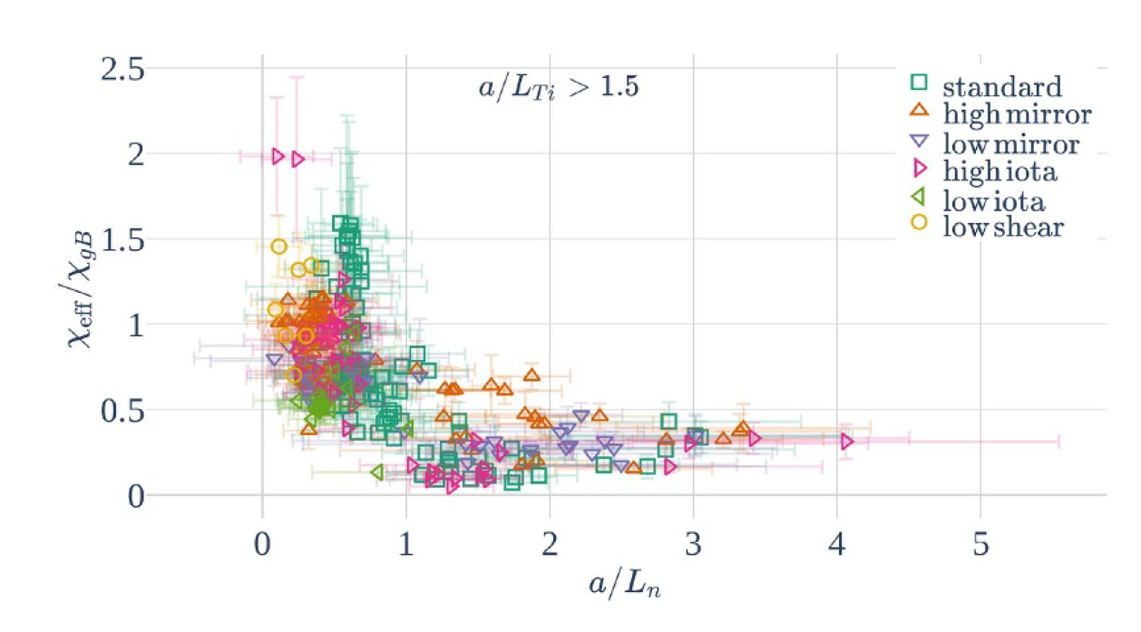
  Transport in the LDHP regime
Power balance (electrons+ions)
Usual a/Ln effect on core transport!
M. Wappl, PPCF 25
Power balance was used to calculate transport. Some caveats in order:
No P_{rad} included (see D. Zhang PPCF 23)
No NBI deposition
Only Q_{e+i} is reliable
6

Slide 13
  Transport in the LDHP regime
Power balance (electrons+ions)
NC transport becomes dominant at mid-radius:
During LDHP, Q_{turb} ~ Q_{NC}
During ECRH ramp, Q_{turb} < Q_{NC}
Coherent experimental picture, consistent with NC simulations:
Very strong suppression of density fluctuations
Radial position consistent with χ_{turb}/χ_{GB}
Radial position aligned with maximum E_{r} gradient?
Connection to Adrian, Andreas K-F?
Power balance was used to calculate transport. Some caveats in order:
No P_{rad} included (see D. Zhang PPCF 23)
No NBI deposition
Only Q_{e+i} is reliable
6

Slide 14
Outline
Introduction
W7-X results
  Baseline density gradient suppression of turbulence
  A low density scenario
  Transport evaluation
LHD results
    LHD experimental scenarios
    Transport evaluation
Multi-machine comparison and preliminary validation results
Summary

Slide 15
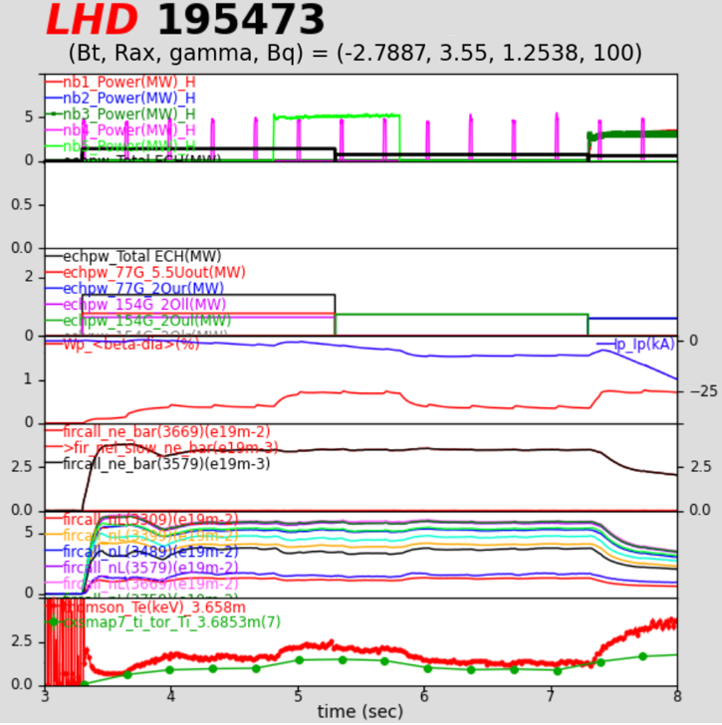
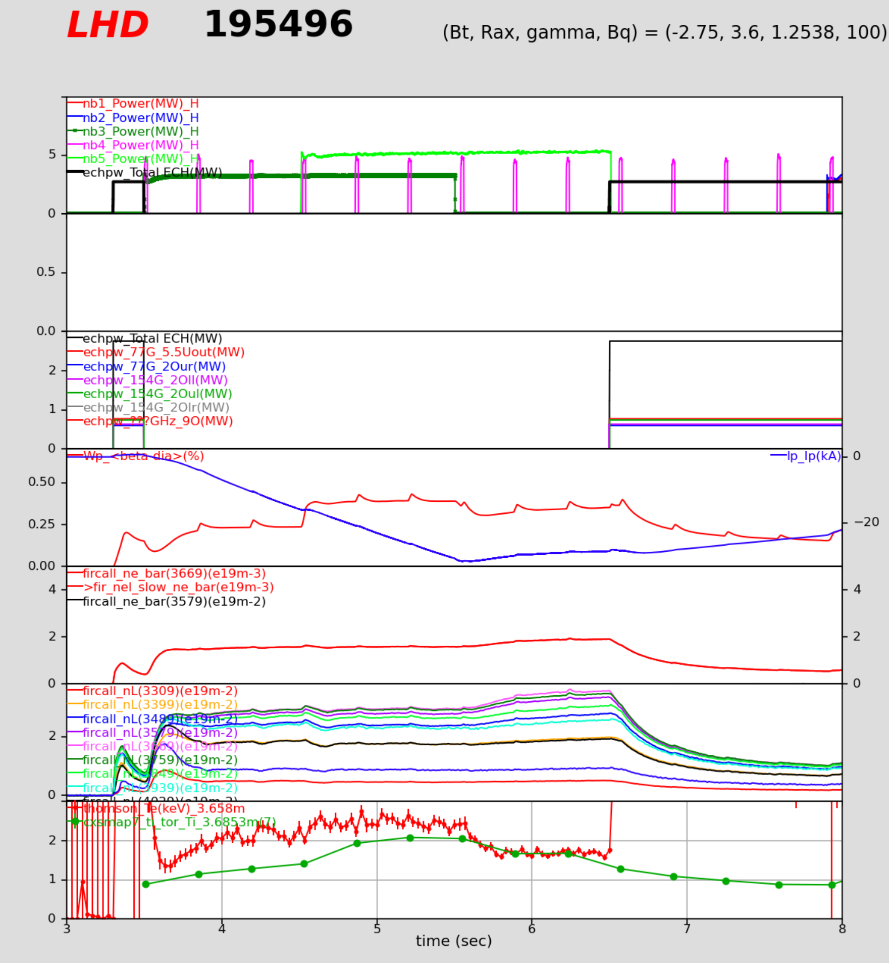
  LHD experimental scenarios
Step down
Power scan
Two kinds of scenarios were carried out in the 2025 LHD campaign.
Step down scenario:
  Direct repetition of W7-X LDHP, aimed at reproducing original profiles.
  PNB is used to increase a/Ln during ECRH phase.
Power scan scenario:
  Low collisionality to ensure IC stability and ITG-dominated transport.
  Core ∇n_{e} was scanned by means of different ratios of positive and negative NBI.
NNB
PNB
In LHD, PNB tends to create peaked profiles, while NNB tends to flat ones
ECRH +PNB
back to ECRH
PNB + NNB
ECRH
7

Slide 16
  LHD scenarios – profiles and gradients
LHD, Step Down
W7-X
ne, Te, Ti
a/L_{ne}, a/L_{Te}, a/L_{Ti}
ECRH
ECRH
ne, Te, Ti
a/L_{ne}, a/L_{Te}, a/L_{Ti}
NBI+ECRH
NBI+ECRH
back to ECRH
Early HP
Late HP
LHD/W7-X agreement is remarkable in the Step Down scenario:
Initially, profiles and normalized gradients are almost equal
No transition to LDHP is observed in LHD.
8

Slide 17
  LHD scenarios – profiles and gradients
Step down
Power scan
ne, Te, Ti
ECRH
ne, Te, Ti
a/L_{ne}, a/L_{Te}, a/L_{Ti}
a/L_{ne}, a/L_{Te}, a/L_{Ti}
NNB
NBI+ECRH
PNB+NNB
back to ECRH
PNB
The Power Scan scenario introduces lower density discharges:
A similar range of core a/Ln is covered with substantially lower density/collisionality
No transition to LDHP is observed in these discharges either.
8

Slide 18
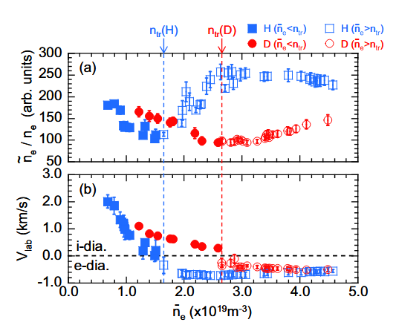
  Transport in LHD scenarios
Transport is evaluated by power balance. Two clearly different trends appear, depending on the scenarios:
In the Step Down scenario (similar to W7-X), a/Ln increases transport and does not improve confinement.
Density (thus collisionality) reduces transport and improves confinement.
In the Power Scan scenario, a/Ln causes a moderate, but clear reduction of transport and confinement improvement.
In this case, density/collisionality have no effect on performance.
At first sight, these results are consistent with previous studies:
Step down (W7X-like)
IC-like
Power Scan
IC-like
ITG-like
T. Kinoshita PRL 2024
Low density data are better suited for inter-machine comparison!
ITG-like
9

Slide 19
Outline
Introduction
W7-X results
  Baseline density gradient suppression of turbulence
  A low density scenario
  Transport evaluation
LHD results
    LHD experimental scenarios
    Transport evaluation
Multi-machine comparison and preliminary validation results
Summary

Slide 20
  Multi-machine transport comparison
LHD
W7-X
H. Thienpondt et al., NF 2025
We recover the main qualitative features of the model for LHD and W7-X:
Transport falls around one order of magnitude within 0 < a/L_{n} < 2. Same in stella for 0.5 < a/L_{n} < 2.5
Instead, LHD transport decays around 30% 0.3 < a/L_{n} < 1. The code shows a similar decay for 0.5 < a/L_{n} < 2
10

Slide 21
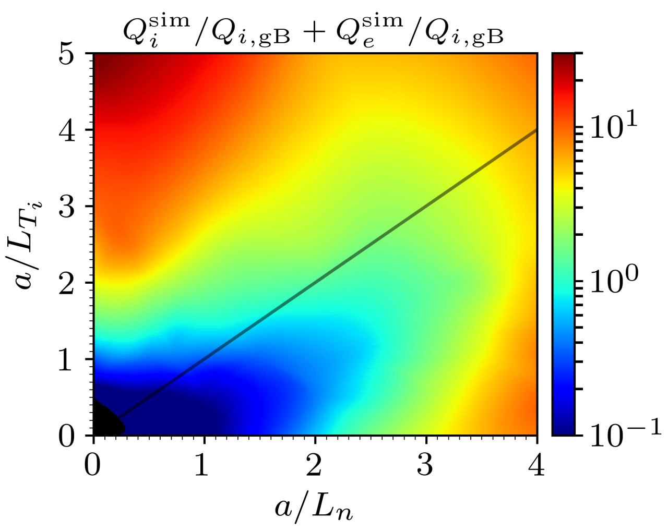
  Preliminary validation attempts
stella
Q_{total}
Q_{turb}
A more quantitative comparison of transport is being developed using interpolation of “academic scans” (see J.M. García-Regaña I07):
Comparison of normalized Q_{e+i} at ρ = 0.7 produces rather good quantitative agreement with code predictions.
11

Slide 22
  Preliminary validation attempts
stella
Q_{total}
Q_{turb}
A more quantitative comparison of transport is being developed using interpolation of “academic scans” (see J.M. García-Regaña I07):
Comparison of normalized Q_{e+i} at ρ = 0.7 produces rather good quantitative agreement with code predictions.
Unfortunately, this result could not be reproduced generally. More detailed analysis is ongoing.
11

Slide 23
  Summary and outlook
Experimental validation of predictive codes is essential to determine the operation point of a stellarator reactor
We have created a multi-machine transport database allowing:
  Evaluation of the singled-out effect of density gradient
  Comparison of equivalent scenarios in W7-X and LHD
In W7-X, this also also led to a promising low density HP regime, reminiscent of the W7-AS “Optimum confinement“
First results show qualitative agreement with GK predictions in W7-X and LHD.
A quantitative validation of transport predictions is still ongoing:
  Detailed comparison, including additional ingredients (several gradients, T_{e}/T_{i}, potential influence of radial position, etc.)
  TJ-II results still to be included in the multi-machine database. Experiments in the spring campaign!
  Evaluation of path dependence
W7-X low density HP scenario will be further explored in the next experimental campaigns, with the aim of rising the achieved triple product.
12

