Slide 1


PSD-DCT Meeting Pedestal Fueling / Transport
Marco Andrés Miller
with contributions from many, including Jerry Hughes, Saskia Mordijck, Aaron Rosenthal, Richard Reksoatmodjo, Jamie Dunsmore
September 29, 2025

Slide 2
Topics
Previous work on fueling
Poloidal symmetries
Pedestal Opaqueness
On the importance of particle transport
Fueling on DEMO?

Slide 3
Previous work on fueling

Slide 4

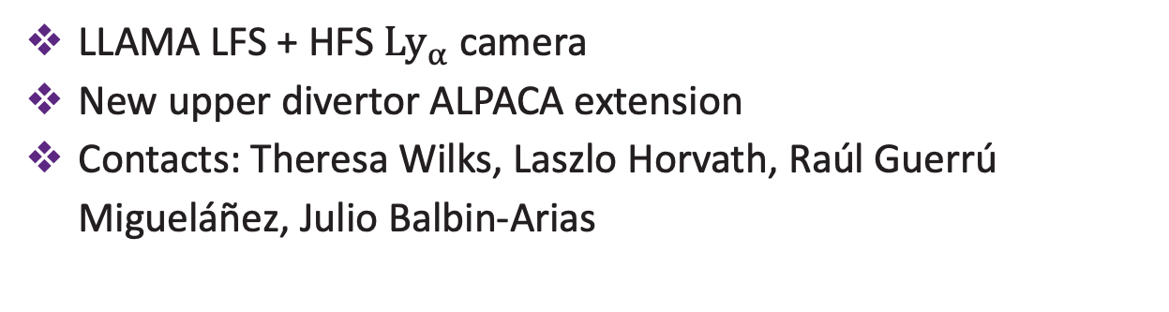
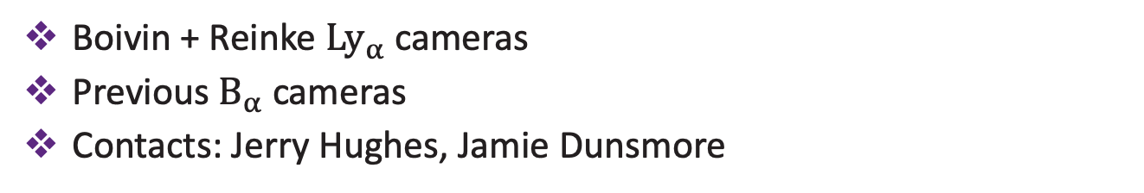
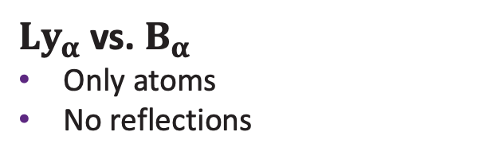
Experimental work on fueling
MIT/C-Mod
Boivin et al. Rev. Sci. Instrum. (2001)
LaBombard et al. Phys. Plasmas (2001)
${Ly}_{α}$ vs. $B_{α}$
Only atoms
No reflections
Hughes et al. Phys. Plasmas (2006)
Boivin + Reinke ${Ly}_{α}$ cameras
Previous $B_{α}$ cameras
Contacts: Jerry Hughes, Jamie Dunsmore
LaBombard et al. Phys. Plasmas (2008)
Hughes et al. Nucl. Fusion (2008)
Miller et al. Nucl. Fusion (2025)
PPPL/DIII-D
Miller et al. Nucl. Mat. Energy (2025)
LLAMA LFS + HFS ${Ly}_{α}$ camera
New upper divertor ALPACA extension
Contacts: Theresa Wilks, Laszlo Horvath, Raúl Guerrú Migueláñez, Julio Balbin-Arias
Rosenthal et al. Rev. Sci. Instrum. (2021)
Laggner et al. Rev. Sci. Instrum. (2021)
Rosenthal et al. Nucl. Fusion (2023)
Chaban et al. Nucl. Fusion (2024)
Horvath et al. Rev. Sci. Instrum. (2024)
Balbin-Arias et al. Nucl. Fusion (2025)
UKAEA/MAST-U
William & Mary
Neutrals modeling
Contacts: Saskia Mordijck
Mordijck et al. Nucl. Fusion (2020)
New HSV camera measuring neutral emission ($B_{α}$)
Contacts: Steven Thomas
Mordijck et al. Nucl. Fusion (2024)
M. A. Miller / PSD-DCT Meeting / 29.04.26

Slide 5
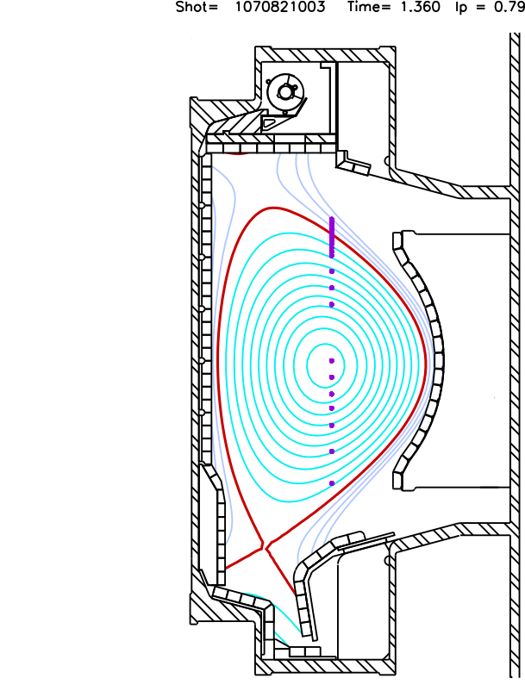

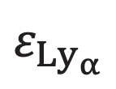




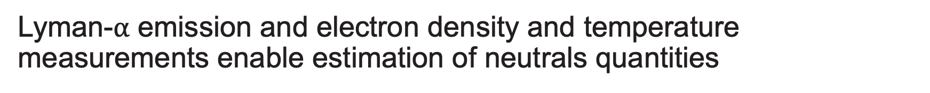



Lyman-$α$ emission and electron density and temperature measurements enable estimation of neutrals quantities
Edge Thomson Scattering (ETS)
Ly_{α} array (LYMID)
Experimentally inferred
ETS
$$n_{0}$$
$$B=Tε$$
$$ε=T^{−1}B$$
$$S_{ion}$$
LYMID
$$Γ_{D}$$
ADAS
$$ε_{Ly_{α}}$$
$$n_{e}$$
$$T_{e}$$
$$D_{eff}$$
Collisional-radiative model
M. A. Miller / PSD-DCT Meeting / 29.04.26

Slide 6
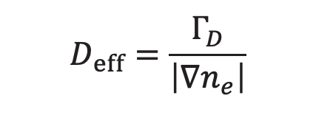
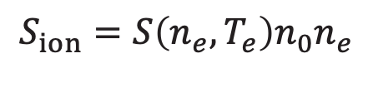

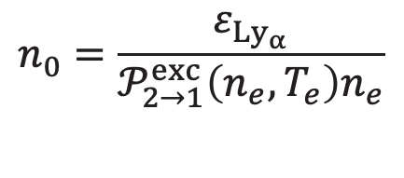
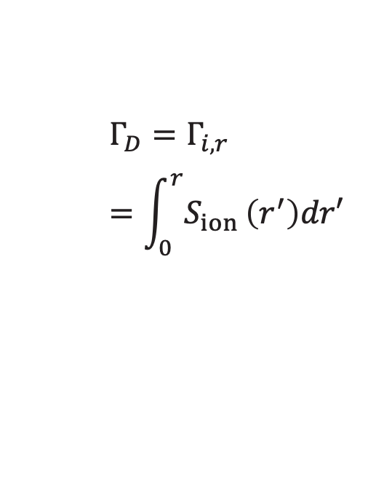


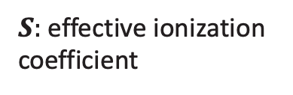

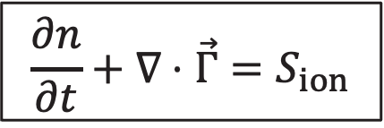
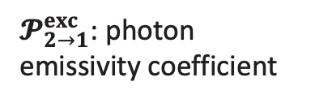
Measurements of plasma and neutral emissivity allows inference of ionization and particle flux profiles
$$\frac{∂n}{∂t}+∇⋅\vec{Γ}=S_{ion}$$
$$n_{0}$$
$$S_{ion}$$
$$Γ_{D}$$
$$D_{eff}$$
$$n_{0}=\frac{ε_{Ly_{α}}}{𝒫_{2→1}^{exc}\left(n_{e},T_{e}\right)n_{e}}$$
$$Γ_{D}=Γ_{i,r}=\int_{0}^{r}{S_{ion}}\left(r^{′}\right)dr′$$
$𝓟_{2→1}^{exc}$: photon emissivity coefficient
$$D_{eff}=\frac{Γ_{D}}{\left|∇n_{e}\right|}$$
$$S_{ion}=S\left(n_{e},T_{e}\right)n_{0}n_{e}$$
$S:$ effective ionization coefficient
M. A. Miller / PSD-DCT Meeting / 29.04.26

Slide 7
Asymmetries

Slide 8
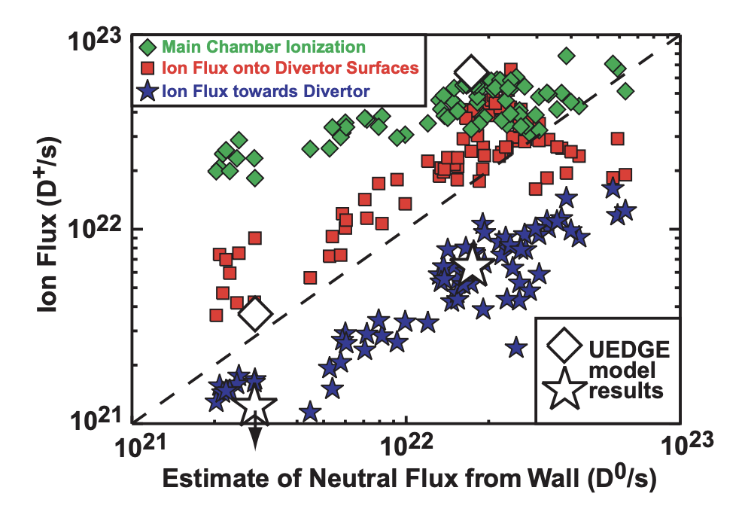
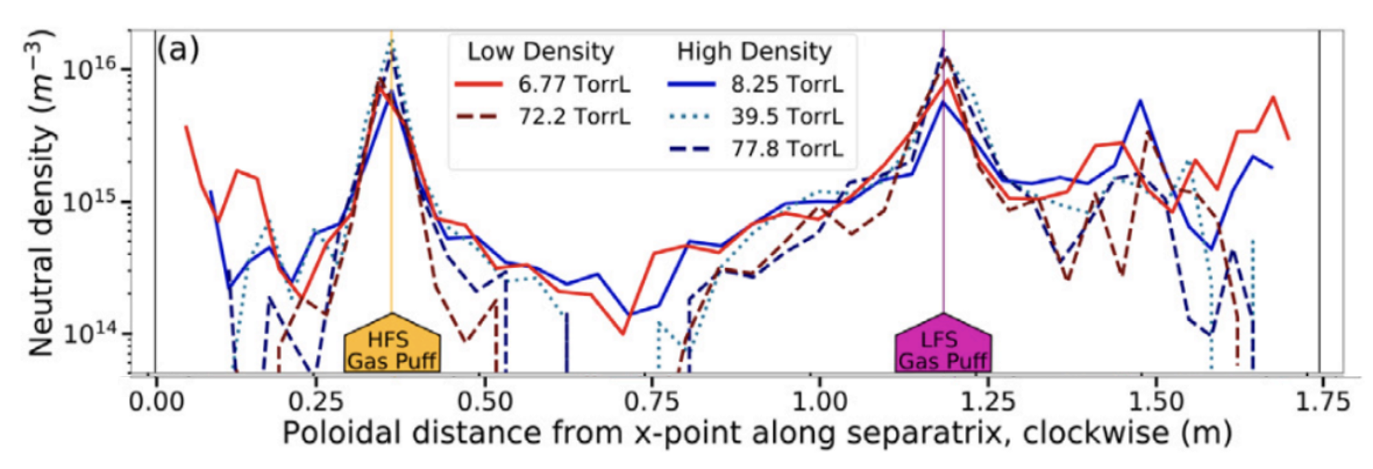

Asymmetries
Toroidal
In presence of gas puff → have asymmetries in $n_{0}$ but probably small in $n_{e}$
Vessel asymmetries – e.g. limiters
Can be modeled in SOLPS-ITER – may not have as big of an effect
Poloidal
Majority of fueling typically through X-point – may be machine-dependent
Alcator C-Mod fairly uniquely fueled primarily through midplanes – main-chamber recycling machine – H-mode could be sustained without active puffing
LaBombard et al. Nucl. Fusion (2000)
Reksoatmodjo et al. Nucl. Mat. Energy (2021)
M. A. Miller / PSD-DCT Meeting / 29.04.26

Slide 9
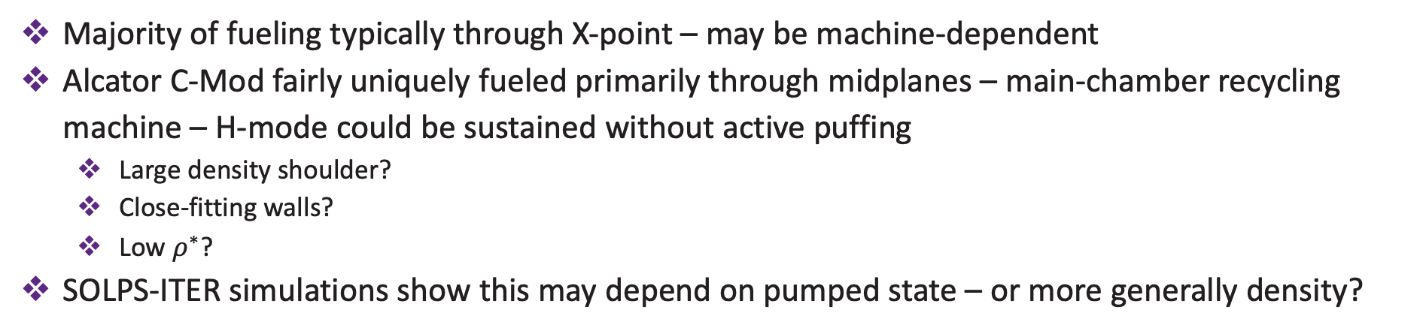
Asymmetries
LaBombard et al. Nucl. Fusion (2000)
Poloidal
Reksoatmodjo et al. Nucl. Mat. Energy (2021)
Majority of fueling typically through X-point – may be machine-dependent
Alcator C-Mod fairly uniquely fueled primarily through midplanes – main-chamber recycling machine – H-mode could be sustained without active puffing
Large density shoulder?
Close-fitting walls?
Low $ρ^{∗}$?
SOLPS-ITER simulations show this may depend on pumped state – or more generally density?
M. A. Miller / PSD-DCT Meeting / 29.04.26

Slide 10
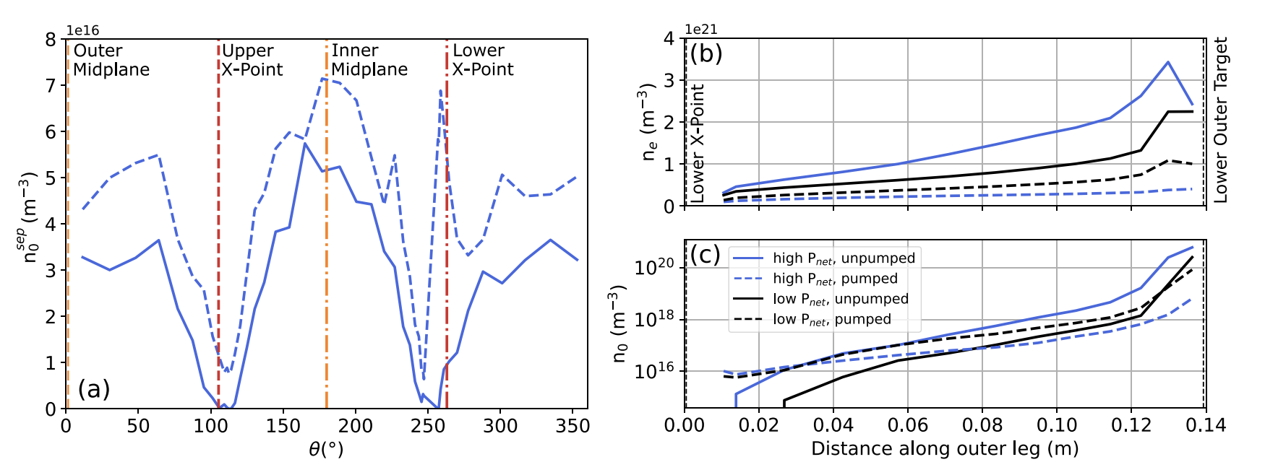
Asymmetries
Poloidal
Miller et al. Nucl. Mat. Energy (2025)
Majority of fueling typically through X-point – may be machine-dependent
Alcator C-Mod fairly uniquely fueled primarily through midplanes – main-chamber recycling machine – H-mode could be sustained without active puffing
Large density shoulder?
Close-fitting walls?
Low $ρ^{∗}$?
SOLPS-ITER simulations show this may depend on pumped state – or more generally density?
M. A. Miller / PSD-DCT Meeting / 29.04.26

Slide 11
Opaqueness

Slide 12
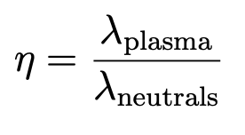

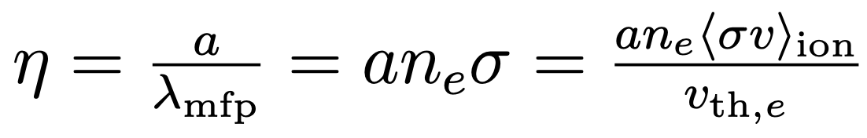
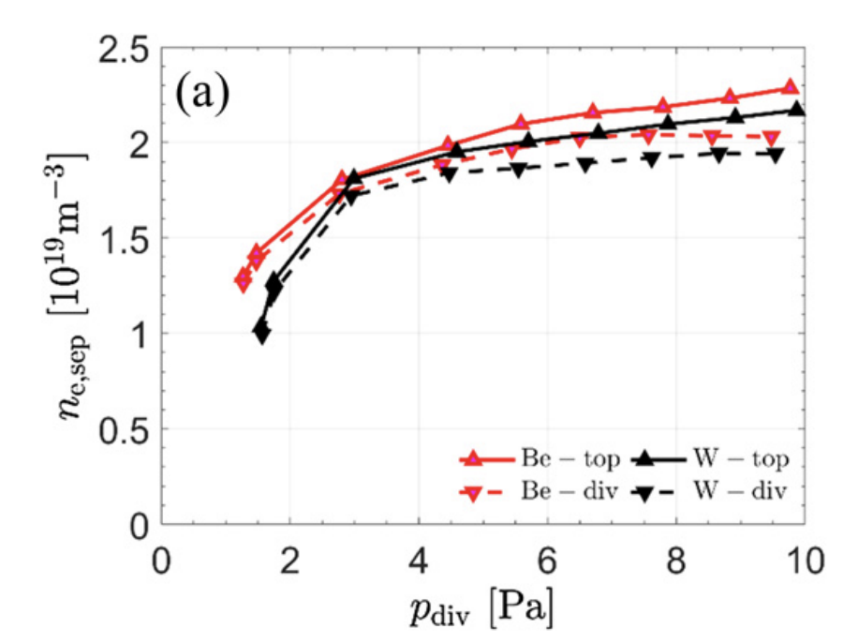
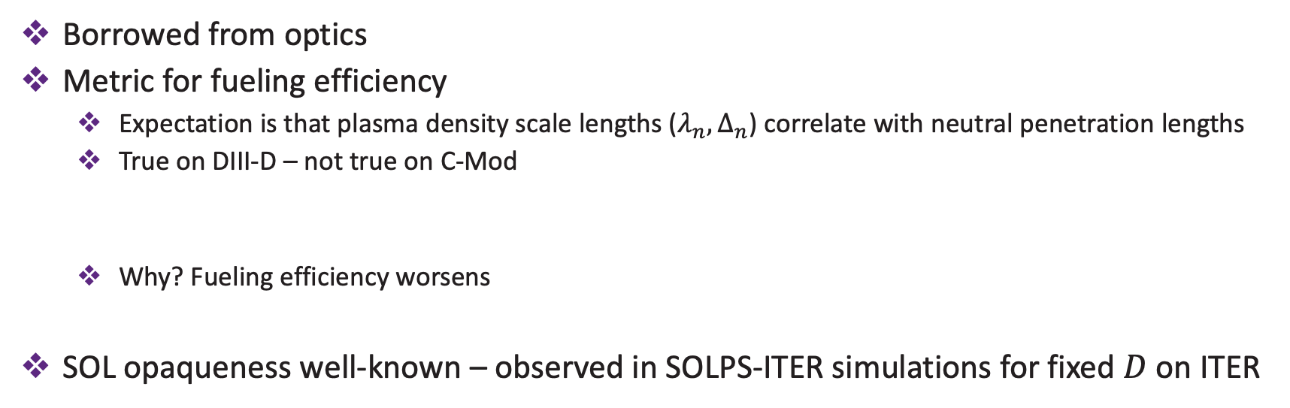
Opaqueness at high $n_{e}$
Opaqueness
Borrowed from optics
Metric for fueling efficiency
Expectation is that plasma density scale lengths ($λ_{n}, Δ_{n}$) correlate with neutral penetration lengths
True on DIII-D – not true on C-Mod
Why? Fueling efficiency worsens
SOL opaqueness well-known – observed in SOLPS-ITER simulations for fixed $D$ on ITER
Groebner et al. Phys. Plasmas (2002)
Hughes et al. Nucl. Fusion (2007)
Mordijck et al. Nucl. Fusion (2020, 2024)
Pitts et al. Nucl. Mat. Energy (2019)
Park et al. Nucl. Fusion (2021)
M. A. Miller / PSD-DCT Meeting / 29.04.26

Slide 13

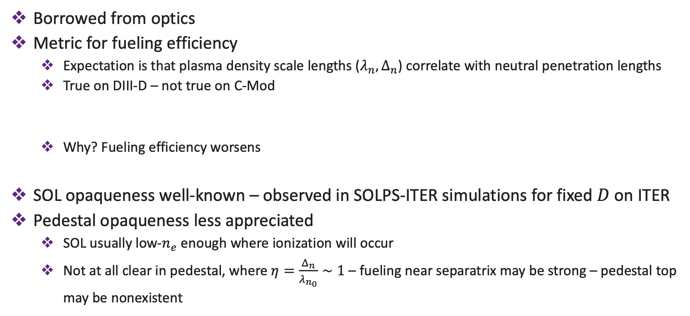

Opaqueness at high $n_{e}$
Opaqueness
Borrowed from optics
Metric for fueling efficiency
Expectation is that plasma density scale lengths ($λ_{n}, Δ_{n}$) correlate with neutral penetration lengths
True on DIII-D – not true on C-Mod
Why? Fueling efficiency worsens
SOL opaqueness well-known – observed in SOLPS-ITER simulations for fixed $D$ on ITER
Pedestal opaqueness less appreciated
SOL usually low-$n_{e}$ enough where ionization will occur
Not at all clear in pedestal, where $η=\frac{Δ_{n}}{λ_{n_{0}}}∼1$ – fueling near separatrix may be strong – pedestal top may be nonexistent
Groebner et al. Phys. Plasmas (2002)
Hughes et al. Nucl. Fusion (2007)
For relatively fixed $σ$:
Mordijck et al. Nucl. Fusion (2020, 2024)
Opaqueness [ ]
Opacity [$m^{−1}]$
M. A. Miller / PSD-DCT Meeting / 29.04.26

Slide 14
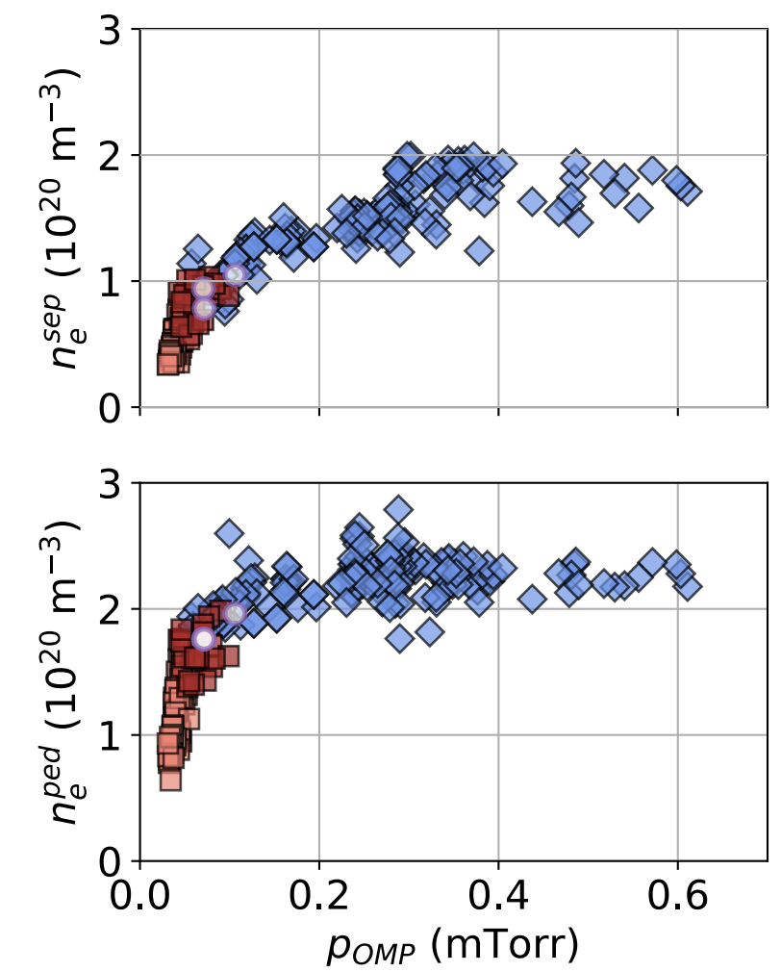
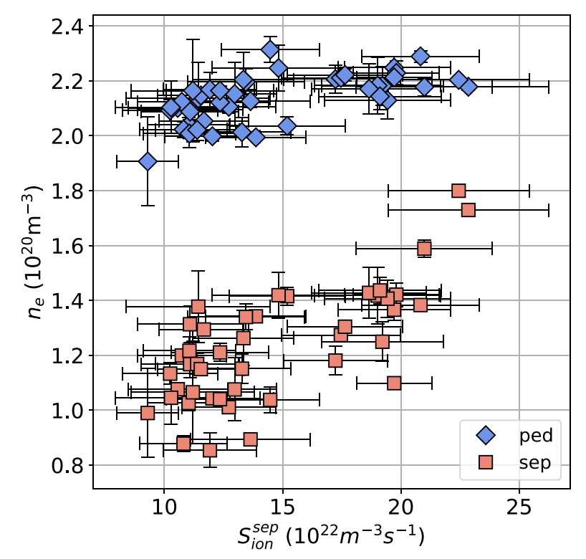
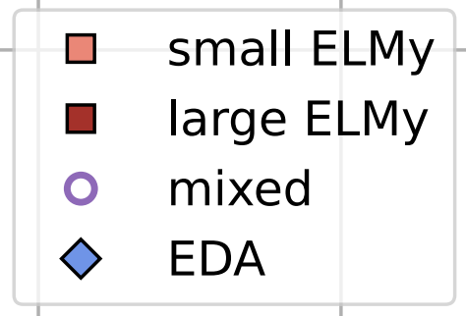
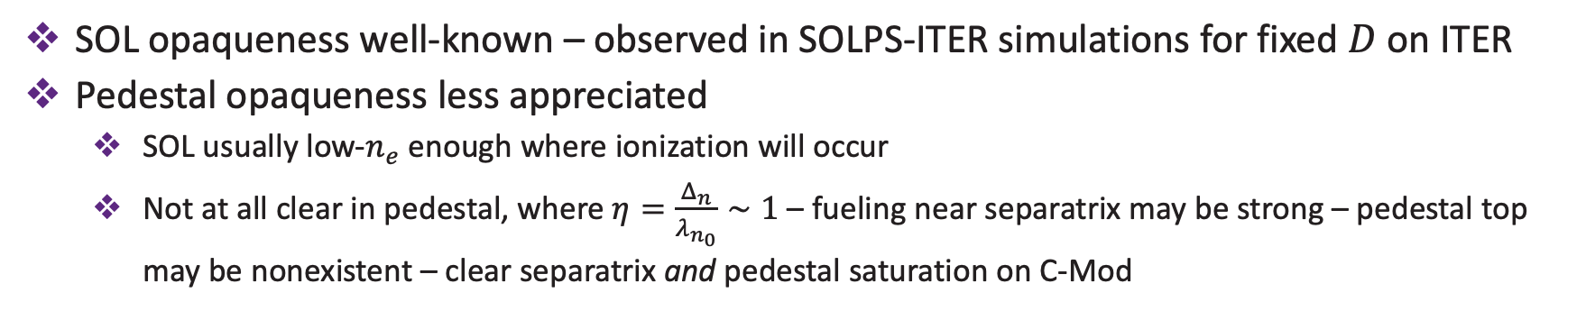
Opaqueness at high $n_{e}$
Miller et al. arXiv: 2603.16515 (2026)
Opaqueness
Miller et al. Nucl. Fusion (2025)
Park et al. Nucl. Fusion (2021)
SOL opaqueness well-known – observed in SOLPS-ITER simulations for fixed $D$ on ITER
Pedestal opaqueness less appreciated
SOL usually low-$n_{e}$ enough where ionization will occur
Not at all clear in pedestal, where $η=\frac{Δ_{n}}{λ_{n_{0}}}∼1$ – fueling near separatrix may be strong – pedestal top may be nonexistent – clear separatrix and pedestal saturation on C-Mod
M. A. Miller / PSD-DCT Meeting / 29.04.26

Slide 15
Particle transport

Slide 16
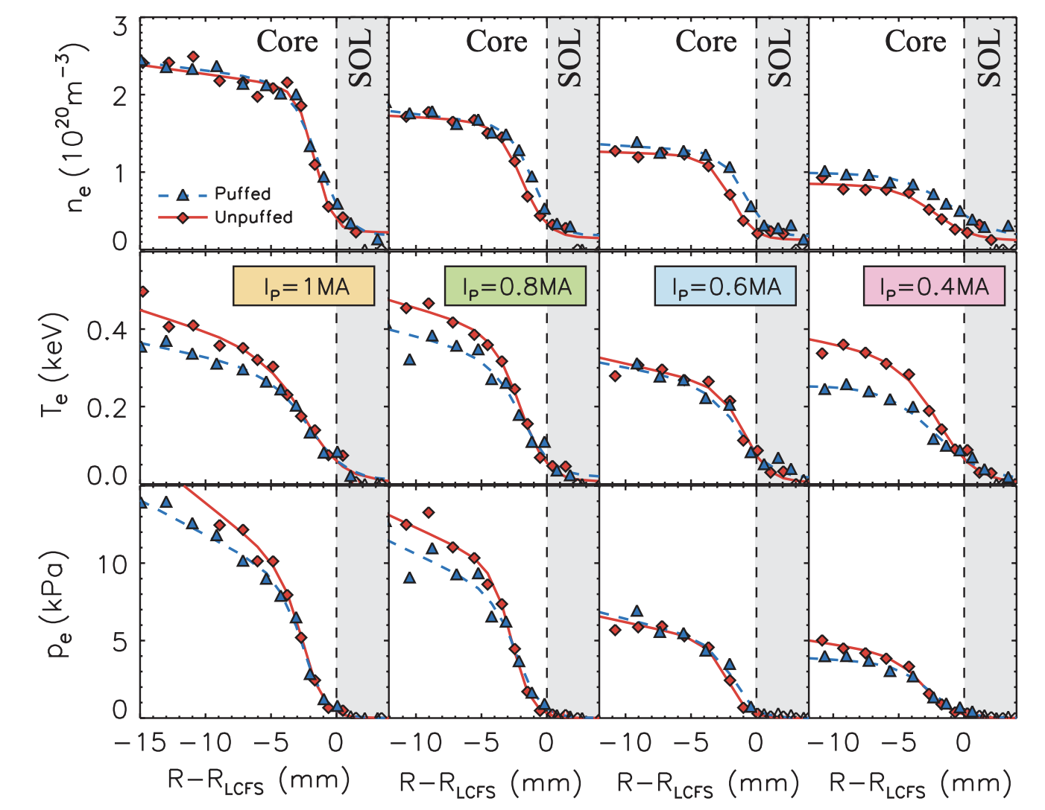
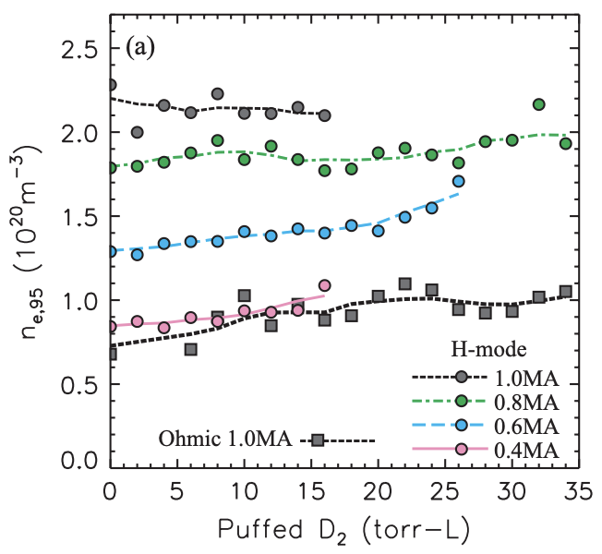
Transport
Resistive modes – high main-chamber fluxes
Pedestal saturation may also be related to modes driving large particle transport at high $n_{e}$
Experimentally, gas puffing at high $n_{e}$ (or always on C-Mod), moves $n_{e}$ profile out, not up
Hughes et al. Nucl. Fusion (2007)
Dunne et al. Plasma Phys. Control. Fusion (2016)
Frassinetti et al. Nucl. Fusion (2017)
M. A. Miller / PSD-DCT Meeting / 29.04.26

Slide 17
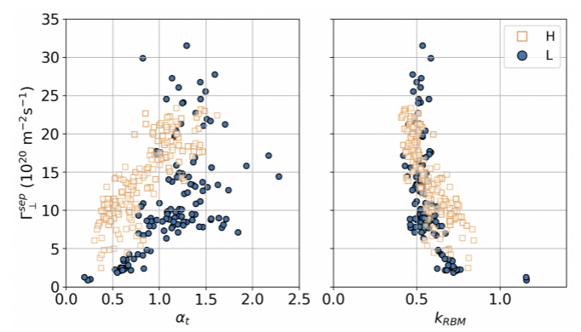
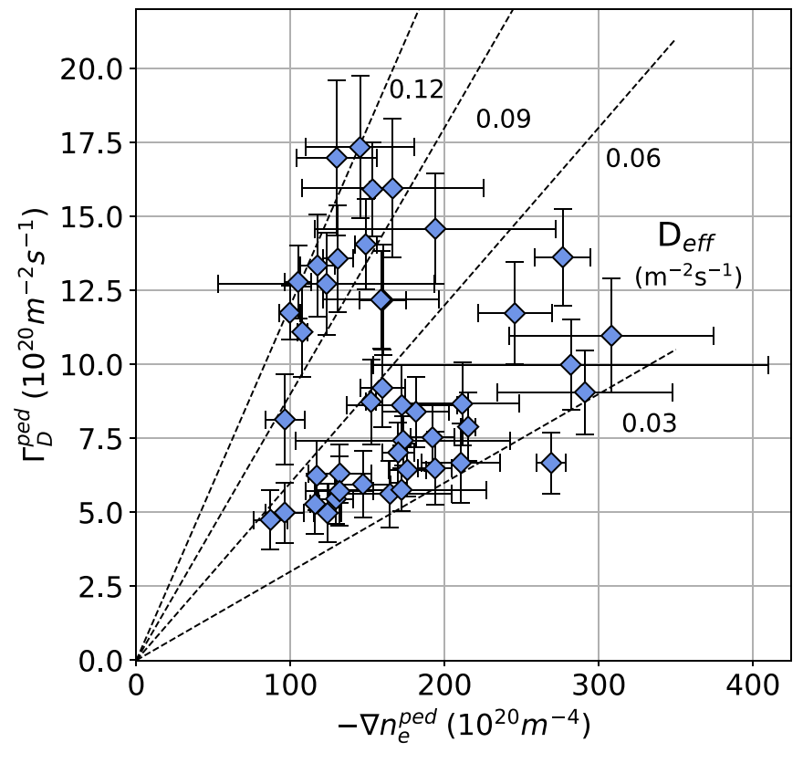
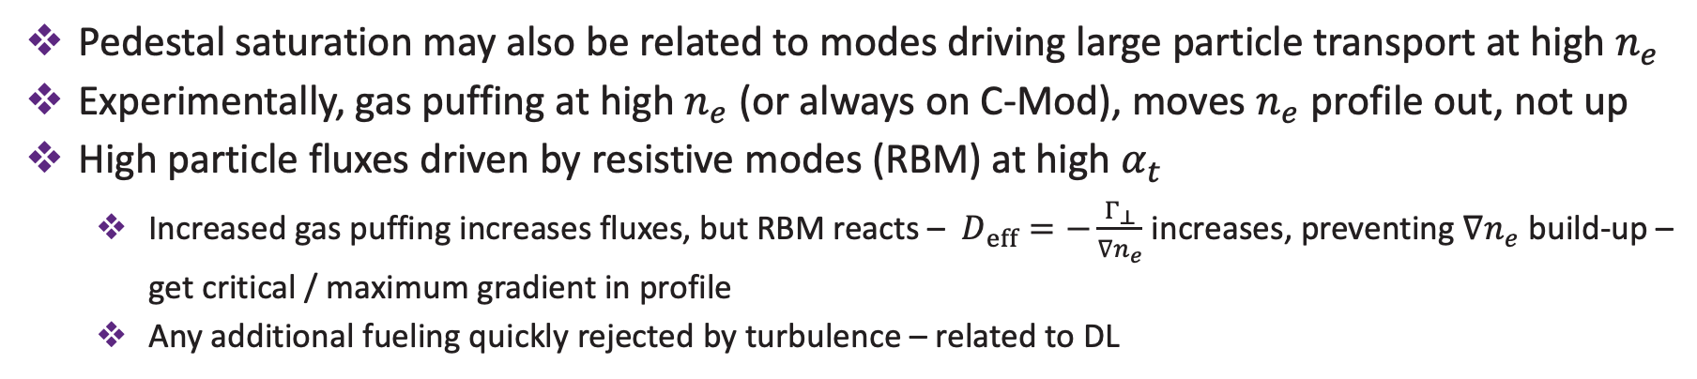
Transport
Resistive modes – high main-chamber fluxes
Pedestal saturation may also be related to modes driving large particle transport at high $n_{e}$
Experimentally, gas puffing at high $n_{e}$ (or always on C-Mod), moves $n_{e}$ profile out, not up
High particle fluxes driven by resistive modes (RBM) at high $α_{t}$
Increased gas puffing increases fluxes, but RBM reacts – $D_{eff}=−\frac{Γ_{⊥}}{∇n_{e}}$ increases, preventing $∇n_{e}$ build-up – get critical / maximum gradient in profile
Any additional fueling quickly rejected by turbulence – related to DL
LaBombard et al. Phys. Plasmas (2001)
LaBombard et al. Phys. Plasmas (2008)
Miller et al. Nucl. Fusion (2025)
Miller et al. arXiv:2603.24512 (2026)
M. A. Miller / PSD-DCT Meeting / 29.04.26

Slide 18
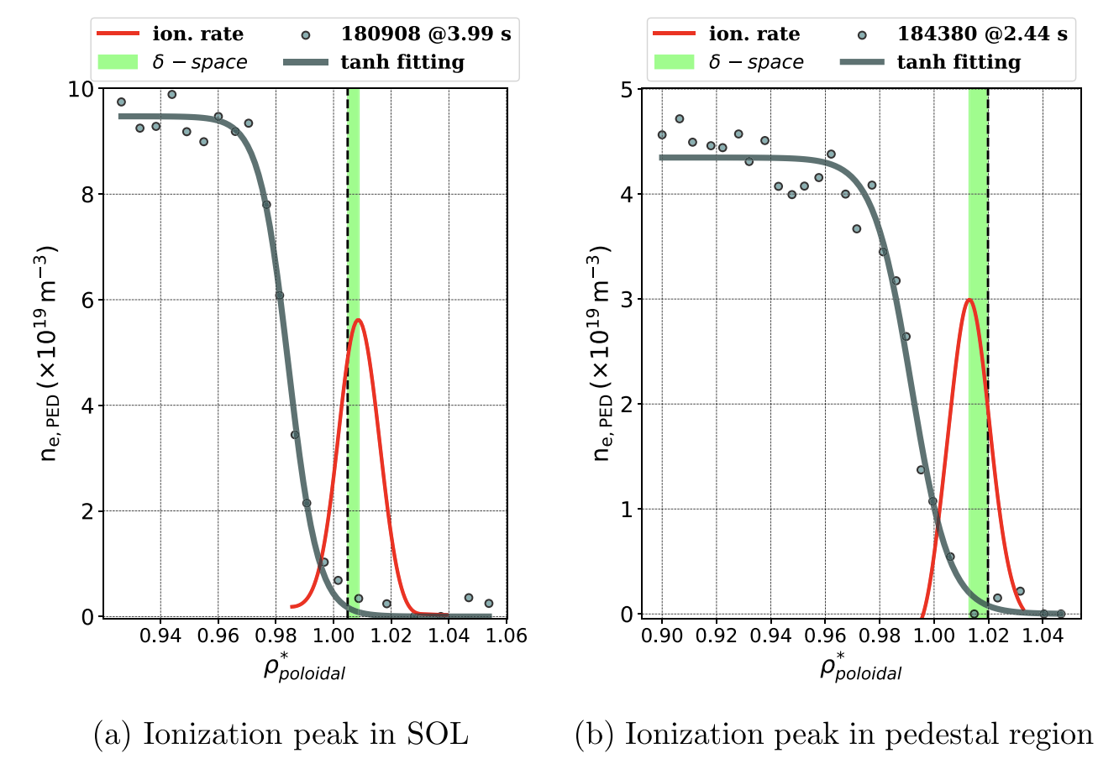
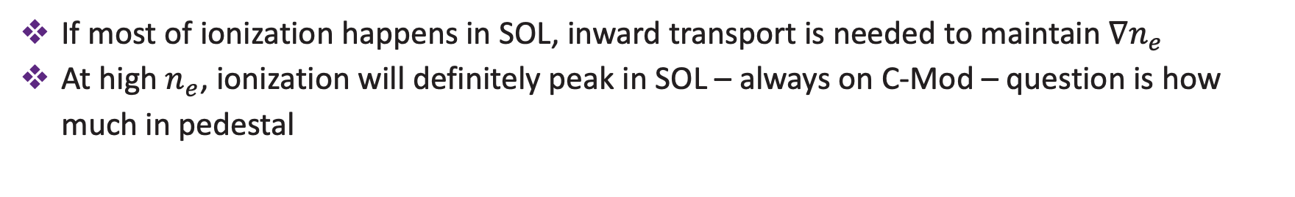
Transport
Resistive modes – high main-chamber fluxes
Inward pinch
If most of ionization happens in SOL, inward transport is needed to maintain $∇n_{e}$
At high $n_{e}$, ionization will definitely peak in SOL – always on C-Mod – question is how much in pedestal
Balbin-Arias et al. Nucl. Fusion (2025)
M. A. Miller / PSD-DCT Meeting / 29.04.26

Slide 19
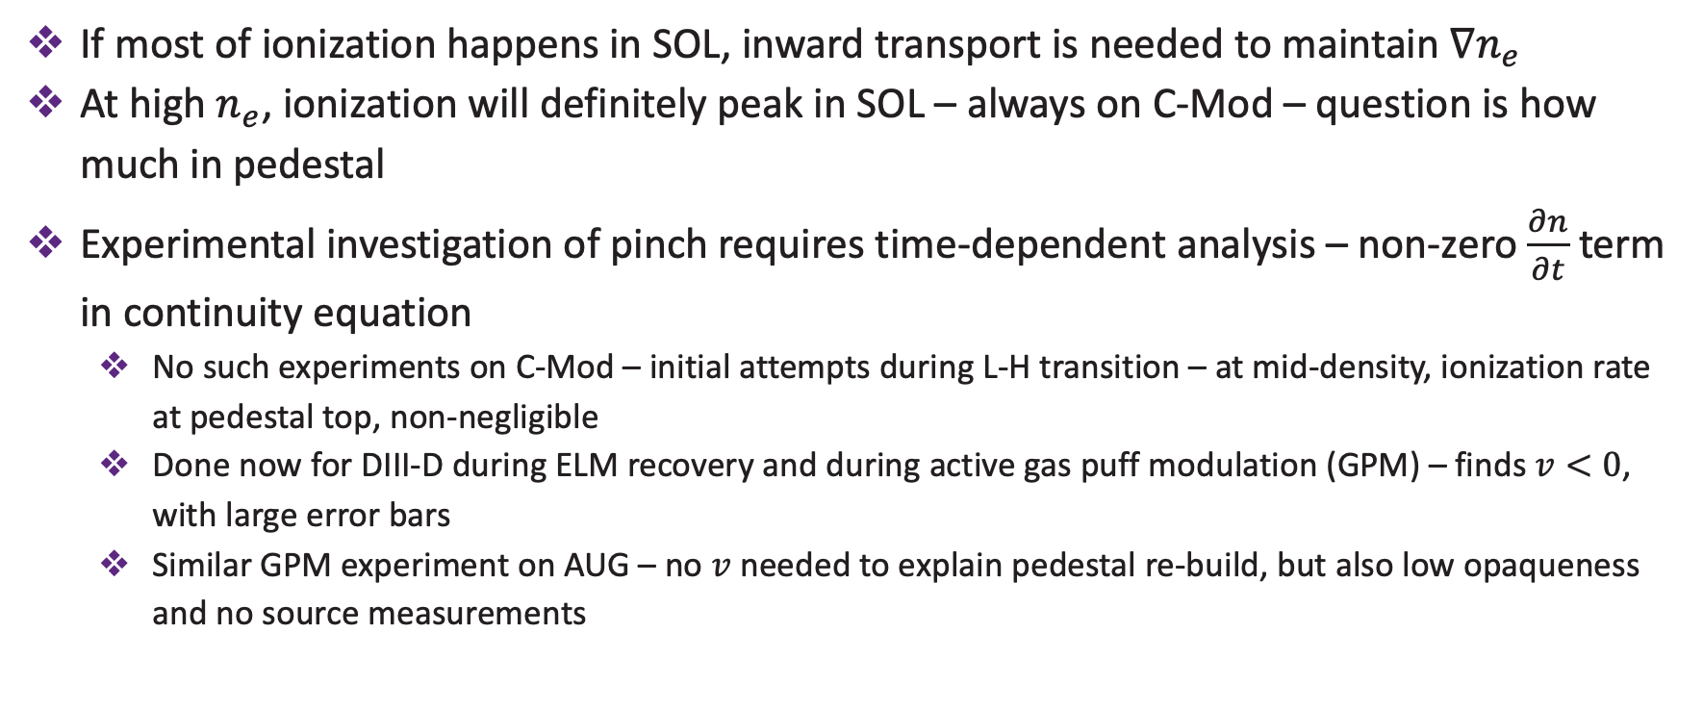
Transport
Resistive modes – high main-chamber fluxes
Inward pinch
If most of ionization happens in SOL, inward transport is needed to maintain $∇n_{e}$
At high $n_{e}$, ionization will definitely peak in SOL – always on C-Mod – question is how much in pedestal
Experimental investigation of pinch requires time-dependent analysis – non-zero $\frac{∂n}{∂t}$ term in continuity equation
No such experiments on C-Mod – initial attempts during L-H transition – at mid-density, ionization rate at pedestal top, non-negligible
Done now for DIII-D during ELM recovery and during active gas puff modulation (GPM) – finds $v<0$, with large error bars
Similar GPM experiment on AUG – no $v$ needed to explain pedestal re-build, but also low opaqueness and no source measurements
Rosenthal et al. Nucl. Fusion (2024)
Schuster et al. Nucl. Fusion (2022)
M. A. Miller / PSD-DCT Meeting / 29.04.26

Slide 20
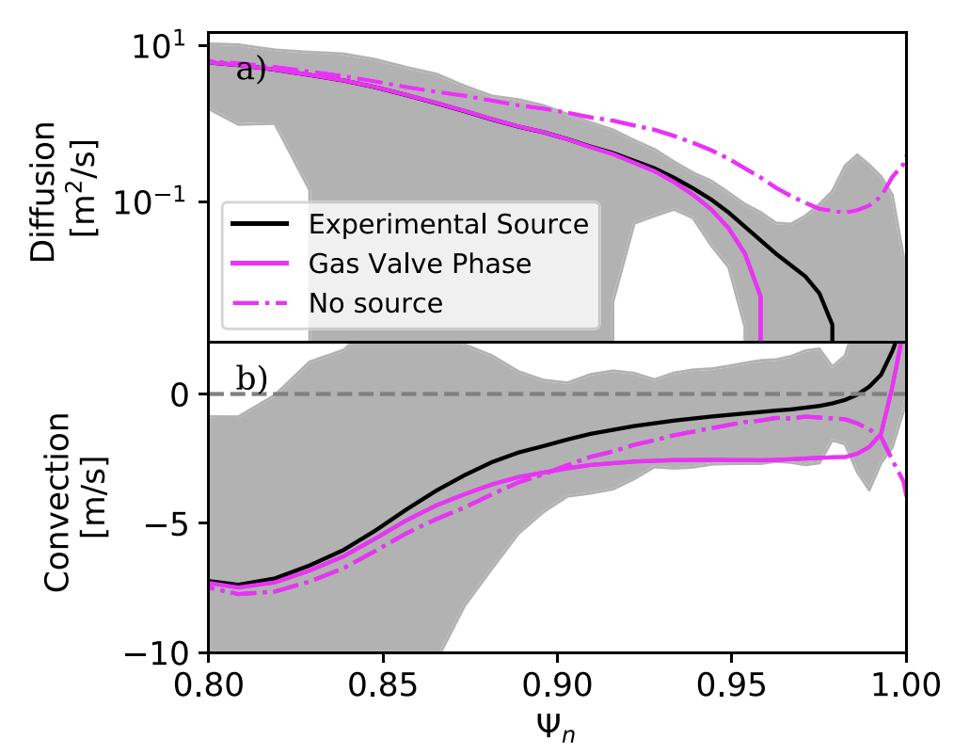
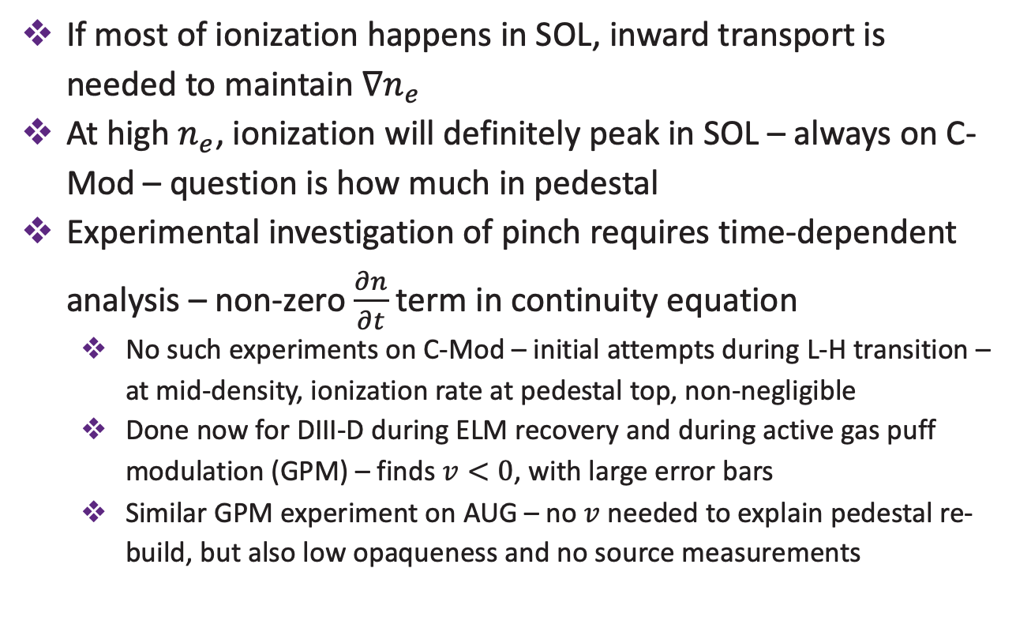
Transport
Inward pinch
If most of ionization happens in SOL, inward transport is needed to maintain $∇n_{e}$
At high $n_{e}$, ionization will definitely peak in SOL – always on C-Mod – question is how much in pedestal
Experimental investigation of pinch requires time-dependent analysis – non-zero $\frac{∂n}{∂t}$ term in continuity equation
No such experiments on C-Mod – initial attempts during L-H transition – at mid-density, ionization rate at pedestal top, non-negligible
Done now for DIII-D during ELM recovery and during active gas puff modulation (GPM) – finds $v<0$, with large error bars
Similar GPM experiment on AUG – no $v$ needed to explain pedestal re-build, but also low opaqueness and no source measurements
Rosenthal et al. Nucl. Fusion (2024)
M. A. Miller / PSD-DCT Meeting / 29.04.26

Slide 21
Fueling on DEMO

Slide 22
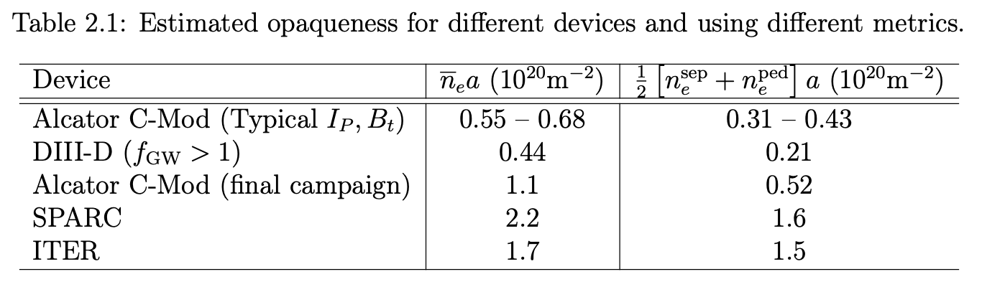
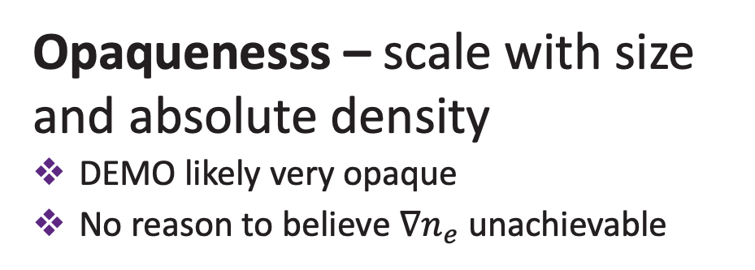
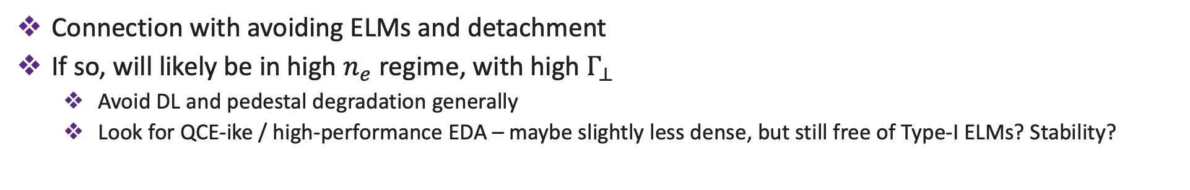
Projections to DEMO
Asymmetries – depend on ratio of directional fluxes
Toroidal unavoidable – symmetrize VV and puff at multiple locations, but not as important
Poloidal also unavoidable – can be modified, but possibly tied to recycling regime – would like compressed divertor – is MC recycling a bad thing?
Opaquenesss – scale with size and absolute density
DEMO likely very opaque
No reason to believe $∇n_{e}$ unachievable
Transport – driven by dimensionless parameters
Miller, PhD Thesis (2025)
Connection with avoiding ELMs and detachment
If so, will likely be in high $n_{e}$ regime, with high $Γ_{⊥}$
Avoid DL and pedestal degradation generally
Look for QCE-ike / high-performance EDA – maybe slightly less dense, but still free of Type-I ELMs? Stability?
M. A. Miller / PSD-DCT Meeting / 29.04.26

Slide 23
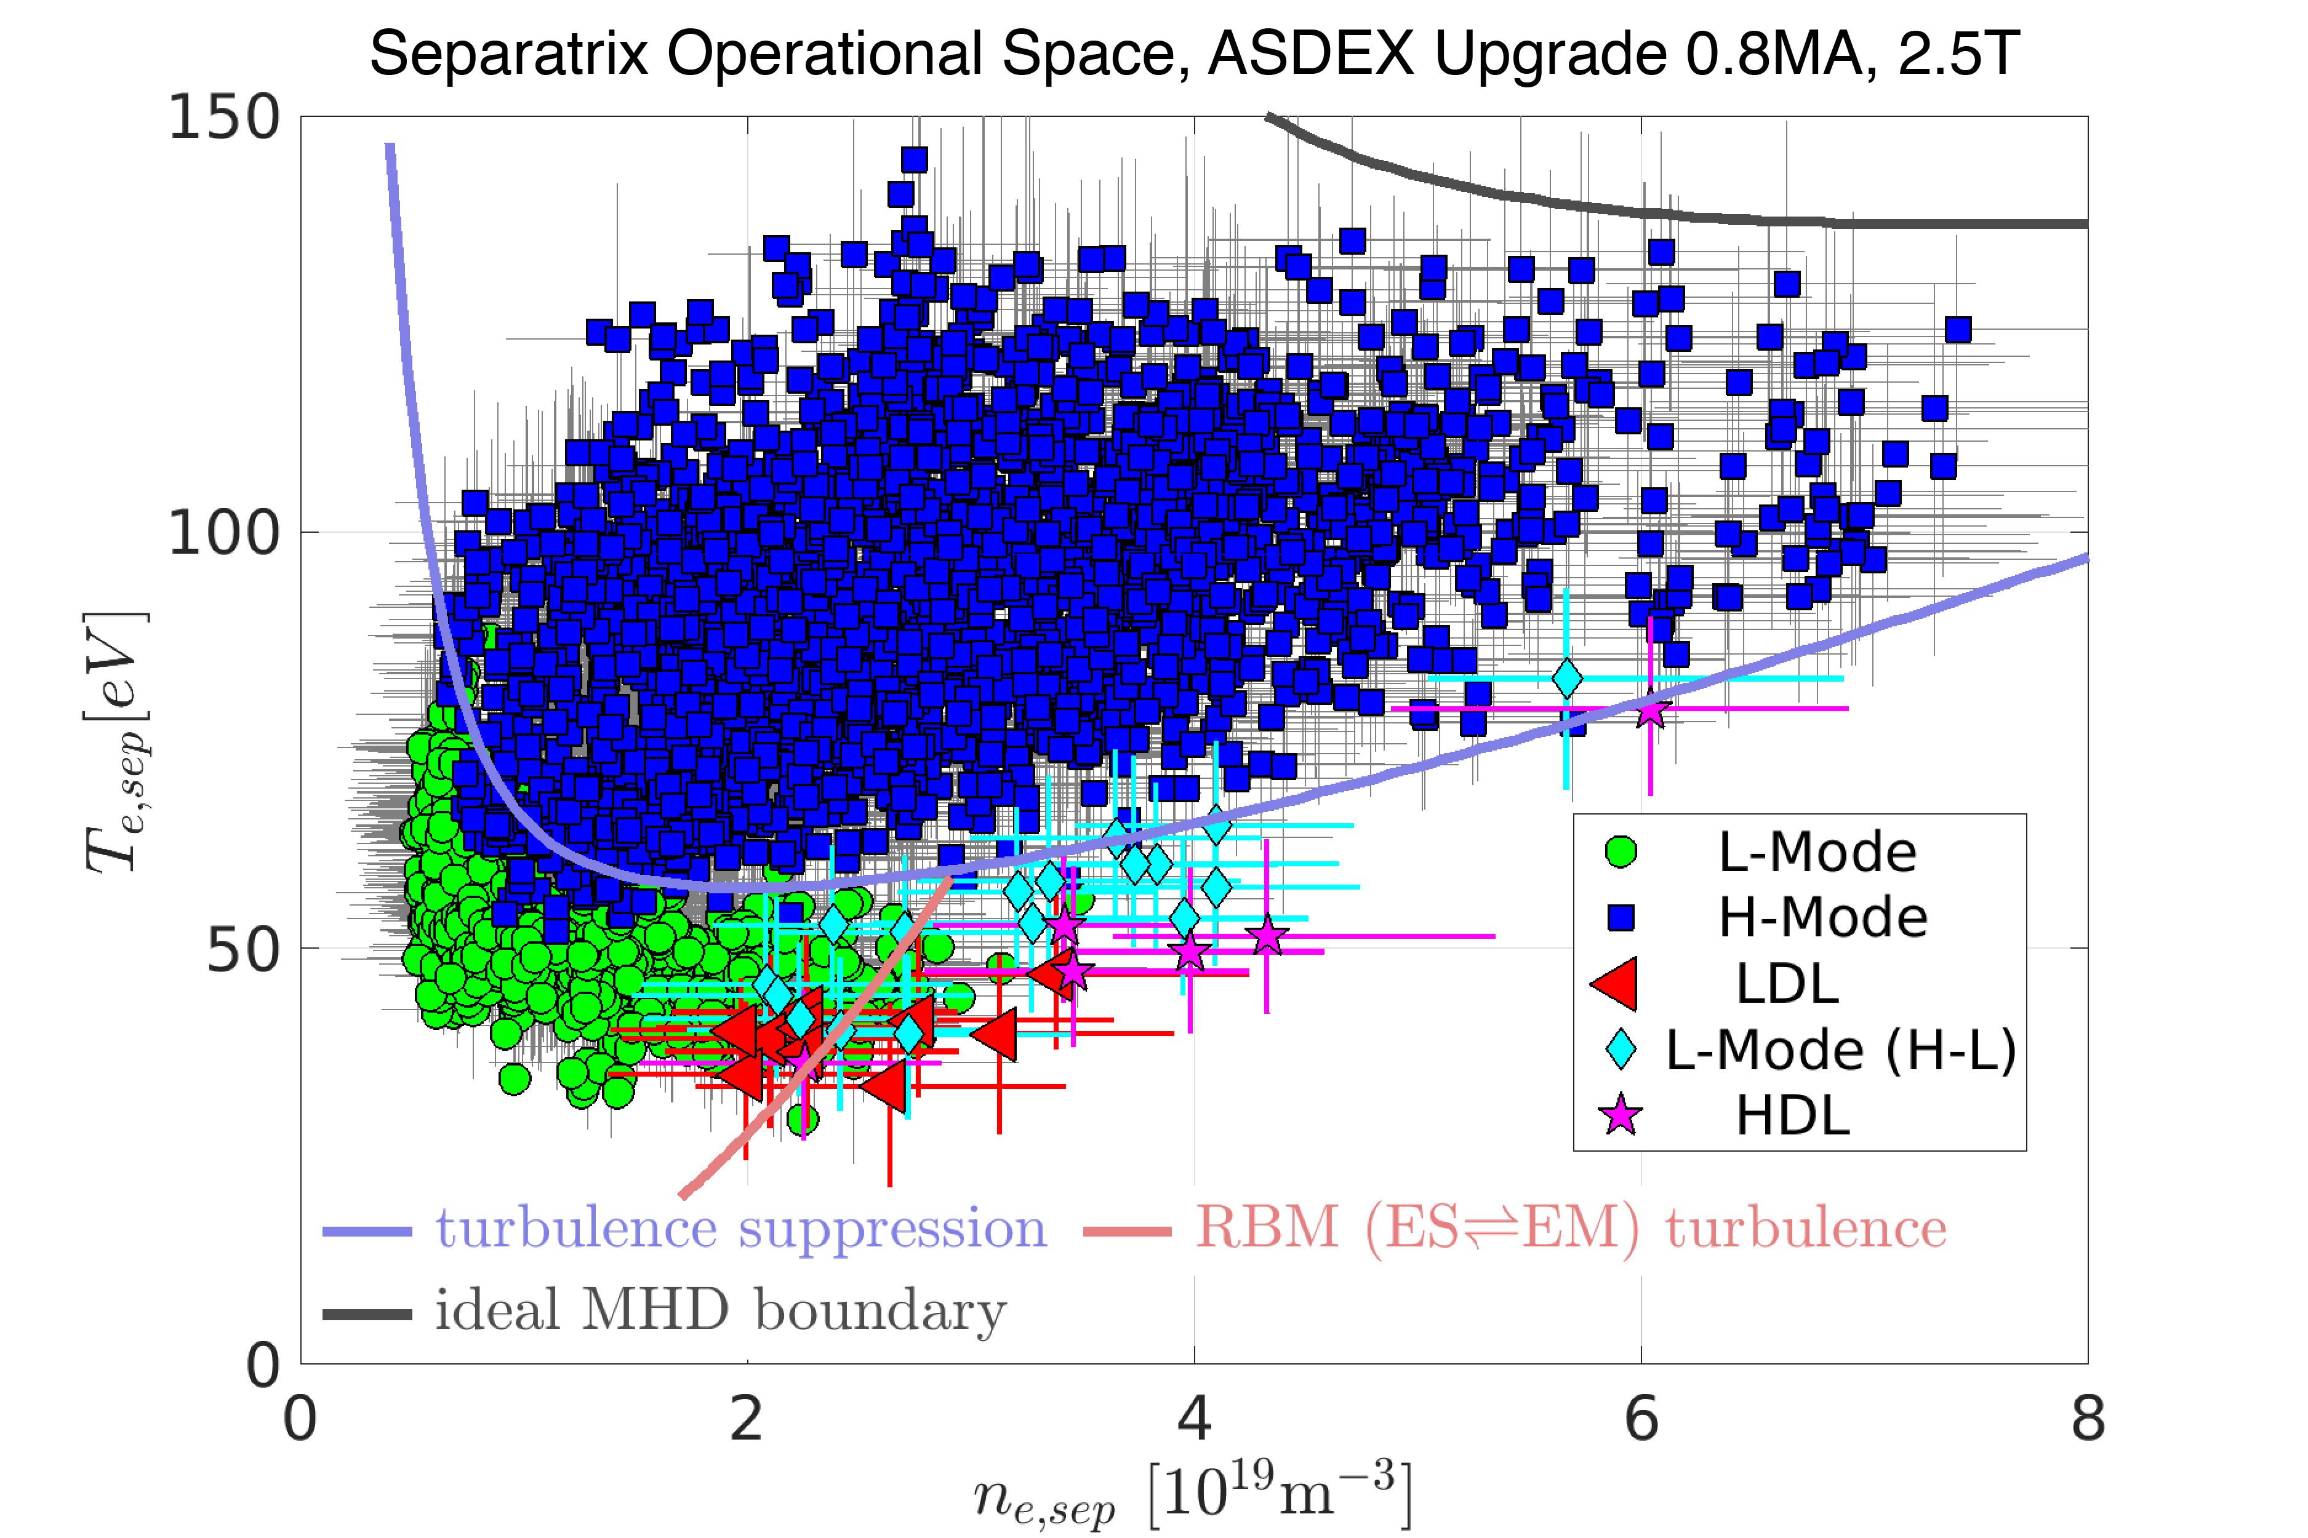
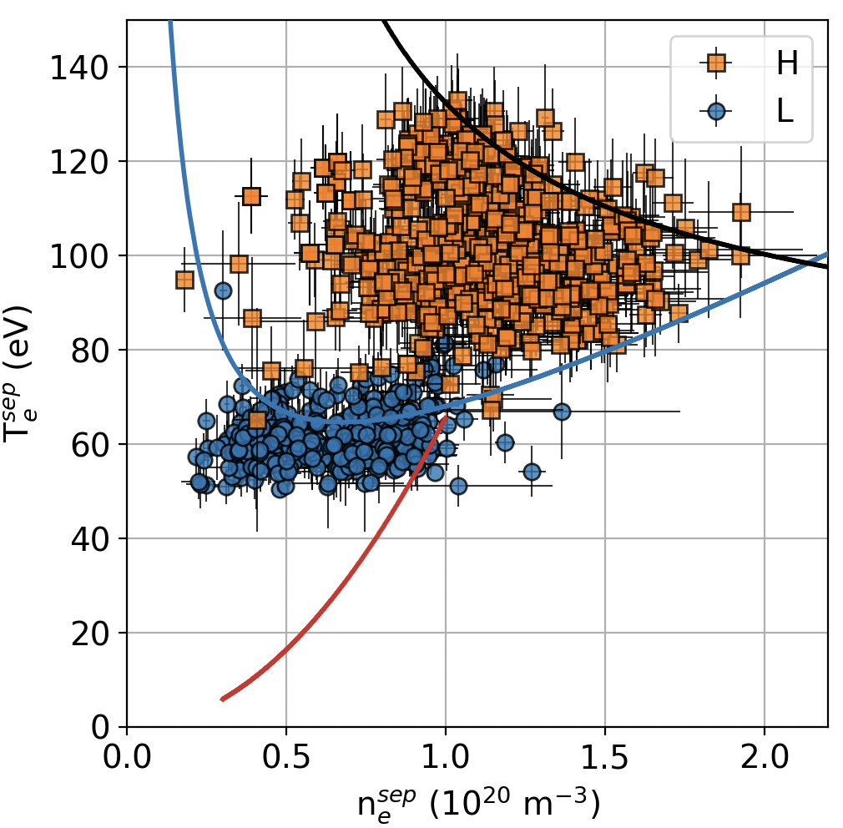
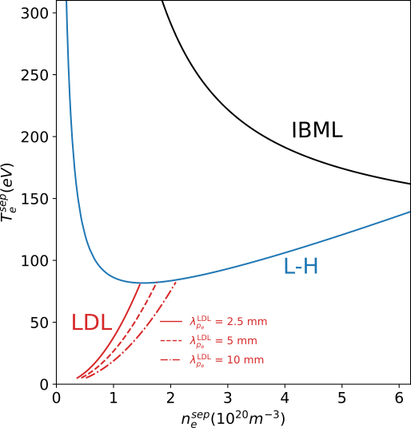




Puffs or pellets?
ASDEX Upgrade
Alcator C-Mod
DEMO
Eich & Manz Nuclear Fusion (2021)
Miller et al. PhD Thesis (2025)
0.8 MA, 2.5 T
0.8 MA, 5.4 T
17.8 MA, 5.9 T
?
$$B_{T} × \sim 2$$
$$B_{T} × \sim 2$$
SepOS boundaries – allowed space for a plasma to live – turbulence physics
Actual data points – what machine likes – geometry, atomic physics, SOL turbulence
AUG – most data in left “half” of H-mode space – mostly gas-fueled – pellets needed to get to high density half
C-Mod – most data in right “half” of H-mode space – all gas fueled, and no gas puffs in H-mode needed to sustain these densities
DEMO – want to put data in right half to avoid ELMs (but not too far to avoid DL) – will machine allow it?
Not clear why
M. A. Miller / PSD-DCT Meeting / 29.04.26

Slide 24
Backup slides

Slide 25
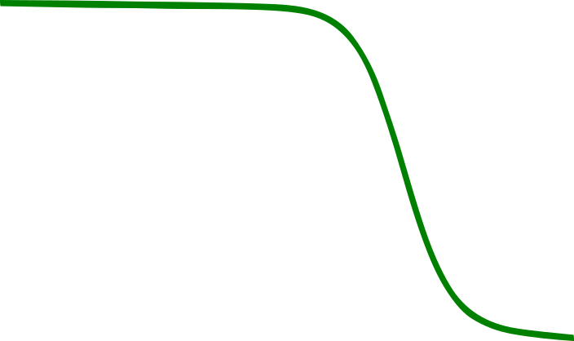




The basic picture of fueling in the edge
Sources
Gas puffs and intrinsic recycling
Important processes:
Ionization
Charge exchange
Recombination / dissociation
Asymmetric – poloidally / toroidally
Core
Edge
SOL / Divertor
$$n_{e}$$
$$D_{eff}$$
wall
Transport
$$S_{ion}$$
Must balance sources
Without knowledge of source, cannot know transport
Pinch likely important
$$ψ_{n}$$
M. A. Miller / PSD-DCT Meeting / 29.04.26

Slide 26

The basic picture of fueling
Sources
Gas puffs and intrinsic recycling
Important processes:
Ionization
Charge exchange
Recombination / dissociation
Asymmetric – poloidally / toroidally
Core
Edge
SOL / Divertor
$$n_{e}?$$
$$D_{eff}$$
wall
Transport
$$S_{ion}$$
Must balance sources
Without knowledge of source, cannot know transport
Pinch likely important
$$ψ_{n}$$
M. A. Miller / PSD-DCT Meeting / 29.04.26

Slide 27
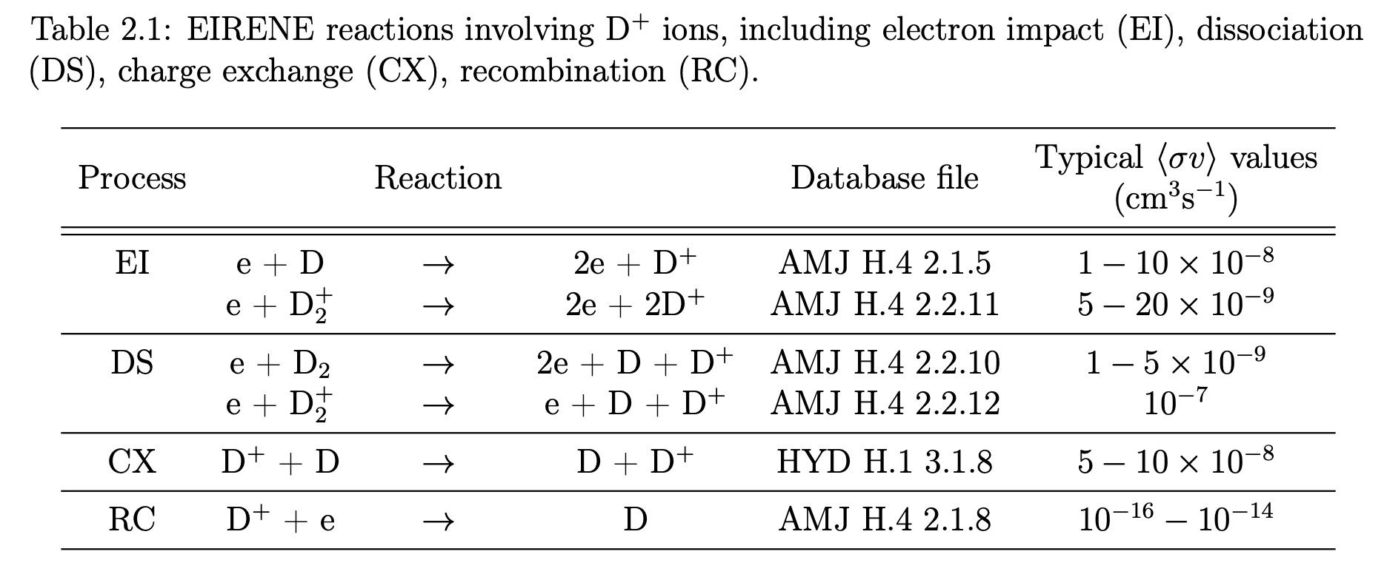
Typical cross-section values for key SOLPS-ITER neutral reactions
M. A. Miller / PSD-DCT Meeting / 29.04.26

Slide 28
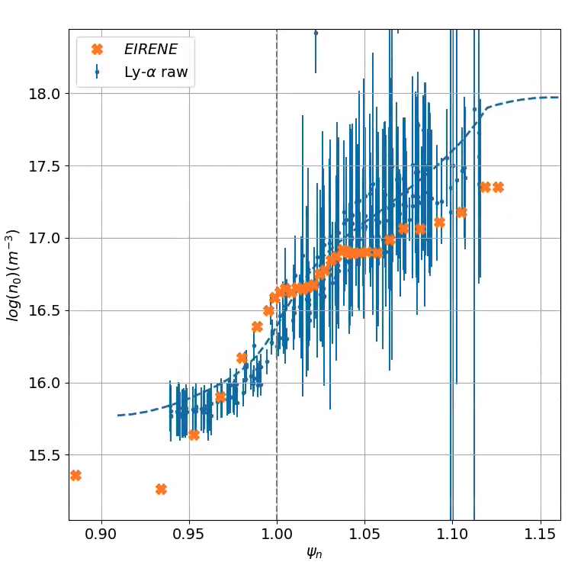
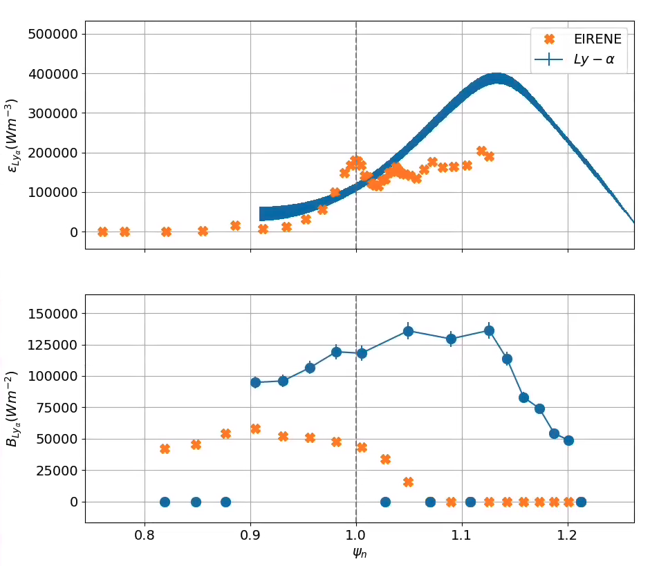



Synthetic diagnostic shows promise for agreement
$$ε_{Ly−α}$$
$$n_{0}$$
$$B_{Ly−α}$$
M. A. Miller / MFE IM / Sep. 20, 2023
M. A. Miller / PSD-DCT Meeting / 29.04.26

Slide 29
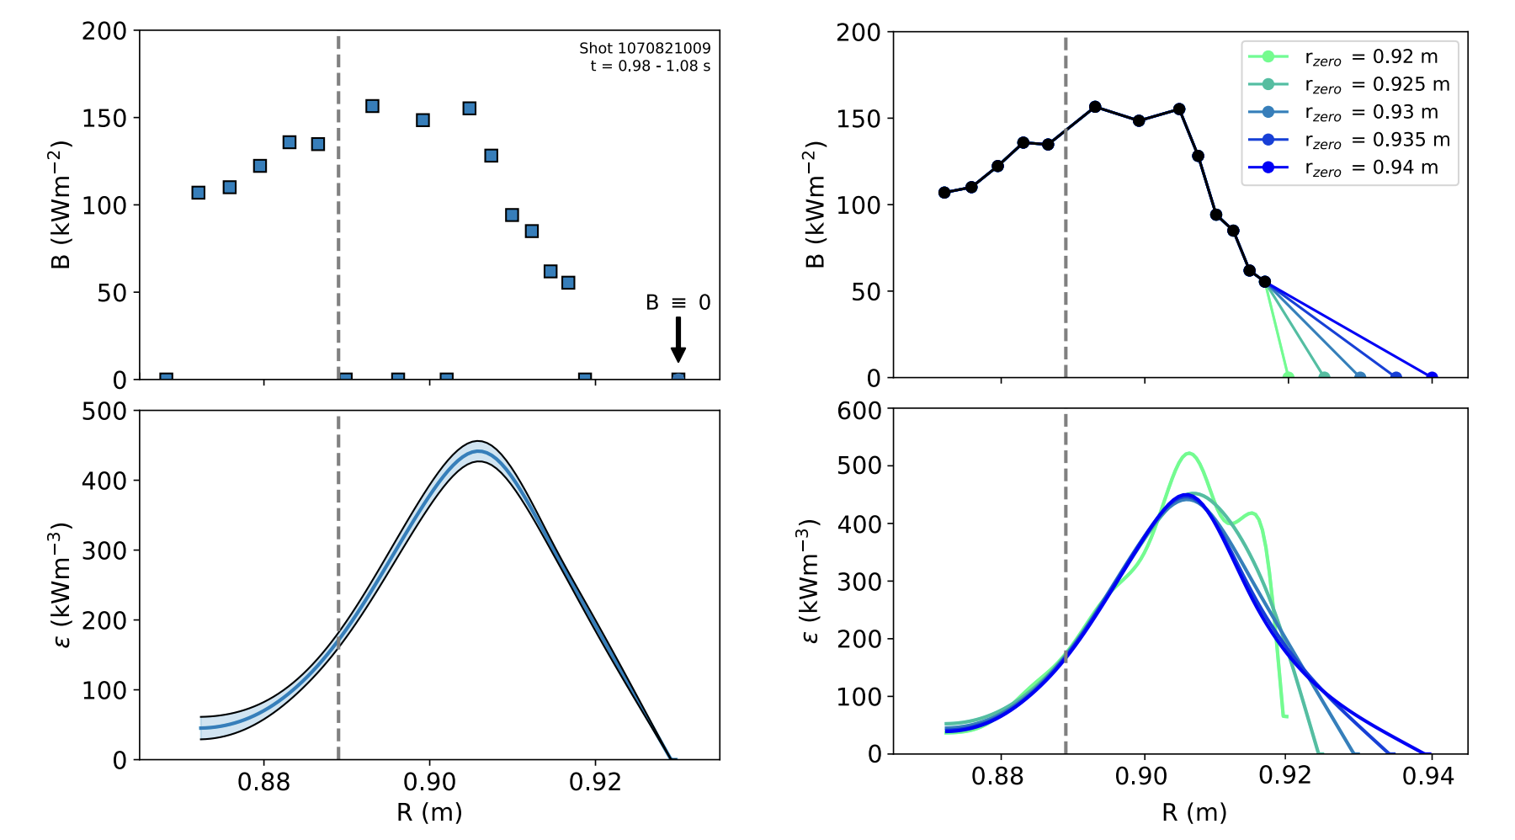
Sensitivity of inversion to position of the zero
M. A. Miller / PSD-DCT Meeting / 29.04.26

Slide 30
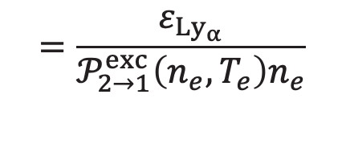








Measurements of plasma and neutral emissivity allows inference of ionization and particle flux profiles
$$\frac{∂n}{∂t}+∇⋅\vec{Γ}=S_{ion}$$
$$=\frac{ε_{Ly_{α}}}{𝒫_{2→1}^{exc}\left(n_{e},T_{e}\right)n_{e}}$$
$$=Γ_{i,r}=\int_{0}^{r}{S_{ion}}\left(r^{′}\right)dr′$$
$$n_{0}$$
$$Γ_{D}$$
$$=\frac{Γ_{D}}{−∇n_{e}}$$
$$S_{ion}$$
$$=S\left(n_{e},T_{e}\right)n_{0}n_{e}$$
$$D_{eff}$$
Procedure used for computation of fluxes and transport through the edge at outer midplane
M. A. Miller / PSD-DCT Meeting / 29.04.26

Slide 31





SOLPS-ITER useful for testing transport and studying poloidal variation
SOLPS-ITER
Enables 2D calculation of neutral flux as a check on 1D inference
Couples B2.5, plasma fluid solver with EIRENE, kinetic neutral solver
outer loop
inner loop
Transport coefficients
SOL boundary conditions
$$D$$
$$χ_{i,e}$$
$$α_{n}$$
$$α_{T_{i,e}}$$
$$n_{e}, T_{e}$$
$$n_{0}$$
M. A. Miller / PSD-DCT Meeting / 29.04.26

Slide 32



SOLPS-ITER useful for testing transport and studying poloidal variation
SOLPS-ITER
Couples B2.5, plasma fluid solver with EIRENE, kinetic neutral solver
Run interpretively on selected discharges using experimental constraints
$$n_{e} (m^{−3})$$
Plasma (B2.5) – no drifts
Solution constrained by $n_{e}$, $T_{e}$ from TS
Vary transport coefficients $(D, χ_{e,i})$ iteratively
$$D (m^{2}s^{−1})$$
M. A. Miller / PSD-DCT Meeting / 29.04.26

Slide 33



SOLPS-ITER useful for testing transport and studying poloidal variation
SOLPS-ITER
Couples B2.5, plasma fluid solver with EIRENE, kinetic neutral solver
Run interpretively on selected discharges using experimental constraints
Plasma (B2.5) – no drifts
Solution constrained by $n_{e}$, $T_{e}$ from TS
Vary transport coefficients $(D, χ_{e,i})$ iteratively
$$n_{0} (m^{−3})$$
Neutrals (EIRENE)
Solution constrained by $n_{0}$ from $Ly_{α}$ camera
Vary SOL boundary conditions $(α_{n}, α_{T_{e,i}})$to match ${L_{n}}_{0}$ in pedestal
Constraining $n_{0}$ in pedestal makes $D_{ped}$ unique
M. A. Miller / PSD-DCT Meeting / 29.04.26

Slide 34






SOLPS-ITER useful for testing transport and studying poloidal variation
B2.5: 2D multi-fluid plasma transport solver
EIRENE: 3D multi-species kinetic neutral Monte Carlo solver
Transport coefficients chosen to reproduce experimental plasma profiles
$$α_{T_{e,i} }$$
$$α_{n }$$
$$D^{new}=−\frac{Γ^{SOLPS}}{∇n^{exp}}$$
Neutral profile tailoring via modification of SOL flux boundary conditions, $α_{n}, α_{T_{e,i}}$
M. A. Miller / PSD-DCT Meeting / 29.04.26

Slide 35







SOLPS-ITER useful for testing transport and studying poloidal variation
outer loop
inner loop
Transport coefficients
SOL boundary conditions
$$D$$
$$χ_{i,e}$$
$$α_{n}$$
$$α_{T_{i,e}}$$
$$n_{e}, T_{e}$$
$$n_{0}$$
M. A. Miller / PSD-DCT Meeting / 29.04.26

Slide 36
SOLPS-ITER useful for testing transport and studying poloidal variation
outer loop
inner loop
Transport coefficients
SOL boundary conditions
$$D$$
$$χ_{i,e}$$
$$α_{n}$$
$$α_{T_{i,e}}$$
$$n_{e}, T_{e}$$
$$n_{0}$$
M. A. Miller / PSD-DCT Meeting / 29.04.26

