Slide 1
Tangential phase-contrast imaging diagnostic for JT-60SA
S. Coda¹ , K. Tanaka² , M. Noël¹
¹EPFL-SPC, ²NIFS WPSA Enhancements Monitoring meeting, 20.4.2026

Slide 2
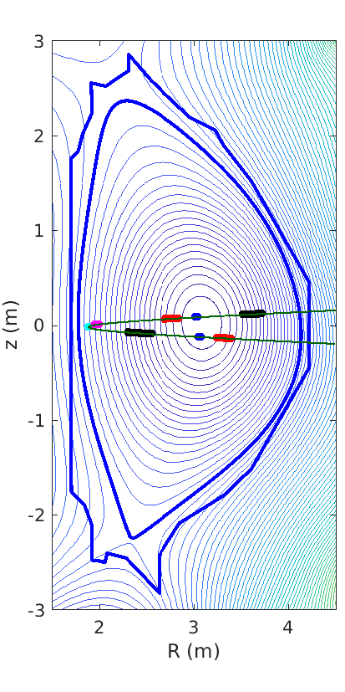
Phase-contrast imaging on JT-60SA
CO₂-laser based transmission diagnostic
Will provide localized density fluctuation measurements across the minor radius and in all plasma regimes
δn/n~10⁻⁵, 0.06<kρ_{i}<12 (ITG/TEM/ETG)
high spatial resolution in the center and at the edge (very favorable configuration on JT-60SA)
Europe/NIFS collaboration and cost split
S. Coda et al, Nucl. Fusion 61, 106022 (2021), DOI:10.1088/1741-4326/ac2081

Slide 3
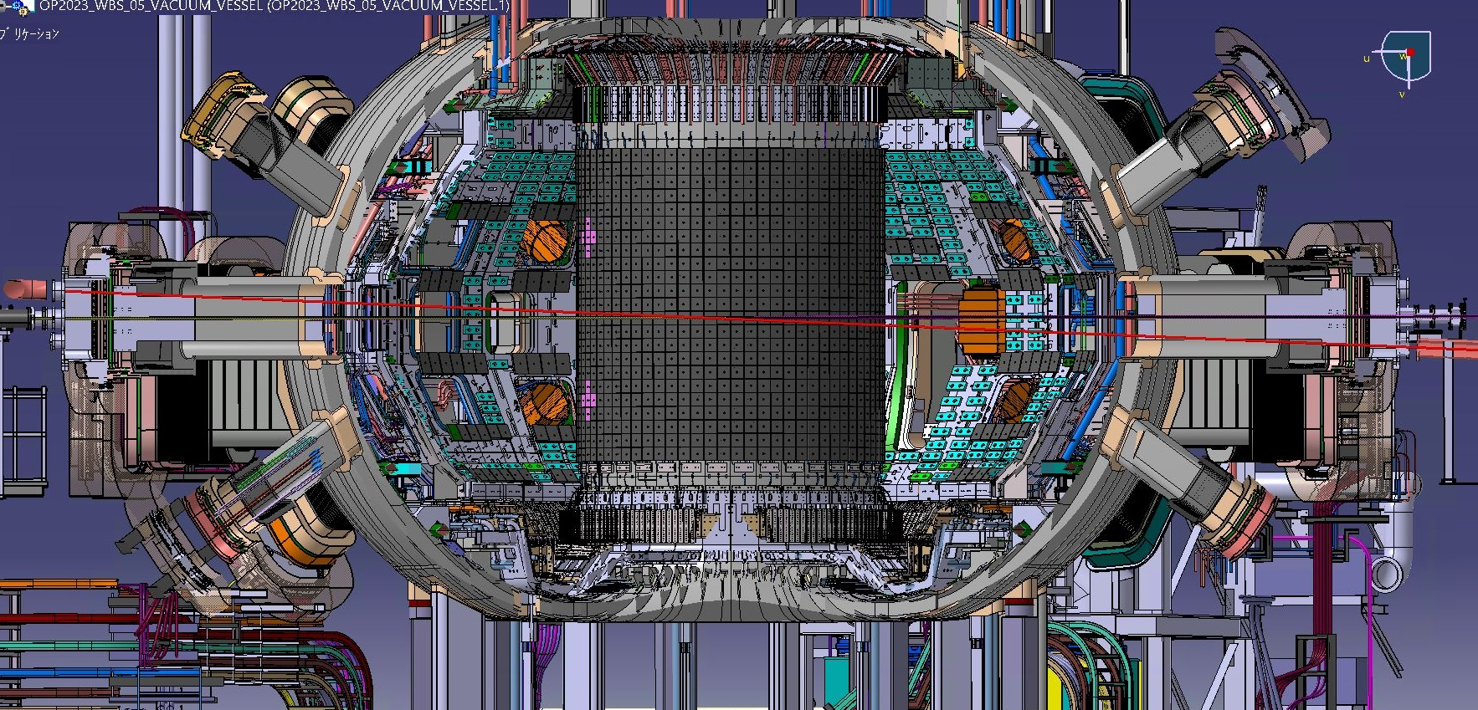
Optical-path design
P01H
CO2
PCI
CO2
YAG
P08H
PCI
P01H
CO2
YAG
PCI
YAG
P08H
3

Slide 4
Current status and planning
Procurement Agreement signed last year.
Procurements are ongoing on the NIFS side (LN2 filling station, radiation shielding) and on the European side (combined supports for TS and TPCI beam tubes).
The optics and optical supports from the laser room to a point before the beam expander (before entering the torus) are to be installed in ME1. The rest in ME2.
Mechanical and optical design for ME1, including a complete Installation Procedure, to be finished by May 2026. All procurements and manufacturing to follow quickly.
QST is organizing installation with subcontractor.
The ME2 component design is also at a mature stage.

Slide 5
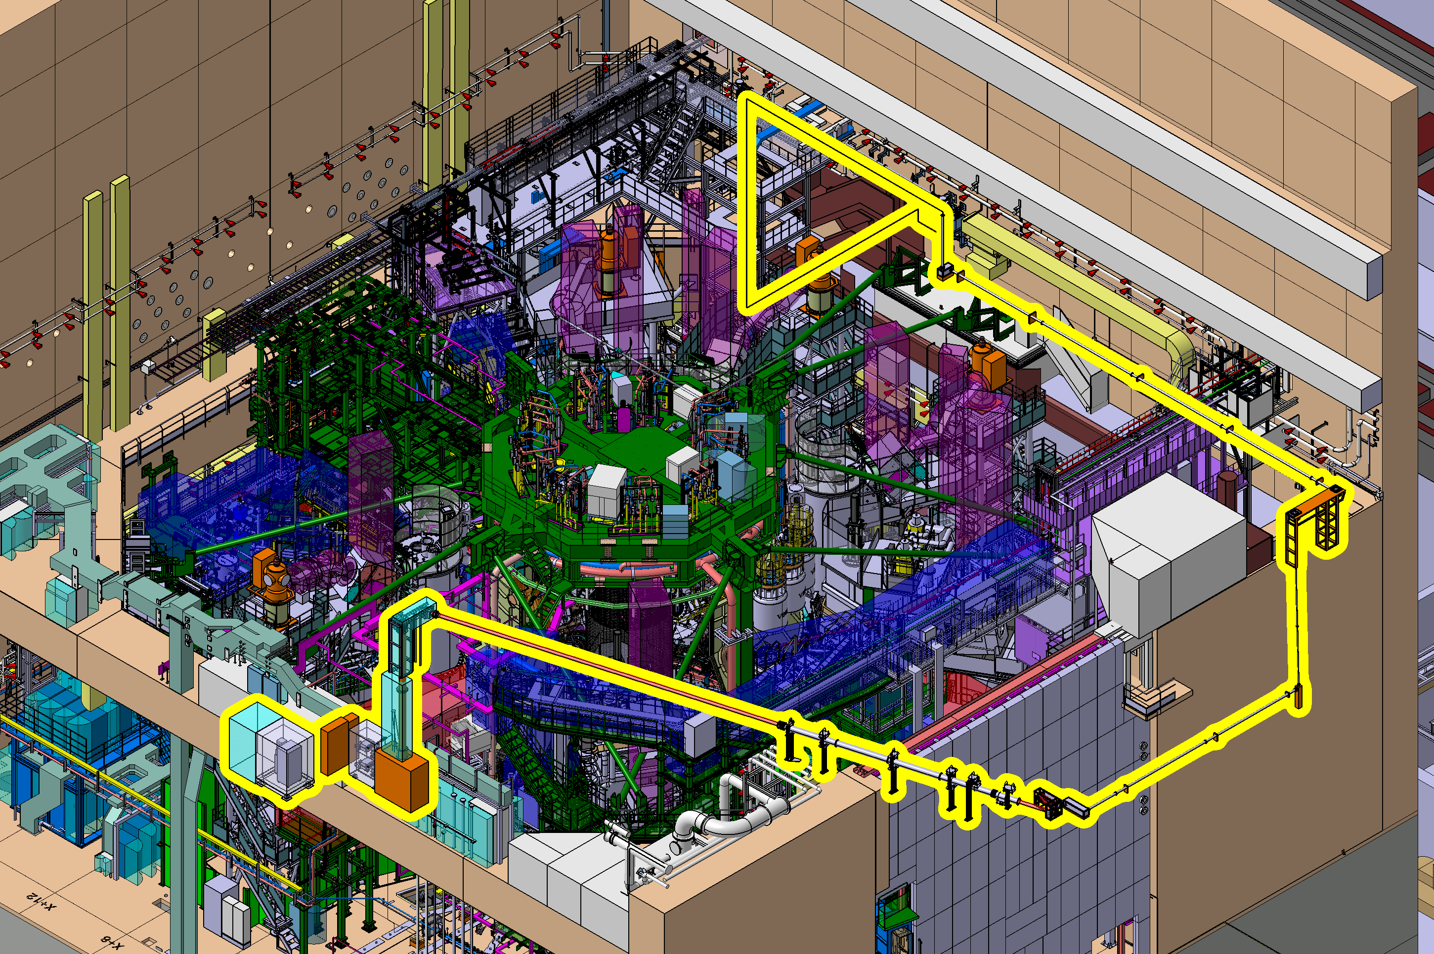
Optical path layout

Slide 6
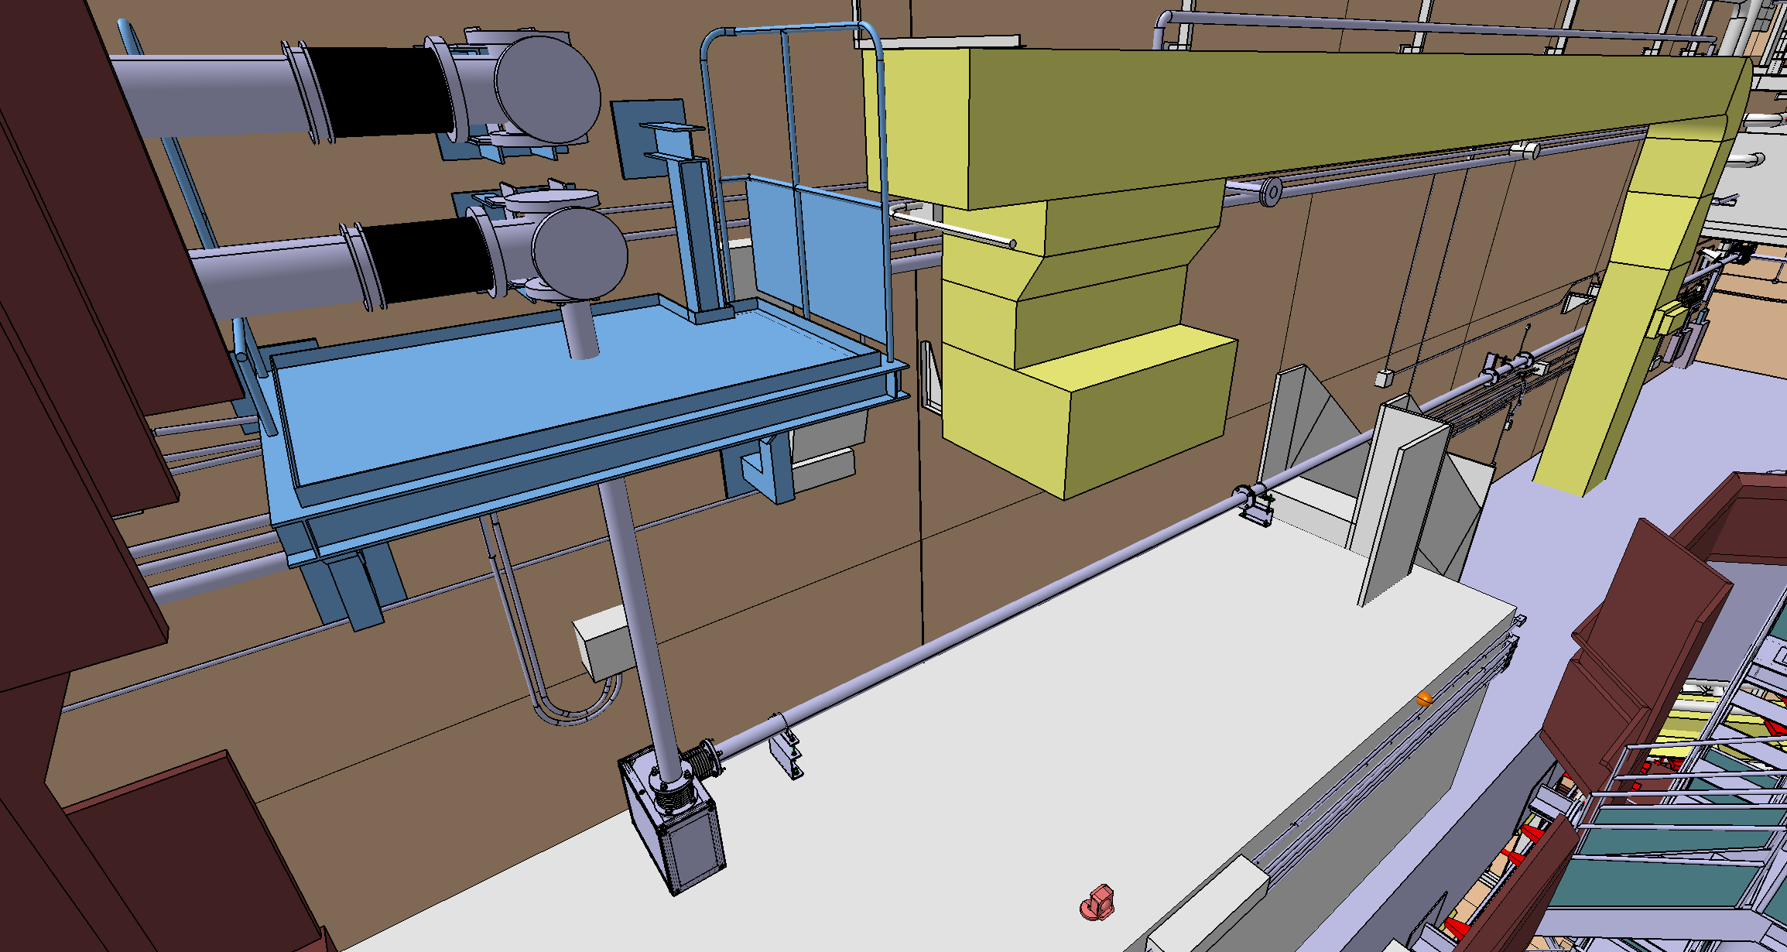
Beam trajectory: mirror supports

Slide 7
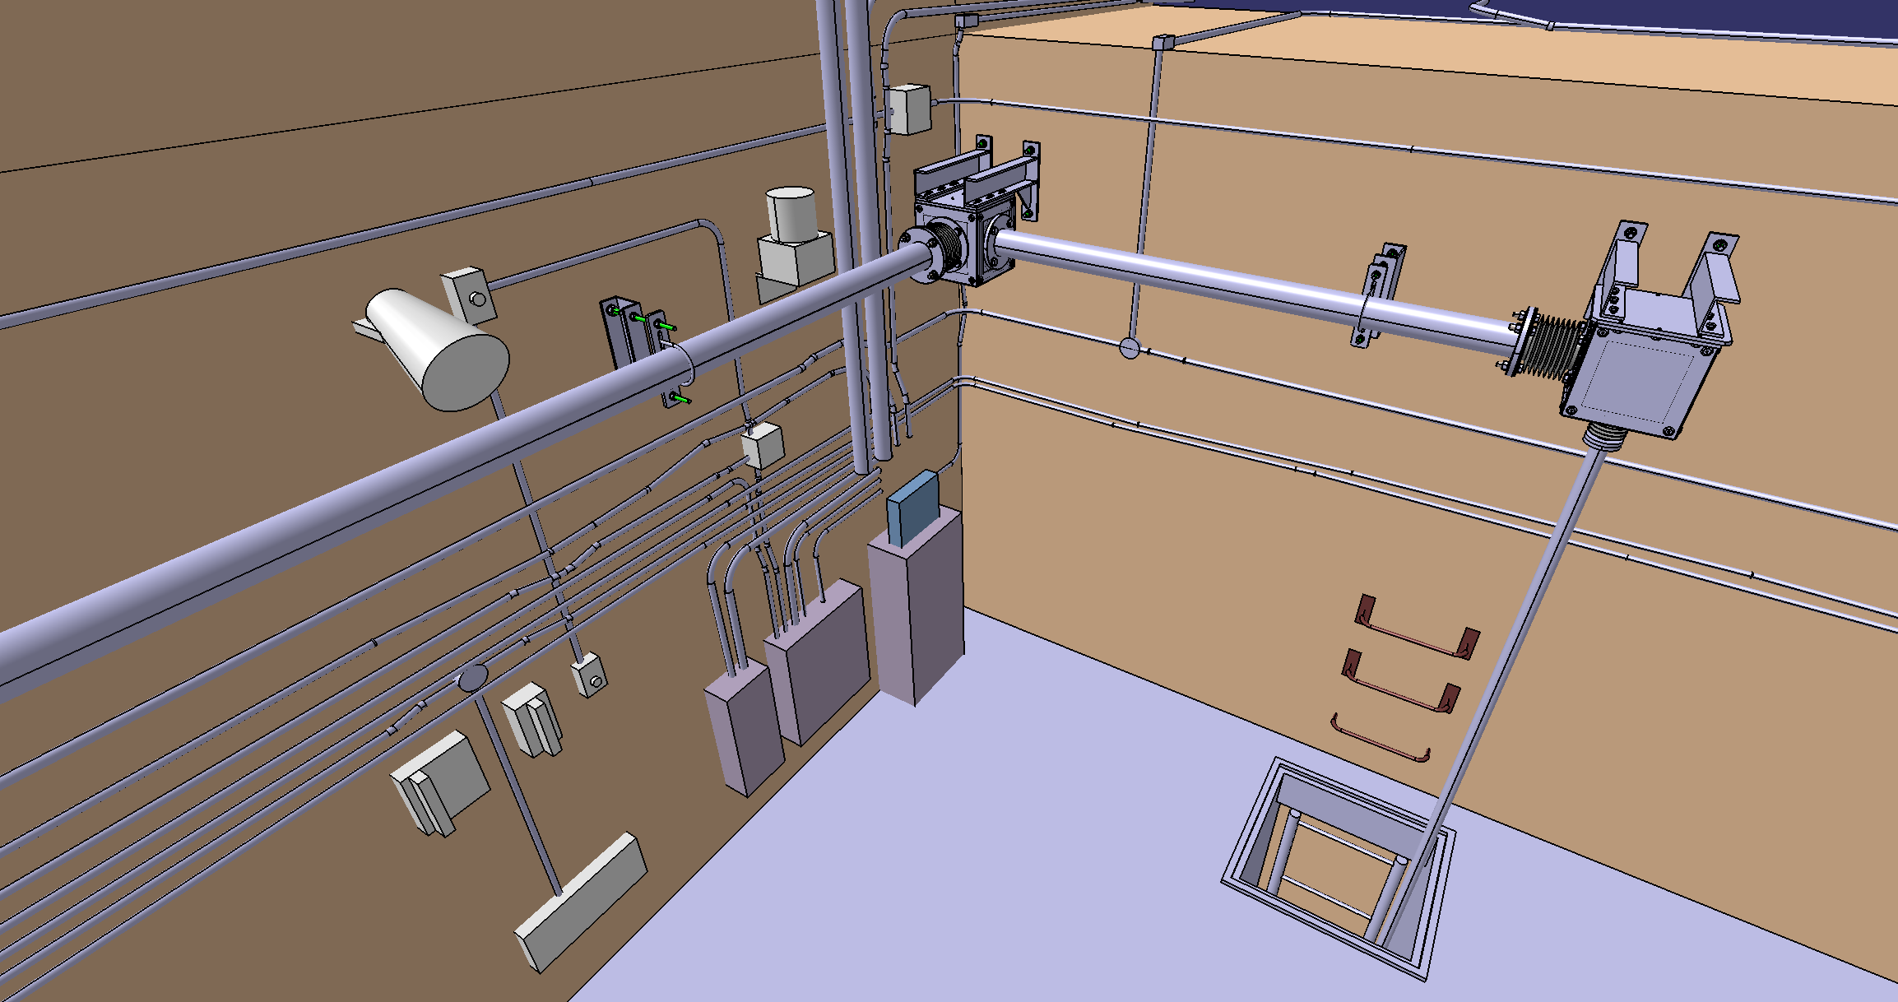
Beam trajectory: mirror supports

Slide 8
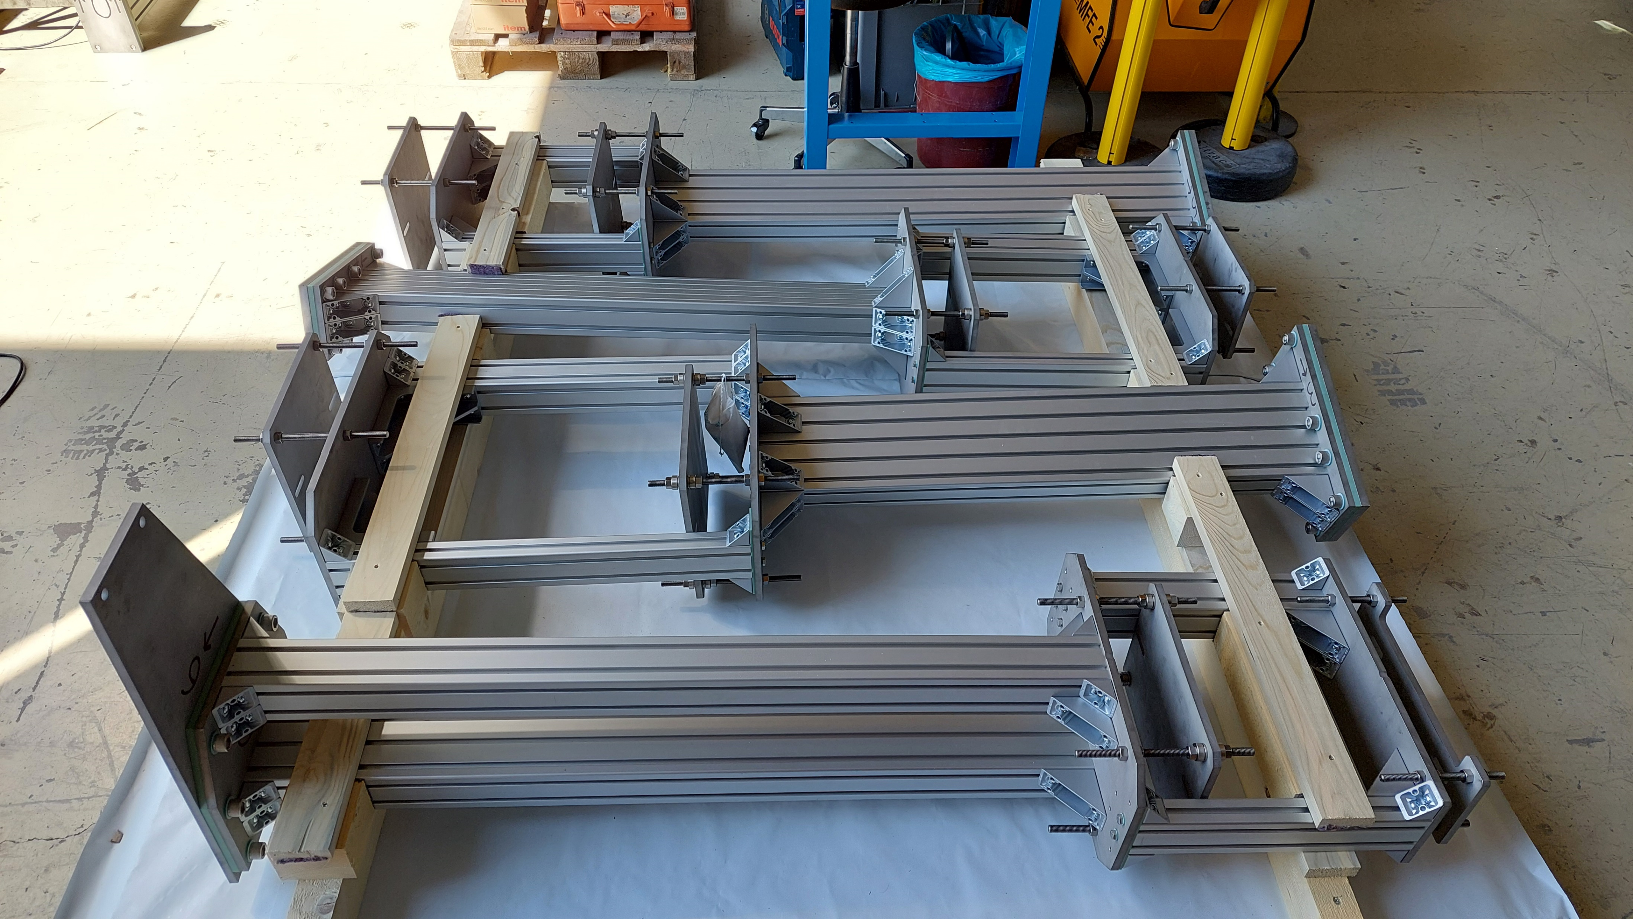
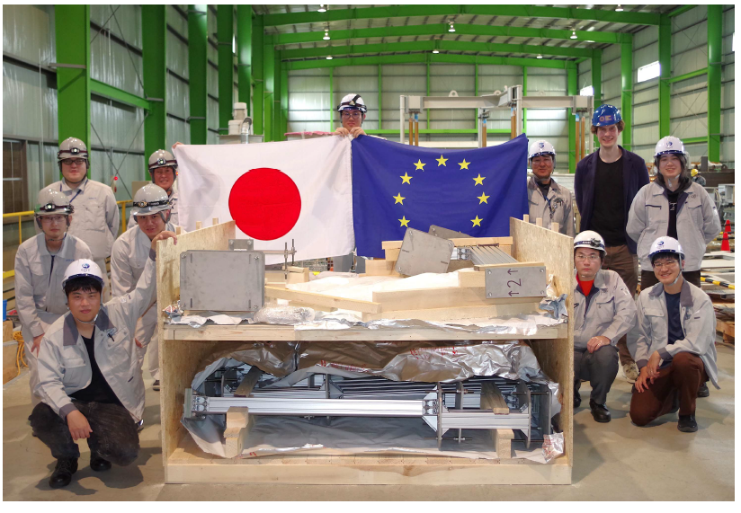
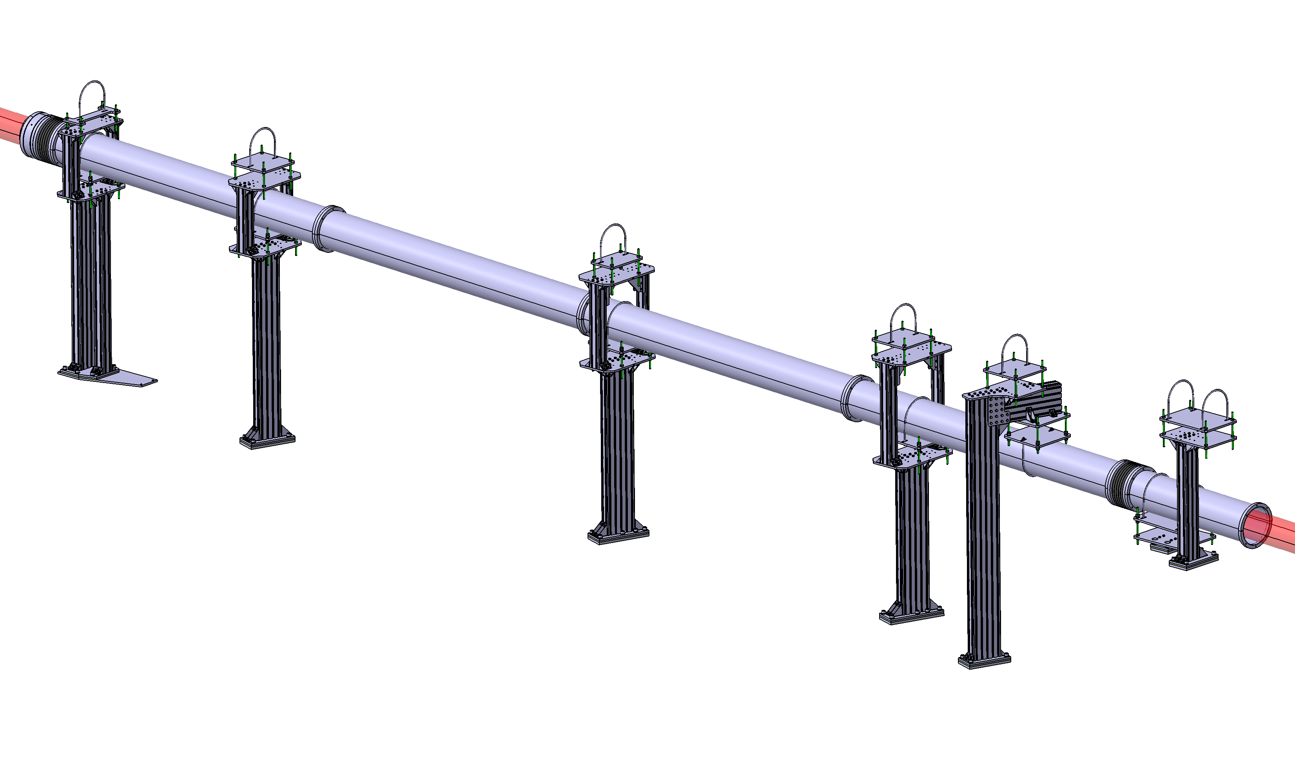
Delivery of supports for TPCI + TS tubes

Slide 9
Calendar for 2026 and 2027
ME1 component design and installation procedure to be finished in May 2026.
Procurements and fabrication can follow if the F4E-EPFL contract is signed (the process has been underway for some time).
Installation of ME1 components planned for September-November 2026.
The ME2 component design and detailed optical design, with finalized installation procedure, is expected for September 2026.
The full installation of the system is planned for ME2.

Slide 10
Outstanding needs
The physics personnel is highly insufficient. A postdoc has been advocated and requested for a number of years, but there is no mechanism in place yet to hire one. The F4E-EPFL contract should include a service provision for a postdoc.
The timeline indicated earlier cannot be met without this postdoc.

Slide 11
additional slides

Slide 12
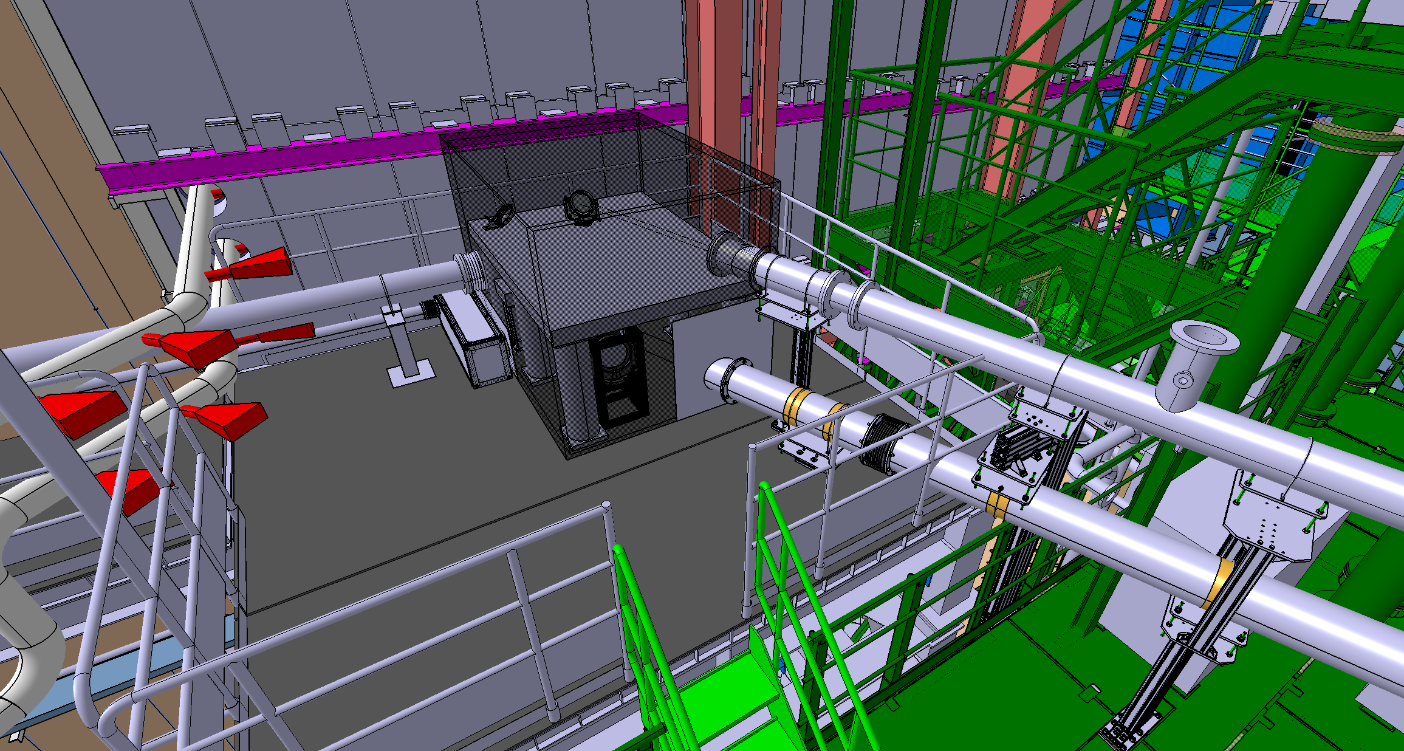
Beam expander under optical table

Slide 13
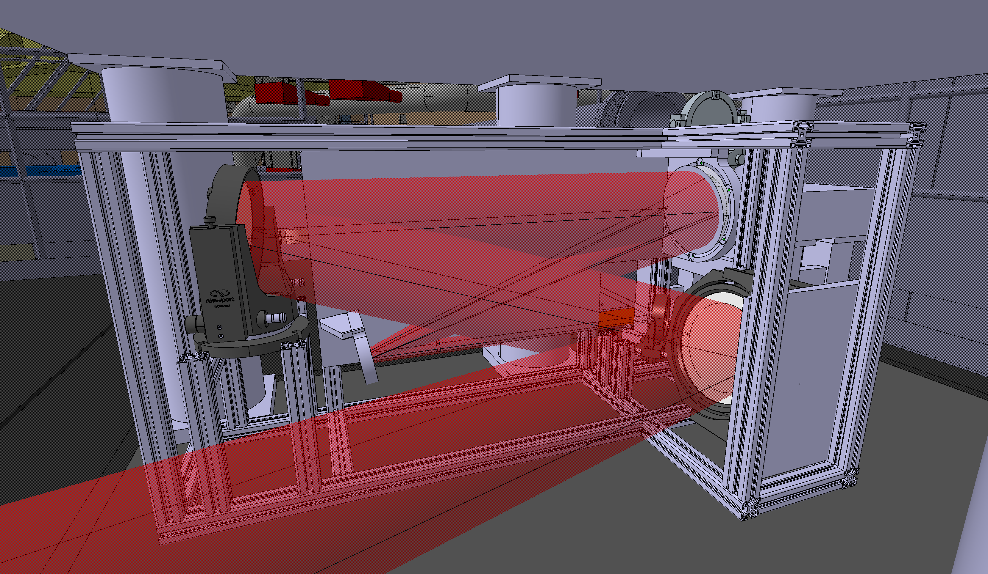
Beam expander under optical table

Slide 14
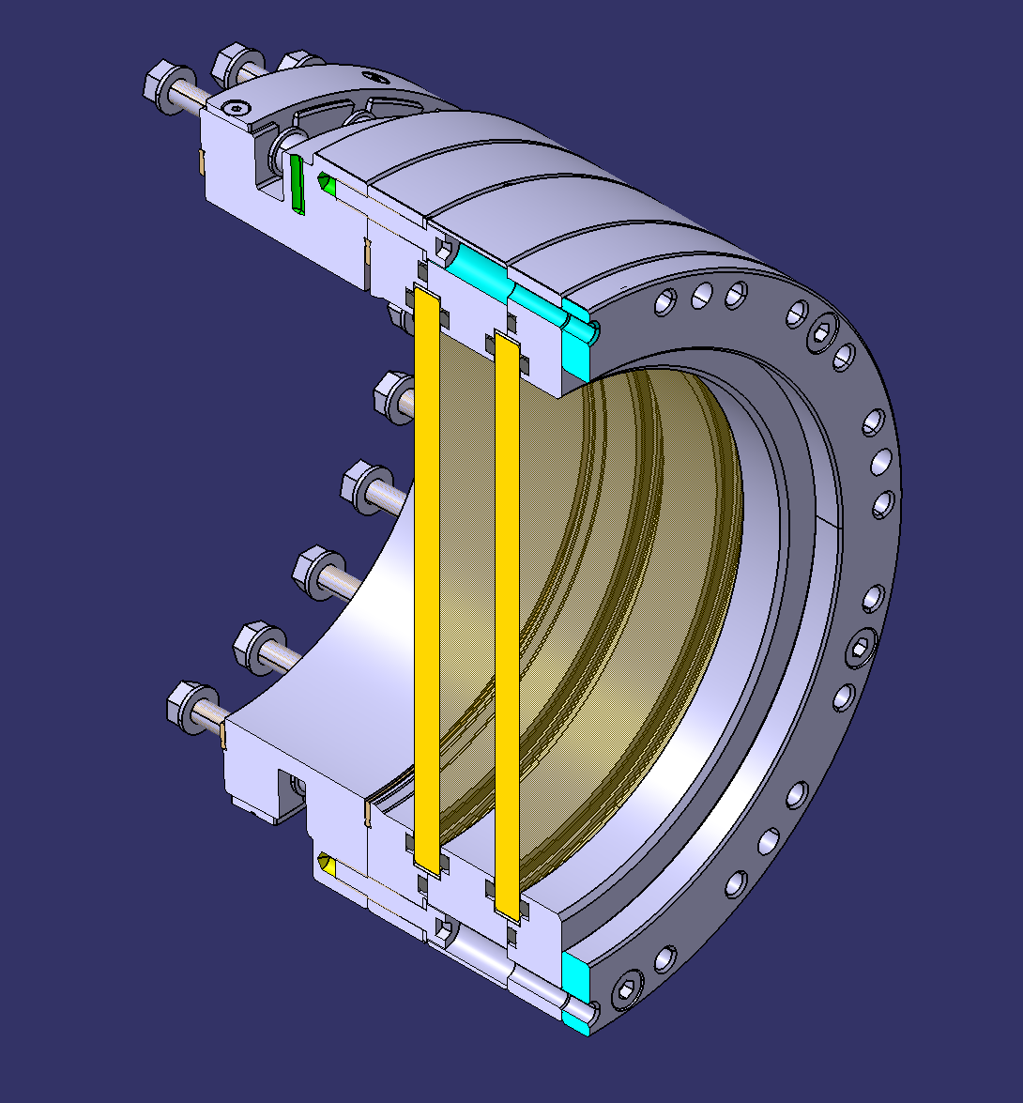
Entry window assembly

Slide 15
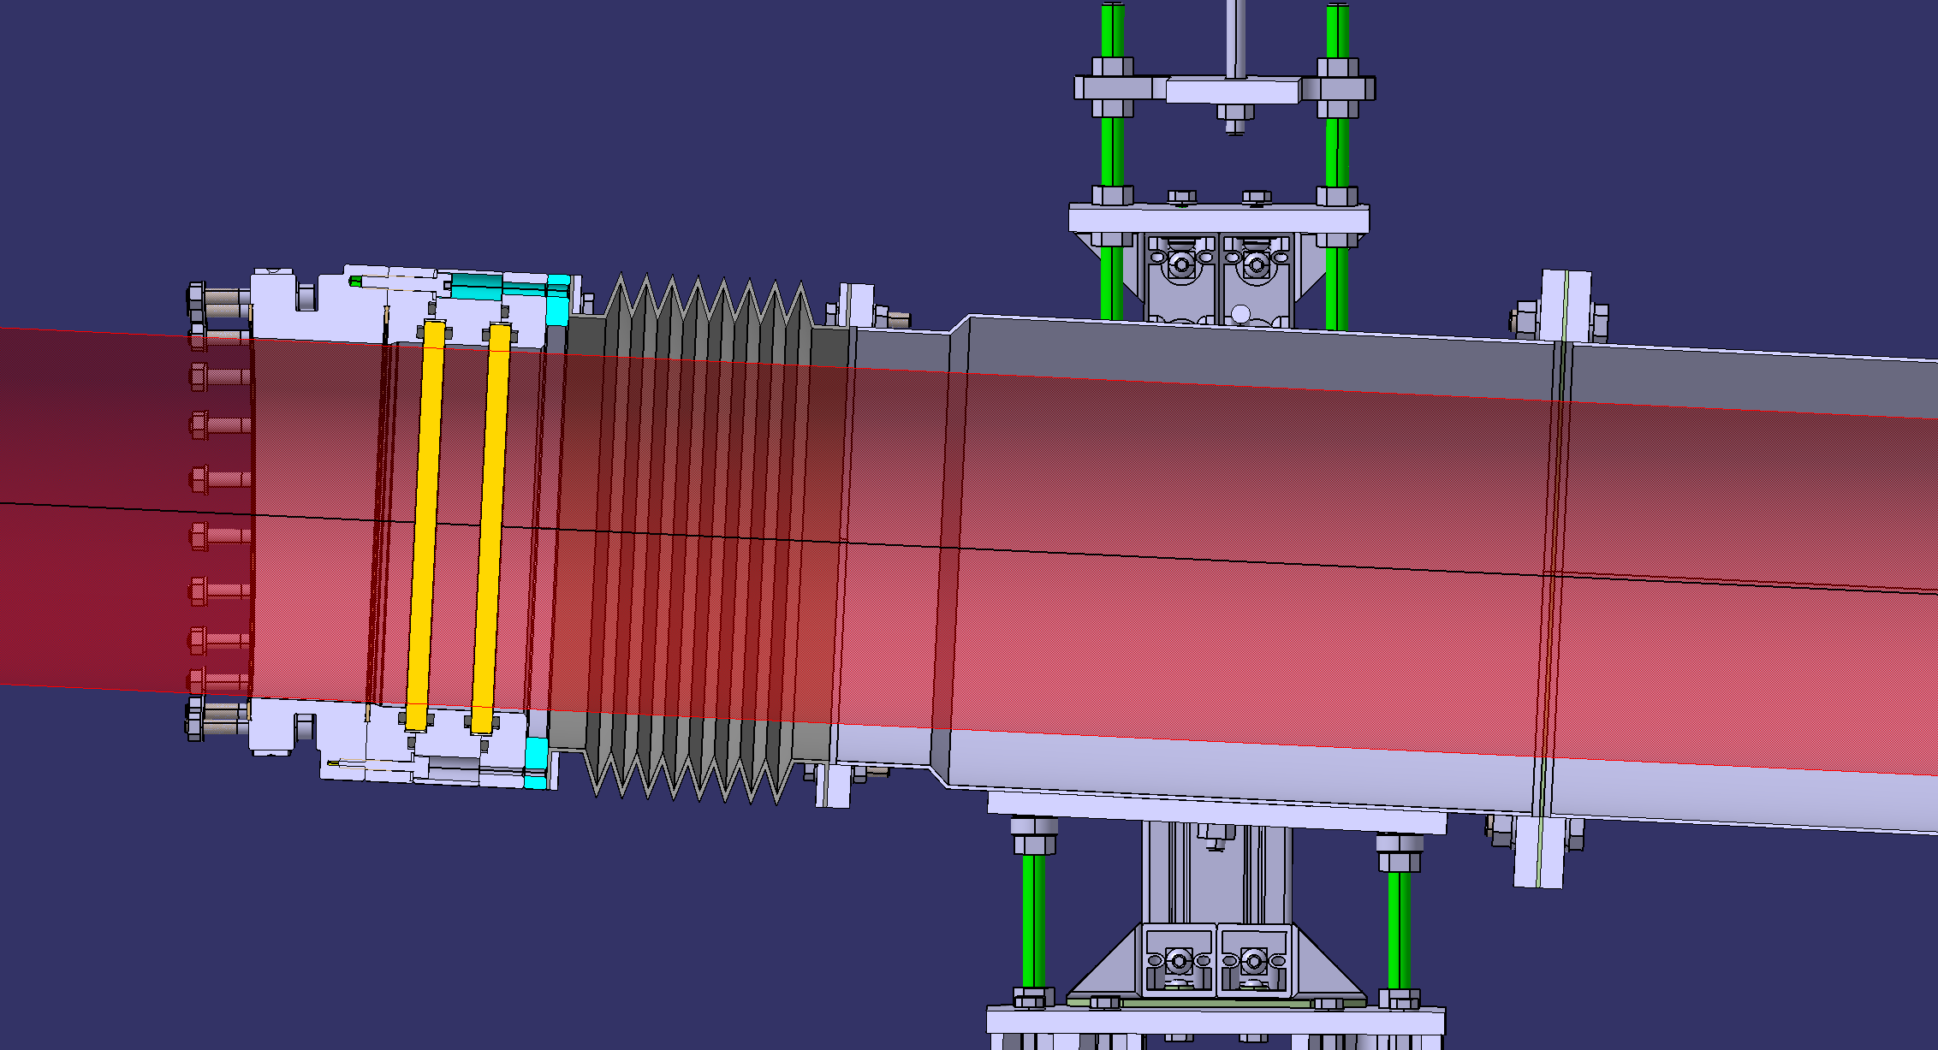
Entry window assembly

