Slide 1

Progress of the Directional Electron Probe design for JT60-SA
20.04.2026 I Yunfeng LIANG, Jiankun Hua, Liang Liao, Alexander Knieps, Kaixuan Ye, Dirk Nicolai, Daniel Höschen, Shaocheng Liu and FZJ team

Slide 2
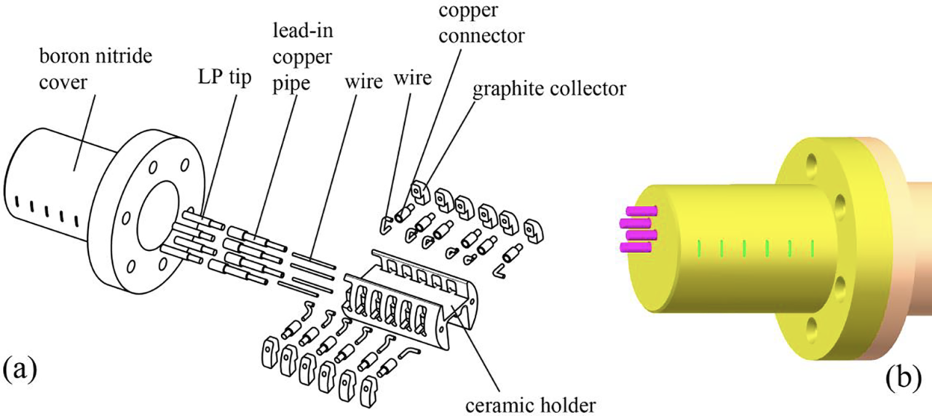
Progress of the Directional Electron Probe design for JT60-SA
20.04.2026 I Yunfeng LIANG, Jiankun Hua, Liang Liao, Alexander Knieps, Kaixuan Ye, Dirk Nicolai, Daniel Höschen, Shaocheng Liu.
Current status
Design (Base on experiments from some devices)
apply a bias voltage to collectors
Input parameters
Limits of probe weight and size
The number of data collection channels and power supplies
SOL parameters
Sketch of DEP. (a) Exploded drawing; (b) side view
SOL plasma parameters and parallel current
Have been used in W7-X, EAST and J-TEXT

Slide 3
Workplan & Timeline
During the 2026 and 2027 campaigns on JT-60SA, probe measurements will not be feasible. At present, the work is therefore limited to the design stage.
The preliminary design of the probe has been completed. Further optimization can be made according to future requirements. (Easy to modify)
Typically, the full process from component fabrication to final assembly can be completed within about half year.
A manipulator (probe insertion system) for the fast-ion probe will be designed and installed in the future.
If feasible, the DEP can be mounted on the same manipulator, so that related experiments can also be performed in future.

