Slide 1

WPSA: Support WPSA and F4E in neutronics assessments for systems and enhancements radiation shielding
Title: 2026 simulation/CAD works for neutronics assessments
WPSA Kick-off Meeting, 20 April 2026
B. Bienkowska, S. Akbas and F4E team
Institute of Plasma Physics and Laser Microfusion (IPPLM)

Slide 2
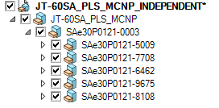
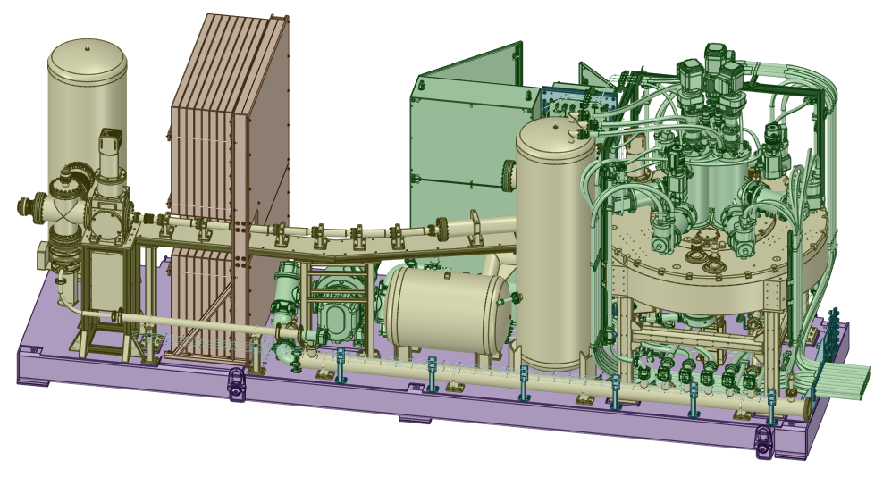
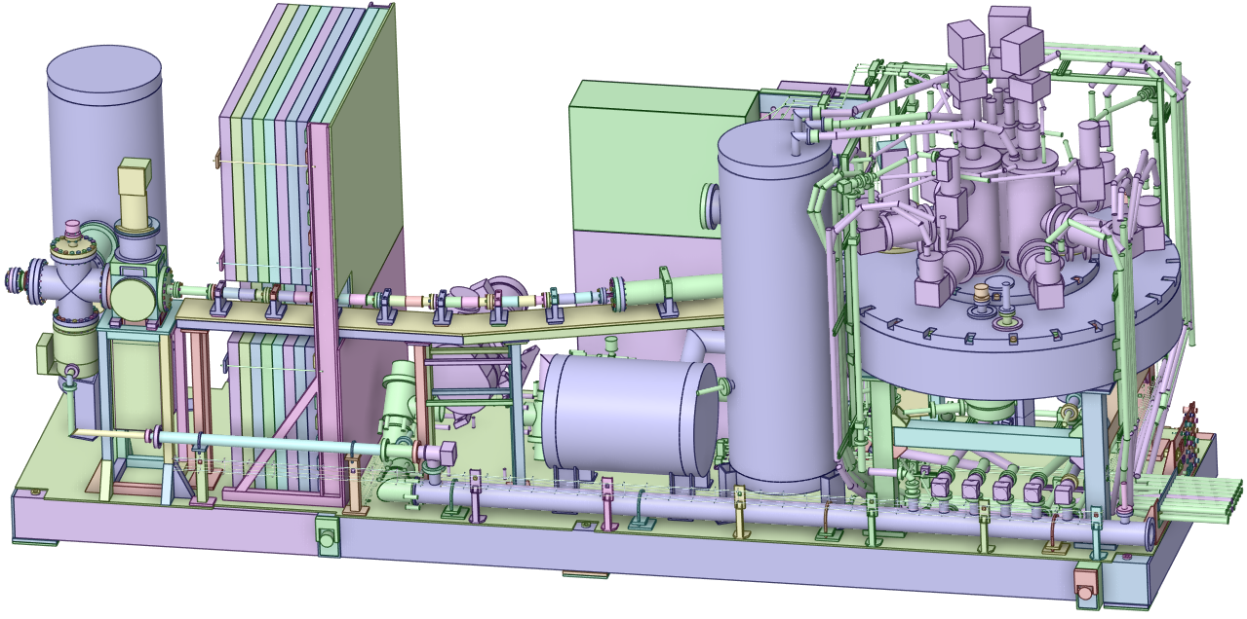
status of the JT-60SA Pellet Launching System (PLS)
Original PLS CAD model
Simplified PLS CAD model
total solids number= 7633
original volume=2115334.75cm3
total solids number= 2230
simplified volume=2124050.74 cm3 (<1 % volume deviation)
Simplification process is completed (rounds, welds, chamfers, smaller screws, washers, splines and torus, etc.)
Due to the complexity, the CAD simplification is performed on every main component separately,
Conversion into MCNP is completed,
Lost Particle tests and material assignments are ongoing for full PLS MCNP model.

Slide 3
Code/technique/methodology
  Workflow of the conversion of the PLS CAD-to-MCNP model:
Original PLS CAD model
Simplification
-SpaceClaim
-RadModeling
GEOUNED
MCNP input
MCNP
MCNP volume ratio
Material
assignment
lost particle test
  For performing work under this task, the following tools are used:
  Run SpaceClaim to simplify the components in PLS CAD model,
  Run RadModeling scripts (developed by F4E) to support CAD pre-processing, model simplification and defeaturing, change tracking, volume consistency checks, and automatic assignment of volumes, materials, and densities to the MCNP model,
  Run GEOUNED to convert CAD model-to-MCNP input,
  Run MCNP6 simulation to stochastic volume calculations and lost particle tests.

Slide 4
Plan for 2026 and 2027
Define material composition for each component,
Continue to collaborate with F4E for preparing MCNP models of the system in JT-60SA
Participation in the neutronics workshop organized by F4E in November 2026 – can we apply for a mission in IMS?

Slide 5
References
  B. Bienkowska and S. Akbas – Simulation/CAD works for neutronics assessments 2025 (PLS), EFDA_D_2T2XET,
  B. Bienkowska and S. Akbas – Simulation/CAD works for neutronics assessments (TSS+VUV), EFDA_D_2RLUJU,
  B. Bienkowska and S. Akbas – CAD works and MCNP simulations for neutronics assessments (VUV), EFDA_D_2R8DTJ.
  M. Di Giacomo , A. Cubi, N. Hajnal, B. Bienkowska , S. Akbas , M. Cavinato , A. Kolsek, and M. Fabbri, „Simplification in 3-D Neutronics Analysis: Implication for Fusion Diagnostic Systems” in IEEE Transactions on Plasma Science, doi: 10.1109/TPS.2026.3680654
  S. Akbas, B. Bienkowska, A. Cubi, N. Hajnal, M. Cavinato, J. Ayllon-Guerola and C. Sozzi „Performance Evaluation of CAD-to-MCNP Conversion Tools in Complex Fusion Systems: A Case Study of VUV Diagnostics in JT-60SA” presented during the PLASMA2025 conference and submitted to PPFC

Slide 6
Thank you for your attention!

