Slide 1



Neutron Spectrum Reconstruction Studies - continuation
Katarzyna Mikszuta-Michalik
Kick-off Meeting for the WPSA Enhancements Area

Slide 2
Neutron Spectrum Reconstruction Studies
Purpose:
Investigation of the possibility of validating the MCNP model for JT-60SA by comparing simulated neutron spectra with experimental neutron activation measurements. While MCNP simulations can be validated by comparing experimental activity with FISPACT-II results, different neutron spectra may produce similar activation, making direct comparison insufficient. Neutron spectrum reconstruction offers a more detailed assessment of simulation–experiment agreement.
Preparation of the tools optimized for analysis on JT-60SA
Methods of reconstruction:
Tikhonov Regularization - TR,
Minimum Fisher Regularization - MFI,
Maximum Entropy - ME,
Maximum Likelihood – ML,
The average spectrum from various method

Slide 3
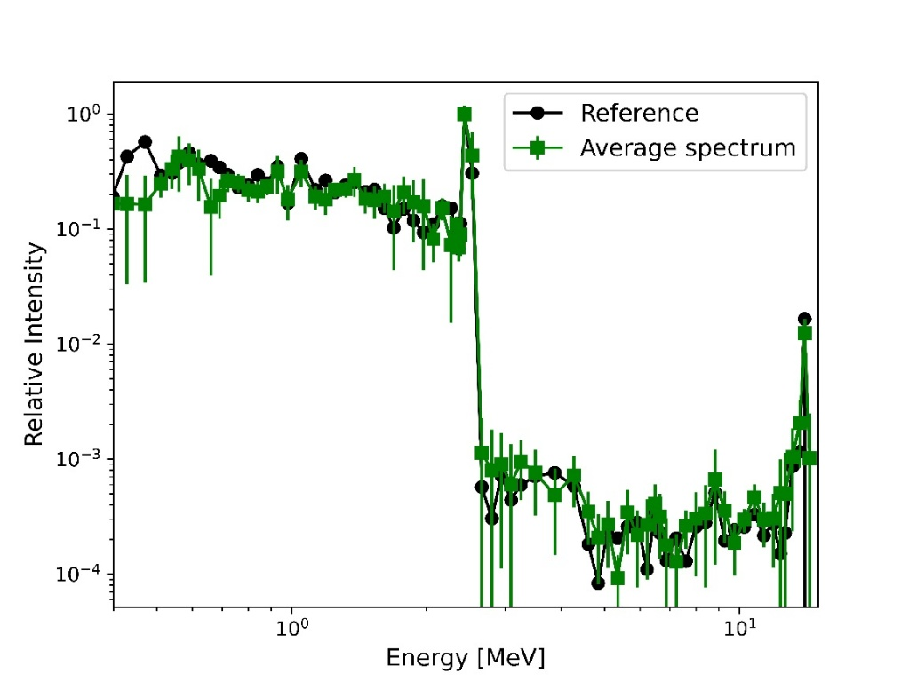
Preliminary analysis with MCNP spectrum done in 2025
Inputs provided by F4E:
Neutron spectrum at the P10 port of JT-60SA calculated using MCNP
Irradiation time: entire experimental campaign (simulation of continuous irradiation)
Foil | Reaction | Activity [Bq/g] | Uncertainty [%]
Al | Al-27(n,a) Na-24​ | 6.75E+02 | 9.44
Ti​ | Ti-48(n,p)Sc-48​ | 4.82E+01 | 8.21
Fe​ | Fe-56(n,p)Mn-56​ | 1.59E+03 | 8.00
Ni | Ni-58(n,2n)Ni-57​ | 1.37E+01 | 12.88
 | Ni-58(n,d)Co-57 | 2.39E+00 | 11.04
​Zn | Zn-64(n,2n)Zn-63 | 1.93E+03 | 11.16
In​ | In-115(n,n')In-115m​ | 8.39E+04 | 9.03
Co | Co-59(n,p)Fe-59​ | 1.95E+00 | 9.10
 | Co-59(n,2n)Co-58m​ | 1.66E+03 | 5.39
Nb​ | Nb-93(n,2n)Nb-92m​ | 4.44E+01 | 15.94
Errors | Average
2.43 MeV | 3%
14 MeV | 22%
High intensity part 0.4 - 2.5 MeV | 24%
Standard deviation | 20%
Full spectrum | 41%
Standard deviation | 44%

Slide 4
Neutron Spectrum Reconstruction Studies 2026
usage of the same neutron spectrum at P10 port of JT-60SA
consideration of the same foils set
Work plan:
1. Preparation of the tool that allows for including the irradiation sequence to the analysis (pulse duration + cooling time + pulse duration…)
2. FISPACT-II activity simulations
3. Deconvolution calculations with further optimization of the procedure
4. Analysis of the results uncertainty
Plan for 2027:
Neutron spectrum reconstruction studies with foils that will be actually used in the first experiment. Pre-experimental analysis for reconstruction parameters optimization.

