Slide 1

SA-EN.FE.11-T004-D003:
LEI support to neutronics activities 2026
Gediminas Stankunas, Andrius Tidikas, Benjaminas Togobickij
Lithuanian Energy Institute (LEI)

Slide 2
Outline
Task specification
Past experiance under WPENS, WPSAE and WPJET3

Slide 3
SA-EN.FE.11-T004-D003: LEI support to neutronics activities 2026
The activities include:
- Review and assessment of existing neutronics geometry models of JT-60SA.
- Analysis of previous work and studies performed in the framework of JT-60SA development.
- Participation in technical discussions and coordination activities with F4E and WPSA partners.
- General support to ongoing neutronics activities within WPSA.
- Contribution to further development or refinement of models and approaches, as required by project needs

Slide 4
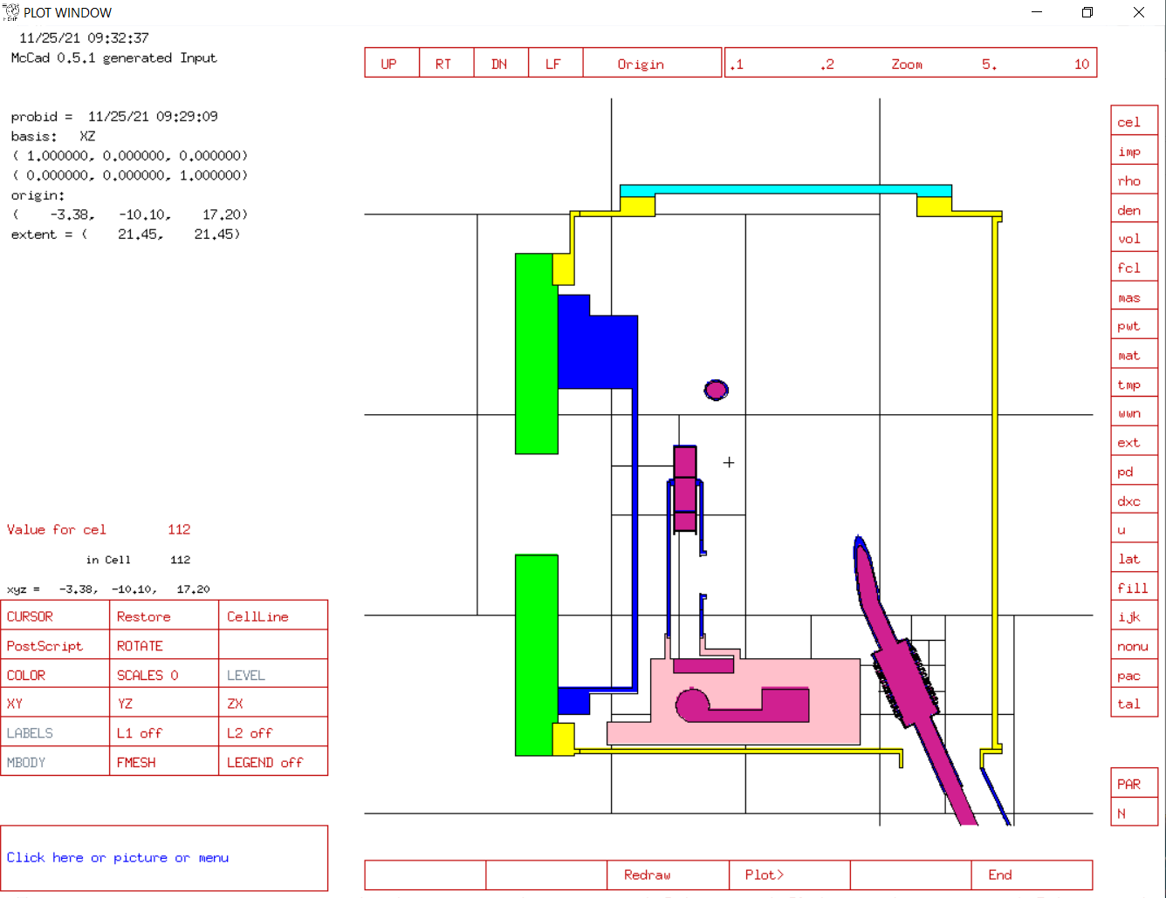
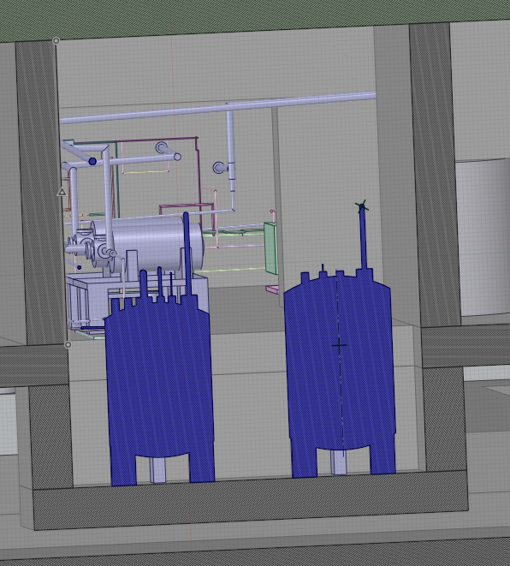
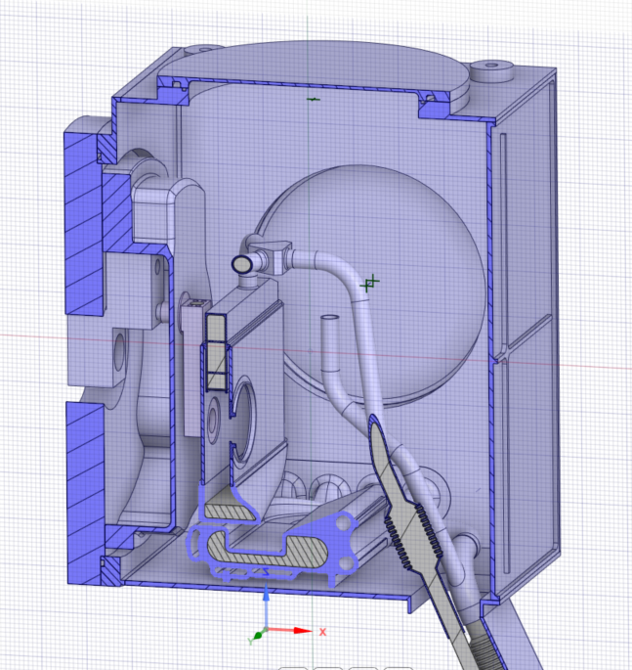
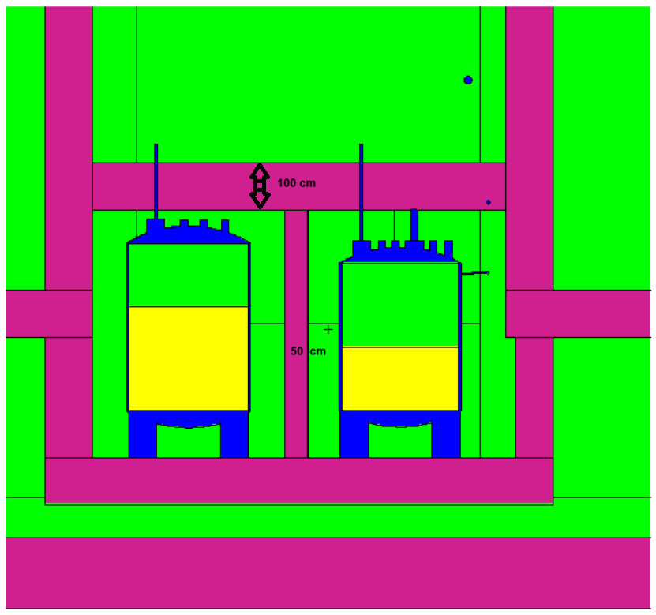
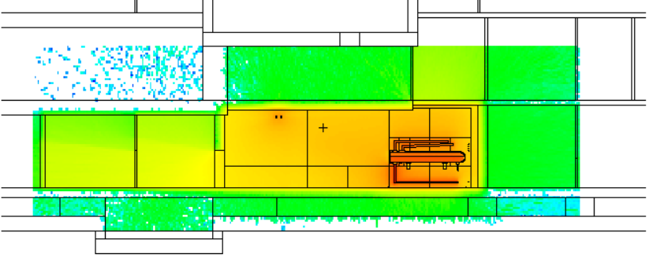
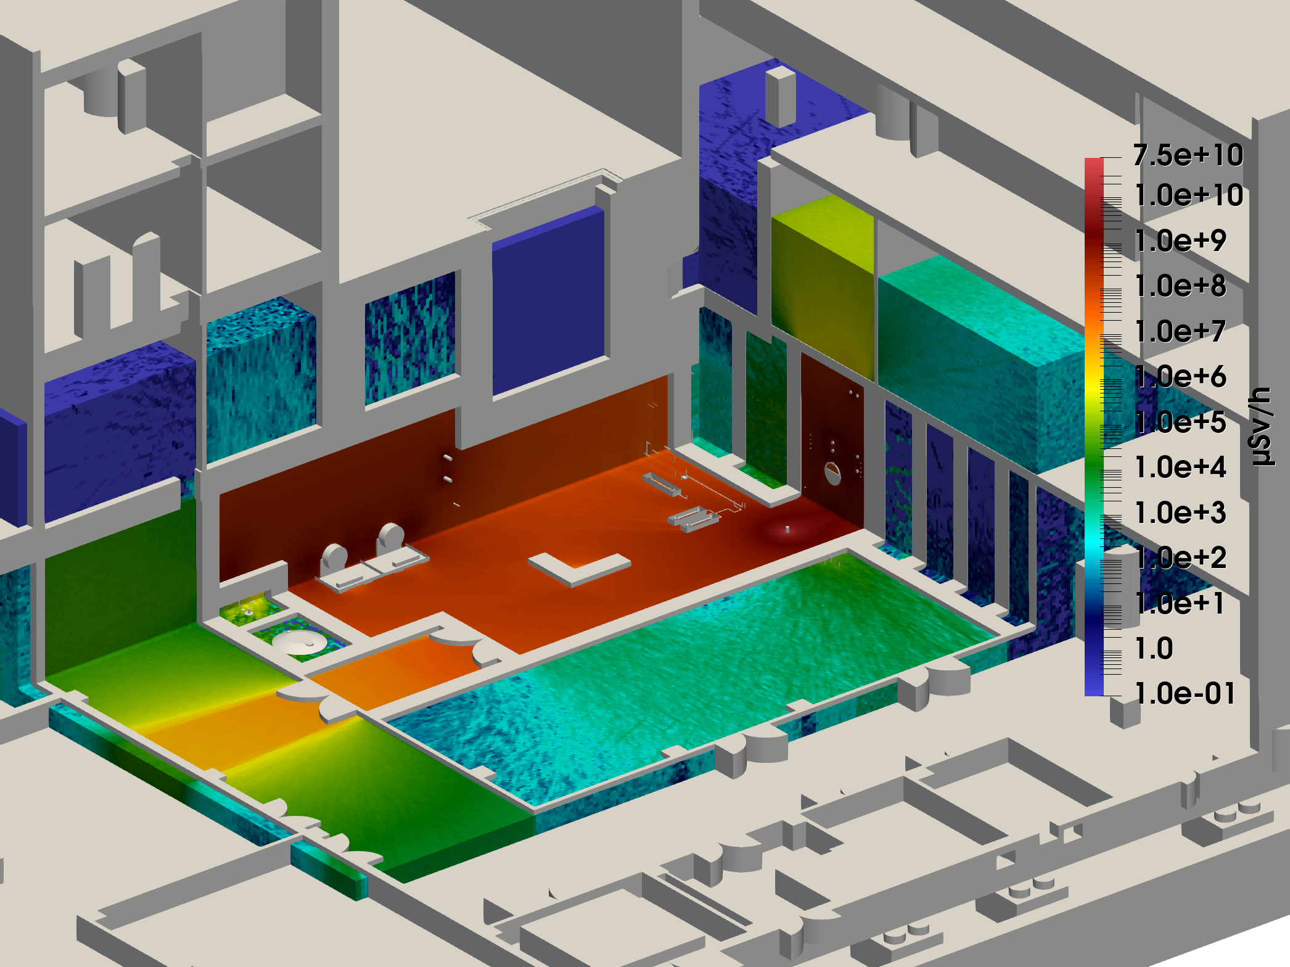
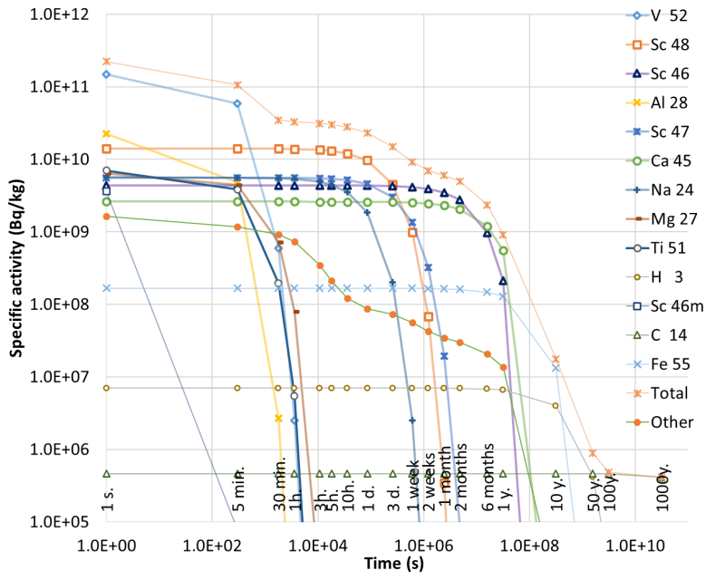
Past experiance under WPENS, WPSAE and WPJET3
CAD to MCNP conversion
MCNP simulations:
Flux/Dose rate maps
ADVANTG weight-windows generation
Activation calculations
SDDR calculations

Slide 5
Thank You for Your attention
Gediminas Stankunas, Andrius Tidikas, Benjaminas Togobickij
Lithuanian Energy Institute (LEI)

