Slide 1
JT-60SA W divertor modeling: Status of SOLPS-ITER modelling with drifts and extended grids
28/04/2026
W. Van Uytven, S. Van den Kerkhof, W. Dekeyser

Slide 2
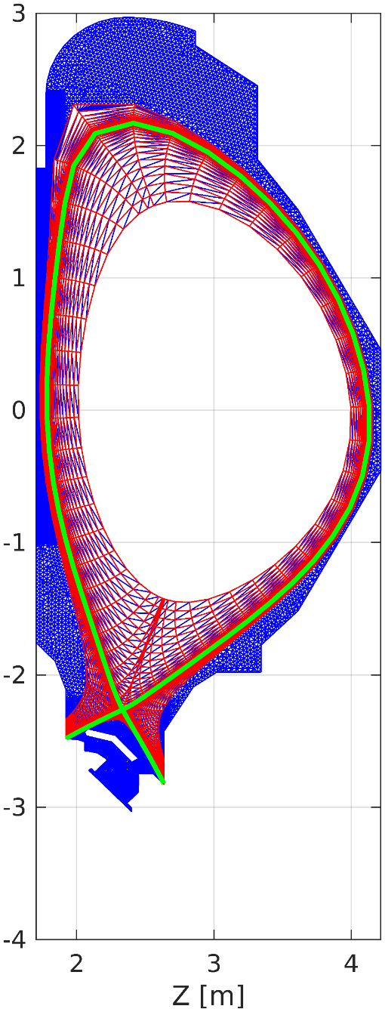
Scope
Provide support for the possible transition to W divertor through SOLPS-ITER exhaust scenario assessment
Previous work (G. Rubino, L. Balbinot): high temperatures at OT restrictive for current baseline scenario
Refine predictions through simulations with drifts, and extending up to the full vessel wall
Explore whether divertor shape modifications can mitigate this problem
D₂
Ne

Slide 3
Overview of JT-60SA modelling efforts in Wide Grids version of SOLPS-ITER (D+Ne)
 | Narrow plasma grid |  | Fully extended plasma grid
 | Fluid neutrals | Kinetic neutrals | Fluid neutrals | Kinetic neutrals
w/o drifts | Stable convergence Duration: hours Large parameter/geometry scans possible. | Stable convergence Duration: few days Parameter/geometry scans possible. | Running stably with physically sensible solutions. | Running stably with physically sensible solutions.
With drifts | Stable convergence Duration: few days Parameter/geometry scans possible. | Stable convergence. Duration: multiple weeks - month Limited parameter/geometry scans possible. | Not yet attempted. | Not yet attempted.
Note: successful backwards compatibility testing with structured code version; small bugs in structured version and model discrepancies identified.

Slide 4
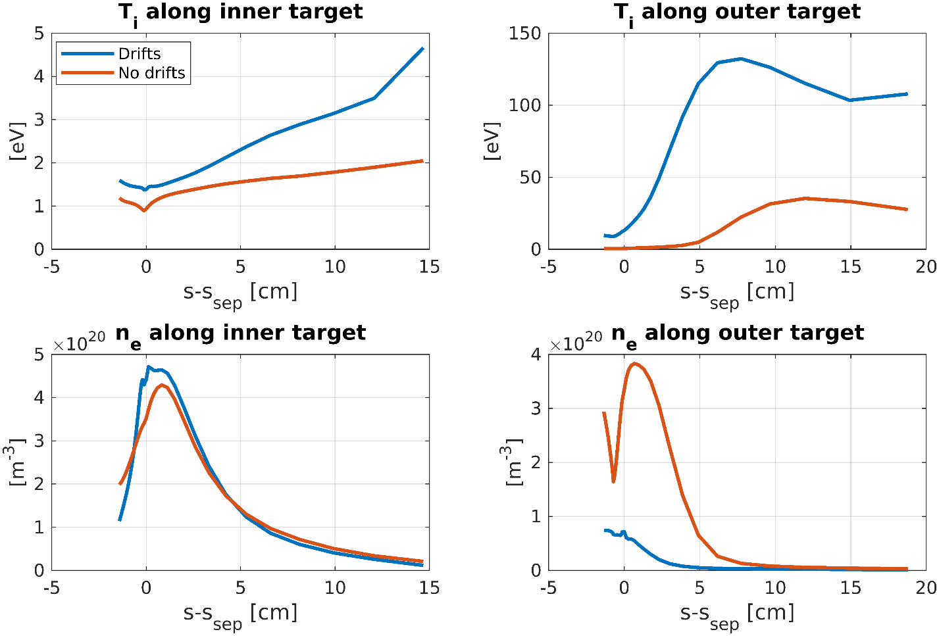
Results from drift simulations
Case setup:
Non-extended grid, kinetic neutrals, drifts
Parameters from no-drift reference case with 13 MW input power and n_{e,sep} of 2.0e19m⁻³
First results from drift simulations:
Expected inner-outer target symmetries due to drifts recoverd
Drifts aggravate situation w.r.t. W sputtering at OT: even higher T_{i} at outer baffle
Important: this is for fixed BCs and gas puff from reference case (no feedback on n_{e,sep})
Slighly lower n_{e,sep} in drifts case
To be repeated with feedback on n_{e,sep} to recover exact density from reference case

Slide 5
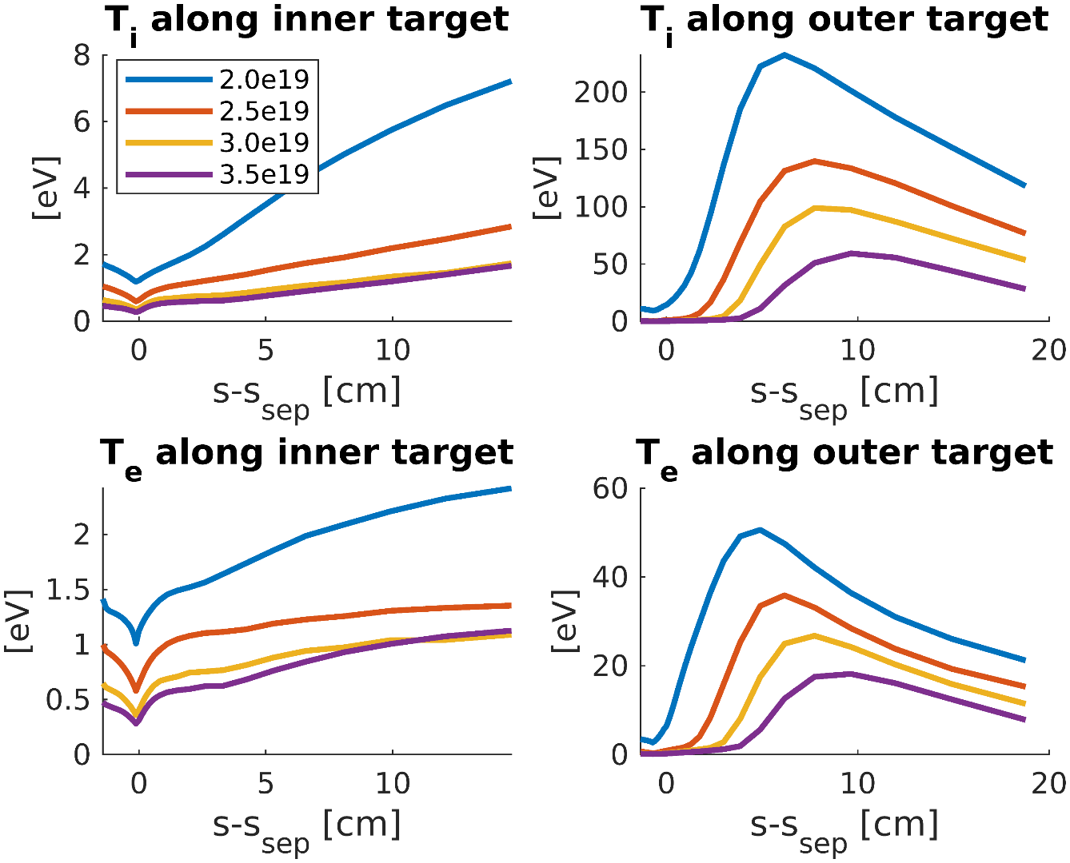
Results from no-drift simulations: density scan
Pushing separatrix density of reference scenario up to 3.5e19 m⁻³ at fixed Ne puff of 4.1e20 s⁻¹ still leads to (unacceptably) high OT temperatures
Compatibility with core to be investigated for these higher-density cases

Slide 6
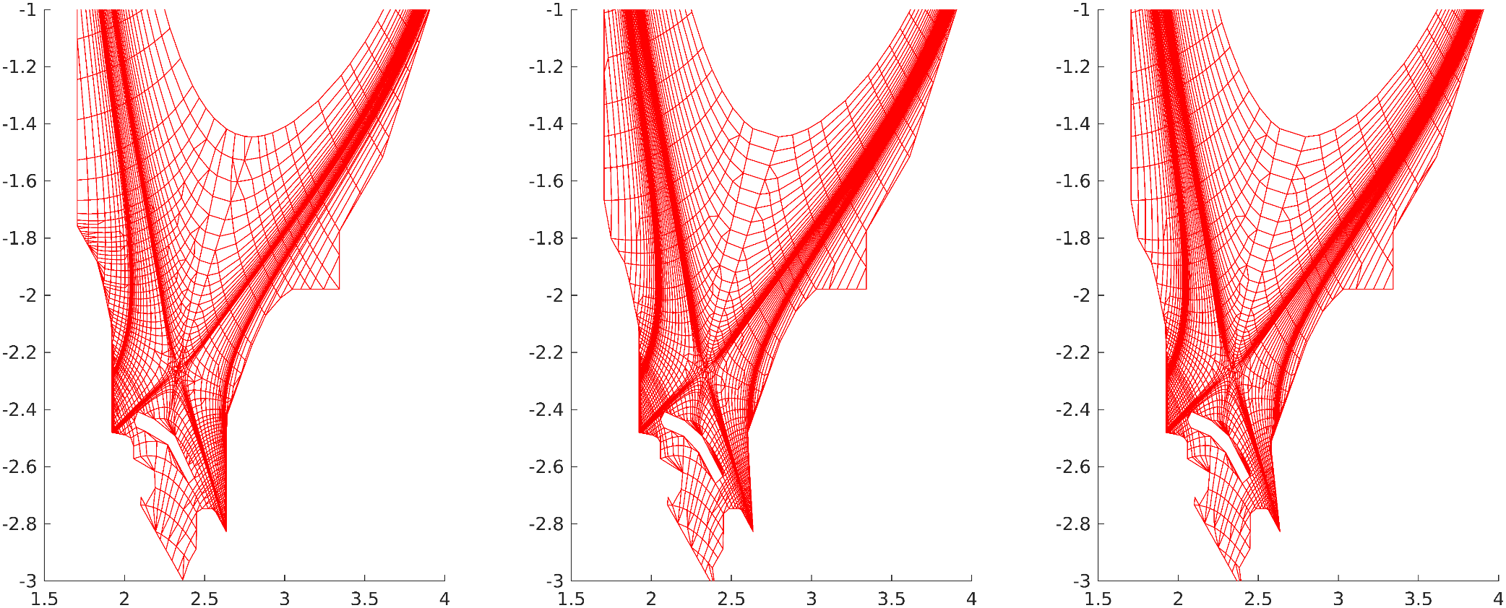
Alternative geometries
Investigate whether OT inclination has any significant effect on high temperatures
Currently: rotated outer target by 0, 5 or 10 degrees around lower corner to avoid strike point moving onto reflector plate. But: now outer baffle protrudes into plasma => undesired
Need new equilibrium in order to rotate target plate around ‘upper hinge point’ at baffle without moving strike point onto reflector plates

Slide 7
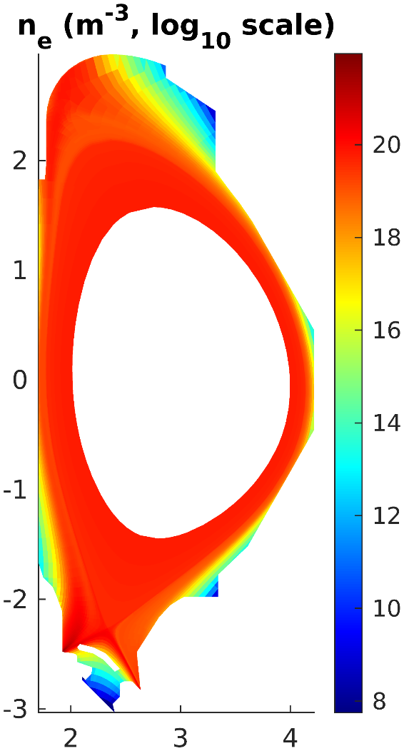
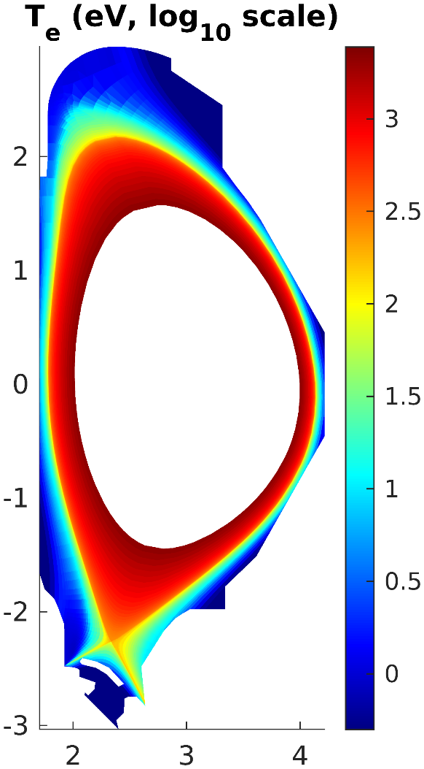
Preliminary results extended grids simulations
Case setup:
Extended grid, fluid neutrals (AFN model), no drifts
Parameters from no-drift reference case with 13 MW input power and n_{e,sep} of 2.0e19m⁻³
Running stably with fluid and kinetic neutrals

