Slide 1
Modelling and analysis of SOL plasma and pumping towards W transition
Update on W transition in JT-60SA
L. Balbinot (DTT), G. Rubino (ISTP-CNR Bari)
K. Galazka, G. Ciraolo, G. Falchetto, V. Tomarchio, C. Sozzi

Slide 2
Scientific objectives
Evaluate power exhaust and impurity concentration of JT-60SA high performance scenario (scenario 2, the most demanding for the divertor) with W first wall
Evaluate power density fluxes to the first wall in different plasma conditions
Evaluate detachment onset conditions
Argon seeding (SOLEDGE)
Neon seeding (SOLPS)
Evaluate pumping efficiency and divertor geometry effect
Evaluate pumping efficiency and divertor geometry effect
SOLPS → evaluate the effect of divertor corner
SOLEDGE → evaluate the effect of divertor geometry and strike point position

Slide 3
Power exhaust: two approaches
Neon seeding modelling with SOLPS-ITER
Argon seeding modelling with SOLEDGE
Input power scan
Input power scan
D fueling feedback to obtain n_{e,sep} = 2x10¹⁹m⁻³ (Sc. reference)
Impurity seeding tuned to obtain detachment or to mitigate power flux within technological limits
D fueling feedback to obtain n_{e,sep} = 3x10¹⁹m⁻³ (higher)
Impurity seeding set to obtain a given plasma purity (<n_{D}/n_{e}>_{sep} = 66%)
Question: What is the maximum input power that allows detachment with a “reasonable” impurity concentration?
Question: How much impurity seeding is required for detachment with a given power flux?
G. Rubino & L. Balbinot | Update on W transition in JT-60SA

Slide 4
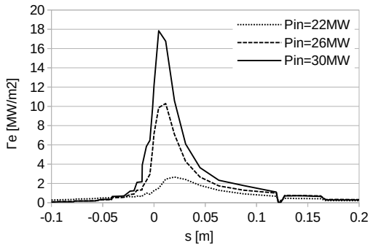
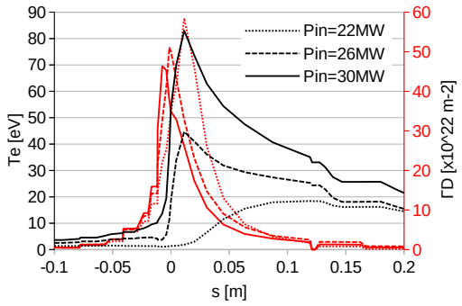
Main results in Ar seeded case
n_{e,sep} = 3.0x10¹⁹m⁻³ (high value → it has consequences on scenario performances)
High impurity concentration (n_{D}/ n_{e,sep} = 66%)
Performed an input power scan (22-26-30MW)
SOLEDGE-EIRENE
MAIN RESULTS
High power scenarios will be operated with high radiated power fraction (f_{RAD,TOT}>80%)
Power flux peak is not a major concern
W erosion is the showstopper (detachment threshold)
P_{sep,L-H}=10/14 MW → H-mode access is guaranteed; detachment can be obtained with higher P_{sep}
P_{ρ=0.9 (in. bound.)} | 22 MW | 26 MW | 30 MW
Γ_{E} peak | 2.5 MW/m² | 10 MW/m² | 18 MW/m²
Div. plasma | Detached | Attached | Attached
P_{rad,SOLEDGE} | 16.4 | 18.9 | 17.5
P_{rad,SOL (ρ>1)} | 11.6 | 13.3 | 12.8
P_{sep,ρ=1} | 17.8 | 20.4 | 25.3
P_{part,wall} | 5.6 | 7.1 | 12.5
G. Rubino & L. Balbinot | Update on W transition in JT-60SA

Slide 5
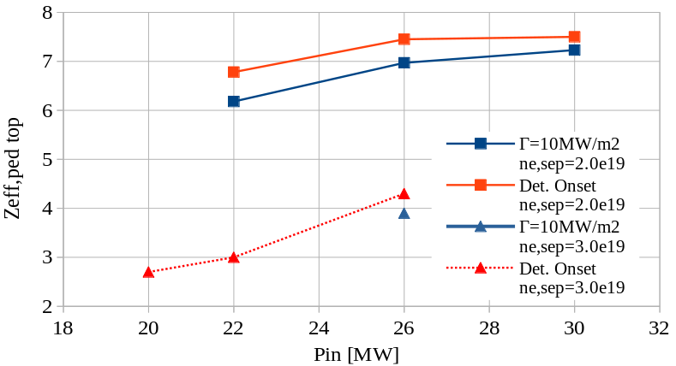
Main results - Conclusions
High power scenarios will be operated with high radiated power fraction: f_{RAD,TOT}>80%
Power flux peak is not a major concern (easiest limit to achieve)
W erosion is a major concern: detachment threshold is most stringent limit
Not feasible at low density level (n_{e,sep}~2x10¹⁹m⁻³)
SOLPS-ITER
Ongoing activity:
What is the effect of higher density on core plasma performances?
Core-edge-SOL integrated modelling ongoing
Compatibility with PWI
Tungsten sputtering evaluation with IMPGYRO (QST)
Future plans:
What is the effect of drifts?
G. Rubino & L. Balbinot | Update on W transition in JT-60SA

Slide 6
Effect of divertor geometry on pumping efficiency
G. Rubino & L. Balbinot | JT-60SA ETCM-4 meeting | 20 Feb. 2025

Slide 7
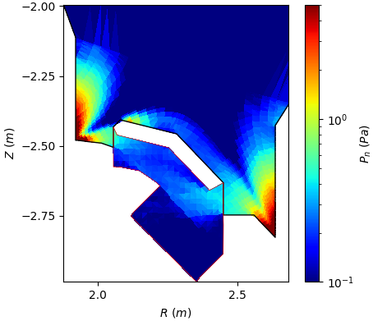
Pumping in low density cases
Both codes showed a very low pumping rate ~3x10²¹ D/s
We wanted to prove that low pumping throughput was given by neutral trapping
study divertor pumping rate in different regimes and how it could be increased
Methodology
Assess the effect of the V-shape geometry on neutral D leakage
Pure D case
Scan in P_{in} from 2 to 10 MW to cope a wide range of divertor plasma conditions
Fixed upstream density n_{e,sep} = 2x10¹⁹ m⁻³ (feedback controlled)
Albedo set at 0.95 (v_{pump}~100m³/s)
G. Rubino & L. Balbinot | Update on W transition in JT-60SA

Slide 8
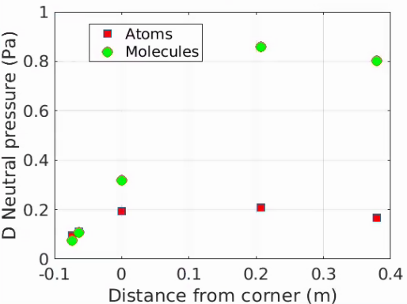
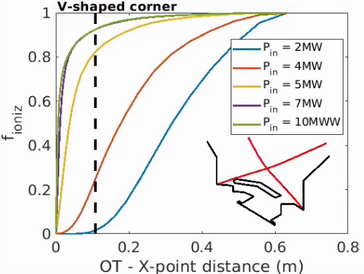
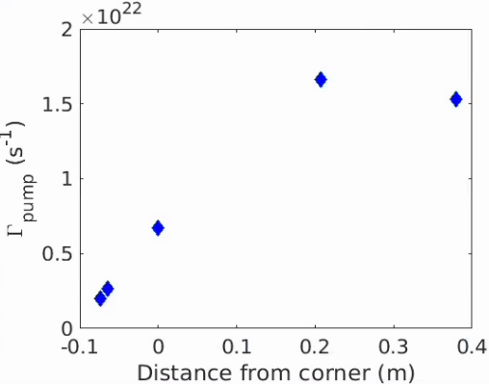
V-shape effect - quantitative estimation
Position of the ionization front where f_{ionz} > 0.8
A slight increase when detachment starts (P= 5MW)
Strong increase when the ionization front is well above the V corner​
​
Γ_{pump} ~ 1.5e22 D/s, and P_{sub-div}~1Pa in line with current experiments​
G. Rubino & L. Balbinot | Update on W transition in JT-60SA

Slide 9
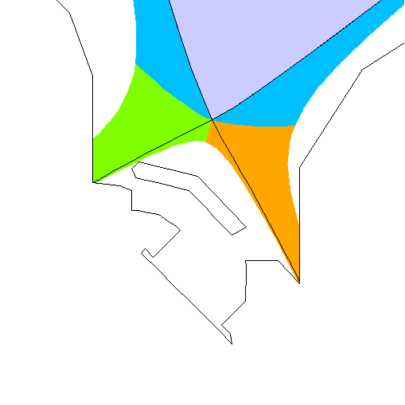
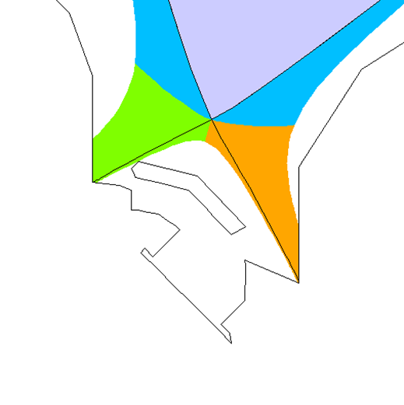
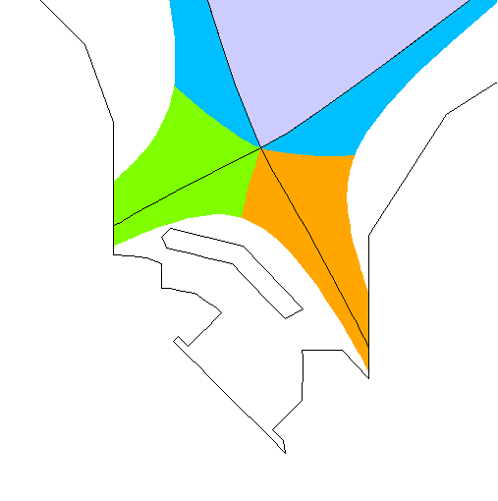
Effect of divertor geometry on detachment
3 different geometry configurations:
V-Shaped: reference
V-open: open the V-corner
High OSP: V-shaped but the strike point located above the corner
V-Shaped
V-open
High OSP
 | Std. case | No-corner | High strike point
Pumping rate | 4.1x10²¹ D/s | 5.62x10²¹ D/s | 9.56x10²¹ D/s
Crio press. | 0.25 Pa | 0.45 Pa | 1.0 Pa
G. Rubino & L. Balbinot | Update on W transition in JT-60SA

Slide 10
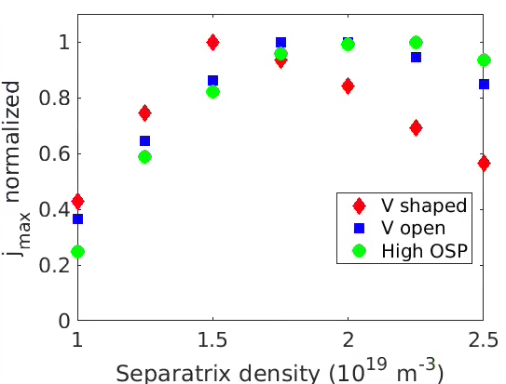
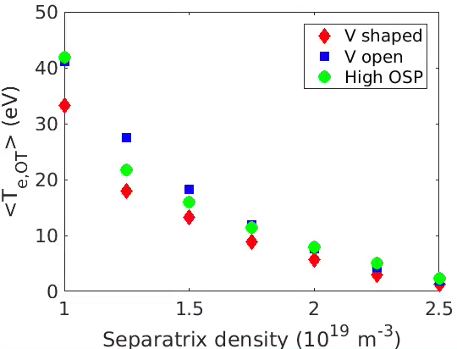
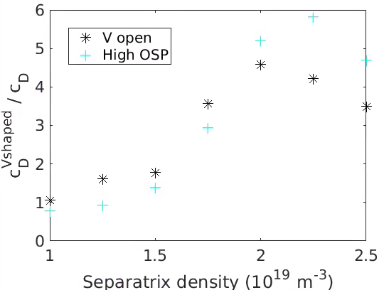
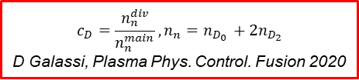
Effect on detachment achievement
Pure D scan in the different divertor geometry with fixed P_{in} = 5MW (≈ power able to dissipate in impurity seeded cases)
Evaluation of roll-over point
V-Shaped shows a considerable benefit
V-shaped detach at lower upstream density
OSP shows the worst behaviour
Effect of V closure on SP temperature
Weighted <Te,OT> decreased in V-shaped at low density thanks to the neutral trapping
Favour the detachment in the SP region
Increased neutral compression ratio c_{D} in detached OT conditions, by factor 4-5
Less effective at very low density (low neutral densities)
$$c_{D}=\frac{n_{n}^{div}}{n_{n}^{main}}, n_{n}=n_{D_{0} }+2n_{D_{2}}$$
D Galassi, Plasma Phys. Control. Fusion 2020
<T_{e,IT/OT}> = ∫ _{IT/OT} T_{e,IT/OT} Γ_{D} / ∫_{IT/OT} Γ_{D}
B. Lomanowski, Nucl. Fus. 2022
G. Rubino & L. Balbinot | Update on W transition in JT-60SA

Slide 11
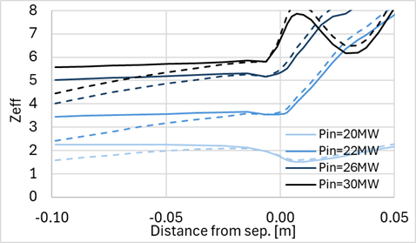
Ongoing and future wok
Continue integrated modelling with core modelling
Made SOLEDGE simulations with pinch velocity obtained by S. Gabriellini
no major difference
Possible inclusion of drifts in SOLPS-ITER?
G. Rubino & L. Balbinot | Update on W transition in JT-60SA

Slide 12
Thank you for your attention

