Slide 1
Modeling (scenarios, core, edge, W core transport)
Update on W transition in JT-60SA
Luca Garzotti
UKAEA

Slide 2
Work in progress
Europe
Modelling with SOLPS-ITER (Giulio Rubino). No new progress with respect to what presented at the last ETCM (February 2026).
ASTRA/TGLF-SAT2/NEO (Clemente Angioni and co-workers) extra additional simulations performed).
COCONUT modelling (Rachele Cicioni) scans in pedestal height and Ar seeding performed.
SOLEDGE modelling (Luca Balbinot) will report on own progress.
Japan
SONICS modelling (Riuichi Sano) scan in fuelling rate (no progress since February).
IMPGYRO modelling (Yamoto) W transport with and without drifts no progress since February).

Slide 3
COCONUT modelling
Objective of the Work: assess the impact and feasibility of a W wall + W divertor in Scenario #2 of JT-60SA with integrated plasma simulations performed with JINTRAC, focusing on the Ar seeding case.​
PROBLEM: discrepancy for the power crossing ρ=0.9 surface P_{ρ=0.9} :​
from JETTO core simulations (by S. Gabriellini) P_{rad,ρ<0.9} ~ 6 MW → P_{ρ=0.9} = P_{aux} - P_{rad,ρ<0.9} ~ 35 MW ​
for SOLEDGE simulations (by L. Balbinot) Pρ=0.9 = 22 ÷ 30 MW
Technical problems using FACIT instead of NCLASS. Reported, under investigation.

Slide 4
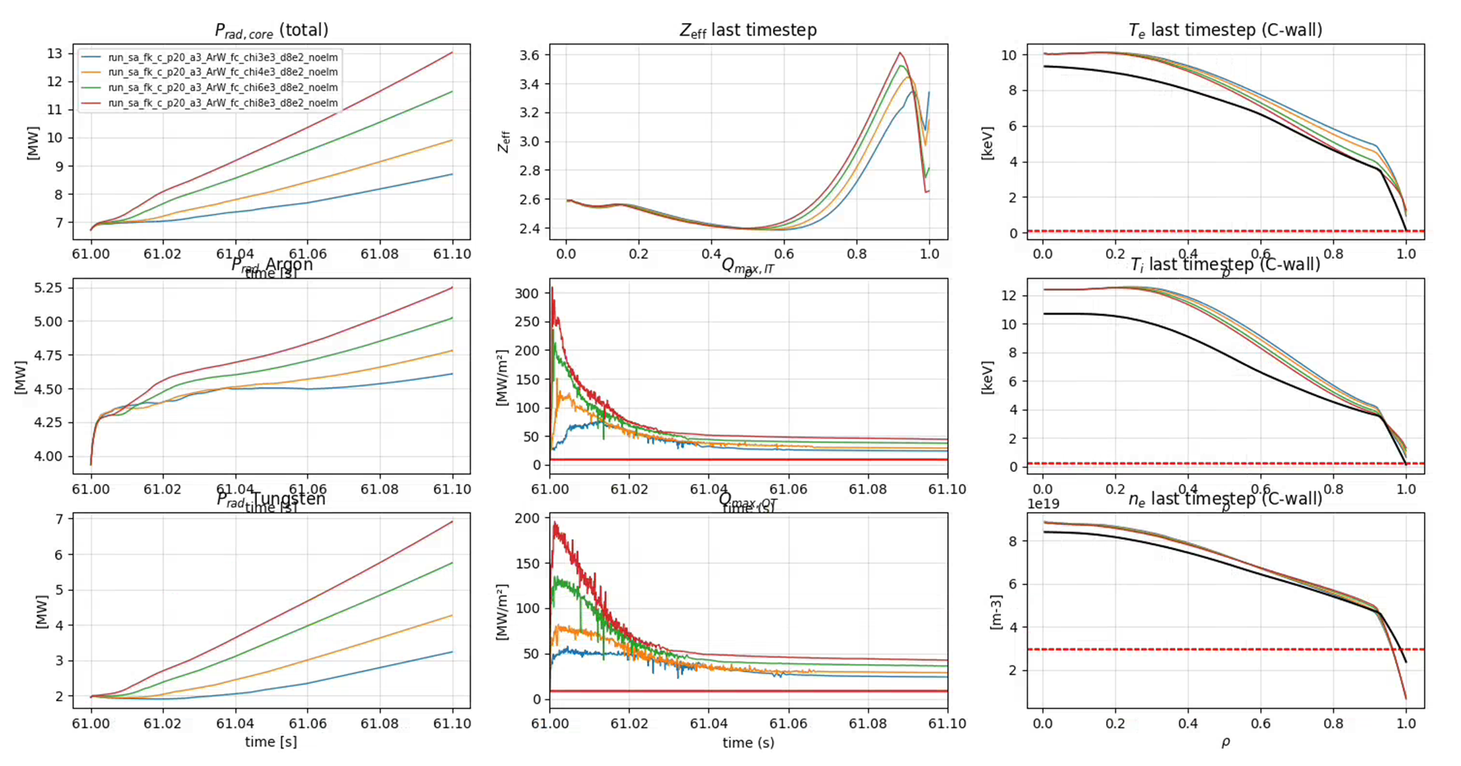
Scan pedestal height
Gas puff 10²⁰ 1/s
Ar seeding 10²⁰ 1/s
Screening plays important role but no solution with power load <10 MW/m²

Slide 5
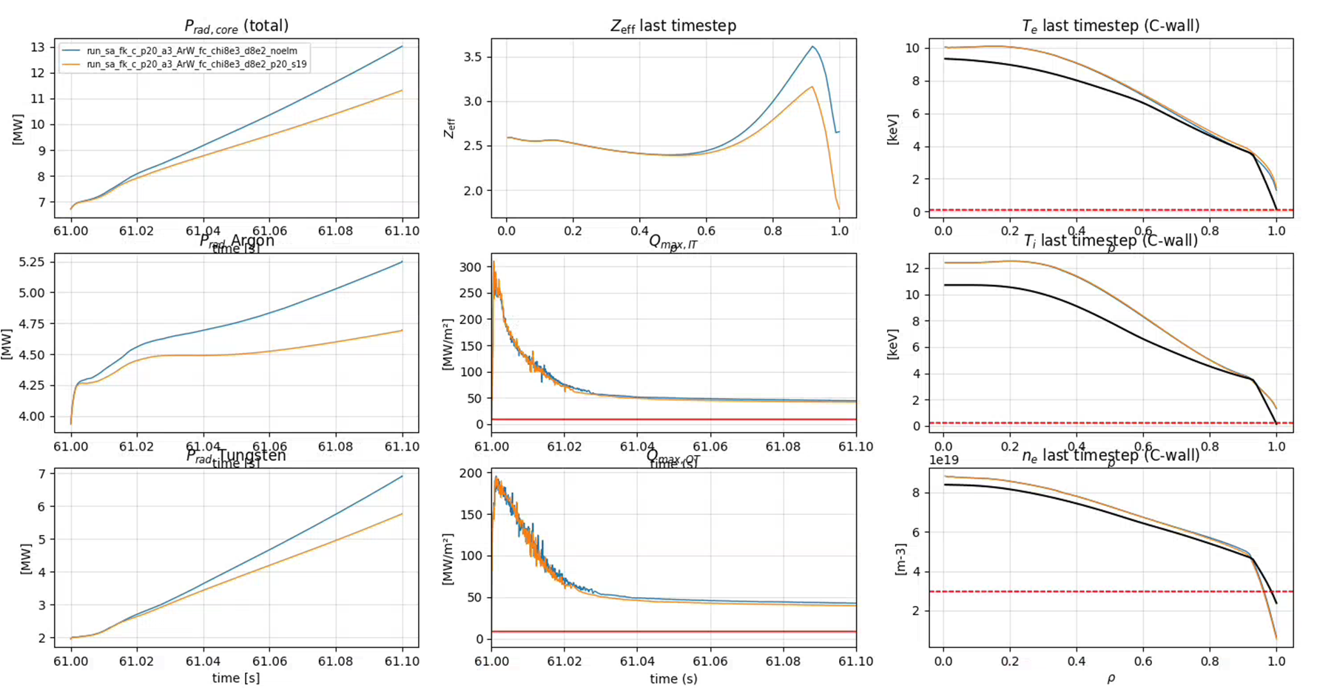
Scan Ar seeding
Increasing seeding by one order of magnitude (from 10¹⁹ to 10²⁰ 1/s) has modest effect.

Slide 6
Preliminary conclusions and future work
Challenging to replicate SOLEDGE results.
Replicate modelling presented at the modelling week in November 2025 with new settings provided by Florian Koechl and, possibly, FACIT.
Increase seeding even more but with hight temperature pedestal.
This would likely give the integrated modelling results closest to SOLEDGE.

Slide 7
ASTRA TGLF-SAT2 NEO
Solved a problem related to a spurious mode preventing simulations from being run at nominal β.
More simulations performed at nominal β.
Up to 8 profiles are evolved, 7 equations
electron and ion temperatures,
electron, tungsten and argon densities, deuterium density by quasi-neutrality
toroidal rotation and poloidal flux (current density)
Turbulent transport for temperatures and densities by TGLF-SAT2, neoclassical transport from NEO, toroidal momentum transport from Zimmermann et al PoP 2024
Profiles of NBI heat, particle, torque and CD sources and boundary conditions of electron density and temperatures at ped. top (ρ=0.89) from Garzotti et al NF 2018
Toroidal rotation boundary condition from τ_{ϕ}= τ_{𝑬}

Slide 8
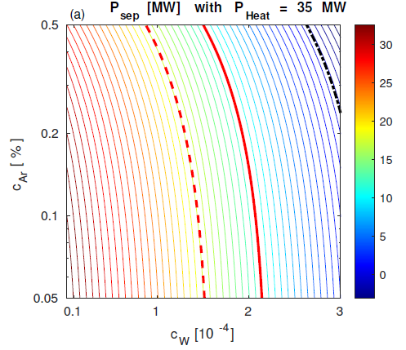
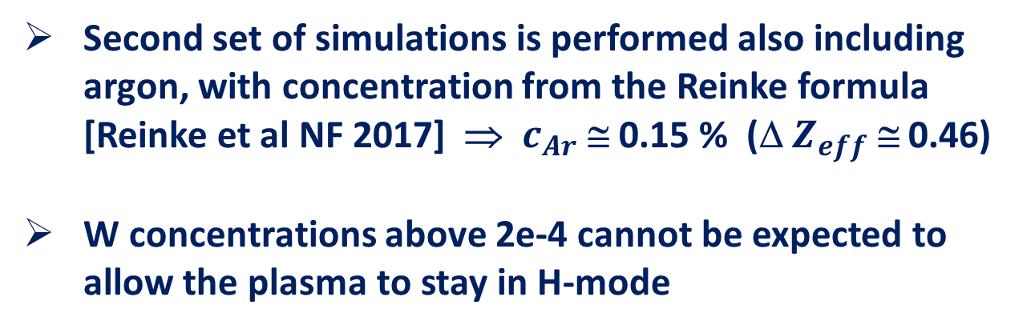
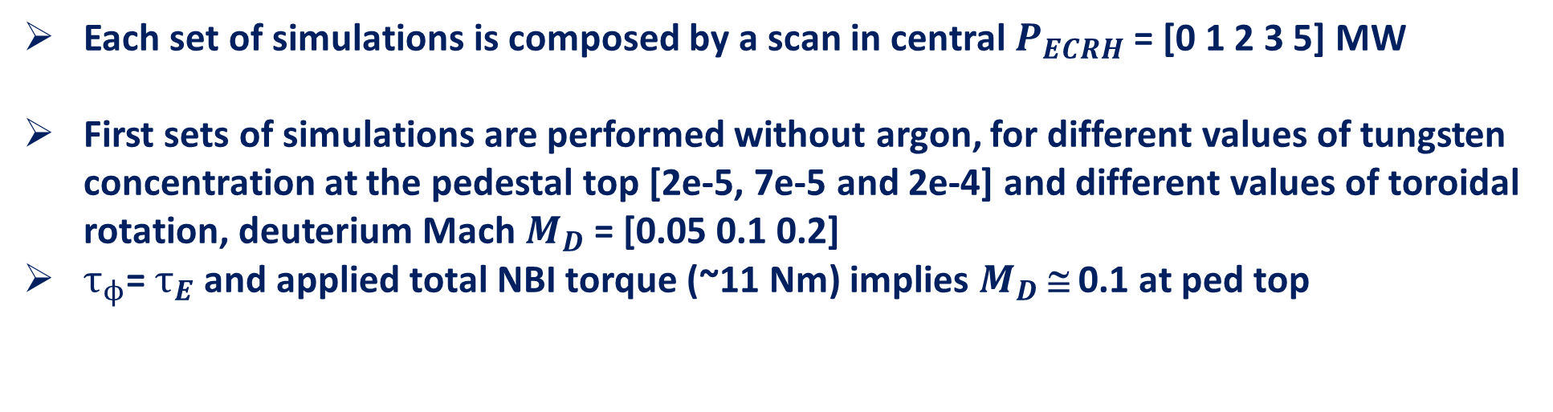

Modelling approach, scans in central ECRH power
Each set of simulations is composed by a scan in central $P_{ECRH}$ = [0 1 2 3 5] MW
First sets of simulations are performed without argon, for different values of tungsten concentration at the pedestal top [2e-5, 7e-5 and 2e-4] and different values of toroidal rotation, deuterium Mach $M_{D}$ = [0.05 0.1 0.2]
$τ_{ϕ}$= $τ_{E}$ and applied total NBI torque (~11 Nm) implies $M_{D}$ ≅ 0.1 at ped top
Second set of simulations is performed also including argon, with concentration from the Reinke formula [Reinke et al NF 2017] ⇒ $c_{Ar}$ ≅ 0.15 % (Δ $Z_{eff}$ ≅ 0.46)
W concentrations above 2e-4 cannot be expected to allow the plasma to stay in H-mode
$$P_{LH}$$

Slide 9
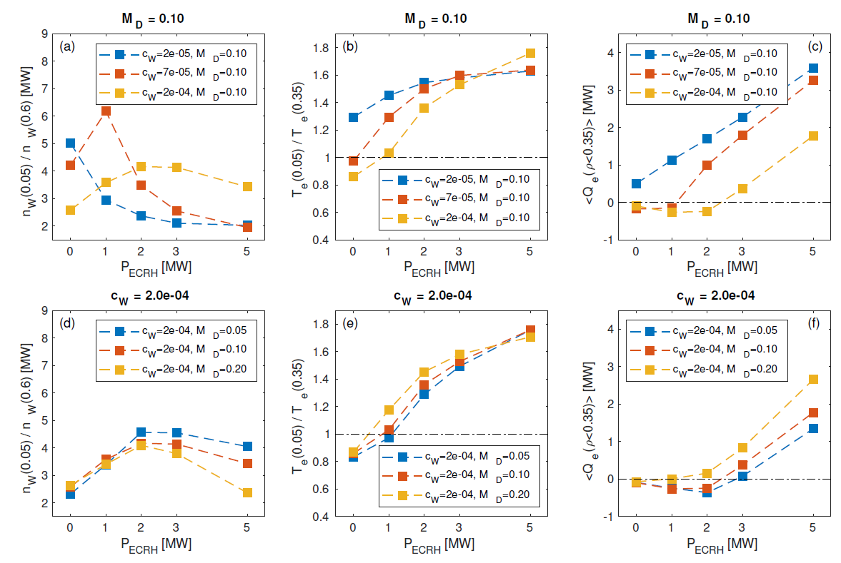
Increase of rotation has a favorable impact and reduces the W peaking
Complex W behavior reflects specific low collisionality regime of JT-60 SA plasmas

Slide 10
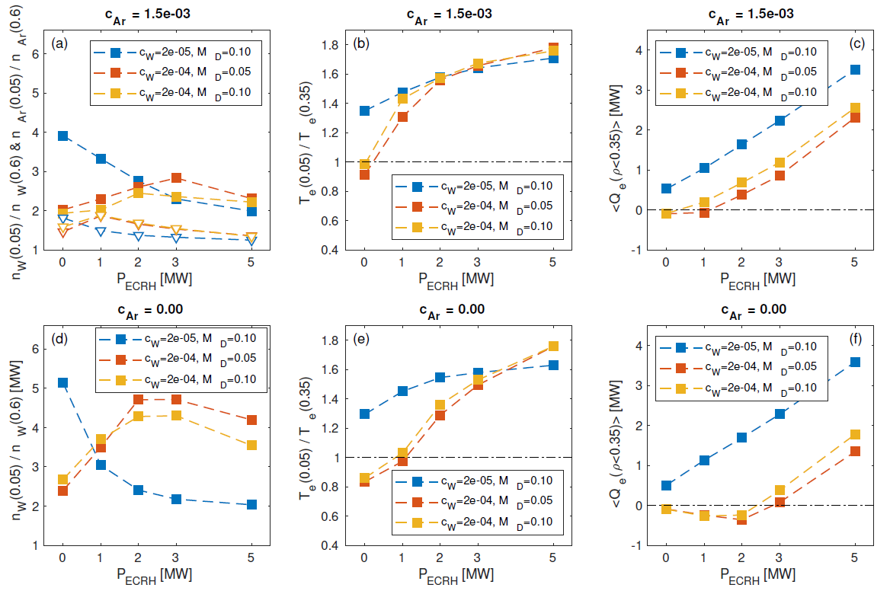
Addition of Ar has a beneficial effect in reducing W peaking
Central electron heat flux is already positive with $P_{ECRH}  2$MW

Slide 11
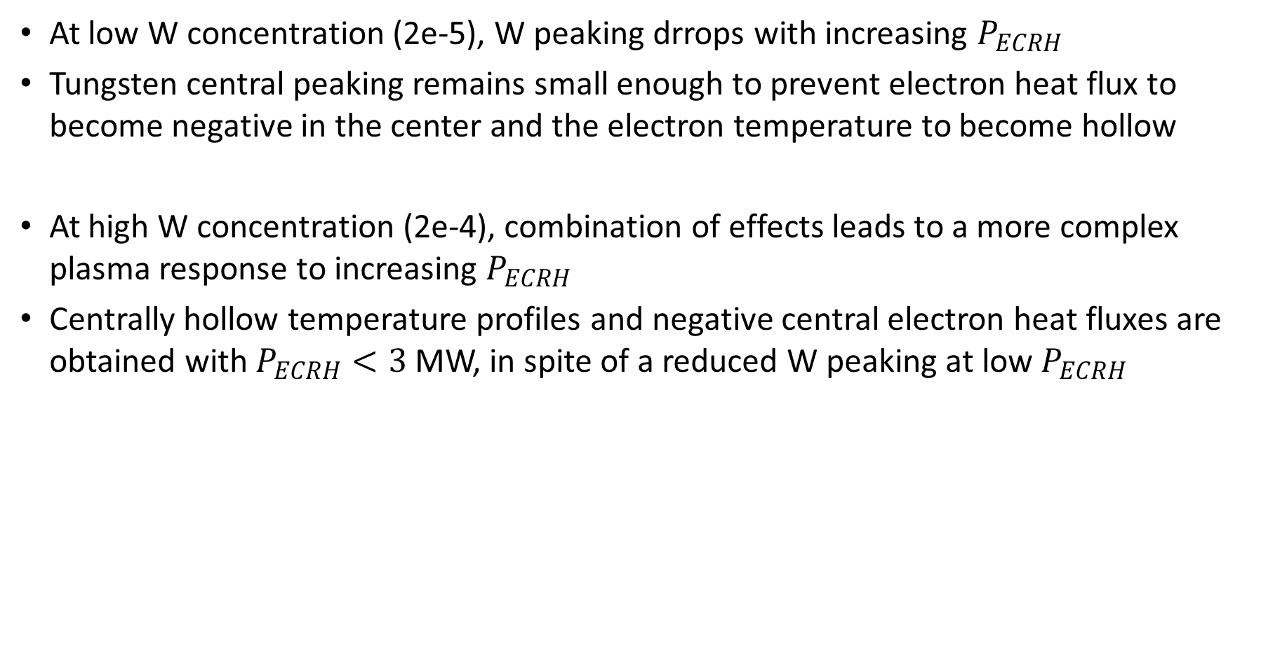
W peaking
At low W concentration (2e-5), W peaking drrops with increasing $P_{ECRH}$
Tungsten central peaking remains small enough to prevent electron heat flux to become negative in the center and the electron temperature to become hollow
At high W concentration (2e-4), combination of effects leads to a more complex plasma response to increasing $P_{ECRH}$
Centrally hollow temperature profiles and negative central electron heat fluxes are obtained with $P_{ECRH}<3$MW, in spite of a reduced W peaking at low $P_{ECRH}$

