Slide 1

PFCs concepts and qualification for the first wall PFCs (WPDIV)
No task on first wall in WPDIV
Qualification of F4E components
Advanced PFCs : Goal sustain heat loads higher than the monoblock concept
Instrumentation (thermocouple) of normal heat flux components
This presentation: Focus on the qualification of F4E components
M. Richou
CEA, IRFM

Slide 2
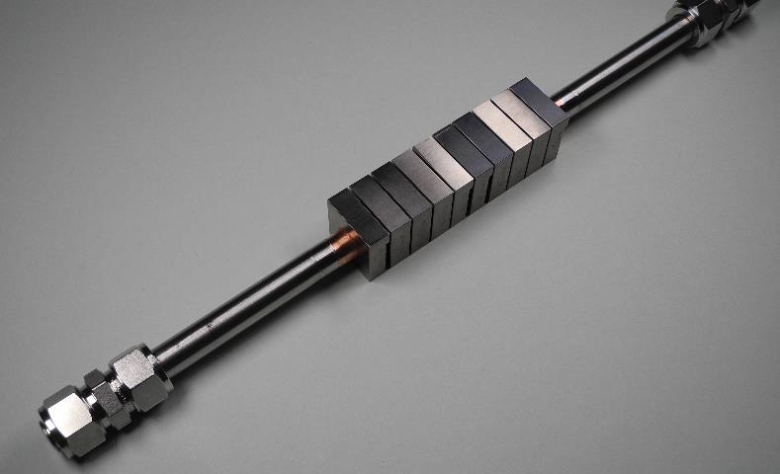
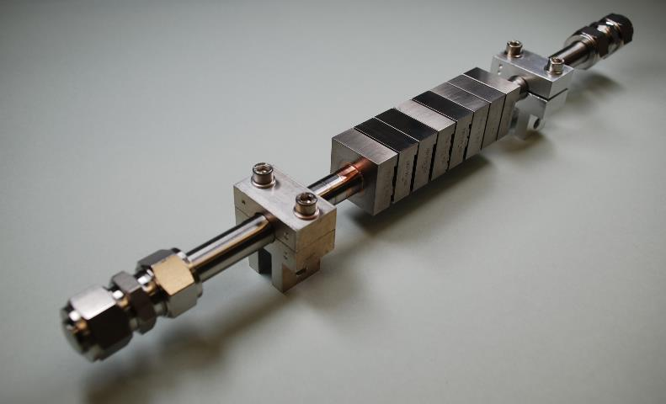
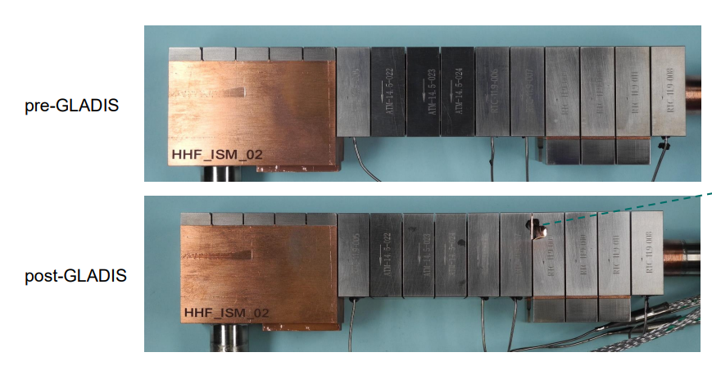
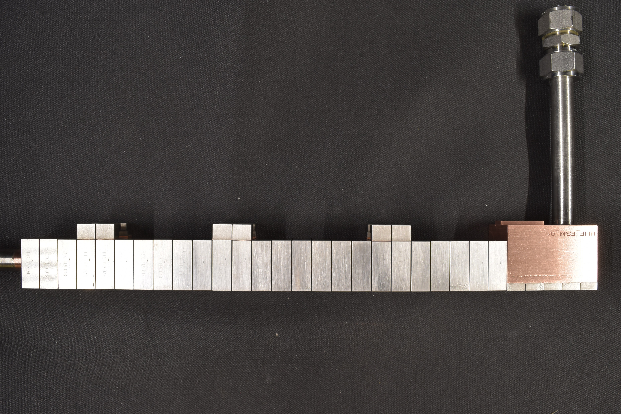
Status on the qualification of F4E components
M. Richou
W transition meeting
28h of April 2026
ISM01_02_03
FSM00_01_02

Slide 3
CONTENT
Procedure
Components
Results
M. Richou | W transition meeting | 28th of April 2026

Slide 4
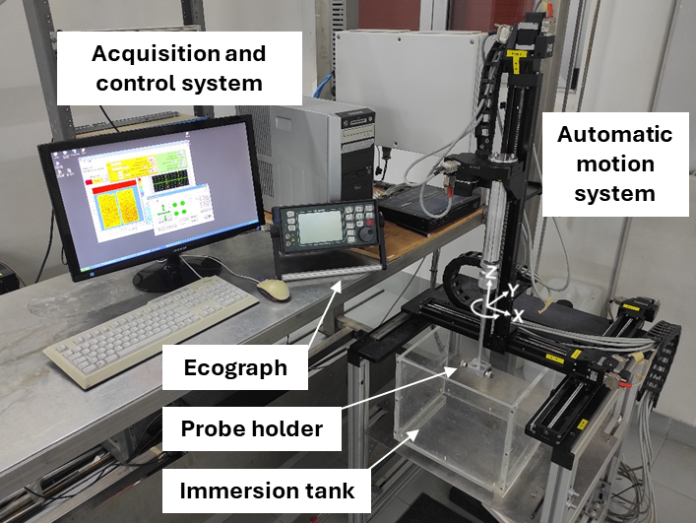
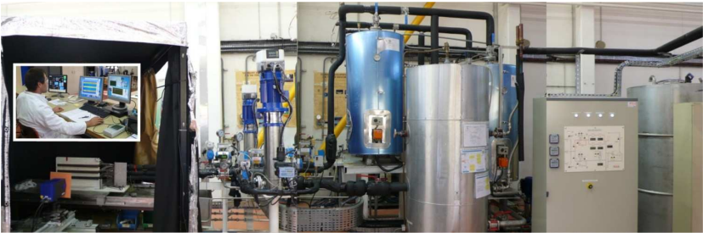
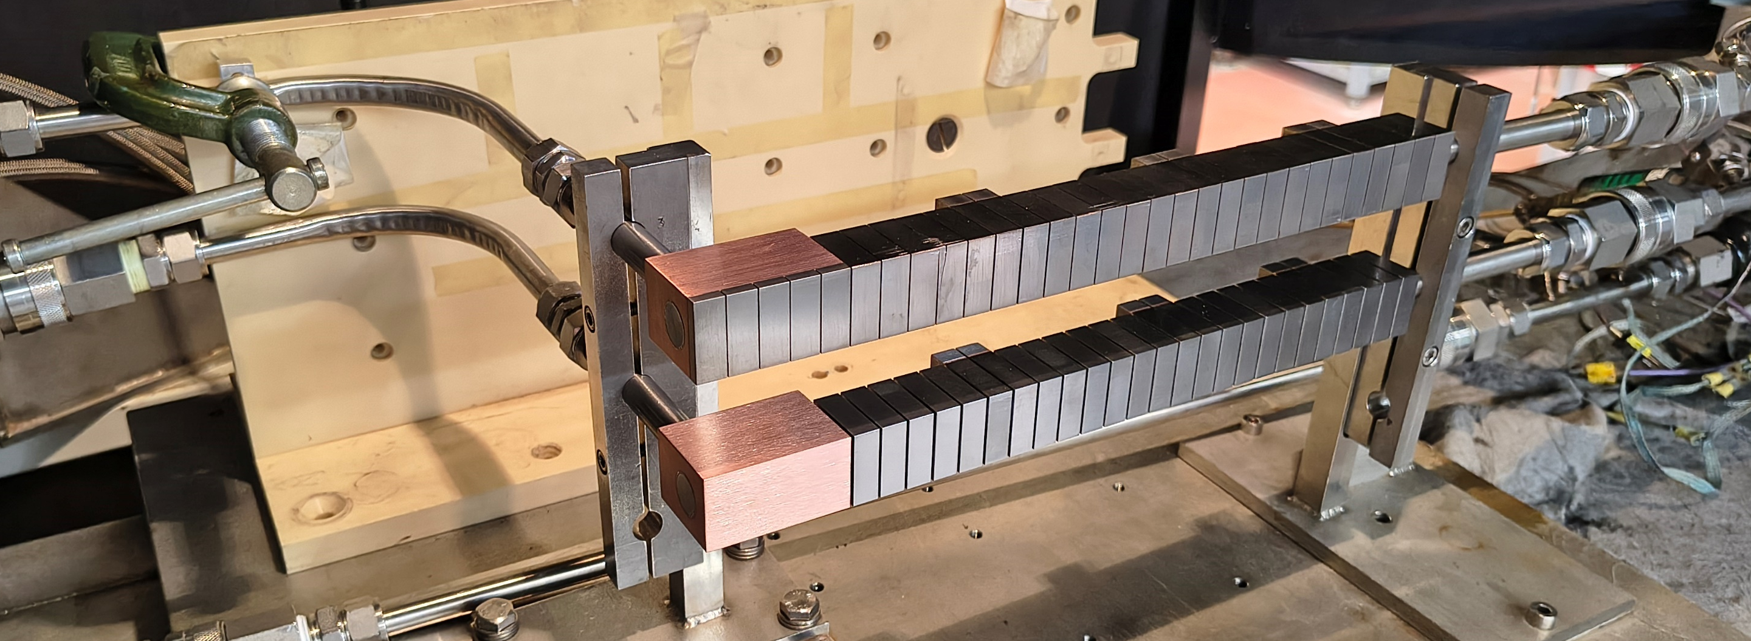
Qualification procedure
Non destructive testing
Ultrasonic testing (ENEA, RTC company)
Infrared thermography (CEA))
High Heat Flux test (Gladis (IPP), CEA (Hades))
At GLADIS:
Screening (Increase of power) 6 – 10 MW/m²
Cyclic loading, 100 x 10 MW/m², 10 s
Screening 15 MW/m², 5 - 12 s pulse length
Cyclic loading, 100 x 15 MW/m², 10 s
High power transient loading, 3 x 20 MW/m²
AT HADES : High number of cycling (up to 2000cycles)
Screening (Increase of power) 6 – 10 MW/m²
Cyclic loading, 2000 x 10 MW/m², 10 s
Screening at 5 MW/m²
Non destructive testing
Ultrasonic testing (ENEA, RTC company)
Infrared thermography (CEA))
M. Richou | W transition meeting | 28th of April 2026

Slide 5

Components
Monoblock | HHF Tested
11_4 | 03/2025
14_5 | 01/2025
ISM | HHF Tested
ISM_01 | 09/25 (Gladis)
ISM_02 | 09/25(Gladis)
ISM_03 | 04/26 (Gladis)
FSM | HHF Tested
FSM_00 | 01/26
FSM_01 | 01/26
FSM_02 | 01/26

Slide 6
Testing and results
Mock-ups | UT | SATIR | HHF | UT | SATIR
11_4 10 blocks |  | Bl10 | Bl 10 | Bl10 | Bl10
14_5 8 blocks
ISM_01 10 bl+ 5 TP |  |  |  | Bl 2➔9 All FTs | Bl 2➔9 All FTs
ISM_02 |  |  | Bl 2 | Bl 1➔7; 10 All FT | Bl 1➔6; 10 All FT
FSM_00 25bl +5 TP (W) |  | Bl 10;19;25 | Under inv. | ? | Under inv.
FSM_01 25bl +5 TP (W) |  | Bl 1➔15; 20;23 All FTs | Under inv | ? | Under inv
FSM_02 25bl +5 TP (W) |  | Bl 6➔15; 25 FT5 | Under inv | ? | Under inv
ISM_03 |  |  | Under inv | Planned | Planned
Not tested | Tested: Thermal imperefection detected | Tested No thermal imperfection | Tested Under inv. | Planned

Slide 7
Monoblock (T1 2025)

Slide 8
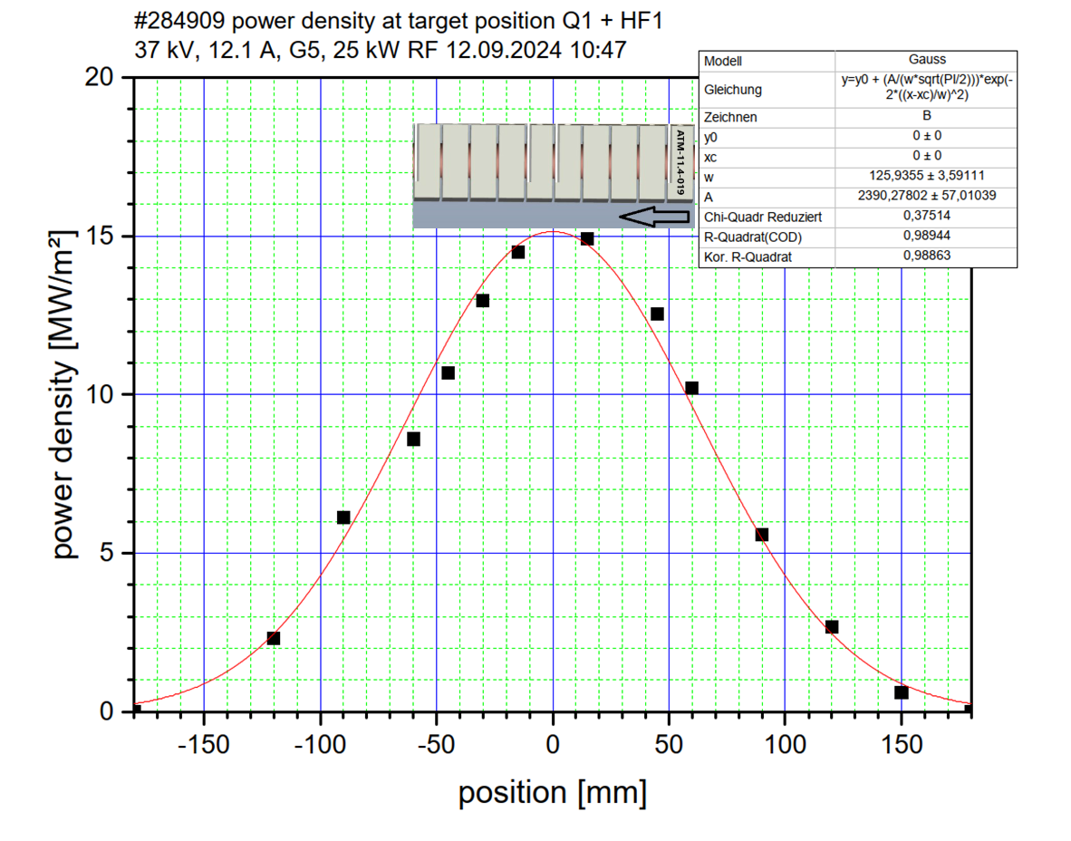
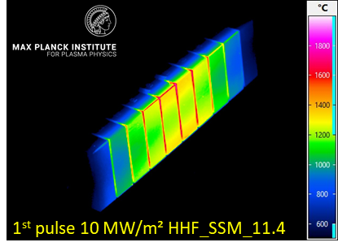
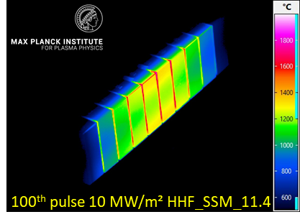
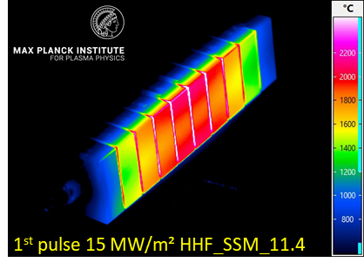
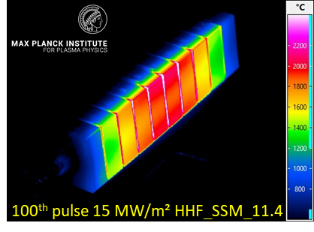
Monoblock 11_4
Mock-up HHF_SSM_11.4:
10 monoblocks
11.4 width per block
different blocks labeled ATM and RTC
1
10
1
10
Cold water cooling 15°C, flow 0.8 l/s
Screening 6 – 10 MW/m², up to 15 s pulse length, 15 MW/m², 5 s
Cyclic loading, 100 x 10 MW/m², 10 s – No evolution
Screening 15 MW/m², 5 - 12 s pulse length
Cyclic loading, 100 x 15 MW/m², 10 s – No evolution – B10 >B1
High power transient loading, 3 x 20 MW/m²
1
1
10
10

Slide 9
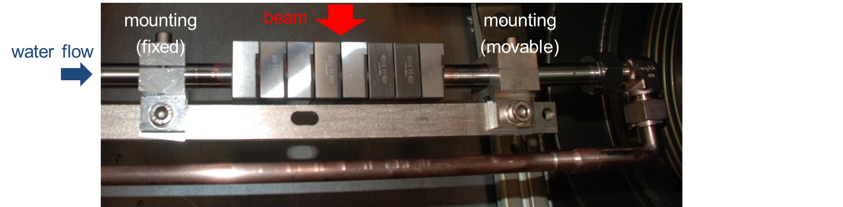
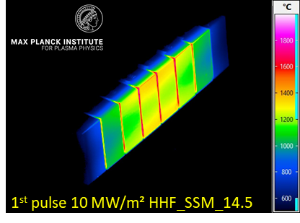
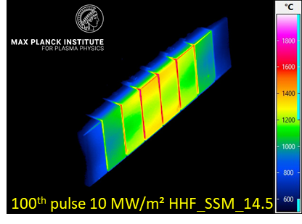

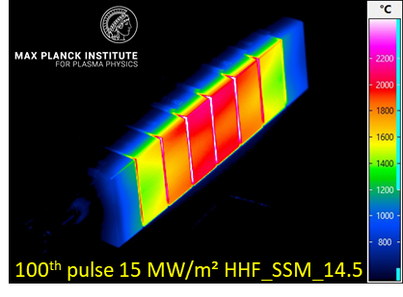
Monoblock 14_5
8 monoblocks
14.5 mm width per block
different blocks labeled ATM and RTC
Cold water cooling 15°C, flow 0.8 l/s
Screening 6 – 10 MW/m², up to 15 s pulse length, 15 MW/m², 5 s
Cyclic loading, 100 x 10 MW/m², 10 s – No evolution
Screening 15 MW/m², 5 - 12 s pulse length
Cyclic loading, 100 x 15 MW/m², 10 s – No evolution
High power transient loading, 3 x 20 MW/m²

Slide 10
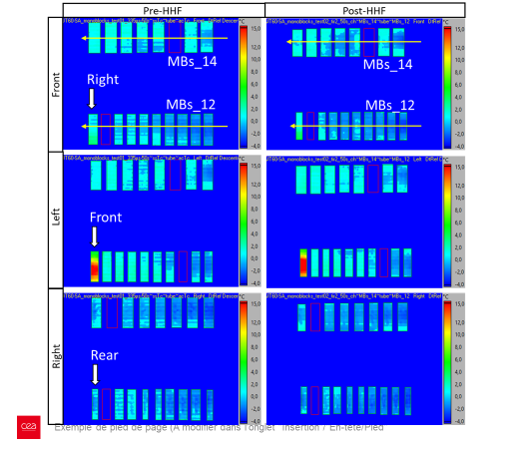
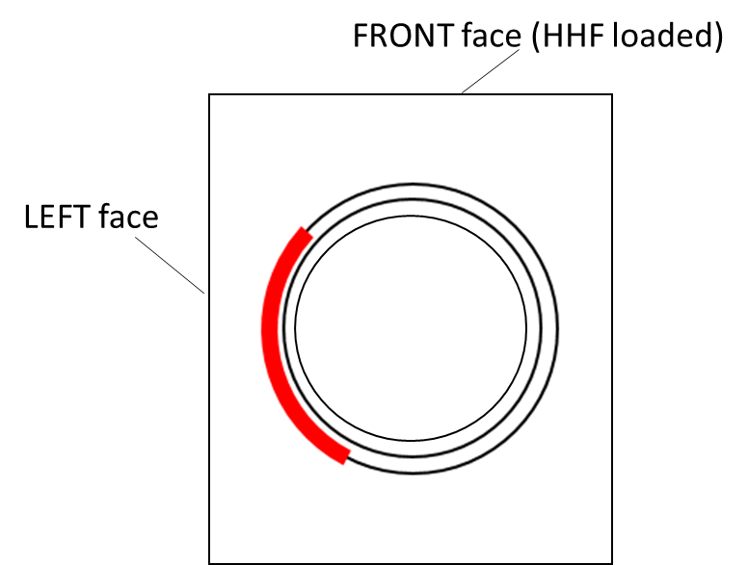
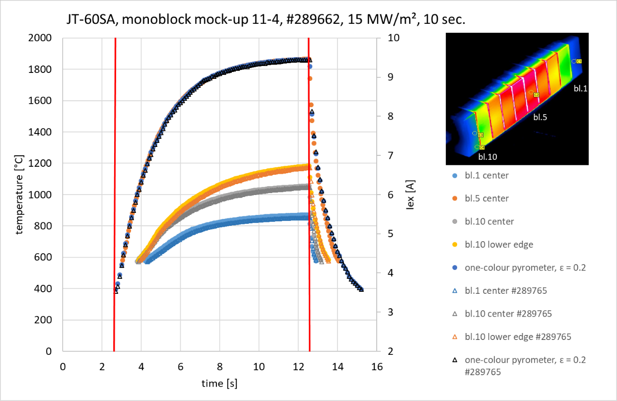
(2) SATIR tests pre and post HHF
Imperfection still present after HHF tests
Imperfection with effect on thermal exhaust
14_5
11_4
14_5
11_4
14_5
11_4
10

Slide 11
ISM (T2 2025 and T1 2026)

Slide 12
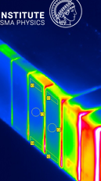
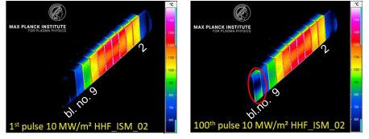
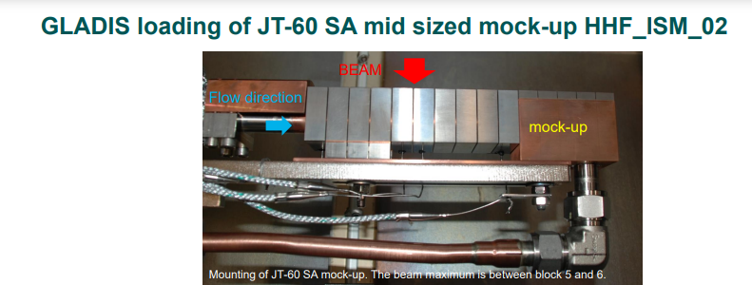
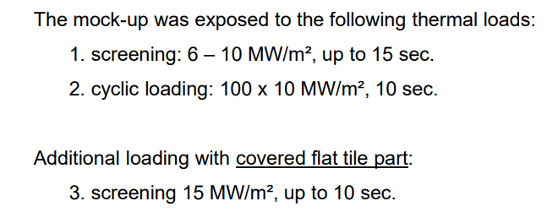
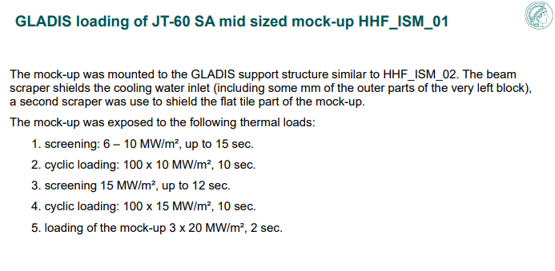
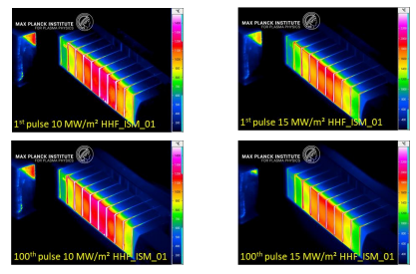
ISM_02 and 01
Block and Flat tiles exposed
Higher temperature fo MB2
The first flat tile showed an increase ot the temperature of both edge during the cycling at 10 MW/m² - > Flat tile were screened
-> INFO FROM F4E: the company did not apply the planned manufacturing process for this particular mock-up
Only block exposed
Successful tests since temperatures are stable along cycle

Slide 13
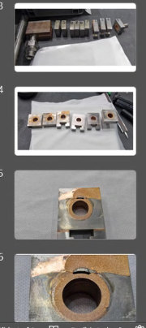
Non-destructive testing (Correlation with HHF tests ?)
 | GLADIS | SATIR | UT
ISM-01 | OK (FT not tested) | MB#2 to 9 FT#5 (larger) | From outside: MB#2 to 9 (detachement at Cu/CuCrZr) FT#all
ISM-02 | Failure Sign on MB#2 and FT#1 | MB#1; FT#1; FT#4 (larger) MB#2 to 6; MB#10 | No swirl – conventional method MB#1 (larger) MB#2 to 7; MB#10 FT#4 (larger) FT#all
Good correlation between SATIR and UT
Metallographic examination performed after HHF tests lead to confirm the Cu/CuCrZr detachment

Slide 14
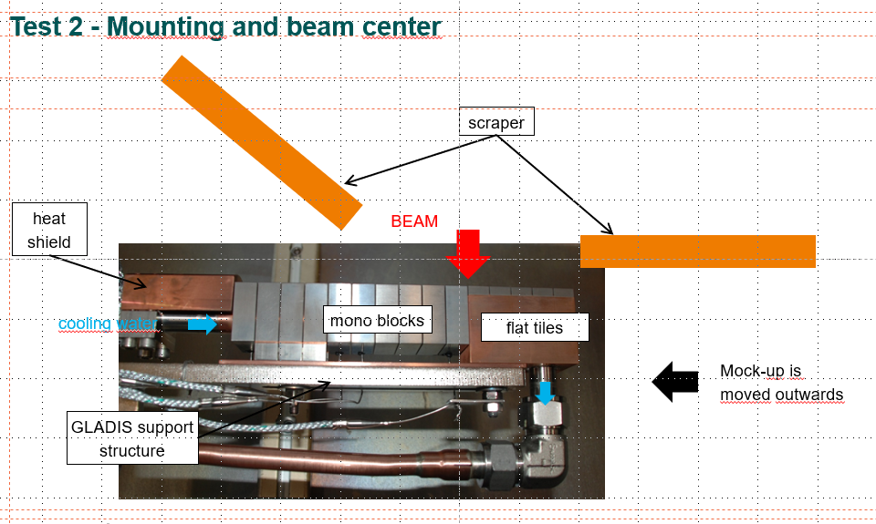
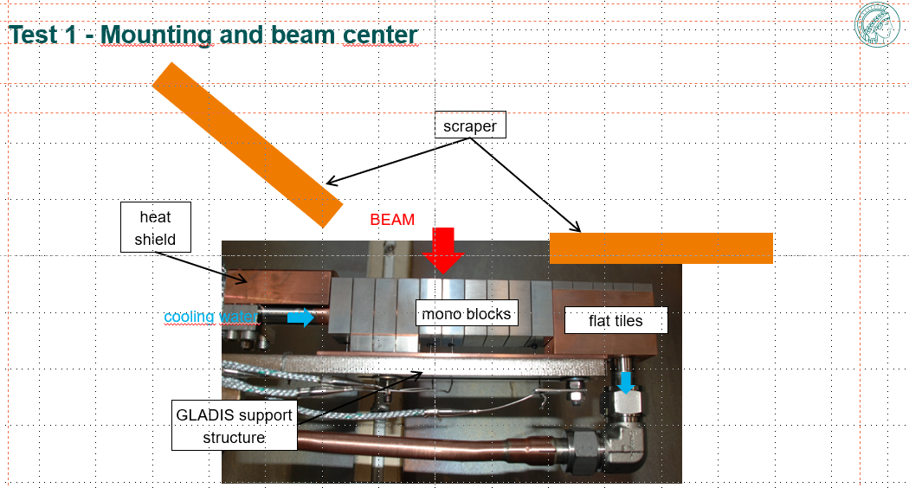
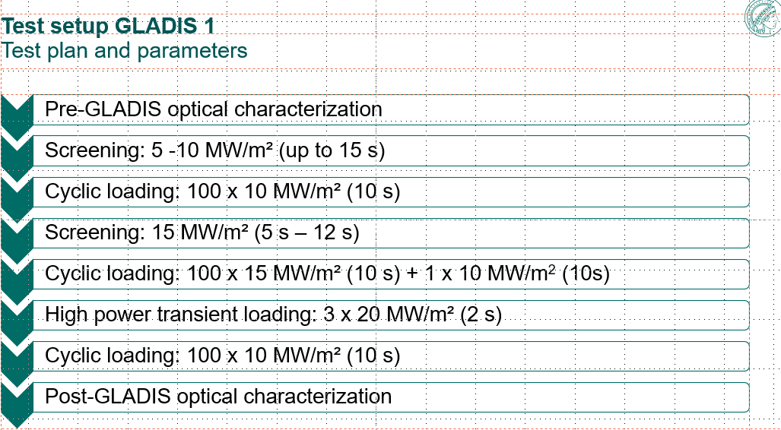
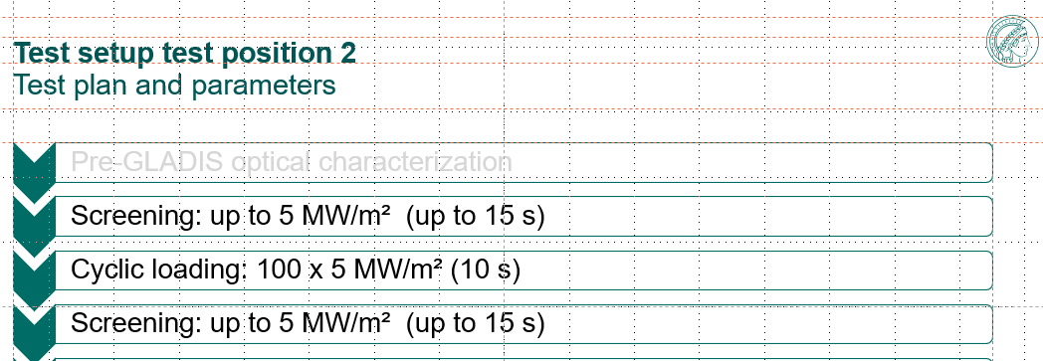
Test mock-up ISM-03 - Proposal (GLADIS, 2026)
ISM-03 manufacturing technologies and steps integrate the feedback from the other ISM fab. and test.
Non destructive testing (UT by ENEA)- OK
No sign of degradation after the completion of the HHF test
SATIR test post HHF and UT tests planned

Slide 15
Full Scale mock-up

Slide 16
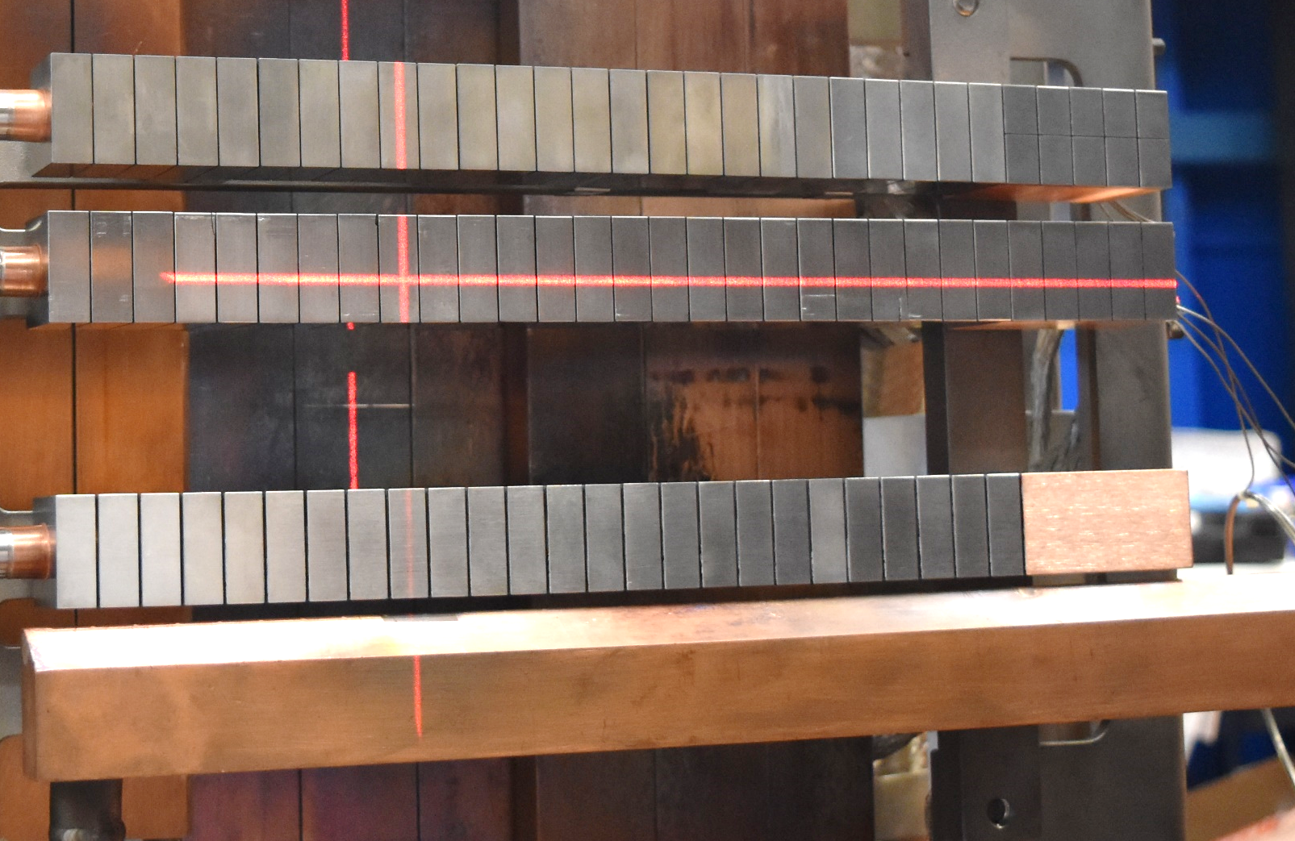
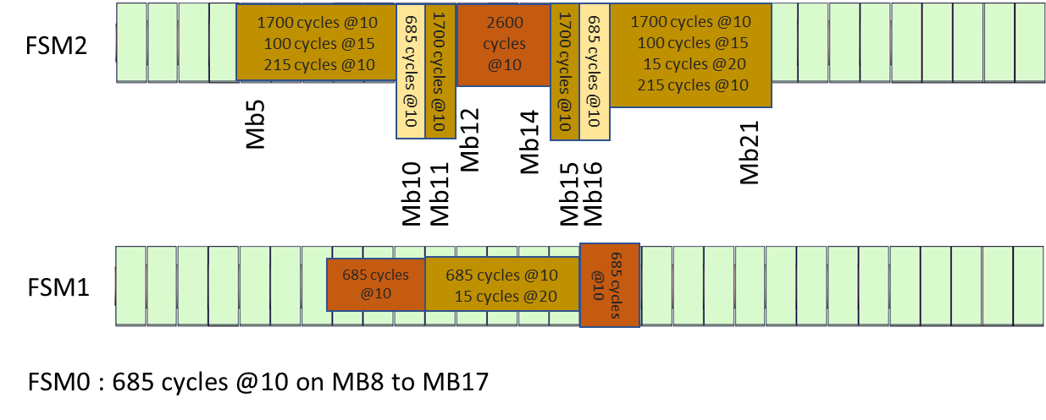
High heat flux tests of full-scale mock-ups
Potential thermal imperfection detected on SATIR before HHF tests
FSM02, loading 2x 10 blocks Mb5 &Mb14 and M12 & Mb21
FSM01, loading between Mb8 & Mb17
FSM00, loading on calibrated defaults, between Mb8 & Mb17
Flat tile
FSM02
FSM01
Mb1
Mb13
FSM00
Mb8
Mb17
Up to 2600 c@10 MW/m² (Monoblock part)
Some cycles at 15MW/m² and 20 MM/m²
14s Beam ON (@10 and 15 MW/m²)

Slide 17
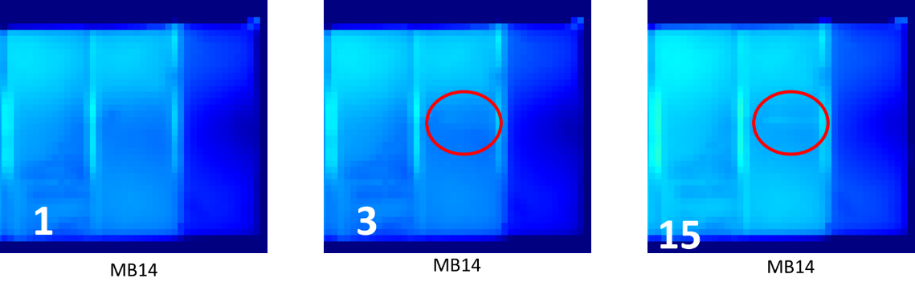
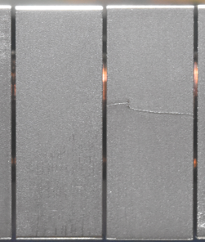
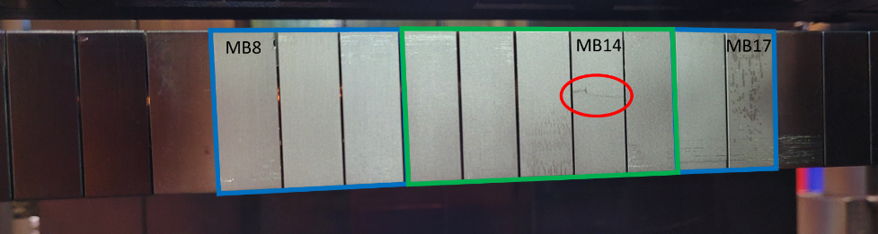
Preliminar analysis
Summary of heat loads on FSM1 for the different blocks
IR pictures during cool down phase, during the step related to the test at 20 MW/m²
 | # cycles | Heat flux (MW/m²) | Duration on (s) | Duration off (s)
Blue framed zones | 685 | 10 | 14 | 66
Green framed zones | 685 | 10 | 14 | 16
 | 2 | 5 | 14 | 14
 | 3 | 15 | 14 | 14
 | 15 | 20 | 2 | 17
 | 2 | 5 | 14 | 14
Analysing the IR films, it is clear that this crack had appeared during 20MW/m² cycles, precisely the cool down phase. It appeared after the 3rd shot, and did not show large evolution during the cycles.
Results of SATIR tests pending
Sent to RTC (company) for examinations
M. Richou | W transition meeting | 28th of April 2026

Slide 18
Nest steps
F4E qualification : finalise the analyses (SOFT + Publication outside conference )
Summary of the performance of the advanced concepts (BACM, TCM, SOFT)
2026 mid-term meeting in Garching 21st and 22nd of June (combined with WPDIV W7X)

