Slide 1

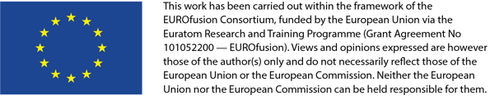
MECS-CREATE interface
23 April 2026
G. De Tommasi, F. Fiorenza
on behalf of CREATE Team

Slide 2
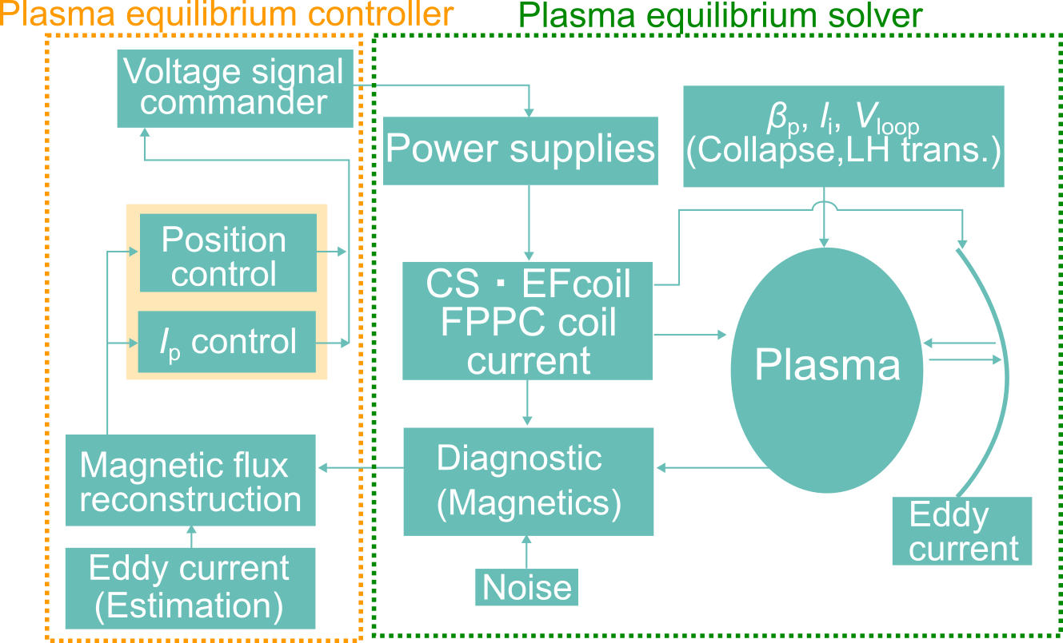
Scope
MECS code was used in integrated commissioning (IC) on JT-60SA and will be used in OP-2, including auto-shape control and fast plasma position control by in-vessel coils.
MECS solves the free boundary equation in each time-step and controls the position and Ip.
Slow Calculation (Ts = 0.250 ms)
High Accuracy
Plasma Equilibrium Control is integrated in MECS
External Controllers cannot be tested on MECS
MECS interface with other codes may be useful in next OP

Slide 3
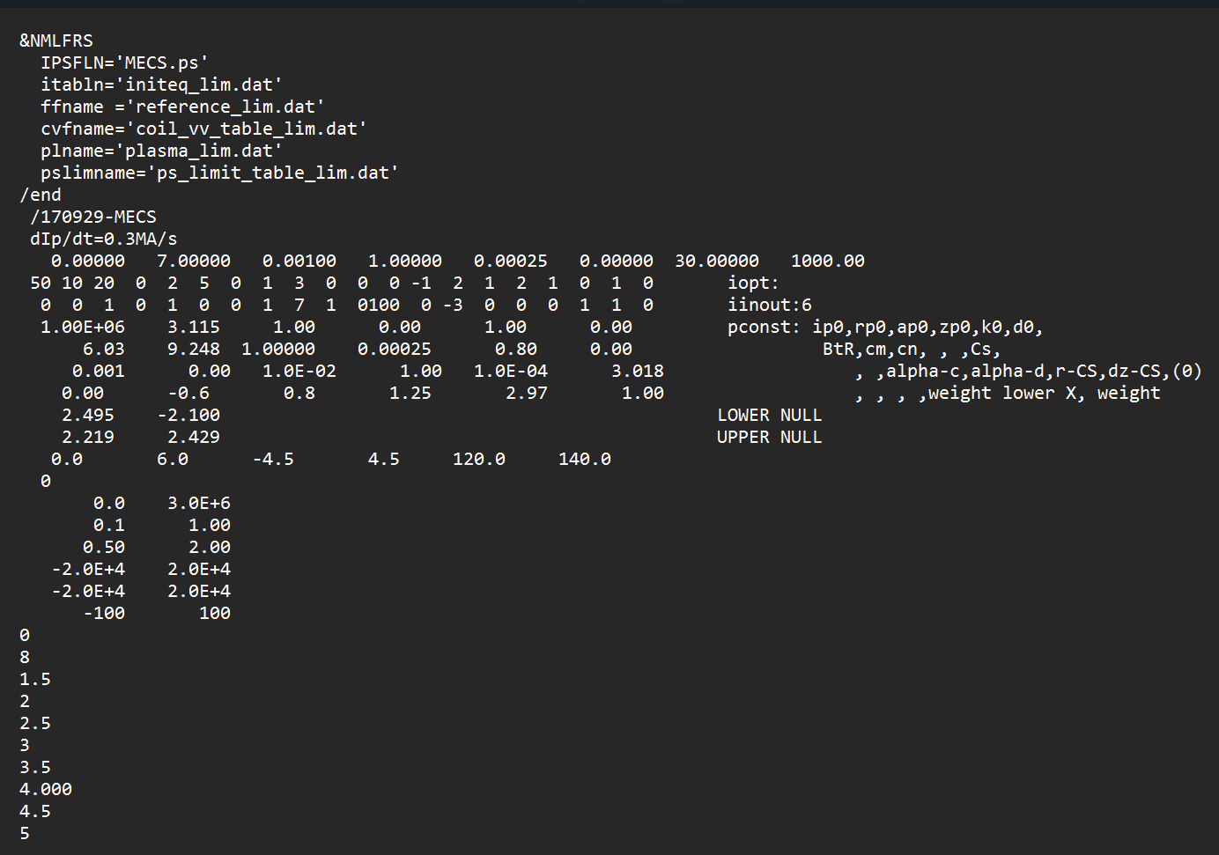
MECS-CREATE Interface
Together with Kojima-san we developed an interface to test CREATE controllers and models
MECS runs for one iteration
Writes outputs on a text file
MECS stops and waits for trigger
External controller computes input voltages
It writes voltages on a text file
It triggers MECS and stops
Exploiting this interface we could
Benchmark CREATE plasmaless models
Test CREATE Plasma Equilibrium Controllers

Slide 4
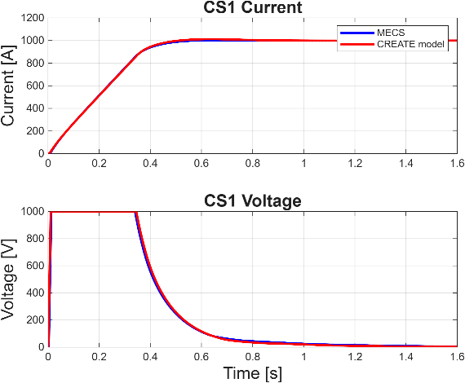
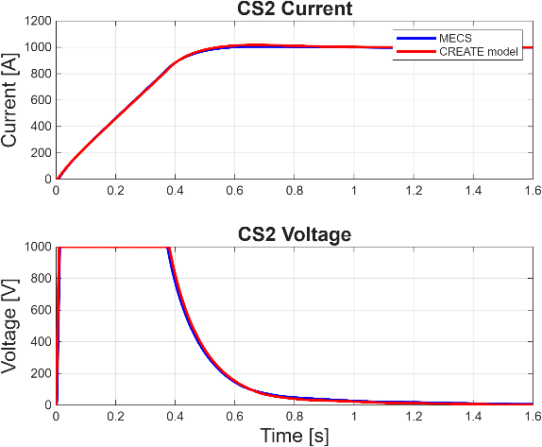
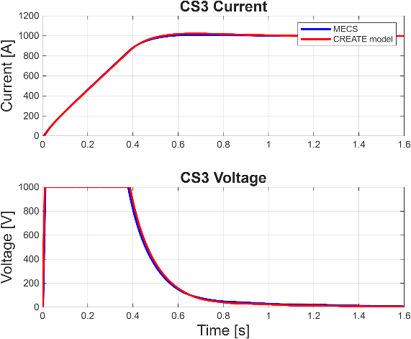
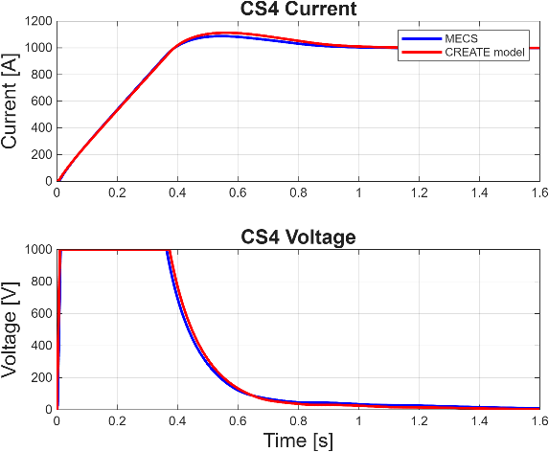
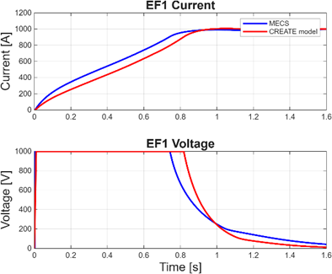
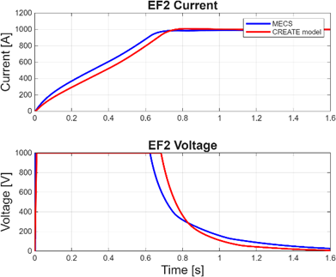
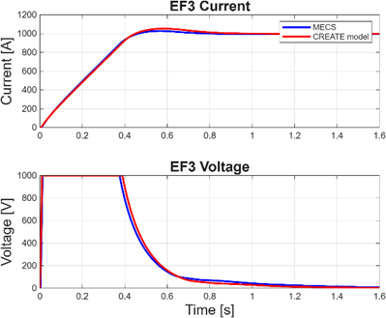
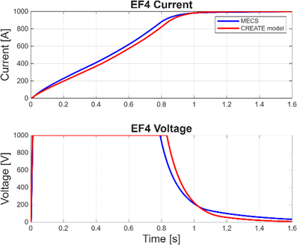
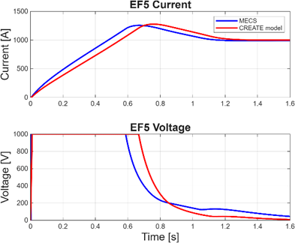
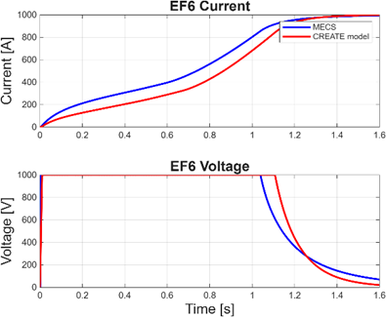
Plasmaless tests
An active current controller was tested on MECS and compared against CREATE linear model simulations
Plasmaless simulations can take up to 1-2 hours with MECS (linear model takes less than 1 s)

Slide 5
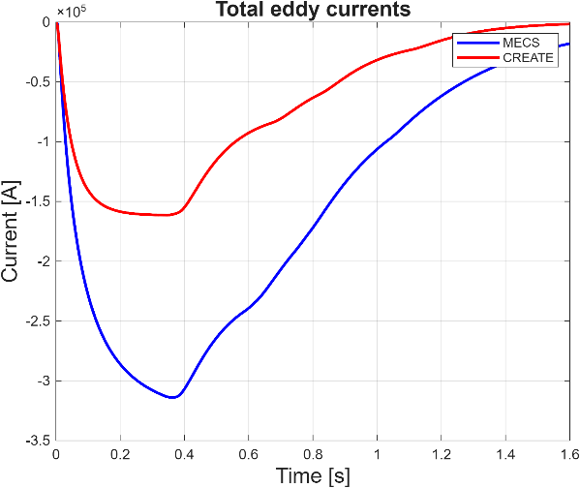
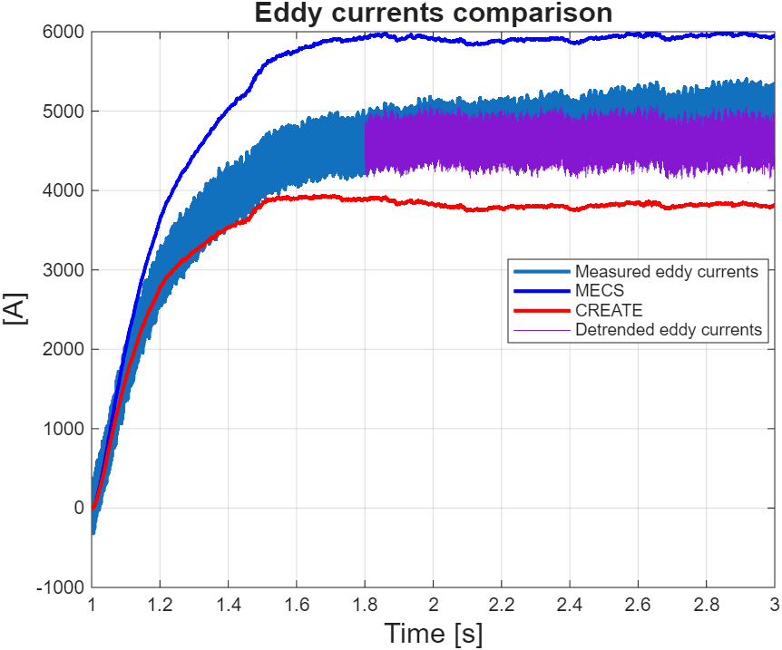
Plasmaless tests
The self and mutual inductances of the coils are almost equal
The observed difference arise from a different vessel description
Coils | Inductance MECS | Inductance CREATE
CS1 | 0.2889 H | 0.2893 H
EF6 | 0.7125 H | 0.7149 H
EF6-EF5 (mutual inductance) | 0.1867 H | 0.1884 H
A broader comparison exploiting experimental data has also been carried out
CREATE linear model captures well the vessel dynamics

Slide 6
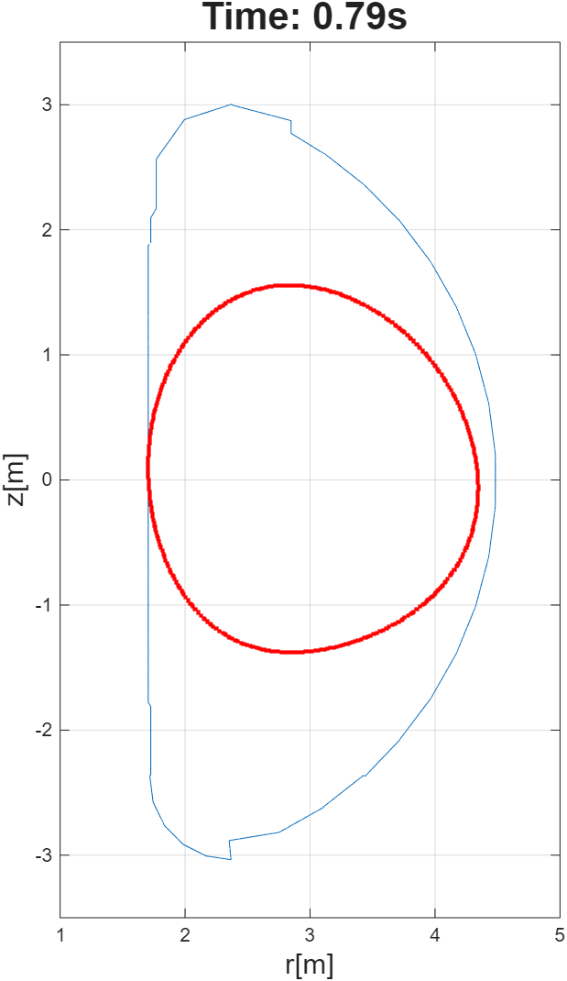
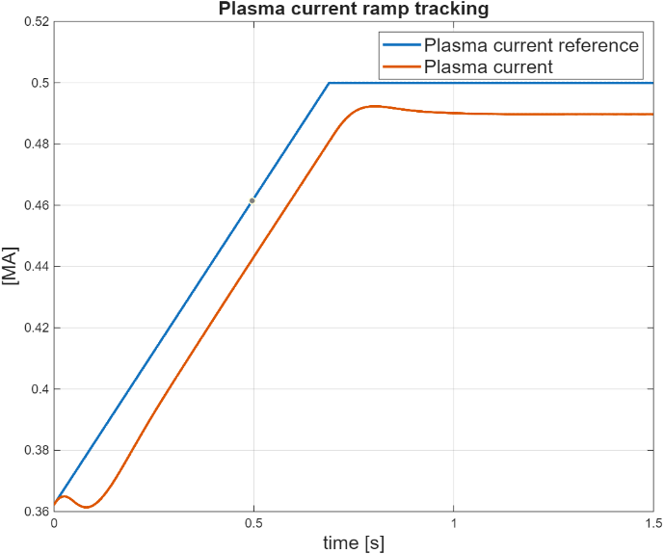
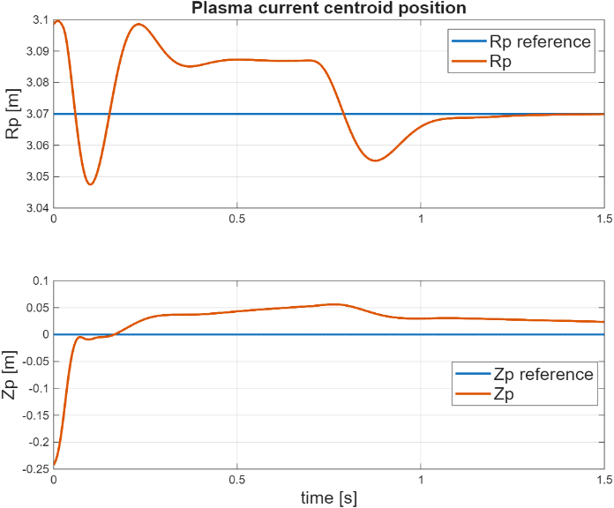
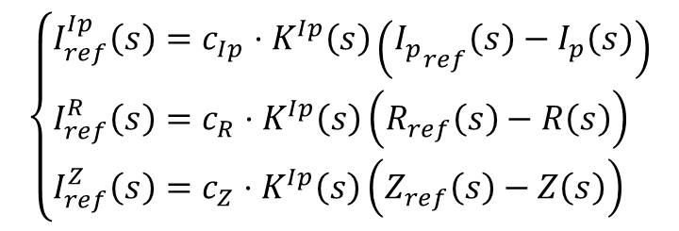
RZIp Control – limiter plasma
Control directions have been computed with CREATE linearized models
They generates current references for the PF current controller
They have been tested on MECS exploiting the interface
$$\left\{\begin{aligned}&I_{ref}^{Ip}\left(s\right)=c_{Ip}⋅K^{Ip}\left(s\right)\left({I_{p}}_{ref}\left(s\right)−I_{p}\left(s\right)\right) \\ &I_{ref}^{R}\left(s\right)=c_{R}⋅K^{Ip}\left(s\right)\left(R_{ref}\left(s\right)−R\left(s\right)\right) \\ &I_{ref}^{Z}\left(s\right)=c_{Z}⋅K^{Ip}\left(s\right)\left(Z_{ref}\left(s\right)−Z\left(s\right)\right)\end{aligned}\right.$$

Slide 7
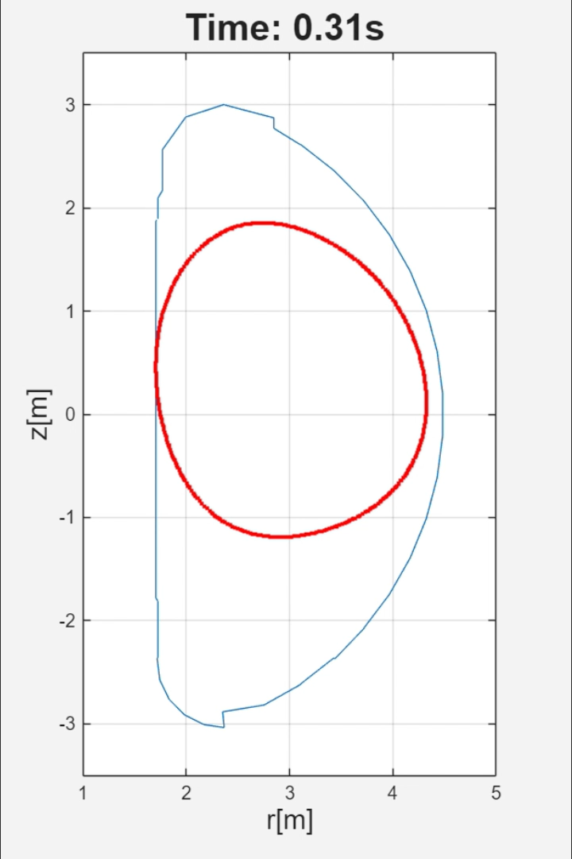
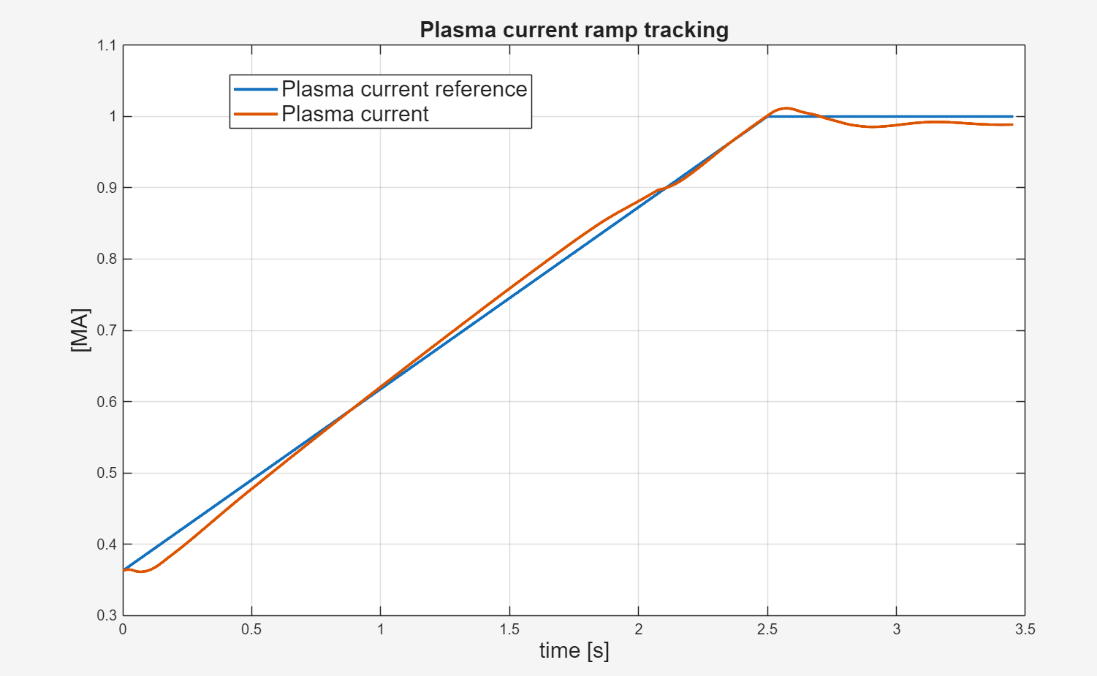
RZIp Control – diverted plasma
Exploiting feedforward currents a diverted 1 MA has been achieved on MECS
MECS can now run with desired sampling time to speed up simulations
Up to now Ts=0.250 ms was fixed

Slide 8
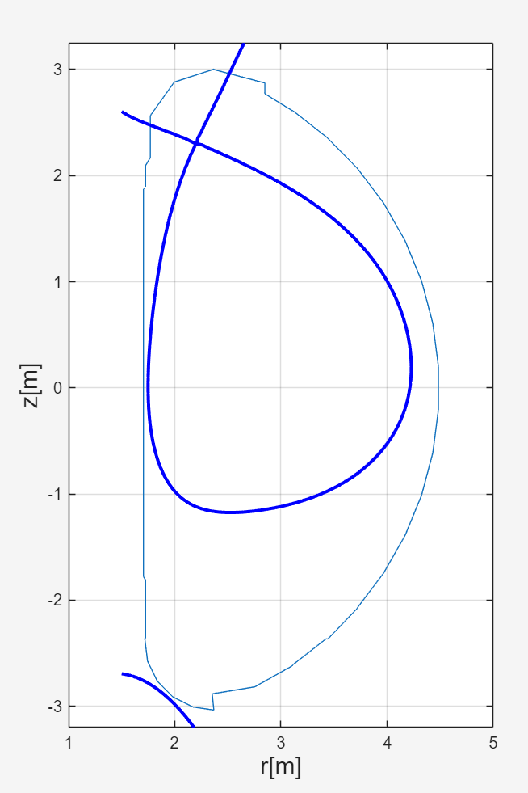
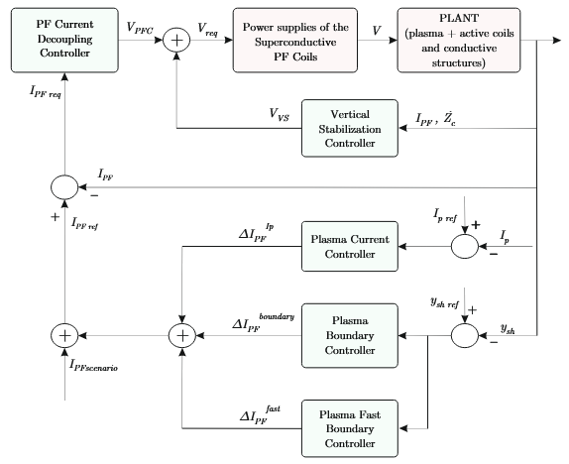
Advanced control tests
We initialized MECS to a 1 MA diverted plasma to test advanced control logic
This control system has been designed entirely exploiting CREATE-NL linear models

Slide 9
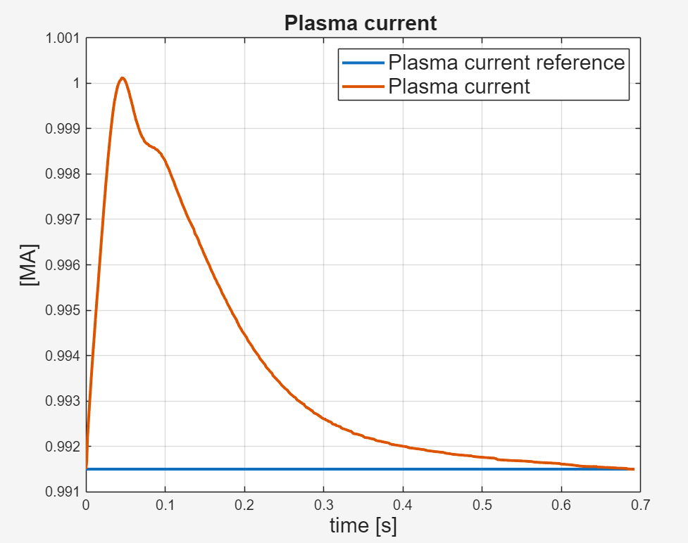
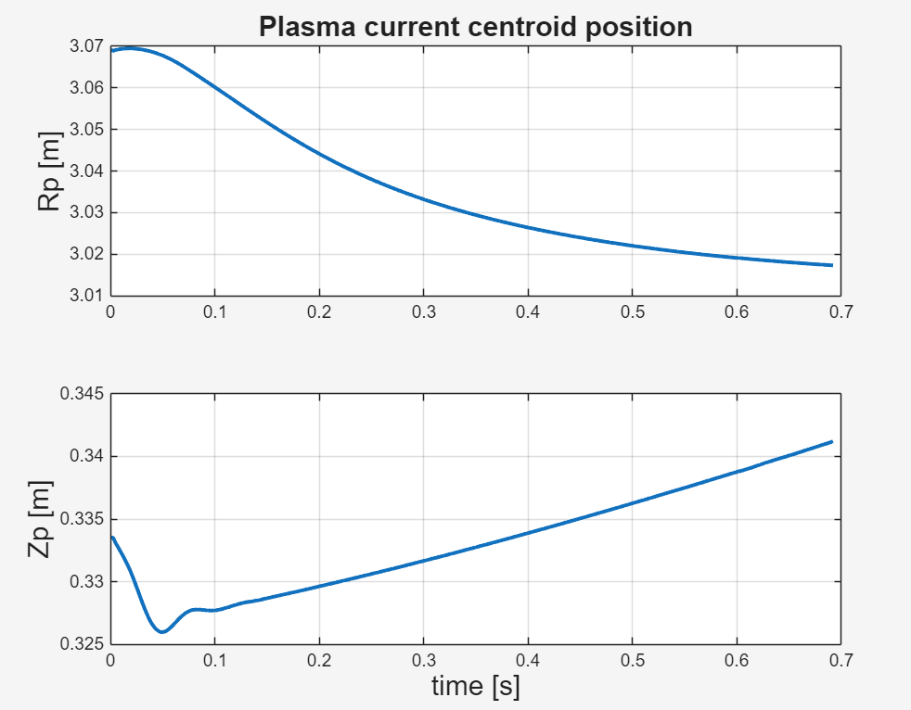
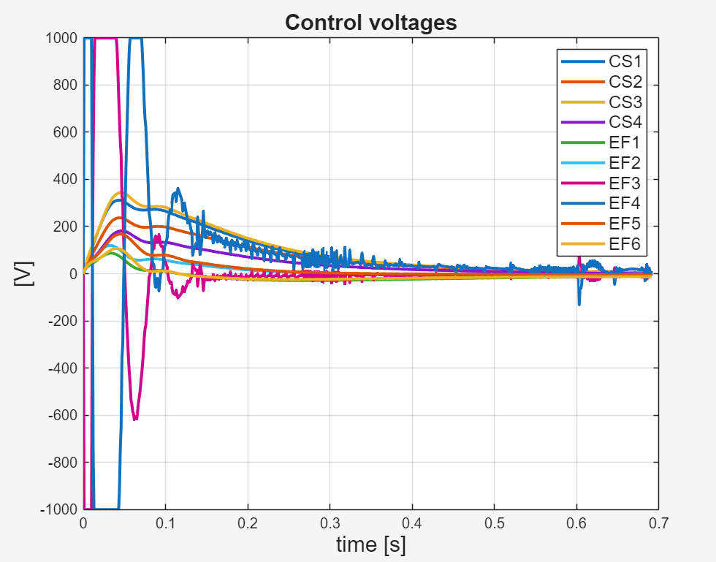
Advanced control tests
We achieved preliminary results using VS and plasma current controller
Plasma shape control still not working properly on MECS
Next step is to compute linear models from MECS equilibria to investigate

Slide 10
Conclusions
With QST help, we developed an interface to test controllers not designed with MECS
Using this interface we could:
Test PF Current Controller
Validate CREATE plasmaless linear model
Test RZIp controller designed on linearized plasma model computed with CREATE-NL
Still some work is needed to complete assessment of advanced control schemes
Controllers could be designed on linear models and then tested on MECS as final assessment. This would allow to drastically reduce MECS simulation time

