Slide 1





Consolidation of JT-60SA Pulse Design Simulator
Emmanuel Joffrin
CEA/IRFM, Centre de Cadarache, France
J.F. Artaud (CEA), M. Mattei (CREATE), D. Frattolillo (EPFL), L. E. Di Grazia (CREATE), G. Giruzzi (CEA), B. Faugereras (U. Nice), V. Ostuni (CEA), W. Bin (CNR), M. Iafrati (ENEA), A. Mele (EPFL), G. Falchetto (CEA), M. Schneider (IO)
C R E A T E

Slide 2
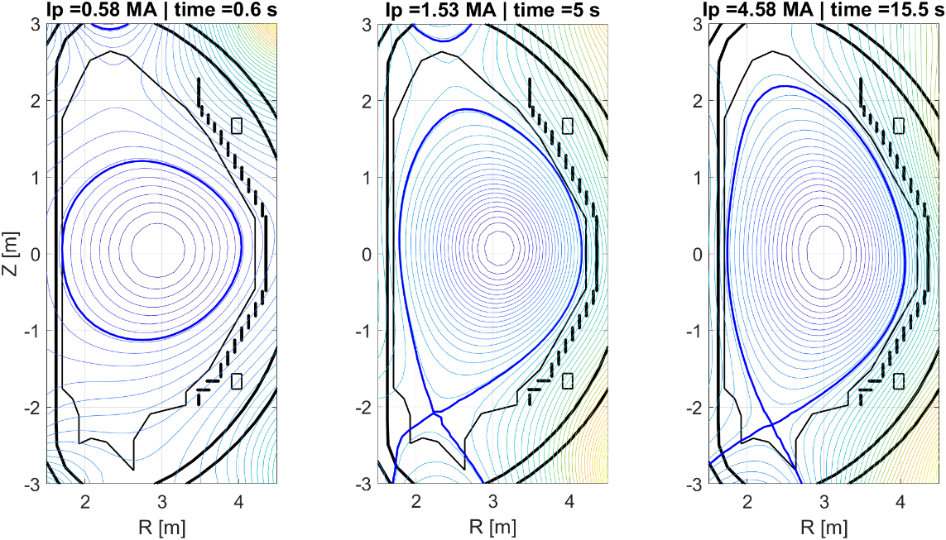
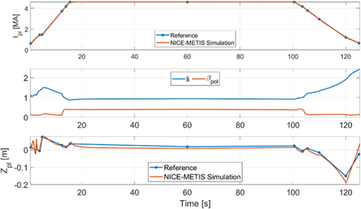
Status
A full simulation of JT-60SA scenario 4.6MA has been produced with the PDS
For the moment, the simulator is running on the EUROfusion gateway and are not those of JT-60SA.
The controllers used in the simulator have been designed in an ad hoc way.
The CPU time is still excessive (typically 1h of computing for each second) for a complete discharge and has not yet been fully optimized.
The current settings consist in using a high-resolution grid (triangular mesh consisting of approximately 9000 nodes and 19000 elements) and a step time of 2.5ms.
User manual has been produced.
See E. joffrin. Fusion Energy Conference, IAEA, Chengdu 2025

Slide 3
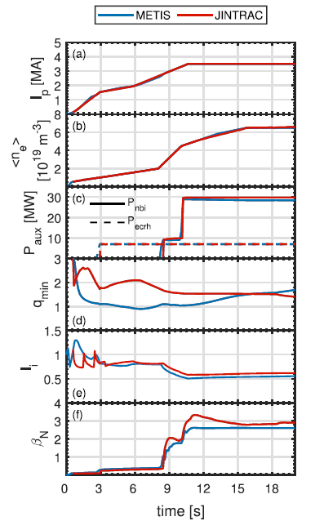
Plans for the 2026 deliverables
1- Consolidation
Test the simulator with a less refined mesh to reduce CPU time
Introduce the JT-60SA QST controller into the PDS
Train expert users (planned but awaiting for the gateway issue)
From 9 to 16 :30 each day | Content
Monday | Introduction to JT-60SA device Introduction to the simulator (modules, numeric, etc …) Introduction to the controllers Methodology for running the simulator
Tuesday | List of exercises for the week. Practical exercises with the different modules of the simulator separately and creation of the scenario (EGENE, METIS, FEEQS).
Wednesday | Run the full simulator with the controller on parts of the scenario and test controller design.
Thursday | Run the full simulator with the controller on parts of the full scenario
Friday | Finalize the full scenario run with its controllers. Debriefing and wrap-up
2- Application of the PDS to the hybrid scenario
​ | Ip/Bt (q95)​ | b_{N}​ | H_{H}​ | f_{GW}​
OP2 Baseline​ | 4.6 MA/2.28 T (q₉₅ ~ 3)​ | < 1.8​ | ~ 1​ | 0.4-0.6​
OP2 Hybrid​ | 2.7-3.5 MA/1.70 T (q₉₅ ~ 4)​ | ~ 2​ | > 1.1​ | > 0.4​
OP2 ITB​ | 1.7-2.0 MA/1.70 T (q₉₅ > 6)​ | > 3.5​ | > 1.2​ | > 0.5​
See S. Gabriellini Nucl Fus 2025

