Slide 1

WPSA – 2026 task specifications
Tools development in support of OP 2 magnets operation
ENEA - Chiarasole FIAMOZZI ZIGNANI, Gianluca DE MARZI
CEA - François BONNE, Quentin LE COZ

Slide 2
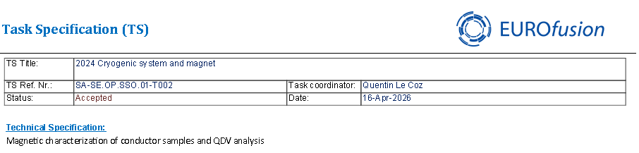
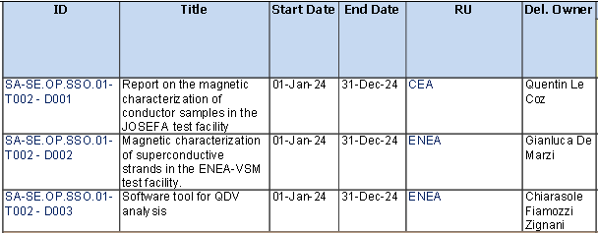
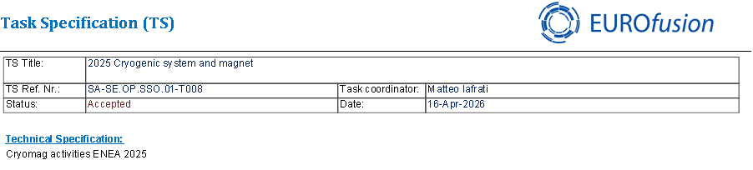
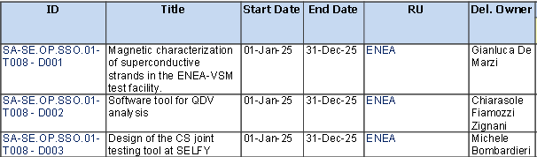
Task Specifications: 2024 & 2025
2024
2024 and 2025 activities completed → deliverable uploaded and approved
2025
SA-SE.CM.OP.06-T003-D001 «Simcryogenics model development for JT-60SA operation” (Francois Bonne)
developed tools include:
J_{c} parameterization and assessment of hysteresis loss in CEA experiments
Th simulations of EF coils
TF QDV data retrieval and manipulation
Symcryogenics: global FSD of the loop 2 magnets EF + CS
SA-SE.OP.SSO.01-T007 “2025 Cryogenic models” (Francois Bonne)

Slide 3
Task Specifications - 2026
Tools development in support of OP 2 magnets operation.
Update of the magnet THEA models (settings and code consolidation) in preparation of OP 2.
In order to improve the accuracy and reliability of THEA simulations, the J_{c} laws will be consolidated and cross-checked. Also, the updated friction factor correlations will be implemented in the models. The resulting J_{c}(B,T,ε) parameterization will be implemented in the THEA software, to update and consolidate the thermo-electro-magnetic models. The updated models, including the refined parameterization of the critical surface, will be used in quench simulations under different operational scenarios to assess hot-spot temperatures and thermal margins, related to OP 2.
Based on the 2025 activities where the expected behaviour of magnets of loop 2 (PFs) were calculated in case of global FSD at 20 kA current, we will calculate the profile of power that is going to be extracted by the bath. The deliverable will include comparison with loop 1 FSD to have a better understanding of what to expect from the bath/refrigerator point of view in the PF FSD case.
The TFQDV signal processing activities will be devoted to the validation and the consolidation of software tool (ANN-based) aimed at TFQDV signal retrieval, correction and transmission to TF interlock system.
2 PM shared between 2 institutes (1 PM each): CEA (F. Bonne, Q. Le Coz), ENEA (G. De Marzi, C. Fiamozzi Zignani)

Slide 4
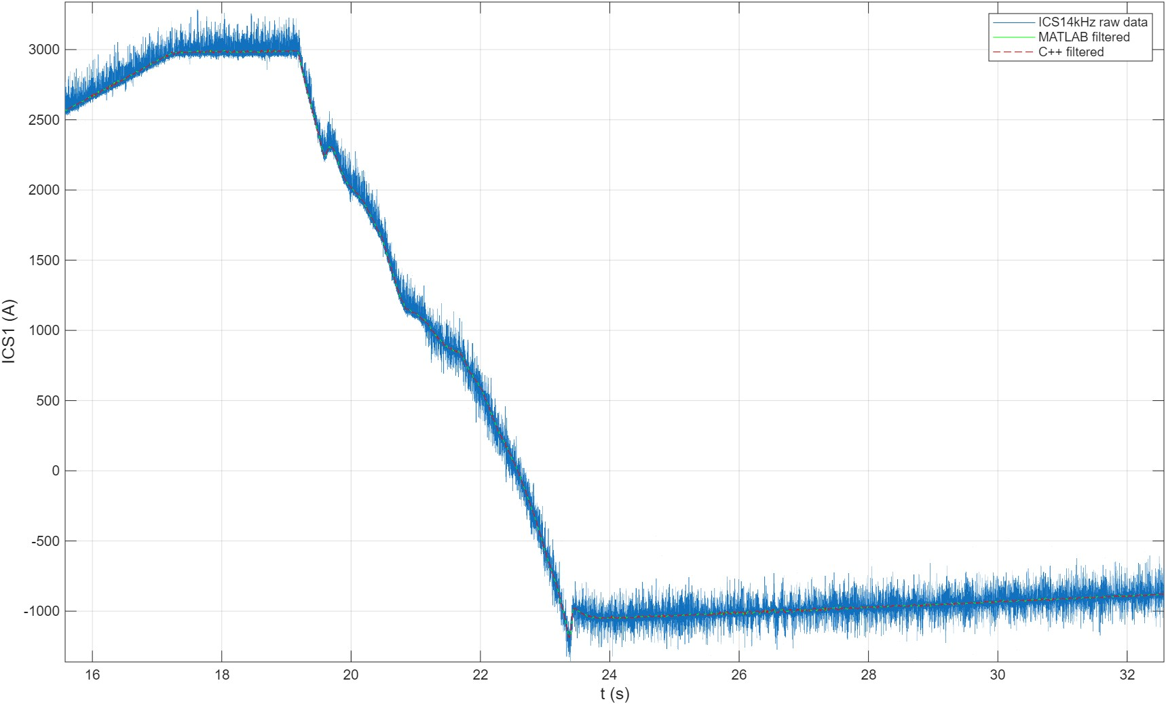
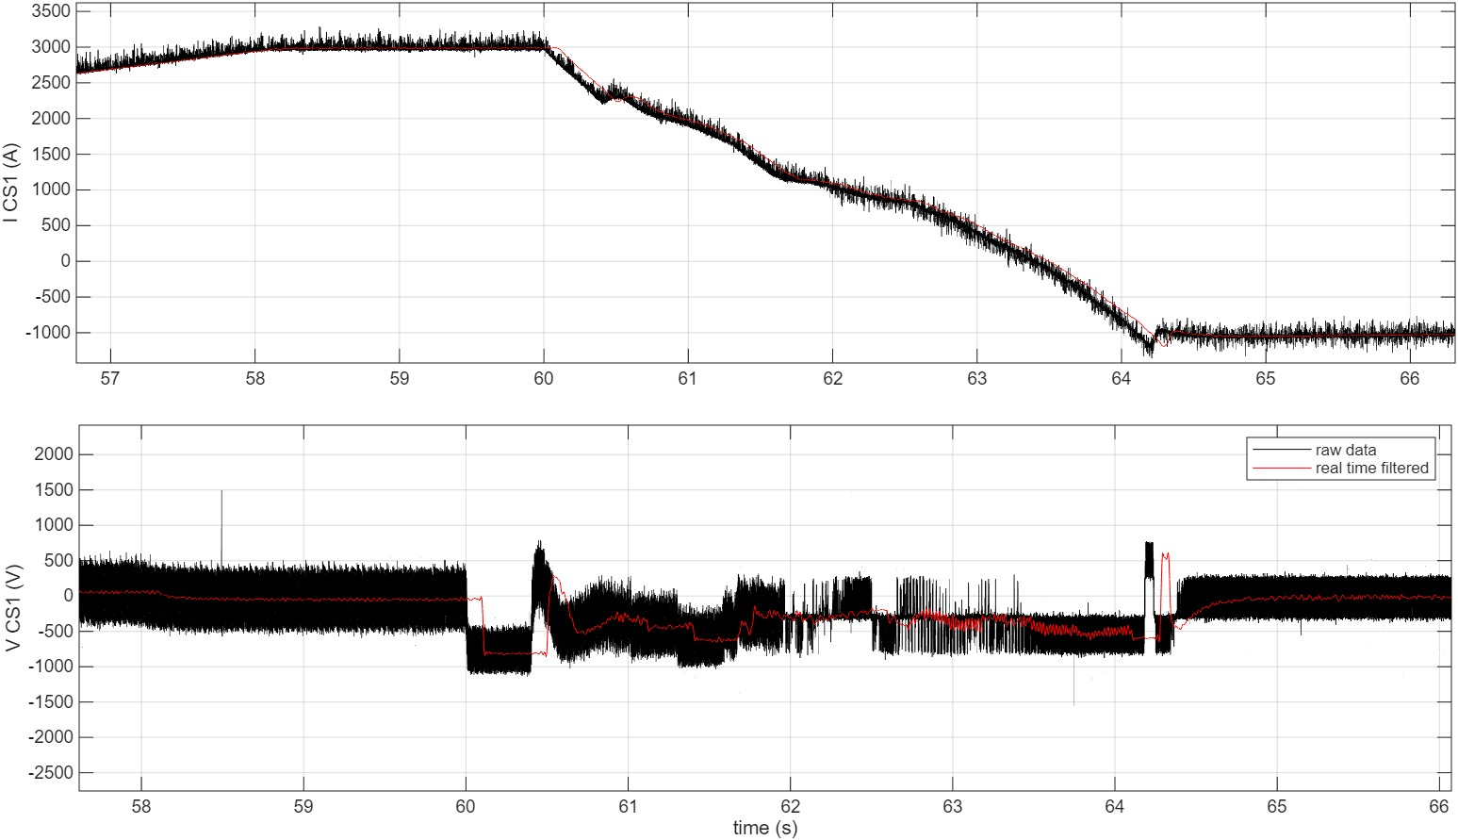
Update on 2026 task activities
Thea models → Spiral tests are foreseen
Jc parametrization:
Consolidated and cross-checked the Jc parametrization, with the aim to establish a common framework between CEA and ENEA codes
Introduced a low field cut-off in the Jc formulation
TFQDV signal processing activities
Filter lenght =800 → delay 400 samples → 0.1s= 100ms
Real-time filtering shown → delay assessed (3 cases)
Next tests: all U_{PF} filtered, to be evaluated with the TFQDV software. For ex. cases with N= 1600 & 200.
update on the QST scheme of workflow for data process

Slide 5
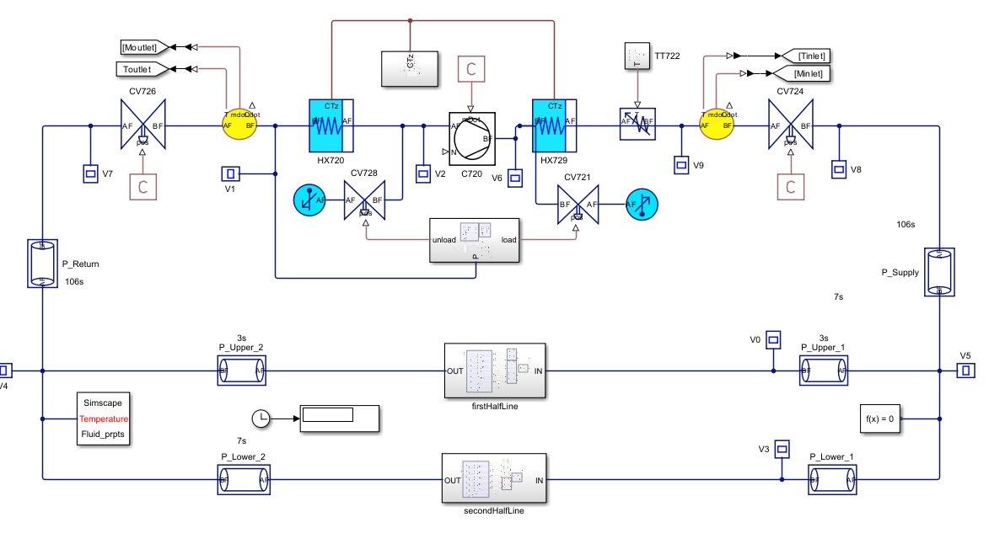
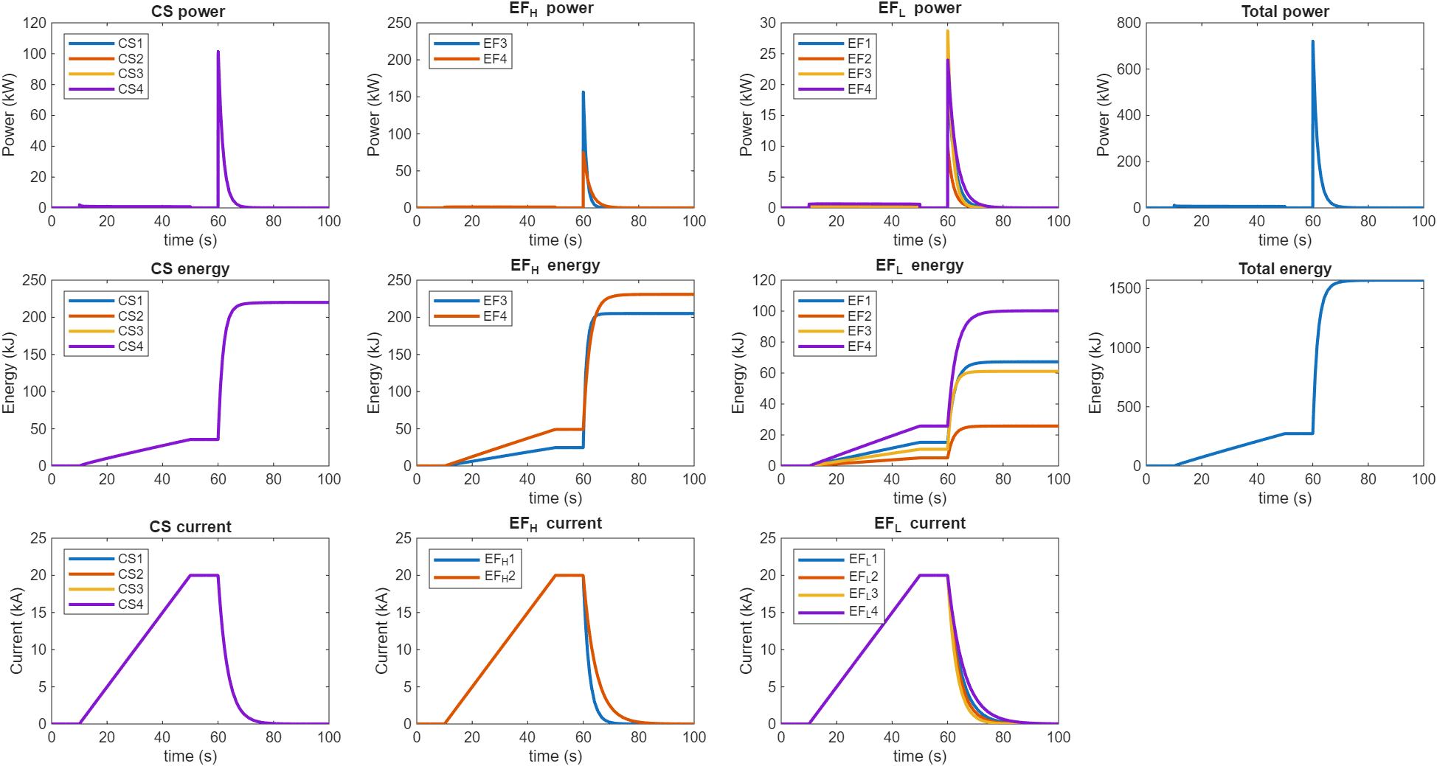
Update on 2026 task activities
Simcryogenics modeling of loop 2 : energy assessment and bath behavior
The global FSD of the loop 2 magnets EF + CS has been performed in 2025. Final checks will be done to verify that the energy deposited on the magnets in case of FSD in matching other code, and the behavior of the thermal buffer will be predicted.
Simcryogenics modeling of loop 2
Power, energy and current in case of PF magnet FSD

Slide 6
Thanks for your attention

