Slide 1
Data analysis tools adapted to OP-2
E. Giovannozzi, E. Alessi

Slide 2
Actions
Program show
  This is under active development on JT60-SA, MASTU and JET.
  Get the most updated version to JT60-SA
SXR analysis
  The program has been ported from MASTU to JT60 in the previous OP1
  It is looking only to horizontal chords. This allows a simple interpretation on what is seen perfect for a control room tool.
  For OP2 one has to remove one of the array with the Be window not present anymore.
  Possible updates linked to the additional SXR arrays added in OP2.
MHD analysis
  Possible improvement to be deviced.
  The poloidal analysis is not working as expected. The actual one has been ported from MASTU.
  Additional coherencee with Te or SXR to be implemented as that done on JET.
Other tools related to the other new diagnostic that will be installed in OP2

Slide 3
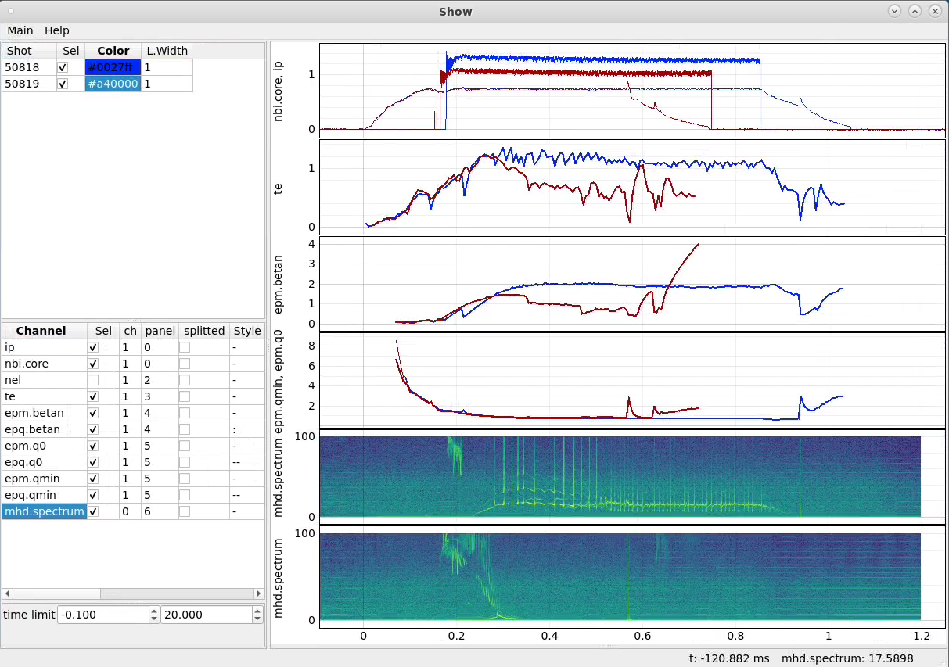
Show
Example from MAST-U
A version exists also on JT60-U.
Can read standard sets.
Can select available data.
Other features can be added.
Etc.

Slide 4
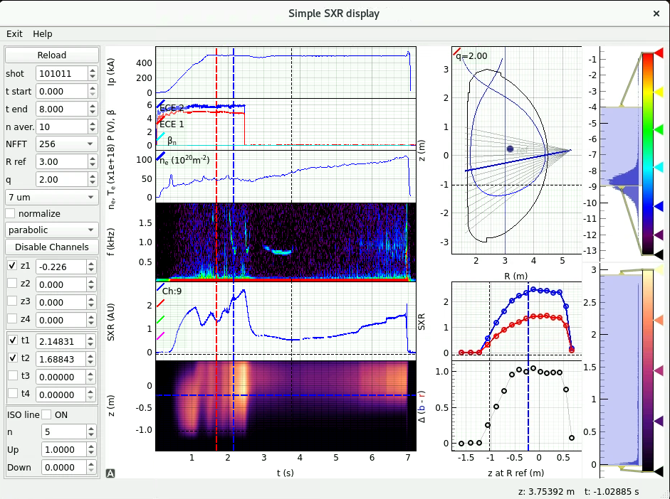
SXR
The program read both 7um and 50um array and estimate a plasma temperature.
It can be used to show the difference between two profiles-
It makes an FFT of one channel (the blue one)
The profiles are function of the z intersection of the chords with a vertical line.
How to extend it to multiple SXR Array not so obvious.
We may add additional panels with a sort of fast tomographic inversion. And some correlation with the mhd signals.

Slide 5
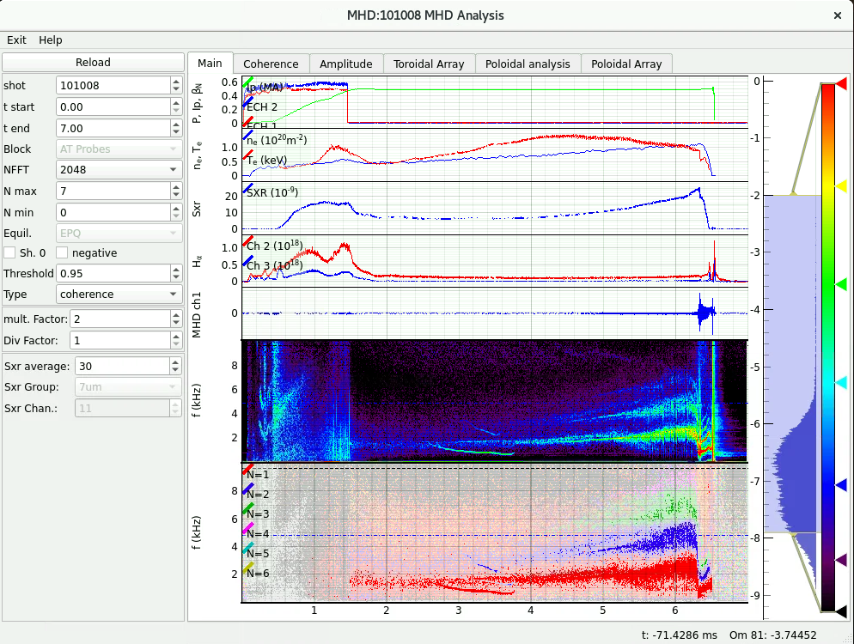
MHD Analysis
The main panel shows some plasma quantities together with the spectrum and the toroidal number reconstruction.
The Te is calculated from the ratio of two central SXR chords. An actual Te measurement will be use when available

Slide 6
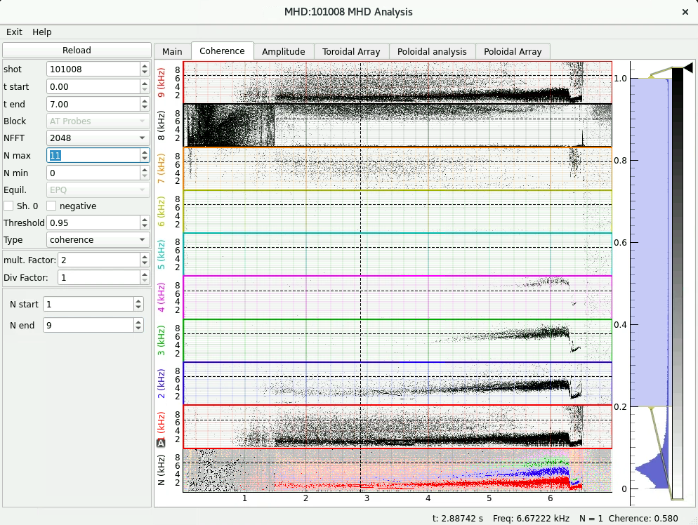
MHD Analysis
The coherence panel show it for the different mode numbers.
It can be used in case of aliasing.
The actual toroidal array evidently has 8 equally spaced coils, making N=1 and N=9 indistinguishable.

Slide 7
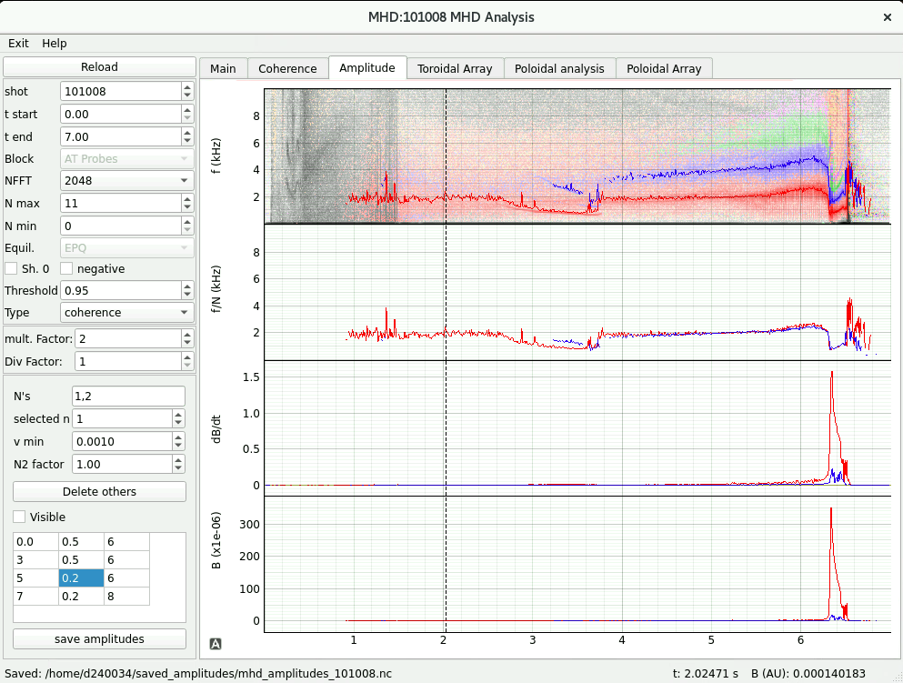
MHD Analysis
As usual one can integrate over the spectrum to get the amplitudes.
A panel shows the frequency of the mode divided for its toroidal mode number. It will be the same in case of harmonics.
The amplitudes and frequencies can be saved in a file in an xarray format (netcdf).

Slide 8
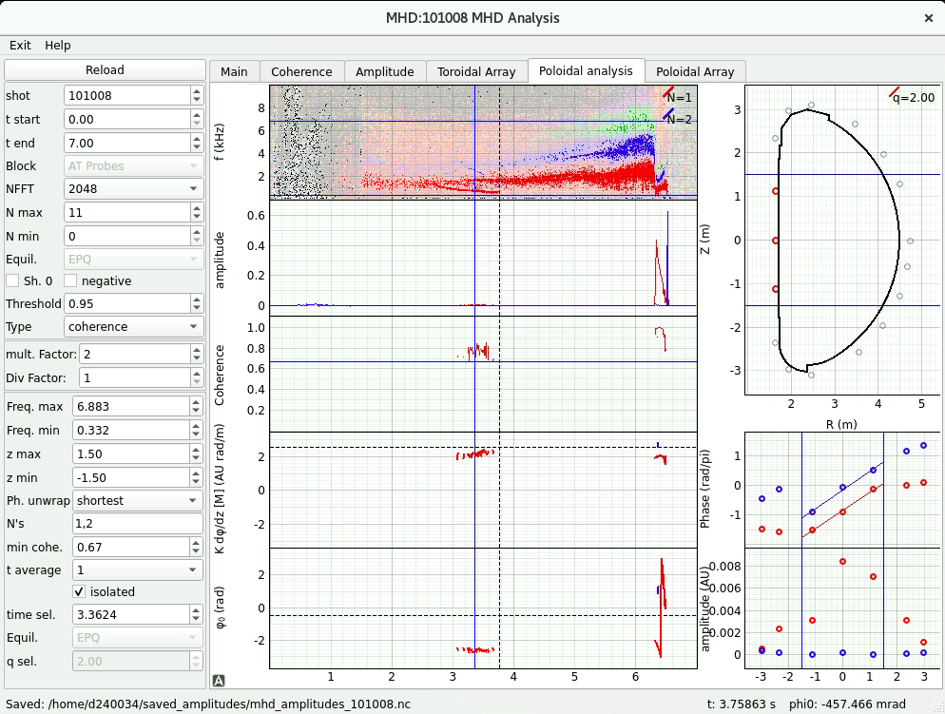
MHD Analysis
But the simple poloidal analysis algorithm that we implemented in MAST is not working well in JT60 as coils in the HFS are too far away one from the other.
We may need something cleverer to devise.

Slide 9
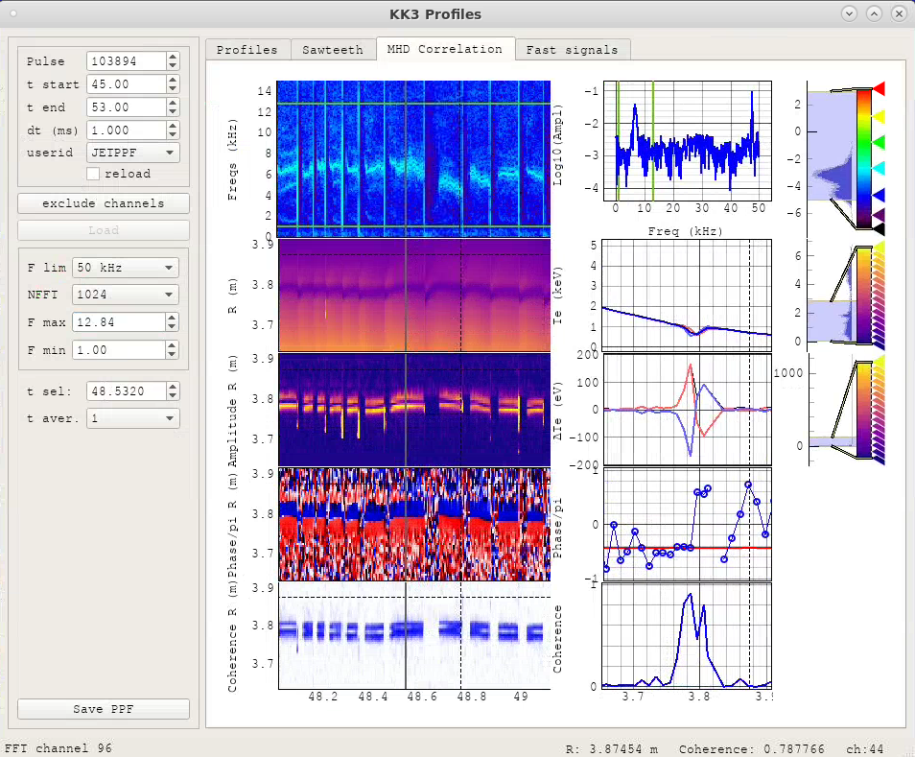
TE or SXR correlation like in JET
The correlation of the electron temperature with the MHD is shown here.
One can measure the amplitude, the phase and the coherence and the position of the modes.
The implementation on JT60 depends on the actual data.

Slide 10
Conclusion
It is a work in progress.
I like to work with actual data to see if it really works.
Different algorithms could be tested and a selection of them could be used (correlation between SXR vs SVD to be extended to ECE, SXR Tomography, etc.).
The main constraint is that they should be fast enough for control room (show, MHD, SXR and otyher tools).
But of course, they can also be used for some detailed analysis

