Slide 1


SA-SE.CM.OP.07-T002:
EC HCD and ECE modelling tools
WPSA Code Management 2026 tasks – Kick-off Meeting
L. Figini¹, M. Guerini Rocco^{1,2}, C. Tsironis³
¹Institute for Plasma Science and Technology – CNR Milan, Italy (ENEA)
²Università degli Studi di Milano – Bicocca, Italy (ENEA)
³National Technical University of Athens, Greece (NCSRD)

Slide 2
Task description
The task aims at providing simulation software for EC waves, both to prepare plasma operation and to analyze experimental results, modelling:
The EC HCD optical system
The ECE diagnostic antennas configuration
The interaction of EC waves with the plasma
Deliverable D001: Consolidation of EC HCD and ECE modelling tools
Consolidation of EC HCD and ECE modelling tools (GRAY and SPECE) for use in the control room
Implementation of input data interface
Testing on Naka server
Resources: 2PM (1PM ENEA + 1PM NCSRD)

Slide 3
2025 results and current status (1/2)
Simulation tools installed on the Naka server
  GRAY, for EC Heating and Current Drive (H&CD) computation
  SPECE, for Electron Cyclotron Emission (ECE) diagnostics data analysis
CLI interface
  Parameters configuration
  Run code
Python module (GRAY)
  Input/output data import as NumPy struct arrays
  Script for input/output data visualization
JT-60SA EC HCD optical model
  Integrated Commissioning / OP1 launcher (no mirrors)
  Complete EC launcher (full optical system)
  82 GHz model copied from 110 GHz model. Beam divergence needs to be adjusted
ECE diagnostics configuration still missing (line-of-sight, antenna pattern, frequency range)

Slide 4
2025 results and current status (1/2)
Simulation tools installed on the Naka server
  GRAY, for EC Heating and Current Drive (H&CD) computation
  SPECE, for Electron Cyclotron Emission (ECE) diagnostics data analysis
CLI interface
  Parameters configuration
  Run code
Python module (GRAY)
  Input/output data import as NumPy struct arrays
  Script for input/output data visualization
JT-60SA EC HCD optical model
  Integrated Commissioning / OP1 launcher (no mirrors)
  Complete EC launcher (full optical system)
  82 GHz model copied from 110 GHz model. Beam divergence needs to be adjusted
ECE diagnostics configuration still missing (line-of-sight, antenna pattern, frequency range)
$ gray -c inputs/gray.ini -g raytracing.nrayr=1 -g raytracing.ipass=1 -g antenna.fghz=82 -g antenna.iox=MODE_O -v
[0006963] [main] [info] using GRAY INI config
[0039175] [gray_tables:find_flux_surfaces] [info] constant ψ surfaces for:
[0039202] [gray_tables:find_flux_surfaces] [info] q=1.50 ψ_n=0.382 ρ_p=0.618 ρ_t=0.503
[0039211] [gray_tables:find_flux_surfaces] [info] q=2.00 ψ_n=0.618 ρ_p=0.786 ρ_t=0.692
[0039218] [gray_core:gray_main] [info] initial position: 521. 0.00 177.
[0039223] [gray_core:gray_main] [info] initial direction: α=36. β=0.0
...
[0074726] [main] [info] total absorption: P=0.208E-1 MW
[0074728] [main] [info] total current drive: I=0.132E-2 kA

Slide 5
2025 results and current status (1/2)
Simulation tools installed on the Naka server
  GRAY, for EC Heating and Current Drive (H&CD) computation
  SPECE, for Electron Cyclotron Emission (ECE) diagnostics data analysis
CLI interface
  Parameters configuration
  Run code
Python module (GRAY)
  Input/output data import as NumPy struct arrays
  Script for input/output data visualization
JT-60SA EC HCD optical model
  Integrated Commissioning / OP1 launcher (no mirrors)
  Complete EC launcher (full optical system)
  82 GHz model copied from 110 GHz model. Beam divergence needs to be adjusted
ECE diagnostics configuration still missing (line-of-sight, antenna pattern, frequency range)
$ python
>>> import gray
>>> d = gray.read_table(‘’)
>>> type(d)
<class 'numpy.ndarray’>
>>> d.shape
(501,)
>>> d.dtype.names
('ρ_p', 'ρ_t', 'J_φ', 'J_cd', 'dPdV', 'I_cd_inside', 'P_inside', 'Trad_inside', 'index_rt')
$ gray-visual -h
usage: gray_visual [-h] [--kind {raytracing,beam,profiles,inputs} [{raytracing,beam,profiles,inputs} ...]] [--outfile FILE]
[--interactive] [--legend | --no-legend]
inputs outputs

Slide 6
2025 results and current status (1/2)
Left WG – 138 GHz
Simulation tools installed on the Naka server
  GRAY, for EC Heating and Current Drive (H&CD) computation
  SPECE, for Electron Cyclotron Emission (ECE) diagnostics data analysis
CLI interface
  Parameters configuration
  Run code
Python module (GRAY)
  Input/output data import as NumPy struct arrays
  Script for input/output data visualization
JT-60SA EC HCD optical model
  Integrated Commissioning / OP1 launcher (no mirrors)
  Complete EC launcher (full optical system)
  82 GHz model copied from 110 GHz model. Beam divergence to be adjusted
ECE diagnostics configuration still missing (line-of-sight, antenna pattern, frequency range)

Slide 7
2025 results and current status (1/2)
Simulation tools installed on the Naka server
  GRAY, for EC Heating and Current Drive (H&CD) computation
  SPECE, for Electron Cyclotron Emission (ECE) diagnostics data analysis
CLI interface
  Parameters configuration
  Run code
Python module (GRAY)
  Input/output data import as NumPy struct arrays
  Script for input/output data visualization
JT-60SA EC HCD optical model
  Integrated Commissioning / OP1 launcher (no mirrors)
  Complete EC launcher (full optical system)
  82 GHz model copied from 110 GHz model. Beam divergence needs to be adjusted
ECE diagnostics configuration still missing (line-of-sight, antenna pattern, frequency range)

Slide 8
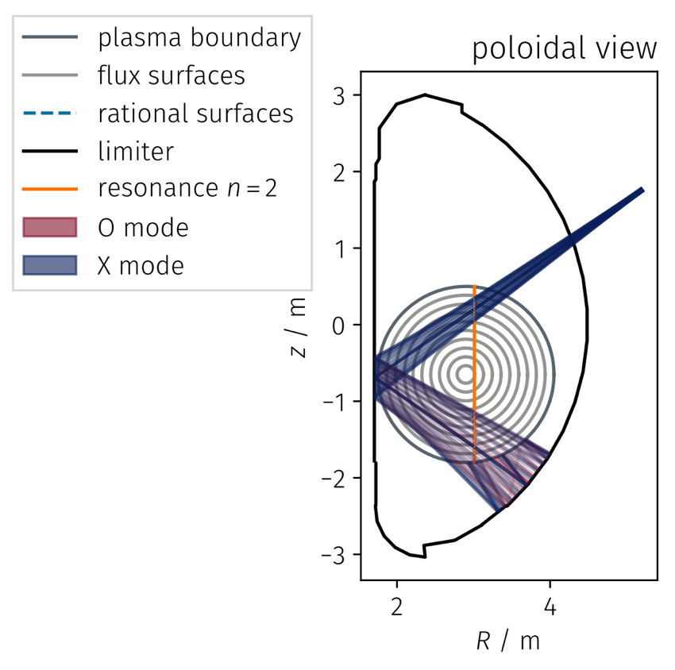
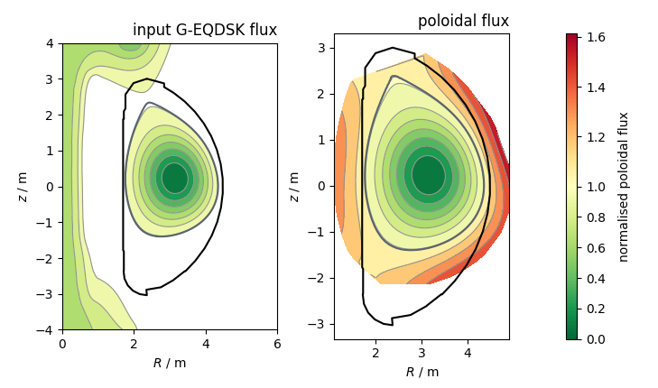
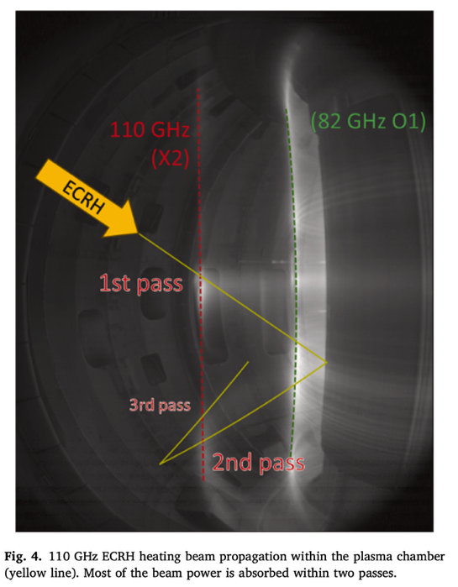
2025 results and current status (2/2)
(Preliminary) tests on JT-60SA plasma scenarios
  IC shot #1154
  (Dummy) plasma start-up configuration
ECE Computation added to GRAY (experimental, thermal plasma only)
  EC HCD and ECE modelling with a common interface
  SPECE still needed for non-thermal distributions
#1154 at t=6s
EDICAM image, from Fig. 4 in [Szepesi FED 222 (2026) 115530]

Slide 9
2025 results and current status (2/2)
(Preliminary) tests on JT-60SA plasma scenarios
  IC shot #1154
  (Dummy) plasma start-up configuration
ECE Computation added to GRAY (experimental, thermal plasma only)
  EC HCD and ECE modelling with a common interface
  SPECE still needed for non-thermal distributions
$ gray -c inputs/gray.ini -v -t all
[0007771] [main] [info] using GRAY INI config
...
[0171681] [gray_core:gray_main] [info] partial results:
[0171691] [gray_core:gray_main] [info] final step: n=11501 (s, ct, Sr)=230.0
[0171696] [gray_core:gray_main] [info] optical depth: τ_min=12.04 τ_max=12.04
[0171700] [gray_core:gray_main] [info] absoption: P=1.00 MW
[0171702] [gray_core:gray_main] [info] current drive: I=2.46 kA
[0171705] [gray_core:gray_main] [info] emission: T=11.0 keV
...

Slide 10
Work plan for 2026
Guide/automate input data preparation
  Get magnetic equilibrium from available codes (SELENE, LIUQE, CHEASE)
  Identify best sources for kinetic profiles (T_{e}, n_{e}, Z_{eff}) reconstruction
  EC launcher configuration
    Read active launchers, frequency, power, angles from DB (for exp data analysis)
    Get injection angles required to aim at a given target radius ρ (for experiment preparation)
Compute EC HCD beam model (focusing) at 82 GHz
Obtain and implement ECE diagnostics specifications
  Line of sight
  Antenna pattern
  Measured frequency range
Codes verification/validation on IC/OP1 data
Finalize interface for data visualization (ECE)
Prepare training material (documentation, small tutorials)

Slide 11
EC H&CD – GRAY
Propagation, absorption and current drive of Gaussian beams with general astigmatism (non-orthogonal optical systems) in axisymmetric plasmas
Quasi-optical ray-tracing
  accurate description of the near field region z/z_{R} ≲ 1
  requires λ << w << L
Linear plasma response
Cold-plasma approximation for propagation
Fully-relativistic formulation for wave absorption
Momentum-conserving collisions in CD calculation
IMAS version still outdated, updated IMAS interface in finalization (expected in Q2 2026)
Kinetic profiles
T_{e}, n_{e}, Z_{eff}
Magnetic equilibrium
B(R, z)
Injected EC beam
x₀, k, λ, w, R_{c}
GRAY
First wall shape
R_{w}, z_{w}
Beam path
x(s)
Shine-through & multi-pass absorption
H&CD profiles
dP/dV, J_{CD}

Slide 12
ECE – SPECE
Forward modelling of ECE spectra for diagnostics with arbitrary line of sight and astigmatic antenna pattern in tokamak plasmas with thermal or non-thermal electron distributions
Geometrical optics ray-tracing
  requires λ << L
Linear plasma response
Cold-plasma approximation for propagation
Fully-relativistic formulation and
Multi-Maxwellian distribution model for absorption and emission
Fast multi-reflection model for optically thin conditions
Simple model for T_{e} perturbation by NTMs
Partially ported in IMAS, not fully verified yet
Kinetic profiles
T_{e}, n_{e}
Magnetic equilibrium
B(R, z)
ECE antenna / detector
x₀, k₀, w₀, f_{i}
SPECE
NTM islands width/phase
w_{NTM}, φ_{NTM}
Electrons distribution function
ECE spectrum T_{rad}(f)
Velocity space analysis
Radiation path
x(s)
Localization & resolution
<x>(f), dx(f)

