Slide 1
10/06/2026 – H-mode and Er well physics
Project news
TSVV-B – Regular advancement meeting
P. Tamain

Slide 2
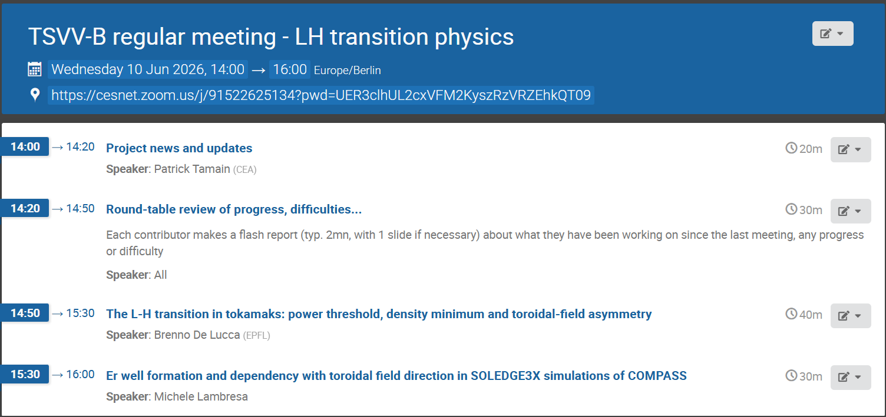
Today’s meeting agenda

Slide 3
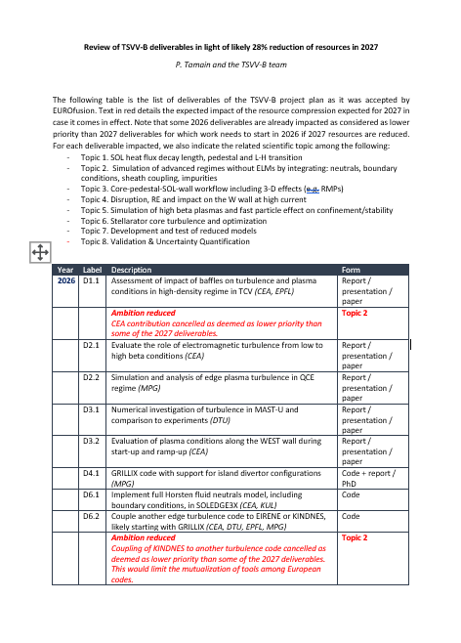
ETASC budget issues
The document we prepared concerning the objectives reduction has been submitted and discussed at dedicated meeting
X. Litaudon preparing presentation for EUROfusion meeting summarizing the impact on WPTM

Slide 4
Reminder: annual meeting
When?
  Wed. 30 Sep. – Fri. 02 Oct.
Where?
  Prague agreed last time
  @David: everything OK?
Agenda:
  To be prepared second half of June
  @all: Wednesday am to Friday pm?
  @all: no further meeting until end of September? Or a last meeting in July?

Slide 5
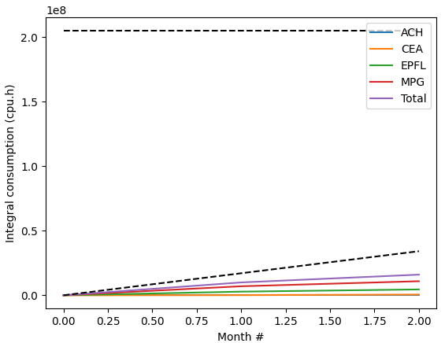
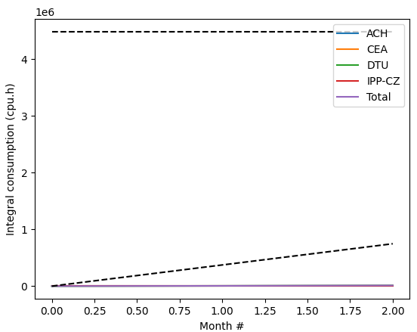
Pitagora usage
Project names: FUPA2_TSVVB (CPU) and FUPB2_TSVVB (GPU)
CPU
GPU
Pitagora down today… could not update data since last meeting
~60%
~2%

Slide 6
Latest publications
Please use from now on WPTM-TSVV-B-CEA
TCV-X21 and RANS models
S Carli et al : 9th June 2026 | DocumentID : 42892
: Calibration of cross-field transport models in SOLPS-ITER on the TCV-X21 case
Journal : Nuclear Fusion, .
LH transition physics
B De Lucca et al : 1st May 2026 | DocumentID : 42752
: The L-H transition in tokamaks: power threshold, density minimum and toroidal-field asymmetry
Journal : Physical Review Letters, .
Please upload PSI contributions (posters and talks) so that they are archived and accounted for in the end of year report

Slide 7
Milestones and deliverables
1 milestone announced for mid 2026 in our workplan:
  D6.3 = KINDNES kinetic neutrals module compatible with flexible wall geometry (EPFL)
Please update status during round-table.

Slide 8
Today’s meeting agenda
Please upload materials to https://indico.euro-fusion.org/event/4006/

