Slide 1
SP B kick-off meeting 2026
Overview and discussion of tasks, 29 April, 2026
Antti Hakola
On behalf of the SP B team and task holders

Slide 2
2026 Tasks and Deliverables
SP B.1 Determine differences in erosion patterns on re-deposited vs. virgin W and W-B based co-deposits in high-flux and/or high-fluence conditions in linear devices and tokamaks
Deliverable ID | Deliverable Title
D001 | Report on erosion rates for B reference layers on MAGNUM-PSI as a function of their ion energy and temperature (DIFFER)
D002 | Report on erosion rates for selected W and B reference layers on GyM/BiGyM as a function of the sample composition (ENEA)
D003 | Report on erosion and re-deposition rates for selected W and B reference layers on PSI-2 as a function of sample composition (FZJ)
D004 | Preliminary report on effective sputtering yields of 2D/3D microstructures exposed on MAGNUM-PSI (IPP.CR)
D005 | Comparison between erosion rates of selected W and B reference layers in ion-beam exposures at different temperatures (ÖAW)
The work will be based on corresponding activities in 2025 but now the focus will be set on higher fluxes or fluences than was the case in the period 2021-2025 to reach conditions relevant for ITER and pilot plants
In addition, systematic studies on the impact of sample composition, structure, morphology, and surface temperature will be carried out – these were only superficially addressed in 2021-2025
In many deliverables the work in 2026 will be summarized in a preliminary or interim report while the final report with more detailed experimental data and full set of experiments will be provided in 2027

Slide 3
2026 Tasks and Deliverables
SP B.2 Characterize samples coming from PWIE experiments (under WPTE) in full-W devices (AUG, WEST): interpret results, assess changes in their surface state, erosion, and deposition patterns on them. Provide benchmarking data for modelling (SP D) and boron studies (SP F)
Deliverable ID | Deliverable Title
D001 | Erosion and deposition patterns extracted for PFUs removed from WEST after C6-C12 campaigns (CEA)
D002 | Interim report on microscopy investigations for various B-containing layers and ITER-like monoblocks removed from WEST after C6-C12 campaigns (CEA)
D003 | Report on the feasibility of applying picosecond and top-hat laser beam profiles for analyses of WEST Phase 2 samples (CU)
D004 | Composition of deposited layers on selected WEST PFUs from Phase 2 operations (IST)
D005 | Interim report on erosion, deposition, and surface-modification patterns on selected WEST Phase 2 samples (MPG)
D006 | Compositional and structural properties of selected samples following boronizations and high-fluence operations on WEST (NCSRD)
D007 | LIBS elemental depth profiles for marker-tile samples from WEST Phase 1 operations (UT)
D008 | Deposition patterns of B, D, and plasma impurities on the surface layers of different PFUs from WEST Phase 2 operations (VR)
D009 | High-resolution depth profiles on WEST PFUs and samples removed after Phase 2 operations during C6-C12 campaigns (VTT)
D010 | Interim report on the erosion properties of probes and marker samples exposed to specific AUG plasmas (FZJ)
D011 | Interim report on erosion and deposition patterns on samples exposed to specific AUG plasmas and boronizations (MPG)
Deliverable ID | Deliverable Title
D012 | Gross and net erosion patterns for marker-samples exposed to specific AUG plasmas (VTT)
D013 | Comparative report on broad-beam and microbeam analyses for detailed elemental composition on selected WEST samples (JSI)
D014 | Interim report on elemental concentrations on the surfaces of marker samples exposed to specific AUG plasmas at high spatial resolution (RBI)
D015 | Erosion and deposition patterns on W7-X samples exposed during specific OP2 experiments (FZJ)
D016 | Interim report of erosion and deposition patterns on W7-X samples exposed during OP2 (MPG)
D017 | Interim report on surface changes on selected W7-X and WEST wall components and samples exposed to boronizations (IPPLM)
D018 | Elemental depth profiles for B-containing samples from GyM/BiGyM experiments (CIEMAT)
D019 | Erosion patterns on specific B- and W-containing samples from MAGNUM-PSI/UPP experiments (DIFFER)
D020 | Interim report on changes in the surfaces of B- and W-containing samples during GyM/BiGyM experiments (ENEA)
D021 | Erosion patterns on specific B- and W-containing samples from PSI-2 experiments (FZJ)

Slide 4
2026 Tasks and Deliverables
SP B.2 Characterize samples coming from PWIE experiments (under WPTE) in full-W devices (AUG, WEST): interpret results, assess changes in their surface state, erosion, and deposition patterns on them. Provide benchmarking data for modelling (SP D) and boron studies (SP F)
SP B.2 is the largest of the three Tasks under SP B, addressing surface analyses of components coming from various experiments in tokamaks/stellarators (AUG, WEST, W7-X) and linear devices (experiments under SP B.1)
Large part of the work will deal with samples from WEST with the focus set on the Phase 2 operations (only started in 2021-2025), in particular to the samples originating from the different high-fluence campaigns (in C7 and C12)
The AUG work will be on detailed surface characterization of exposed marker samples (only erosion was investigated in 2025) and other samples becoming available after the 2025 campaign (incl. boronization samples)
Concerning W7-X, there is an extensive set of tiles + samples removed after the OP 2.3 campaign – all pending for assessing their erosion and deposition patterns and to be compared with the OP 2.1/OP 2.2 data (in 2021-2025)
Analyses of samples from SP B.1 will be a service task feeding back the information to planning additional experiments
Boronization samples will be studied jointly with SP F: under SP B we will concentrate on the co-deposits and aspects related to material migration
All the data can be used as benchmarking cases for SP D activities, up to the point of data validation

Slide 5
2026 Tasks and Deliverables
SP B.3 Provision of reference layers (B layers with D, W+B layers etc.) and compare with layers obtained from tokamak experiments with focus on the composition and structure
Deliverable ID | Deliverable Title
D001 | Characterized W and B reference coatings for laboratory and linear-machine experiments – initial batches (ENEA)
D002 | Characterized B coatings for linear-machine experiments – initial batches (FZJ)
D003 | Characterized W reference coatings for laboratory and linear-machine experiments – initial batches (IAP)
D004 | Characterized B reference coatings for laboratory and linear-machine experiments and for permeation studies – initial batches (IAP)
D005 | Characterized B reference coatings for linear-machine experiments and oxidization studies – initial batches (VR)
D006 | Interim report on the characteristics of different B reference coatings with focus on retention and compositional properties (VTT)
D007 | Interim report on Raman characterization of the produced B and W reference layers with focus on their structural and chemical properties (CEA)
D008 | Interim report on microscopy investigations of the produced W and B reference layers with focus on their surface morphology (IPPLM)
D009 | Interim report on the characteristics of the produced B and W reference layers with focus on their retention and permeation properties (JSI)
D010 | Interim report on the characteristics of the produced B and W reference layers with focus on mechanical and compositional properties (NCSRD)
D011 | Elemental composition for the produced B and W reference layers – interim report (RBI)
In 2026, several W- and B-based reference layers will be produced and characterized for their properties – to be further provided in experiments under SP B.1/SP B.2 as well as SP A, SP C, SP F, and SP X
Different from 2021-2025, the B layers will exhibit more complex compositions (mixed W+B layers, D and seeding impurity inclusions)
Concerning the W layers, the focus will be on layers simulating re-deposits – in 2021-2025, virgin W coatings as well as W co-deposits were produced

Slide 6
Main points to be discussed today – in connection with the individual talks to follow now
SP B.1 – physics of erosion and deposition
What are the relevant fluence and flux regimes allowing cross-comparison between different linear devices?
Which physics parameters are the most important ones to be understood for their role on sample erosion?
How differently modified surfaces will be eroded compared to flat or technically rough ones?
SP B.2 – material migration in toroidal and linear devices
Which components from WEST, AUG, and W7-X are becoming available and which analyses are the most urgent?
How to share the work equally such that each contributing lab can meet their deliverable by the end of 2026?
What physics questions are to be concentrated on in the different devices?
Inclusion of new groups (e.g., CU) in the ”SP B family”?! Role of LIBS in analyses wrt. SP X?
How to share the activities on B layers between SP B and SP F?
Which analyses are needed for samples originating from SP B.1?
SP B.3 – production and characterization of reference layers
Production matrix for 2026 – which samples are of interest and required to fulfill the set deliverables?
Which samples are needed for SP B.1 experiments, which are for ”round-robin” studies?
Which samples are required for SP B.2 experiments and for SP C, SP X etc. – and how about their specifications?

Slide 7
SP B.1 activities in 2026
Experiments on linear devices
MAGNUM-PSI – see separate talk by M. Komm
PSI-2 – see separate talk by O. Marchuk
GyM/BiGyM – see separate talk by A. Uccello
Experiments in laboratory conditions
Quartz Crystal Microbalance (QCM) for sputtering yield measurements from W-B samples at different temperatures
Some preliminary results (right)
No temperature dependence for Ar plasmas
In pure B samples, D implantation dominates at low temperatures → sputtering only measurable at >150°C and no temperature dependence visible
In W-B mixtures, sputtering yield decreases with increasing temperature

Slide 8
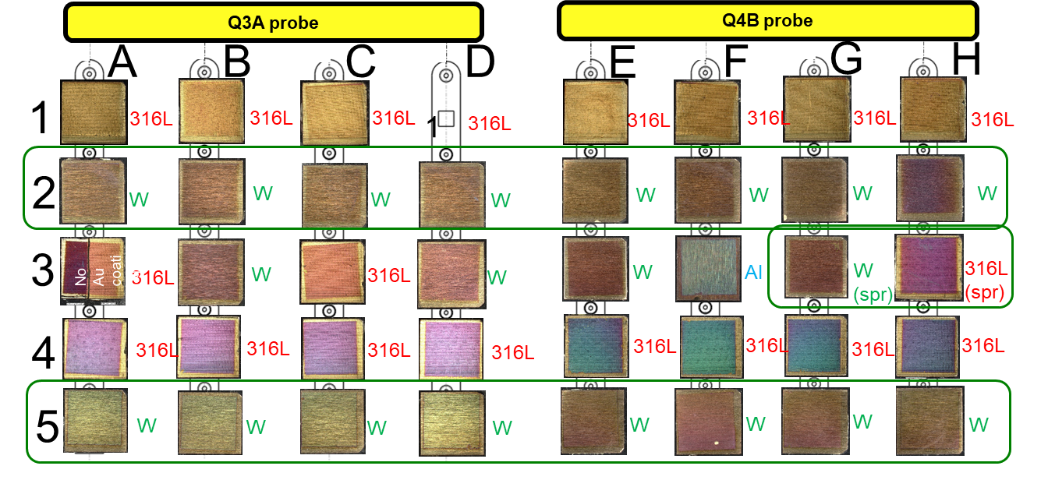
SP B.2 activities in 2026
WEST analysis priorities – see talk by M. Diez
Boronization samples
PFUs exposed to C7 and C12 high-fluence campaigns
PFU with erosion indentations (C6→C12)
Several boronization samples from WEST already available
Thickness measurements of cross sections (CEA, IPPLM)
Fuel retention and compositional studies (MPG, NCSRD, VR)
Pt
B
W
134 ±19 nm
Au
SEM of FIB cross section
Boron
Deuterium
Al
Al
SS
SS
Top: examples of SEM-FIB cross sections from Au-coated boronization samples
Bottom: preliminary results for the B and D amounts on selected boronization samples

Slide 9
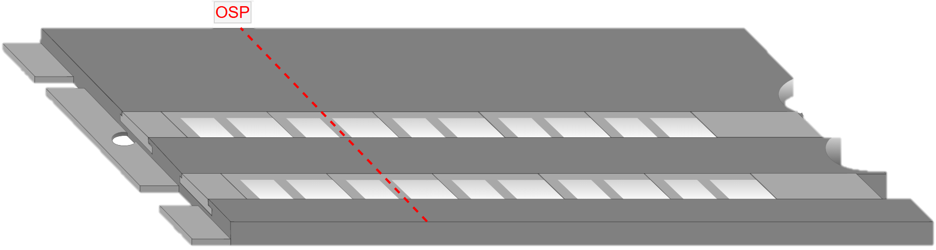
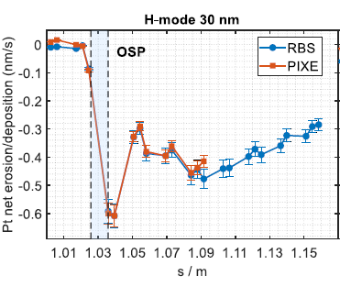
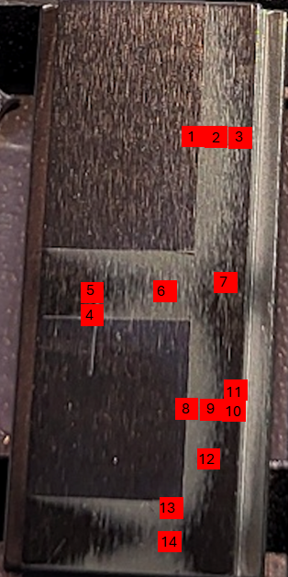
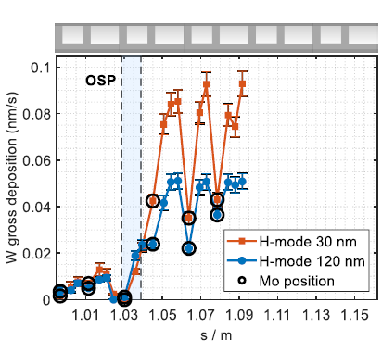
SP B.2 activities in 2026
Marker samples mounted on target tiles on AUG
WEST analysis priorities – see talk by M. Diez
Boronization samples
PFUs exposed to C7 and C12 high-fluence campaigns
PFU with erosion indentations (C6→C12)
AUG and W7-X analysis priorities
See separate talks by M. Balden and F. Maragkos
Continuation of AUG marker-sample analyses (Pt coatings on Mo)
More in-depth analysis of the samples scheduled including
Analysis of the measured RBS, NRA, and PIXE data (VTT)
Micro-beam measurements for the samples: Pt outside of markers (RBI)
Microscopy measurements on the areas of interest (MPG)
TOF-SIMS measurements for the surface layers (VTT)
Close collaboration with SP D and WPTE for modelling activities
Other activities
Focus on erosion/deposition patterns for samples exposed in linear plasma devices
Measurement positions for micro-PIXE
Erosion profiles of 30-nm thick Pt marker coatings following exposure to H-mode discharges (top) and deposition of W on different regions (bottom)

Slide 10
SP B.3 activities in 2026
Production and characterization of B layers
Production – see separate talks by C. Porosnicu and D. Dellasega
Role of oxygen in B layers – expose layers to low-energy O beams and study both O inclusions and fuel retention in the films
Biggest analysis needs for B layers arising from last year’s experiments
Different chemical phases and structures
Permeation and retention characteristics
Oxidization and evolution with air exposure
Erosion and deposition patterns following plasma exposure
…
Production and characterization of W layers
See SP B.1 talks for needs in linear plasma devices
Using different deposition methods (DC magnetron sputtering DCMS, HiPIMS, CMSII etc.) at different deposition parameters to produce W coatings
Different crystallographic structure for coatings deposited by different deposition methods
Retention capabilities potentially influenced?
XRD pattern for W coating deposited by CMSII
XRD pattern for W coating deposited by HiPIMS

Slide 11
Next steps
Your SP B contact
Antti Hakola (antti.hakola@vtt.fi)
Project leader
Sebastijan Brezinsek (s.brezinsek@fz-juelich.de)
Deputy project leader
David Douai (david.douai@cea.fr)
Follow-up meeting in June-July 2026 to define
Detailed contents of the Master Excel
Exact number and specifications of samples to be analysed by contributing labs
Please check if you have colleagues that are not included in the SP B mailing list!
Minutes and slides of the meeting at
https://indico.euro-fusion.org/event/4008/

