Slide 1

WP SP B.1 : Erosion studies for W and B layers on PSI-2 O. Marchuk, M. Sackers, M. Rasinski, M. Klein, S. Brezinsek, A. Houben, E. Warketin and A. Kreter
Notes:
Please Indicate your subproject

Slide 2
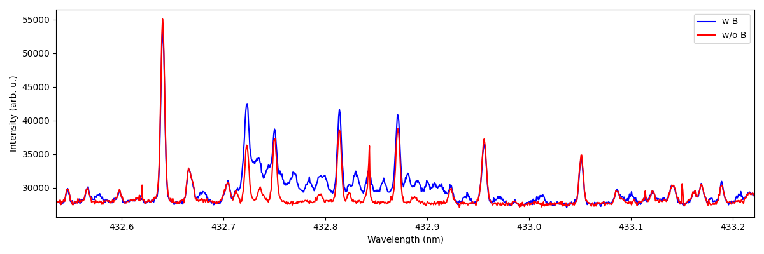
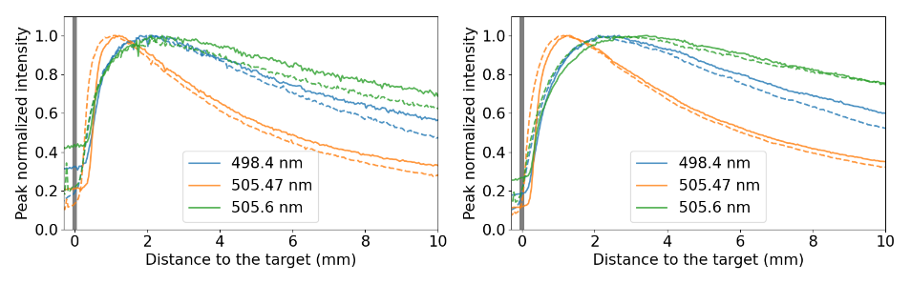
Plans for 2026: Exposition of W/B reference layers to PSI-2 plasmas
Emission of BD molecules @ PSI-2
High resolution (HRS) and imaging spectroscopy (IS) of bulk and redeposited W and B layers in PSI-2
Study of sputtering rates of W+B layers in PSI-2
Analysis of B I and BD lines in UV and VIS at different flux of D
Discrimination between the chemical and physical erosion
Measurements of energy and angular distribution of B I lines
Erosion rates of W in linear cross machine comparison study by impact of different gases such as Ar or Ne.
Time-of-Flight Experiments @PSI-2
Sputtering of W(poly) (solid lines) and W(111) (dashed lines) by Ne ions.
Emission of spectral lines from different excited levels will be analyzed.

Slide 3
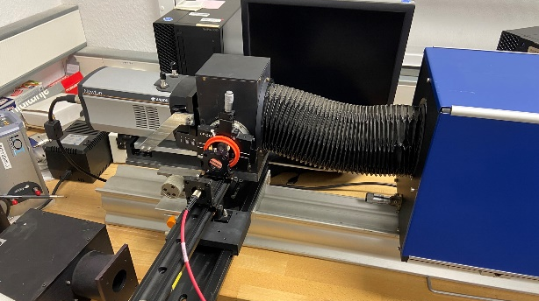
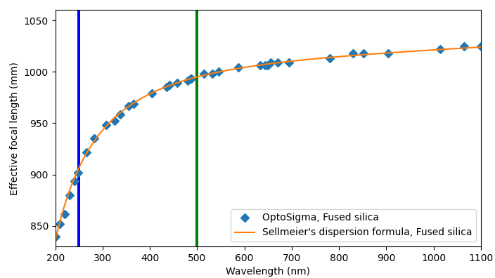

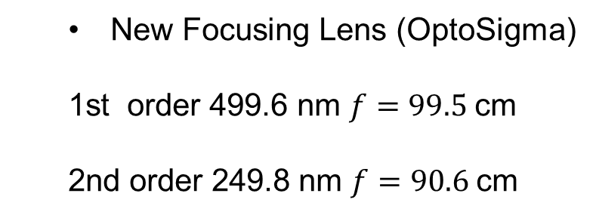

High Resolution „Blue“ Spectrometer
Chromatic aberration acts as a „filter“:
Operating range:
$$f=\frac{R}{1−n(λ)}$$
$$R=460 mm$$
New Focusing Lens (OptoSigma)
1st order 499.6 nm $f=99.5$cm
2nd order 249.8 nm $f=90.6$cm

Slide 4
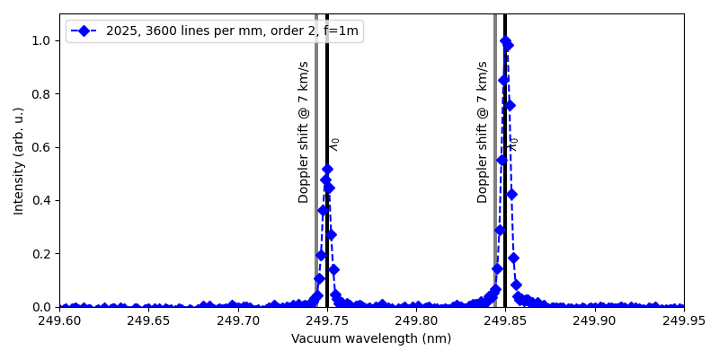
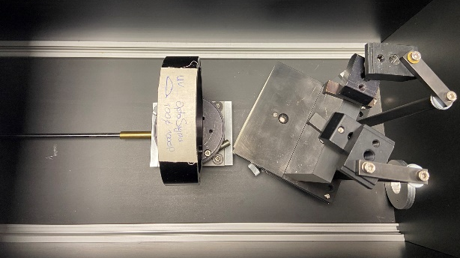
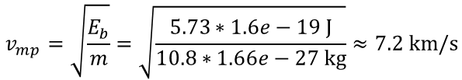

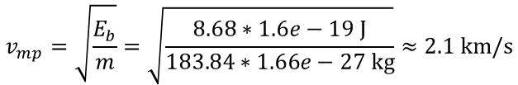



Status: Line shape of sputtered B
Tungsten W I 498.4 nm
Boron B I 249.7 nm
$$v_{mp}=\sqrt{\frac{E_{b}}{m}}=\sqrt{\frac{8.68∗1.6e−19 J}{183.84∗1.66e−27 kg}}≈2.1 km/s$$
$$v_{mp}=\sqrt{\frac{E_{b}}{m}}=\sqrt{\frac{5.73∗1.6e−19 J}{10.8∗1.66e−27 kg}}≈7.2 km/s$$
$$λ_{DShift}≈\frac{v_{mp}}{c}λ_{0}=3.5 pm$$
$$FWHM=3.3 pm$$
$$λ_{DShift}≈\frac{v_{mp}}{c}λ_{0}=6 pm$$
$$FWHM=5.7 pm$$
Position of the lens depends on wavelength
to CCD
Lens
Grating
(motorized drive 2026)
Dispersion from B HCL: 1.14 pm/px

Slide 5
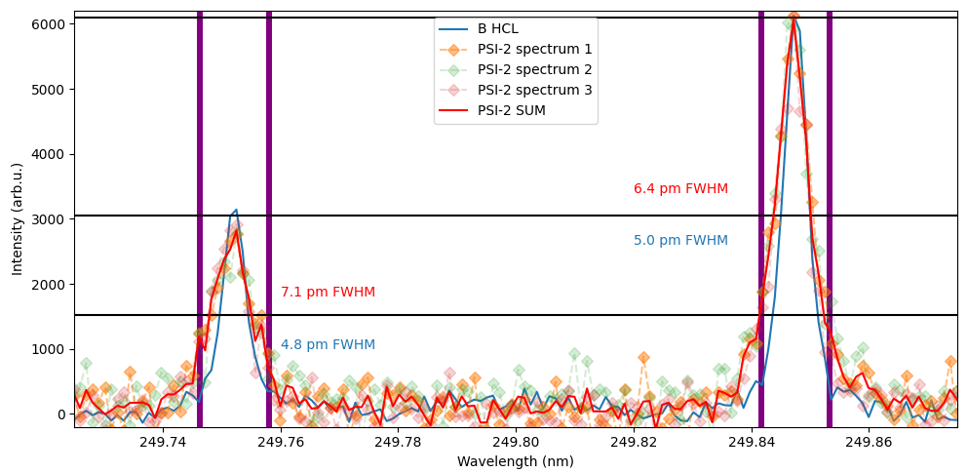
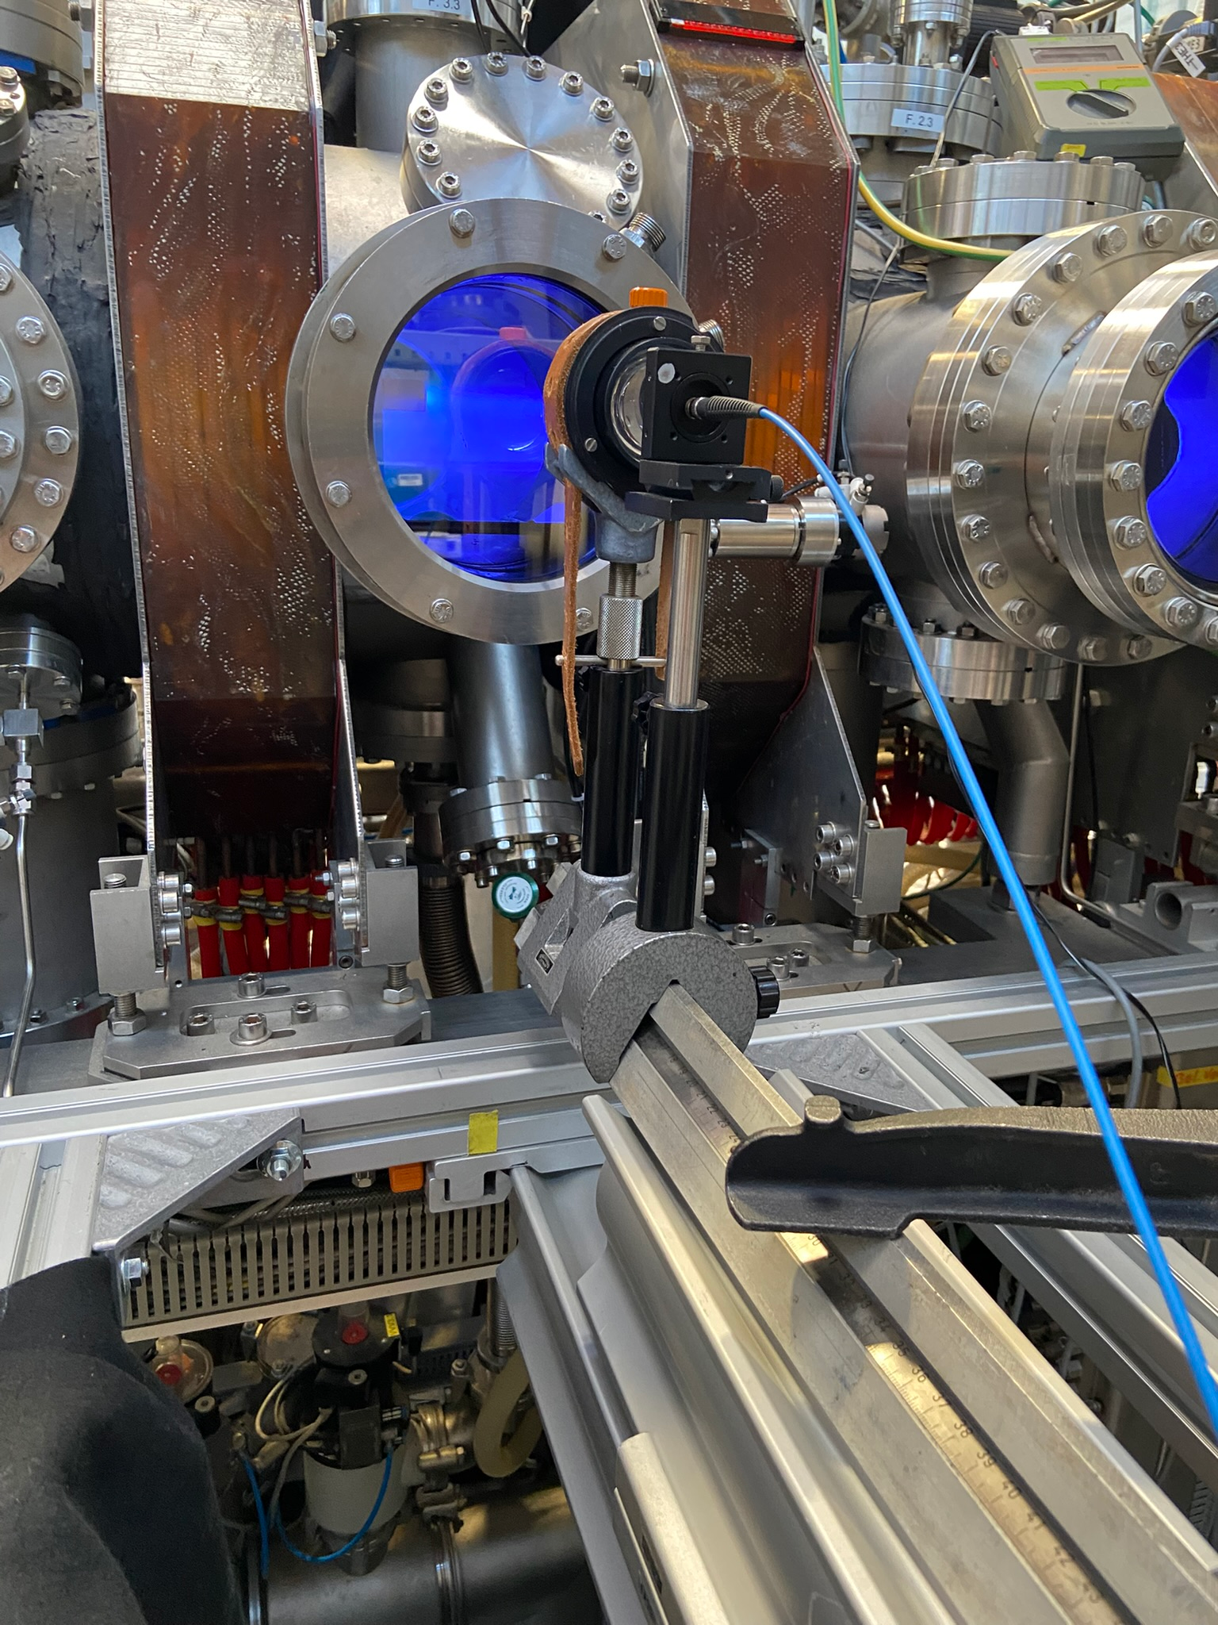
First HRS PSI-2 Spectra for B I Lines
We are trying to improve the statistic now by using other UV fibers

Slide 6
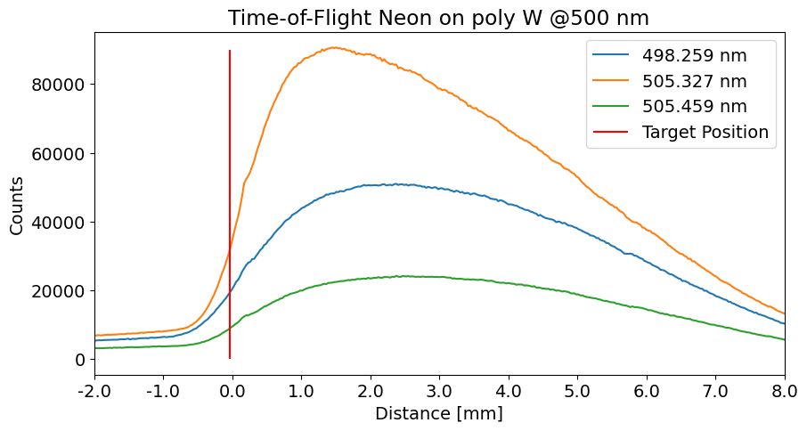
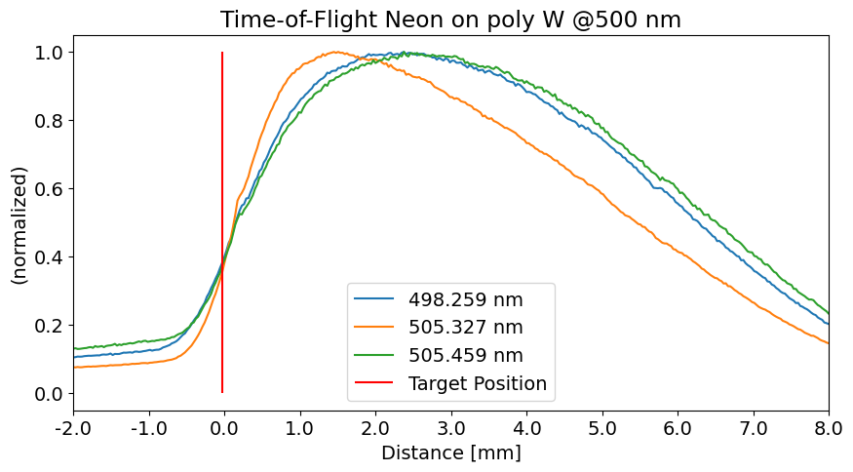
Results Time-of-flight experiment
498.259 nm: Aij = 4.2e+05 s⁻¹ τ = 1.9 μs 0.00000 – 2.48766 eV
505.327 nm: Aij = 1.9e+06 s⁻¹ τ = 0.27 μs 0.20709 – 2.65995 eV
505.459 nm: Aij = 3.3e+05 s⁻¹ τ = 3 μs 0.20709 – 2.65931 eV
Incident energy: 86.5 eV
Notes:
Some physics to start with. Linien mit kleinem Einsteinkoeffizienten kommen früher, steilerer Anstieg.

Slide 7
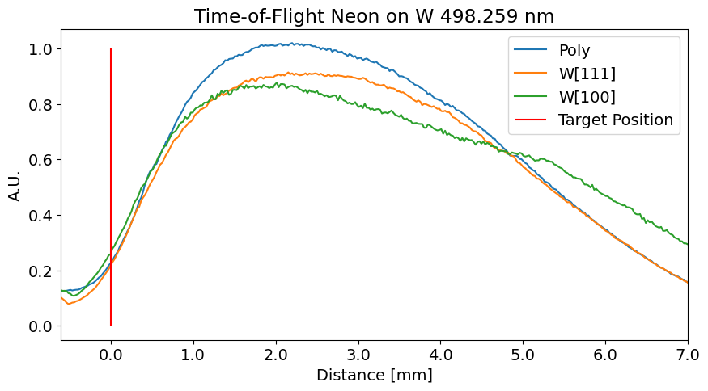
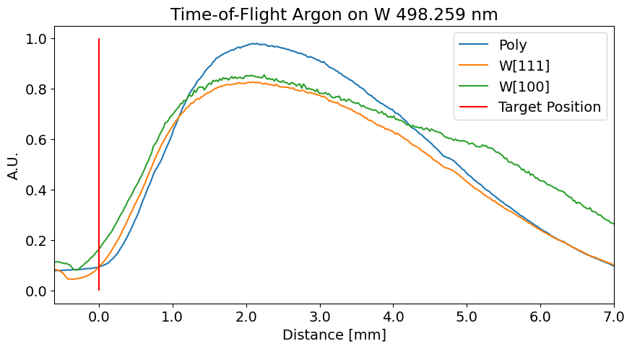
Comparison Between Poly- and Monocrystal Tungsten
We do not entirely see confirmation of the High-Res Result in the ToF result.
Further investigation still required.

Slide 8
Plans for 2026: Exposition of W/B reference layers to PSI-2 plasmas
High resolution (HRS) and imaging spectroscopy (IS) of bulk and redeposited W and B layers in PSI-2
Study of sputtering rates of W+B layers in PSI-2
Analysis of B I and BD lines in UV and VIS at different flux of D
Discrimination between the chemical and physical erosion
Measurements of energy and angular distribution of B I lines
Erosion rates of W in linear cross machine comparison study by impact of different gases such as Ar or Ne.

