Slide 1
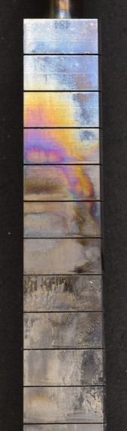
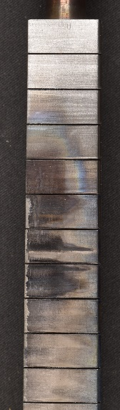
WEST samples: analysis programme in 2026
1) IMPACT OF HIGH FLUENCE PLASMA ON THE DIVERTOR
C7 (2023) high fluence PFU (PFU#484)
  High resolution photos, optical microscopy (CEA) done in 2025
  Cutting into 6 segments (CEA) done in 2025
  Fuel retention, IBA (IST) on going
  Thickness and composition of redeposited layers scheduled for 2026
    Tof-SIMS, VTT ?
    FIB, MPG ?
  C12 (2025) high fluence PFU (PFU#055)
    Surface analysis (roughness), confocal microscopy (PIIM) scheduled for 2026 (done)
    High resolution photos, optical microscopy (CEA) scheduled for 2026 (done)
    Cutting into segments (CEA) scheduled for 2026
    Fuel retention, IBA (IST) scheduled for 2026
VS
C7 (2023)
Attached scenario
C12 (2025)
XPR radiative scenario
Less erosion?
Less redeposited layers ?

Slide 2
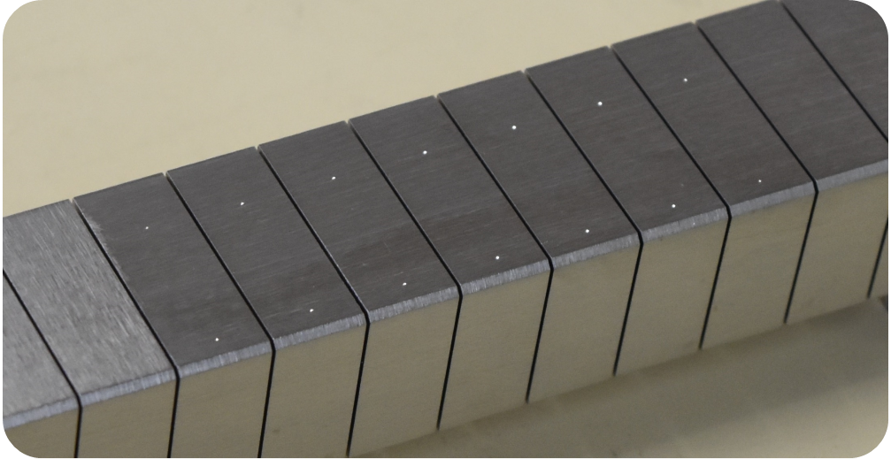
WEST samples: analysis programme in 2026
  2) EVALUATION OF DIVERTOR EROSION
  C9 erosion PFU (PFU#357)
  Depth measurement of erosion indents, confocal microscopy (CEA) done in 2024
  Cutting into MBs and segments (CEA) done in 2025
  High resolution photos, optical microscopy (CEA) done in 2025
  Surface analysis of erosion indents on MB 13,14,15,16,26,28, SEM/FIB (MPG) on going
  C12 erosion PFU (PFU#356)
    Depth measurement of erosion indents, confocal microscopy (CEA) scheduled for 2026 (done)
    Cutting into MBs and segments (CEA) scheduled for 2026
    High resolution photos, optical microscopy (CEA) scheduled for 2026
    Surface analysis of erosion indents on MB 14,15,16,26,28, SEM/FIB (MPG) scheduled for 2026-2027
  3) BORONISATION SAMPLES
  Non uniform boronisation 1-2-3 (february 2025) done in 2025 → 2026 PSI talk
  Non uniform boronisation 4-5-6 (october 2025) on going
  Uniform boronisation (scheduled for May 2026) scheduled for 2026
    Fuel retention, IBA (VR, MPG, Demokritos)
    Thickness of B layers, FIB (IPPLM, PIIM)

Slide 3
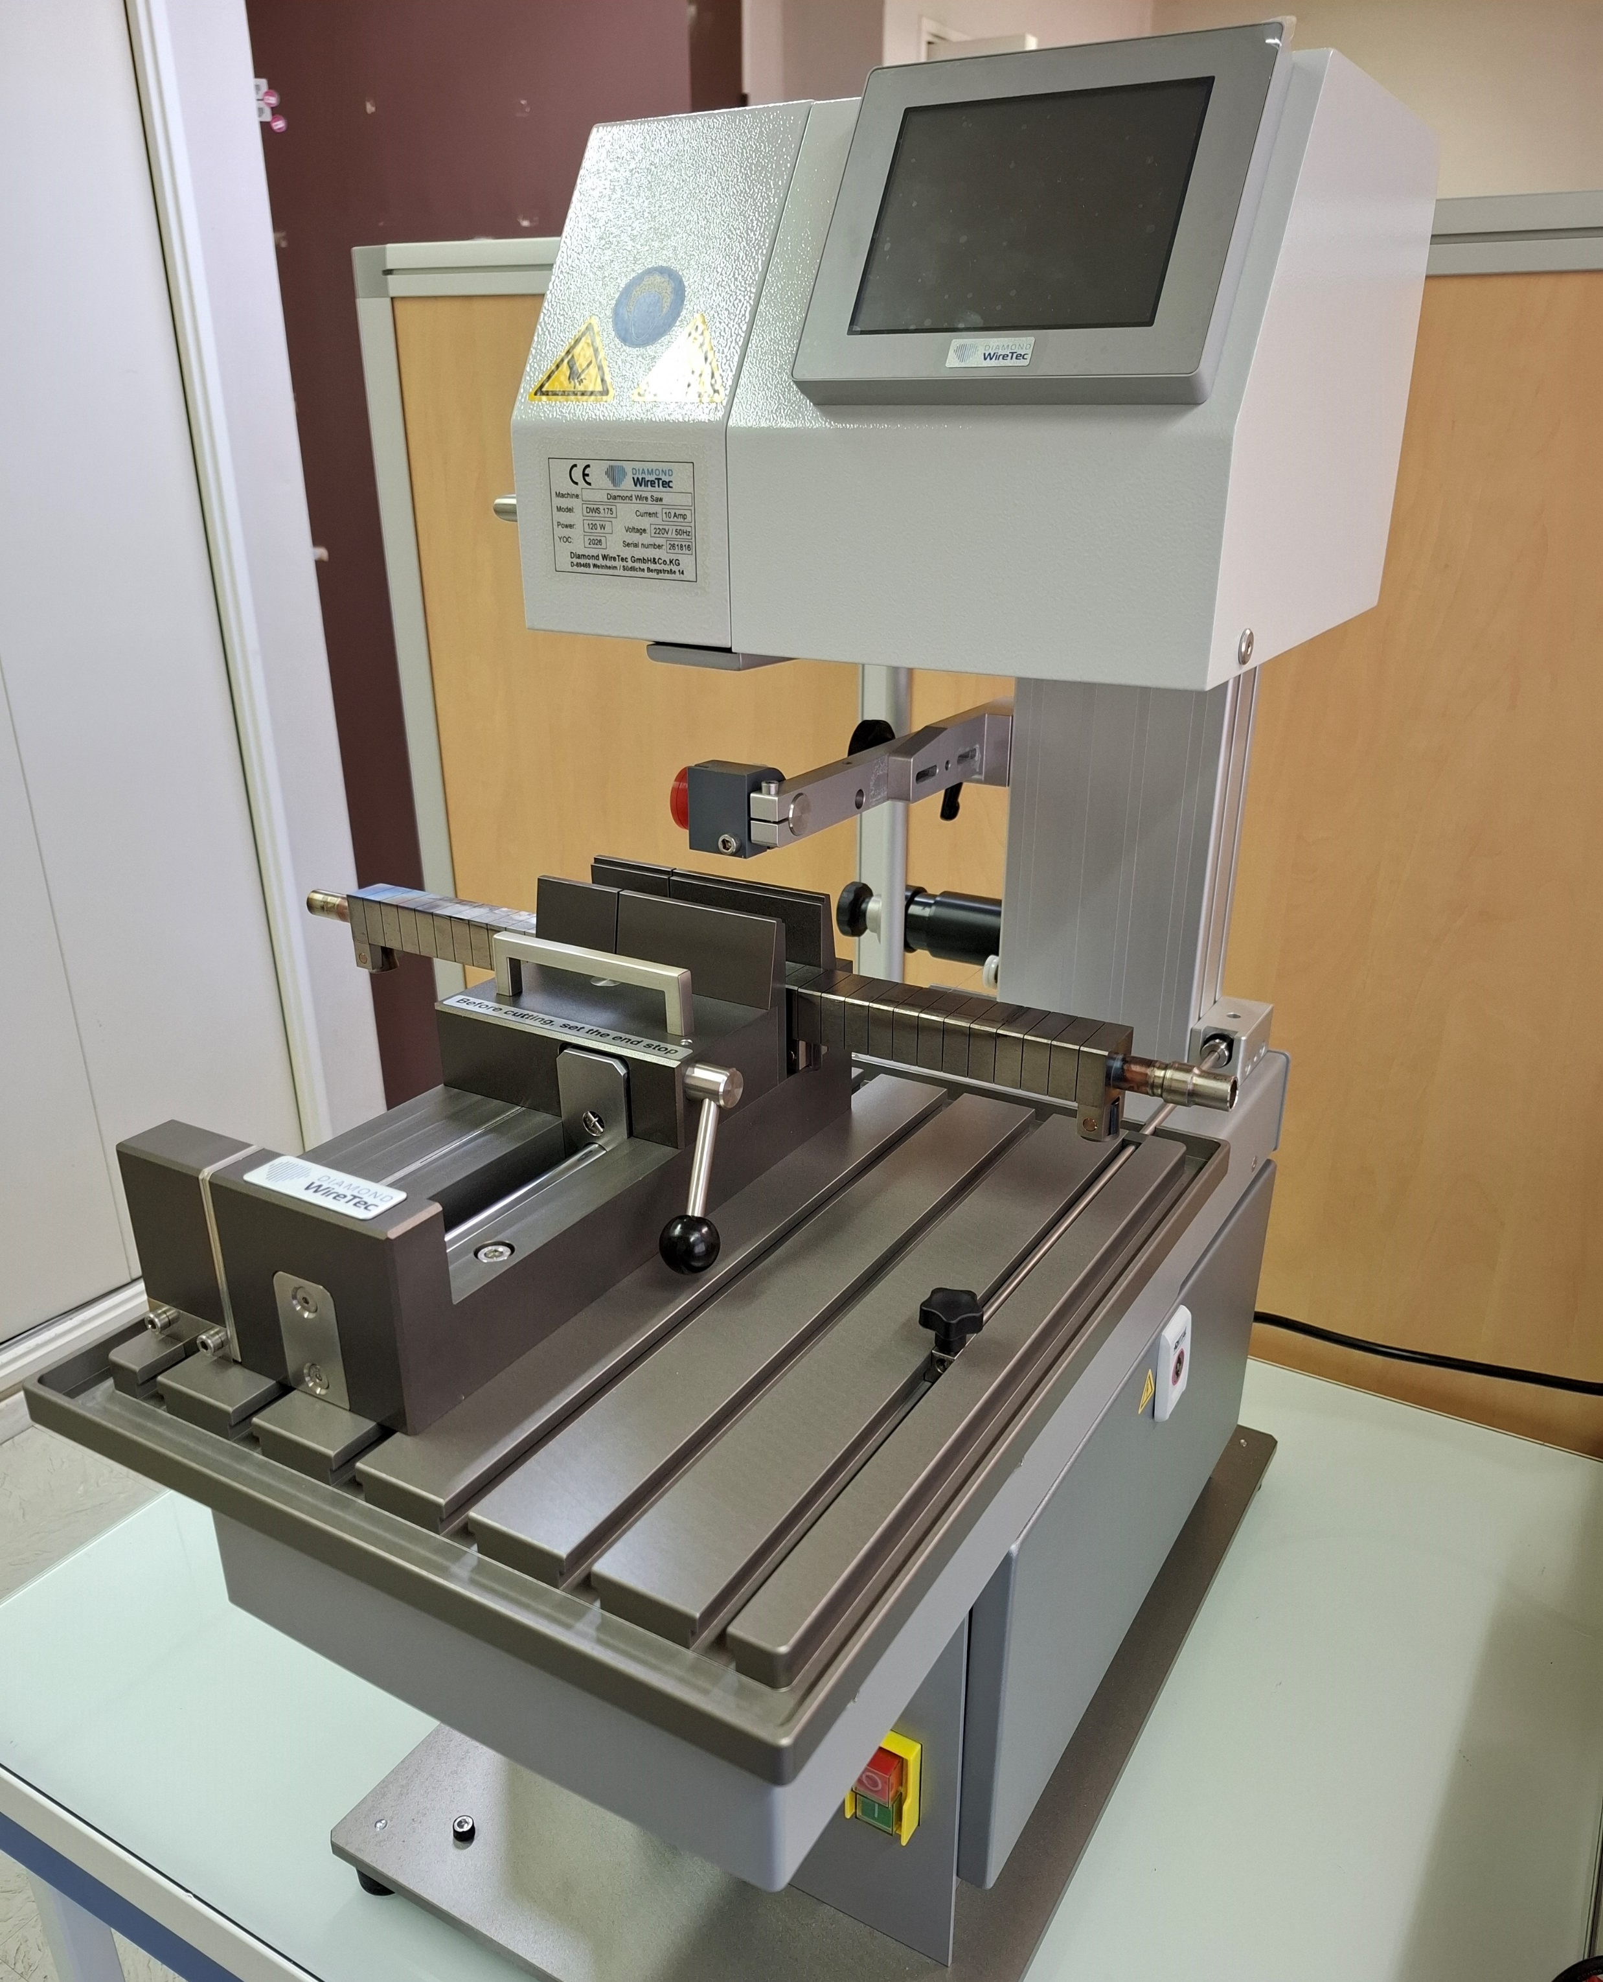
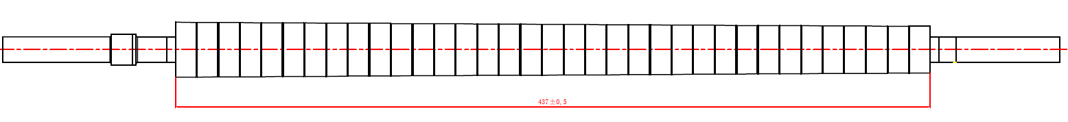
WEST samples: analysis programme in 2026
  4) PURCHASE OF A NEW CUTTING MACHINE
  Get the machine operational (safety documentation, first trials with non-activated W)
  Move it to a controlled area for activated materials
  Cutting campaign scheduled for June-July 2026 ?
Qualification LIBS (CORIA)
Emissivité (IUSTI)
Erosion indents (PWIE, MPG)
PFU#055
C12 high fluence campaign
13
6
7
12
30
18
19
24
31
25
35
20
28
34
PFU#356
C12 erosion PFU
3 4
8 - 9
12-13-14-15-16
26 25

