Slide 1
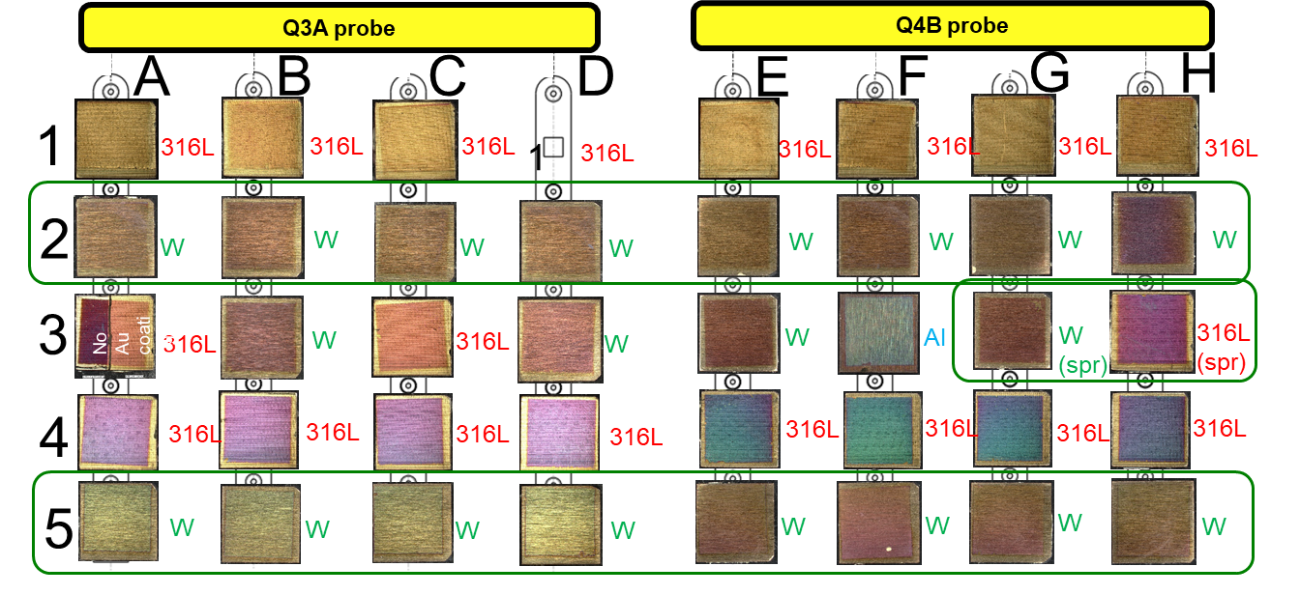
Priorities for WEST analyses
Priority#1 : high fluence campaigns and impact on divertor erosion/redepostion/fuel retention
Change of surface morphology of high fluence PFU055 using Confocal Laser Microscopy (roughness):
C12 (2025) : XPR scenario, detached plasma, 4h30 → 1 PFU selected (max outer) for characterization
Pre-exposure caracterisation of roughness in OSP max area (M23-M30)- june 2025
Post-exposure caracterisation of roughness in the same locations – april 2026
To do Data analysis and plots of change in roughness along toroidal profile on M24, M25, M26, M27 et M28, scheduled in june-july
Priority#2 : Thickness measurements on cross-sections by FIB/SEM for Boronisation samples from WEST
18 samples for the first non-uniform boronisation (on going poster preparation for PSI2026 PIIM,CEA,DEMOKRITOS)
To do samples from second non-uniform boronisation and for uniform boronisation (scheduled as soon samples will be recieved -> see Mathilde)
C12
Pt
B
134 ±19 nm
Au
W
SEM of FIB cross section

