Slide 1

Analysis plan for WEST components at NCSRD
P. Tsavalas, A. Lagoyannis, M. Axiotis, K. Mergia
National Center for Scientific Research “Demokritos”, Athens, Greece
M. Diez and the WEST team
CEA, IRFM, F-13108 Saint-Paul-Lez-Durance, France

Slide 2
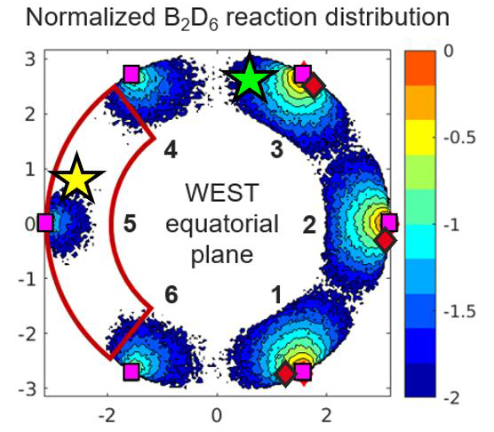
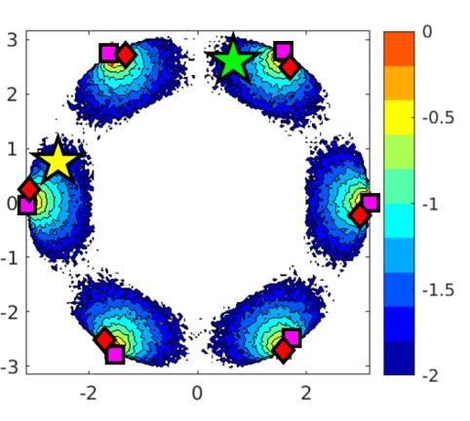
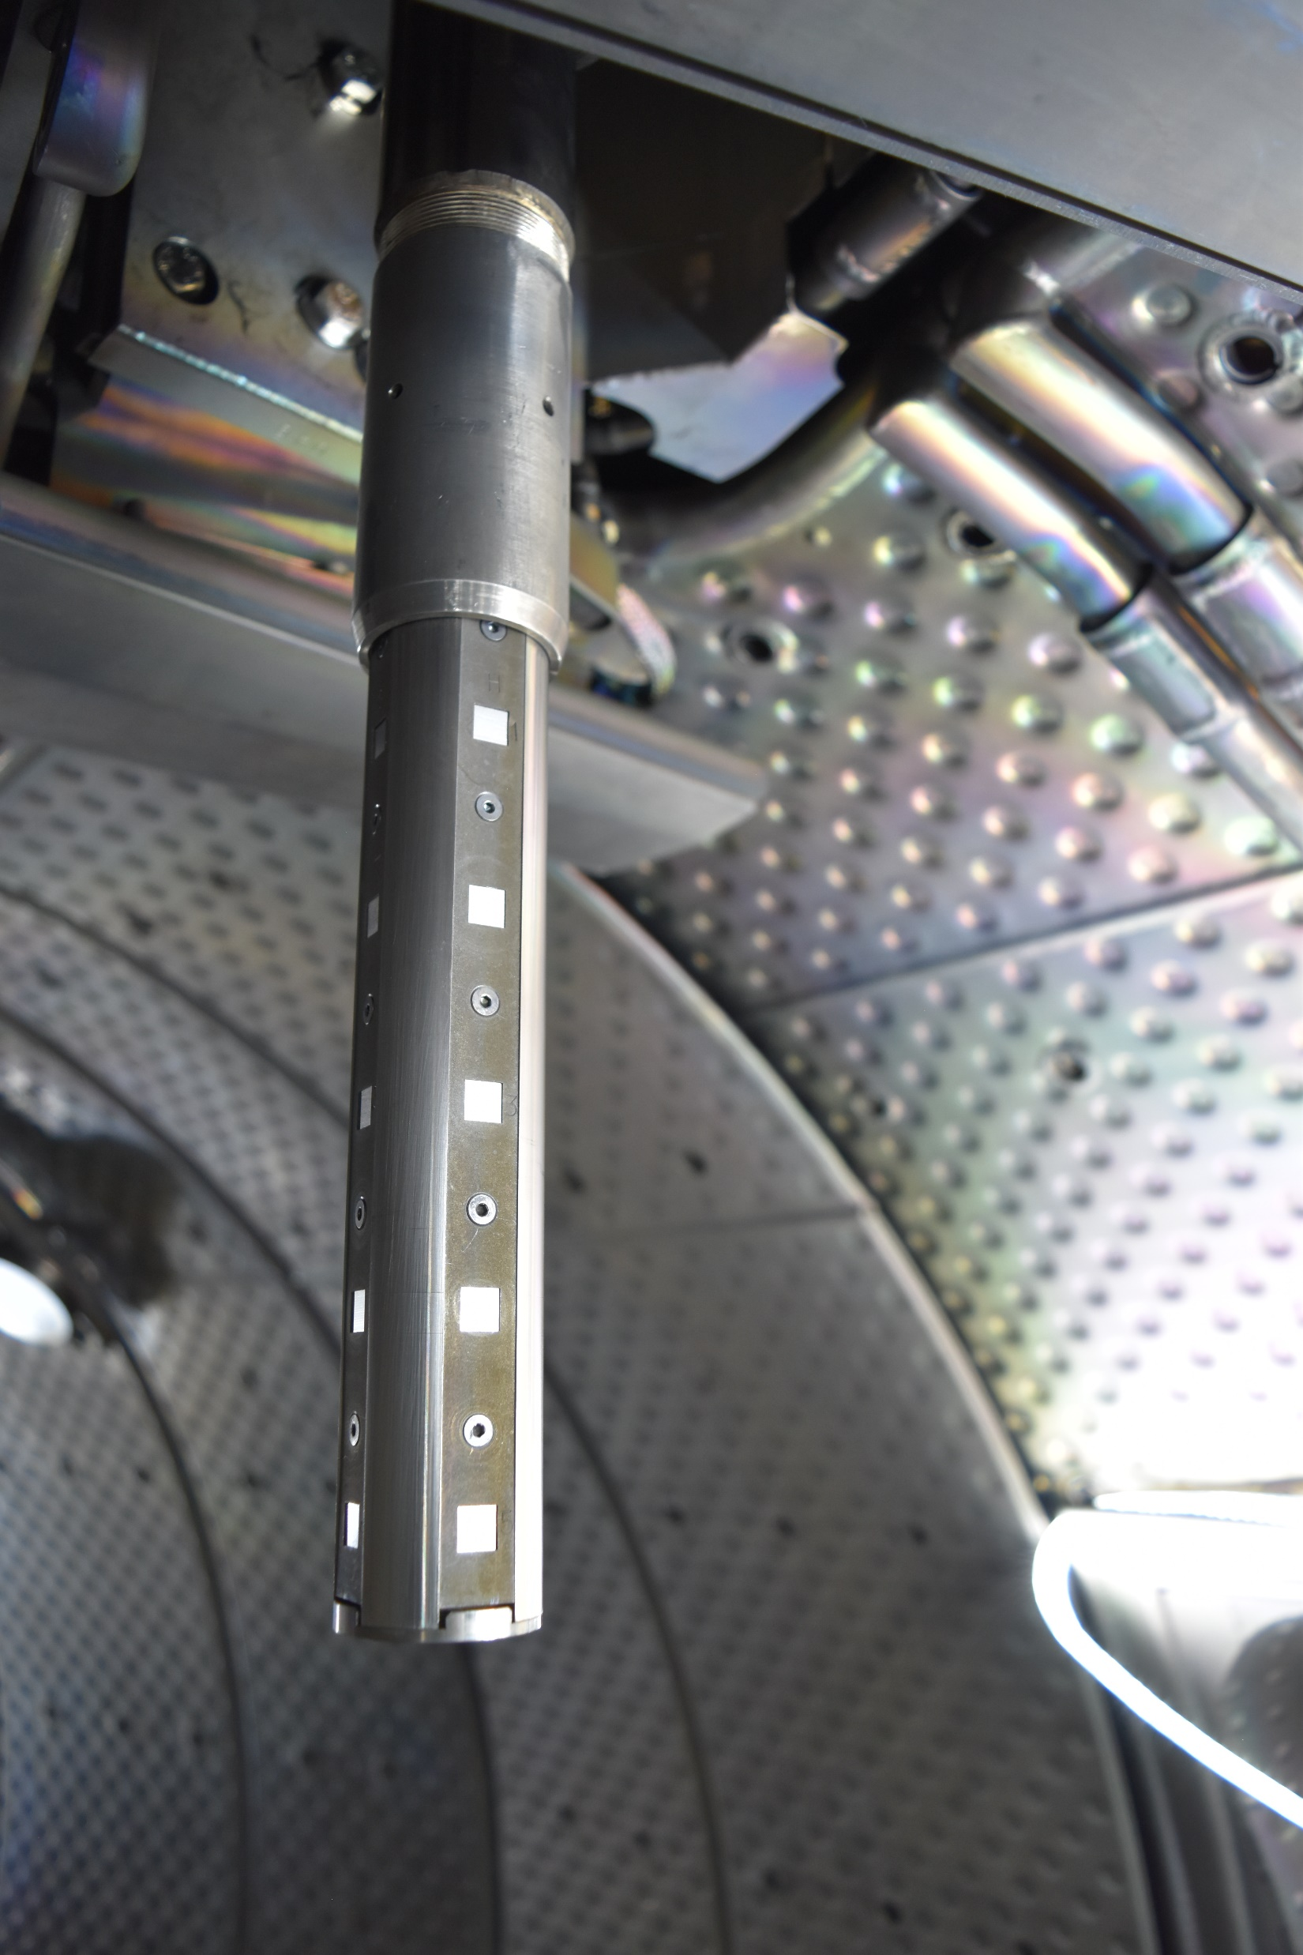
Background
Plasma restart has been proven difficult on pristine, unboronised W wall at both WEST and AUG
Predictive simulations of glow discharge boronisation (GDB) performance for ITER require experimental validation
WEST simulations ‘predict’ 100x less B₂D₆ reactions in sectors 4-5-6 if only gas inlets in sectors 1-2-3 are utilized (left). If all inlets are utilized, toroidal symmetry is predicted (right).
Q3
1st non-uniform boronization at WEST
Q4
Boron
B-rich area
B-depleted area
Source: A. Gallo
1
2
3
4
5
Pos 5
Pos 2
22 days later
No dependence on the toroidal location

Slide 3
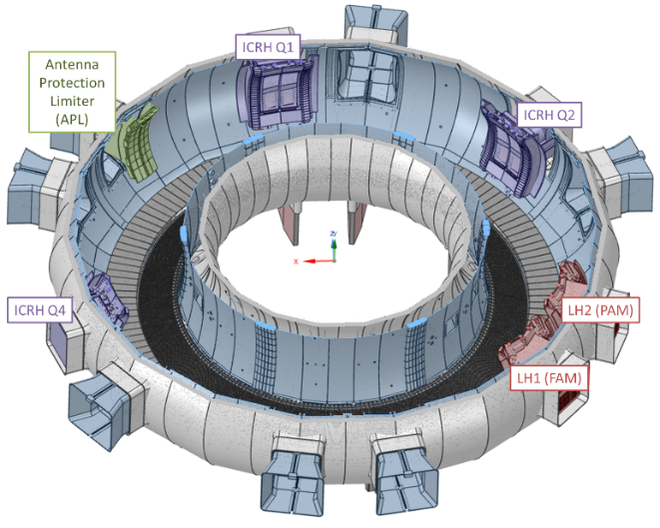

2026 activities
Q3
Q4
D
C
H
G
Completed (Jan – Apr 2026)
Ion beam analysis of samples from 2nd non-uniform boronisation (4-5-6) in WEST using a 1.4 MeV deuterium beam
Determination of B, D, O, N and C content as a function of vertical position on the probe (poloidal direction), toroidal location (rich and depleted B area), facing surface and substrate
SEM image analysis of the boronised samples with EDX elemental mapping (in some samples non-uniform covering of B layer by the Au layer is observed)
Q2
A
B
E
F
Q3
Q1
1
2
3
4
5
Pos 2
Q4
Q6
Pos 3
Q5
W
Boron
Deuterium
Oxygen
SS
Al
B-depleted area
B-rich area
B-depleted area
B-rich area
B-depleted area
B-rich area
Side Y
Side Z
Al
Al
Al
SS
SS
SS
Reference

Slide 4
2026 planned activities
On-going and planned activities
Contribution to PSI paper (Sehoon Ann)
1st and 2nd non-uniform boronisation (1-2-3 & 4-5-6) at WEST: Results post-processing and comparison of the two batches of boronised samples
Post-mortem analysis (ion beam analysis & SEM/EDX) of the 3rd batch of samples from uniform boronisation (scheduled for May 2026, samples to be delivered in summer)
Comparison of the results of all boronised samples

