Slide 1

WP-PWIE SP B kick-off meeting 2026
SP B.1 & 2 - Plans for BiGyM and PWI experiments therein
Andrea Uccello
CNR-ISTP
G. Alberti, A. Cremona, M. De Angeli, D. Dellasega, F. Gaspari,
F. Ghezzi, M. Passoni, M. Pedroni, D. Ripamonti
Beneficiary: ENEA
Linked Third Parties: CNR-ISTP Milano and Politecnico di Milano

Slide 2

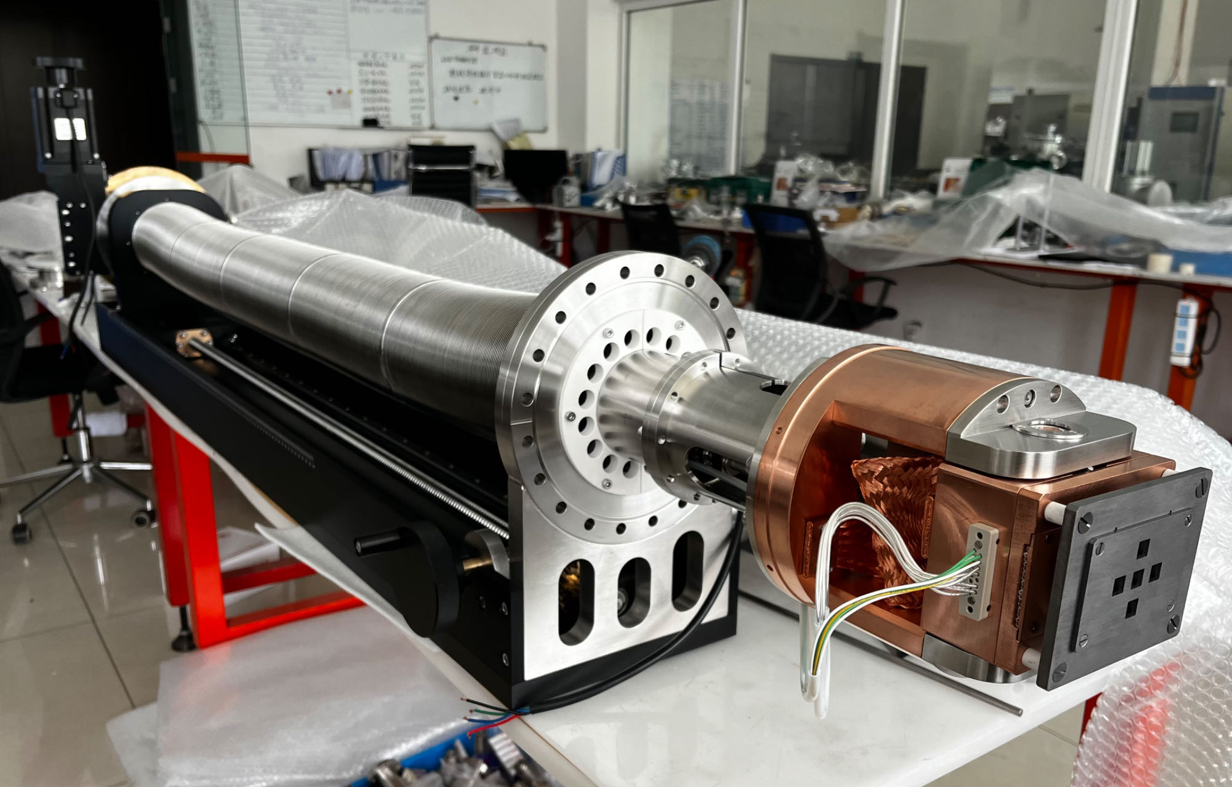
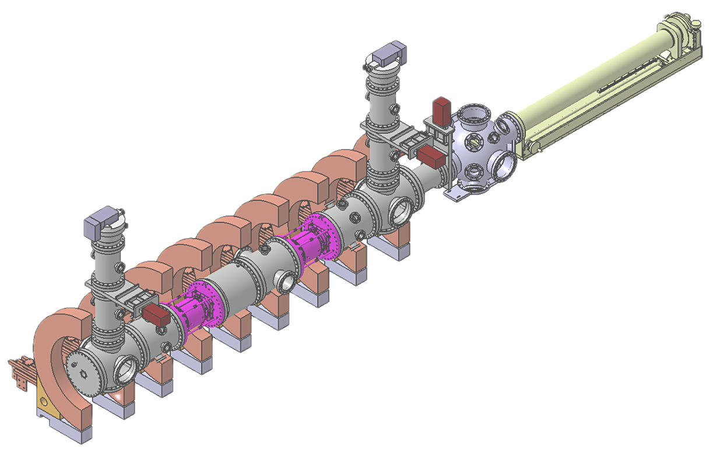
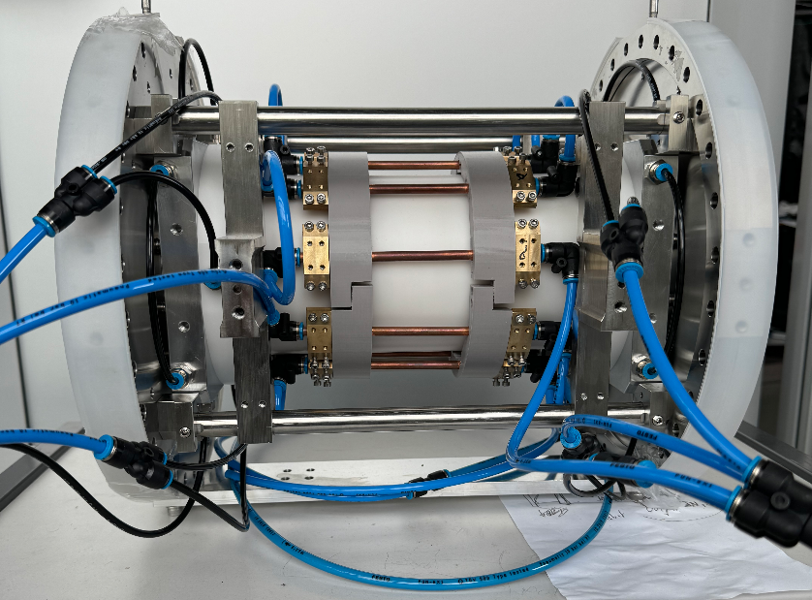
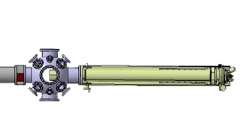
SP B.1 & 2 - Plans for BiGyM and PWI experiments therein
New sample exposure system
 | GyM | BiGyM
n_{e} [m⁻³] | 10¹⁵ – 10¹⁷ | 10¹⁸ – 10¹⁹
Γ [m⁻²s⁻¹] | 10²¹ | 10²² – 10²³
Sources | 2 magnetrons @2.45 GHz | 2 RF antennas @13.56 MHz
P_{in} [kW] | 4.5 | 20
Birdcage antennas
Helicon wave plasma
Sample temperature
up to 1500 K
New plasma sources
New sample exposure system
Picosecond-laser induced
breakdown spectroscopy (ps-LIBS)
Infrared camera
Upgrade of vacuum system:
pumps
pressure gauges
isolation valves
pressure control valves
New CODAS and storage system
Ps-LIBS
Beam guide
τ = 29 ps
E_{p,max} = 70 mJ
Fiber optics
High-resolution monochromator
λ = 200 –1000 nm, Δλ = 0.06 nm
PI-MAX 4 ICCD camera w/ Gen II SR intensifier
SP F.1 2026 - Commissioning on BiGyM and first tests with B-coated samples
First plasma is expected by June 2026. PWI experiments planned for the second half of 2026

Slide 3
SP B.1 & 2 - Plans for BiGyM and PWI experiments therein
Upgrade Status
Disassembly of GyM ✔
Assembly of BiGyM vacuum vessel and repositioning of coils ✔
Vacuum leak testing of the vessel (down to 1e-7 mbar) ✔
Installation of sample exposure system on BiGyM support structure ✔
Installation of pumping lines, including gate valves (safety) and butterfly valves (pressure control) ✔
System-wide vacuum leak testing
First plasma (in collaboration with SPC–EPFL): by June 2026
Characterization of plasma parameters using optical emission spectroscopy and interferometry
Connection of sample exposure system to BiGyM vacuum vessel: by September 2026
First SP B.1 BiGyM PMI experiments on W/B reference layers like those exposed in GyM
D plasma exposure of ns-PLD 100 nm-thick compact B films
E_{ion} =76 eV according to PSI-2 experiments [M. Sackers, et al., Nucl. Mater. Energy 45 (2025) 102003]
Φ =4e23 D⁺m⁻² to avoid full layer erosion

Slide 4
SP B.1 & 2 - Plans for BiGyM and PWI experiments therein
Analysis programme
In-house at CNR-ISTP and PoliMi
Semi-micro balance → mass loss (sputtering yield)
AFM, SEM → surface morphology
XPS, LEIS → surface chemistry
SIMS, TDS → deuterium retention
EUROfusion partner laboratories
(aiming to follow the same analysis chain as B layers exposed to D plasma of GyM in 2025)
ToF-ERDA, EBS+NRA+PIXE, ToF-MEIS - Uppsala University
SIMS - CIEMAT
Raman and XPS - Aix Marseille Université
Analysis of B layers exposed to D plasma of GyM in 2025
Completion of the analysis with SEM investigation of surface structure changes
(in-house or EUROfusion partner laboratories)

