Slide 1
Continuation of on-going projects and new planned studies in 2026 for W7-X
M. Mayer, M. Balden, C.P.Dhard, F. Maragkos

Slide 2
Measurement of charge-exchange (CX) fluxes and determination of the corresponding energy distributions in W7-X
H⁺ (fast) + H⁰ (slow) → H⁰ (fast) + H⁺ (slow)
Energetic plasma ions capture electrons from neutral gas atoms
Fast neutral particles not confined by magnetic field cause erosion, implantation at the vessel walls
Energy range: few hundred eV to few keV, penetration depth of a few nm, few previous studies
1st experimental approach: Collector probes
Implantation of neutrals on suitable materials (amorphous Carbon samples)
    Number of implanted neutrals provides the total CX fluence
    Depth profile of implanted neutrals provides their energy distribution
High-resolution TOF-ERD able to provide the required depth resolution, preliminary tests achieved ~ 5 nm
H. Verbeek et al., Nuclear Fusion 38 (1998) 1789
2nd experimental approach: Layered samples
Implantation of neutrals on special multi-layered samples
Barrier layer: Al₂O₃, varying layer thickness allows the determination of the CX flux energy distribution
Diffusion layer: Fe, separation of surface-barrier and getter layer signals
Getter layer: Zr, thickness tens of nm to avoid possible saturation
Gas
Slow CX
Fast CX
Barrier
layer
Al₂O₃
Diffusion
layer
Fe
Getter
layer
Zr
Substrate
F. MARAGKOS | WPPWIE SPB KICK-OFF MEETING | 29.04.2026
2

Slide 3
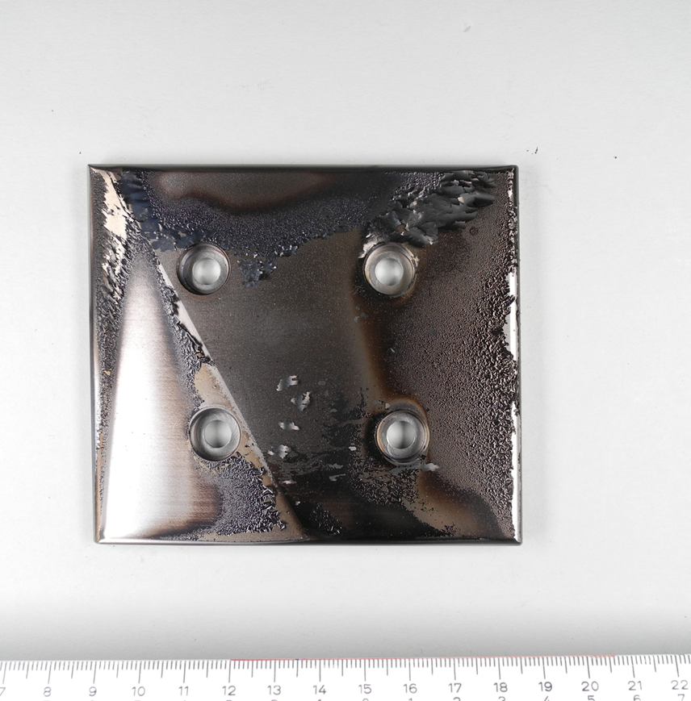
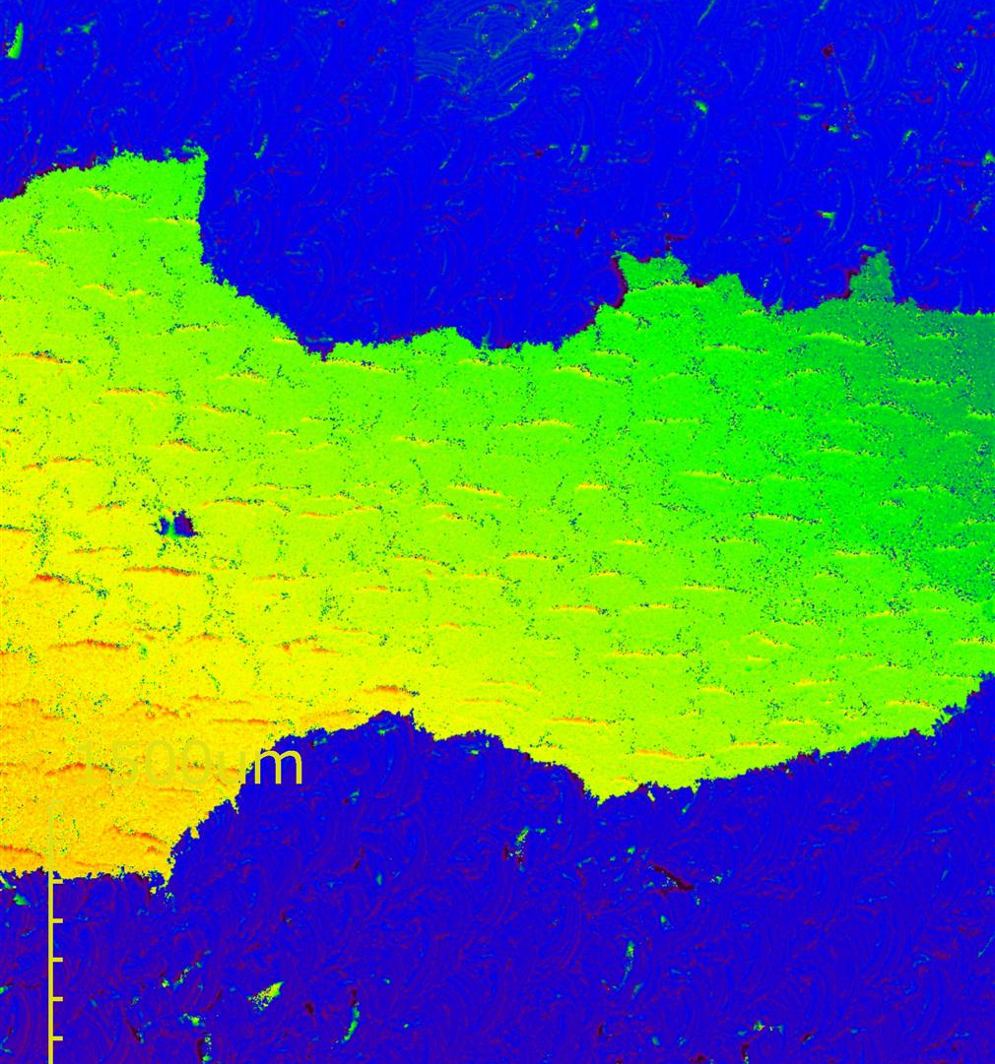
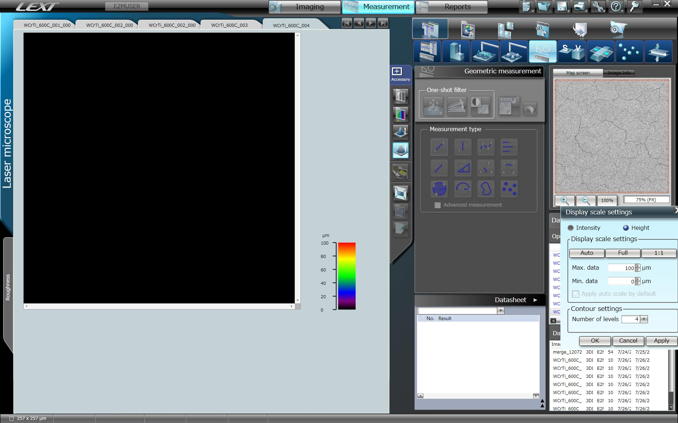
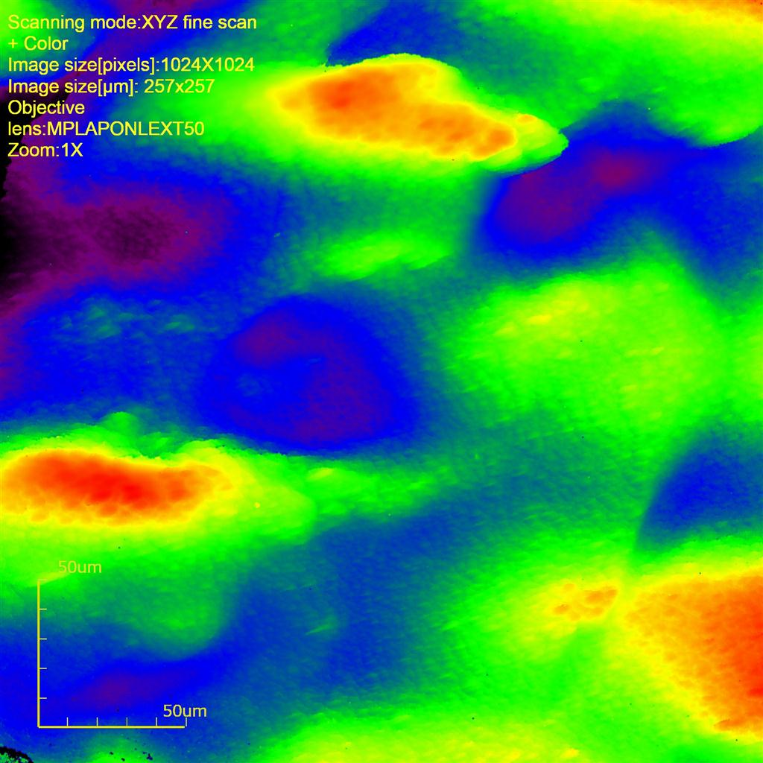
Continuation of ongoing projects into OP 2.4 and 2.5 of W7-X
Erosion and re-deposition studies
Exposure of samples to boronization and plasma during W7-X OP 2.4 and 2.5
    Multi-purpose manipulator, probe head FZJ-MAT1
    Multiple types of material (C, Al, Tungsten alloys, stainless steel,…) and surfaces
Analysis of the samples and determination of their composition before and after exposure via ³He – NRA
Goals :Identification of parameters that affect the boronization and boron deposition processes
    Determination of empirical formula correlating boronization parameters and deposited boron
    Determination of elemental erosion rates
    Comparison to calculated sputtering yields
TB-W049-11-001_p01-flake_023_x5_4x1_H
TB-W049-13#1
6
xx µm
7
5
4
8
2
3
1
0
9
10
Post- characterization of deposition on tiles and comparison to collected dust
Aim: Determination of erosion and deposition areas in W7-X, transport of light impurities
33 tiles dismounted and analysed after OP 2.3
    Baffle tiles (W, tungsten heavy alloys)
    Inner wall tiles (graphite, W-coated graphite)
Samples analysis via Ion Beam Analysis (IBA), Confocal Laser Scanning Microscopy (CLSM) and Scanning Electron Microscopy (SEM) (M. Mayer and M. Balden)
Deposit peel off producing large flakes as observed on the samples with collected dust, analogous morphology
Deposit thickness on tiles: ~20 µm, collected dust: up to 100 µm
20 µm
200 µm
20 µm
10 µm
0
50 µm
F. MARAGKOS | WPPWIE SPB KICK-OFF MEETING | 29.04.2026
3

