Slide 1
WP PWIE SP B - kick-off meeting for 2026 activities
SP B.2 - IBA capabilities for SP B samples (IST)
Rodrigo Mateus, Norberto Catarino, Rui Silva
Notes:
Please Indicate your subproject

Slide 2
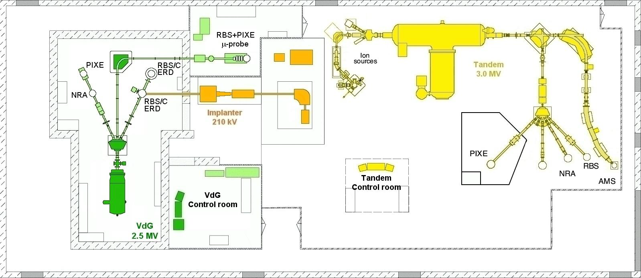
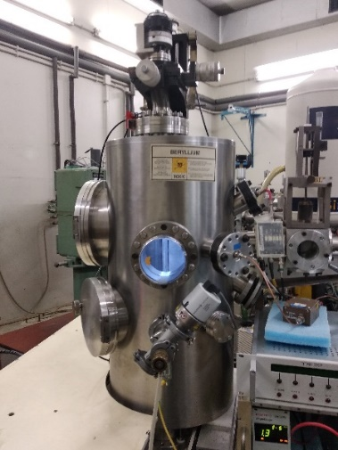
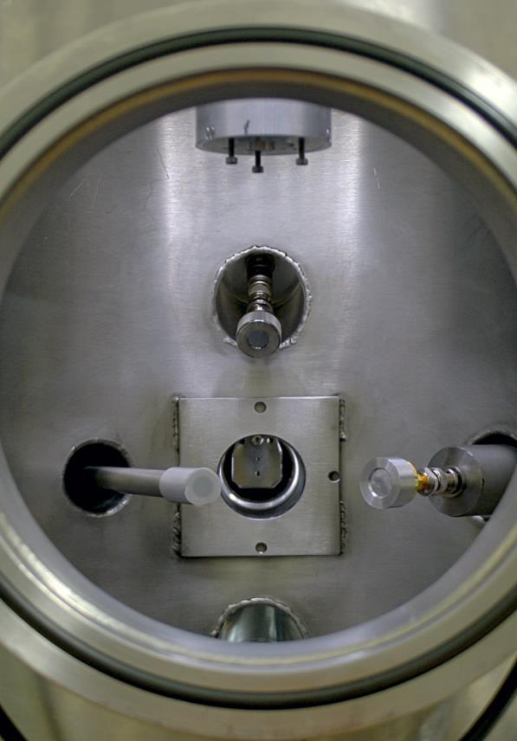
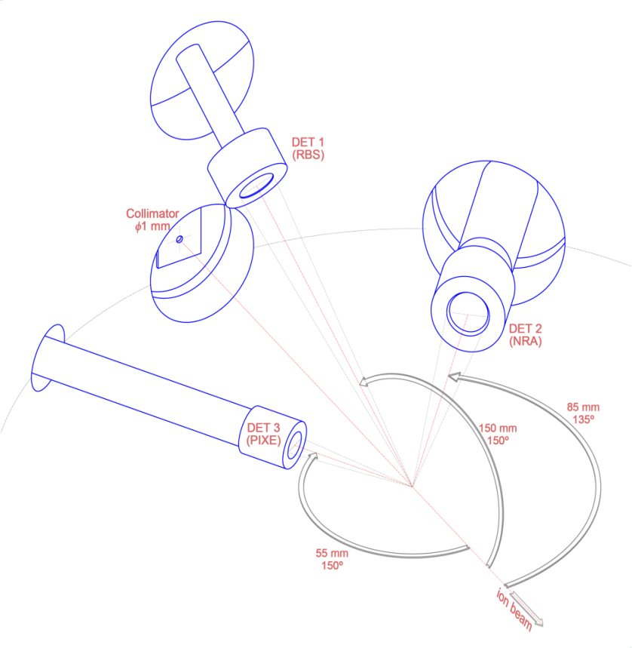
IBA laboratory of IST
Experimental JET chamber
JET
JET chamber - EBS, RBS, NRA, PIXE, from small samples to full tiles
RBS/C chamber - EBS, RBS, NRA, small samples
μ-probe – EBS, RBS, NRA, PIXE, PIGE, up to 75 mm long samples

Slide 3
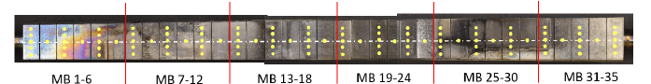
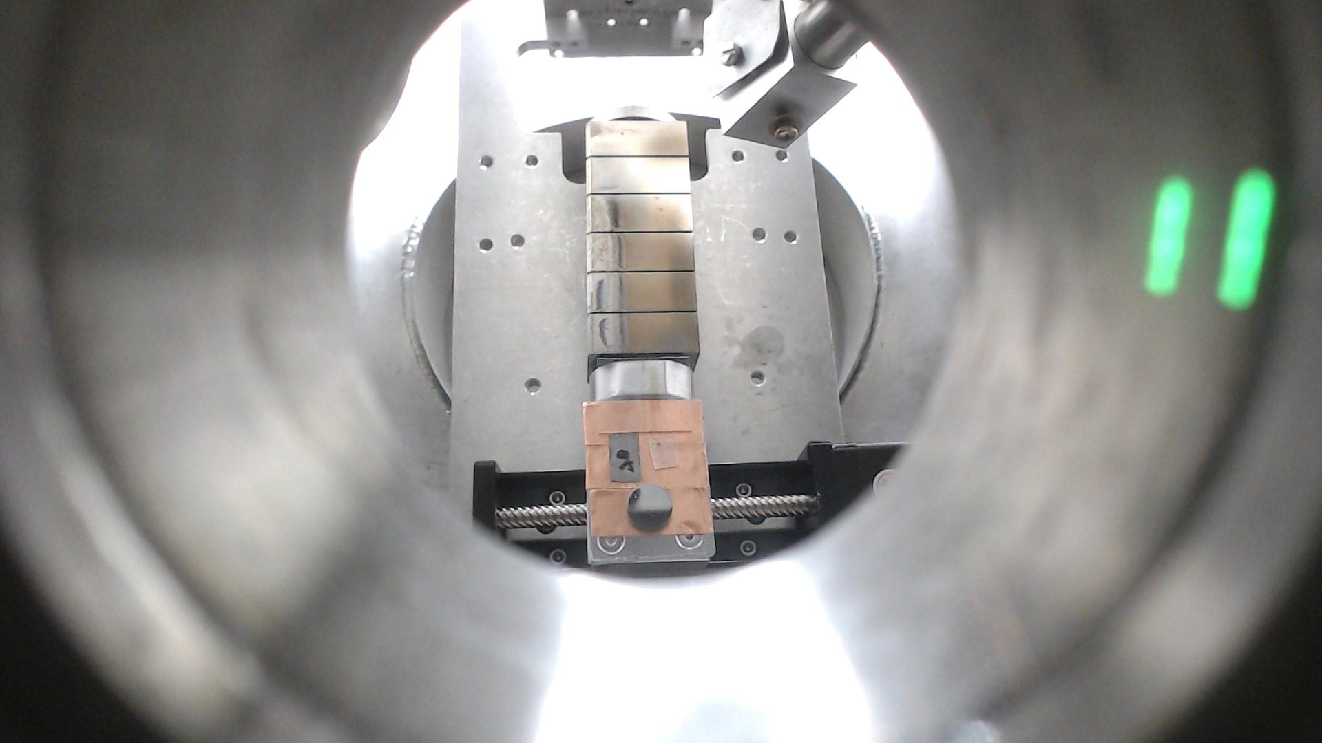
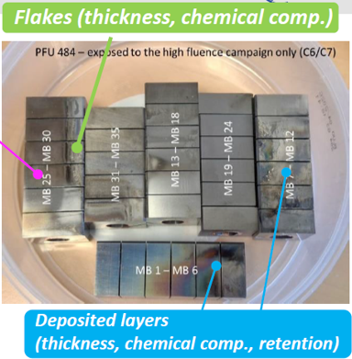
SP B.3 - Analysis of WEST PFU #484 / high fluence C7 campaign (2023)
PFU #484
Experimental measurements
MB 25 - 30
56
42
28
49
35
MB 25
z 130
MB 26
z 118
MB 27
z 105
MB 28
z 93
MB 29
IBA
2200 keV ¹H⁺ , 2µC , 2 nA , EBS-PIXE
2200 keV ³He⁺ , 5µC , 8 nA , NRA-RBS
z 81
MB 30
z 69
Glass
Be
NbLiO₃
z 37
W+D
z 25

Slide 4
MB 30
W-L
E
D
C
B
A
²H(³He.p₀)⁴He
IBA and ion implantation of D₂⁺ in W and B coatings / Oxidation behaviour of B coatings
1 - Targets for LIBS depth profiling (prepared for delivery)
(Univ. Tartu , Comenius Univ.)
IBA and D implantation in W coatings (IST):
Step 1 - 150 keV D₂⁺ / 2 x 10¹⁷ at./cm²
Step 2 - 75 keV D₂⁺ / 2 x 10¹⁷ at./cm²
Step 3 - 50 keV D₂⁺ / 1 x 10¹⁷ at./cm²
Four 5 μm compact-W on Mo plates (IU-961-8/9/12/13 ; INFLPR)
Two 5 μm porous-W on Mo plates (EU-156-12/15 ; INFLPR)
2 - PSI-27 conference (Comenius Univ., INFLPR, IST) / LIBS depth profiling
B and B+D co-deposited coatings on W and Si plates (INFLPR)
IBA and D implantation in B coatings (IST):
D implantation - Step 1 - 75 keV D₂⁺ / 1 x 10¹⁷ at./cm²
- Step 2 - 50 keV D₂⁺ / 1 x 10¹⁷ at./cm²
- Step 3 - 25 keV D₂⁺ / 0.5 x 10¹⁷ at./cm²
3 - Study of Oxidation behaviour of B coatings (INFLPR , IST)

