Slide 1
WP PWIE SP B - kick-off meeting for 2026 activities
SP B.3 - Production of B reference layers for ITER-relevant studies (IAP)
Corneliu Porosnicu, Paul Dinca, Bogdan Butoi, Cristian Lungu & all EPPA team
Notes:
Please Indicate your subproject

Slide 2
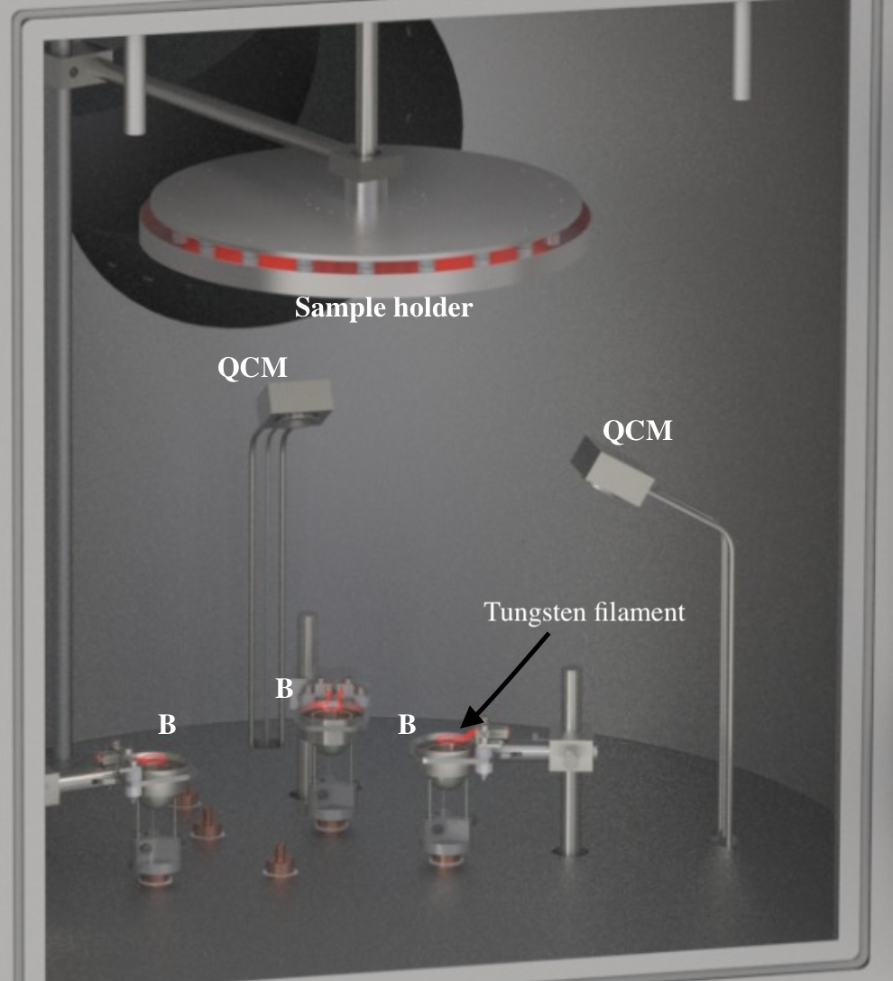
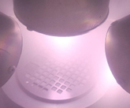
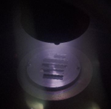
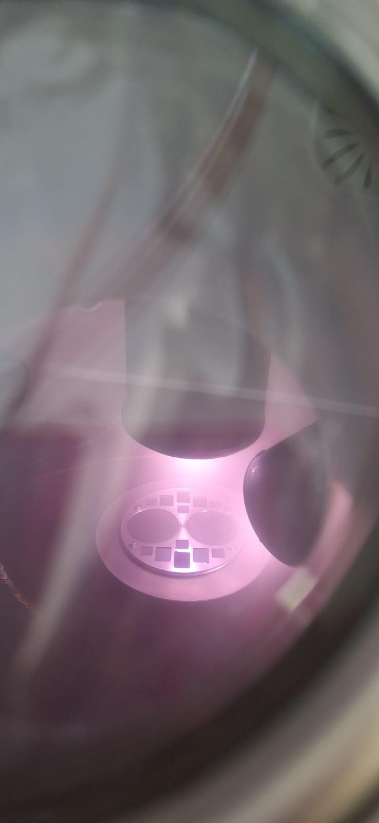
SP B.3: D004: Production of B reference layers and multilayer coatings
Coatings to be produced for SP B.1 and SP X:
Deposition of B (5 µm) on Mo - study the impact of roughness on erosion characteristics and LIBS spectra
Coatings to be produced for SP C (permeation studies):
Up to 5 mm B layers (pure and with D) on Eurofer and W (and Si) → V. Nemanic @JSI
Experiments agreed with colleagues under SP B:
B coatings with D inclusions (10 at.%) and annealed at 50–500°C → C. Pardanaud @CEA
Oxidation under controlled thermal conditions for B layers on W → R. Mateus @IST
  Vary O₂ partial pressure (10⁻²-10 mbar), surface T (100-1000 °C), and D ion energy (40-200 eV)
  Micromechanical studies on W-B layers with and without D → Y. Zayachuk @UKAEA
  LIA-LIBS-QMS and detection and separation of H isotopes in B-D samples using laser ablation and MW-plasma, collaboration with Institute of Physics Belgrade
  Other samples to be discussed today or individually with other task owners
Task owner: Corneliu Porosnicu(IAP)

Slide 3
SP B.3: D004: Production of B reference layers and multilayer coatings
Experiments: Planned
Study the oxidation of boron layers under controlled thermal conditions (ongoing with R. Mateus @IST)
  Objectives: oxidation study of the boron layers as a function of temperature and oxygen partial pressure; evaluation of D retention of boron oxide layers; erosion of the boron oxide layers under D exposure.
  Permeation studies on up to 5 mm B layers (pure and with D) on Eurofer and W (ongoing with V. nemanic @JSI
LIA-LIBS-QMS Studies. Objectives: distinction betwen H isotopes in B-D (2026) and B-T (2027) samples using laser ablation and MW-plasma (ongoing with Institute of Physics Belgrade)
Experiments: Ideas
1. Investigate the formation of B-W alloys at ITER relevant parameters
Experimental: Deposition of B, W and B/W on polycrystalline tungsten, B substrates and W. Thermal treatment at up to–2500 °C Furnace in vacuum, H2, inert gases 1800°C and 1100°C(IAP)
Investigation: XPS (metallic boron, boron oxide, and boron-tungsten alloy ), RBS (intermixture of the layers).
2. The morphological changes induced by plasma impurity bombardment on B layers
  Exposure of B layers to N/Ne/He plasma produced by a plasma source/torch/ linear plasma device at relevant ion energies (40 eV-200 eV) and temperatures.
  Investigation Methods: HR-SEM, AFM , XRD, XPS.
  3. Study of erosion rates in the presence of different gaseous impurities from the plasma
  He/Ne/N/D or mixed D-N/D-Ne/D-He plasma exposure at 0.5 to 10 Pa and ion energies between 40 to 200 eV.
  Measurements: In situ B erosion by OES, mass loss technique and TDS to study the release of D and impurities
  4. Study of the hydrogen isotope exchange in boron layers under ITER relevant wall conditioning procedures
  300-500 nm H-B Boron layers (10 at % H). Exposure to (50 eV to 500 eV) D plasma, between 100 ºC up to 300 ºC.
  SEM, AFM and sputtered XPS investigations. NRA and ERDA for the depth profiling of D and H respectively.

