Slide 1


WPSA report 2026-10-20
EUROfusion PSD Management Meeting
Carlo Sozzi

Slide 2
WPSA resources status (2026)
activity |  | ~k€ cc | comment
Unallocated resources |  | 0
Available mission budget 2026 (19.10.2026) |  | -187.071
SNE salary EdgeTS |  | 21.6875 | from mission budget 2026
SNE salary divVUV |  | 25.30208333 | from mission budget 2026
CEA SELFIE task withdrawn |  | 0 | (not usable, OLD task) -16.984 k€
additional DR task 2026 (ENEA-CNR) |  | 3.614583333
additional PDS task 2026 (EPFL) |  | 7.083333333
Mission plan (2026*) |  | 64.75 | * part of this budget likely to be shifted to 2027 due to the delay in the IC (to be added to the “balance”)
Activities shifted to 2027
 | CCG (cryomagnet system) | 10 | 30 days mission JA
 | ECH and ECE control room tools | 10 | 30 days mission JA
 | PDS training in EU | 20 | 12 x 1 week
 | PDS training in EU 1pm | 4.27
 | Balance | -20.3635 | remaining mission budget, currently to be carried over to 2027

Slide 3
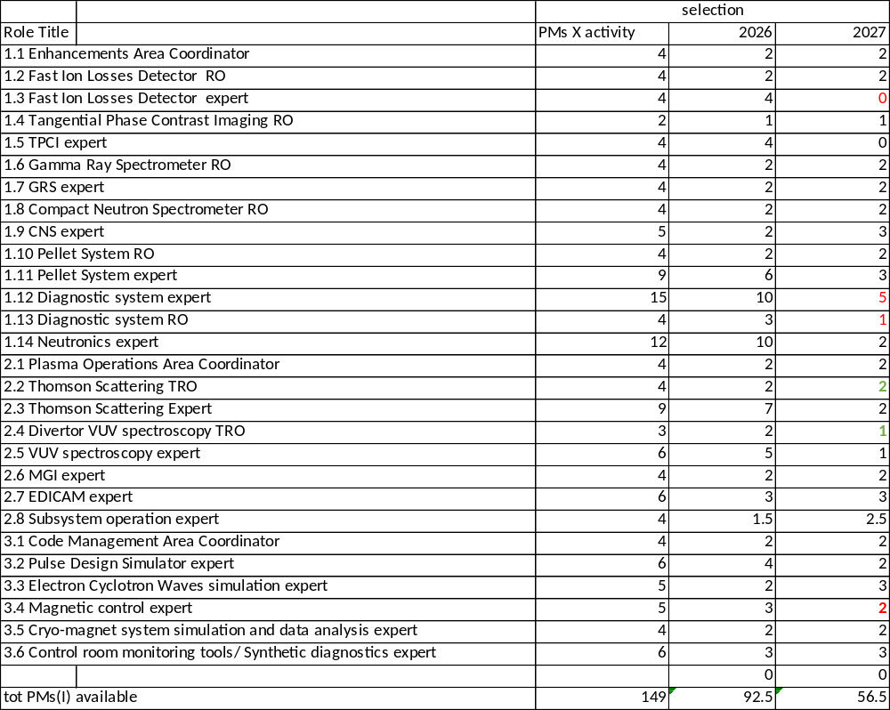
Resource plan

Slide 4
Task table
ID | Title | Deliverable Owner | DO e-mail | Contractual Status
SA-EN.AC.01-T006-D001 | Report on coordination of WPSA Enhancements Area 2026 | Pilar Cano Megias | pcano1@us.es | Running
SA-EN.FE.11-T004-D001 | Report on simulation/CAD works for Neutronics assessments 2026 | Barbara Bienkowska | barbara.bienkowska@ifpilm.pl | Running
SA-EN.FE.11-T004-D002 | Report on Neutron Spectrum Reconstruction and Activation Foils studies 2026 | Katarzyna Mikszuta-Michalik | katarzyna.mikszuta@ifpilm.pl | Running
SA-EN.FE.11-T004-D003 | Report on LEI support to neutronics activities 2026 | Gediminas Stankunas | Gediminas.Stankunas@lei.lt | Running
SA-EN.FE.14-T001-D001 | 2026 report on Design and Procurement of a Doppler Reflectometer | Elena De La Luna | elena.delaluna@ciemat.es | Running
SA-EN.FE.14-T002-D001 | 2026 report on support activities for VNC and CNS development | Marco Cecconello | marco.cecconello@physics.uu.se | Running
SA-EN.FE.14-T003-D001 | 2026 report on design and procurement of a Vertical Neutron Camera | Lukasz Swiderski | l.swiderski@ncbj.gov.pl | Running
SA-EN.FE.14-T004-D001 | 2026 Report on development of a Runaway Electron Monitor | Daniele Marocco | daniele.marocco@enea.it | Running
SA-EN.FE.14-T005-D001 | 2026 Report on feasibility of a Directional Electron Probe diagnostics | Yunfeng Liang | y.liang@fz-juelich.de | Running
SA-EN.FE.14-T006-D001 | 2026 Report on feasibility of a Collective Thomson Scattering system for JT-60SA | Soren Bang Korsholm | sbko@fysik.dtu.dk | Running
SA-EN.IM.01-T004-D001 | Report on activities for FILD procurement during 2026 | Juan Ayllon | jayllon@us.es | Running
SA-EN.IM.07-T003-D001 | Report on Phase Contrast Imaging system design, procurement, and partial installation 2026 | Stefano Coda | stefano.coda@epfl.ch | Running
SA-EN.IM.10-T003-D001 | Report on activities for Gamma-ray spectrometer design and procurement 2026 - ENEA | Massimo Nocente | massimo.nocente@unimib.it | Running
SA-EN.IM.10-T003-D002 | Report on activities for Gamma-ray spectrometer design and procurement 2026 - UKAEA | Vasily Kiptily | vasili.kiptily@ukaea.uk | Running
SA-EN.IM.11-T001-D001 | Report on activities for Compact Neutron Spectrometer design and procurement 2026 | Davide Rigamonti | davide.rigamonti@istp.cnr.it | Running
SA-EN.IM.05-T004-D001 | Report on progress made on pellet injection system design and procurement 2026 | Peter Lang | ptl@ipp.mpg.de | Running
SA-SE.CM.OP.08-T001-D001 | Magnetic control tool demonstrated on a relevant scenario_ENEA | Gianmaria De Tommasi | detommas@unina.it | Running
SA-SE.CM.OP.08-T001-D002 | Magnetic control tool demonstrated on a relevant scenario_EPFL | Adriano Mele | adriano.mele@epfl.ch | Running
SA-SE.CM.OP.01-T009-D001 | PDS optimised and applied to JT-60SA hybrid scenario | Emmanuel Joffrin | emmanuel.joffrin@cea.fr | Running
SA-SE.CM.OP.01.00-T001-D001 | Data analysis tools adapted to OP-2 | Edmondo Giovannozzi | edmondo.giovannozzi@enea.it | Draft
SA-SE.CM.OP.07-T002-D001 | Consolidation of EC HCD and ECE modelling tools | Lorenzo Figini | lorenzo.figini@istp.cnr.it | Running
SA-SE.CM.OP.06-T004-D001 | Tools in support of OP 2 magnets operation | Quentin Le Coz | quentin.lecoz@cea.fr | Running
SA-SE.OP.AC.01-T007-D001 | Report on the activities related to Operations Area 2026 | Matteo Iafrati | matteo.iafrati@enea.it | Running
SA-SE.OP.REC.01-T003-D001 | OLD_SA-SE.OP.REC.01-T002-D003_Test the new access procedure to EU diagnostics via the IFERC network from a trusted EU site | Frederic Imbeaux | frederic.imbeaux@cea.fr | Running
SA-SE.OP.SSO.01-T009-D002 | OLD_SA-SE.OP.SSO.01-T006-D001_SELFIE Tests CS Joints resistivity measurement | Clément Nguyen Thanh Dao | clement.nguyenthanhdao@cea.fr | Withdrawn
SA-EN.IM.06-T003-D001 | OLD_SA-EN.IM.06-T002-D001_Report on procurement of multiple EDICAMS for JT-60SA 2025 | Tamas Szepesi | Szepesi.Tamas@ek.hun-ren.hu | Running
SA-SE.OP.DO.04-T004-D001 | Thomson Scattering TRO | Federico Antonio D'Isa | federico.disa@igi.cnr.it | Running
SA-SE.OP.DO.04-T004-D002 | Thomson Scattering Expert_ENEA | Federico Antonio D'Isa | federico.disa@igi.cnr.it | Running
SA-SE.OP.DO.04-T004-D003 | Thomson Scattering Expert_IAP | Sorin Soare | sorin.soare@icsi.ro | Running
SA-SE.OP.DO.05-T004-D001 | Divertor VUV spectroscopy TRO | Andrea Belpane | andrea.belpane@igi.cnr.it | Draft
SA-SE.OP.DO.05-T004-D002 | VUV spectroscopy expert_ENEA | Marco Valisa | valisa@igi.cnr.it | Draft
SA-SE.OP.DO.01-T006-D001 | EDICAM expert | Tamas Szepesi | Szepesi.Tamas@ek.hun-ren.hu | Running
SA-SE.OP.PO.01-T008-D001 | Plasma operations expert | Philippe Moreau | philippe.jacques.moreau@cea.fr | Draft
SA-SE.OP.SSO.03-T003-D001 | MGI expert | Paul Heinrich | paul.heinrich@ipp.mpg.de | Draft
SA-SE.OP.DO.05-T004-D003 | VUV spectroscopy Expert_IAP | Sorin Soare | sorin.soare@icsi.ro | Draft
SA-SE.CM.OP.01-T009-D002 | JT-60SA PDS documented test case for training | Domenico Frattolillo | domenico.frattolillo@epfl.ch | Running
SA-EN.FE.11-T004-D004 | Report on UKAEA support for neutronics activities in 2026 | Alex Valentine | Alex.Valentine@ukaea.uk | Running
SA-SE.OP.SSO.07-T001-D001 | Report on the Fabrication Procedure and Manufactured TESPELs for JT-60SA | Naoki Tamura | naoki.tamura@ipp.mpg.de | Draft
SA-SE.OP.DO.04-T004-D004 | Thomson Scattering TRO - on site work | Federico Antonio D'Isa | federico.disa@igi.cnr.it | Draft
SA-SE.CM.OP.09-T001-D001 | Data analysis tools adapted to OP-2 - ENEA and CNR | Edmondo Giovannozzi | edmondo.giovannozzi@enea.it | Draft

