Slide 1




Explaining observed potential and drift phenomena in Wendelstein 7-X with the mean-field Braginskii model
T. Tork^{1,2}, F. Reimold¹, D. Bold¹, B. Dudson³, A. Stegmeir⁴, V. Perseo¹, D.M. Kriete⁵, A. Bonciarelli¹, C. Killer¹, F. Scharmer¹, A. von Stechow¹, B. Shanahan⁶, P. Manz^{2,1} and the W7–X Team
¹Max Planck Institute for Plasma Physics, Wendelsteinstr. 1, 17491 Greifswald, Germany
²Institute of Physics, University of Greifswald, 17489 Greifswald, Germany
³Lawrence Livermore National Laboratory, 7000 East Avenue, Livermore CA 94550,USA
⁴Max Planck Institute for Plasma Physics, Boltzmannstr. 2, 85748 Garching, Germany
⁵Auburn University, Auburn, Alabama 36849, USA
⁶Plasma Science and Fusion Center, Massachusetts Institute of Technology, Cambridge, MA, USA
Prepared in part by LLNL under Contract DE-AC52-07NA27344 and supported by the HiFiStell SciDAC.

Slide 2
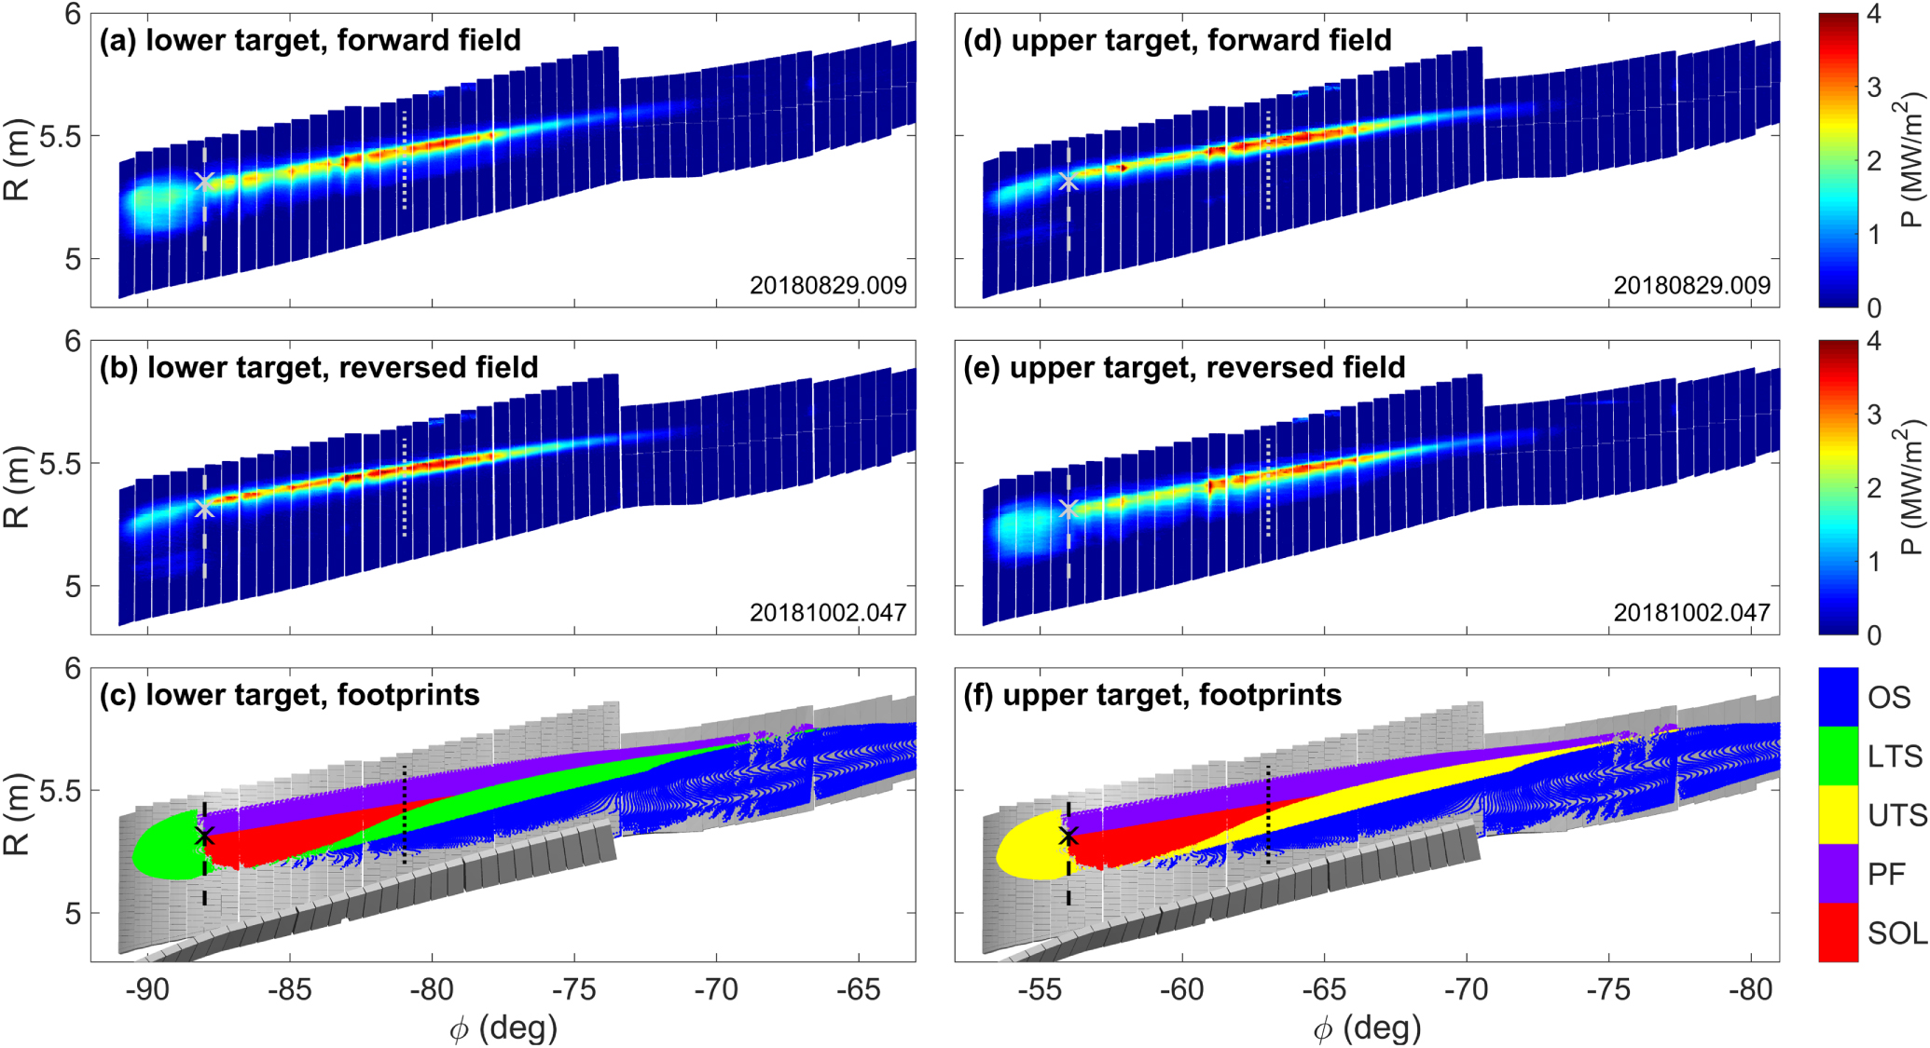
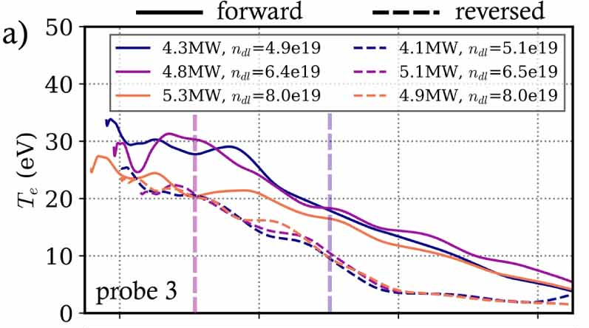
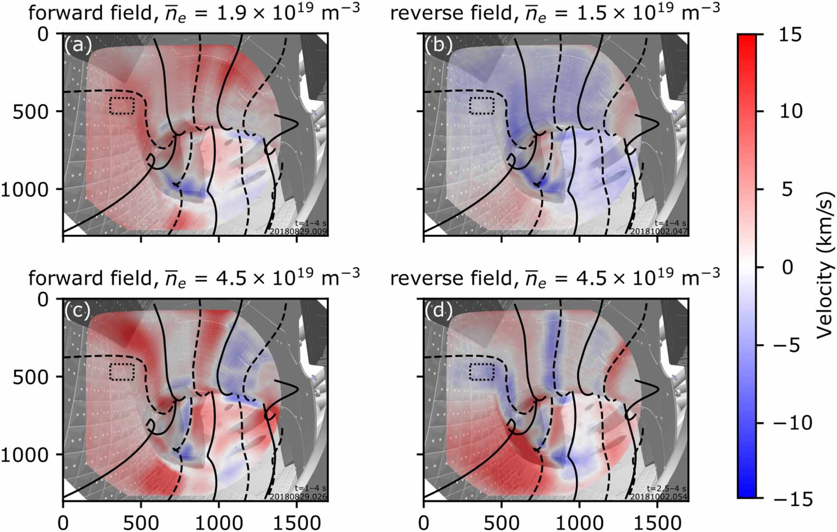
Motivation
Divertor heat loads
Drifts are expected to play an elevated role in the SOL of island diverted stellarators
Increased importance of perpendicular transport [1]
Experimental observations support the expectations [2-4]
Self-consistent modelling drifts has been absent in 3D mean-field simulations of stellarators
Challenging to implement in state-of-the-art code, EMC3 [5]
Self-consistent description of the electrostatic potential needed
Langmuir profiles
[3]
Ion flows
[4]
[1] Y Feng et al 2011 Plasma Phys. Control. Fusion 53 024009
[2] K C Hammond et al 2019 Plasma Phys. Control. Fusion 61 125001
[3] Carsten Killer et al 2026 Nucl. Fusion 66 056031
[4] D.M. Kriete et al 2023 Nucl. Fusion 63 026022
[5] R. De Wolf et al 2024 Contrib. Plasma Phys. 2024, 64(7-8)

Slide 3
Outline
Simulation setup
Experimental comparison
Langmuir probe measurements
Gas puff imaging
Coherence imaging diagnostics
Physics implications
ExB fluxes between SOL regions
Redistribution of trace densities by the ExB vortex

Slide 4
Simulation setup
Implemented in BOUT++ [1]
First simulated geometries include simplified island divertors, TCV X-21 and now W7-X
What the simulation
does:
Provides e/i-density, e/i-velocities, e/i-pressures and the electrostatic potential
Diamagnetic/ExB drifts
Impact on profiles
Self-consistent description of the balance of currents
Evolve vorticity from which we infer the potential
does not:
Neutral physics
Limits simulations to low densities/powers to stay closer to the experiment
Impurity physics
No radiation etc.
Turbulence
Turbulent fluxes are closed by heuristic diffusion coefficients (inputs)
[1] B Dudson et al 2009 Computer Physics Communications 180 (2009) 1467–1480

Slide 5
Simulation setup
Implemented in BOUT++ [1]
First simulated geometries include simplified island divertors, TCV X-21 and now W7-X
What the simulation
does:
Provides e/i-density, e/i-velocities, e/i-pressures and the electrostatic potential
Diamagnetic/ExB drifts
Impact on profiles
Self-consistent description of the balance of currents
Evolve vorticity from which we infer the potential
does not:
Neutral physics
Limits simulations to low densities/powers to stay closer to the experiment
Impurity physics
No radiation etc.
Turbulence
Turbulent fluxes are closed by heuristic diffusion coefficients (inputs)
Carry out W7-X simulations of one module
Standard configuration
Forward and reverse field simulation
[1] B Dudson et al 2009 Computer Physics Communications 180 (2009) 1467–1480

Slide 6
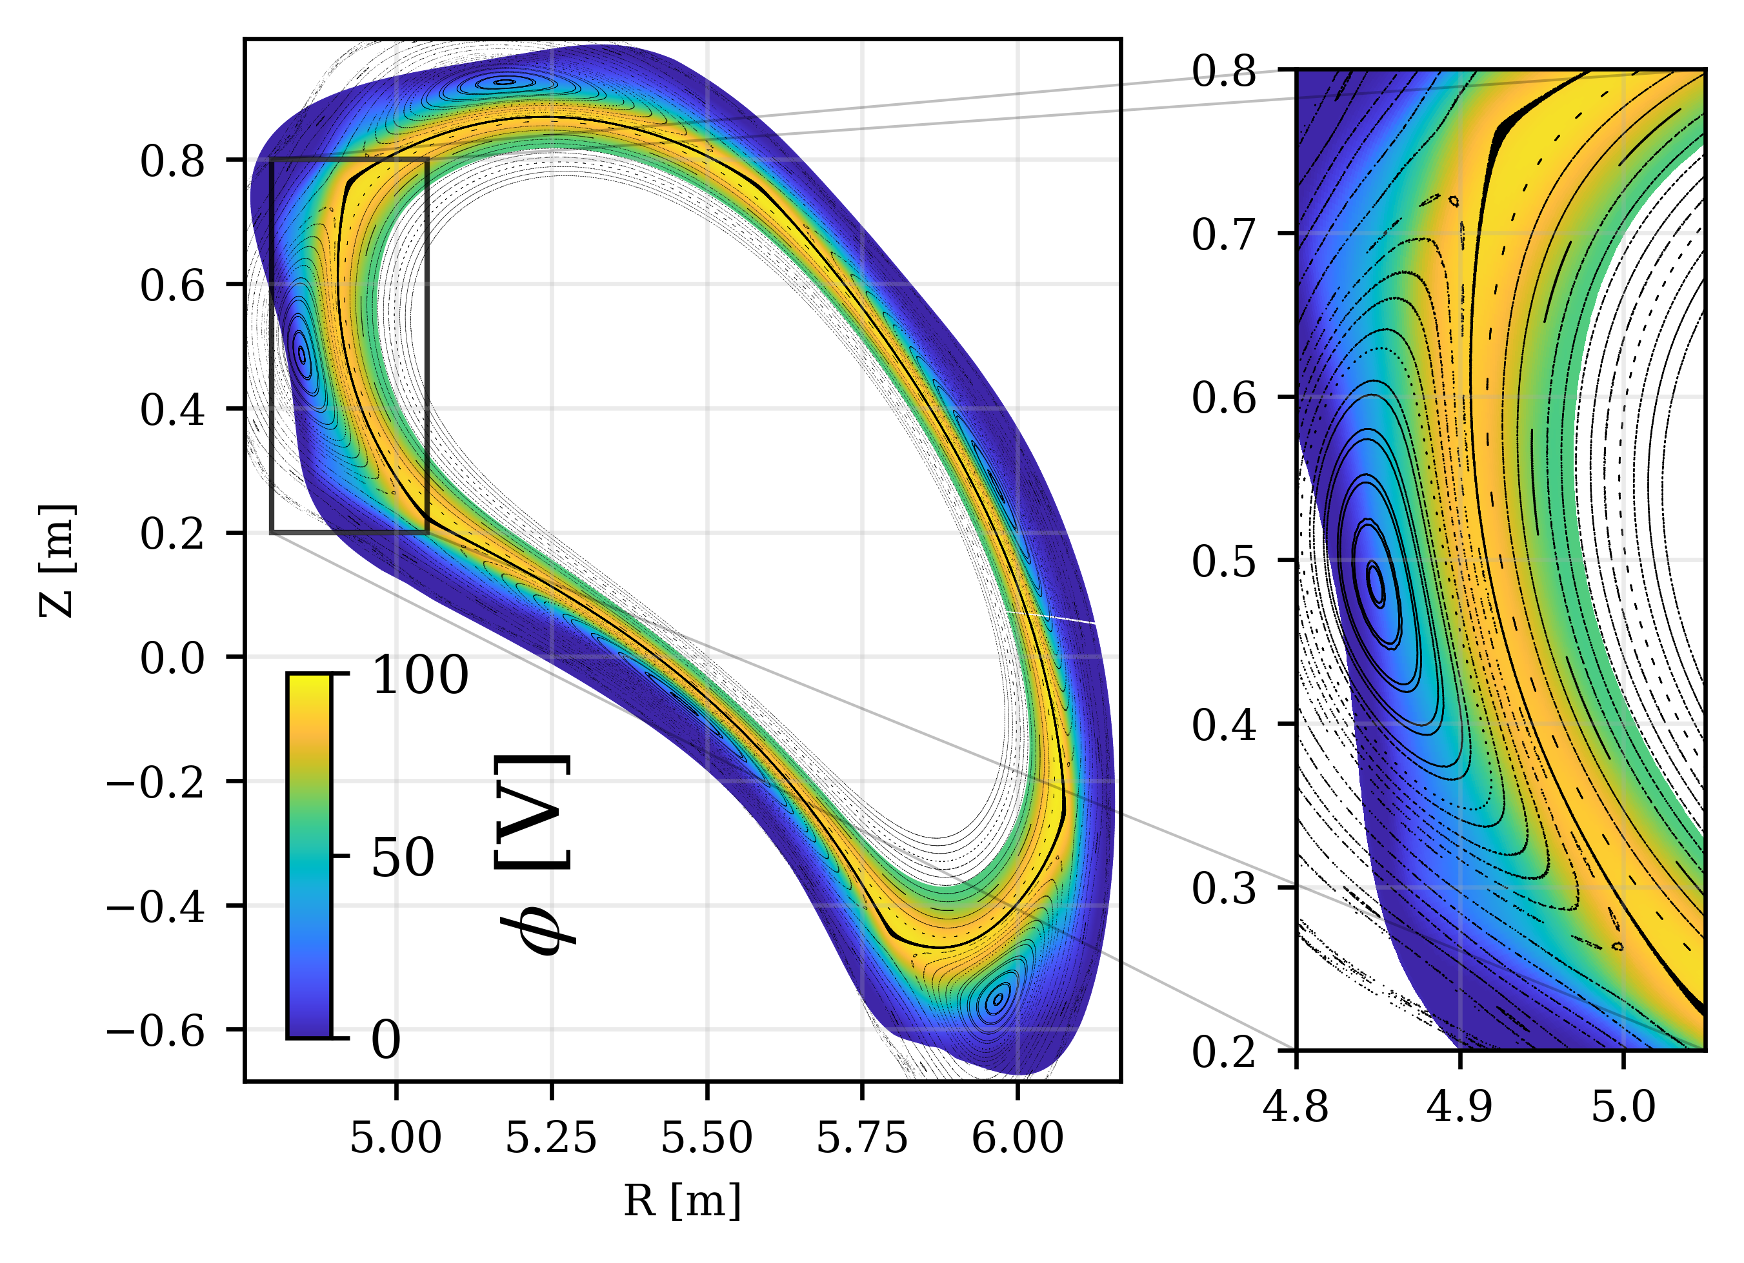
Electrostatic potential and ExB flows
Electrostatic potential is mostly aligned with LCFS
Maxima close to the separatrix
LCFS

Slide 7
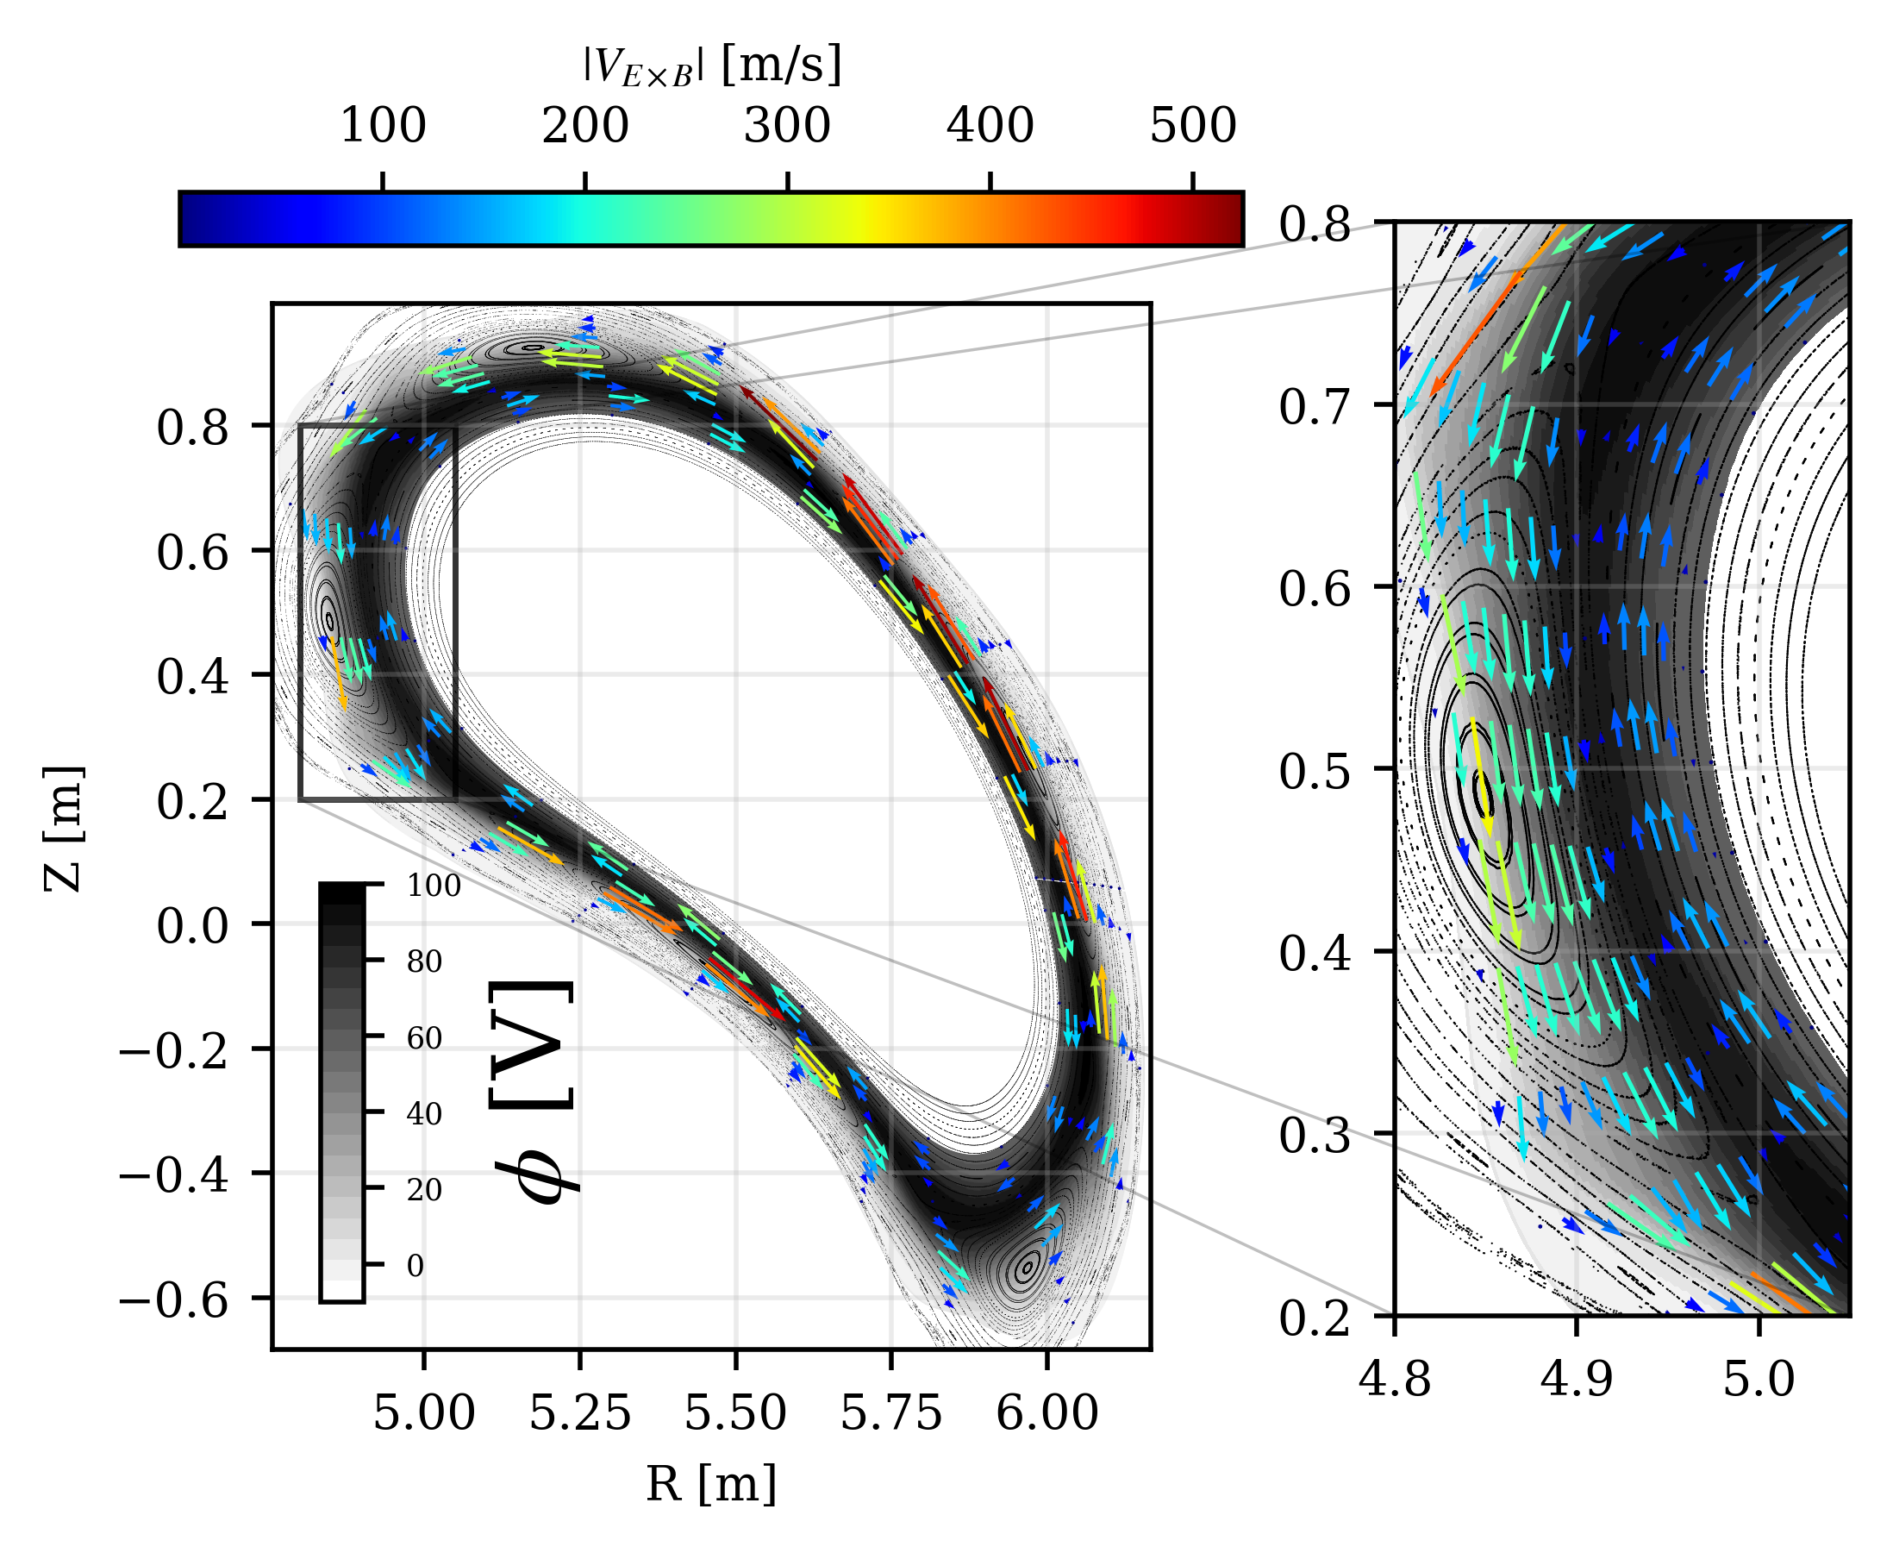
Electrostatic potential and ExB flows
Electrostatic potential is mostly aligned with LCFS
Maxima close to the separatrix
ExB vortex
Clockwise in the core, counter-clockwise in the SOL
in the main SOL mainly poloidal
Highest (~500 m/s) in regions of densely packed flux surfaces
ExB vortex

Slide 8
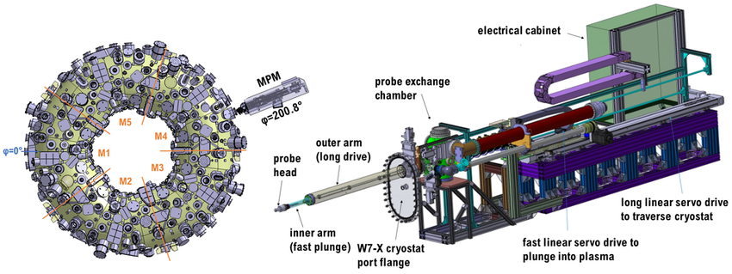
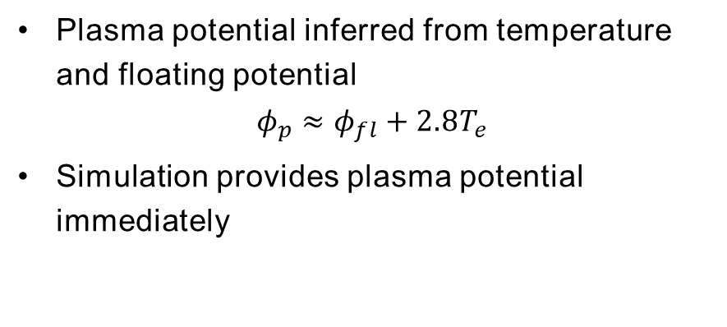
Experimental comparison – Langmuir probes
W7-X provides Langmuir probe measurements of the floating potential and the electron temperature [1]
[1]
Plasma potential inferred from temperature and floating potential
$$φ_{p}≈φ_{fl}+2.8T_{e}$$
Simulation provides plasma potential immediately
[1] C. Killer et al 2022 JINST 17 P03018

Slide 9
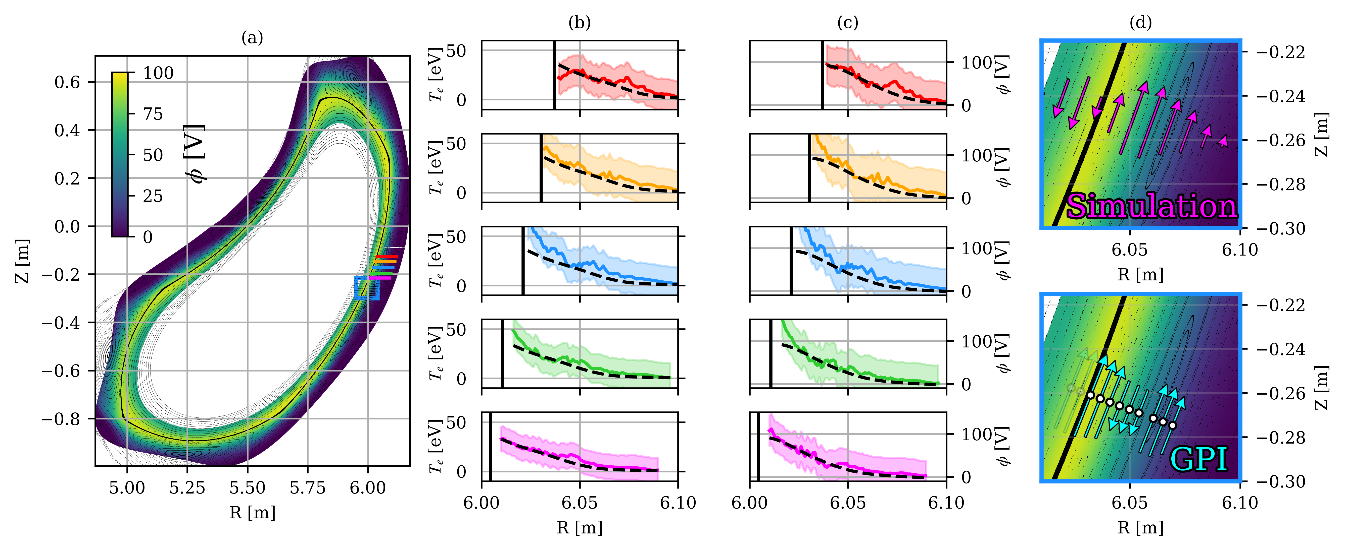
Experimental comparison – Langmuir probes
W7-X provides Langmuir probe measurements of the floating potential and the electron temperature [1]
Simulation
LCFS
[1]
Plasma potential inferred from temperature and floating potential
$$φ_{p}≈φ_{fl}+2.8T_{e}$$
Simulation provides plasma potential immediately
Comparison between simulation and experiment
Simulation and experiment agree within error bars
Finer structure not fully resolved, but overall gradient are mostly recovered
20231126.23
[1] C. Killer et al 2022 JINST 17 P03018

Slide 10
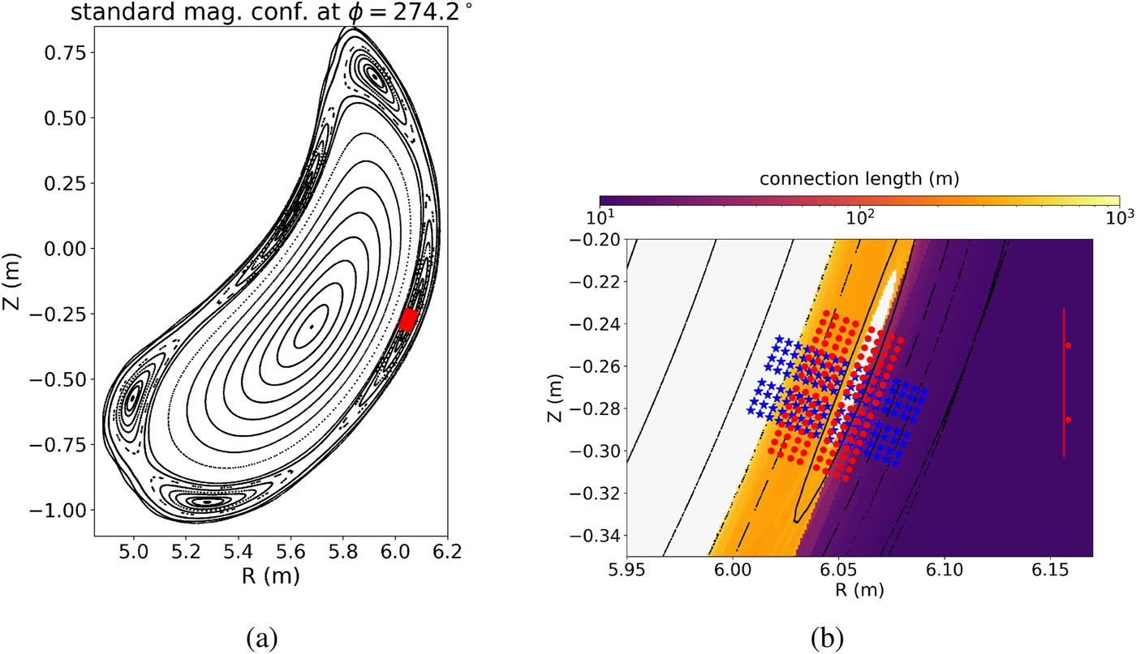
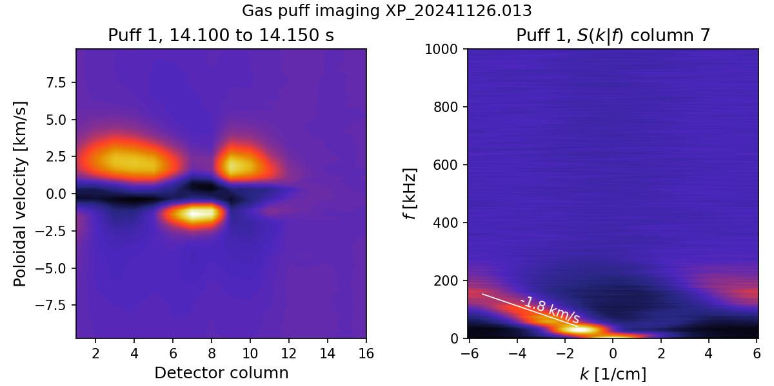
Experimental comparison – Gas puff imaging
W7-X provides poloidal velocity estimations based on the gas puff imaging diagnostic [1]
[1]
Velocity estimations based on the movement of brightness fluctuations
[1] J. L. Terry et al, Rev. Sci. Instrum. 95, 093517 (2024)

Slide 11
Experimental comparison – Gas puff imaging
W7-X provides poloidal velocity estimations based on the gas puff imaging diagnostic [1]
LCFS
[1]
Comparison between simulation and experiment
Dominant upwards velocity recovered
Smaller shear layers are not resolved
GPI velocities generally a factor 2-4 higher
Velocity estimations based on the movement of brightness fluctuations
[1] J. L. Terry et al, Rev. Sci. Instrum. 95, 093517 (2024)

Slide 12
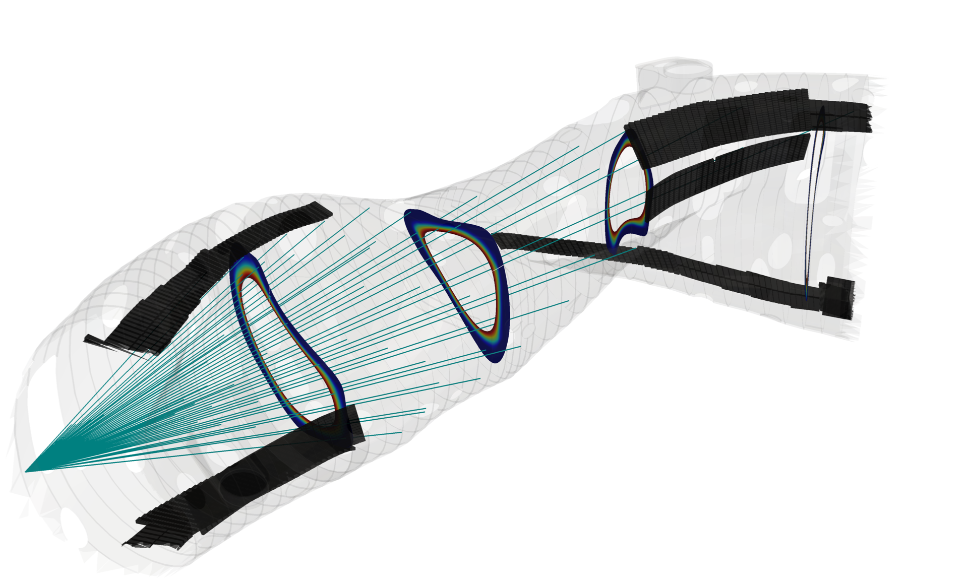
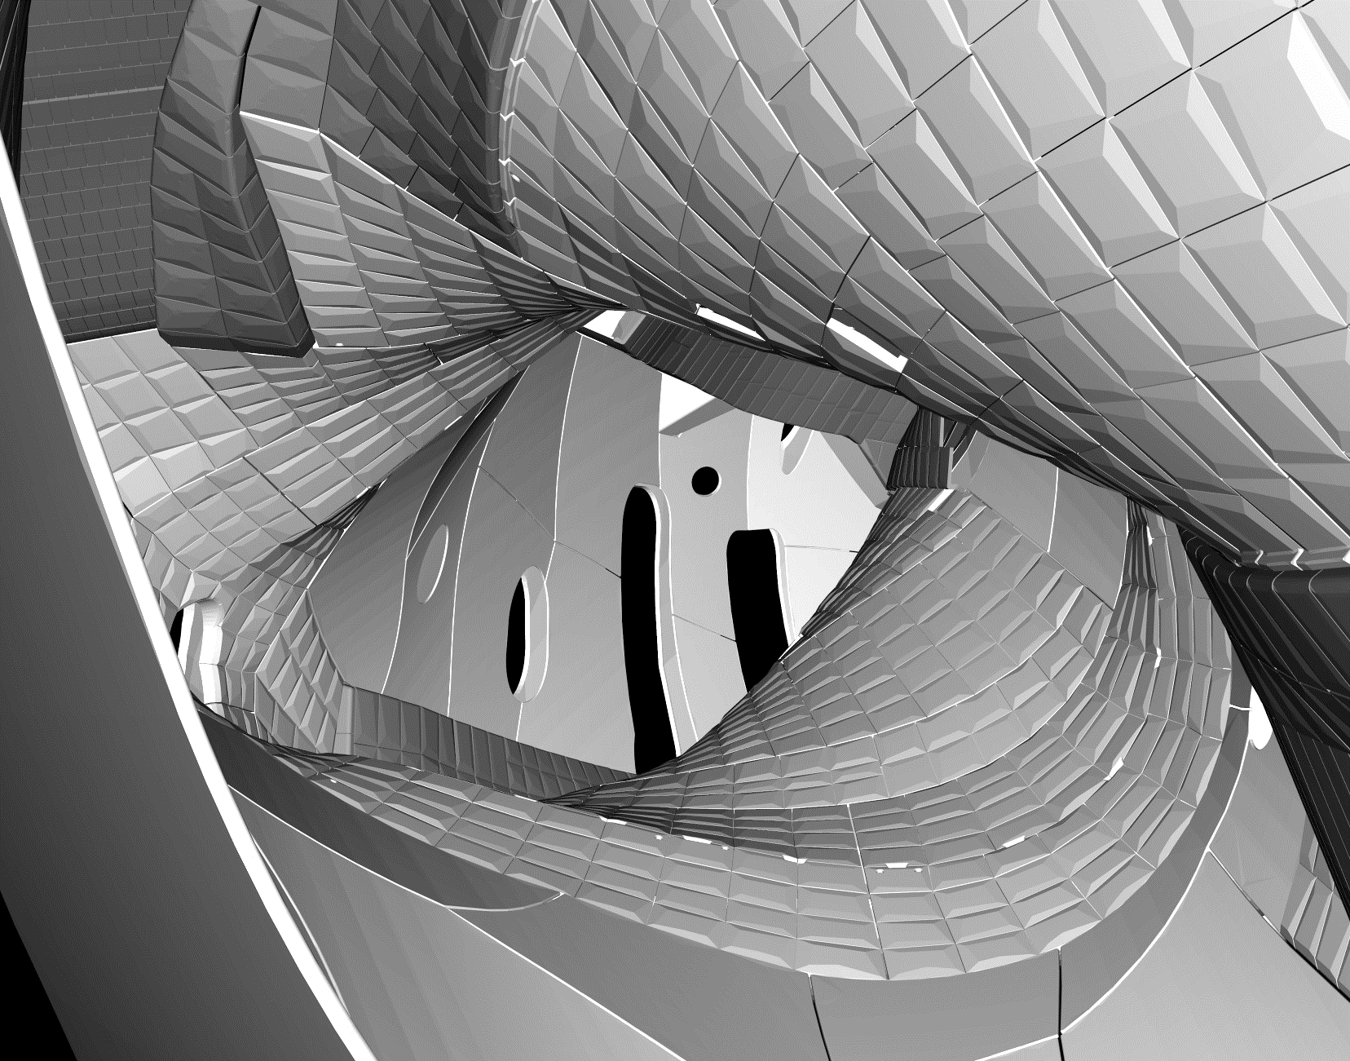
Experimental comparison – Coherence imaging spectroscopy
Coherence imaging spectroscopy provides C²⁺ impurity flow measurements [1]
Implementation of synthetic diagnostic that infers emissivity from local parameters in the simulation
2D image of ion flows
Divertor
[1] V. Perseo et al 2021 Nucl. Fusion 61 116039

Slide 13
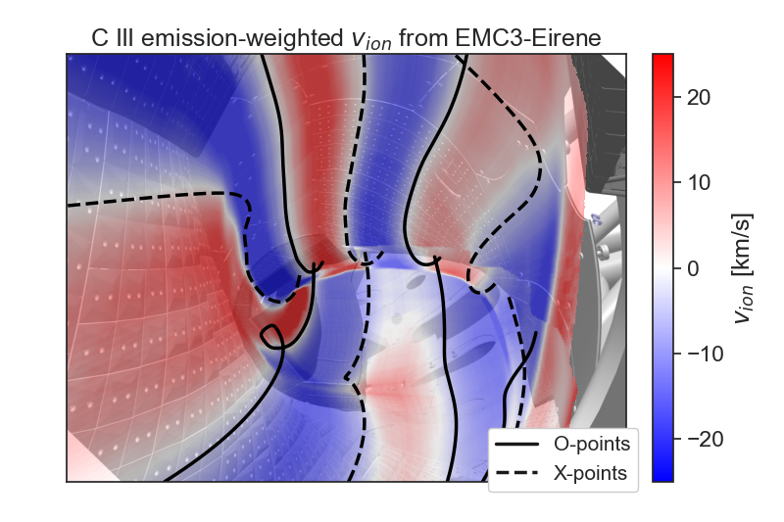
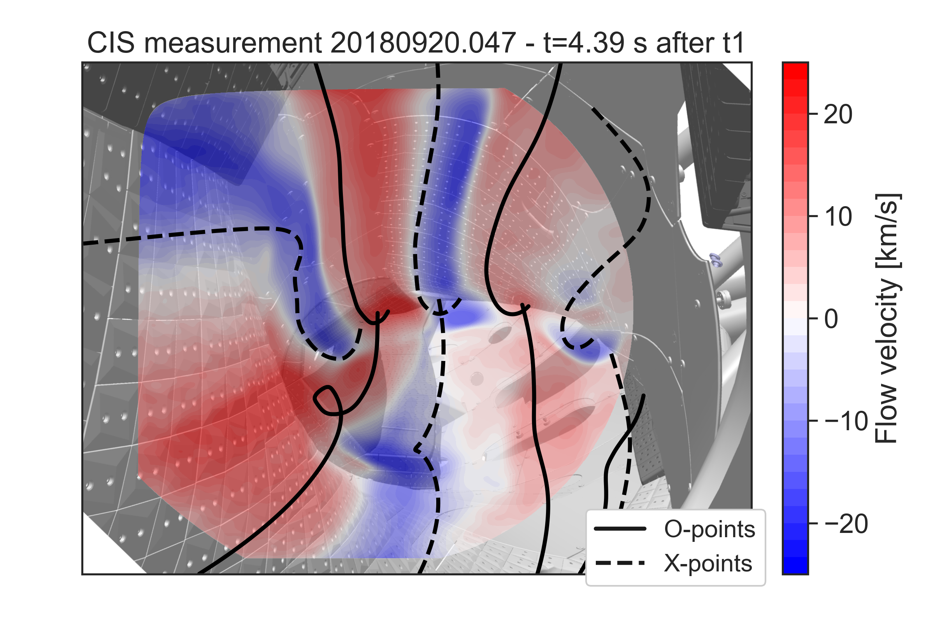
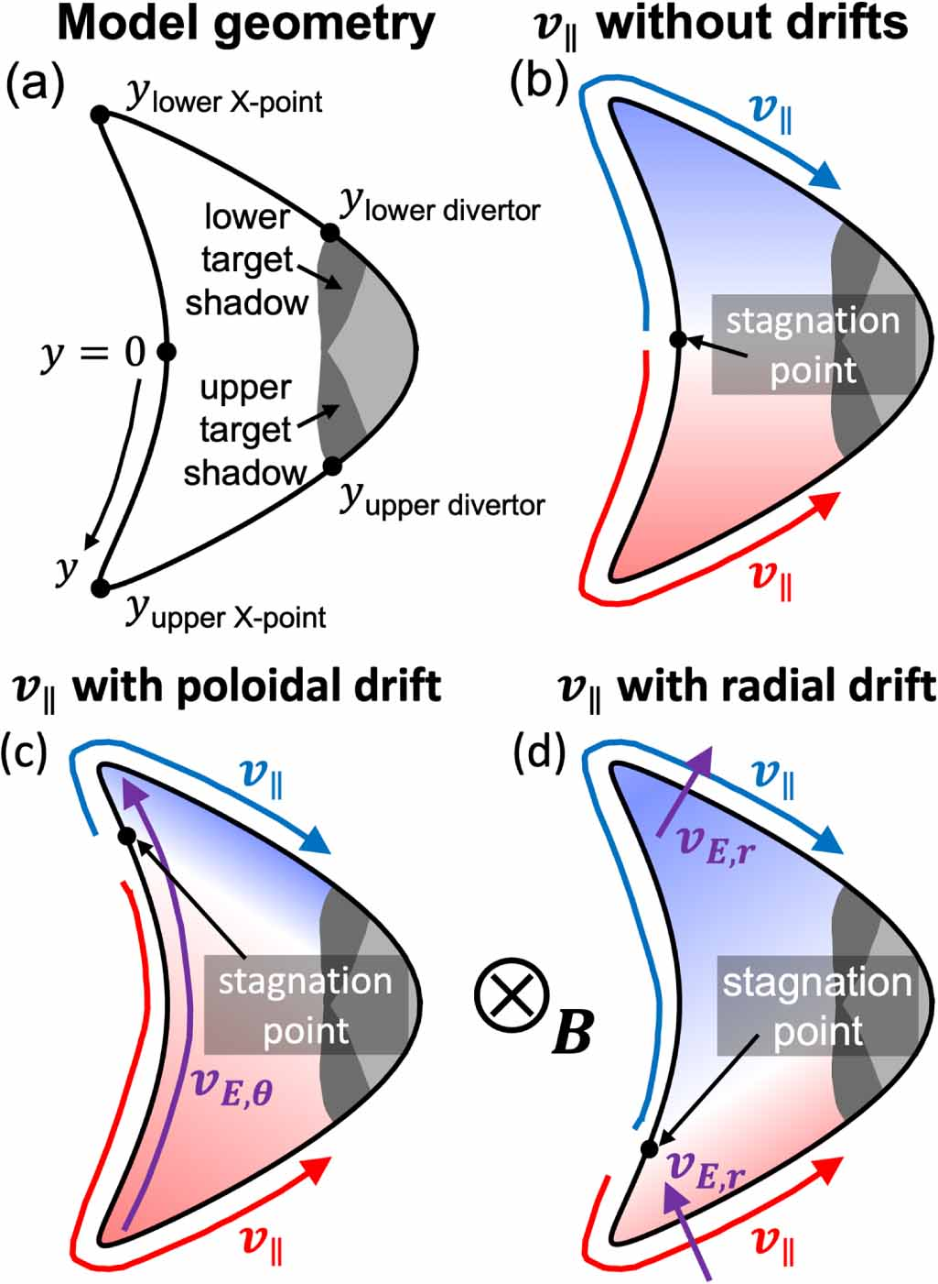
Experimental comparison – Coherence imaging spectroscopy
Coherence imaging spectroscopy provides C²⁺ impurity flow measurements [1]
Implementation of synthetic diagnostic that infers emissivity from local parameters in the simulation
2D image of ion flows
Starting point
Previous EMC3-EIRENE simulations show strong alignment of stagnation points with X- and O-points [3]
Divertor
[3]
Previous simplified model predicts movement of stagnation points at O-points due to poloidal drift [2]
[2]
[1] V. Perseo et al 2021 Nucl. Fusion 61 116039
[2] D.M. Kriete et al 2023 Nucl. Fusion 63 026022
[3] V. Perseo et al 2022 PSI 2022

Slide 14
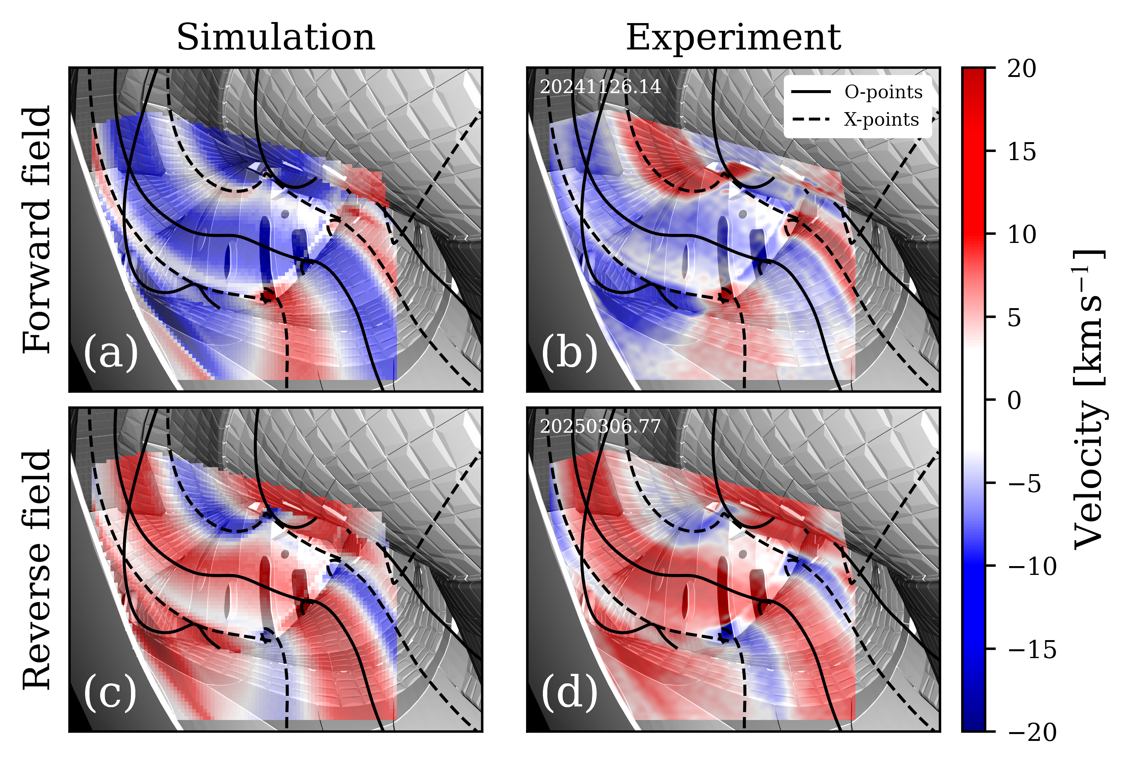
Experimental comparison – Coherence imaging spectroscopy
With drifts
Coherence imaging spectroscopy provides C²⁺ impurity flow measurements [1]
Implementation of synthetic diagnostic that infers emissivity from local parameters in the simulation
2D image of ion flows
Divertor
[1] V. Perseo et al 2021 Nucl. Fusion 61 116039

Slide 15
Experimental comparison – Coherence imaging spectroscopy
With drifts
Coherence imaging spectroscopy provides C²⁺ impurity flow measurements [1]
Implementation of synthetic diagnostic that infers emissivity from local parameters in the simulation
2D image of ion flows
Divertor
Comparison between simulation and experiment
Reproduce shift of stagnation points and dominant flow velocity
Due to movement of gradients and poloidal momentum transport
[1] V. Perseo et al 2021 Nucl. Fusion 61 116039

Slide 16
Physics implications

Slide 17
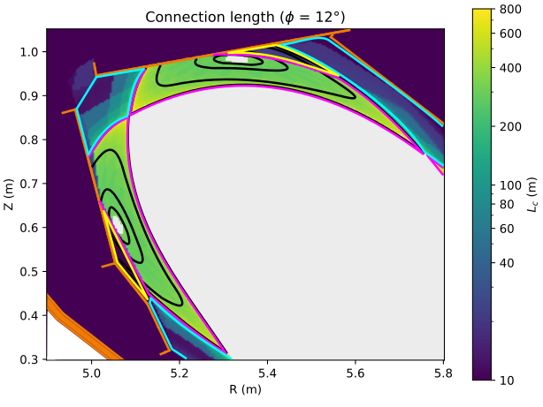
ExB fluxes across SOL region boundaries
ExB drift is suggested to be main driver of asymmetries in the SOL of low density W7-X discharges [1]
Depending on field direction, regions experience different heat loads
Does the simulation see ExB fluxes into the different SOL regions ?
PFR
Lower target shadow
Main SOL
TSR
V. Perseo, 2025 IAEA TM Divertor
[1] K C Hammond et al 2019 Plasma Phys. Control. Fusion 61 125001

Slide 18
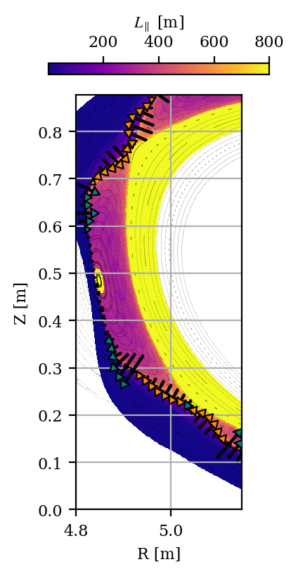
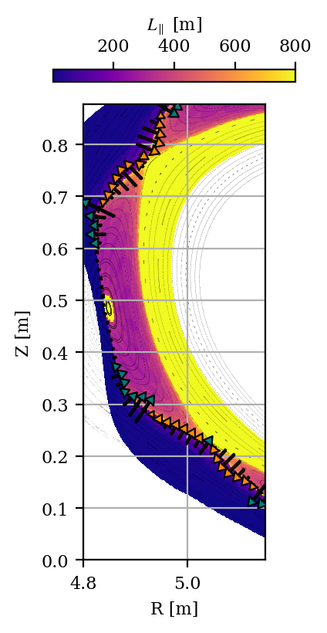
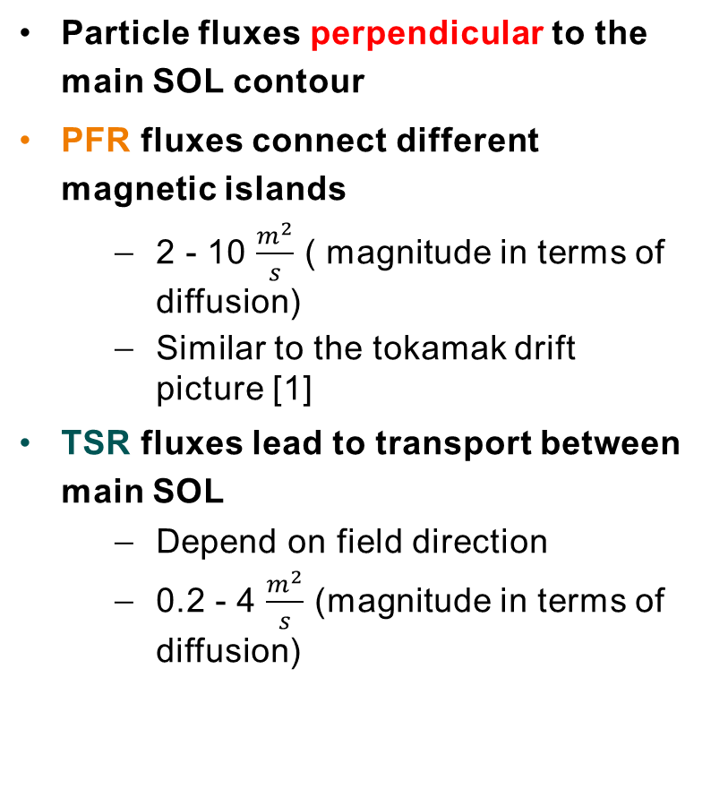
ExB fluxes across SOL region boundaries
Particle fluxes perpendicular to the main SOL contour
PFR fluxes connect different magnetic islands
2 - 10 $\frac{m^{2}}{s}$ ( magnitude in terms of diffusion)
Similar to the tokamak drift picture [1]
TSR fluxes lead to transport between main SOL
Depend on field direction
0.2 - 4 $\frac{m^{2}}{s}$ (magnitude in terms of diffusion)
PFR
TSR
Main SOL
TSR
PFR
[1] A.V. Chankin 1997
Forward field
Reverse field

Slide 19
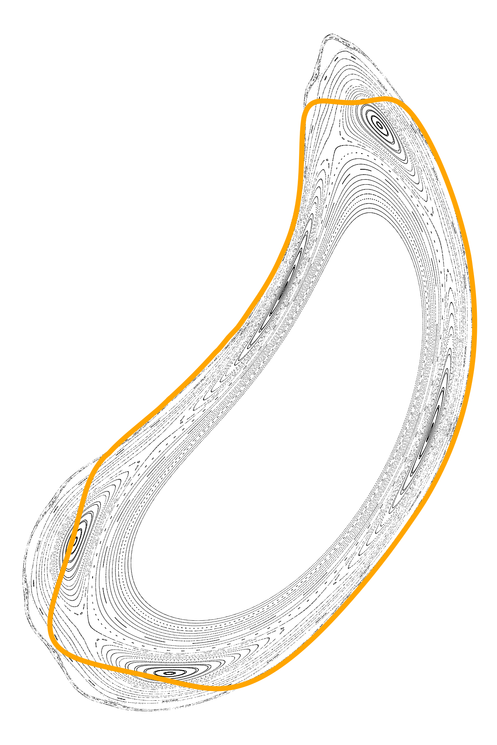
Redistribution of trace densities by the ExB vortex
Islands are topologically separated*
Cross-field transport required to exchange particles
Boundary
Impurity seeding
*In standard configuration

Slide 20
Redistribution of trace densities by the ExB vortex
Islands are topologically separated*
Cross-field transport required to exchange particles
Without drifts
Boundary
Diffusion
Impurity seeding
*In standard configuration

Slide 21
Redistribution of trace densities by the ExB vortex
Islands are topologically separated*
Cross-field transport required to exchange particles
Without drifts
Boundary
ExB
With drifts
Impurity seeding
*In standard configuration

Slide 22
Redistribution of trace densities by the ExB vortex
Islands are topologically separated*
Cross-field transport required to exchange particles
Drifts facilitate fast poloidal redistribution
No gradients needed
W7-X can detach in all islands even though seeding is happening in just one island [1]
Boundary
ExB
With drifts
Impurity seeding
[1] M Krychowiak et al Nuclear Materials and Energy 34, 101363 (2023).
*In standard configuration

Slide 23
Summary and Outlook
Summary
Implementation of transport model with drifts and current balance
LCFS aligned potential and ExB vortex structure
Comparison to probe measurements shows agreement of plasma potential within uncertainties
GPI shows poloidal velocities close to LCFS
Synthetic CIS reproduces impact of drifts on the ion flow in the SOL
ExB fluxes between main SOL and PFR/TSR
Capabilities of ExB vortex to redistribute trace densities with fast ExB flows
[1] Threlfall, E. et al. (2023). Software for fusion reactor design: ExCALIBUR project NEPTUNE, 29th IAEA Fusion Energy Conference

Slide 24
Summary and Outlook
Summary
Implementation of transport model with drifts and current balance
LCFS aligned potential and ExB vortex structure
Comparison to probe measurements shows agreement of plasma potential within uncertainties
GPI shows poloidal velocities close to LCFS
Synthetic CIS reproduces impact of drifts on the ion flow in the SOL
ExB fluxes between main SOL and PFR/TSR
Capabilities of ExB vortex to redistribute trace densities with fast ExB flows
Outlook
Implemented in Hermes-3 now
https://github.com/boutproject/hermes-3
Neutral physics
Fluid neutral model
Kinetic neutrals (VANTAGE framework [1])
Impurity model
Density, momentum and pressure
Turbulence
Fundamental tool to investigate physics in the SOL of island divertors
Increase predictive capabilities for current and future experiments
[1] Threlfall, E. et al. (2023). Software for fusion reactor design: ExCALIBUR project NEPTUNE, 29th IAEA Fusion Energy Conference

Slide 25
Appendix

Slide 26
[1]
[1] K C Hammond et al 2019 Plasma Phys. Control. Fusion 61 125001

Slide 27
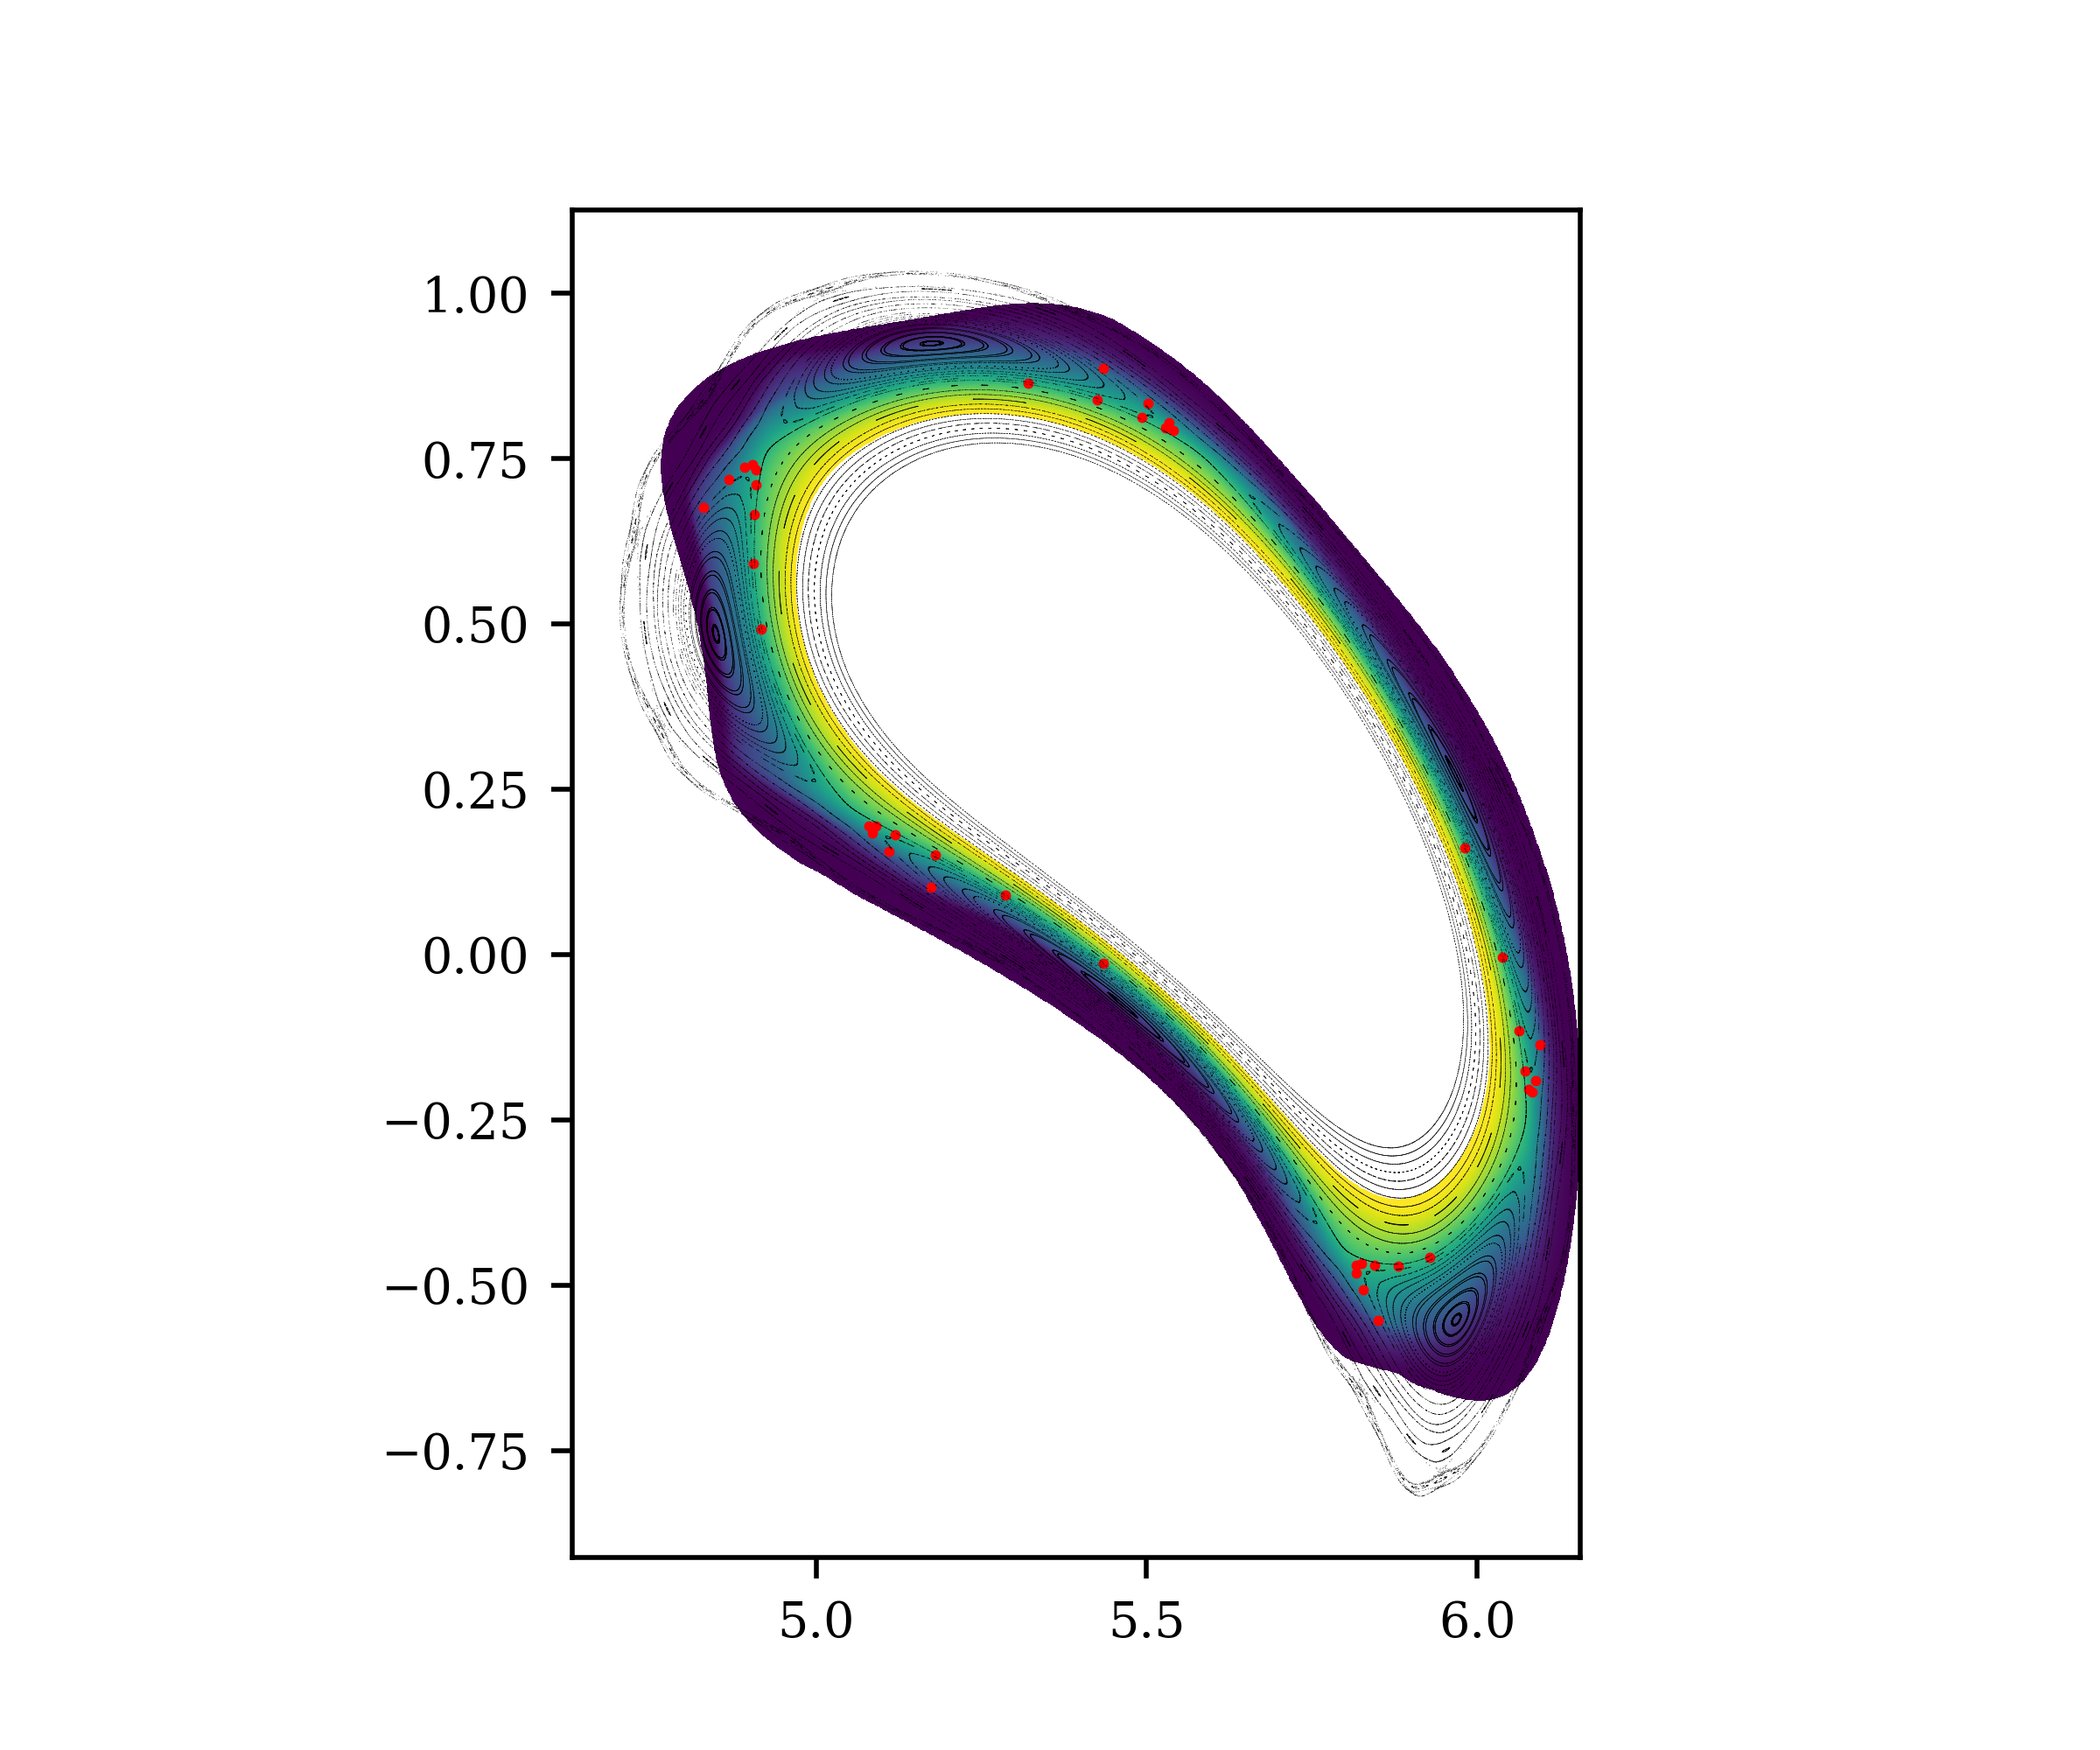
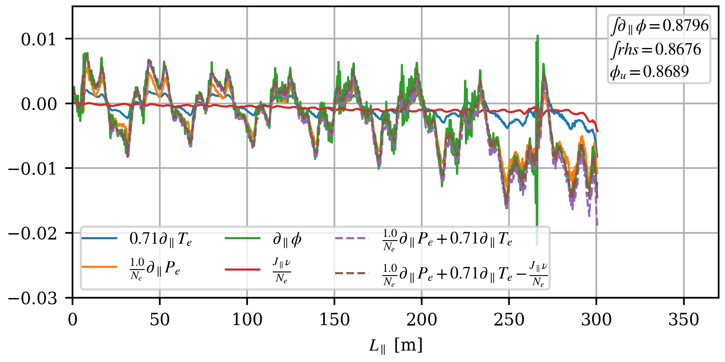
Parallel electric field
Ohm‘s law
$$\frac{∂}{∂t}\left[\frac{m_{e}}{m_{i}}(V_{∥,e}−V_{∥,i})\right]=0=∂_{∥}ϕ−\frac{1}{n}∂_{∥}p_{e}−0.71 ∂_{∥}T_{e}+\frac{νJ_{∥}}{n}$$
Parallel gradients dominate local form
Parallel current is adding constant offsets, especially in the SOL
Neglecting this leads to deviations of ~5-10 V

Slide 28
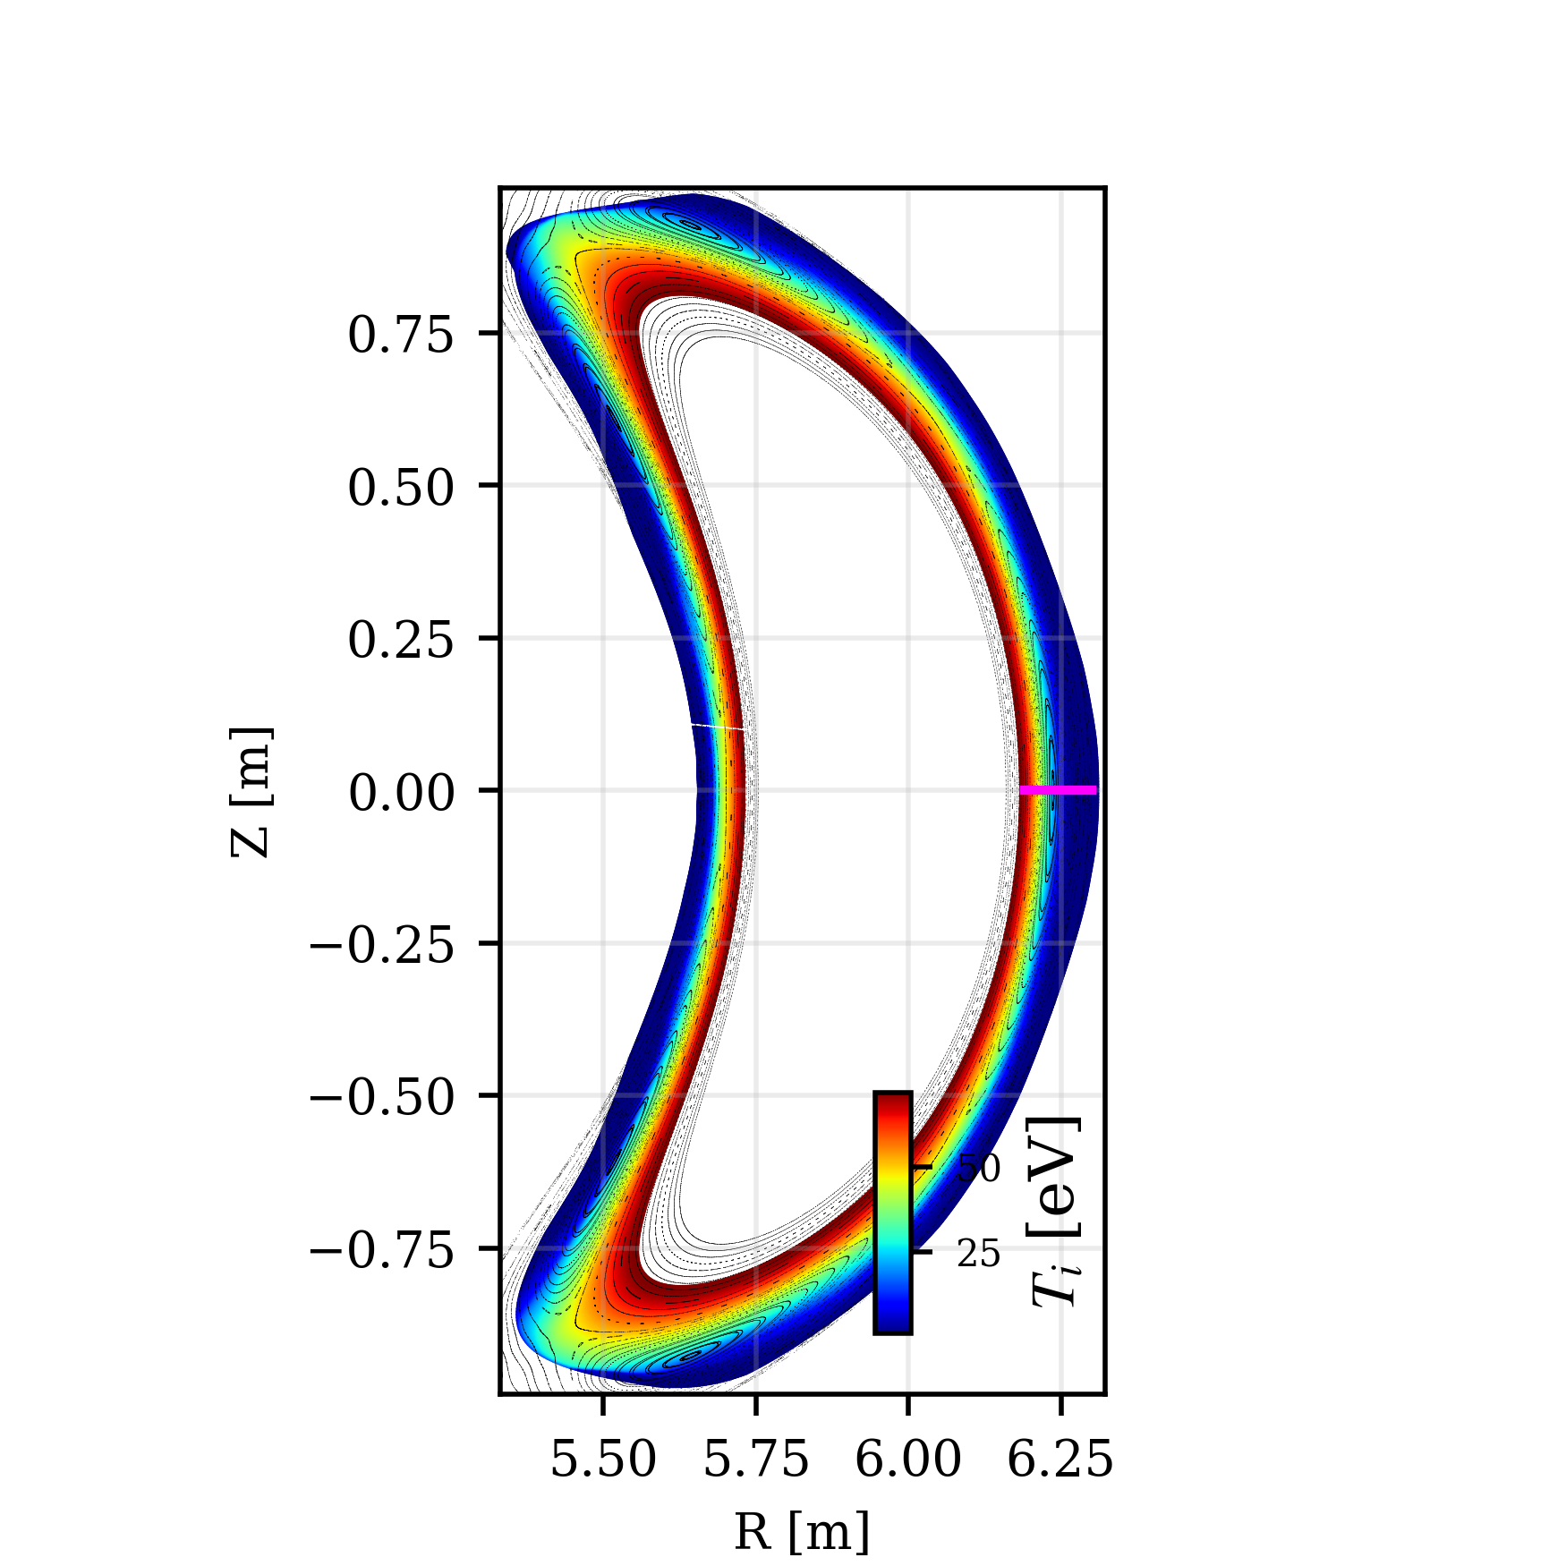
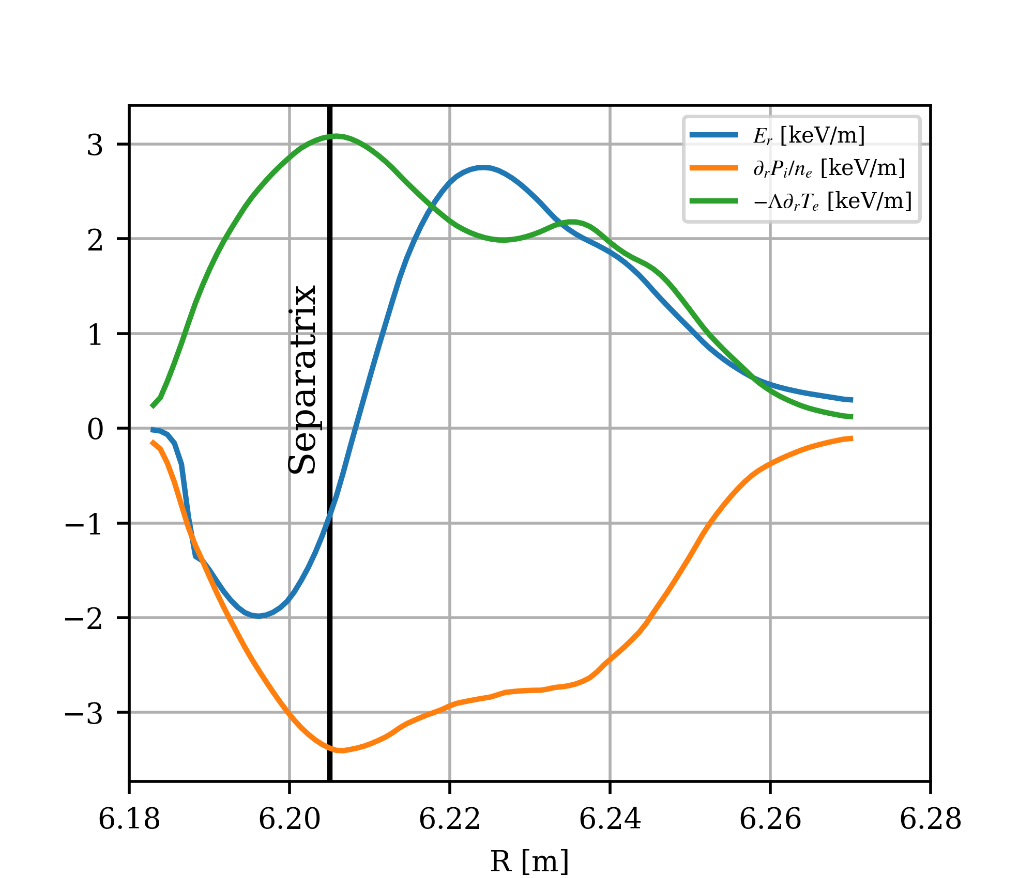
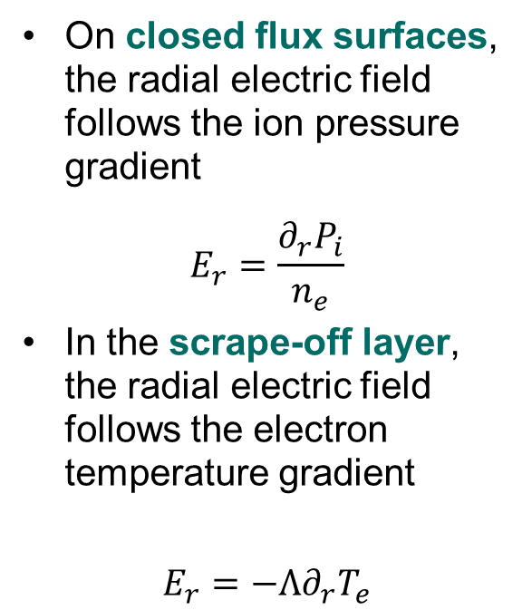
Radial electric field
On closed flux surfaces, the radial electric field follows the ion pressure gradient
$$E_{r}=\frac{∂_{r}P_{i}}{n_{e}}$$
In the scrape-off layer, the radial electric field follows the electron temperature gradient
$$E_{r}=−Λ∂_{r}T_{e}$$

Slide 29
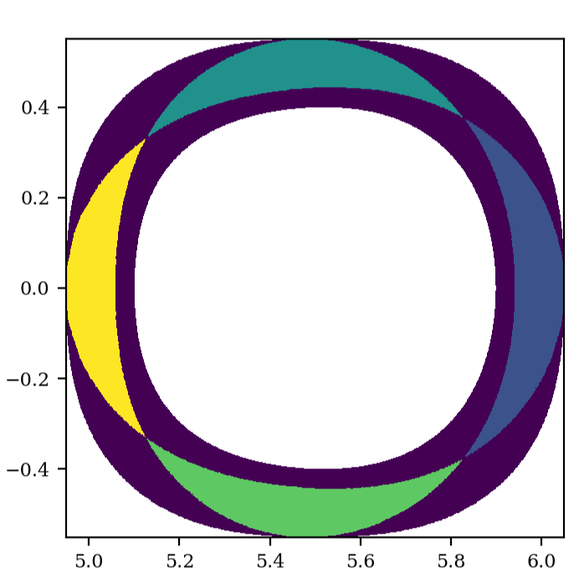
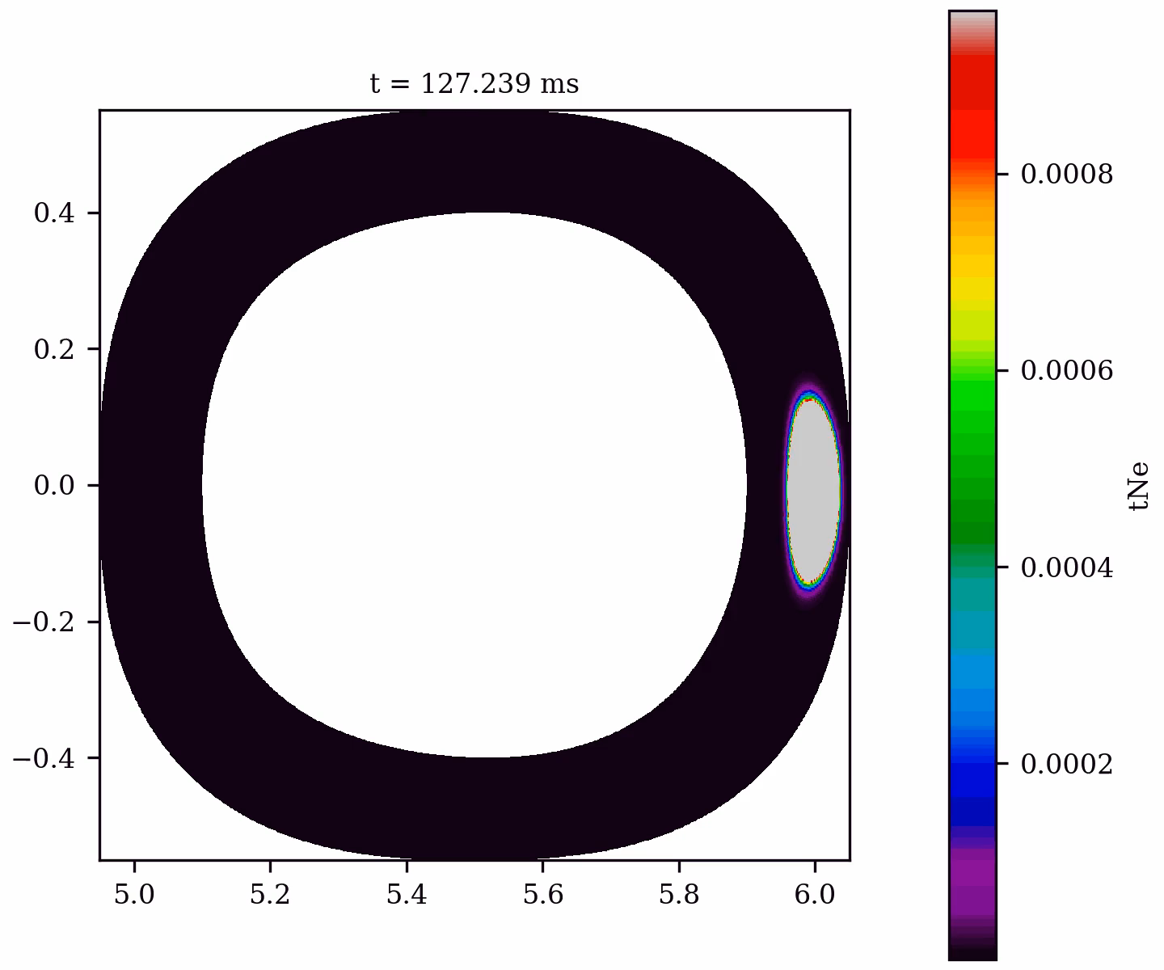
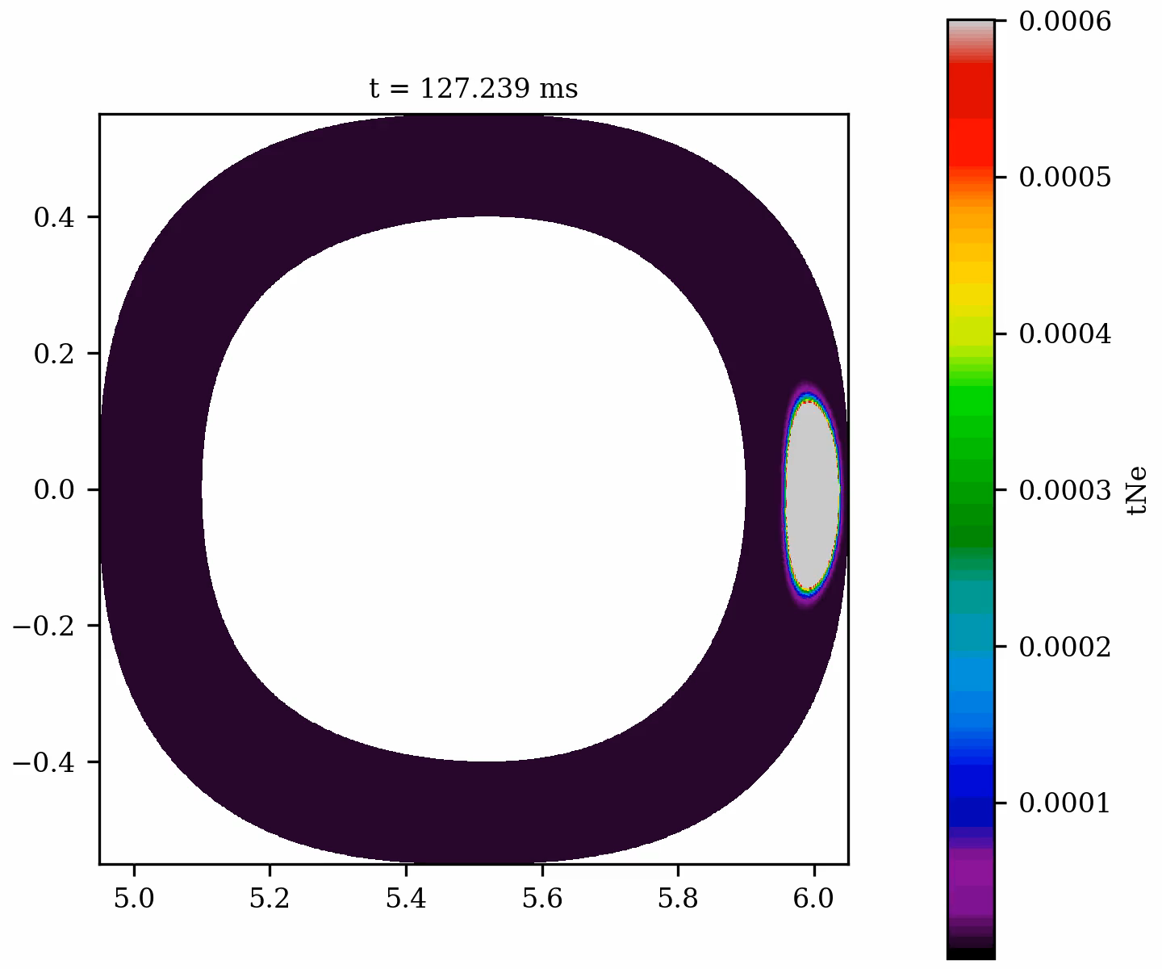
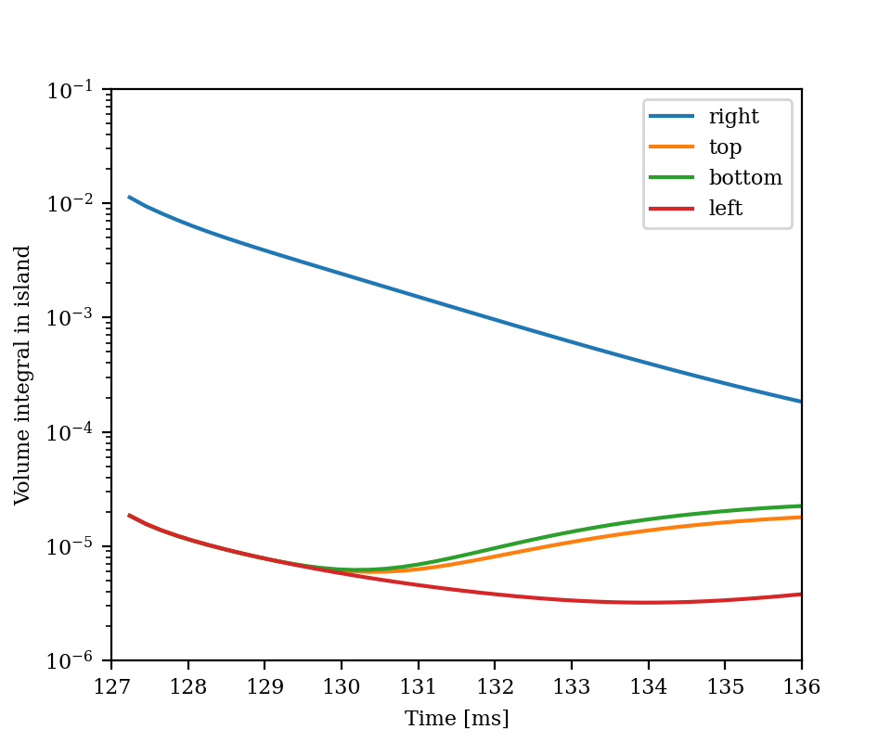
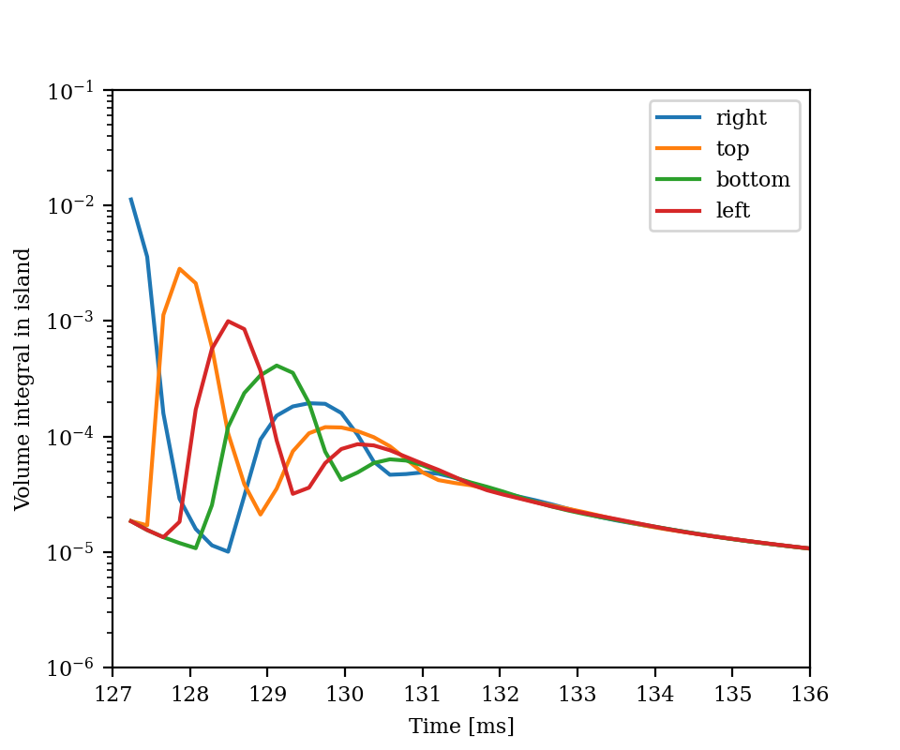
Simulation results
Simplified geometry
4/4 Island chain with island divertor
Seeding begins at the outer island
Without ExB drifts
Trace density diffuses from the right island into the core
From the core, it redistributes to the adjacent islands first
Opposite island experiences isolation from trace density
Still one order of magnitude differences after 10 ms
Atleast 15 ms expected until distribution
With ExB drifts
Counter clockwise distribution of trace density
2 Poloidal turns (~4ms) until full distribution
Overall lower trace densiy in islands
Strong divergences in PFR/TSR can constitute additional sinks (?)

Slide 30
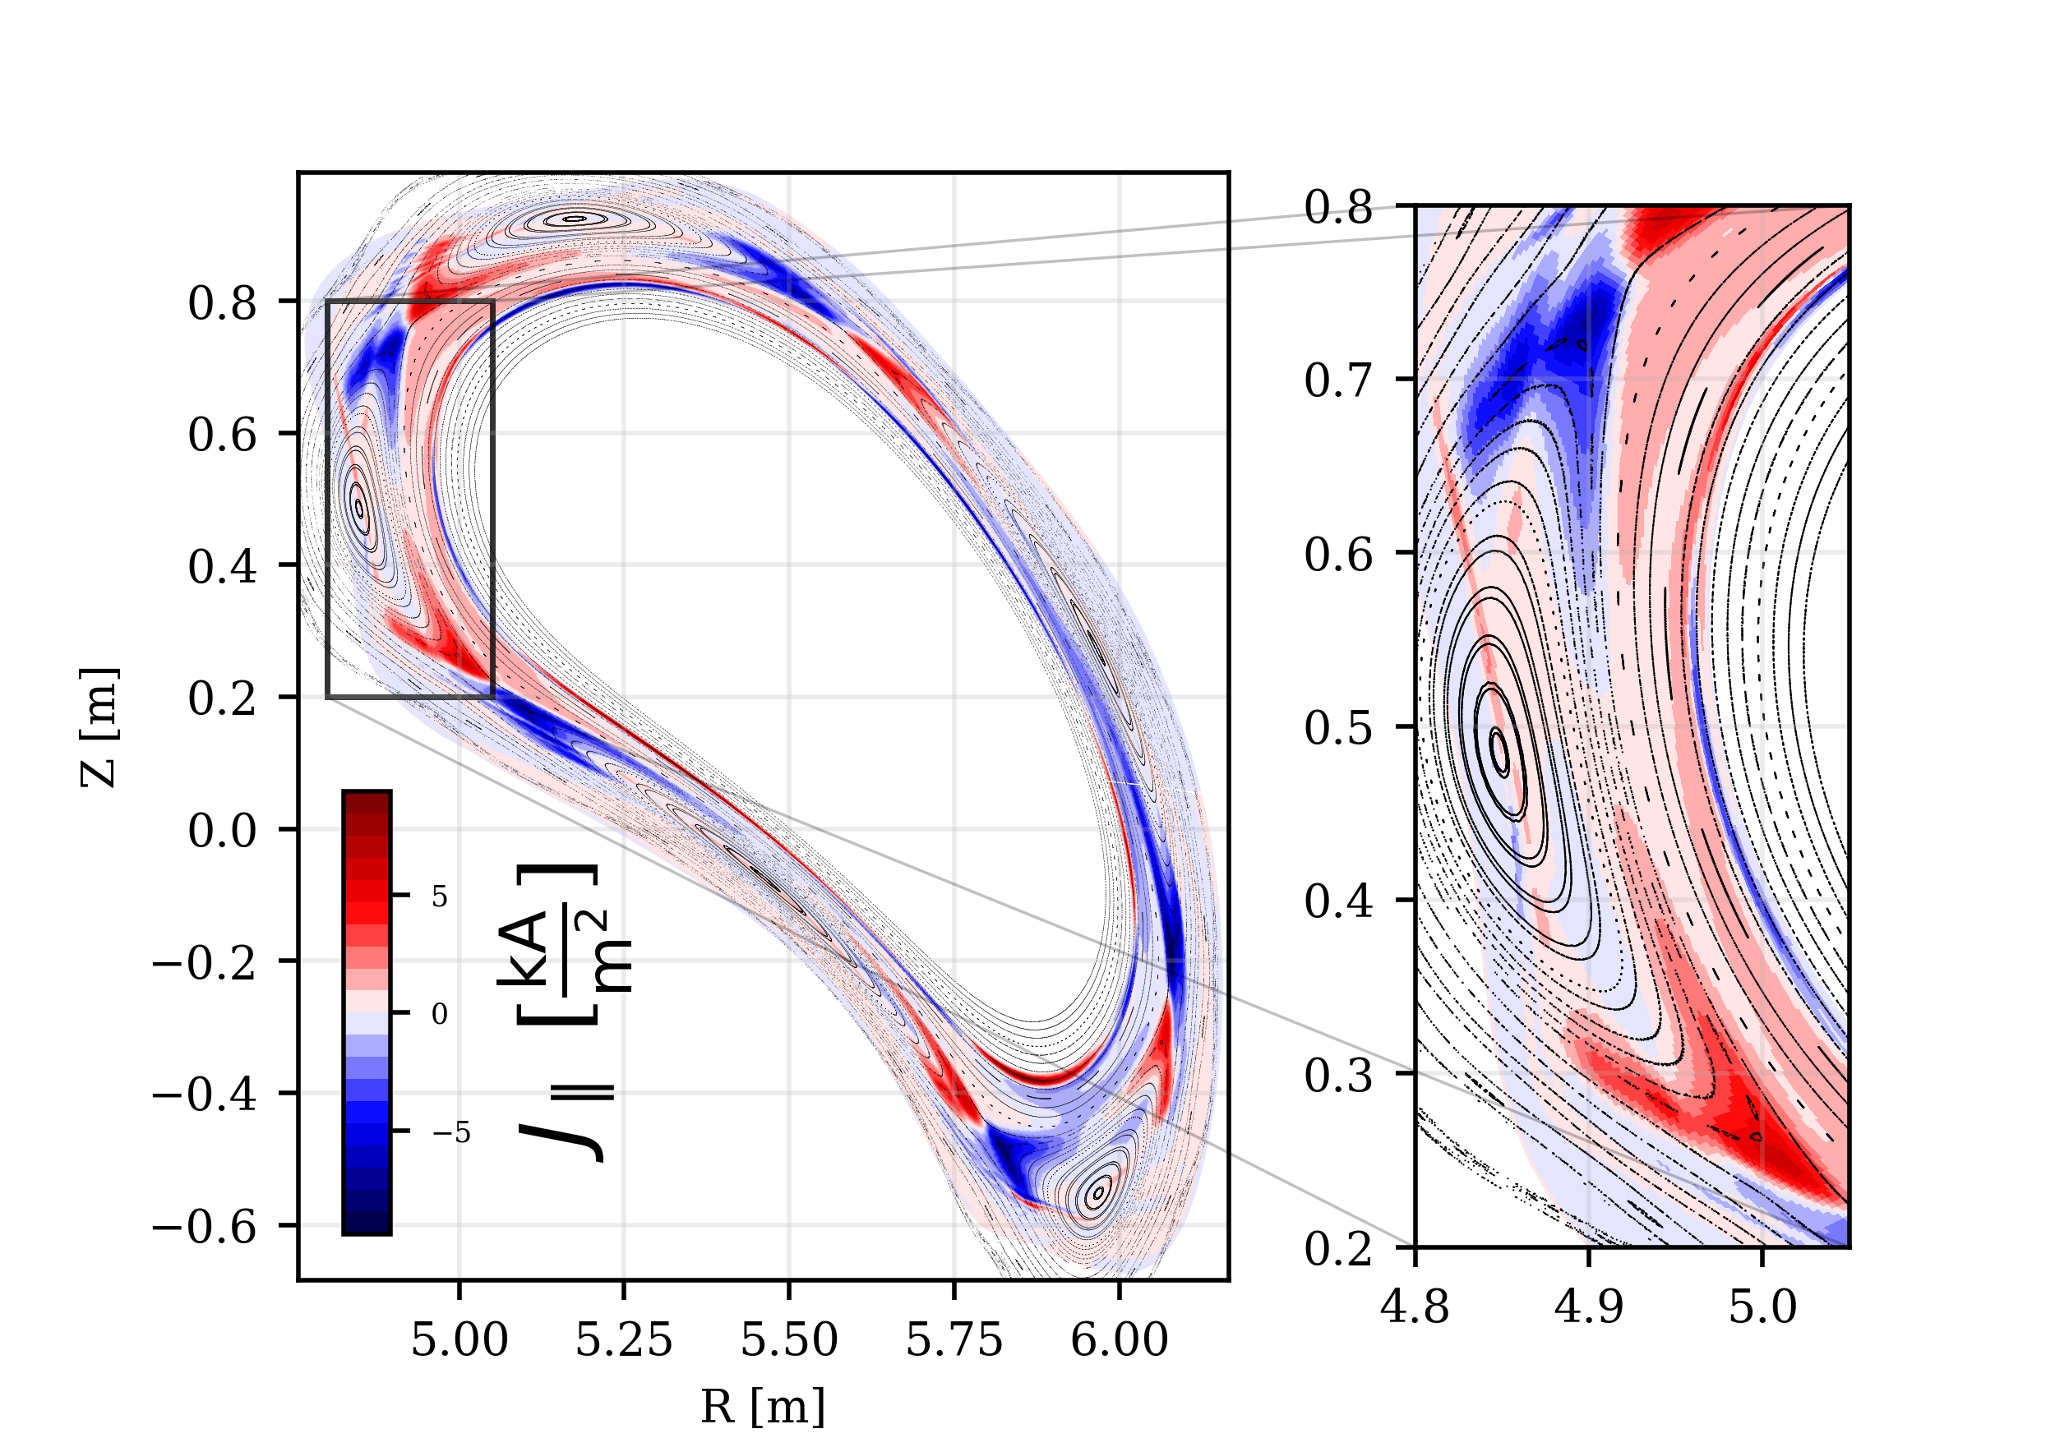
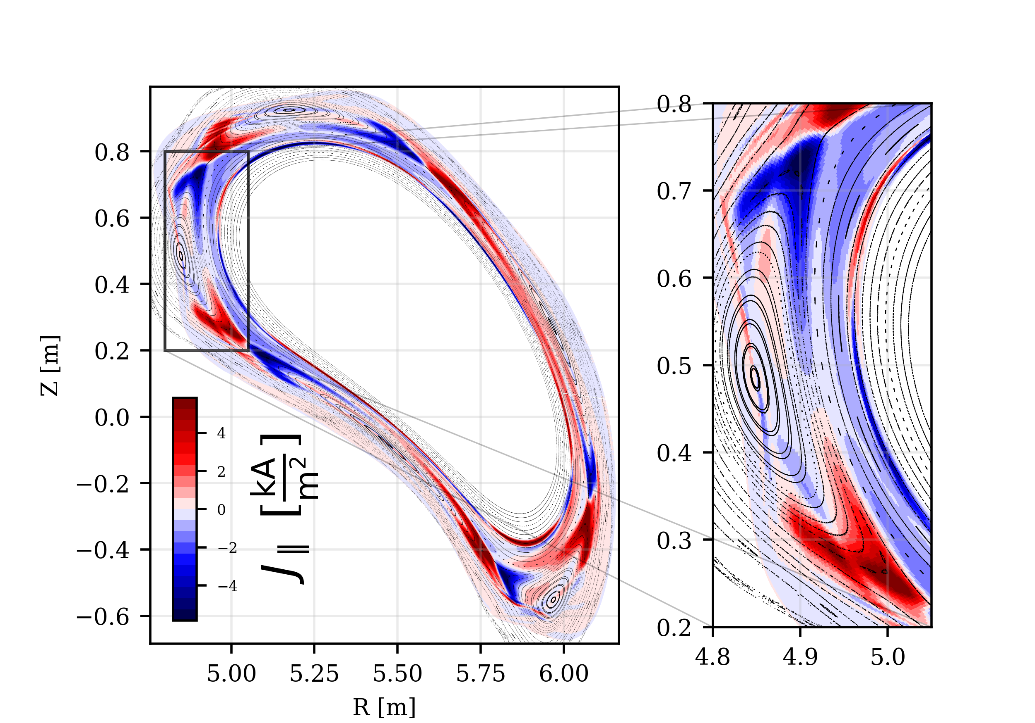
Forward and reverse field simulations
Forward
Reverse

Slide 31
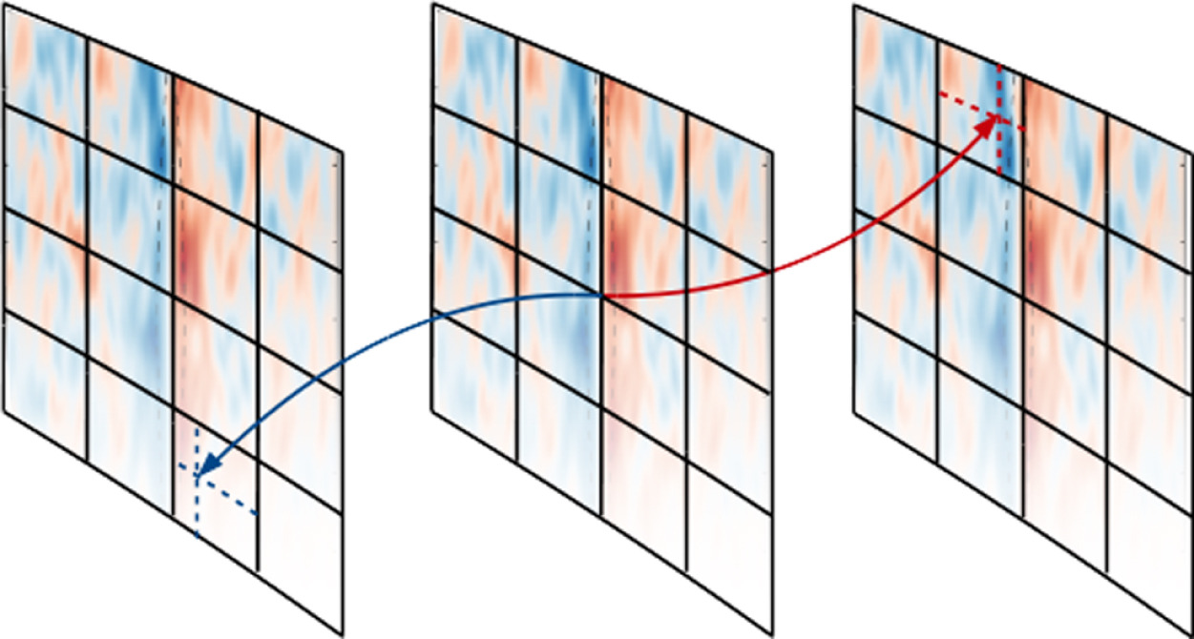
FCI mapping of parallel derivatives
P. Hill et al, CPP Volume 213, April 2017, Pages 9-18

Slide 32
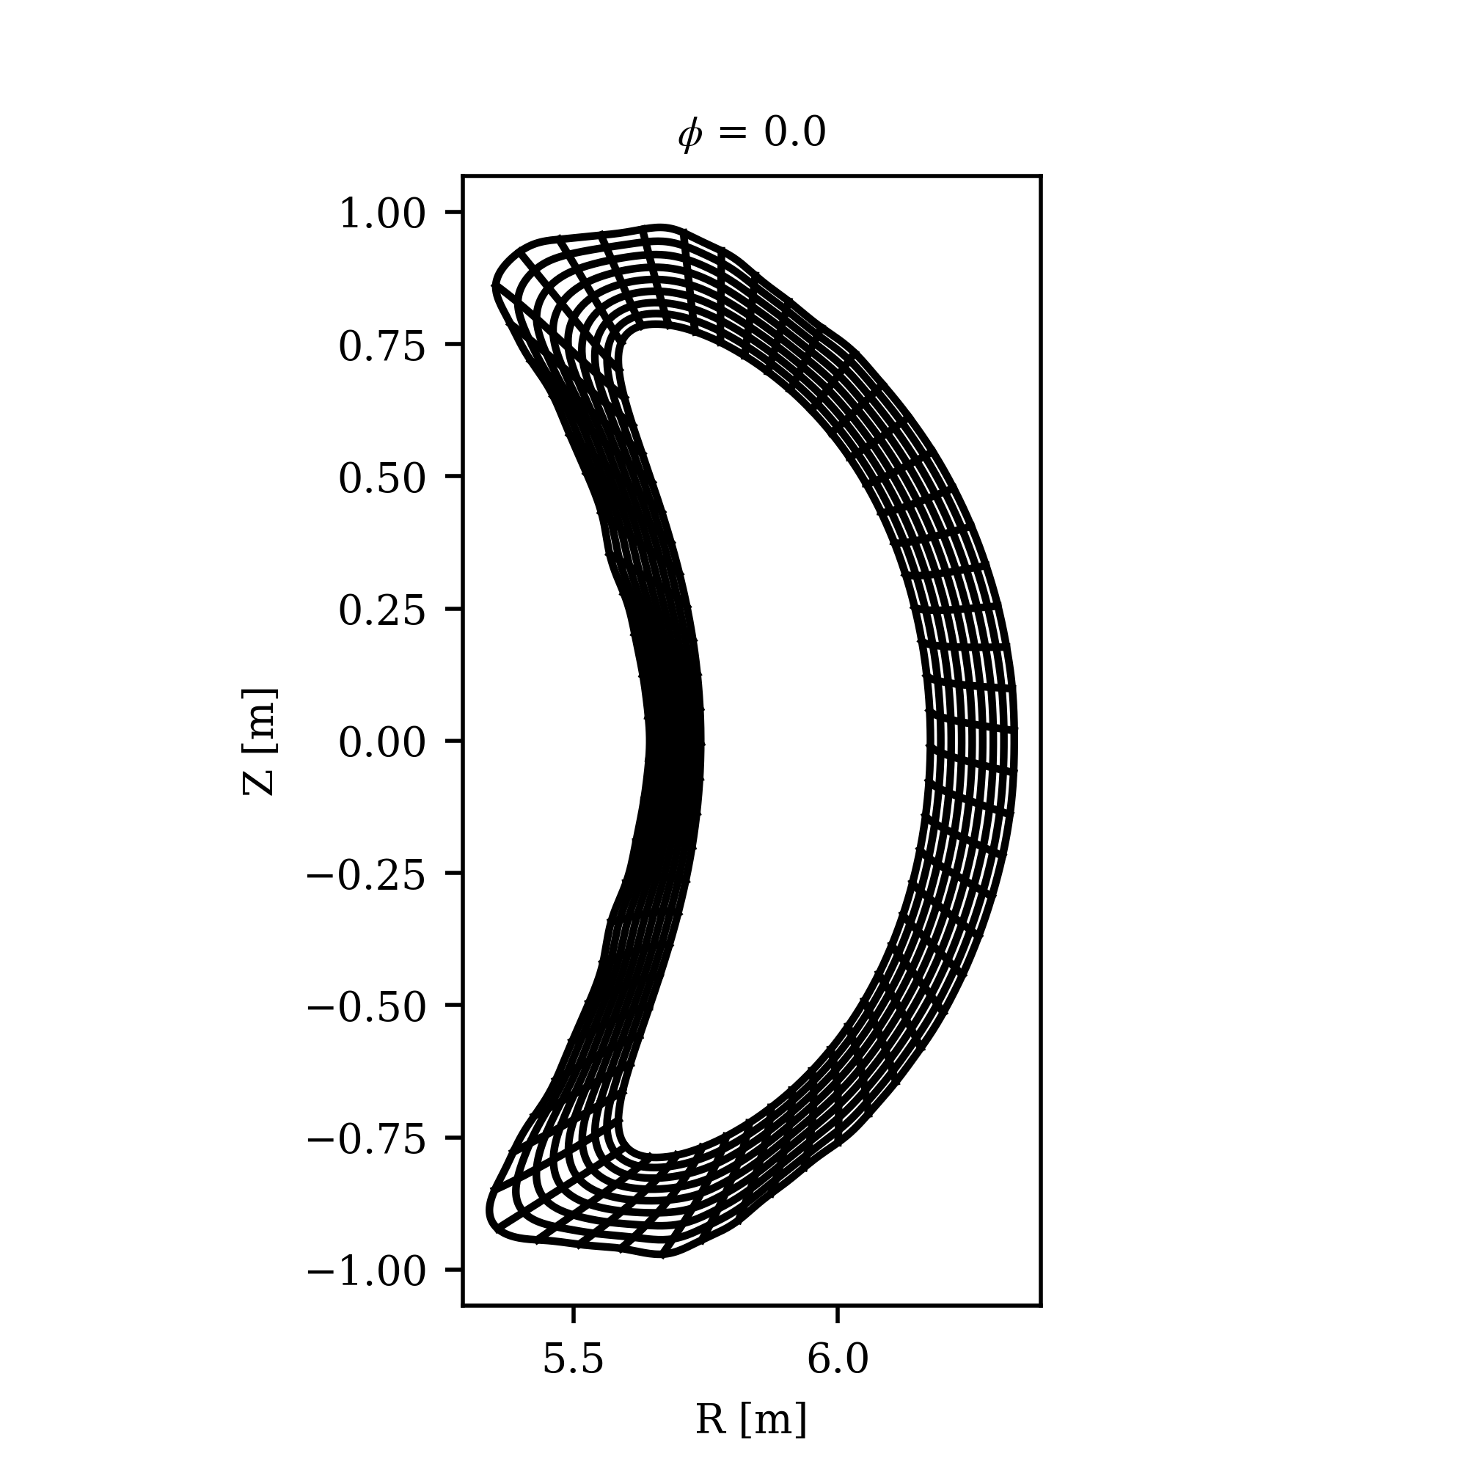
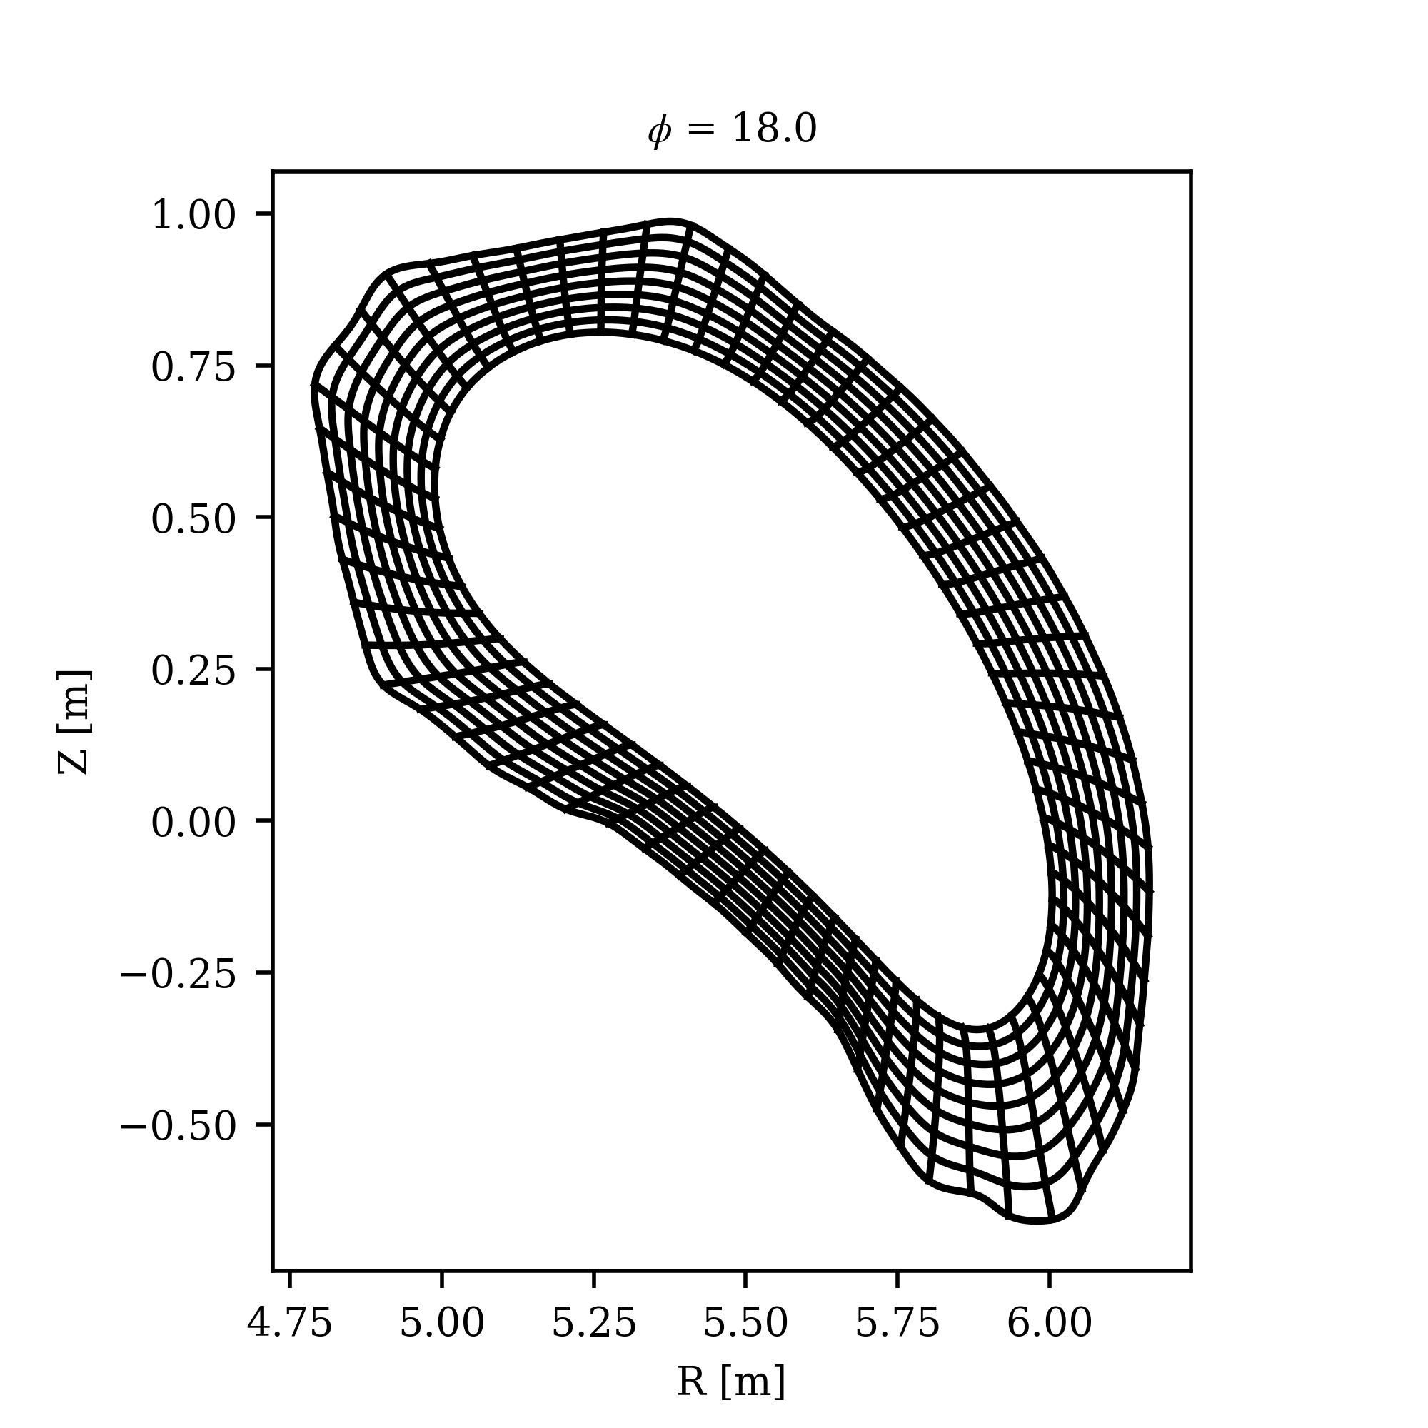
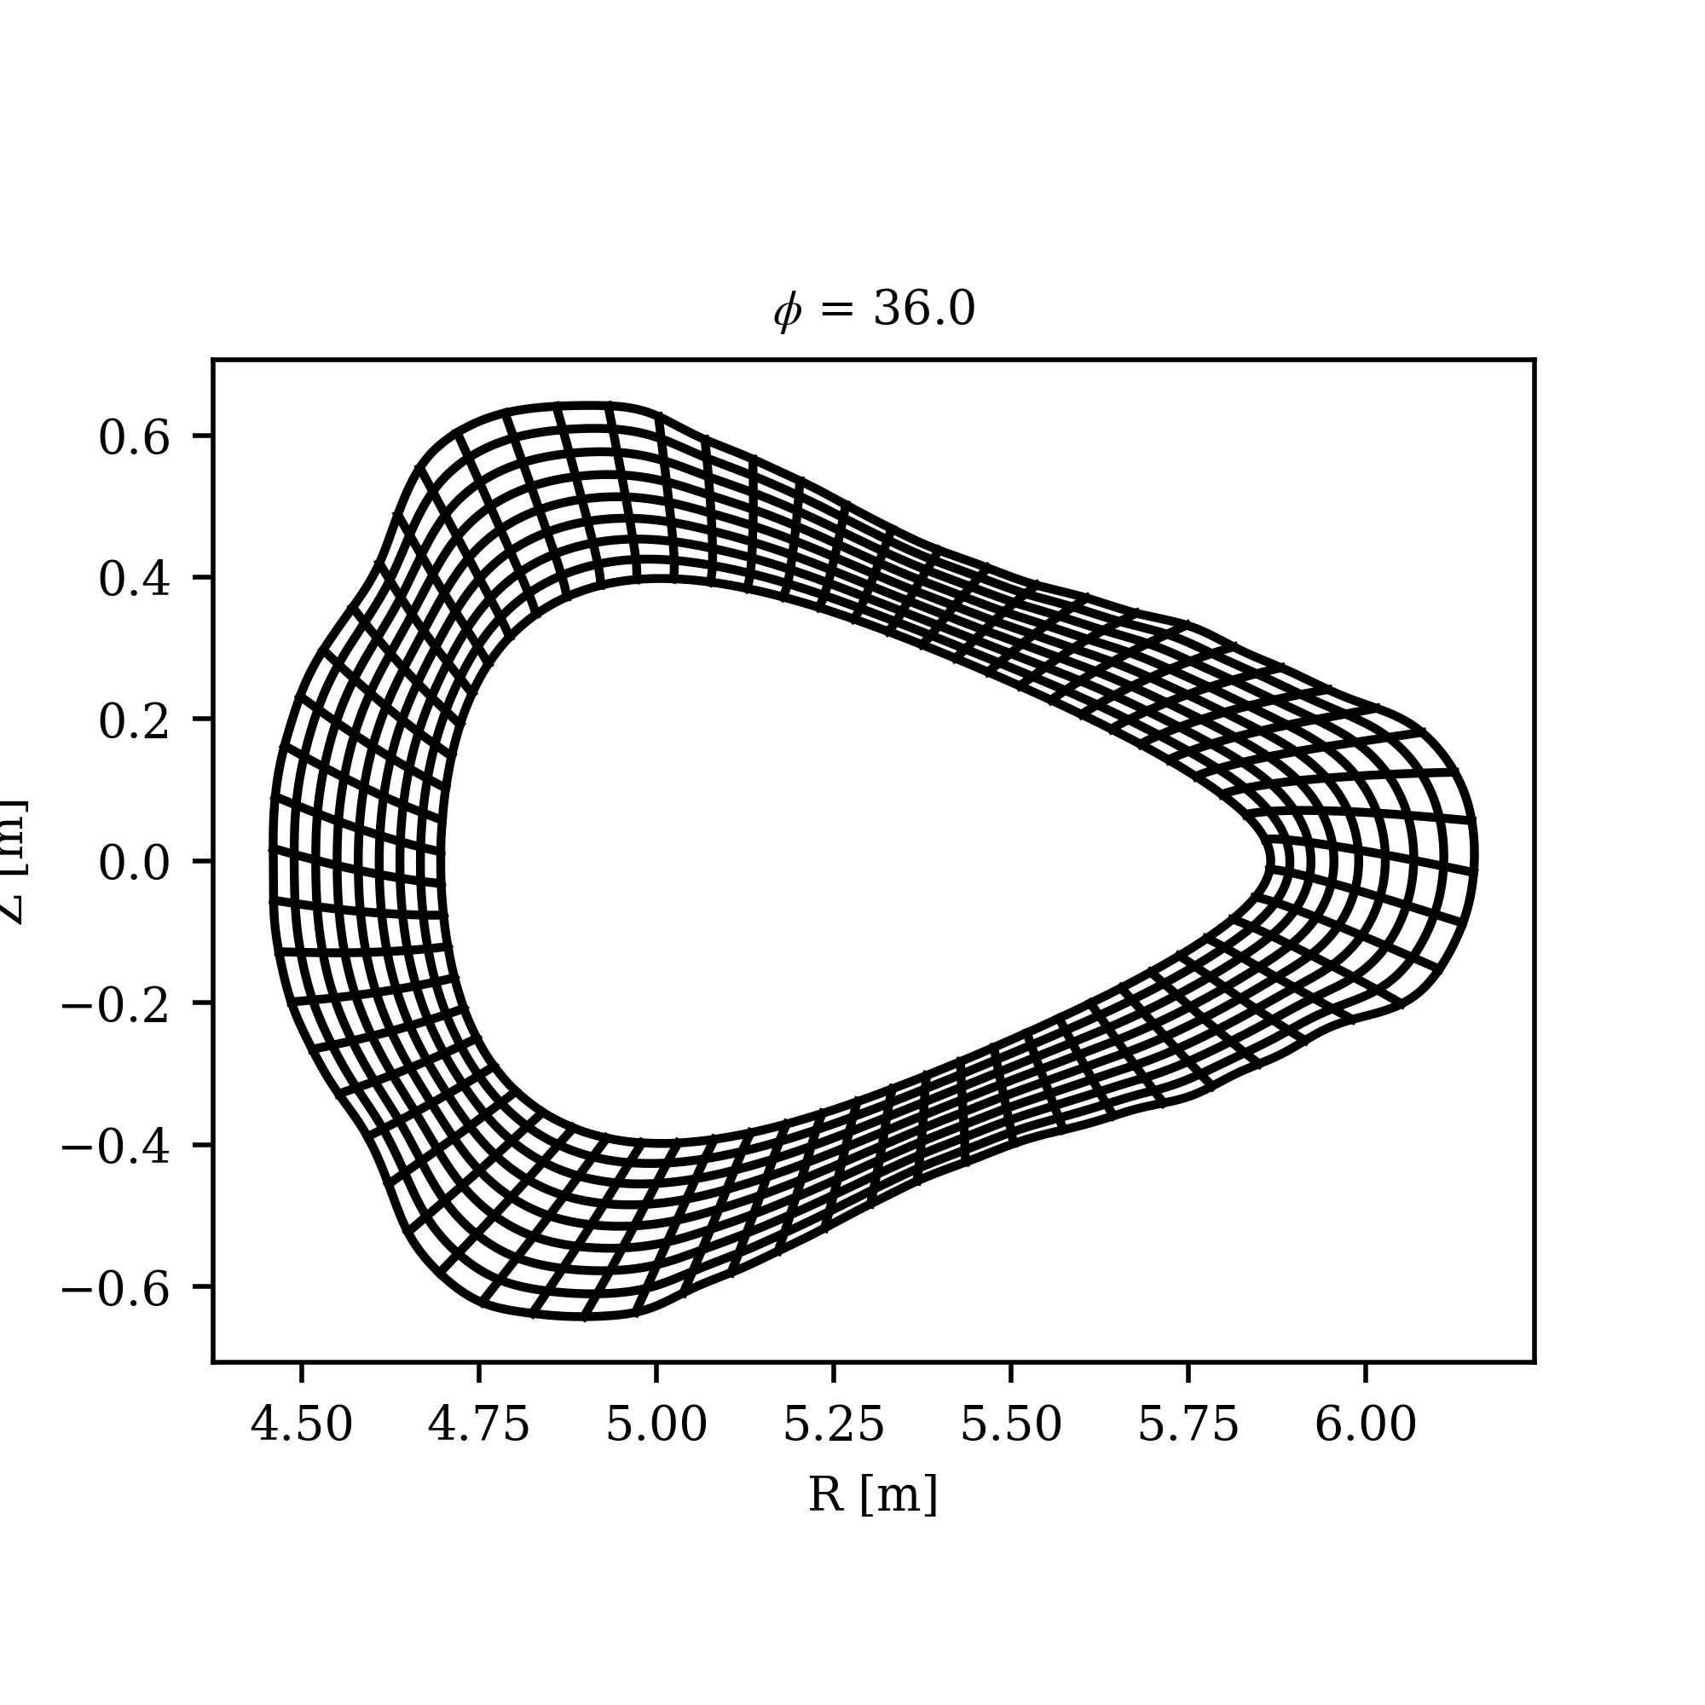
Curvilinear grids for W7-X

Slide 33
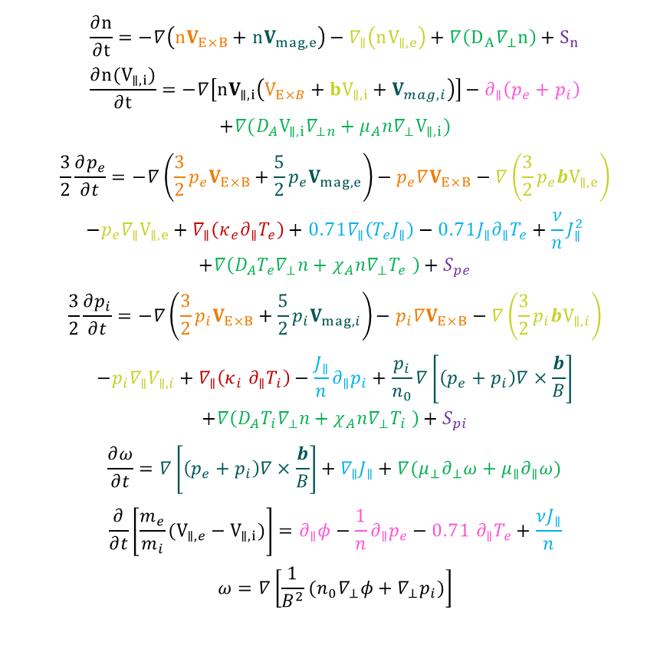
The mean-field Braginskii model
Implementation in BOUT++ [1], derivative of Hermes-2 [2] and using FCI [3]
Starting point: Drift reduced Braginskii model
2 Key adaptions:
$$\frac{∂n}{∂t}=−∇\left(nV_{E×B}+nV_{mag,e}\right)−∇_{∥}\left(nV_{∥,e}\right)+∇\left(D_{A}∇_{⊥}n\right)+S_{n}$$
$$\frac{∂n(V_{∥,i})}{∂t}=−∇\left[nV_{∥,i}\left(V_{E×B}+{bV}_{∥,i}+V_{mag,i}\right)\right]−∂_{∥}\left(p_{e}+p_{i}\right)$$
$$+∇(D_{A}V_{∥,i}∇_{⊥n}+μ_{A}n∇_{⊥}V_{∥,i})$$
$$\frac{3}{2}\frac{∂p_{e}}{∂t}=−∇\left(\frac{3}{2}p_{e}V_{E×B}+\frac{5}{2}p_{e}V_{mag,e}\right)−p_{e}∇V_{E×B}−∇\left(\frac{3}{2}p_{e}bV_{∥,e}\right)$$
$$−p_{e}∇_{∥}V_{∥,e}+∇_{∥}\left(κ_{e}∂_{∥}T_{e}\right)+0.71∇_{∥}\left(T_{e}J_{∥}\right)−0.71J_{∥}∂_{∥}T_{e}+\frac{ν}{n}J_{∥}^{2}$$
$$+∇\left(D_{A}T_{e}∇_{⊥}n+χ_{A}n∇_{⊥}T_{e} \right)+S_{pe}$$
$$\frac{3}{2}\frac{∂p_{i}}{∂t}=−∇\left(\frac{3}{2}p_{i}V_{E×B}+\frac{5}{2}p_{i}V_{mag,i}\right)−p_{i}∇V_{E×B}−∇\left(\frac{3}{2}p_{i}bV_{∥,i}\right)$$
$$−p_{i}∇_{∥}V_{∥,i}+∇_{∥}\left(κ_{i} ∂_{∥}T_{i}\right)−\frac{J_{∥}}{n}∂_{∥}p_{i}+\frac{p_{i}}{n_{0}}∇\left[\left(p_{e}+p_{i}\right)∇×\frac{b}{B}\right]$$
$$+∇\left(D_{A}T_{i}∇_{⊥}n+χ_{A}n∇_{⊥}T_{i} \right)+S_{pi}$$
$$\frac{∂ω}{∂t}=∇\left[\left(p_{e}+p_{i}\right)∇×\frac{b}{B}\right]+∇_{∥}J_{∥}+∇(μ_{⊥}∂_{⊥}ω+μ_{∥}∂_{∥}ω)$$
$$\frac{∂}{∂t}\left[\frac{m_{e}}{m_{i}}(V_{∥,e}−V_{∥,i})\right]=∂_{∥}φ−\frac{1}{n}∂_{∥}p_{e}−0.71 ∂_{∥}T_{e}+\frac{νJ_{∥}}{n}$$
$$ω=∇\left[\frac{1}{B^{2}}(n_{0}∇_{⊥}φ+∇_{⊥}p_{i})\right]$$
Diamagnetic
ExB
Parallel current
Diffusion
[1] B. Dudson et al, Computer Physics Communications 180 (2009), pp. 1467-1480
[2] P. Huslage et al 2024, Plasma Phys. Control. Fusion 66 015006
[3] Shanahan B W, Hill P and Dudson B D 2016 J. Phys:.Conf. Series 775 012012
[4] B. Gui et al 2018 Nucl. Fusion 58 026027
[5] N. M. Li et al 2018, Comput. Phys. Comm. 228 (2018)
Parallel flow
Conduction
Sources
Par. gradients

Slide 34
The mean-field Braginskii model
Implementation in BOUT++ [1], derivative of Hermes-2 [2] and using FCI [3]
Starting point: Drift reduced Braginskii model
2 Key adaptions:
Anomalous transport coefficients
Turbulence is too expensive
$$\frac{∂n}{∂t}=−∇\left(nV_{E×B}+nV_{mag,e}\right)−∇_{∥}\left(nV_{∥,e}\right)+∇\left(D_{A}∇_{⊥}n\right)+S_{n}$$
$$\frac{∂n(V_{∥,i})}{∂t}=−∇\left[nV_{∥,i}\left(V_{E×B}+{bV}_{∥,i}+V_{mag,i}\right)\right]−∂_{∥}\left(p_{e}+p_{i}\right)$$
$$+∇(D_{A}V_{∥,i}∇_{⊥n}+μ_{A}n∇_{⊥}V_{∥,i})$$
$$\frac{3}{2}\frac{∂p_{e}}{∂t}=−∇\left(\frac{3}{2}p_{e}V_{E×B}+\frac{5}{2}p_{e}V_{mag,e}\right)−p_{e}∇V_{E×B}−∇\left(\frac{3}{2}p_{e}bV_{∥,e}\right)$$
$$−p_{e}∇_{∥}V_{∥,e}+∇_{∥}\left(κ_{e}∂_{∥}T_{e}\right)+0.71∇_{∥}\left(T_{e}J_{∥}\right)−0.71J_{∥}∂_{∥}T_{e}+\frac{ν}{n}J_{∥}^{2}$$
$$+∇\left(D_{A}T_{e}∇_{⊥}n+χ_{A}n∇_{⊥}T_{e} \right)+S_{pe}$$
$$\frac{3}{2}\frac{∂p_{i}}{∂t}=−∇\left(\frac{3}{2}p_{i}V_{E×B}+\frac{5}{2}p_{i}V_{mag,i}\right)−p_{i}∇V_{E×B}−∇\left(\frac{3}{2}p_{i}bV_{∥,i}\right)$$
$$−p_{i}∇_{∥}V_{∥,i}+∇_{∥}\left(κ_{i} ∂_{∥}T_{i}\right)−\frac{J_{∥}}{n}∂_{∥}p_{i}+\frac{p_{i}}{n_{0}}∇\left[\left(p_{e}+p_{i}\right)∇×\frac{b}{B}\right]$$
$$+∇\left(D_{A}T_{i}∇_{⊥}n+χ_{A}n∇_{⊥}T_{i} \right)+S_{pi}$$
$$\frac{∂ω}{∂t}=∇\left[\left(p_{e}+p_{i}\right)∇×\frac{b}{B}\right]+∇_{∥}J_{∥}+∇(μ_{⊥}∂_{⊥}ω+μ_{∥}∂_{∥}ω)$$
$$\frac{∂}{∂t}\left[\frac{m_{e}}{m_{i}}(V_{∥,e}−V_{∥,i})\right]=∂_{∥}φ−\frac{1}{n}∂_{∥}p_{e}−0.71 ∂_{∥}T_{e}+\frac{νJ_{∥}}{n}$$
$$ω=∇\left[\frac{1}{B^{2}}(n_{0}∇_{⊥}φ+∇_{⊥}p_{i})\right]$$
Diamagnetic
ExB
Parallel current
Diffusion
[1] B. Dudson et al, Computer Physics Communications 180 (2009), pp. 1467-1480
[2] P. Huslage et al 2024, Plasma Phys. Control. Fusion 66 015006
[3] Shanahan B W, Hill P and Dudson B D 2016 J. Phys:.Conf. Series 775 012012
[4] B. Gui et al 2018 Nucl. Fusion 58 026027
[5] N. M. Li et al 2018, Comput. Phys. Comm. 228 (2018)
Parallel flow
Conduction
Sources
Par. gradients

Slide 35
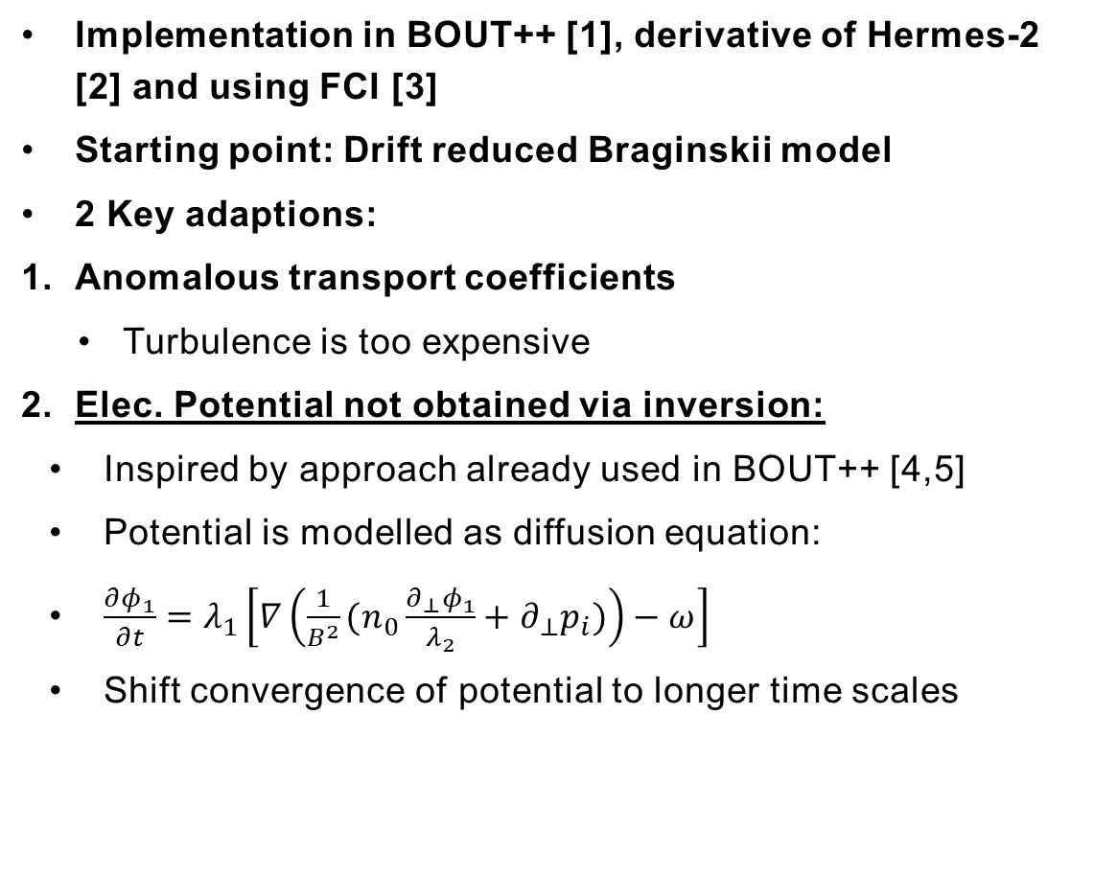

The mean-field Braginskii model
Implementation in BOUT++ [1], derivative of Hermes-2 [2] and using FCI [3]
Starting point: Drift reduced Braginskii model
2 Key adaptions:
Anomalous transport coefficients
Turbulence is too expensive
Elec. Potential not obtained via inversion:
Inspired by approach already used in BOUT++ [4,5]
Potential is modelled as diffusion equation:
$\frac{∂φ_{1}}{∂t}=λ_{1}\left[∇\left(\frac{1}{B^{2}}(n_{0}\frac{∂_{⊥}φ_{1}}{λ_{2}}+∂_{⊥}p_{i})\right)−ω\right]$
Shift convergence of potential to longer time scales
$$\frac{∂n}{∂t}=−∇\left(nV_{E×B}+nV_{mag,e}\right)−∇_{∥}\left(nV_{∥,e}\right)+∇\left(D_{A}∇_{⊥}n\right)+S_{n}$$
$$\frac{∂n(V_{∥,i})}{∂t}=−∇\left[nV_{∥,i}\left(V_{E×B}+{bV}_{∥,i}+V_{mag,i}\right)\right]−∂_{∥}\left(p_{e}+p_{i}\right)$$
$$+∇(D_{A}V_{∥,i}∇_{⊥n}+μ_{A}n∇_{⊥}V_{∥,i})$$
$$\frac{3}{2}\frac{∂p_{e}}{∂t}=−∇\left(\frac{3}{2}p_{e}V_{E×B}+\frac{5}{2}p_{e}V_{mag,e}\right)−p_{e}∇V_{E×B}−∇\left(\frac{3}{2}p_{e}bV_{∥,e}\right)$$
$$−p_{e}∇_{∥}V_{∥,e}+∇_{∥}\left(κ_{e}∂_{∥}T_{e}\right)+0.71∇_{∥}\left(T_{e}J_{∥}\right)−0.71J_{∥}∂_{∥}T_{e}+\frac{ν}{n}J_{∥}^{2}$$
$$+∇\left(D_{A}T_{e}∇_{⊥}n+χ_{A}n∇_{⊥}T_{e} \right)+S_{pe}$$
$$\frac{3}{2}\frac{∂p_{i}}{∂t}=−∇\left(\frac{3}{2}p_{i}V_{E×B}+\frac{5}{2}p_{i}V_{mag,i}\right)−p_{i}∇V_{E×B}−∇\left(\frac{3}{2}p_{i}bV_{∥,i}\right)$$
$$−p_{i}∇_{∥}V_{∥,i}+∇_{∥}\left(κ_{i} ∂_{∥}T_{i}\right)−\frac{J_{∥}}{n}∂_{∥}p_{i}+\frac{p_{i}}{n_{0}}∇\left[\left(p_{e}+p_{i}\right)∇×\frac{b}{B}\right]$$
$$+∇\left(D_{A}T_{i}∇_{⊥}n+χ_{A}n∇_{⊥}T_{i} \right)+S_{pi}$$
$$\frac{∂ω}{∂t}=∇\left[\left(p_{e}+p_{i}\right)∇×\frac{b}{B}\right]+∇_{∥}J_{∥}+∇(μ_{⊥}∂_{⊥}ω+μ_{∥}∂_{∥}ω)$$
$$\frac{∂}{∂t}\left[\frac{m_{e}}{m_{i}}(V_{∥,e}−V_{∥,i})\right]=∂_{∥}φ−\frac{1}{n}∂_{∥}p_{e}−0.71 ∂_{∥}T_{e}+\frac{νJ_{∥}}{n}$$
$$ω=∇\left[\frac{1}{B^{2}}(n_{0}∇_{⊥}φ+∇_{⊥}p_{i})\right]$$
$$φ=\frac{φ_{1}}{λ_{2}}$$
Diamagnetic
ExB
Parallel current
Diffusion
[1] B. Dudson et al, Computer Physics Communications 180 (2009), pp. 1467-1480
[2] P. Huslage et al 2024, Plasma Phys. Control. Fusion 66 015006
[3] Shanahan B W, Hill P and Dudson B D 2016 J. Phys:.Conf. Series 775 012012
[4] B. Gui et al 2018 Nucl. Fusion 58 026027
[5] N. M. Li et al 2018, Comput. Phys. Comm. 228 (2018)
Parallel flow
Conduction
Sources
Par. gradients

Slide 36
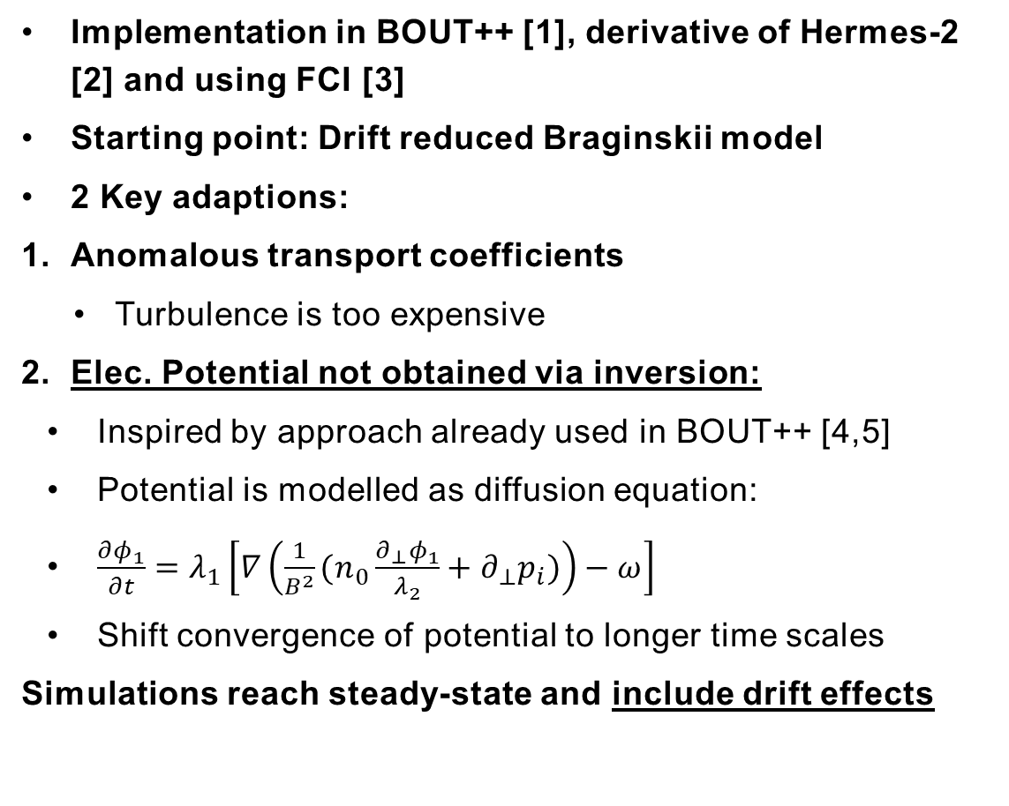
The mean-field Braginskii model
Implementation in BOUT++ [1], derivative of Hermes-2 [2] and using FCI [3]
Starting point: Drift reduced Braginskii model
2 Key adaptions:
Anomalous transport coefficients
Turbulence is too expensive
Elec. Potential not obtained via inversion:
Inspired by approach already used in BOUT++ [4,5]
Potential is modelled as diffusion equation:
$\frac{∂φ_{1}}{∂t}=λ_{1}\left[∇\left(\frac{1}{B^{2}}(n_{0}\frac{∂_{⊥}φ_{1}}{λ_{2}}+∂_{⊥}p_{i})\right)−ω\right]$
Shift convergence of potential to longer time scales
Simulations reach steady-state and include drift effects
$$\frac{∂n}{∂t}=−∇\left(nV_{E×B}+nV_{mag,e}\right)−∇_{∥}\left(nV_{∥,e}\right)+∇\left(D_{A}∇_{⊥}n\right)+S_{n}$$
$$\frac{∂n(V_{∥,i})}{∂t}=−∇\left[nV_{∥,i}\left(V_{E×B}+{bV}_{∥,i}+V_{mag,i}\right)\right]−∂_{∥}\left(p_{e}+p_{i}\right)$$
$$+∇(D_{A}V_{∥,i}∇_{⊥n}+μ_{A}n∇_{⊥}V_{∥,i})$$
$$\frac{3}{2}\frac{∂p_{e}}{∂t}=−∇\left(\frac{3}{2}p_{e}V_{E×B}+\frac{5}{2}p_{e}V_{mag,e}\right)−p_{e}∇V_{E×B}−∇\left(\frac{3}{2}p_{e}bV_{∥,e}\right)$$
$$−p_{e}∇_{∥}V_{∥,e}+∇_{∥}\left(κ_{e}∂_{∥}T_{e}\right)+0.71∇_{∥}\left(T_{e}J_{∥}\right)−0.71J_{∥}∂_{∥}T_{e}+\frac{ν}{n}J_{∥}^{2}$$
$$+∇\left(D_{A}T_{e}∇_{⊥}n+χ_{A}n∇_{⊥}T_{e} \right)+S_{pe}$$
$$\frac{3}{2}\frac{∂p_{i}}{∂t}=−∇\left(\frac{3}{2}p_{i}V_{E×B}+\frac{5}{2}p_{i}V_{mag,i}\right)−p_{i}∇V_{E×B}−∇\left(\frac{3}{2}p_{i}bV_{∥,i}\right)$$
$$−p_{i}∇_{∥}V_{∥,i}+∇_{∥}\left(κ_{i} ∂_{∥}T_{i}\right)−\frac{J_{∥}}{n}∂_{∥}p_{i}+\frac{p_{i}}{n_{0}}∇\left[\left(p_{e}+p_{i}\right)∇×\frac{b}{B}\right]$$
$$+∇\left(D_{A}T_{i}∇_{⊥}n+χ_{A}n∇_{⊥}T_{i} \right)+S_{pi}$$
$$\frac{∂ω}{∂t}=∇\left[\left(p_{e}+p_{i}\right)∇×\frac{b}{B}\right]+∇_{∥}J_{∥}+∇(μ_{⊥}∂_{⊥}ω+μ_{∥}∂_{∥}ω)$$
$$\frac{∂}{∂t}\left[\frac{m_{e}}{m_{i}}(V_{∥,e}−V_{∥,i})\right]=∂_{∥}φ−\frac{1}{n}∂_{∥}p_{e}−0.71 ∂_{∥}T_{e}+\frac{νJ_{∥}}{n}$$
$$ω=∇\left[\frac{1}{B^{2}}(n_{0}∇_{⊥}φ+∇_{⊥}p_{i})\right]$$
$$φ=\frac{φ_{1}}{λ_{2}}$$
Diamagnetic
ExB
Parallel current
Diffusion
[1] B. Dudson et al, Computer Physics Communications 180 (2009), pp. 1467-1480
[2] P. Huslage et al 2024, Plasma Phys. Control. Fusion 66 015006
[3] Shanahan B W, Hill P and Dudson B D 2016 J. Phys:.Conf. Series 775 012012
[4] B. Gui et al 2018 Nucl. Fusion 58 026027
[5] N. M. Li et al 2018, Comput. Phys. Comm. 228 (2018)
Parallel flow
Conduction
Sources
Par. gradients

