Slide 1
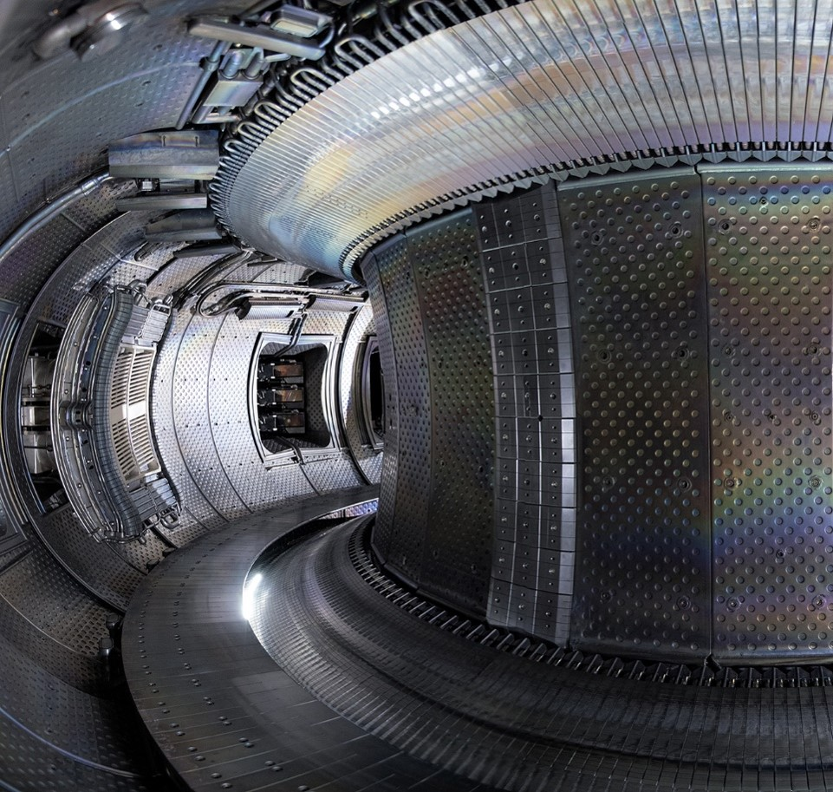

Possible proposal to contribute to WP-SA in 2026
Ph. Moreau
30/04/2026

Slide 2
Possible contribution proposals - 2026
Background: participation to JT-60SA integrated commissioning ~2 years ago, initial implementation of magnetics on IMAS, few presentations during joint WP-SA, JT-60SA meetings, etc.
Review JT-60SA documents about conditioning, plasma and tokamak operation, etc. (any time this year)
Participation to the HMI courses in September (would like to apply through WP-TRED “training of operators”?). β-tester of the HMI and tools.
Tools development with M. Iafrati e.g. MECS usage, interface and visualization, RGA analysis, etc.
Tokamak commissioning (→ December ~2-3 weeks):
Before plasma: contribution to VV conditioning analysis using mostly the RGAs
First plasma: diagnostics data analysis such as equilibrium, etc.
β-tester of the tokamak simulator ?
September ~2 weeks
December ~2-3 weeks
WP-SA contribution

