Slide 1
ETS-6: Comparing solvers in the ETS-6
Thomas Jonsson

Slide 2
Overview
Three solvers used to solver the transport equations in the ETS-6 have been compared:
solver4 – finite difference solver
FEM – finite element on Kolmogorov backward equation; numerical derivatives of D.
FEM2 – finite element on diffusion equation; numerical derivatives avoided
Compare JET #92436 with modified edge profiles; more smooth.
g2tjohns/jet_reference/92436/849
Times:
Simulation domain: 49.0 – 49.5 s
dt = 0.01, 0.05, 0.1
n_rho = 50, 100, 200, 400

Slide 3
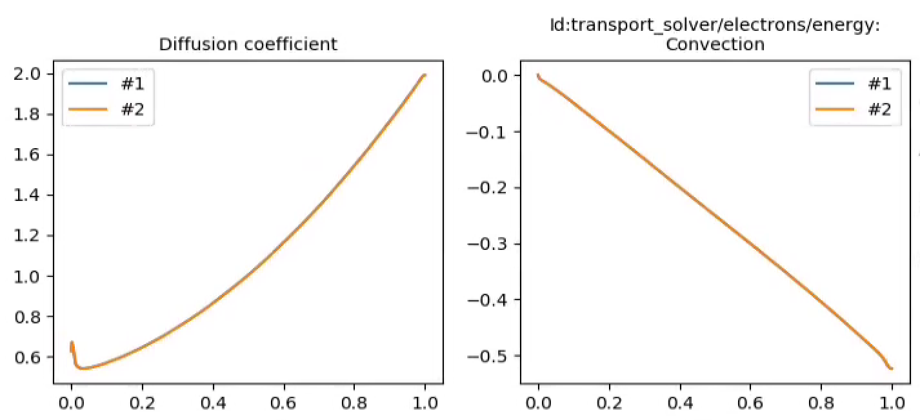
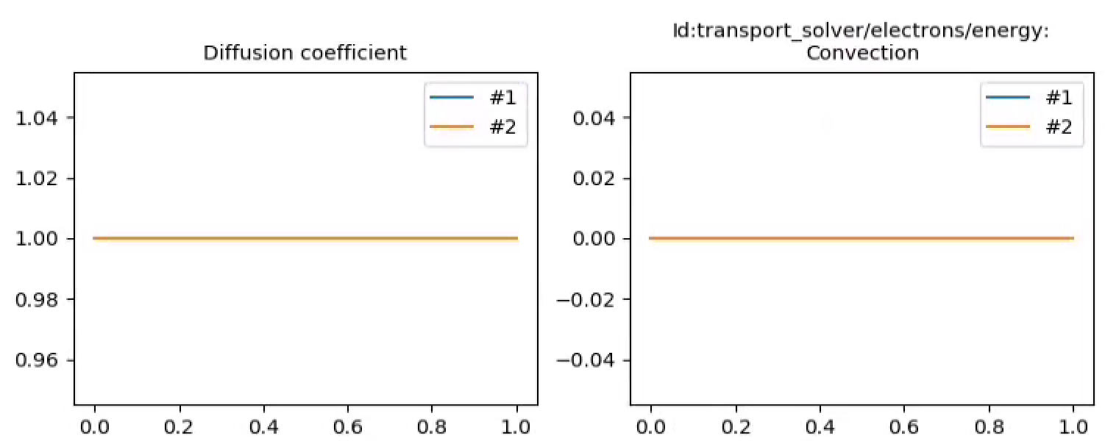
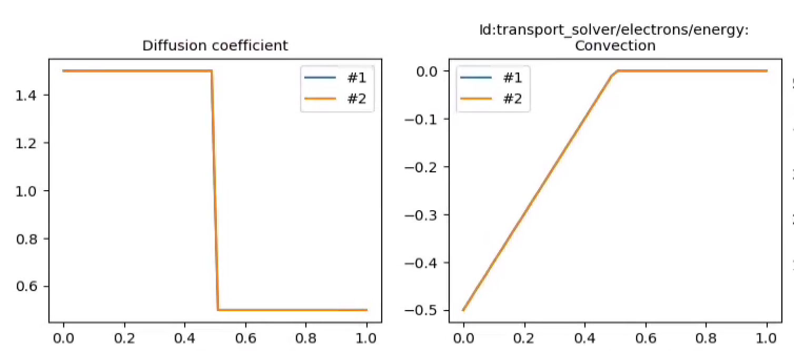
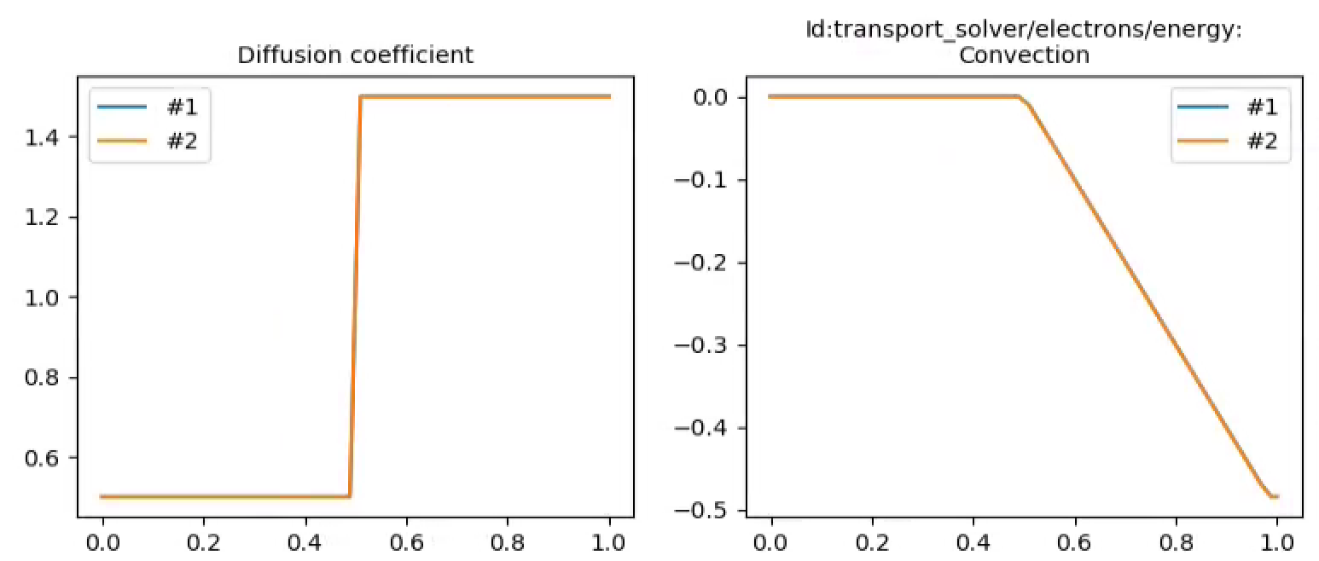
Four test cases; diffusion and convection
Test2
Test1
Diffusion
Convection
Diffusion
Convection
Convection
Diffusion
Convection
Diffusion
Test3
Test4

Slide 4
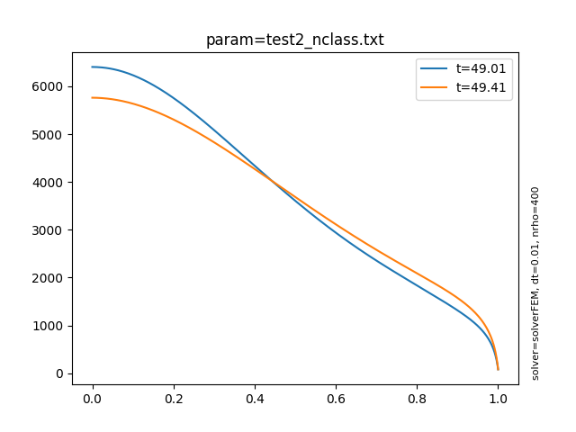
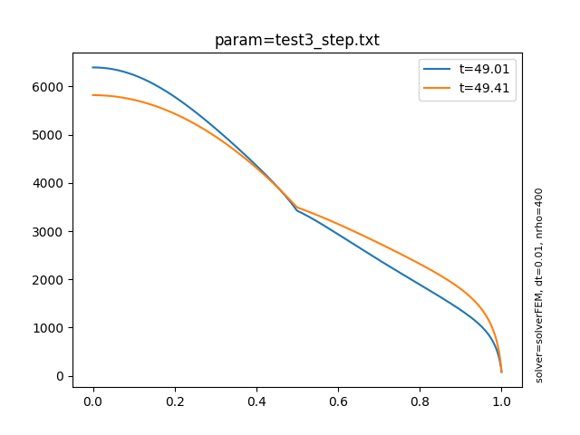
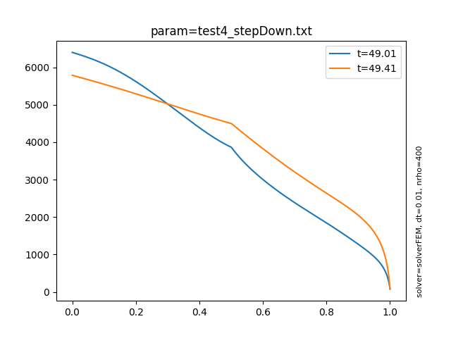
Four test cases; temperature evolution
49.01: After first step
49.41: End of run
Test1
Test2
Evolution changes Te by up to ~600 eV
Test3
Test4

Slide 5
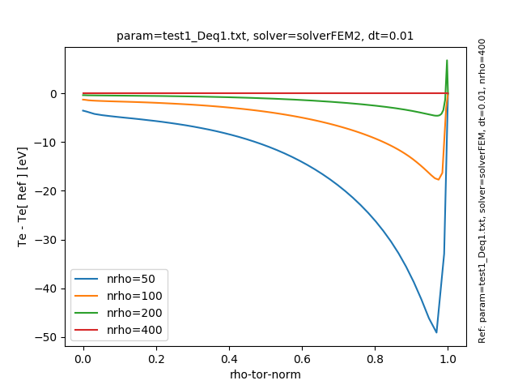
Test 1, FEM and FEM2 give the same results!
FEM
FEM2
In FEM is correct, then errors in FEM2 are large

Slide 6
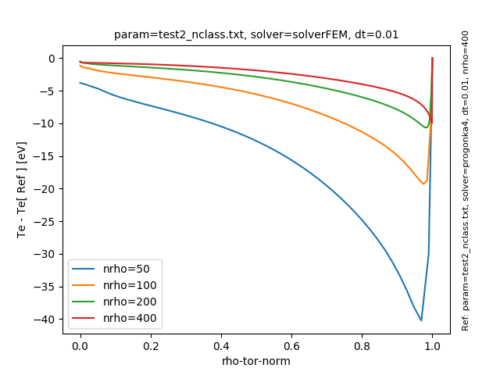
Test2, Progonka4 and SolverFEM converge to the same result
Not converging towards solution from Progonka-4, but only ~ 5eV difference!
Smaller error in FEM
Progonka4 (ref: FEM)
FEM (ref: Progonka4)
CONCLUSION: FEM is more accurate

Slide 7
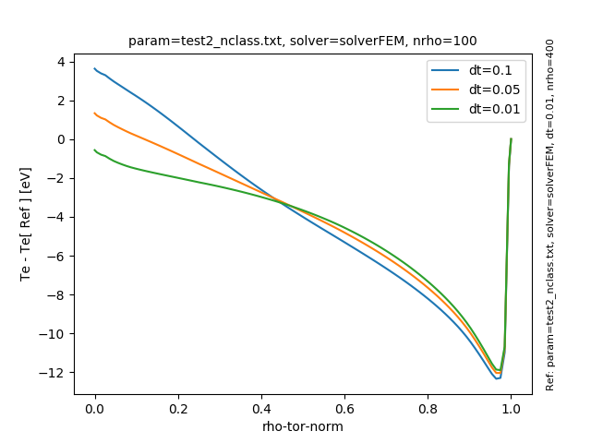
Test 2, Errors due to using finite time-step
Progonka4 (ref. Progonka4)
FEM
(ref. FEM)
CONCLUSION: Error due to finite dt are small

Slide 8
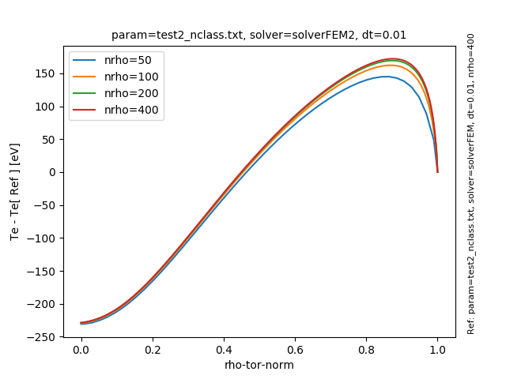
Test 2, FEM and FEM2 are very different!
In FEM is correct, then errors in FEM2 are large
Diverging!!
FEM
FEM2
CONCLUSION: Suspicious FEM2 results PROPOSE: Check the implementation

Slide 9
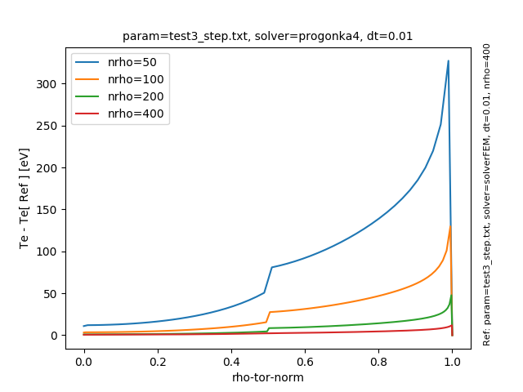
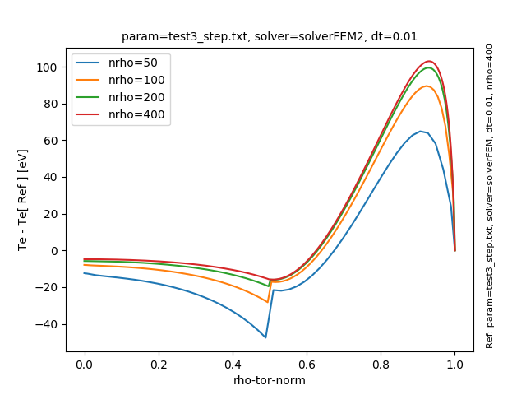
Test 3, Smallest error with FEM; different result with FEM2
Progonka4
FEM
FEM2
CONCLUSION: Similar to Test2

Slide 10
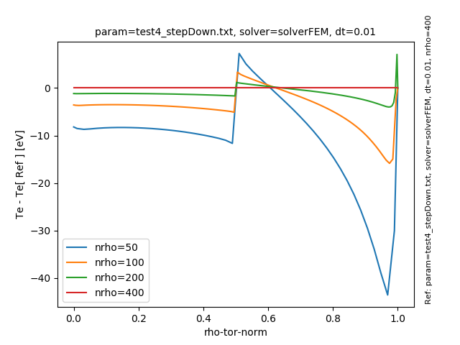
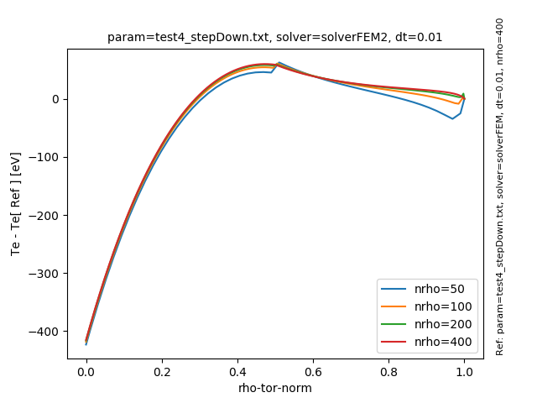
Test 4, Smallest error with FEM; different result with FEM2
Progonka4
FEM
FEM2
CONCLUSION: Similar to Test2

Slide 11
Conclusions
Compare Progonka4 and FEM:
FEM has smaller error than Progonka4 (in this parameter range)
Table show errors at n_rho=100 (independent of dt)
The errors can be compared with a total change in Te due to evolution ~ 600 eV
Compare FEM2 with FEM:
Identical for D=1
For non-uniform D, FEM2 converges to a different results.
 | Error from finite nrho (eV) | Error from finite dt (eV)
FEM | 15 | 4
Progonka4 | 100 | ~4

