Slide 1
VNS physics: integrated modelling and exhaust
C. Bourdelle, S. Wiesen for PSD - WPDES

Slide 2
outline
Pilot Plant A
  Driving principles
  Nature of the challenges
  Exhaust status
  High Fidelity integrated modelling results
Conclusions/perspectives

Slide 3
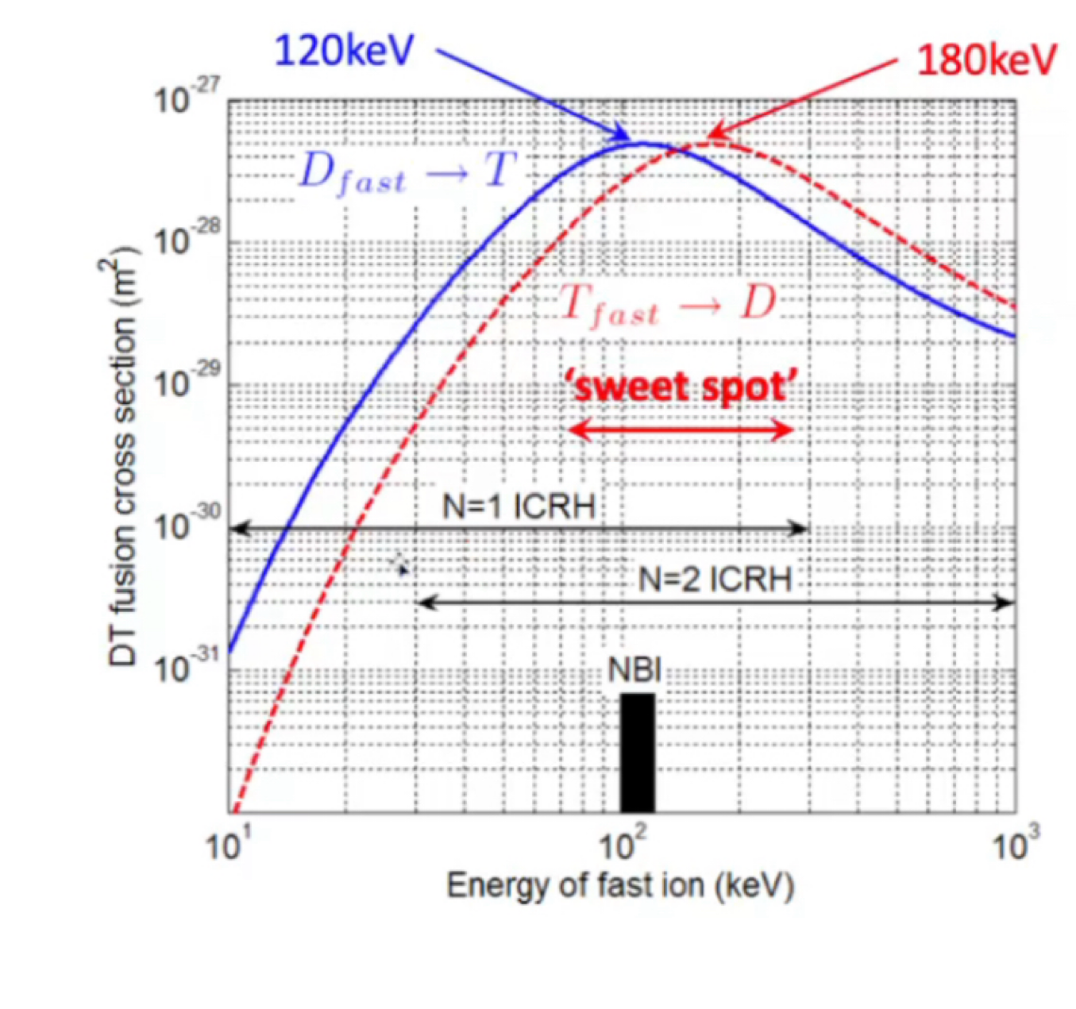
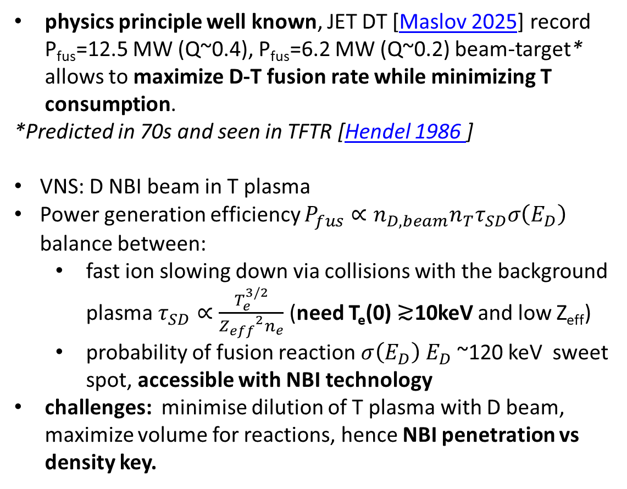
Beam-Target to maximize NWL and minimize T consumption
physics principle well known, JET DT [Maslov 2025] record P_{fus}=12.5 MW (Q~0.4), P_{fus}=6.2 MW (Q~0.2) beam-target* allows to maximize D-T fusion rate while minimizing T consumption.
*Predicted in 70s and seen in TFTR [Hendel 1986 ]
VNS: D NBI beam in T plasma
Power generation efficiency $P_{fus}∝n_{D,beam}n_{T}τ_{SD}σ\left(E_{D}\right)$ balance between:
  fast ion slowing down via collisions with the background plasma $τ_{SD}∝\frac{T_{e}^{3/2}}{{Z_{eff}}^{2}n_{e}}$ (need T_{e}(0) ≳10keV and low Z_{eff})
  probability of fusion reaction $σ\left(E_{D}\right)$ $E_{D}$~120 keV sweet spot, accessible with NBI technology
challenges: minimise dilution of T plasma with D beam, maximize volume for reactions, hence NBI penetration vs density key.
beam target
fusion cross section
Need integration of NBI sources
with T_{e}(ρ) n_{e}(ρ) prediction
Notes:
At fixed heating power, a high density causes a reduction of the electron temperature, which negatively affects the beam slowing down time and thus the fusion power yield.
However, at fixed beam power, a high plasma density (i.e. T-density) reduces the D dilution by the beam, since the number of beam particles is constant. This has positive effects on the achievable fusion power.
In any case, a dense plasma is needed for a safe power exhaust, to ensure high dissipation in the scrape-off layer and in the divertor region. This is clearly a critical point for VNS, since the injected power is large and the volume small, and also a high Z_eff in the core (caused either by seeded or intrinsic impurities) has detrimental effects bith on the beam slowing down time, and thus on the fusion yield, but also on the loop voltage [16][24].

Slide 4
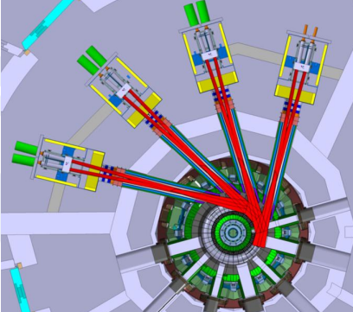
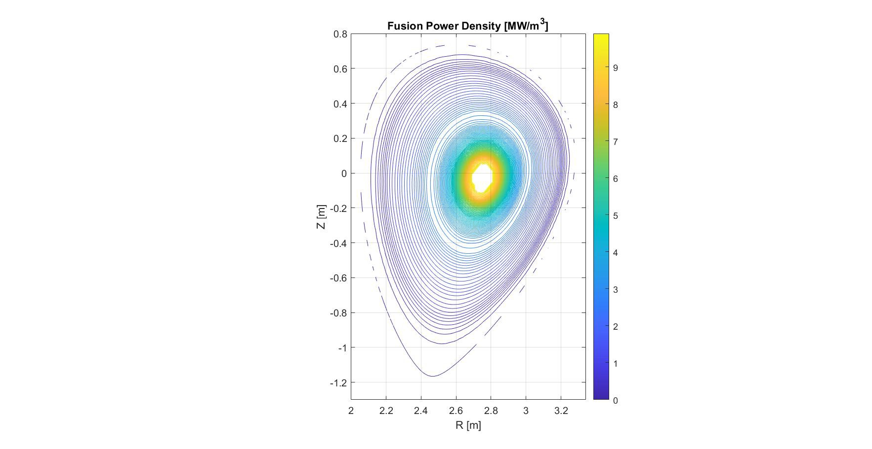
Current VNS design point
Mattia Siccinio
Parameters (METIS, 0.5D code):
Major Radius = Toroidal Field Aspect Ratio =
2.67 m
= 5.6 T
4.25
Sep. Elongation = 1.6 Triangularity = 0.23 NBI Power = 42.5 MW
Beam Energy = 120 keV EC Power = 8 MW Safety Factor q95
= 3.16
Line average density = 11e19m^{-3} f_{Gr}=0.54
Plasma Surface = 95.4 m2
Plasma Volume = 28 m3
Peak NWL = 0.5 MW/m2 Av. NWL = 0.3 MW/m2 BetaN = 2.7 %Tm/MA
More details:
EUROfusion science meeting 23/2/2026
https://indico.euro-fusion.org/event/3586/
Fusion Power = 38.2 MW Centr. El. Temperature Pl. Current = 2.54 MA
= 12.9 keV
Tot. Beta Poloidal = 1.9
D Fraction in Bulk Plasma = 0.17 Power to Divertor = 55.6 MW
ST C, 1
2
Fully non-inductive plasma

Slide 5
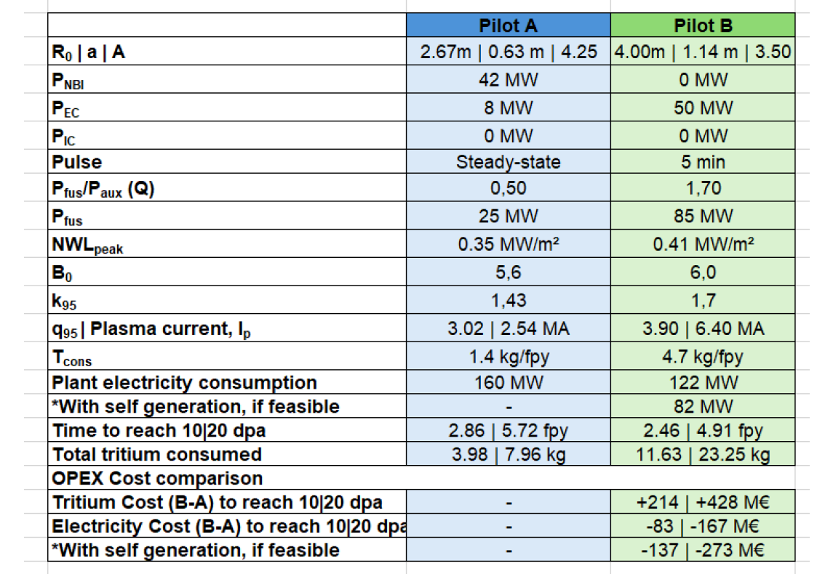
High fidelity integrated modelling of pilot plant A & B
Report to WG on pilot plant
April 2026
None of the approaches meet the requirements for Breeding Blanket assessment
>15 minutes
NWL ~0.5 MW/m2

Slide 6
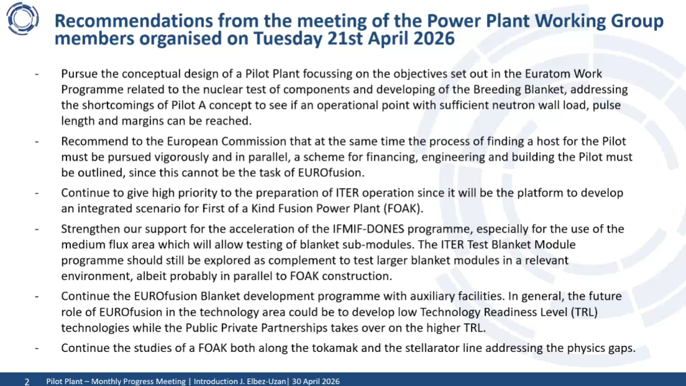

Slide 7
VNS design plan revision strategy
1/ explore the R, A plan by adding informed physics boundary conditions
METIS-MADE R, A exploration [Quartararo]
using informed constrains from exhaust [Wiesen IAEA 2025, NF 2026] , Energetic particle mode drive and high fidelity integrated modelling [E. Bray et al TTF 2025, publication in prep. 2026]
2/ calibrate further the boundary conditions in terms of exhaust and Energetic Particle driven modes thanks to continuation of present VNS baseline (SOLPS-ITER [Wiesen], ASCOT [WPDES+Lauber], high fidelity modelling [Bray, Bourdelle], EP modes [Lauber], MHD stability [WPDES] etc).
Milestones [J. Elbez-Uzan]
18/6: Domain Design points. Report on the maximum pulse length (aiming at steady state) and max NWL (aiming at 0.5 MW/m2). This well informed design space with include high fidelity integrated and SOLPS-ITER modeling of some of the most promising points.
16/7: design point/ 2D shape/geometry/ equilibrium/ input data document
30/10: consolidation of the plasma scenario, i.e. controllability of low Vloop using ECCD as needed and assessing EP modes / NBI interplay as reported on KSTAR.

Slide 8
outline
Pilot Plant A
  Driving principles
  Nature of the challenges
  Exhaust status
  High Fidelity integrated modelling results
Conclusions/perspectives

Slide 9
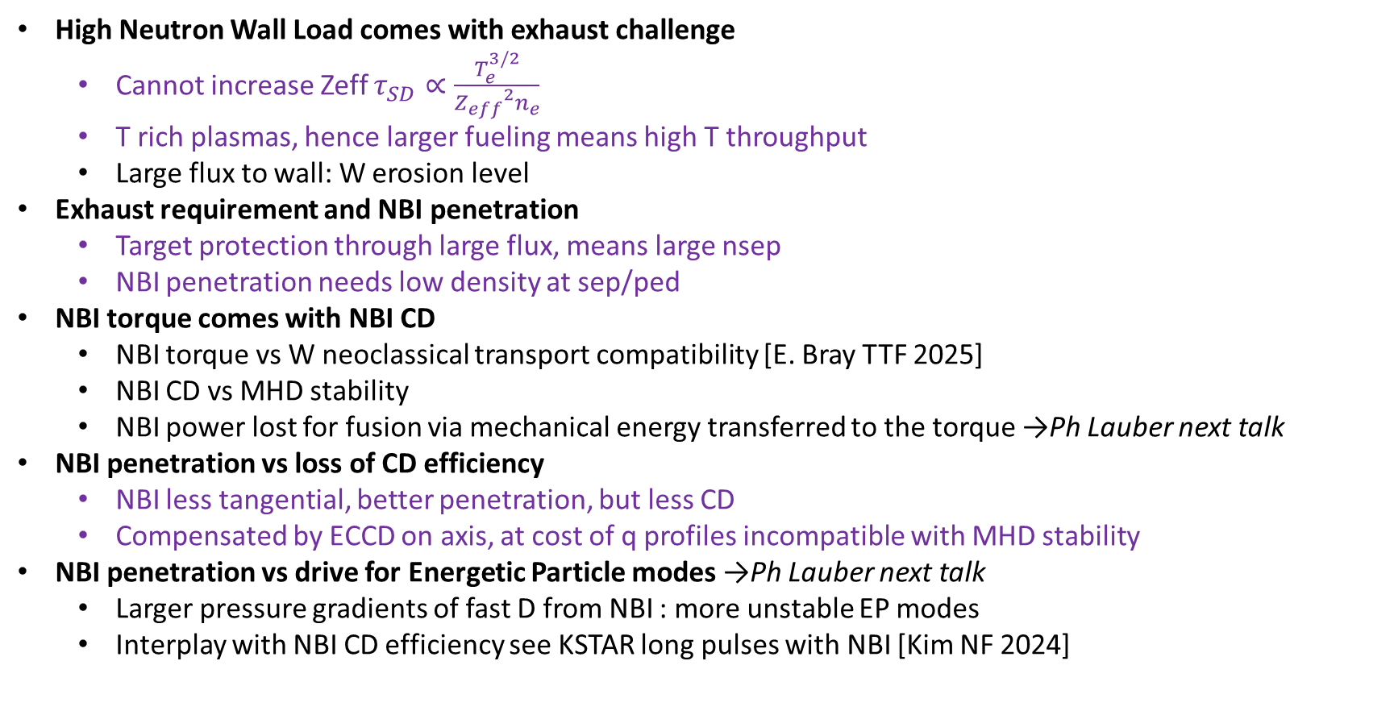
VNS beam target comes with a number of challenges
Addressed in this talk
High Neutron Wall Load comes with exhaust challenge
  Cannot increase Zeff $τ_{SD}∝\frac{T_{e}^{3/2}}{{Z_{eff}}^{2}n_{e}}$
  T rich plasmas, hence larger fueling means high T throughput
  Large flux to wall: W erosion level
Exhaust requirement and NBI penetration
  Target protection through large flux, means large nsep
  NBI penetration needs low density at sep/ped
NBI torque comes with NBI CD
  NBI torque vs W neoclassical transport compatibility [E. Bray TTF 2025]
  NBI CD vs MHD stability
  NBI power lost for fusion via mechanical energy transferred to the torque →Ph Lauber next talk
NBI penetration vs loss of CD efficiency
  NBI less tangential, better penetration, but less CD
  Compensated by ECCD on axis, at cost of q profiles incompatible with MHD stability
NBI penetration vs drive for Energetic Particle modes →Ph Lauber next talk
  Larger pressure gradients of fast D from NBI : more unstable EP modes
  Interplay with NBI CD efficiency see KSTAR long pulses with NBI [Kim NF 2024]

Slide 10
outline
Pilot Plant A
  Driving principles
  Nature of the challenges
  Exhaust status
  High Fidelity integrated modelling results
Conclusions/perspectives

Slide 11
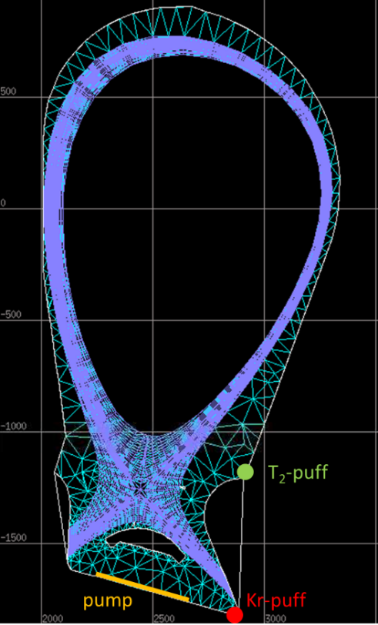
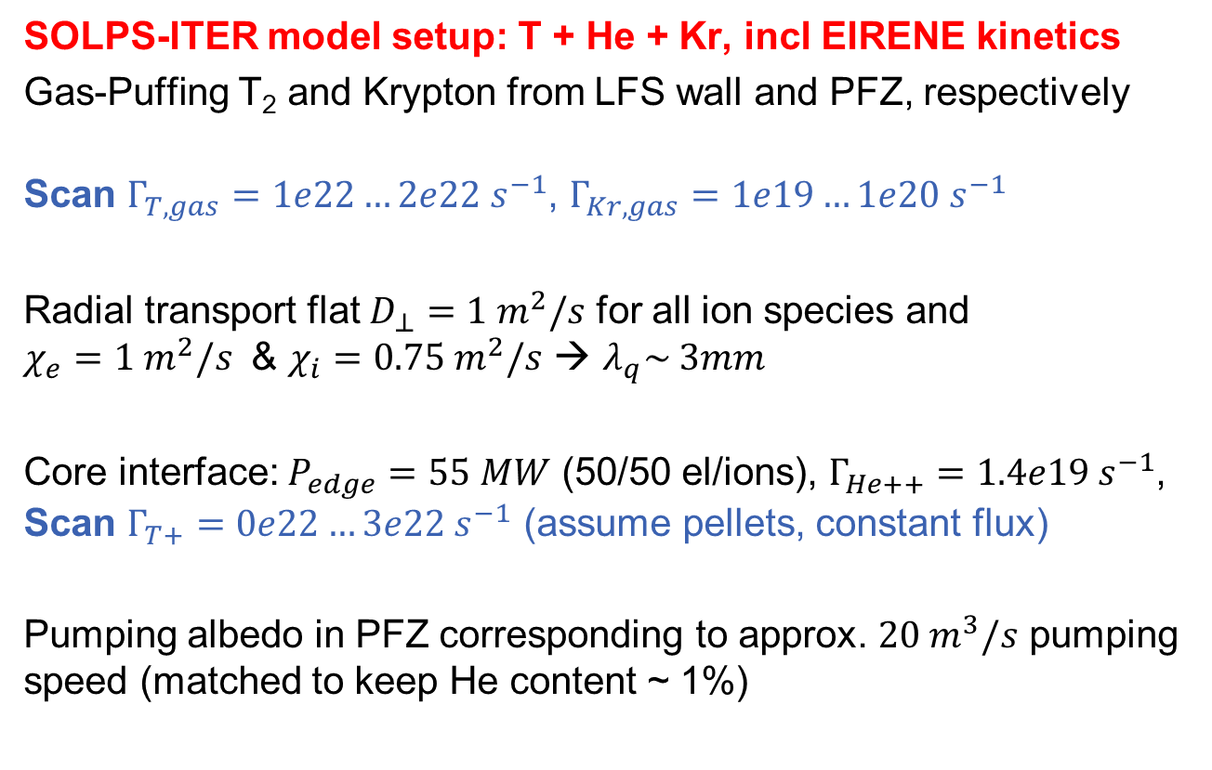
EU-VNS exhaust concept study (SOLPS-ITER)
SOLPS-ITER model setup: T + He + Kr, incl EIRENE kinetics
Gas-Puffing T₂ and Krypton from LFS wall and PFZ, respectively
Scan $Γ_{T,gas}=1e22…2e22 s^{−1}$, $Γ_{Kr,gas}=1e19…1e20 s^{−1}$
Radial transport flat $D_{⊥}=1 m^{2}/s$ for all ion species and
$χ_{e}=1 m^{2}/s$ & $χ_{i}=0.75 m^{2}/s$ → $λ_{q}\sim 3mm$
Core interface: $P_{edge}=55 MW$ (50/50 el/ions), $Γ_{He++}=1.4e19 s^{−1}$,
Scan $Γ_{T+}=0e22…3e22 s^{−1}$ (assume pellets, constant flux)
Pumping albedo in PFZ corresponding to approx. $20 m^{3}/s$ pumping speed (matched to keep He content ~ 1%)
[Sven Wiesen IAEA 2025]

Slide 12

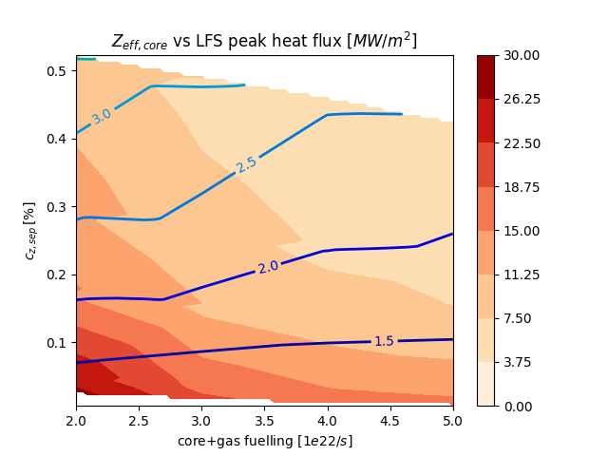
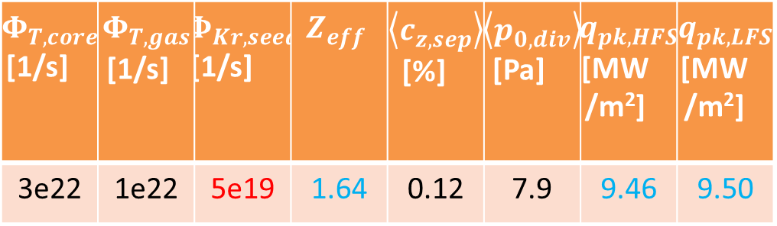
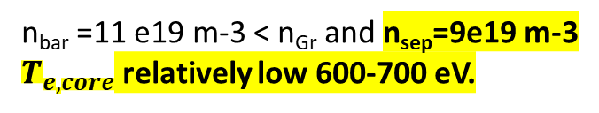
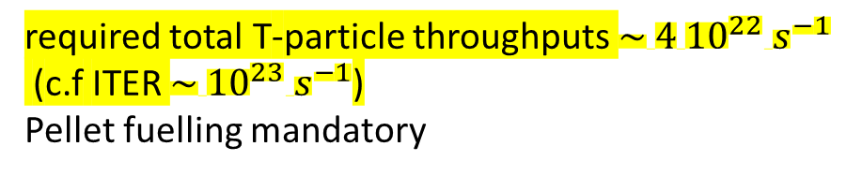
VNS exhaust scheme: Kr seeding, can achieve < 10 MW/m² with c_{Kr} 0.12% /Z_{eff} ~1.6
SOLPS-ITER Results
'ITER-type' transport coefficients for radial diffusion
n_{bar} =11 e19 m-3 < n_{Gr} and n_{sep}=9e19 m-3
$T_{e,core}$ relatively low 600-700 eV.
$Φ_{T,core}$ [1/s] | $Φ_{T,gas}$ [1/s] | $Φ_{Kr,seed}$ [1/s] | $$Z_{eff}$$ | $\left\langle c_{z,sep}\right\rangle$ [%] | $\left\langle p_{0,div}\right\rangle$ [Pa] | $q_{pk,HFS}$ [MW/m²] | $q_{pk,LFS}$ [MW/m²]
3e22 | 1e22 | 5e19 | 1.64 | 0.12 | 7.9 | 9.46 | 9.50
NB: Low Zeff mandatory for beam-target
required total T-particle throughputs $\sim { 4 10}^{22} s^{−1}$
(c.f ITER $\sim {10}^{23} s^{−1}$)
Pellet fuelling mandatory
[Sven Wiesen IAEA 2025]

Slide 13
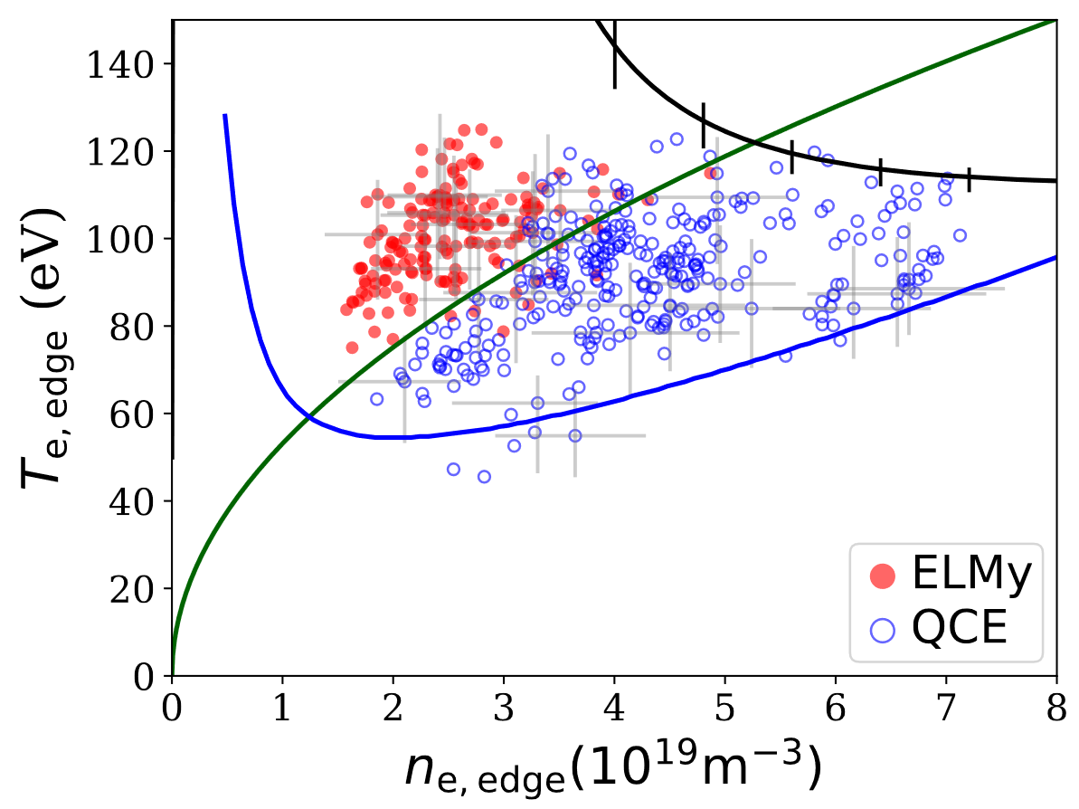
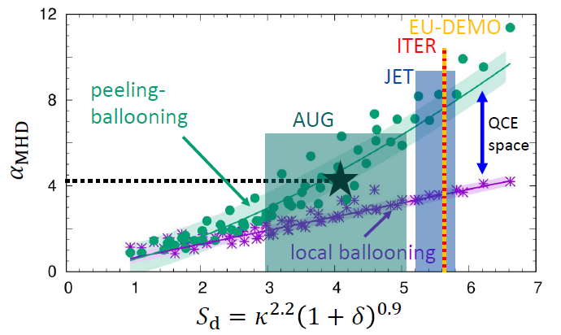
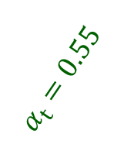
QCE regime should be accessible
Faitsch NF 2023/PSI 2024
ELMy-QCE
transition
Ideal ballooning
High nsep favors QCE regime access
Current VNS design point: k=1.6, d=0.23
→ S_{d} = 3.39 (i.e. just in QCE regime)
T_{e,sep} [eV]
H-L transition
$α_{t}=0.55$
n_{e,sep} [10¹⁹ m⁻³]
the assumed l_{q} ~ 3mm in present VNS simualtions already took this into account to some extent
Increase k ~ 2.1 to have e.g. S_{d} = 6 for VNS
To mimic QCE: SOLPS simulations with enhanced transport ongoing → leads likely to lower requirement for throughput
would need SOLPS validation on existing QCE to guide VNS SOL heat/particle transport
Dunne EPS 2024

Slide 14
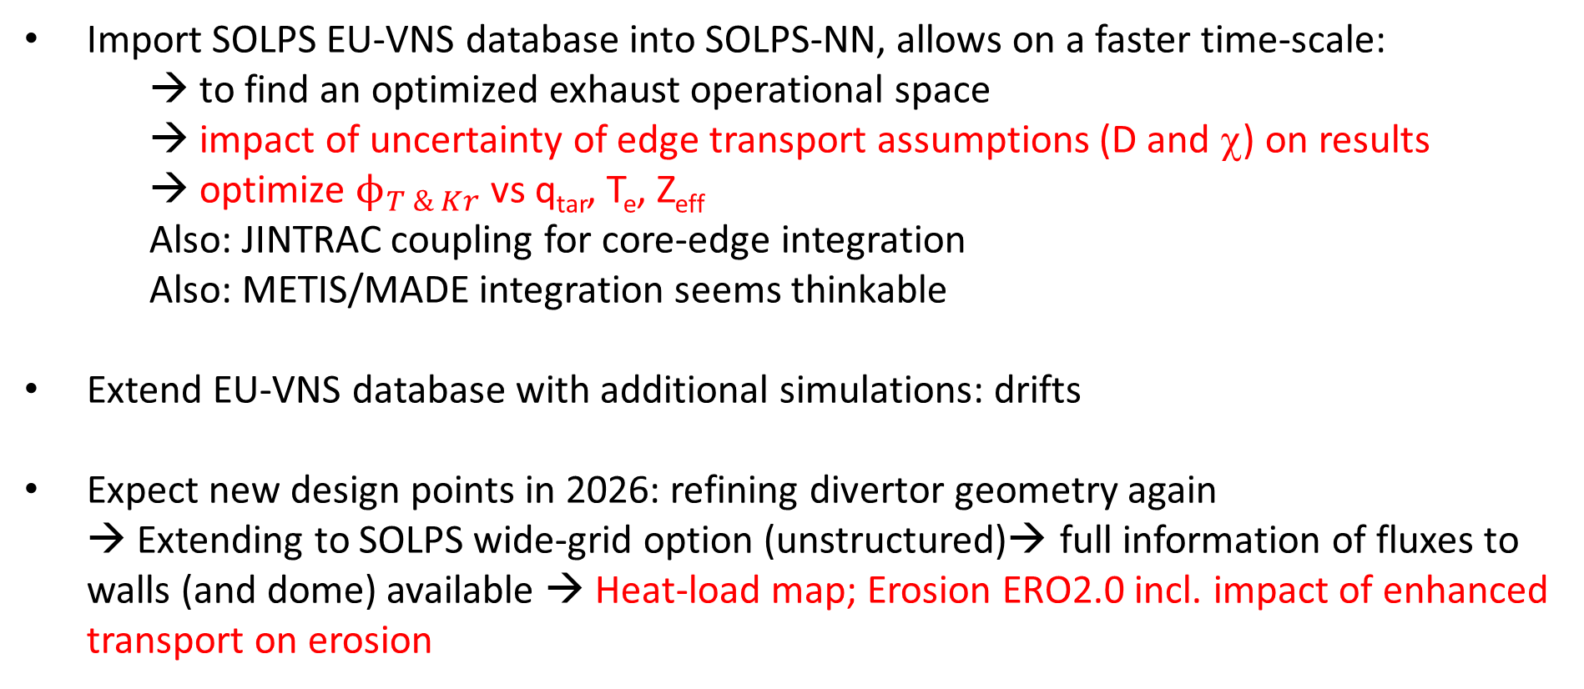
VNS exhaust understanding: Outlook 2026
Import SOLPS EU-VNS database into SOLPS-NN, allows on a faster time-scale:
→ to find an optimized exhaust operational space
→ impact of uncertainty of edge transport assumptions (D and χ) on results
→ optimize $ϕ_{T \& Kr}$vs q_{tar}, T_{e}, Z_{eff}
Also: JINTRAC coupling for core-edge integration
Also: METIS/MADE integration seems thinkable
Extend EU-VNS database with additional simulations: drifts
Expect new design points in 2026: refining divertor geometry again
→ Extending to SOLPS wide-grid option (unstructured)→ full information of fluxes to walls (and dome) available → Heat-load map; Erosion ERO2.0 incl. impact of enhanced transport on erosion
Trade off: minimize fluxes on target thanks to more transport while minimizing W erosion

Slide 15
outline
Pilot Plant A
  Driving principles
  Nature of the challenges
  Exhaust status
  High Fidelity integrated modelling results
Conclusions/perspectives

Slide 16
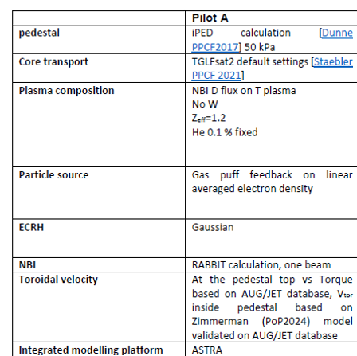
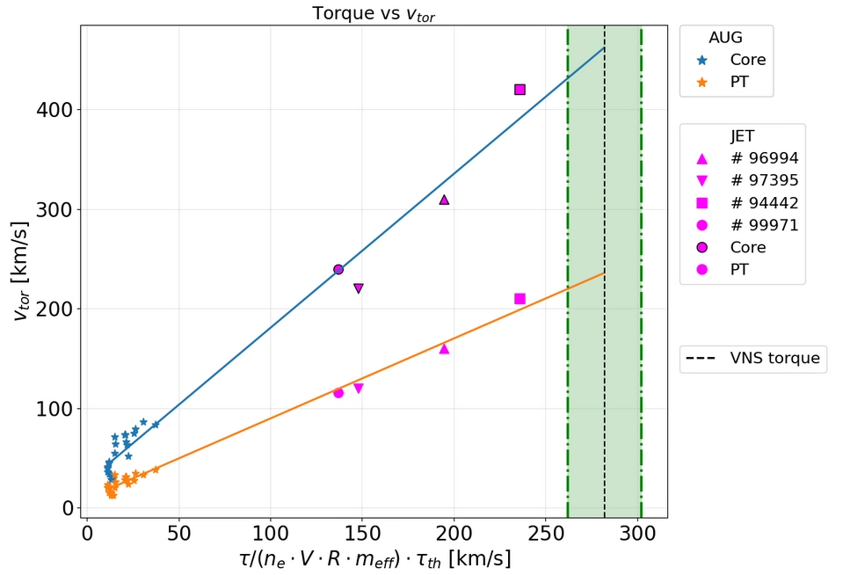
Modelling settings
Elisabetta Bray
PhD student at Politecnico di Torino main modeler
With the support of ASTRA team (E. Fable, C. Angioni), M. Weiland
DCT/PSD C. Bourdelle, Ph. Lauber, M Siccinio
JET M. Maslov, M. Marin
Centered at 0
ECCD 0.5 MA/10 MW

Slide 17
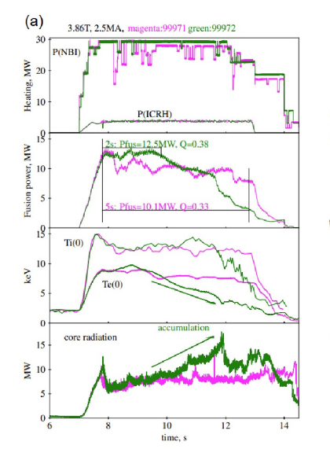
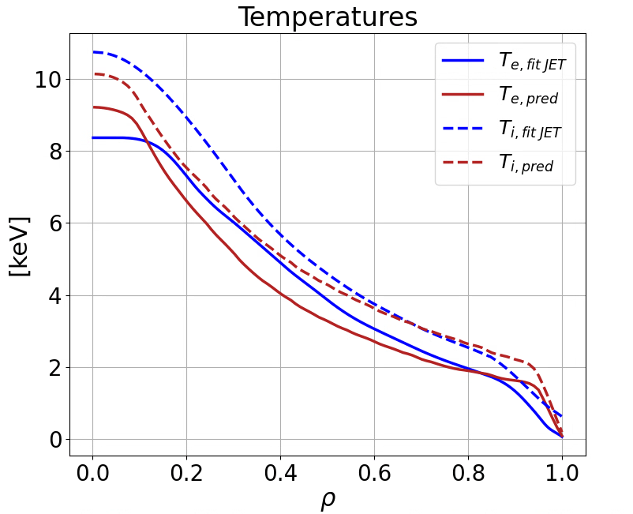
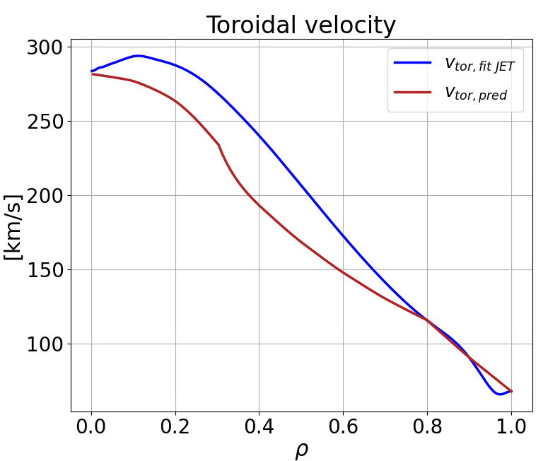
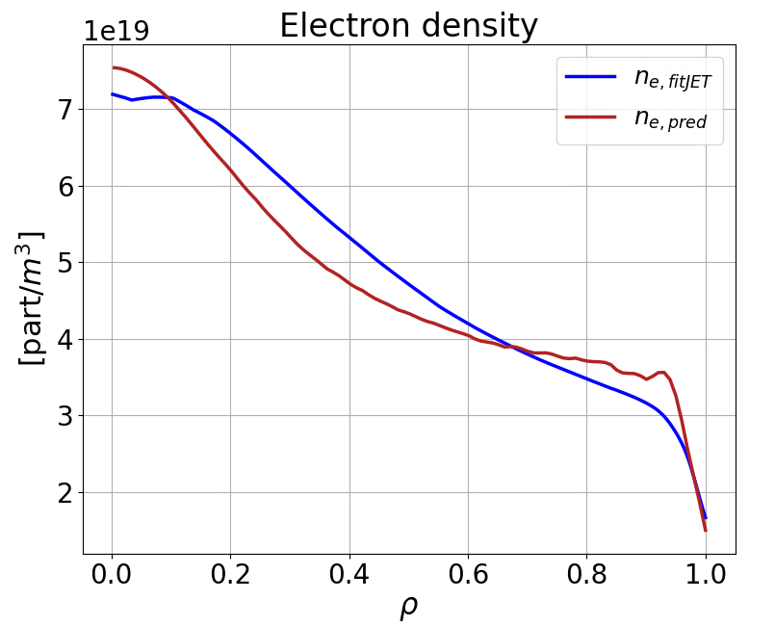
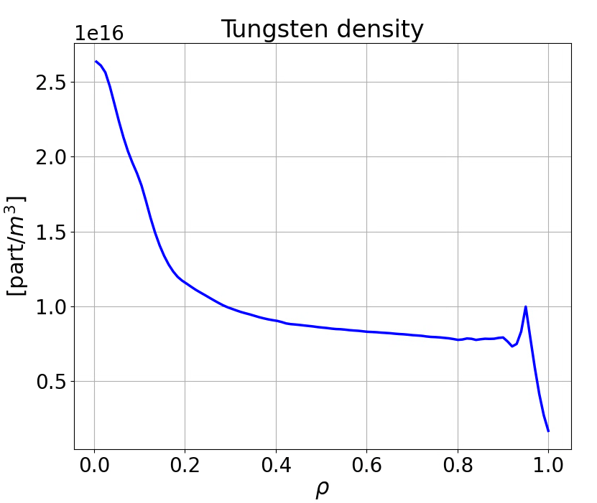
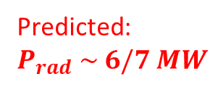
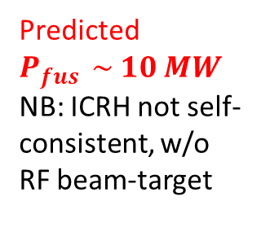
Integrated Modelling settings, validated on JET DTE2 record beam-target
Elisabetta Bray
Fit to meas.
Predicted $P_{fus } \sim 10 MW$
NB: ICRH not self-consistent, w/o RF beam-target
Pred.
Fit to meas.
Pred.
Predicted: $P_{rad} \sim 6/7 MW$
[Maslov M. et al., Nucl. Fusion 63 (2023) 112002]
NB: ICRH not self-consistent, w/o RF beam-target

Slide 18
T rich validation on JET: isotope mixing vs fueling, not always homothetic , to be understood
M. Maslov said (Feb 2026) that on JET beam-target, during the T rich experiments, although fuelled by gas puff, the D/T ratio in the plasma core was as the NBI-D over T gas puff ratio! Meaning that no pellet fueling would have led to improved performances."This is described in the original 2023 paper and I think this is a very important result which for some reason didn’t receive much attention. Only one of Russian colleagues has approached me by email, asking about exactly that – they were planning to use pellets for their own VNS design and they couldn’t understand/model the overall particle balance to get anything similar to JET results.
JET T rich results by Costanza Maggi. At low density (limit of NBI shinethorugh) it was observed that the DT neutron rate could not be explain if keeping T and D ratio homothetic thorughout the plasma around 80% as measured at the edge. Only by assuming 50% D/T in the core can the neutron rate measurement be explain. No fast ion mixing unlike in Maslov's experiments. Is it due to turbulent transport? or the NBI fast ion transport? could it impact VNS results? would need validation of models on these JET cases. For the moment no resources to address this point.
Need to be modelled/validated to extrapolate to VNS fuel mix

Slide 19
Trade off between pulse length and Pfus
Elisabetta Bray
With present VNS design, to maximize Pfus :
Needed to push NBI to max energy 150 keV, to account for ECCD on axis (0.5 MA for 10 MW)
Then to maximize Pus, need to tilt NBI injection at the price of reducing Vloop.
VNS has only ~2Wb available at flat top, hence for > 20 min NEED Vloop < 1.6 mV
 | Injection angle | NBI power | NBI beam energy | ECRH power | Pfus [MW] | Vloop | Rot losses [MW] | Vtor,0 [km/s]
Design | 180 | 42.5 | 120 | 8 | 16,80 | 14 mV | 8.73 | 740
150 keV | 180 | 42.5 | 150 | 10 | 21.54 | -10 mV | 8.10 | 665
1 degree | 179 | 42.5 | 150 | 10 | 28.62 | 10 mV | 7.07 | 620
2 degree | 178 | 42.5 | 150 | 10 | 32.05 | 18 mV | 5.7 | 550
Expected optimum, here w/o W, Pfus ~25 MW, hence peak NWL of 0.34 MW/m2

Slide 20
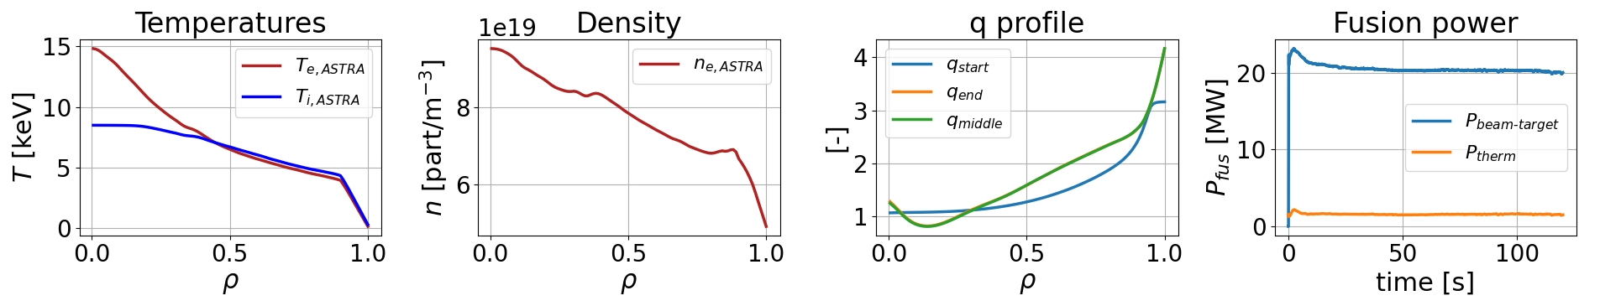
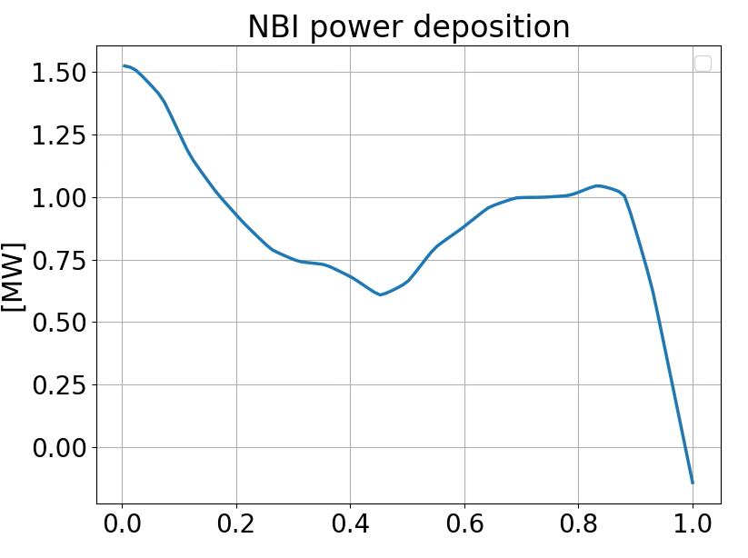
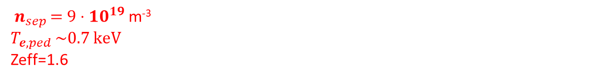
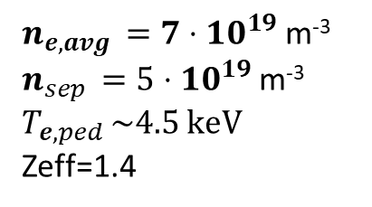
VNS, integrated modelling predictions: reduced line averaged density to allow NBI penetration
Elisabetta Bray
 | Injection angle | NBI power | NBI beam energy | ECRH power | Pfus [MW] | Vloop | Rot losses [MW] | Vtor,0 [km/s]
150 keV | 180 | 42.5 | 150 | 10 | 21.54 | -10 mV | 8.10 | 665
P_{ped}=50 kPa by IMEP, [M. Dunne]
$n_{e,avg }=7⋅10^{19}$m⁻³
$n_{sep }=5⋅10^{19}$m⁻³
$$T_{e,ped }\sim 4.5 keV$$
Zeff=1.4
Not compatible with present SOLPS-ITER exhaust modelling
${ n}_{sep }=9⋅10^{19}$m⁻³
$$T_{e,ped }\sim 0.7 keV$$
Zeff=1.6
E. Bray

Slide 21
outline
Pilot Plant A
  Driving principles
  Nature of the challenges
  Exhaust status
  High Fidelity integrated modelling results
Conclusions/perspectives

Slide 22
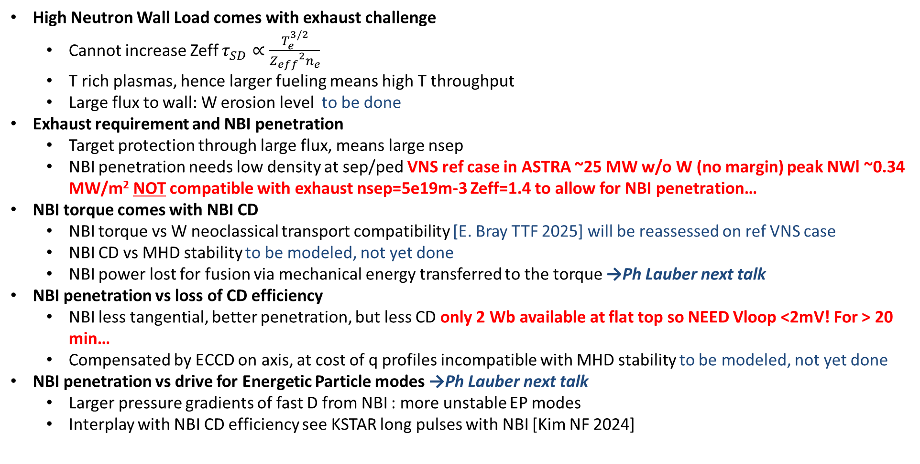
Conclusions & Plasma Science Division proposed actions to support VNS
High Neutron Wall Load comes with exhaust challenge
  Cannot increase Zeff $τ_{SD}∝\frac{T_{e}^{3/2}}{{Z_{eff}}^{2}n_{e}}$
  T rich plasmas, hence larger fueling means high T throughput
  Large flux to wall: W erosion level to be done
Exhaust requirement and NBI penetration
  Target protection through large flux, means large nsep
  NBI penetration needs low density at sep/ped VNS ref case in ASTRA ~25 MW w/o W (no margin) peak NWl ~0.34 MW/m² NOT compatible with exhaust nsep=5e19m-3 Zeff=1.4 to allow for NBI penetration…
NBI torque comes with NBI CD
  NBI torque vs W neoclassical transport compatibility [E. Bray TTF 2025] will be reassessed on ref VNS case
  NBI CD vs MHD stability to be modeled, not yet done
  NBI power lost for fusion via mechanical energy transferred to the torque →Ph Lauber next talk
NBI penetration vs loss of CD efficiency
  NBI less tangential, better penetration, but less CD only 2 Wb available at flat top so NEED Vloop <2mV! For > 20 min…
  Compensated by ECCD on axis, at cost of q profiles incompatible with MHD stability to be modeled, not yet done
NBI penetration vs drive for Energetic Particle modes →Ph Lauber next talk
  Larger pressure gradients of fast D from NBI : more unstable EP modes
  Interplay with NBI CD efficiency see KSTAR long pulses with NBI [Kim NF 2024]
SOLPS validation on existing QCE to guide VNS SOL heat/particle transport
On-going uncertainty exploration SOLPS-ITER transport settings
JET T rich D/T mix from SOL to core: Need to be modelled/validated to extrapolate to VNS fuel mix
Vloop < 2mV with ECCD on-axis expts?

Slide 23
Engineering Design (incl. Sensors, actuators)
Magnetic equilibrium, stability
System code METIS+MADE Optimization incl. physics+magnets | Pulse Design Tools FENIX Full pulse, testing controllers Some physics models & Surrogate models | High Fidelity Integrated Modeling ASTRA 1.5D,HFPS More physics self-consistency | Verification vs 1st principle physics codes Pedestal Transport in high β core EP interplay …
 | Validation against tokamak experiments, high β (JET, JT60-SA), large non-inductive current (ECCD vs bootstrap) (TCV, AUG, WEST), ICRH absorption (AUG, JET, WEST)
3
1
2

