Slide 1
NBI physics and EP Stability/Transport
Plasma System Division
DEMO Central Team
PSD: Philipp Lauber ,Clarisse Bourdelle, Francesco Maviglia, Andrea Quartararo, Sven Wiesen, Pasquale Zumbolo and WPDES contributors: A. Snicker, K. Särkimäki, C. De Piccoli;
And Mattia Siccinio, M. Weiland

Slide 2
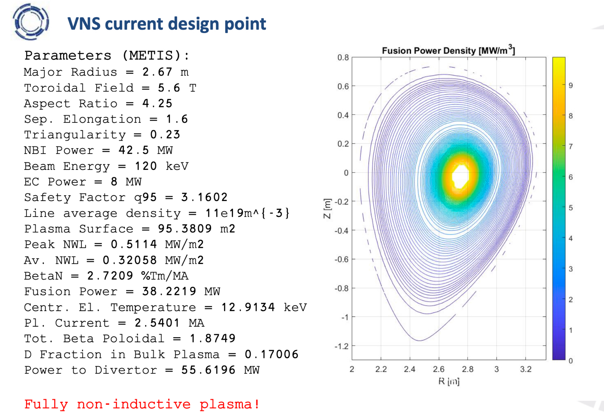
[M. Siccino, ESM Jan 2026]
(0.5D modeling)
4 beam lines (deuterium):
~15MW per beam line
3 operational/1 recycling
NBI needs to be optimised to facilitate: D-T, current drive, profile shaping (MHD), rotation, neocl. W transport, heating mix
~7.5 MW alpha particle heating,
8MW EC power
started 12/2025:
PSD to investigate the current design point with higher fidelty models (ASTRA/TGLF/RABBIT; ASCOT, EP-Stability WF, ATEP,…)
first: JET validation

Slide 3
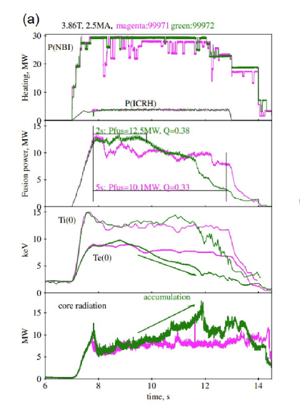
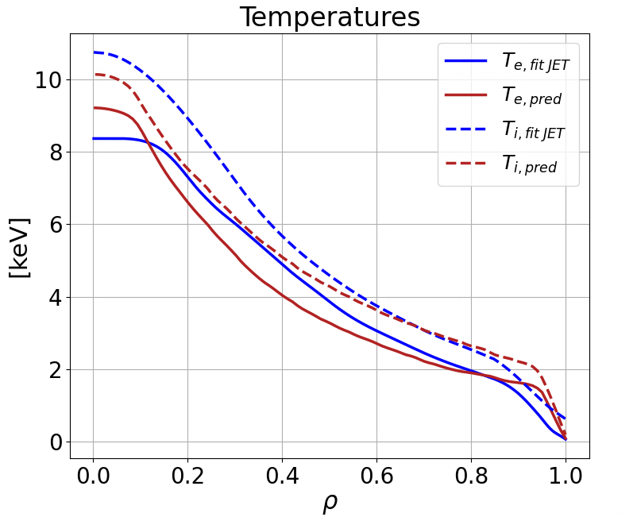
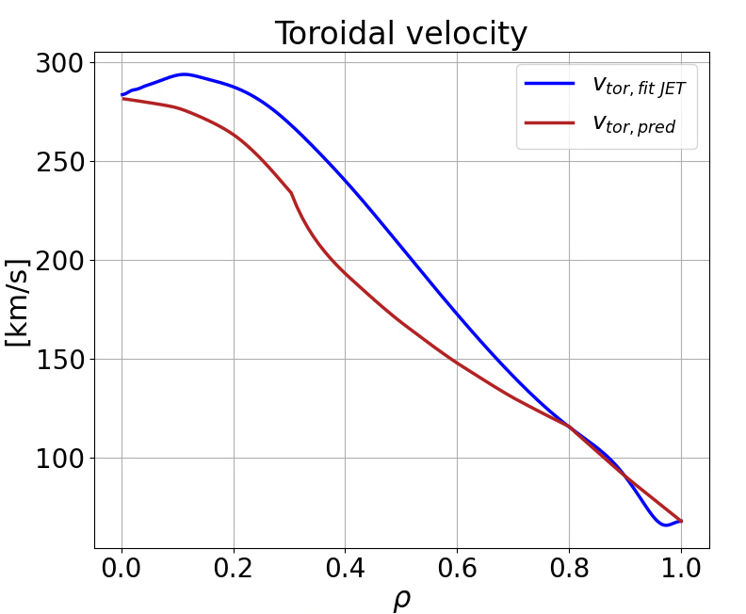
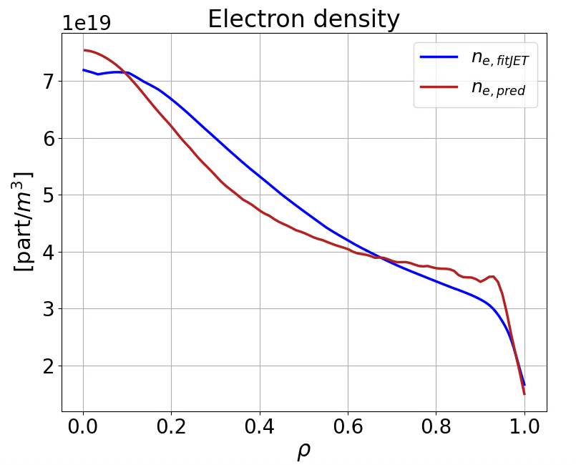
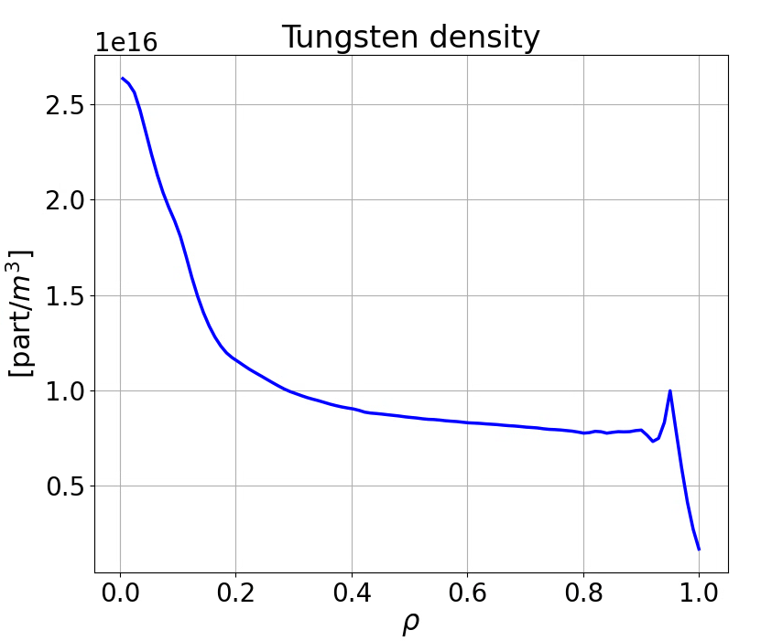
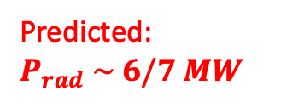
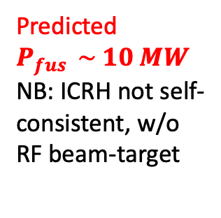
Integrated Modelling settings, validated on JET DTE2 record beam-target
Fit to meas.
Predicted $P_{fus } \sim 10 MW$
NB: ICRH not self-consistent, w/o RF beam-target
Pred.
Fit to meas.
Pred.
Predicted: $P_{rad} \sim 6/7 MW$
[Maslov M. et al., Nucl. Fusion 63 (2023) 112002]
NB: ICRH not self-consistent, w/o RF beam-target

Slide 4
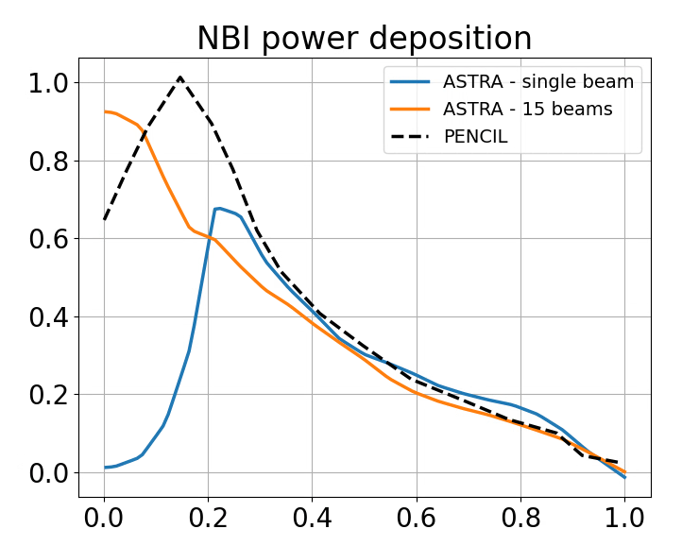
JET validation - NBI geometry and deposition (PENCIL vs RABBIT)
[E. Bray , March 2026]
~ 26 MW
~ 25 MW
many other succesful benchmarks of
RABBIT with TRANSP/Nubeam for AUG, JET, DIII-D etc [Weiland et al 2018-2026]
~ 26 MW
E. Bray | 20/03/2026
reasonable agreement; remaining differences: FOW effects (PENCIL: no FOW)
4

Slide 5
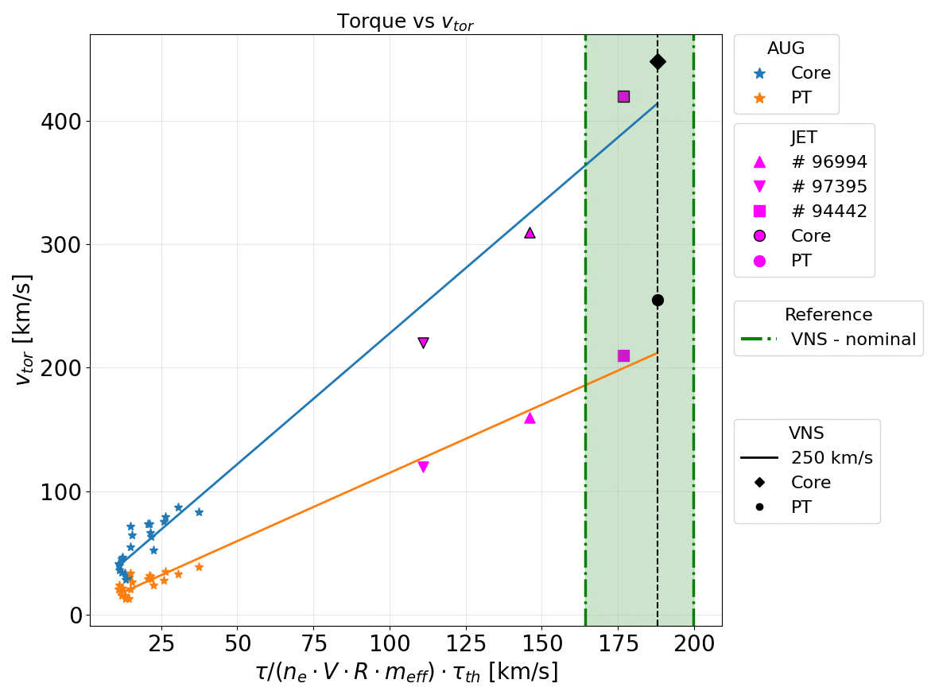
High- rotation cases at JET – close to expected VNS values
significant beam power is ‘lost’ to rotation: lower effective energy of injected ions in the reference frame of the rotating plasma
good agreement of RABBIT-TRANSP for AUG [M. Weiland]
inclusion of this effect largely resolves discrepancies between METIS and ASTRA/RABBIT – see A. Quartararo
however: some differences reported on highly rotating plasmas in JET [Siren EPS 2019] between ASCOT/TRANSP-NUBEAM
Is rotation correctly predicted for higher rotation cases #94442?
record beam target #99971

Slide 6
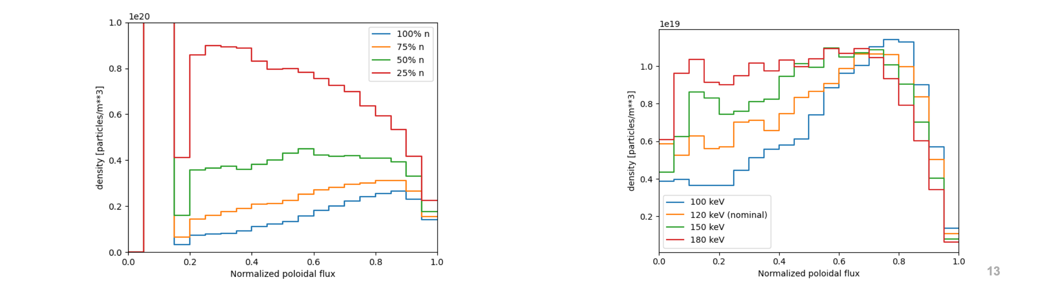
Beam penetration in VNS: beam energy, injection geometry and density scans
ionisation cross section depends mainly on density profile, negligibe temperature effect on ionisation
for maximizing beam-target fusion power: hot electrons are essential; slowing down time ~ T_{e}^{3/2}/n
ASCOT scan on preliminary VNS case (but too far to new reference VNS case): nped=5*10¹⁹m⁻³; non-optimised injection geometry: expected dependecies confirmed
K. Särkimäki, A. Snicker

Slide 7

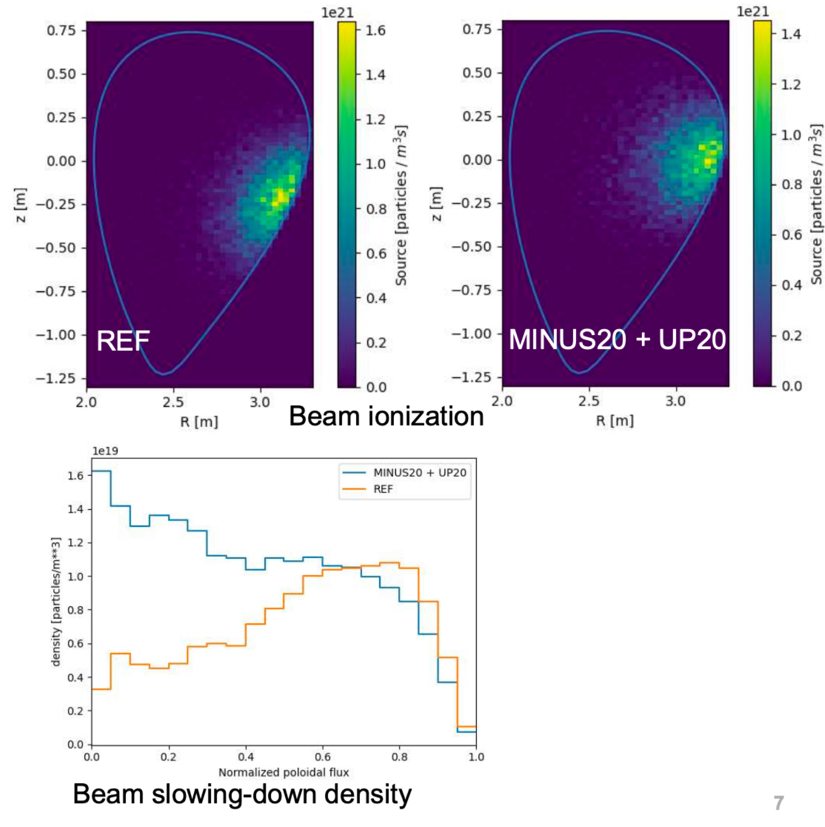
NBI profiles: BBNBI/ASCOT on beam geometry
current (particle) fractions:
75.7% D+, 20.5% D2+, 3.8% D3+
K. Särkimäki, A. Snicker
injection at Z=0cm [right plot] leads to favourable (blue) NBI density profile; 6.1MW alpha power recovered
reason for problems with previous Z=-20cm [REF case, left] understood
moderately peaked density profile - still to be optimised (Te, n dependence!) and used for stability and transport analysi
avoid too peaked profiles: EP stability, see below
here ASTRA 0.5D
profiles were used to
scan sensitivity with respect to geometry

Slide 8
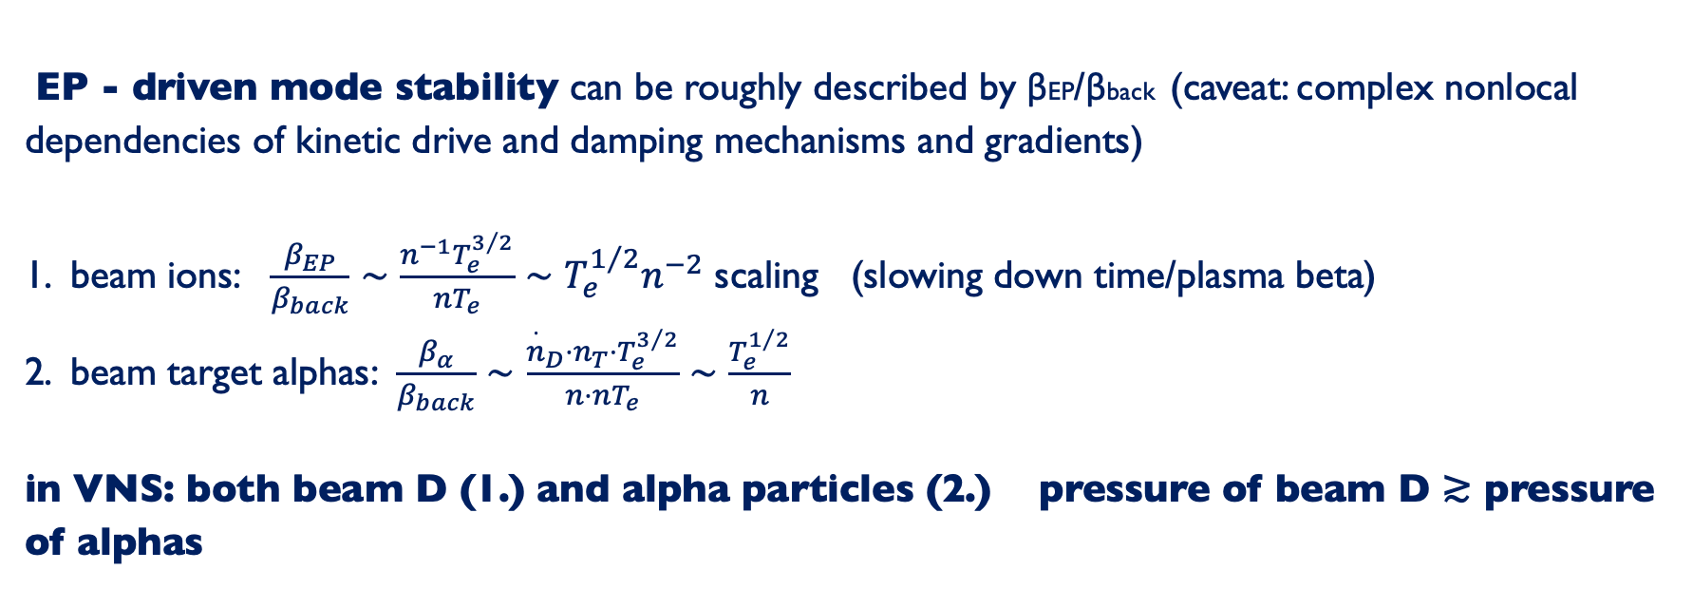
VNS: strongly driven system, large EP fraction
dimensionless parameters (mode spectrum/turbulence spectrum) not relevant for burning plasma physics
large EP fraction (consisting of D beam in T plasma, and alpha particles) - non-perturbative studies needed (on-axis pEP ~1-1.5 pthermal)
mode number spectrum expected to leak at low toroidal mode numbers: 5-12; alpha particles may drive even lower n modes
EP gradients similar to AUG EP super-shots expected [Lauber IAEA 2018, NLED AUG case, G Vlad RMPP 2025]
EP - driven mode stability can be roughly described by βEP/βback (caveat: complex nonlocal dependencies of kinetic drive and damping mechanisms and gradients)
1. beam ions: $\frac{β_{EP}}{β_{back}}∼\frac{n^{−1}T_{e}^{3/2}}{nT_{e}}∼T_{e}^{1/2}n^{−2}$ scaling (slowing down time/plasma beta)
2. beam target alphas: $\frac{β_{α}}{β_{back}}∼\frac{{\overset{·}{n}}_{D}⋅n_{T}⋅T_{e}^{3/2}}{n⋅nT_{e}}∼\frac{T_{e}^{1/2}}{n}$
in VNS: both beam D (1.) and alpha particles (2.) pressure of beam D ≳ pressure of alphas
needs to be
included into
scenario optimisation

Slide 9
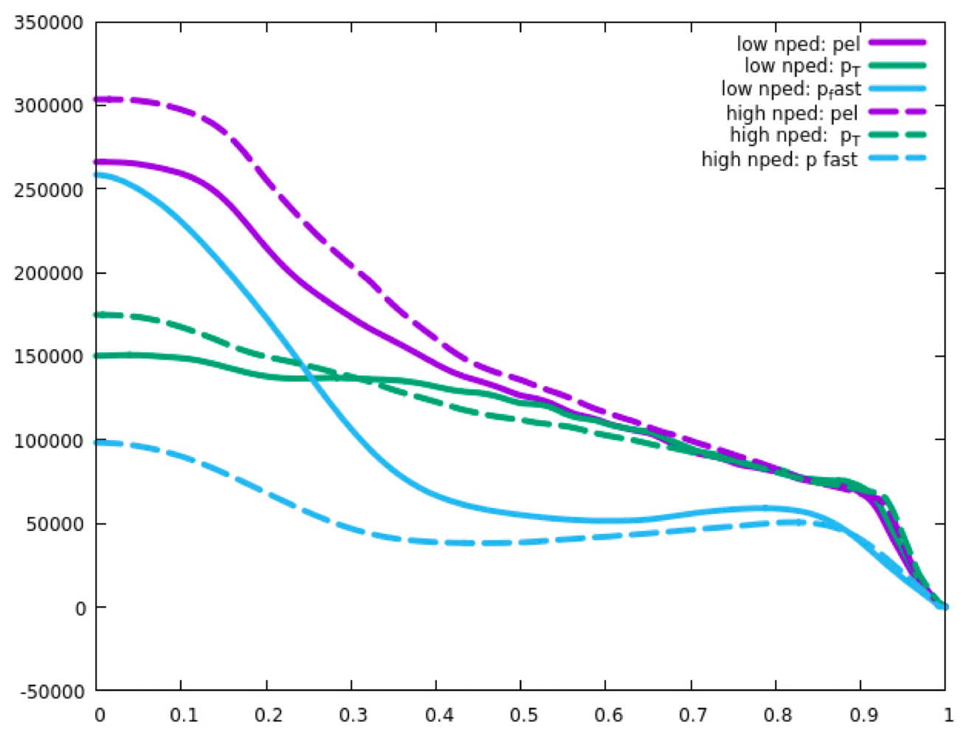
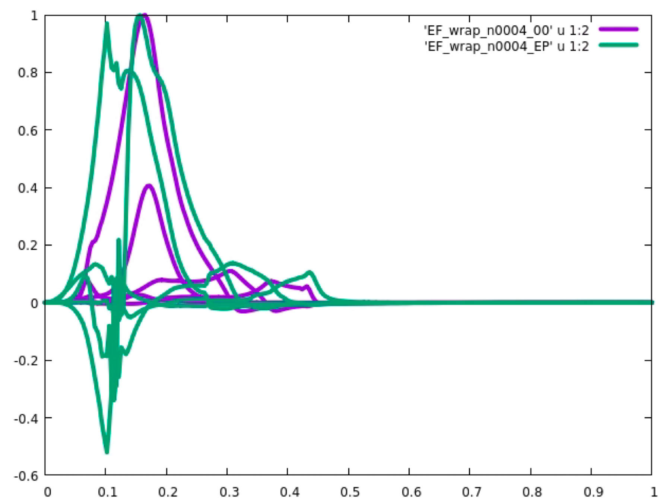
if NBI penetrates: steep gradients of energetic particle pressure
 | VNS | AUG | JET
Vol in m³ | 28 | 13 | 90
P_{NBI}+P_{ICRH}+P_{α} in MW | 42.5+0+6 | 20+5+0 | 30+5+1.4
Power with fast ions / vol. in MW/m³ | 1.7 | <2 | ~0.4
    assess the Energetic Particles (NBI ions and alphas) high pressure gradient stability and control
    energetic particles (NBI+) driving instabilities /EPMs/ avalanches which impact NBI CD efficiency, penetration
Electron pressure
pressure [Pa]
T pressure
e.s. potential
Fast D pressure (without α)
weakly damped RSAE/TAE (no EPs) ~ -1%
ρ_{pol}
unstable TAE/RSAE: growth rate ~+7%
previous VNS cases
-- : P_{fus} = 20 MW - dashed lines
_ : P_{fus}= 28 MW (~ref. ) - solid lines
ρpol
NB: such instability reported to reduce NBI CD on KSTAR [Kim NF2024]
validation on KSTAR foreseen

Slide 10
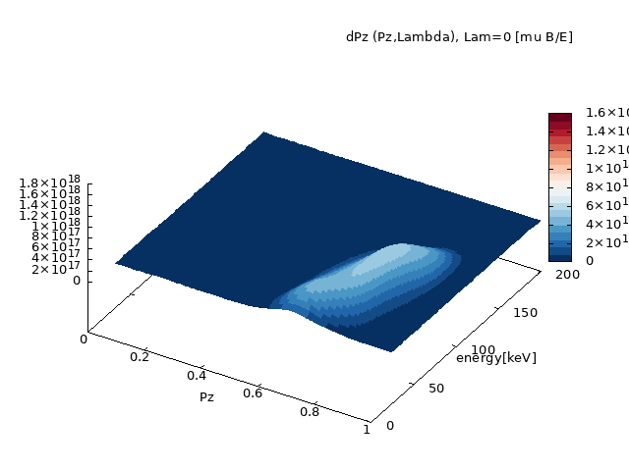
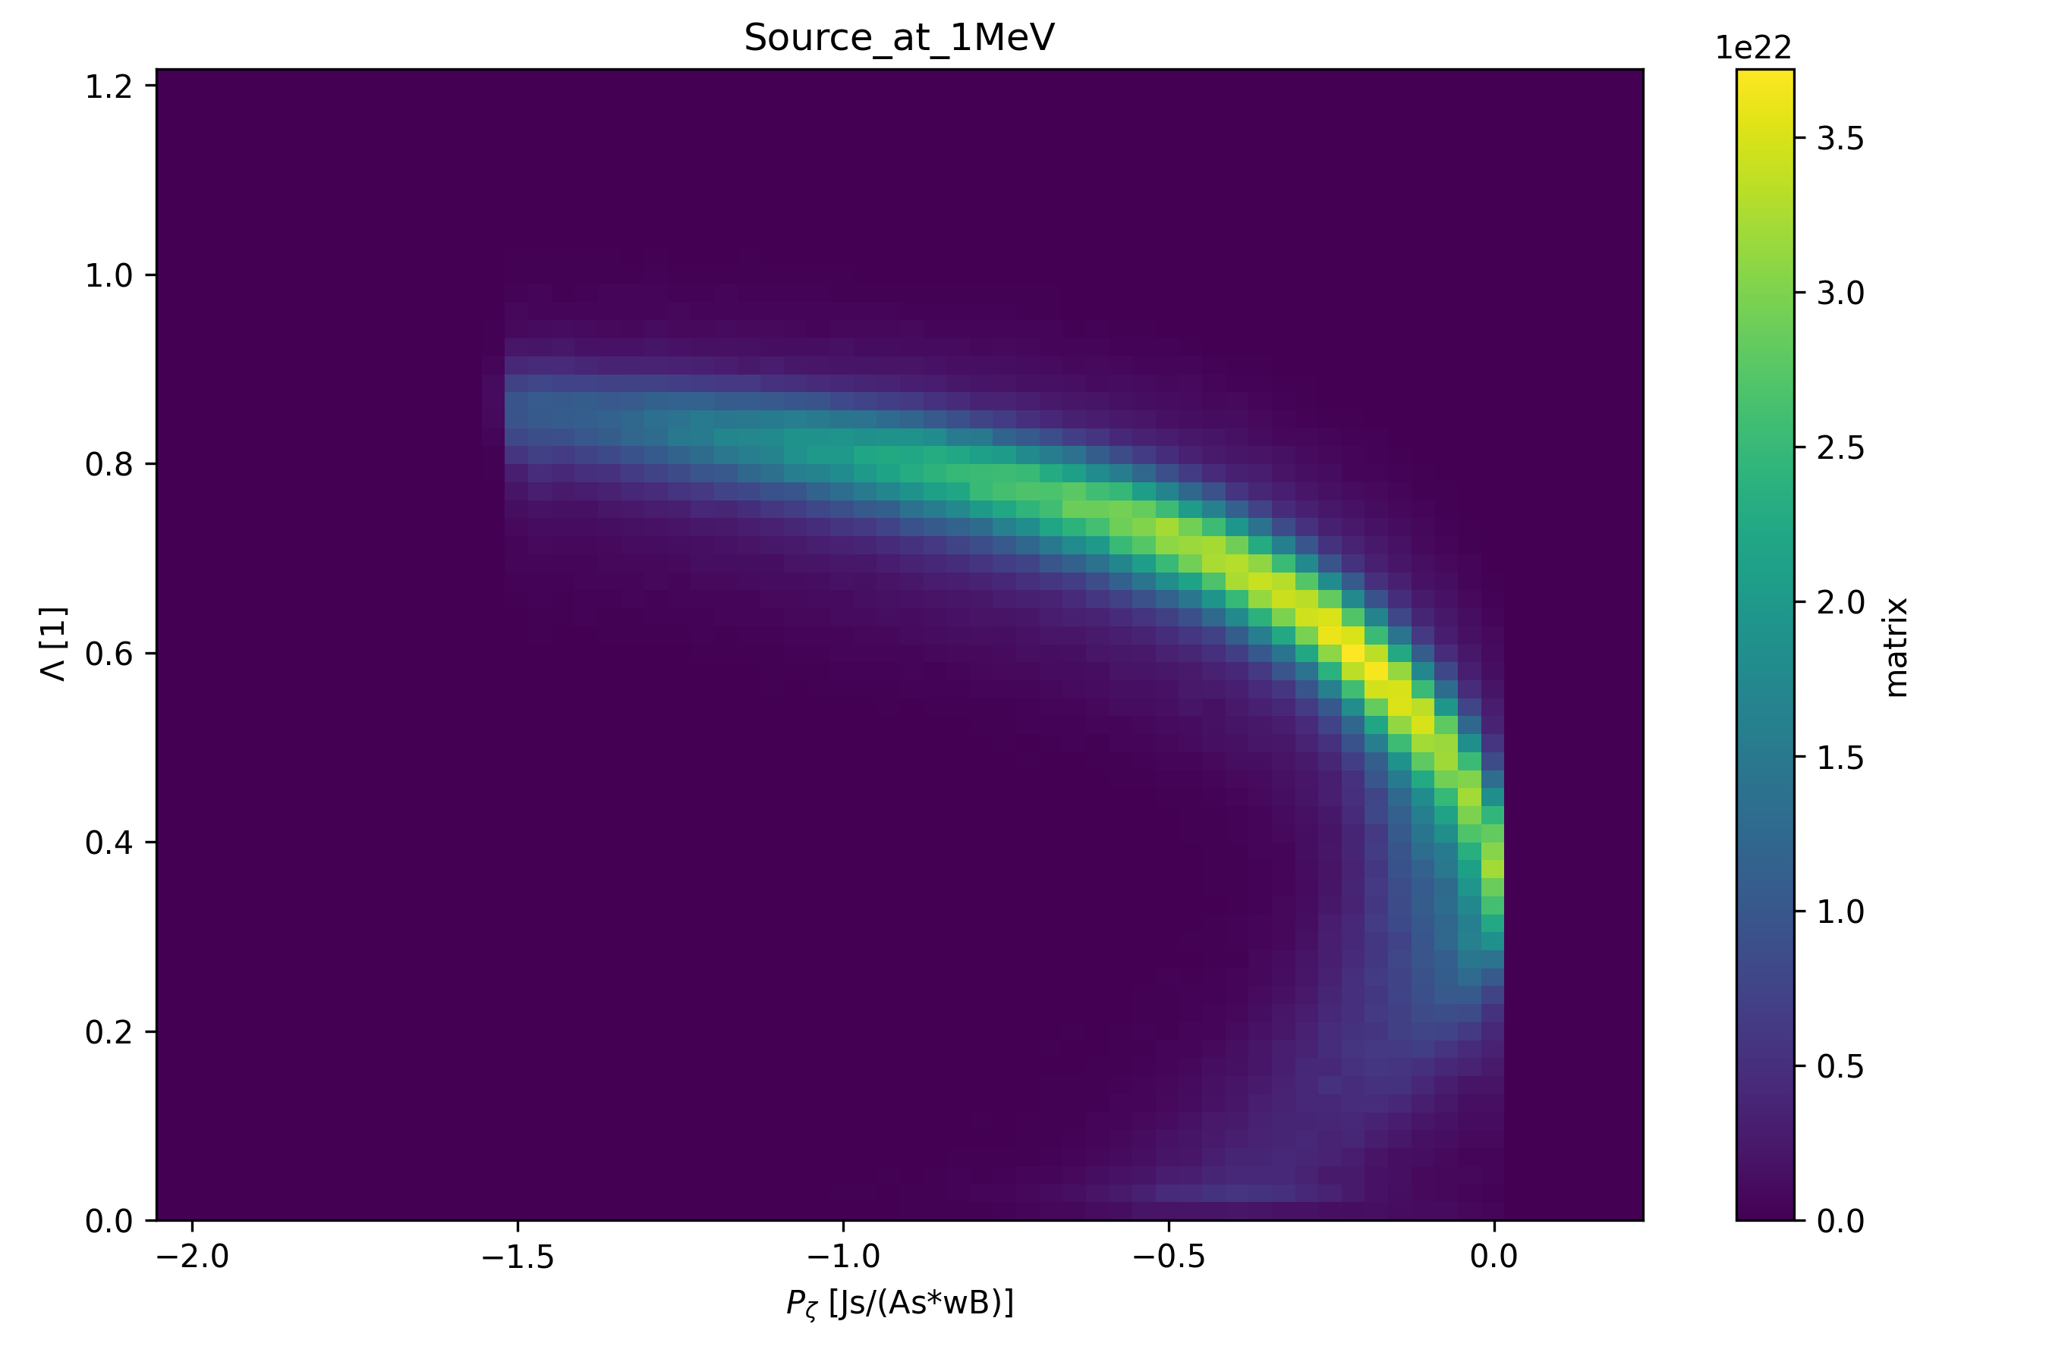
ASCOT- ATEP interface developed:
VNS CoM FNBI as given by ASCOT
recenty: ATEP can use source deposition
(BBNBI) directly [T. Sterkl]:
N-NBI deposition ITER beams @ 1MeV
pitch angle
radial coordinate [Pz]
phase space transport analysis for most unstable AEs/energetic particle modes
multi-modes + different AE types + fishbones + ripple
comprehensive evolution of non-linear equilibria by evolving zonal state
[M.V. Falessi et al, IAEA FEC 2023]
[M.V. Falessi et al, NJP 25 123035 2023]
[Ph. Lauber et al, NF 2024]
[G. Meng et al, NF 2024]

Slide 11
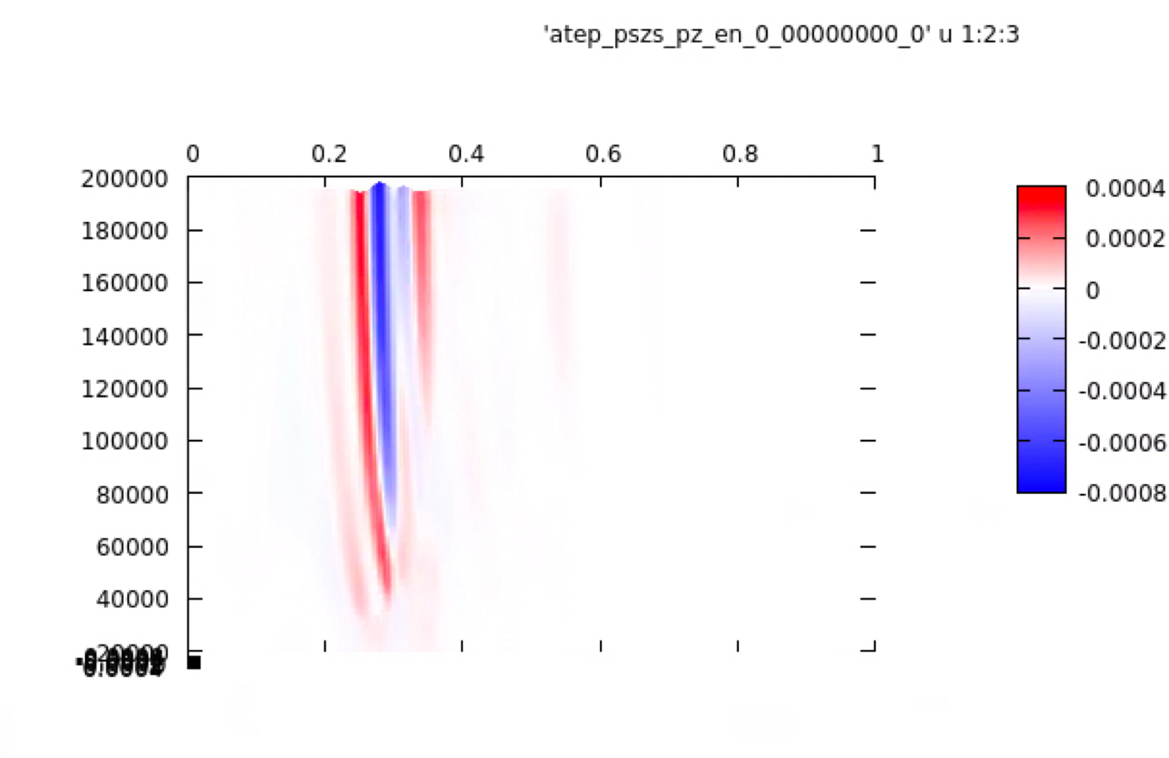
ASCOT- ATEP interface developed:
CoM FNBI as given ASCOT
example: ATEP PSZS fluxes for n=6 TAE modes:
EP flux
energy [eV]
radial coordinate [Pz]
phase space transport analysis for most unstable AEs/energetic particle modes
multi-modes + different AE types + fishbones + ripple
comprehensive evolution of non-linear equilibria by evolving zonal state
[M.V. Falessi et al, IAEA FEC 2023]
[M.V. Falessi et al, NJP 25 123035 2023]
[Ph. Lauber et al, NF 2024]
[G. Meng et al, NF 2024]

Slide 12
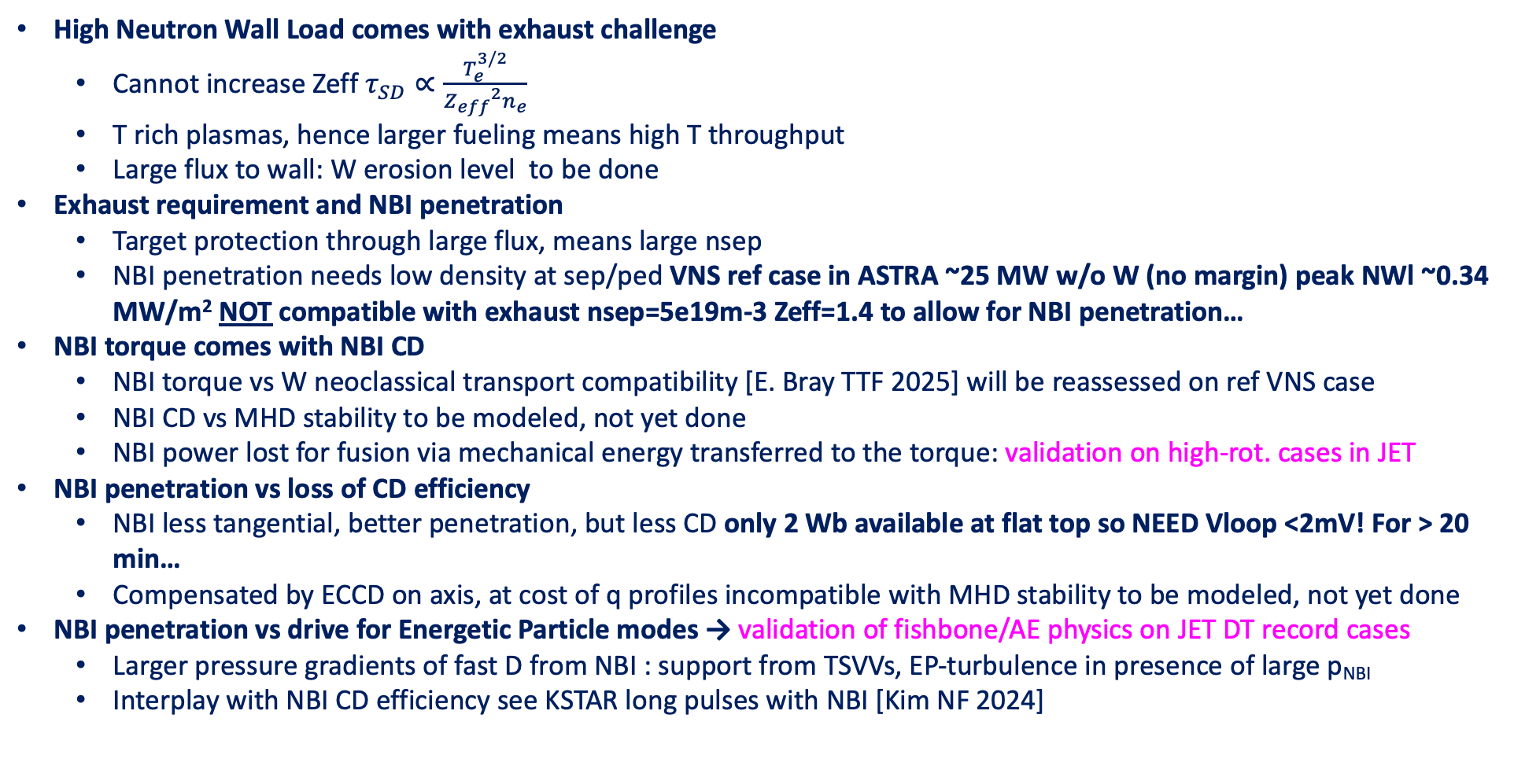
Conclusions & Plasma Science Division proposed actions to support VNS
High Neutron Wall Load comes with exhaust challenge
  Cannot increase Zeff $τ_{SD}∝\frac{T_{e}^{3/2}}{{Z_{eff}}^{2}n_{e}}$
  T rich plasmas, hence larger fueling means high T throughput
  Large flux to wall: W erosion level to be done
Exhaust requirement and NBI penetration
  Target protection through large flux, means large nsep
  NBI penetration needs low density at sep/ped VNS ref case in ASTRA ~25 MW w/o W (no margin) peak NWl ~0.34 MW/m² NOT compatible with exhaust nsep=5e19m-3 Zeff=1.4 to allow for NBI penetration…
NBI torque comes with NBI CD
  NBI torque vs W neoclassical transport compatibility [E. Bray TTF 2025] will be reassessed on ref VNS case
  NBI CD vs MHD stability to be modeled, not yet done
  NBI power lost for fusion via mechanical energy transferred to the torque: validation on high-rot. cases in JET
NBI penetration vs loss of CD efficiency
  NBI less tangential, better penetration, but less CD only 2 Wb available at flat top so NEED Vloop <2mV! For > 20 min…
  Compensated by ECCD on axis, at cost of q profiles incompatible with MHD stability to be modeled, not yet done
NBI penetration vs drive for Energetic Particle modes → validation of fishbone/AE physics on JET DT record cases
  Larger pressure gradients of fast D from NBI : support from TSVVs, EP-turbulence in presence of large p_{NBI}
  Interplay with NBI CD efficiency see KSTAR long pulses with NBI [Kim NF 2024]
SOLPS validation on existing QCE to guide VNS SOL heat/particle transport
On-going uncertainty exploration SOLPS-ITER transport settings
JET T rich D/T mix from SOL to core: Need to be modelled/validated to extrapolate to VNS fuel mix

Slide 14
summary and lessons learned
present high flidelty modelling results falls short of required metrics for VNS’ main mission: 0.5MW/m vs 0.35MW/m;
pulse lenth prediction/availability not yet mature – needs more focused study (NBI/ECCD/...) to recover steady state condition
optimisation of design point and high-fidelity modelling needs to be continued to try to recover nominal NWL/pulse length; assees margins and uncertainties
challenging for VNS, as VNS is a non-perturbative system dominated/determined by NBI (fusion, heating, current drive,profile shaping), different from present day machines and burning plasmas
development of reduced physics-based reduced models need further attention to extrapolate with more confidence
close collabortation of physics and engeneering teams (NBI) remains fundamental for further progress
appropriate resources and support from Eurofusion community will be needed

Slide 15
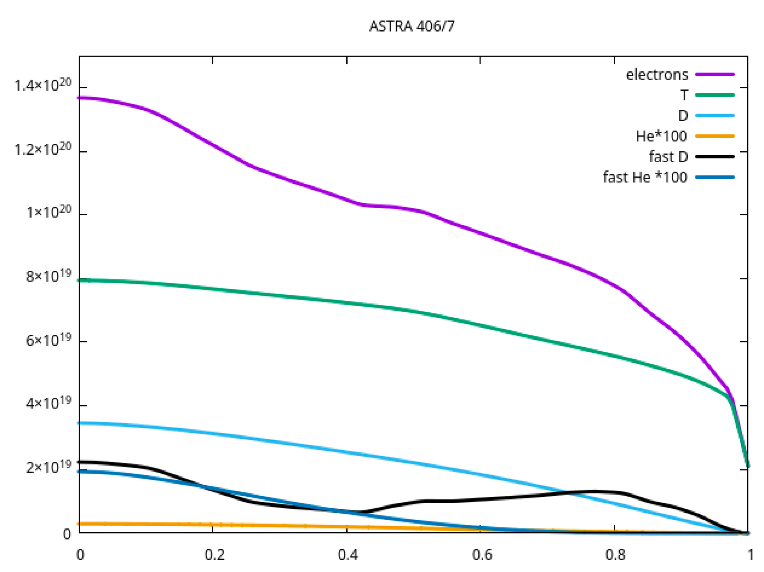
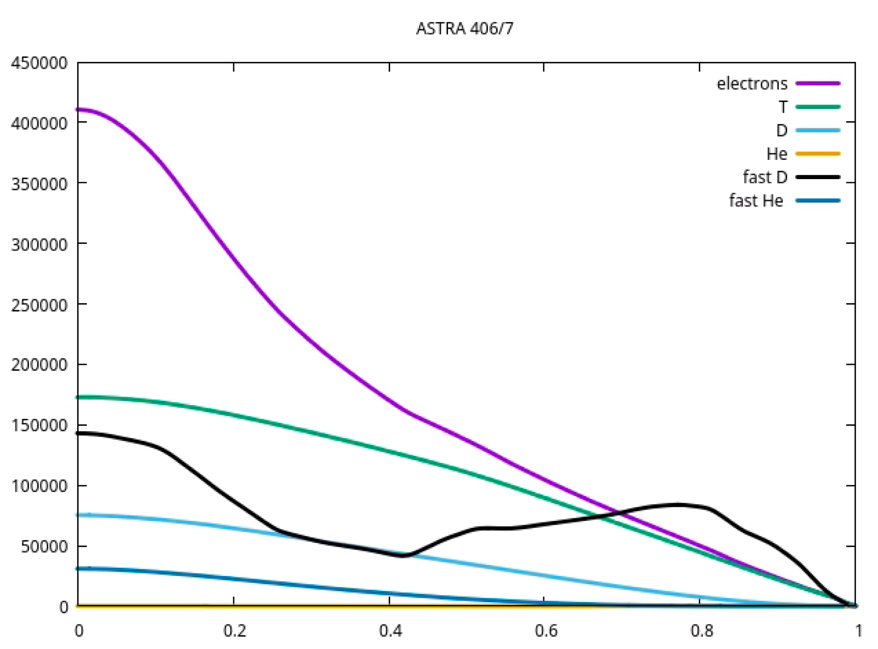
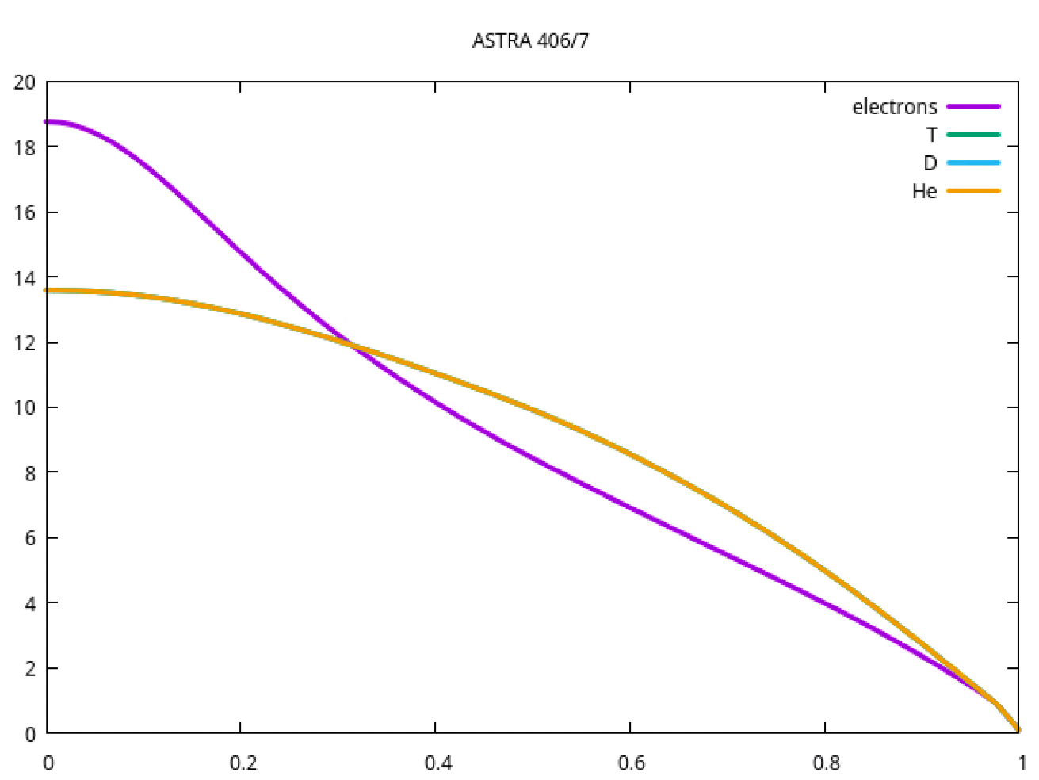
ASTRA profiles (0.5D simulations+ Rabbit)
IMAS IDS 406/7
density[m⁻³]
pressure [Pa]
ρpol
ρpol
lower density than original METIS reference point:
beam penetration marginal with closed density
temperature [keV]
E. Fable
ρpol

Slide 16
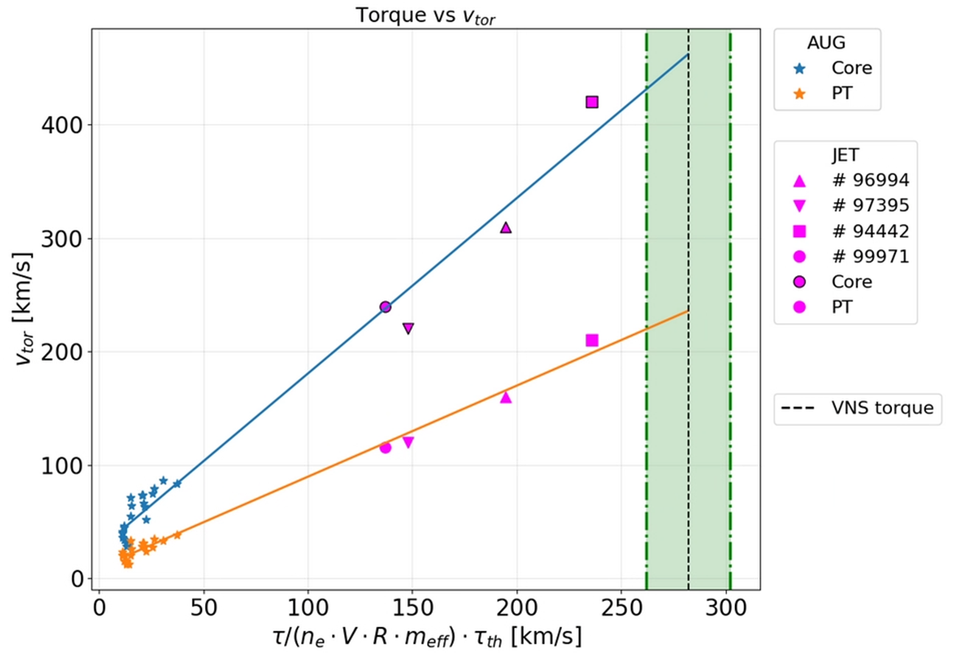
High- rotation cases at JET – close to expected VNS values
significant beam power is ‘lost’ to rotation: lower effective energy of injected ions in the reference frame of the rotating plasma
(inclusion of this effect largely resolves discrepancies between METIS and ASTRA/RABBIT – see A. Quartararo)
however: some differences reported on highly rotating plasmas in JET [Siren EPS 2019]
Is rotation correctly predicted for higher rotation cases #94442?
record beam target

Slide 17
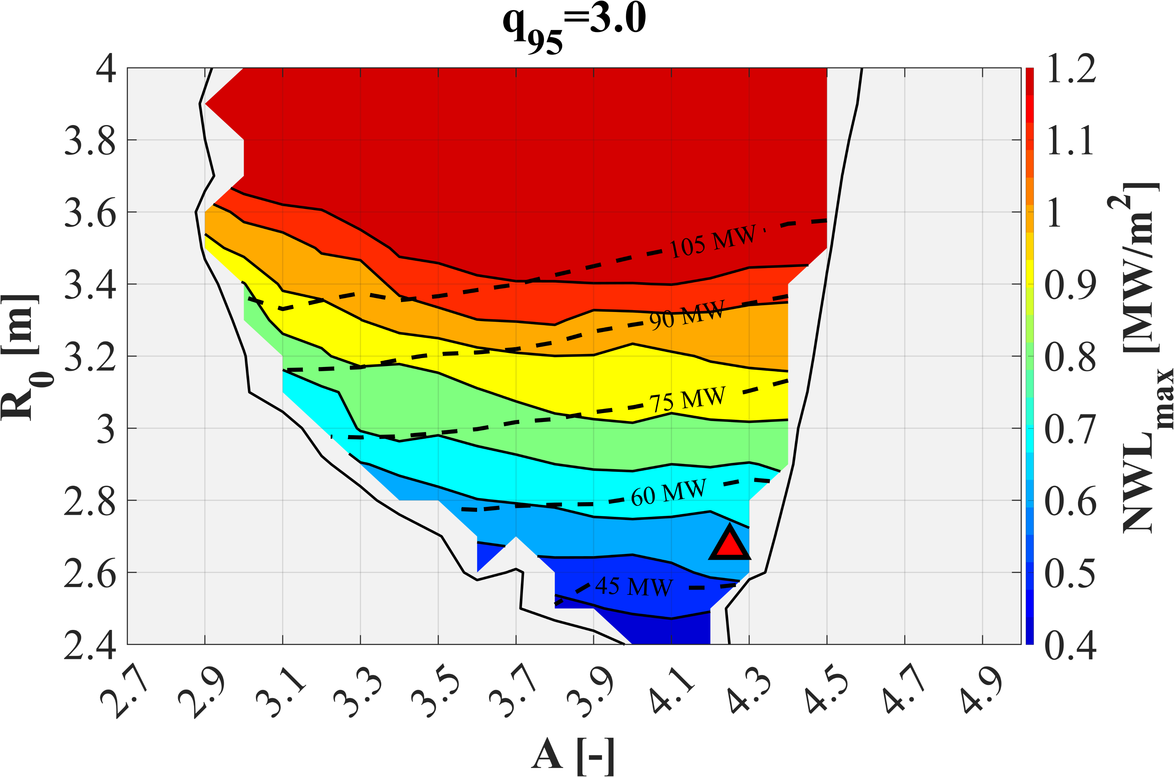
VNS Design Space: constraints
1
2
3
 | Ref. VNS* | 1 | 2 | 3
R₀ [m] | 2.67 | 3.0 | 2.7 | 3.1
A | 4.25 | 4.3 | 3.6 | 3.7
q₉₅ | 3.2 | 3.0 | 3.0 | 3.0
NWL [MW/m²] | 0.51 | 0.89 | 0.62 | 0.92
q’’_{div} [MW/m²] | 80.4 | 126.7 | 88.6 | 131.4
β_{N} [Tm/MA] | 2.7% | 2.9% | 3.2% | 3.0%
P_{NBI} [MW] | 42.5 | 68.1 | 54.3 | 80.2
P_{EC} [MW] | 8.0 | 10.0 | 10.0 | 10.0
P_{fus} [MW] | 38.2 | 79.7 | 52.8 | 100.3
B_{t} [T] | 5.60 | 6.28 | 4.50 | 5.60
I_{p} [MA] | 2.54 | 3.34 | 3.14 | 4.23
T_{cons} [kg/FPY] | 2.13 | 4.44 | 2.94 | 5.59
f_{boot} | 49.6% | 54.5% | 54.9% | 53.4%
f_{GW} | 53.7% | 50.4% | 61.8% | 57.4%
Φ_{cons} [Wb] | 6.7 | 8.8 | 7.8 | 11.3
P_{el.req} [MW] | 175 | 264 | 216 | 306
OPEX [G€] @ 10 dpa | 0.73 | 0.86 | 0.80 | 0.99
CAPEX [G€] @ 10 dpa | 3.30 | 3.57 | 3.28 | 3.60
OPEX+CAPEX [G€] @ 10 dpa | 4.02 | 4.44 | 4.08 | 4.59
Time [years] @ 10 dpa | 8.49 | 4.88 | 7.04 | 4.71
NWL/T_{cons} | 4.18 | 5.00 | 4.78 | 6.08
TBM ports available | 4 | 2 | 3 | 1
fixed n_{e}, k, δ, P_{EC,} Δ_{PW}, Δ_{BB}, Δ_{VV}, etc
METIS/MADE
Φ_{av,CS}= Φ_{RU}
β_{N}>3.3%Tm/MA
No ports for TBM
90 MW NBI
6 ports
3
1
75 MW NBI
5 ports
Plasma equilibrium
2
60 MW NBI
4 ports
NWL_{max}<0.5 MW/m²
45 MW NBI
3 ports
1
: Increase of major radius at fixed A
: Decrease of A at fixed R₀
: Increase of A and R₀ at fixed B₀
2
3
*The current VNS design point has been selected not considering the exact same assumptions.

Slide 18
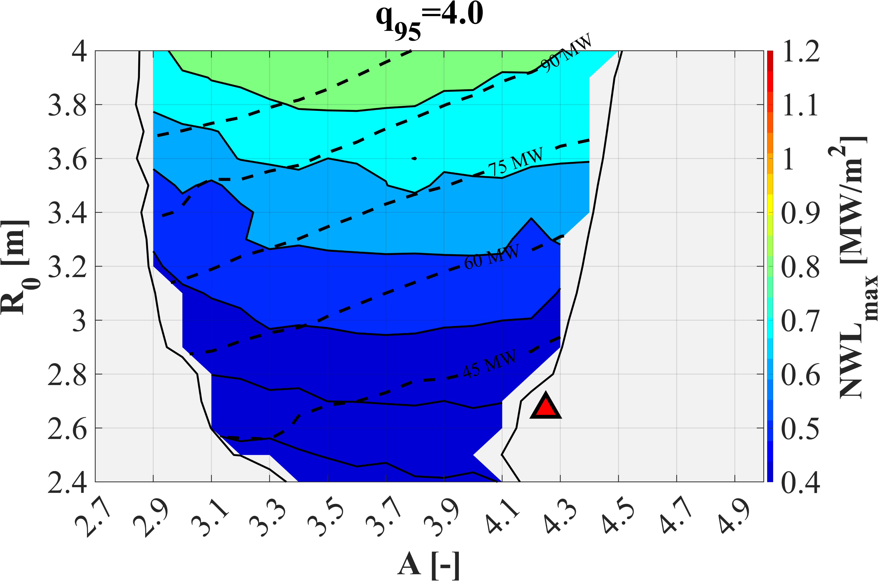
Desing Space Scans
1
 | Ref. VNS* | 1 | 2 | 3
R₀ [m] | 2.67 | 3.0 | 2.7 | 3.1
A | 4.25 | 4.3 | 3.6 | 3.7
q₉₅ | 3.2 | 4.0 | 4.0 | 4.0
NWL [MW/m²] | 0.51 | 0.47 | 0.40 | 0.55
q’’_{div} [MW/m²] | 80.4 | 64.7 | 54.0 | 70.7
β_{N} [Tm/MA] | 2.7% | 2.4% | 2.8% | 2.5%
P_{NBI} [MW] | 42.5 | 47.9 | 45.0 | 60.0
P_{EC} [MW] | 8.0 | 10 | 10 | 10
P_{fus} [MW] | 38.2 | 41.75 | 33.91 | 59.42
B_{t} [T] | 5.60 | 6.38 | 4.69 | 5.78
I_{p} [MA] | 2.54 | 2.52 | 2.49 | 3.29
T_{cons} [kg/FPY] | 2.13 | 2.33 | 1.89 | 3.31
f_{boot} | 49.6% | 58.2% | 59.8% | 59.4%
f_{GW} | 53.7% | 66.9% | 78.0% | 73.7%
Φ_{cons} [Wb] | 6.7 | 7.4 | 6.5 | 9.2
P_{el.req} [MW] | 175 | 194 | 184 | 236
OPEX [G€] @ 10 dpa | 0.73 | 0.82 | 0.83 | 0.92
CAPEX [G€] @ 10 dpa | 3.30 | 3.44 | 3.21 | 3.46
OPEX+CAPEX [G€] @ 10 dpa | 4.02 | 4.26 | 4.04 | 4.38
Time [years] @ 10 dpa | 8.49 | 9.31 | 10.79 | 7.85
NWL/T_{cons} | 4.18 | 5.00 | 4.71 | 6.00
TBM ports available | 4 | 3 | 4 | 3
2
3
Contour: NWL_{max} values
Dashed isolines: NB power required
No ports for TBM
90 MW NBI
6 ports
Plasma equilibrium
75 MW NBI
5 ports
60 MW NBI
4 ports
1
NWL_{max}<0.5 MW/m²
3
3
1
2
2
n_{e}>n_{Gr}
Comparison between current VNS design and three candidate alternative points @q₉₅=4.0.
: Increase of major radius at fixed A
: Decrease of A at fixed R₀
: Increase of A and R₀ at fixed B₀
1
*The current VNS design point has been selected not considering the exact same assumptions.
2
3

Slide 19
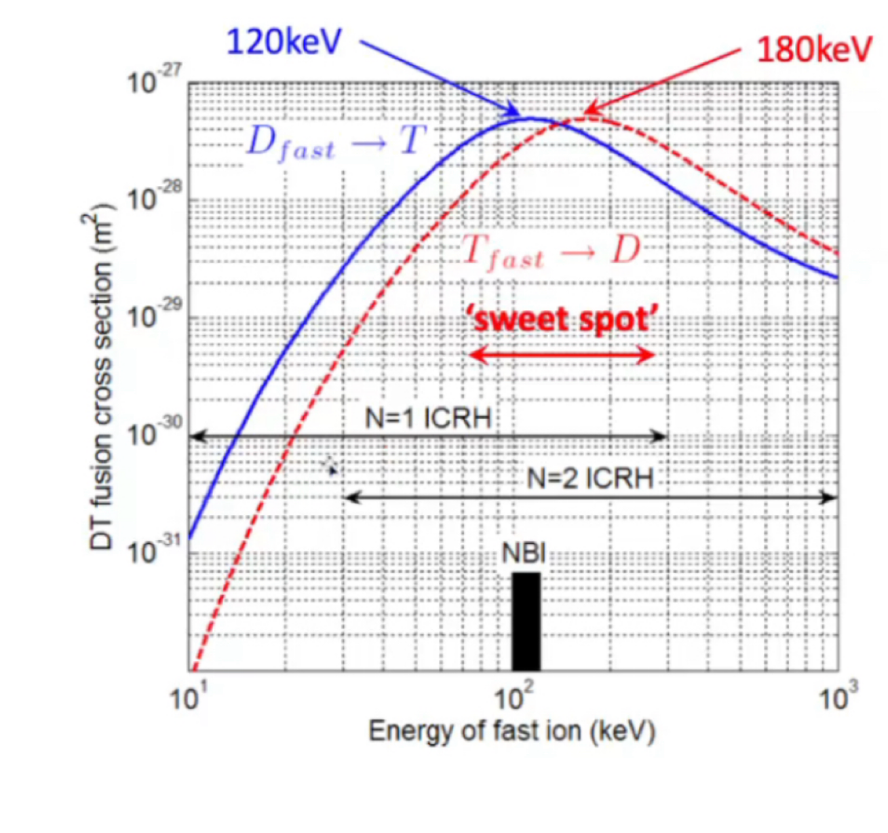
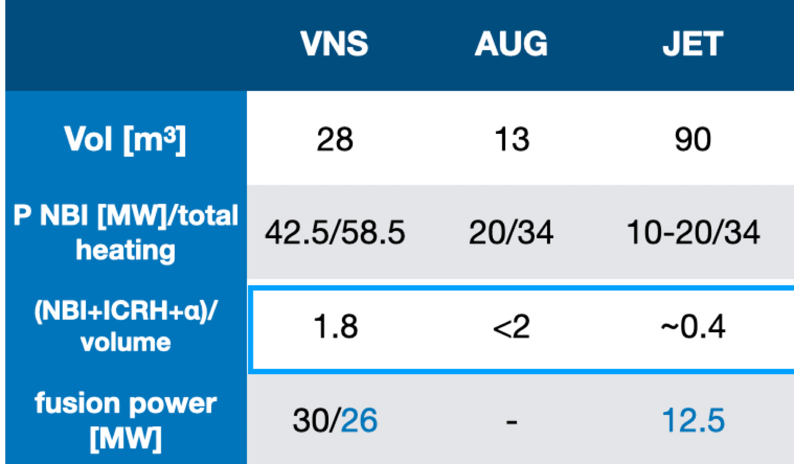
VNS: strongly driven system, large EP fraction
physics principle well known, e.g. recent JET experiments, 12.5MW record [M Maslov, 2025]
VNS: D beam in T plasma; slow down of beam ions on thermal T ions - maximise D-T reactions
~120 keV is sweet spot, accessible with PNBI technology
Te(0) needs to be ≳10keV: Ecrit ~220keV
beam target
fusion cross section
$$P_{beam−target}=f_{T}n_{D−beam}n_{e}<σv>_{beam}E_{DT}$$
$$P_{thermonuclear}=f_{T}(1−f_{T})n_{e}^{2}<σv>_{therm}E_{DT}$$
challenge: minimise dilution of T plasma with D beam, control
n, T, EP, impurity, rotation profiles to maximise neutron wall load, while protecting divertor
→ integrated modelling; challenge: outside well tested parameter range

Slide 20
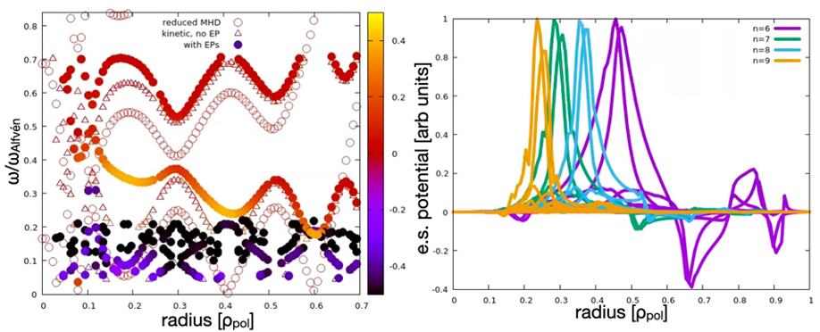
EP-Stability Workflow: preliminary TAE stability assessment
low-medium n Alfvén eigenmodes expected to be most unstable (n=4-12)
TAE
mode structures
modes will be likely unstable - is the related transport small enough to be tolerable
for NWL and current drive? (JET, AUG experiments show small/moderate transport )

Slide 21
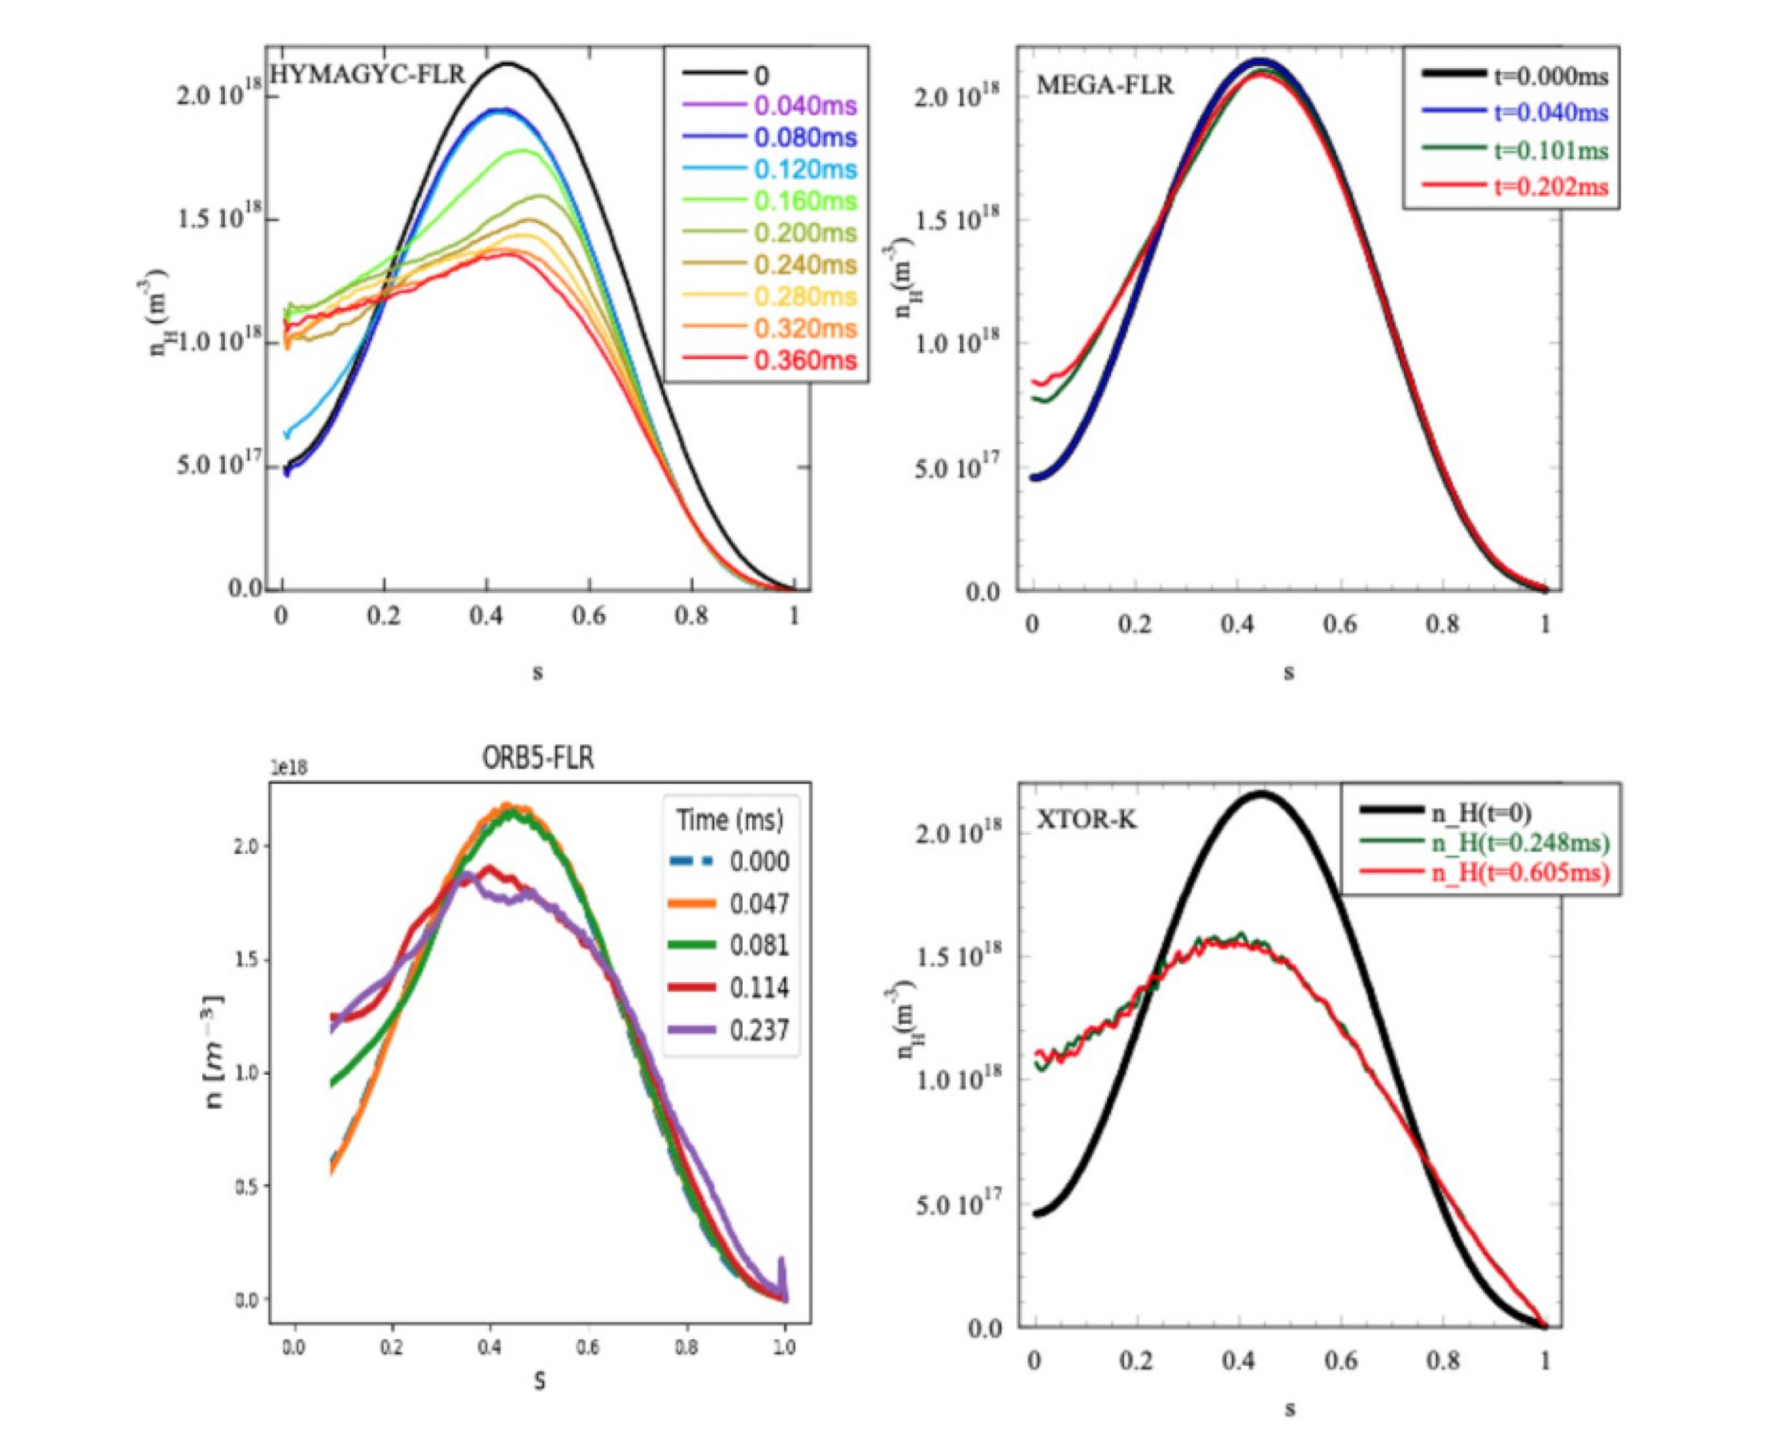
use high-fidelity non-linear codes to benchmark saturation and transport
[G. Vlad et al RMPP (2025) 9:27]
NLED-AUG reference case:
https://pwl.home.ipp.mpg.de/NLED_AUG//data.html
here: EPMs redistribute beam
density considerably
(note: here off-axis case leads to inward transport)
ORB5 analysis planned for VNS
[T Hayward-Schneider]
will allow us to assess possible NWL reduction
importance of zonal currents to be determined [fundamental studies on burning plasmas; WPDES M. Falessi]

Slide 22
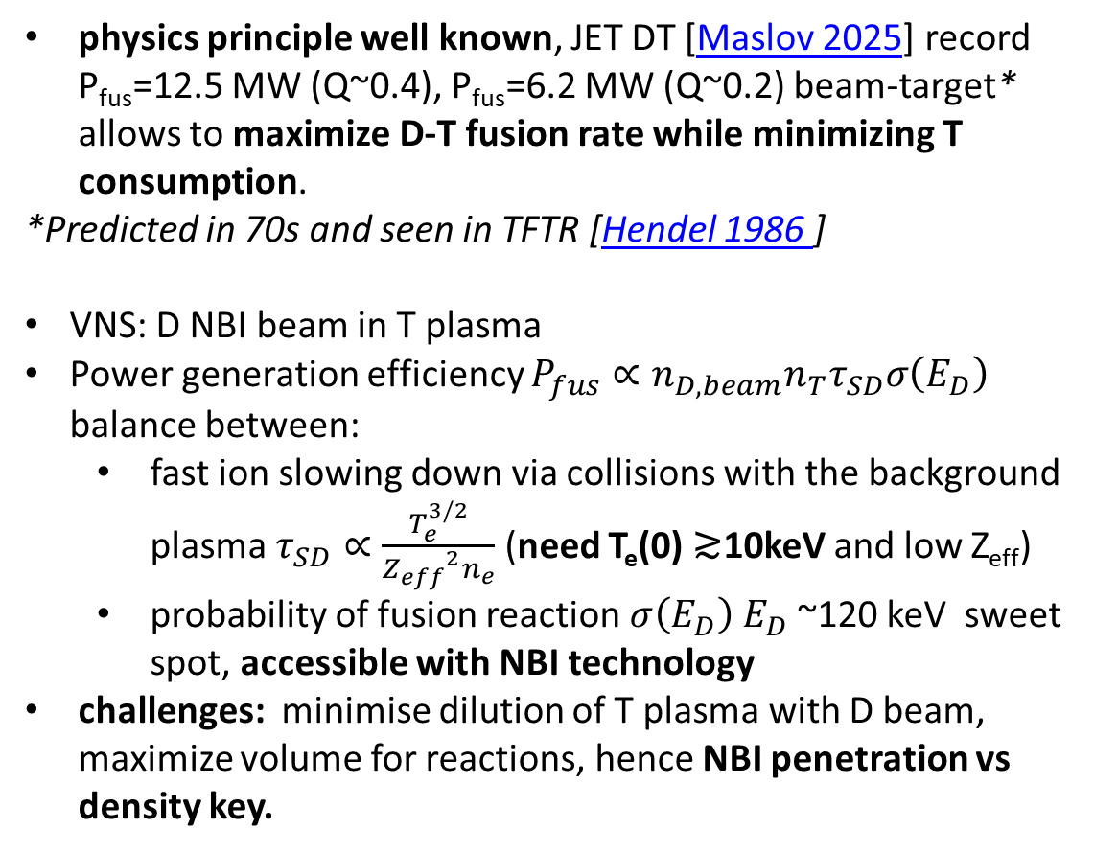
Beam-Target to maximize NWL and minimize T consumption
physics principle well known, JET DT [Maslov 2025] record P_{fus}=12.5 MW (Q~0.4), P_{fus}=6.2 MW (Q~0.2) beam-target* allows to maximize D-T fusion rate while minimizing T consumption.
*Predicted in 70s and seen in TFTR [Hendel 1986 ]
VNS: D NBI beam in T plasma
Power generation efficiency $P_{fus}∝n_{D,beam}n_{T}τ_{SD}σ\left(E_{D}\right)$ balance between:
  fast ion slowing down via collisions with the background plasma $τ_{SD}∝\frac{T_{e}^{3/2}}{{Z_{eff}}^{2}n_{e}}$ (need T_{e}(0) ≳10keV and low Z_{eff})
  probability of fusion reaction $σ\left(E_{D}\right)$ $E_{D}$~120 keV sweet spot, accessible with NBI technology
challenges: minimise dilution of T plasma with D beam, maximize volume for reactions, hence NBI penetration vs density key.
beam target
fusion cross section
Need integration of NBI sources
with T_{e}(ρ) n_{e}(ρ) prediction

