Slide 1
WP PWIE SPE kick-off meeting
29.5.2026
Jari Likonen
VTT

Slide 2
SP E focus points in 2026
I: LIBS at JET → SP E.1
II: 2 Post-mortem analysis of JET DTE3 samples → SP E.2

Slide 3
SP E resources in 2026
Deliverable Owner | Beneficiary | PM
P. Veis | CU | 4
S. Almaviva | ENEA | 3
T. Dittmar/R. Yi | FZJ | 14
E. Grigore | IAP | 9
P. Gasior | IPPLM | 2
J. Butikova/E. Pajuste | ISSP-UL | 9
N. Catarino | IST | 5
A. Lagoyannis | NCSRD | 2
P. Paris | UT | 4
D. Primetzhofer | VR | 3
J. Likonen | VTT | 13
Total |  | 68
II: 2 Post-mortem analysis of JET DTE3 samples → SP E.2
Device | Beneficiary | Days
Accelerator | IST | 10
Accelerator | NCSRD | 3
Accelerator | VR | 3
Accelerator | VTT | 2
Deliverable Owner | Beneficiary | PM
E. Zayachuk | UKAEA | 25
Total |  | 25

Slide 4
2026 SP E Tasks and Deliverables
SPE 2026-2027 activities cover preparations, cutting, and analysis of components in WP-PWIE laboratories
and UKAEA of dedicated post DTE3 samples.
Activity | Deliverable ID(s) | Task Title
SP E.1 | D001-D007 | Spectral analysis, composition of co-deposited layers, fuel content and CF LIBS. Participation in the LIBS experiment at VTT (CU, ENEA, FZJ, IPP_LM, ISPP_UL, UT, VTT)
SP E.2 | D00A-D00C | Transfer from 2025: Sectioning and preparation of samples from limiter and CFC divertor tiles. Distribution of samples to other laboratories. Metallography of Be castellation and W lamellae samples. (VTT, IAP, FZJ)
SP E.2 | D001 | Sectioning and preparation of samples from CFC divertor tiles. Distribution of samples to other laboratories. Characterization of JET plasma facing components using HIERDA, LIBS, SIMS and TDS. (VTT)
SP E.2 | D002 | Sectioning and preparation of samples from metallic components. Distribution of samples to other laboratories. Analysis of JET plasma facing components with TDS and GDOES. (IAP)
SP E.2 | D003 | Provision of DTE3 divertor and limiter tiles. Electron microscopy (SEM, TEM, FIB) and metallography of metallic PFCs (Be limiter tiles, W lamellae); characterization of JET plasma facing components with TDS.(UKAEA)
SP E.2 | D004 | Characterization of JET plasma facing components with LIBS, LID-QMS, TDS and metallography (FZJ)
SP E.2 | D005 | Analysis of JET plasma facing components with TDS, FC and dissolution method (ISSP-UL)
SP E.2 | D006 | Characterization of JET plasma facing components using ion beam analysis (RBS, NRA) (IST)
SP E.2 | D007,D008 | Characterization of JET plasma facing and diagnostics components using ion beam analysis RBS, NRA, HIERDA, μbeam NRA) (NCSRD, VR)

Slide 5
SP E program in 2026
LIBS experiment at VTT using the JET LIBS setup (April 2026)
Data analysis of VTT LIBS experiment
Data analysis of JET LIBS experiment
Post-mortem analysis (LIBS, TOF-SIMS, NRA) of W lamellae (B12, C12, A12, D12) before cutting
Shipment of W lamellae to IAP for cutting (16 pcs), DONE
Samples (W, divertor) available in September
Shipment of divertor tiles to VTT
  HFGC 14N RH (2018-‘23)
  14IW G1A (2018-‘23)
  2IW G1B (2011-‘23)
  14BW G4A (2011-‘23)
  Type A container at VTT will be available in June
  Container will be leak-tested at Croft and then delivered to UKAEA
  Coring at VTT in August-September
Shipment and cutting of bulk Be tiles not yet scheduled
II: 2 Post-mortem analysis of JET DTE3 samples → SP E.2

Slide 6
SPE.1
SP E.1 - LIBS at JET

Slide 7
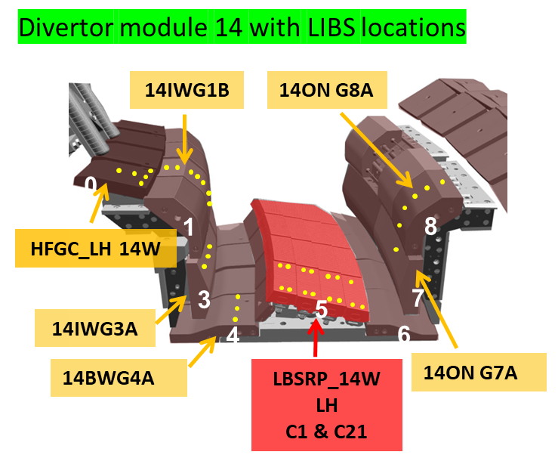
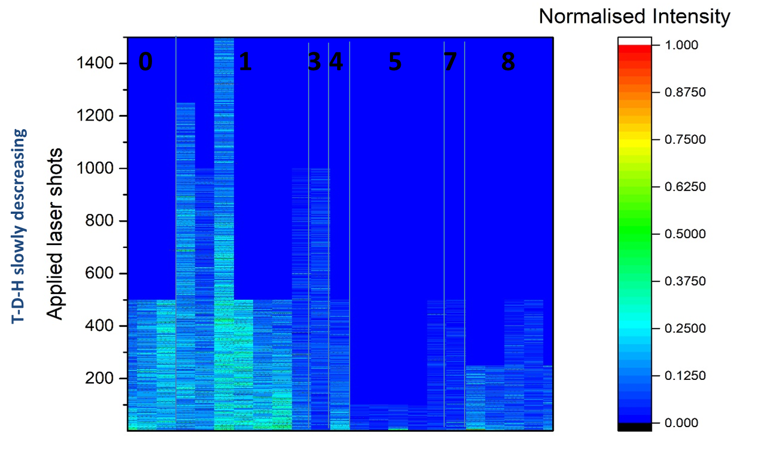
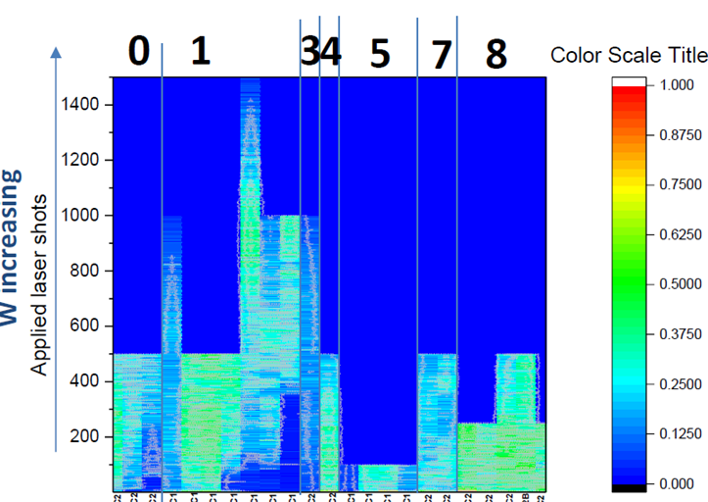
Example of Activity SP E.1: In-vessel LIBS system in JET: H in Be layers
Beryllium
Erosion and deposition pattern in JET
measured with ps-LIBS in W divertor
General pattern in agreement with previous post-mortem analysis
S. Almaviva et al.
PFCM2025
J. Likonen et al.
NME 2025
R. Yi et al.
NME 2025
Transfer to ITER (diagnostic candidate):
Diagnostic and technological capability shown in JET
”Static” LIBS in WEST in preparation
(development under WPTE)
T. Wauters: Memo LIBS on ART (Agile Robot Transporter)
LIBS on ART addresses central ITER risk, complements existing diagnostic systems
Hydrogen Isotopes
Tungsten
S. Almaviva (ENEA)

Slide 8
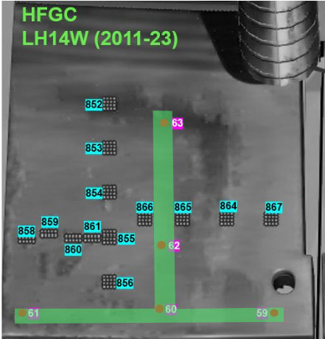
Littrow results in the LID-QMS region (Module 14)
Quantitative analysis is on-going, but ratio should be very accurate
R. Yi (FZJ)

Slide 9

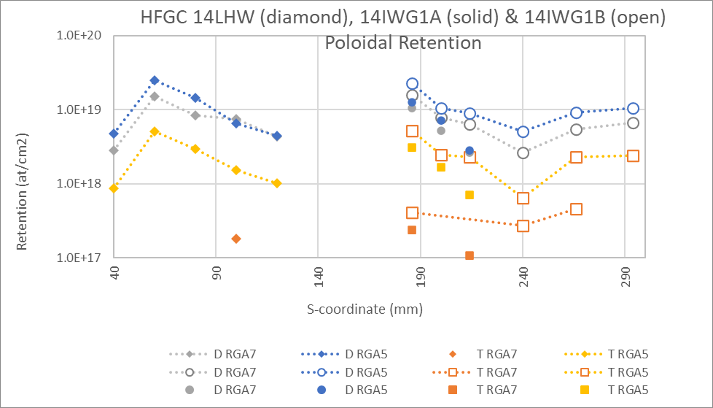
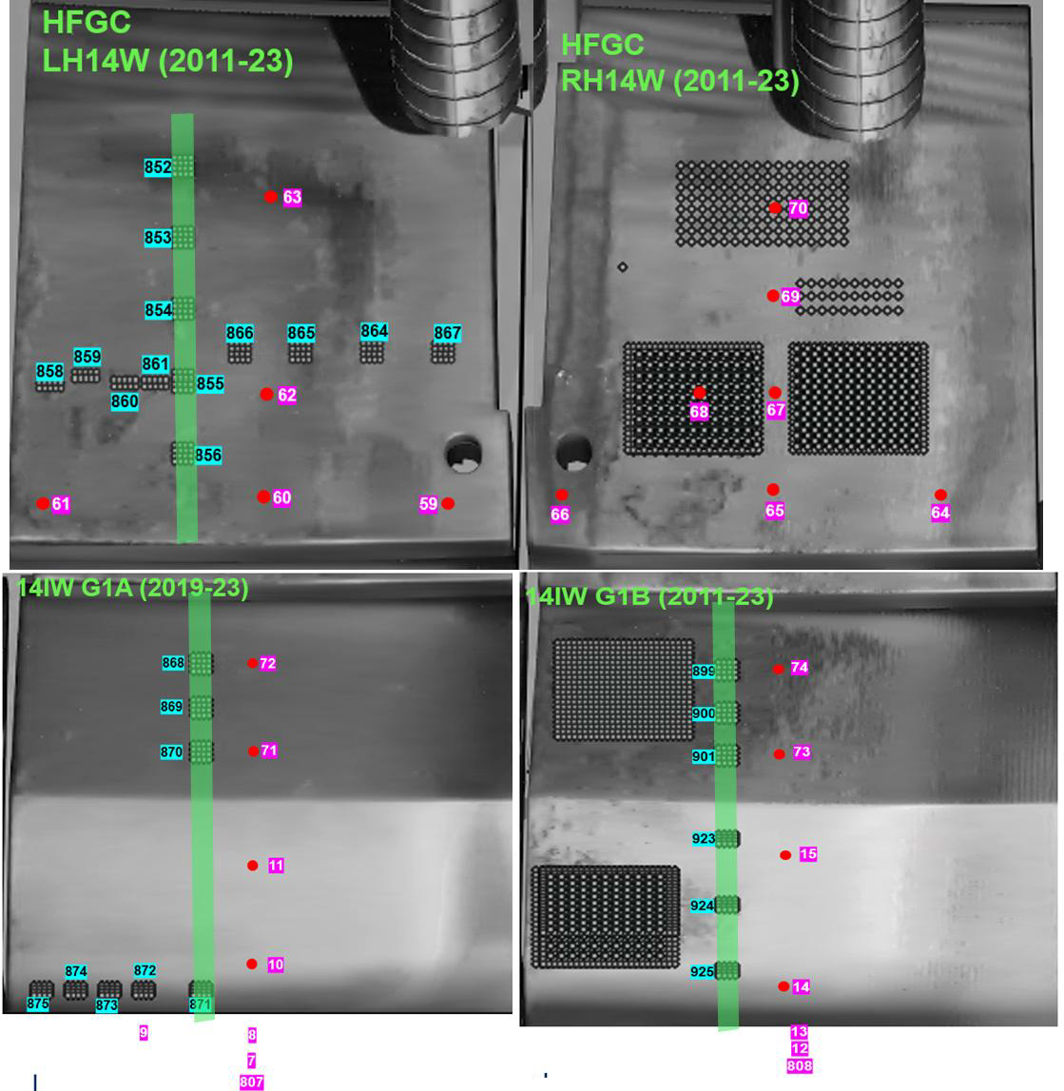
LID-QMS areal fuel retention at end of JET
operations 19 & 20 December 2023
Assumptions:
AMU4 calibration factor used for AMUs
19/12/2023 AMU4 calibration factor used for 20/12/2023 data points
Calibration = Jump method
1
| A. Widdowson & I. Jepu | LIBS & LID-QMS JET Analysis Meeting | 9-12 Dec 2025

Slide 10
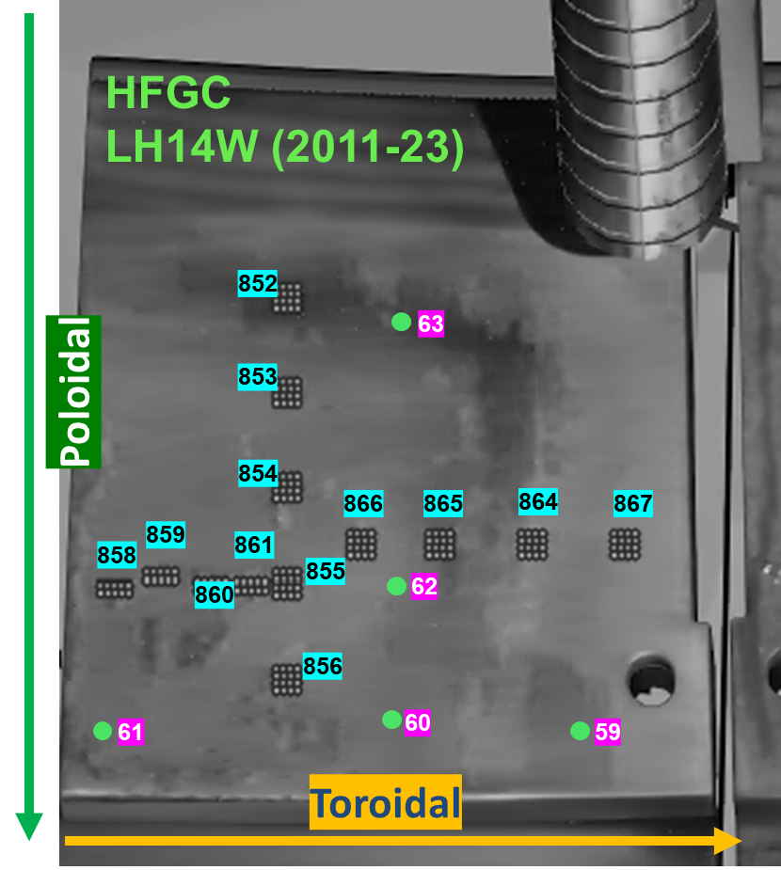
Calibration free LIBS points at JET HFGC point 60 and 61
HFGC LH14W the H-D-T atomic % was measured to be 5-10% (except for point 62)
H-D-T(at/cm²) ≈ 3-6·10¹⁸ at/cm² in a pure W layer of known thickness 10 μm
H-D-T (at/cm²) ≈ 4.5-9·10¹⁸ at/cm² in a 10 μm mixed layer (α = 0.5)
H-D-T (at/cm²) ≈ 0.6-1.2·10¹⁹ at/cm² in a pure Be layer of known thickness 10 μm
Agreement between LID-QMS and LIBS good
S. Almaviva (ENEA)

Slide 11
2026 Plans of SP E.1

Slide 12
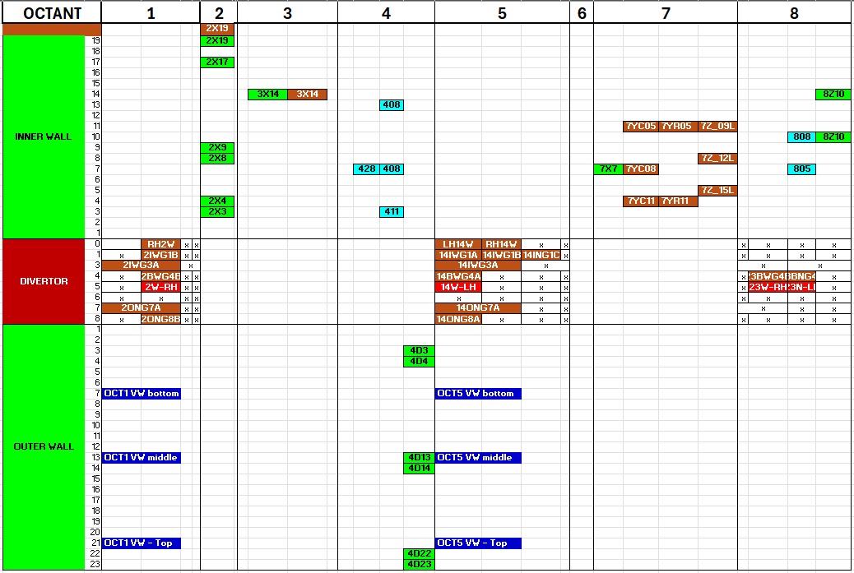
SP E.1 LIBS Activities 2026: LIBS full distribution map
402
Poloidal direction
840 locations
Bulk Be
W – coated CFC
Be coated inconel
Bulk W
Inconel (vacuum vessel)
Toroidal direction

Slide 13
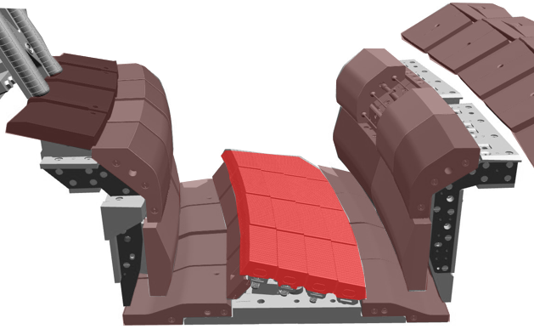
SP E.1 LIBS Activities 2026: LIBS full distribution map
402
0
1
1
8
3
5
7
4
6
PFMC contributions
Poloidal direction
840 locations
Bulk Be
W – coated CFC
Be coated inconel
Bulk W
Inconel (vacuum vessel)
Toroidal direction

Slide 14
SP E.1 LIBS Activities 2026
Divertor poloidal assessment (partially/fully completed)
Tile |  |  | Initial Pulse no. |  |  | Additional pulse no.(relatively same location)
HFGC (LH 14W) |  |  | 59 – 63 |  |  | 777 – 780
Tile 1 (14IW G1B) |  |  | 808; 12 – 15; 73 – 74 |  |  | 786 (a repeat of 74)
Tile 3 (14IW G3A) |  |  | 809 – 811 |  |  | Same as above
Tile 4 (14BW G4A) |  |  | 75 – 77 |  |  | 787 – 788
Tile 5 LBSRP_14WLH | C1 | Stack A | 20 |  | 20 | 765
 |  | Stack B | 23 |  | 23 | 766
 |  | Stack C | 26 |  | 26 | 768
 |  | Stack D | 29 |  | 29 | 769
 | C21 | Stack A | 40 |  | 40 | 770
 |  | Stack B | 43 |  | 43 | 771
 |  | Stack B (C12) |  |  | 34
 |  | Stack C | 46 |  | 46 | 773
 |  | Stack D | 49 |  | 49 | -
Tile 6 |  |  | NO LIBS on T6 | NO LIBS on T6 |  | NO LIBS on T6 | NO LIBS on T6
Tile 7 (14ON G7A) |  |  | 805 | 805 |  | - | -
Tile 8 (14ON G8A) |  |  | 802; 54; 57 | 802; 54; 57 |  | 775 (between 54 and 57) | 775 (between 54 and 57)
Tile 8 (2ON G8B) |  |  | 360 & 368 | 360 & 368 |  | No repeated pulses | No repeated pulses
Top of tile 8 (14ON G8A) |  |  | 51 | 51 |  | - | -
Common area with LID-QMS experiment
14IWG1B
14ON G8A
0
HFGC_LH 14W
1
1
8
3
5
7
14IWG3A
4
6
14BWG4A
LBSRP_14W LH
C1 & C21
14ON G7A
part of PFMC contributions

Slide 15
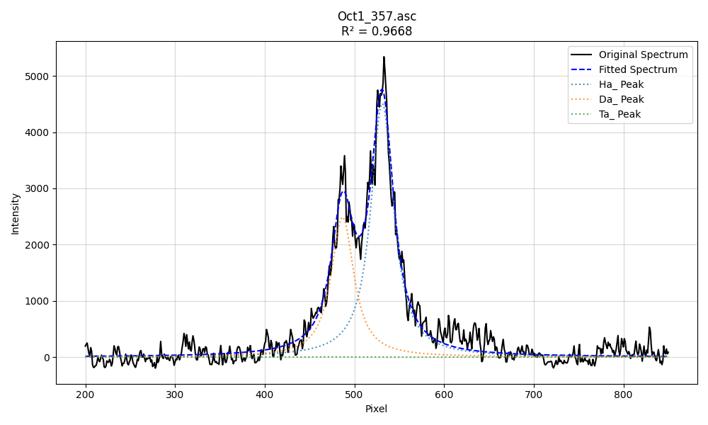
SP E.1 LIBS Activities 2026: LIBS full distribution map
402
Poloidal direction
840 locations
Aryelle
Littrow
D_{α}
H_{α}
Bulk Be
Ni,Fe,Cr
W – coated CFC
Be coated inconel
Bulk W
Inconel (vacuum vessel)
Toroidal direction

Slide 16
SP E.1 LIBS Activities 2026: LIBS full distribution map
Aryelle
402
Poloidal direction
840 locations
Bulk Be
W – coated CFC
Be coated inconel
Bulk W
Inconel (vacuum vessel)
Toroidal direction

Slide 17
SP E.1 LIBS at JET in 2026
Data analysis meetings on a monthly basis (18 already organized)
Next steps
Calibration free LIBS of divertor Mod 14 locations
Outer poloidal limiter tiles 4D04, 4D13, 4D22 (and 4D04, 4D14, 4D23 if time)
Inner wall guar limiter tiles 3X14 (RE damage), 2X3, 2X9, 2X17 (and 2X3, 2X8, 2X19 if time) , 7Y, 7Z, 8Z, IWP
Main wall Oct1 and Oct 5
Divertor Mod 2 locations
Divertor Mod 23 locations
2nd joint LID-QMS/LIBS meeting
1st meeting at ENEA, Frascati on Dec 9-12 2025
PSI-27, May 2026
Jepu (UKAEA), Likonen (VTT), Paris (UT), Sergienko (FZJ), Veis (CU)

Slide 18
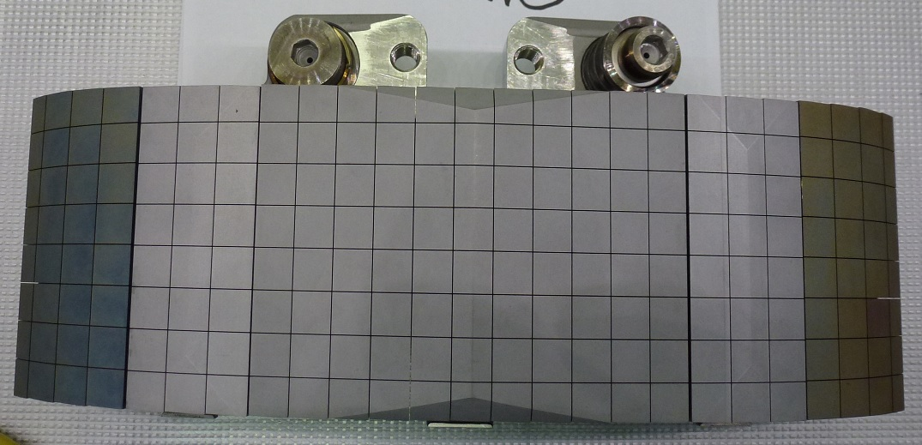
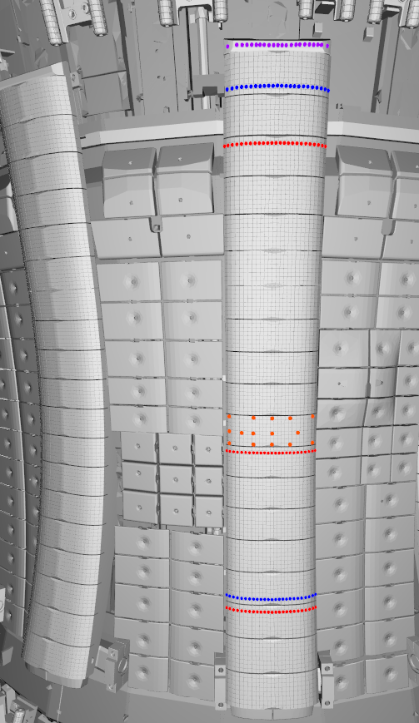
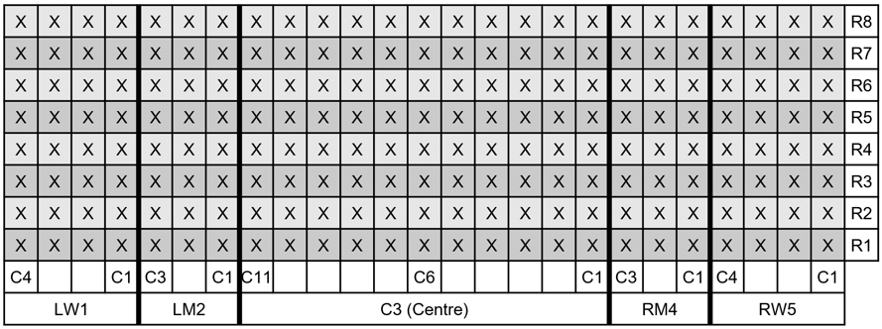
SP E.1 IWGL – 2X beam
IWGL tile layout (each IWGL is made of 5 individual tile blocks)
2X
2X19 Top tile
2X19
1Z
For ref.
LW1
LW1 – Left Wing 1
LM2 – Left intermediate 2
C3 – Centre 3
RM4 – Right intermediate 4
RW5 – Right Wing 5
LM2
C3
RM4
RW5
2X17
LIBS locations for 2X9 – full tile scan
R1 to R8
Full scan
2X9
2X8
Rows R2, R4,
R6 and R8
scanned
2X4
2X3
Not all 100 locations will be analysed

Slide 19
2026 Plans of SP E.2 (Cutting of DTE3 tiles and sample distribution)

Slide 20
SP E.2 Cutting of DTE3 tiles and sample distribution
COMPLETED: JET tile removal and dismantling performed during April-August 2025; available for cutting and analysis.
Ongoing: development of cutting plans to meet the needs of the SP E.2 analysis programme:
Selection of W lamellae for shipments:
    IAP: 16 lamellae (cutting and distribution); UKAEA: 3 lamellae (microscopy); FZJ: 1 lamella (LID-QMS, microscopy); IST: 1 lamella (IBA); VTT: 2 lamellae (LIBS).
    W lamellae for IAP arrived in Bucharest but still at customs
W-CFC tiles shipments: August 2026?
Sectioning and preparation of CFC samples in ~August-September 2026
Distribution of W and CFC samples to other laboratories
Shipment and sectioning of Be tiles to IAP autumn 2026

Slide 21
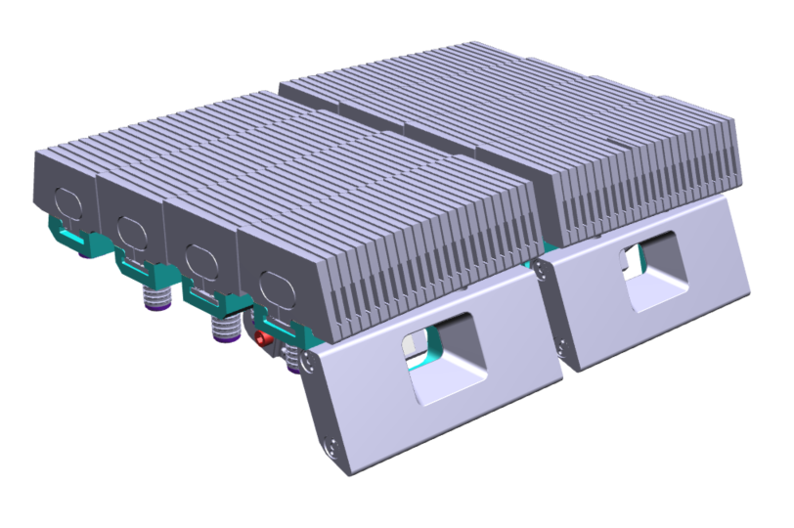
SP E.2 14N W-LBSRP
Fuel retention & Microstructure
Lab | FZJ | IAP | IPPLM | IST | QST | VR | VTT | UKAEA | ISSP-UL
TDS (including T) | y | y |  |  |  |  |  | y
TDS (radiometric T only) |  |  |  |  |  |  |  |  | y
Dissolution |  | y |  |  | y |  |  |  | y
Surface morphology | y |  | ? |  |  |  |  | y
Metallography | y |  |  |  |  |  |  | y
Mechanical |  |  | ? |  |  |  |  | y (Cov)
IBA |  |  |  | ? |  | ? HIERDA
T imaging plate |  |  |  |  | y
SIMS |  |  |  |  |  |  | y
Atom probe tomography |  |  |  |  |  |  |  | y (Ox)
LH
RH
1
24
D
C
B
A
2013-14 & 2018-23
Mirrors
2018-2023
2011-12 & 2018-23
IAP: Cutting 16 whole lamellae, distribution of samples
Fuel retention: D and T retention 2018-23
Microstructure: He interaction with W – Stack B and Stack A
Recrystallisation – Stack C
*Refer to Scott’s IR images during He experiment
†He interaction with W

Slide 22
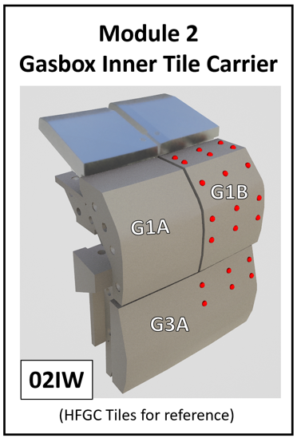
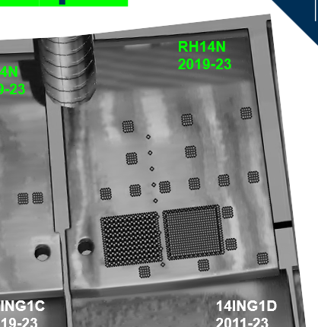
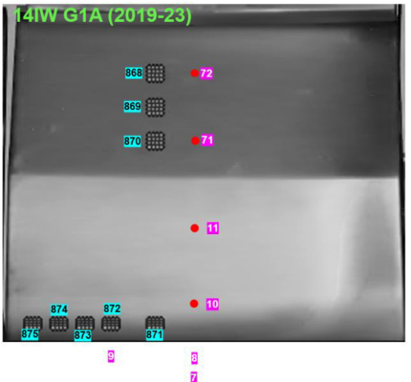
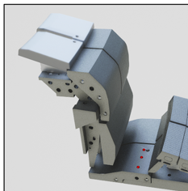
SPE.2 W-CFC tiles shipments (Mod 2, 14)
 | VTT (coring) | UKAEA (TDS)
2IW G1B (2010-2023) | X
2IW G3A (2018-2023)
2ON G7A (2018-2023)
2ON G8B (2018-2023)
No LIBS
 | VTT (coring) | UKAEA (TDS)
14W HFGC LH​ (2010-2023)
14W HFGC RH ​(2010-2023)
14N HFGC LH​ (2018-2023)
14N HFGC RH​ (2018-2023) | X
14 IW G1A (2018-2023) | X
14 IW G1B (2010-2023)
14 IW G3A (2010-2023)
14 BW G4C (2010-2023) | X
LIBS
LIBS+LID-QMS
LID-QMS
14BWG4C
Retention

Slide 23
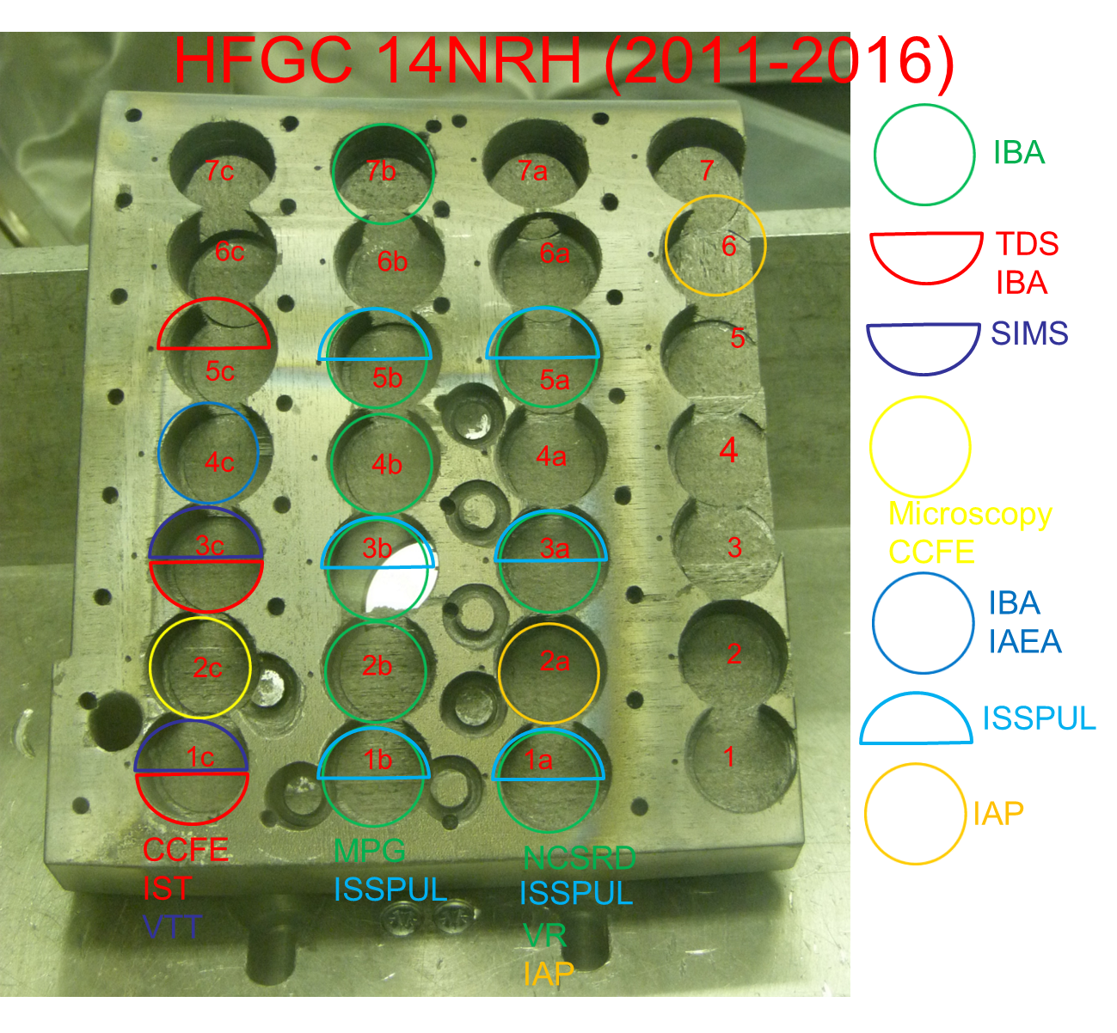
SPE.2 Cutting of W-CFC tiles
Careful planning for LID-QMS tiles required
FREDIS back in operation in 2026-2027, cutting will be made before FREDIS experiments?
No LIBS

Slide 24
2026 Plans of SP E.2 (Post-mortem analysis of JET DTE3 samples

Slide 25
SP E.2 Post-mortem analysis of JET PFCs
Tungsten coated and bulk-W divertor tiles, bulk Be limiter tiles, Inconel components or RE-damaged components
Spatial and depth resolved information regarding impurity and fuel composition will be obtained by different post-mortem analysis techniques.
Global studies will be complemented with local measurements performed with LID-QMS and LIBS.
A comparison of LID-QMS and LIBS at comparable locations will give insights about best method to quantify tritium content in layers.
Integrated tritium content in PFCs will be quantified and compared with gas balances and global gas accounting (ITER).
Toroidal and poloidal information will be compared with existing PWI modelling.
Comparison will be carried out with material migration and fuel retention simulations in SP D.

Slide 26
SP E.2 Post-mortem analysis of PFC components
Post-mortem techniques: dissolution, electron microscopy (SEM, TEM, FIB), GDOES, full combustion (FC), ion beam techniques (HIERDA, NRA, RBS, µ-beam) LIBS, LID-QMS, metallography, SIMS, TDS
W lamellae
  First small samples available in September (IAP, VR, VTT, UKAEA, ISSP_UL)
  Full size lamellae in ~April (FZJ, IAP, VTT)
CFC tiles/samples
  Type A container required, estimated T content/tile ~22 - 48GBq
  Type A container at VTT requires leak testing and license renewal at Croft (in Culham)
  W-CFC tiles shipments: June-August 2026?
  Sectioning and preparation of CFC samples in ~August –September 2026
Be limiter tiles
  Cutting plan in preparation
  Shipment to IAP for cutting autumn 2026

Slide 27
Concluding remarks
LIBS experiment at JET was successfully completed in October 2024 (840 locations)
LIBS data analysis progressing
  Data analysis meetings on a monthly basis
  Significant progress has been made in data analysis (e.g. CF LIBS)
Additional reference LIBS measurements including few DTE3 samples made at VTT (April 2026)
Significant delays in shipment of JET PFCs to IAP and VTT
Shipment of first DTE3 components in April (W lamellae)
Sectioning and preparation of W samples will begin in ~June
First W samples available in September
First analyses of DTE3 samples using IBA, LIBS, GDOES, TDS, metallography, TOF-SIMS
Type A container
  VTT has Croft 2950 Type A container (requires leak testing and re-licensing)
Shipment of CFC divertor tiles to VTT ~June-August?
Sectioning and preparation of CFC samples in ~August –September
Shipment of Be tiles to IAP in autumn 2026

