Slide 1
SPE Kick-off meeting 26
Name
E. Grigore, F. Baiasu, M. Gherendi,
C. Porosnicu, O.Pompilian, V. Zaroschi, C. Staicu
IAP

Slide 2
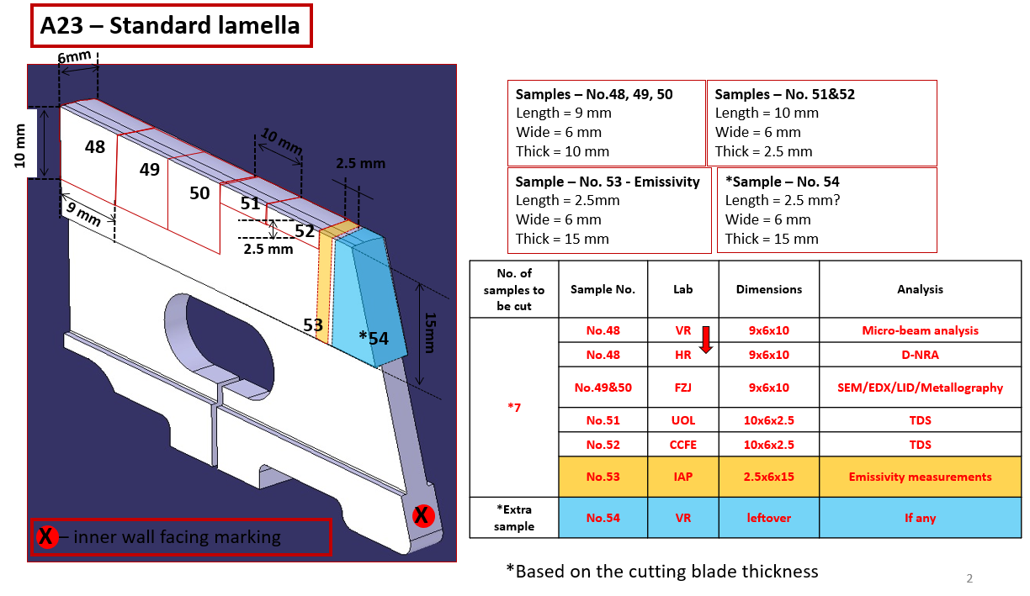
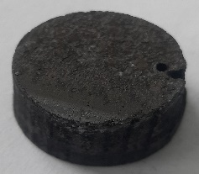
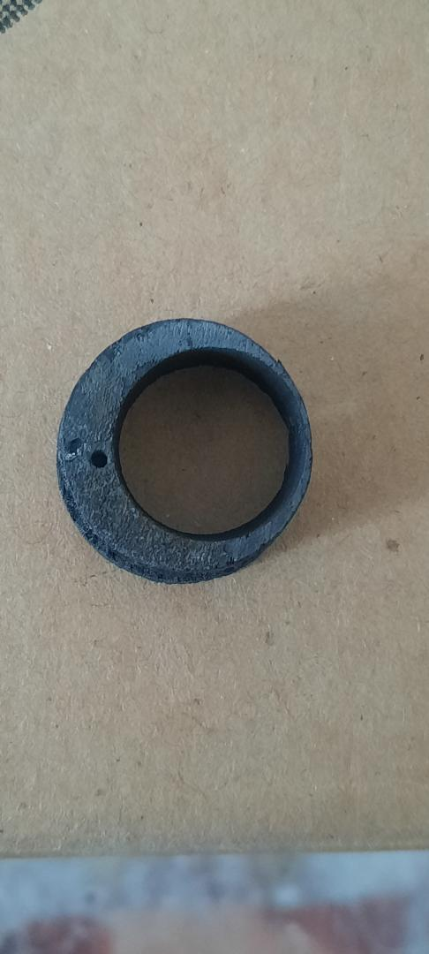
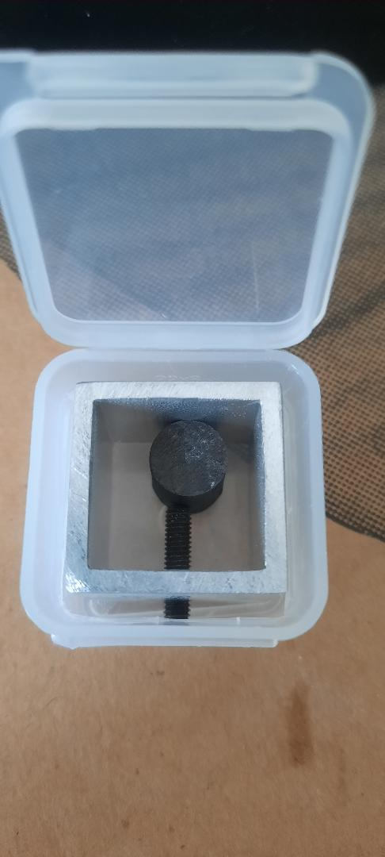
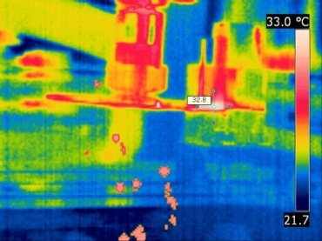
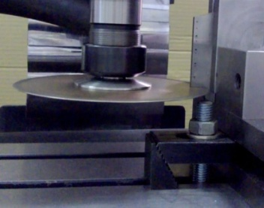
SPE.2
Sectioning and preparation of samples from metallic components. Distribution of samples to other laboratories.
Cutting and processing of the sample
Cutting and processing of the samples was required prior to GDOES
Deuterium thermo-desorption spectra (TDS) for the designated samples
Initial TDS GDOES
TDS on Be castelation (left) and W lamellae (right)
Diamond milling disc in action
Sample temperature monitored by IRcamera
Special cutting discs containing more than 21% diamond powder embedded in a copper alloy were used;
Lamella temperature during cutting - monitored: must not exceed 70ºC
Type A containers are required for shipping the JET DTE3 tiles to the participating beneficiaries (IAP, FZJ, VTT). Estimated cost of the containers is 60kEUR. The shipments will be made as excepted consignments and estimated cost of one shipment (back and forth) is 15kEUR. Support by EUROfusion funding (GA 46 in April 2024).

Slide 3
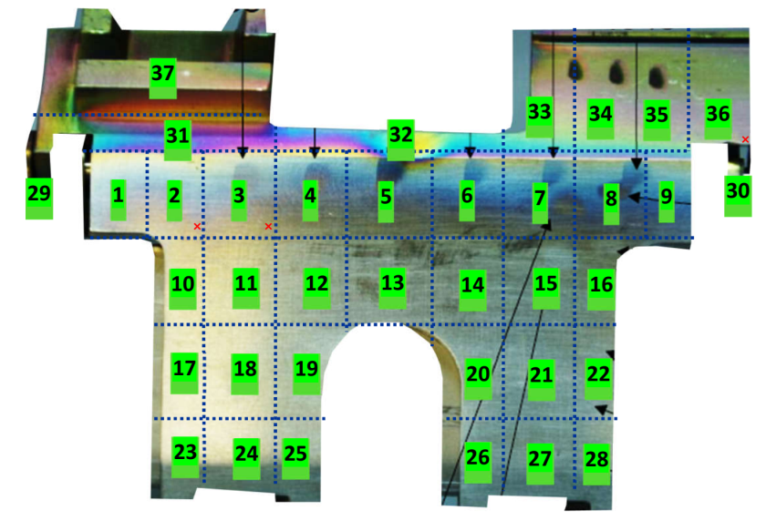
SPE.2
XPS measurements on elements exposed to fusion plasma
Additional samples, besides 12 samples sectioned and analyzed in 2024 from Inner divertor Louvre clip, were analyzed by XPS in 2025
the analyses were performed on 2 points (Pt1: top & Pt2: lower part) on each sectioned sample in order to asses the poloidal elemental distribution
Results (toroidal direction):
The surface composition of consists in a mixture of Be, C and O
The content of Be, C and O for each sample and summarized on Figs. bellow
Louvre clip front side
Illustration of 2 measurements points
Toroidal elemental distribution

Slide 4
SPE.2
Results (poloidal direction):
Poloidal elemental distribution
The analysis of samples 7, 15, 21 and 27 indicated, that except sample 15, the Be concentrations are lower than 10 at.%
For C and O distribution, it seems that there are no particular distribution with the poloidal position and both the C and O concentrations are in the same ranges with the C and O concentrations along toroidal directions
Low concentrations of Fe (0.38 at.%) and Cr (0.1 at.%) were found on sample 27
All samples from poloidal and toroidal directions indicated the presence of Be bonded with O; no transition specific to metallic Be was noticed
The Be 1s position (111.8eV) is shifted towards higher binding energy indicating the formation of Be oxides

Slide 5
GDOES depth profile on CFC coated tiles exposed to ILW-3
GDOES depth profiles for the samples cored from Tile 3 at s = 470 (a) and at s = 554 (b) after plasma exposure in ILW-3 campaign

