Slide 1

PWIE-SPE kick-off meeting
29th of May 2026
I. Jepu, A. Widdowson, Y. Zayachuk
This work has been part funded by the EPSRC Fusion Grant 2022/27 [grant number EP/W006839/1] and by the Fusion Futures Programme. As announced by the UK Government in October 2023, Fusion Futures aims to provide holistic support for the development of the fusion sector. To obtain further information on the data and models underlying this work please contact PublicationsManager@ukaea.uk.

Slide 2
Outline
RE damage to inner limiter & future work
Post DTE2&3 W lamellae analysis & future work
Fuel retention in JET using LID-QMS & future work
Planned activities

Slide 3
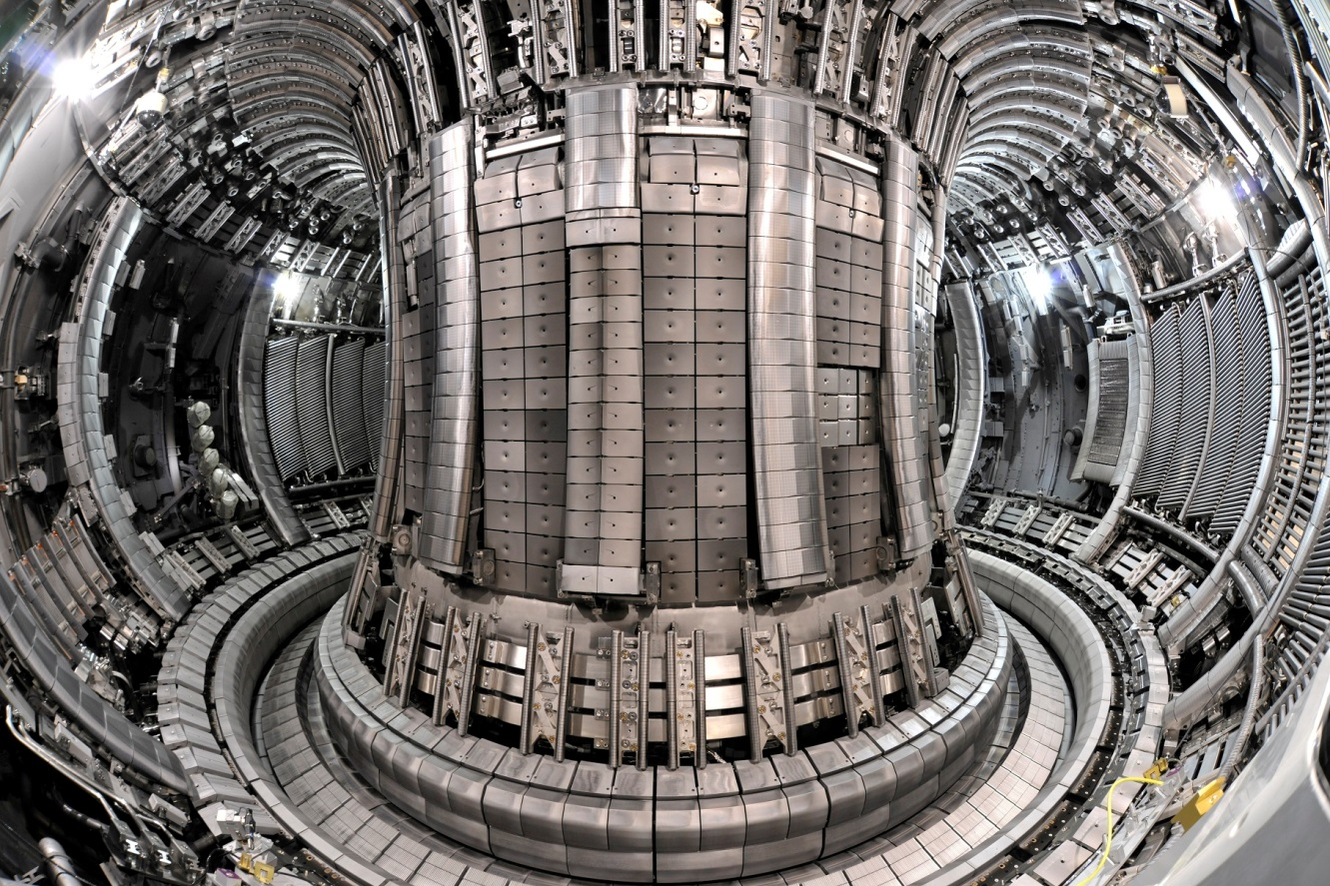
Background – typical JET materials
2010 – 2023
Former ILW era
Main chamber
Bulk Be
Be coated inconel
W – coated CFC
DIVERTOR
W – coated CFC
Bulk W

Slide 4
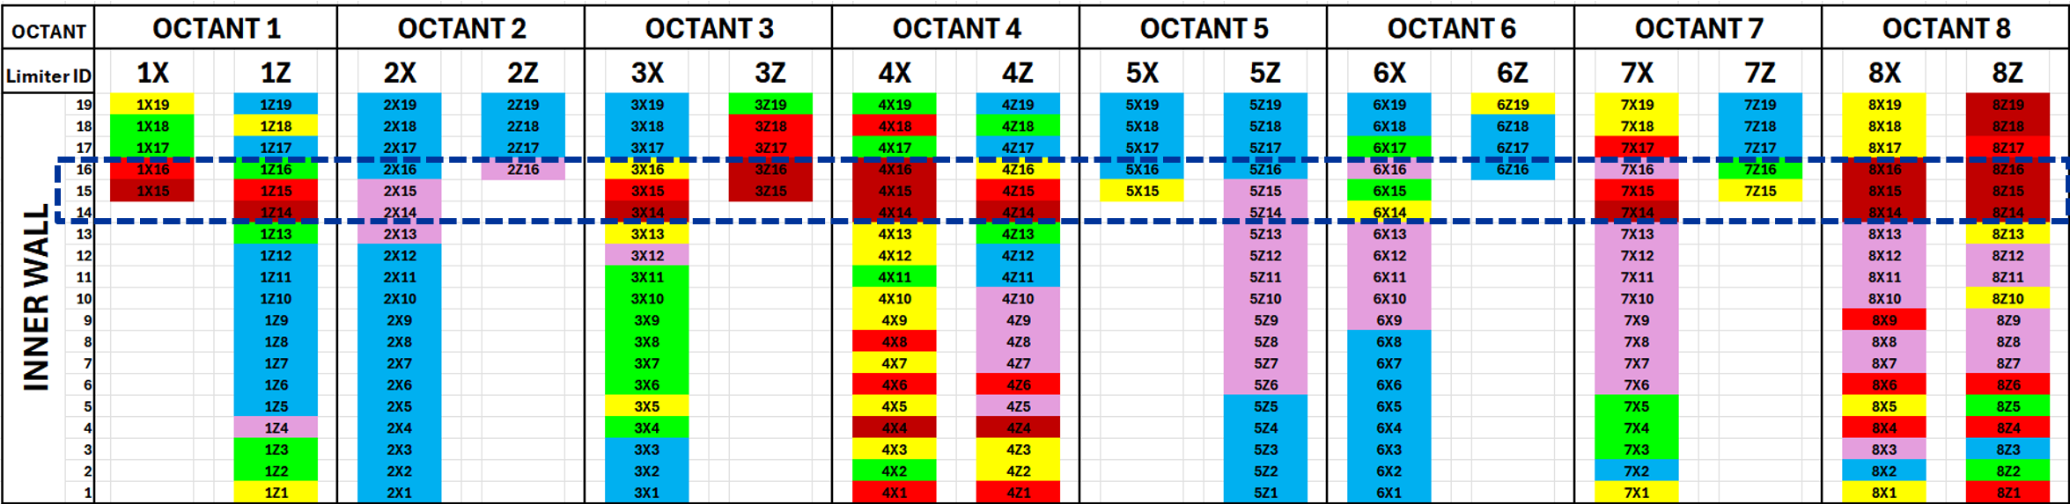
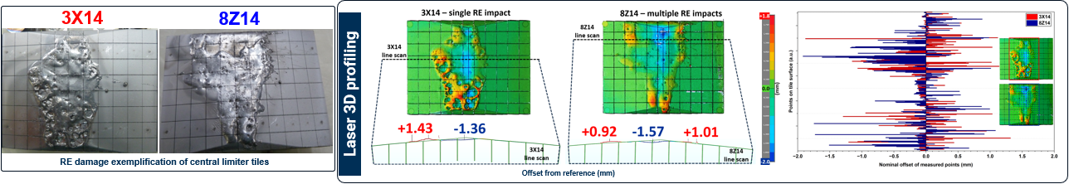
RE damage of inner limiters during the ILW configuration (2010-2023)
I. Jepu PSI-2026

Slide 5
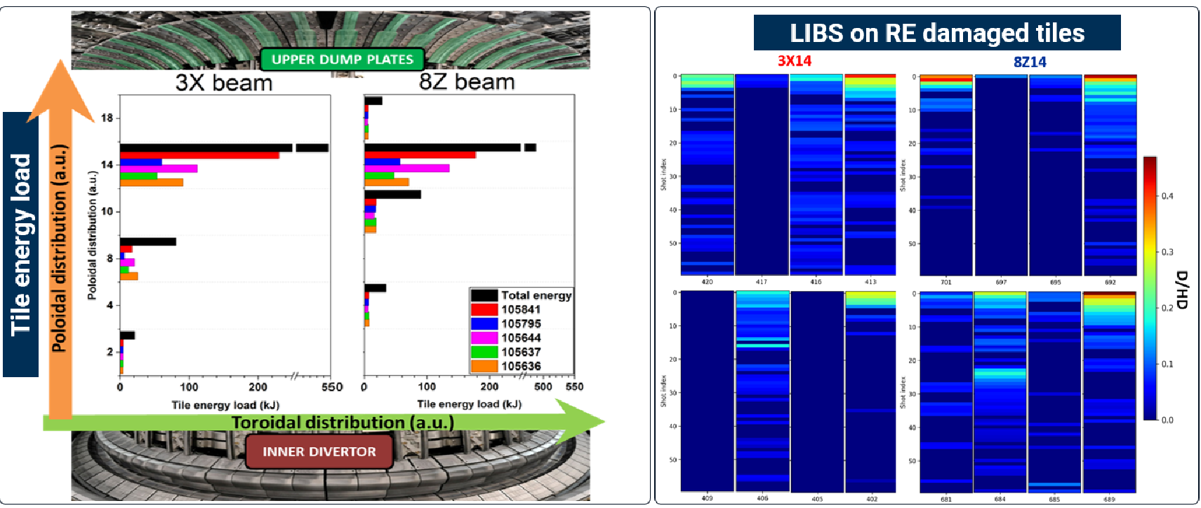
RE damage of inner limiters during the ILW configuration (2010-2023)
I. Jepu PSI-2026

Slide 6
RE damage of inner limiters during the ILW configuration (2010-2023)
Summary and outlook
Current assessment not sufficient for a clear conclusion on the morphological and structural changes from a single impact(3X14) vs multiple RE impact (8Z14)
Future work involves: downsizing the tiles (cutting them) for an in-depth analysis at the melt region, melt propagation in between the castellations, using high-resolution SEM of the surface and cross section, EBSD to assess the melted and re-solidified areas in terms of grain structure topography, IBA analysis on all sides of a damaged castellation for fuel retention assessments
I. Jepu PSI-2026

Slide 7
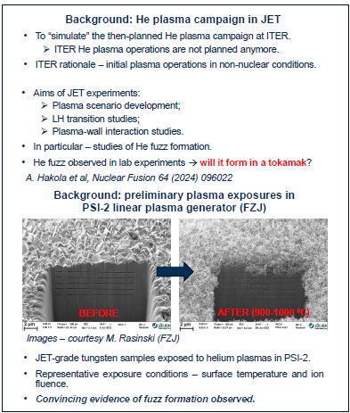
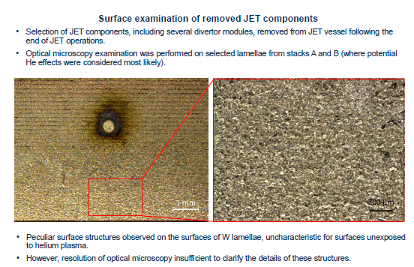
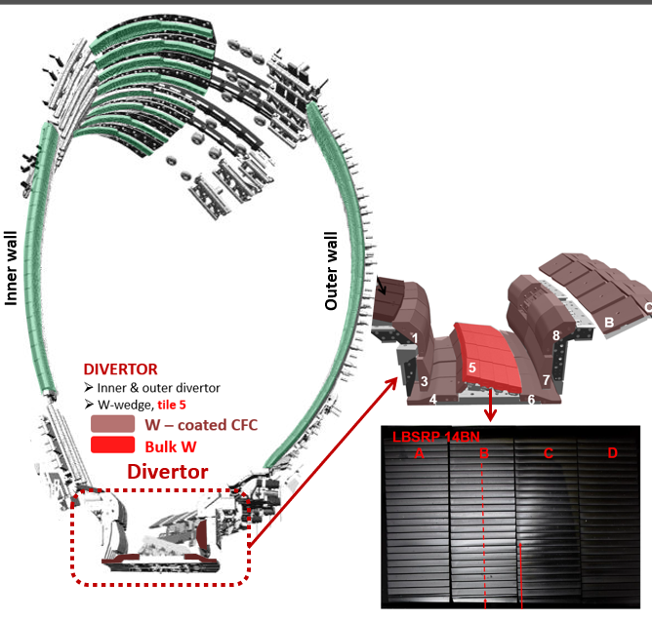
Microscopy study of plasma-and laser-induced effects in tungsten
Summary and outlook
Results of in-vessel optical imaging do not suggest that large-scale formation of helium-induced structures took place on the surfaces of tungsten components of JET divertor.
Optical microscopy of tungsten components indicates possible presence of plasma-induced material modification.
High-resolution SEM of the surface, combined with FIB cross-sectioning to study under-surface structures are necessary to characterize the details of the helium-induced structures (if any are present). These are currently at the planning stage.
Zayachuk PSI-2026

Slide 8
Microscopy of LIBS shot on tungsten lamellae (not exposed in JET)
LIBS produces an affected area considerably larger than the size of the ablated crater.
The produced morphology is complex
  4 distinct morphological zones
  extensive network of cracks extending beyond ~12 μm below the surface
It is necessary to perform similar SEM and FIB studies on well-characterized LIBS craters on tungsten samples removed from JET vessel. These are currently at the planning stage.
Zayachuk PSI-2026

Slide 9
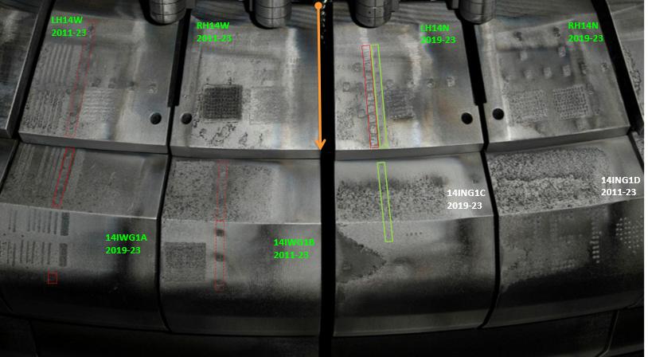
LID-QMS in-vessel Poloidal fuel retention measurements
Deuterium and tritium retention evaluated
Comparison of deuterium with previous post-mortem analysis shows similar retention
Comparison with post-mortem LID-QMS and other techniques to come
In-vessel LID-QMS during & after DT operation
Post-mortem IBA of tiles from earlier DD operations
D end
3 wks into DTE3
T end
Widdowson
HWS 2026

Slide 10
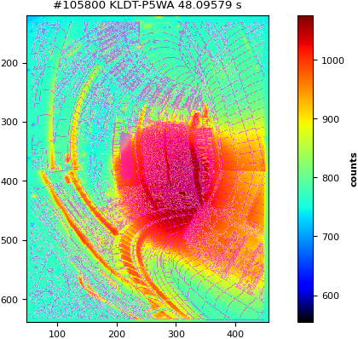
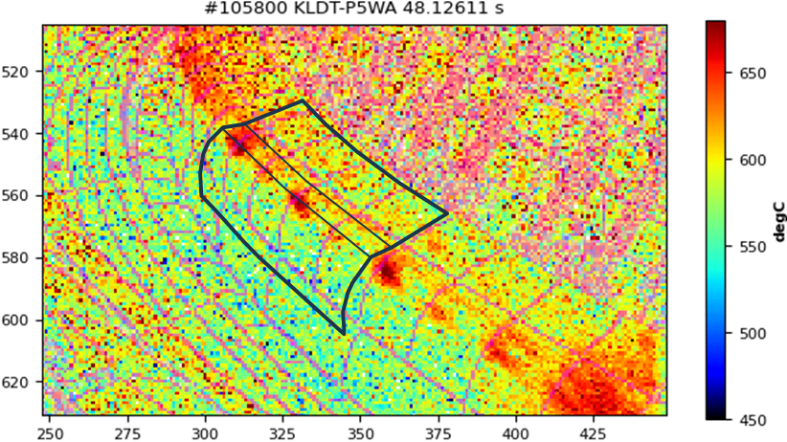
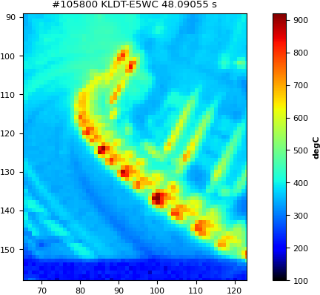
Reduction in fuel retention at end of operations
Deuterium
Downward disruption at end of plasma operations raises surface temperatures >700°C and probably higher
⇒ Expect additional fuel desorption from tiles
Runaway electron damage

Slide 11
Future plans (UKAEA)
TDS on W lamellae & comparison of TDS tritium results with other analysis techniques
Characterisation of RE damage continued
FIB on W lamellae and other tile samples as they become available
Comparison of LID-QMS results with ex-situ LID-QMS at FZJ and other retention measurements
JET component shipping to VTT and IAP for cutting and further distribution
Advanced draft of manuscript
A study of the influence of prolonged baking on deuterium depth distribution and release in JET ILW components – Y. Zayachuk et al

Slide 12
Slides to follow were screen shots from the meeting taken for interest

Slide 13
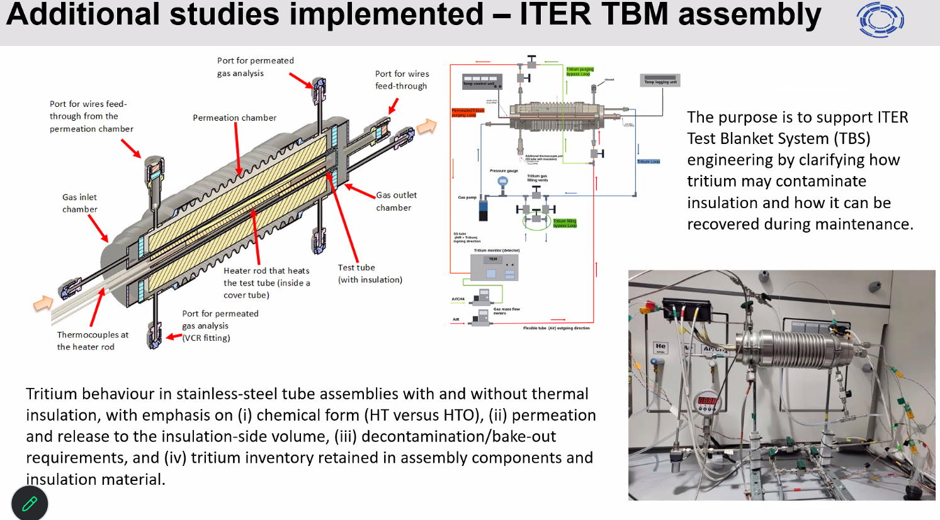
Screen print from Elina – added for interest…

