Slide 1


LID-QMS, LIBS/LIA-QMS, TDS analysis and metallography of JET PFCs
Plans for 2026, 2027
WP PWIE, SP E.3
Kickoff Meeting 29.5.2026
Miroslaw Zlobinski et al.
Forschungszentrum Jülich GmbH, Institute of Fusion Energy
and Nuclear Waste Management – Plasma Physics,
Partner of the Trilateral Euregio Cluster (TEC), 52425 Jülich, Germany

Slide 2
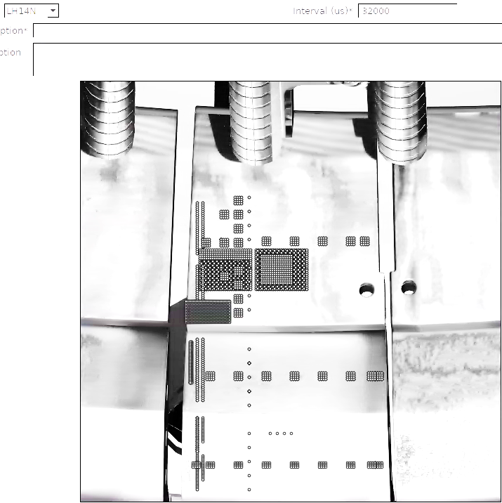
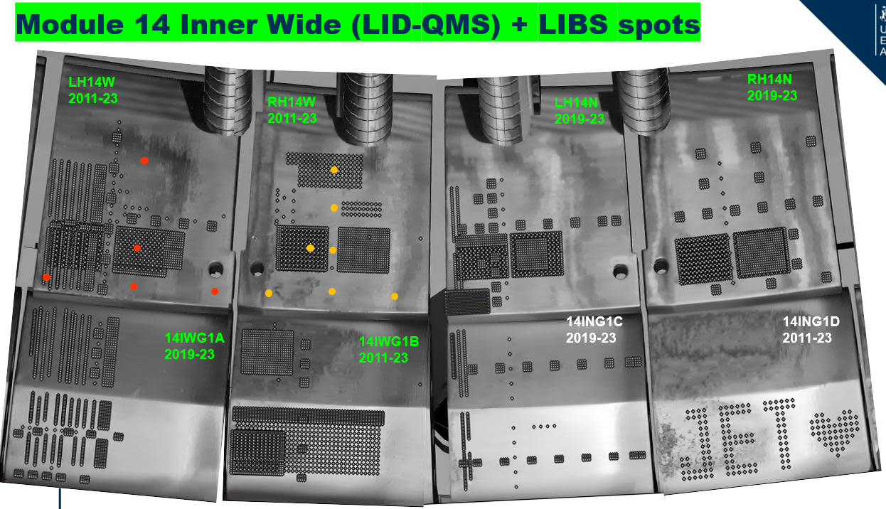
in/ex situ retention comparison with LID-QMS, LIBS, LIA-QMS
Final Measurements at JET after last plasma in December 2023:
Plan: direct comparison of ex situ to in situ LID-QMS in 70 positions ( ) on tiles retrieved from the torus
Plan:
ex situ LID-QMS ( )
and
ex situ LIBS ( )incl. LIA-QMS
around in situ laser spots
Ratio
Spatial distribution
of H, D, T, C, W, …
Depth distribution
TDS on cut samples for temperature dependence
in FREDIS 2.0 (available 2027) upgrade plan:
LIBS and LIA-QMS (20 ps)
autoresonant ion-trap MS
ionisation chamber for
T detection
better pumps
in situ LIBS
JET divertor
tile 0
(= HFGC)
in situ
ex situ
NEW
tile 1
Metallographic cross-sections for layer thickness and structure, melting depth, crater depth

Slide 3
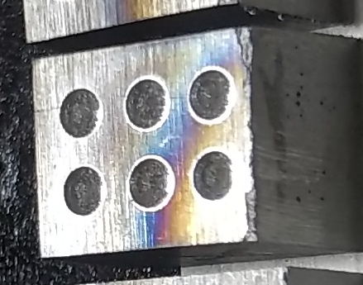
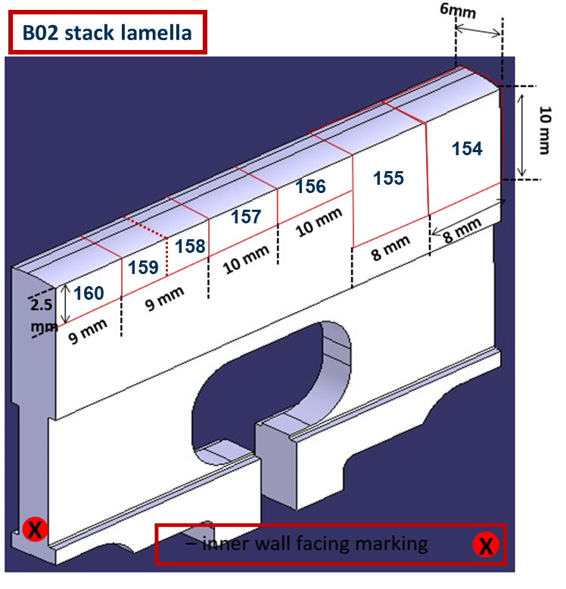
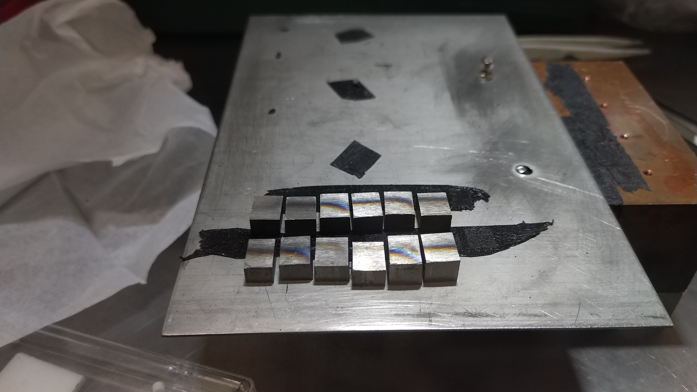
Bulk-W Lamellae incl. potential W fuzz
Plan: On full W lamella measure with LID-QMS and LIBS/LIA-QMS the full poloidal and radial profiles on all 4 plasma-wetted surfaces. Until now max. 3 radial measurements on the sides:
cut lamella samples: TDS analysis for temperature dependence
Oral at PSI conference 21.5.2026 .
X
Top surface = Plasma facing
X
X
End
Poloidal gap surface
plasma side
End
End
Poloidal gap surface
End
Poloidal gap surface
inner wall facing marking
End
End
End
Retention mainly by co-deposition
Ref: M. Zlobinski et al., PSI 2026: https://plan.events.mpg.de/event/187/contributions/2571/
Plan: Metallography for layer thickness and structure, W fuzz thickness and structure, melting depth of LID, crater depth of LIA/LIBS

Slide 4
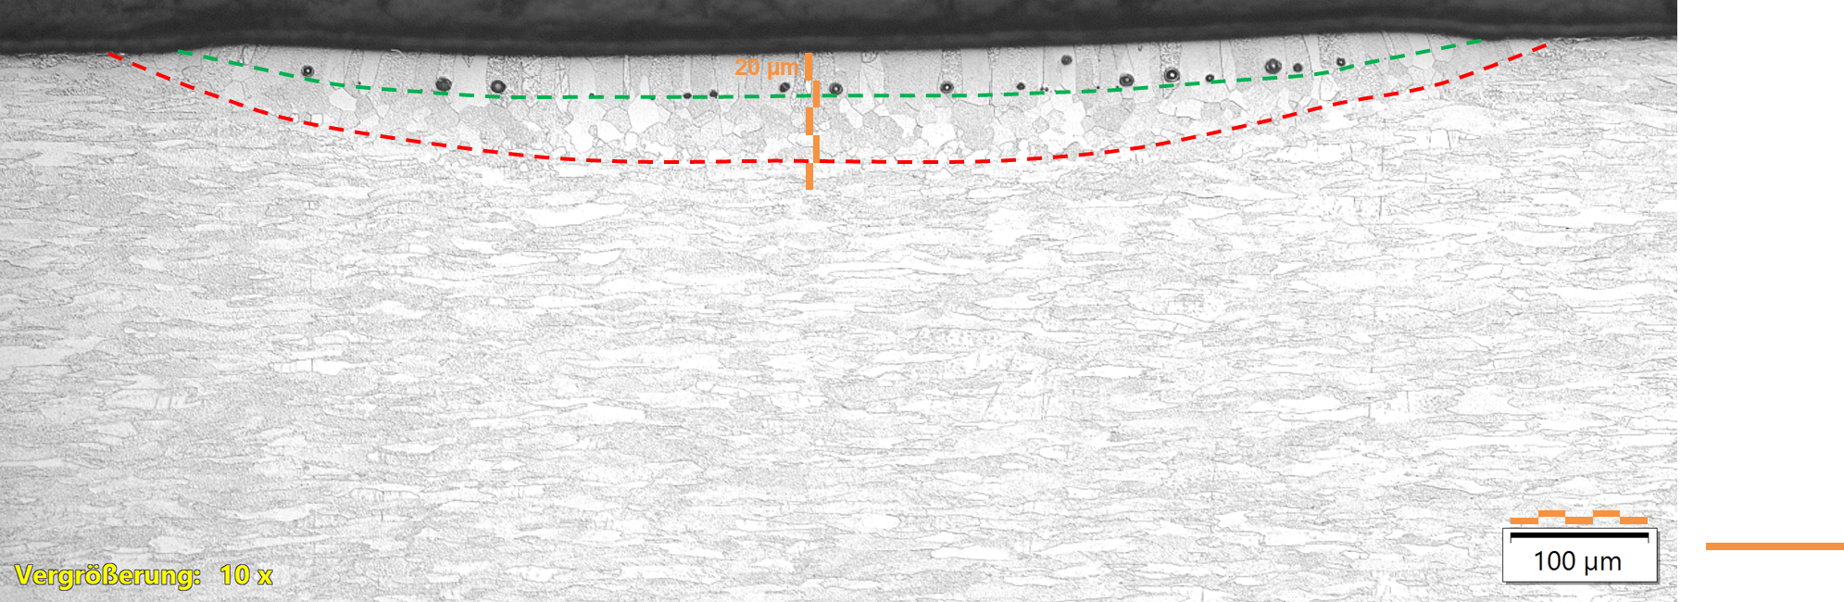
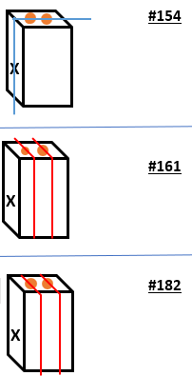
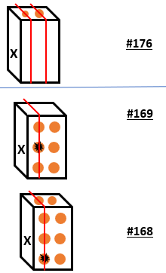
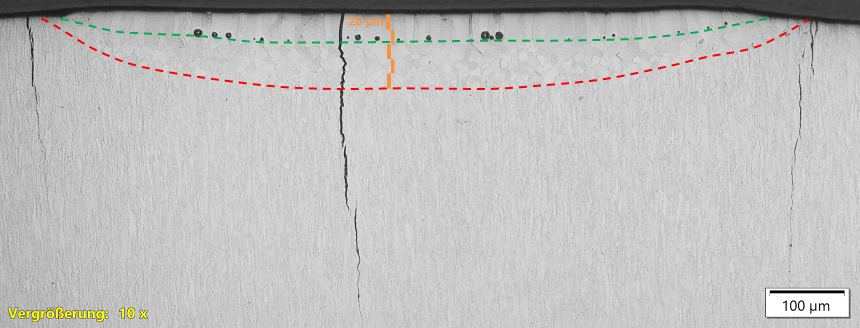
Metallography on bulk-W lamellae
W lamella cuts incl. molten laser spots were cut,
polished, etched (to see the W grains)
for optical microscopy of cross-section.
SEM images of top surface done.
Panorama image with complete laser spot done.
Plan: Repeat for new samples to be received incl.
LIBS craters and LID-QMS spots
cutting done:
spot1 2
spot
1 2
3 4
5 6

