Slide 1

ISSP-UL: Analysis of JET plasma facing components with TPD, FC and dissolution method
E.Pajuste, A.S. Teimane, L. Avotina, M. Sondars, A.Lescinskis

Slide 2
Tritium infrastructure
Current UoL tritium limitations 185 TBq (370 TBq per year)
Available tritium for experiments (procured from Ltd TriTec, Switzerland
HTO liquid
HT mixture in He
T₂ in U bed in procurement
Equipment
Liquid scintillation spectrometers: PerkinElmer TriCarb , PerkinElmer Quantulus, Hidex Triathel
MAB Solutions TEM2100 proportional counter with gas flow detector DDH32 (3 pieces)
Mirion β ionix™ portable tritium monitor
Custom made sorption and thermal desorption system
Custom made permeation system (3 pieces)
Custom made full combustion system (tritium measured by liquid scintillation)
Custom made chemical/electrochemical etching system (tritium measured by liquid scintillation and proportional counter)

Slide 3
Tritium measuement concepts in solid samples
Tritium liberation from the bulk solid
Transfer to the measurement system
Measurement
&
Quantification
Derived information
Thermal
Non-thermal
Purge gas
Ionization chamber/proportional counter
(beta radiation)
Desorption spectra
Chemical/
Electro-chemical etching
Depth profile
Thermally programmed desorption
Vacuum
QMS
(mass)
Total tritium content
Full combustion
Capture in liquid
Liquid scintillation
(beta radiation)
Other components

Slide 4
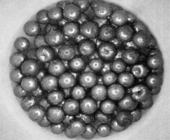
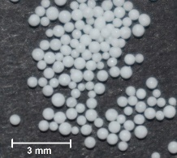
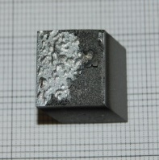
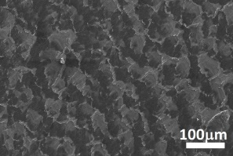
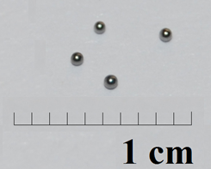
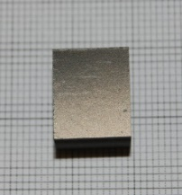
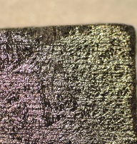
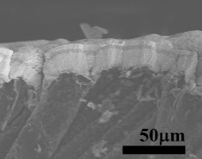
Methods used for JET samples at UoL
Temperature programmed desorption
TD-QMS
With two simultaneously measuring detectors:
1 – 6 amu & 1 – 300 amu
Dissolution &
electrochemical etching
Full combustion
METHOD
PARAMETERS
temperature
atmosphere
tritium detection method
INFORMATION OBTAINED
MATERIALS
up to 1100ºC
He + 0.1% H₂, Ar, air
proportional counter (HT, DT, T₂, lower hydrocarbon) TEM 2100A with gas flow prop. detector DDH 32
up to 1200ºC
vacuum
mass spectrometer (HT, DT, T₂, C_{x}H (D,T)_{y} ) Hositrad MGT 6-300 Multi Gas Analyser
ambient
argon
proportional counter (HT, DT, T₂), liquid scintillation (HTO, DTO) Tri-Carb 2900TR
up to 850ºC
air
liquid scintillation (all forms of tritium are oxidized into HTO, DTO)
Desorption spectra
Total tritium amount (except long-chained hydrocarbons)
Desorption spectra of different tritium containing compounds
Desorption spectra of other desorbed gases
Depth profile
Total tritium amount
Chemical state
Total tritium amount
All solid materials
Metals (Be, W, inconel, steel)
Carbon based materials, metals
Beryllium and lithium-containing ceramic pebbles
Plasma facing materials PFM (Be, W, CFC)
Beryllium pebbles
Metallic PFM
Carbon based PFM - CFC, W coated CFC

Slide 5

Dissolution method
Consecutive layers of metallic sample are etched by a solvent (acid or base)
Dissolution is controlled based on known dissolution rate for a given concentration
Tritium measurement in gaseous phase
(proportional gas flow detector)
HT, DT, T₂
T₀ interstitial
T⁺ chemically bonded to impurities
HT, DT or T₂ in pores
Me
$$A_{T_{total}}=A_{T_{gas}}+A_{T_{liquid}}$$
PF surface
Me⁺, T⁺, DTO, HTO
Tritium measurement by the means of liquid scintillation
If dissolution/ etching rate is controlled - depth profile can be assessed

Slide 6
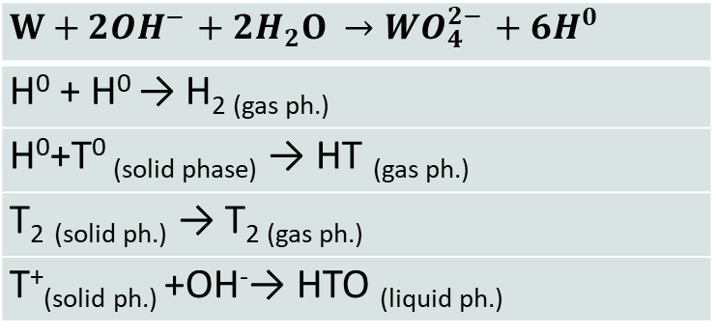

Electrochemical dissolution method
For electrochemical dissolution sample is used as an electrode with another electrode present
Power is supplied and the sample is etched at a certain voltage
Tritium measurement in gaseous phase
(proportional gas flow detector)
HT, DT, T₂
T₀ interstitial
T⁺ chemically bonded to impurities
HT, DT or T₂ in pores
Me electrode
Me
$$A_{T_{total}}=A_{T_{gas}}+A_{T_{liquid}}$$
PF surface
$$W+2{OH}^{−}+2H_{2}O →{WO}_{4}^{2−}+6H^{0}$$
H⁰ + H⁰ → H_{2 (gas ph.)}
H⁰+T⁰ _{(solid phase)} → HT _{(gas ph.)}
T₂ _{(solid ph.)} → T_{2 (gas ph.)}
T⁺_{(solid ph.)} +OH⁻→ HTO _{(liquid ph.)}
Tritium measurement by the means of liquid scintillation
Me⁺, T⁺, DTO, HTO
Power supply
Successive layers of W are removed electrochemically in 35% KOH solution where both electrodes are tungsten.

Slide 7
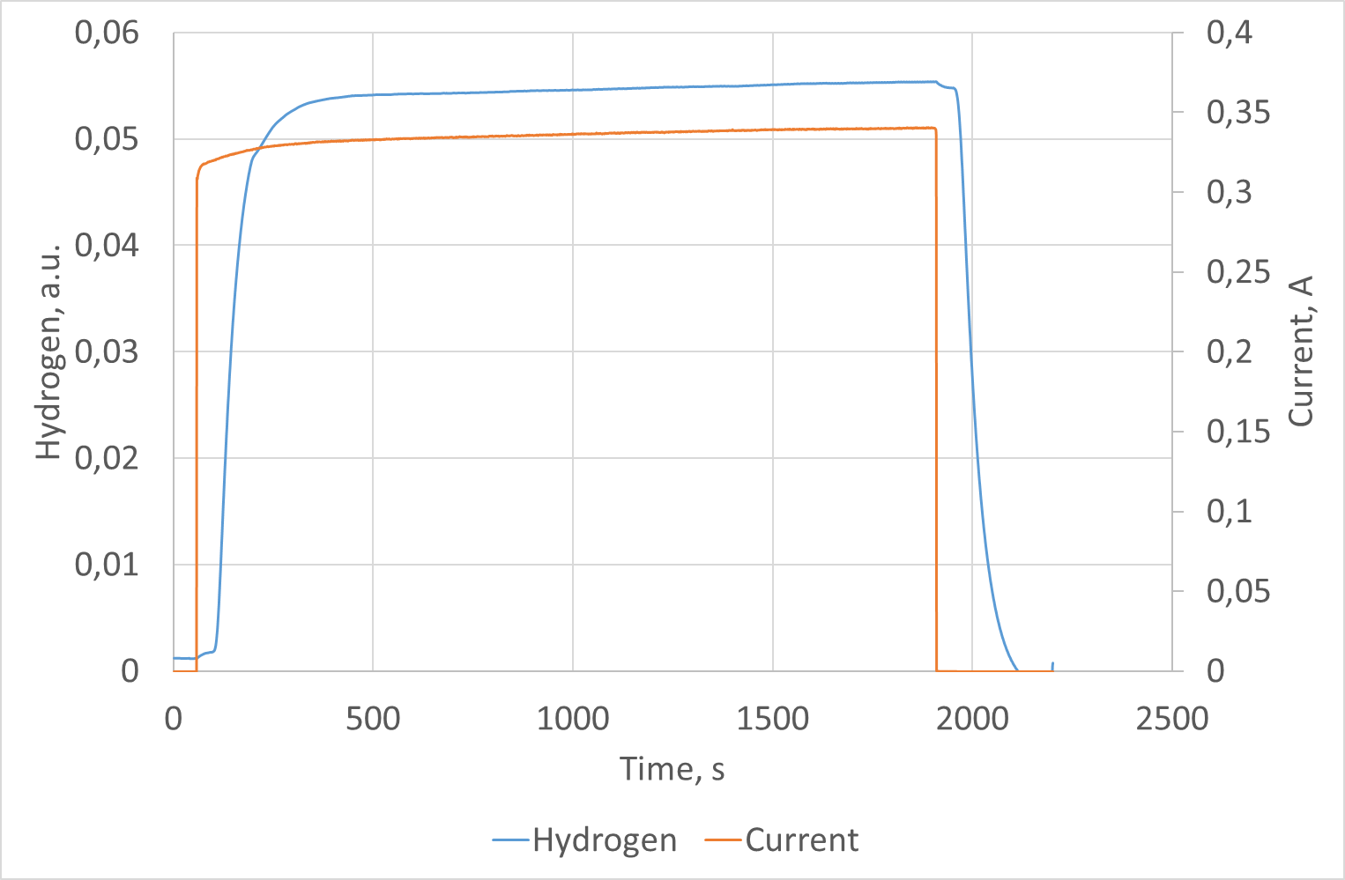
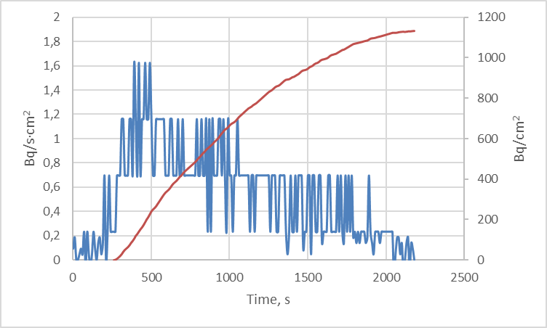
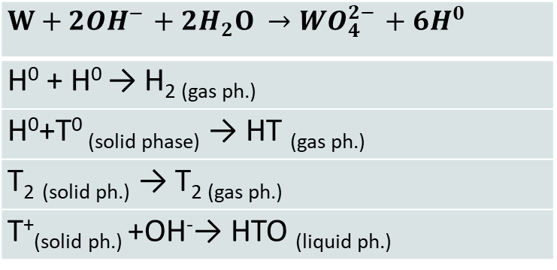
Example of tungsten
Successive layers of W are removed electrochemically in 35% KOH solution where both electrodes are tungsten.
Amount of evolved hydrogen (depicted as ‘H’) and released tritium (depicted as ‘T’) measured. Applied voltage ~3V.
$$W+2{OH}^{−}+2H_{2}O →{WO}_{4}^{2−}+6H^{0}$$
H⁰ + H⁰ → H_{2 (gas ph.)}
H⁰+T⁰ _{(solid phase)} → HT _{(gas ph.)}
T₂ _{(solid ph.)} → T_{2 (gas ph.)}
T⁺_{(solid ph.)} +OH⁻→ HTO _{(liquid ph.)}
In particular exapmle:
Gaseous phase ~1,1kBq/cm2
Liquid phase 4,8kBq/cm2
Total tritium amount - ~6kBq/cm² (3.4∙10¹² atoms/cm²)

Slide 8
Mixed materials - beryllium coated inconel
Dissolution method can be used for mixed materials – gives insight in which layer tritium is retained
Successive layers of Be are removed using 4 mol/L sulphuric acid, whereas Inconel - by electrochemical etching in the same solution by applying the 3V voltage.
HT, DT, T₂
Me
Me electrode
Me1
Me2
PF surface
Me⁺, T⁺, DTO, HTO
Power supply

Slide 9
Temperature Programmed Desorption (TPD)
Based on controlled thermal treatment tritium is being released and continuously measured with gas flow detector and/or liquid scintillation
Tritium measurement in gaseous phase (proportional gas flow detector)
HTO can be collected in water and measured by liquid scintillation
HTO,DTO,
HT, DT, T₂
Heating rate up to 20 K·min⁻¹
T_{max} ~1300K
Purge gas
Solid matrix
Solid matrix
T⁰ interstitial
T+ chemically bonded to impurities
HT, DT or T₂ in defects

Slide 10


Comparison
Dissolution/etching
TPD
Full combustion
Information on
  total tritium amount
  depth profile
  chemical state (can be adapted)
In layered materials information on tritium in each layer can be assessed
Fast
No elevated temperatures used (safe)
Information on
  total tritium amount
  Desorption spectra
Tritium trapping energies can be assessed
Applicable to all kinds of materials
High sensitivity
Information on
  total tritium amount
Can be assumed that all tritium is measured since the «hosting matrix» is fully destroyed.
ADTVANTAGES
Not all tritium might be measured if not sufficient layer thickness is etched (remains in bulk)
Some data might be lost if tritiated water vapor condensates before reaching the Zn bed
Time consuming
Limited information on tritium initial state in the material
DISADTVANTAGES

Slide 11
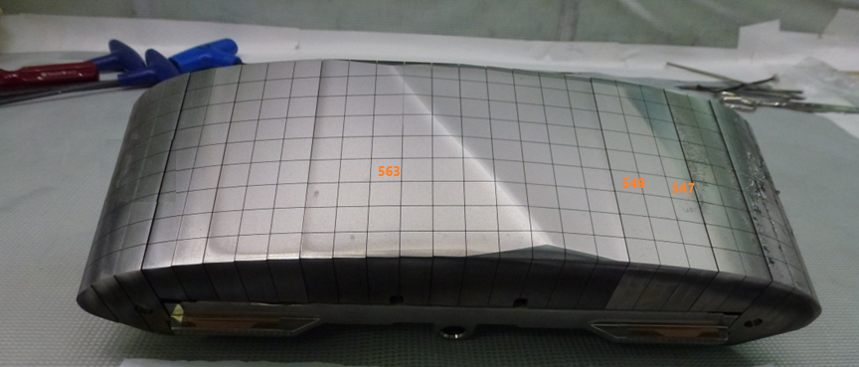
Example for application of different methods for similar samples - beryllium
Three samples had been cut in 4 pieces to perform 3 different tritium measurements (1 spare)
Sample 563 shows considerable difference which might be related:
Uncertainties of the sample
Tritium retention deeper in the bulk resulting in insufficient layer etching and not full release during TPD.

Slide 12
Comparison of methods
Dissolution/etching
TPD
Full combustion
Information on
  total tritium amount
  depth profile
  chemical state (can be adapted)
In layered materials information on tritium in each layer can be assessed
Fast
No elevated temperatures used (safe)
Information on
  total tritium amount
  Desorption spectra
Tritium trapping energies can be assessed
Applicable to all kinds of material
High sensitivity
Information on
  total tritium amount
Can be assumed that all tritium is measured since the «hosting matrix» is fully destroyed.
ADTVANTAGES
Not all tritium might be measured if not sufficient layer thickness is etched (remains in bulk)
Some data might be lost if tritiated water vapor condensates before reaching the Zn bed
Time consuming
Limited information on tritium initial state in the material
DISADTVANTAGES

Slide 13
Assessment of detritiation efficiency - baking experiment
Tungsten interlayered with Mo coated CFC tiles were baked in a temperature proposed to ITER to assess the baking efficacy
Vacuuming the test tube with the sample to 10⁻³ bar
Heating
t = 350 ℃
5 days
Purging with Ar+0,1%H₂ to tritium monitor
TPD with purge gas
10℃/min
t_{max} = 1000℃
1h at T_{max}
Full combustion
Tritium released during baking process
Residuals of tritium in the sample (if any)
Tritium released during high temperature heating

Slide 14
Detritiation results
Baking samples for 5 days at 350 ºC showed low tritium removal efficiency - below 40%.
For 2 Tile 0 samples large fraction of tritium still remained in the sample even after TPD

Slide 15
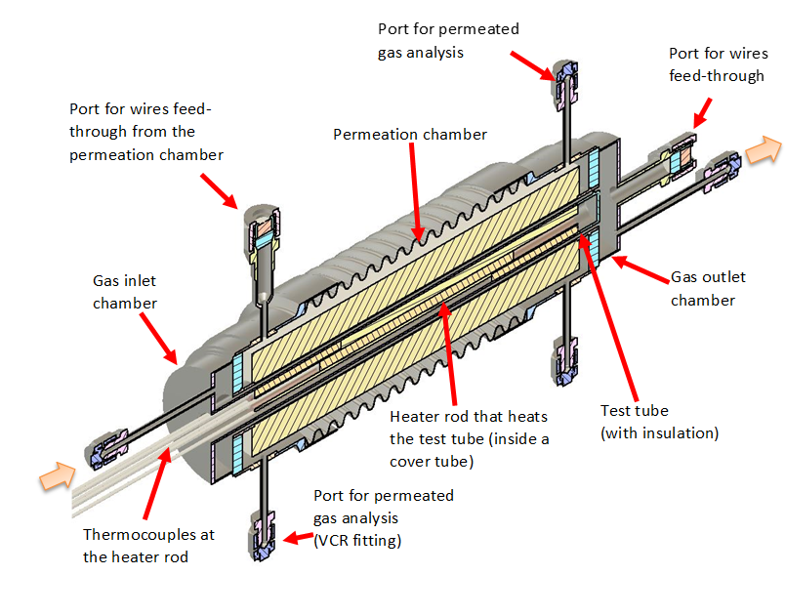
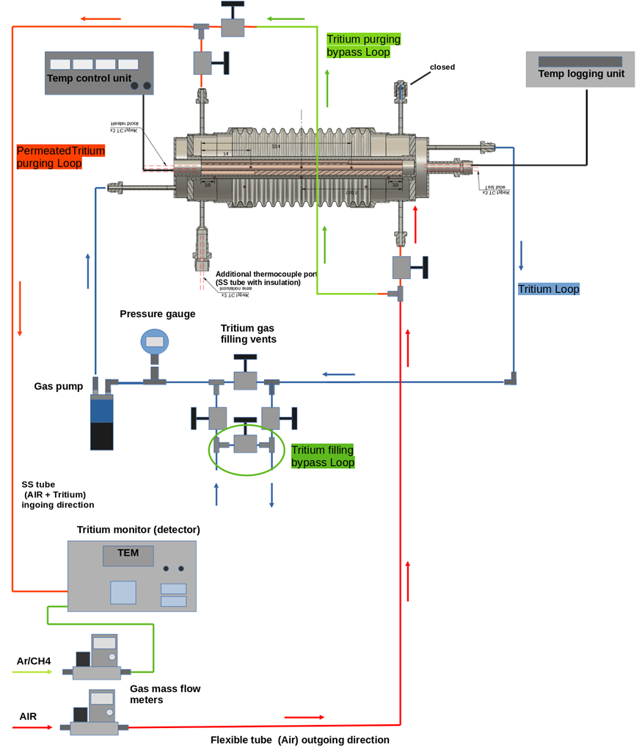
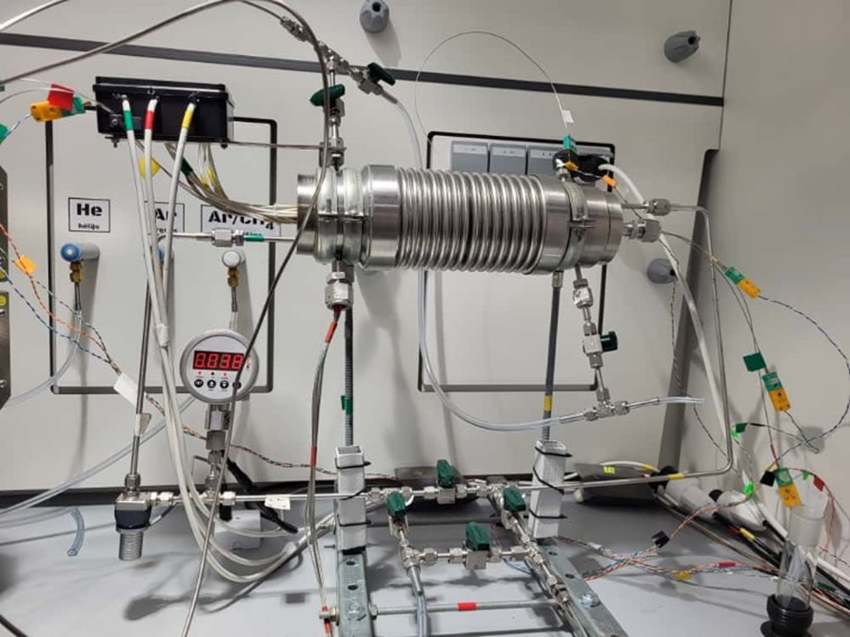
Additional studies implemented – ITER TBM assembly
The purpose is to support ITER Test Blanket System (TBS) engineering by clarifying how tritium may contaminate insulation and how it can be recovered during maintenance.
Tritium behaviour in stainless-steel tube assemblies with and without thermal insulation, with emphasis on (i) chemical form (HT versus HTO), (ii) permeation and release to the insulation-side volume, (iii) decontamination/bake-out requirements, and (iv) tritium inventory retained in assembly components and insulation material.

Slide 16
Summary
Laboratory is ready to receive tritiated samples
The license includes also other radionuclides (Co-60, Cs-137 etc), therefore, if neutron activation had taken place we are still able to receive material
Available methods allows to determine total tritium concentration, desorption pattern and depth profile as well as detritiation efficiency
Different tritium species and custom made equipment are available if other tritium behavior experiments

Slide 17
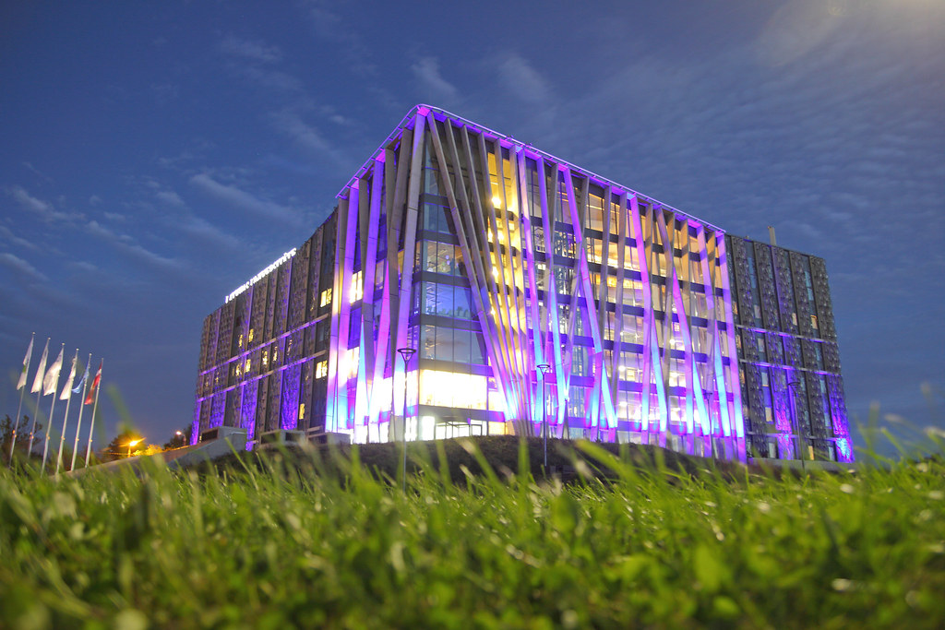
Thank you for your attention!
Prof. Elina Pajuste
Institute of Chemical Physics
University of Latvia
Jelgavas 1, Riga, Latvia
elina.pajuste@lu.lv
University of Latvia Academic Center of Natural Sciences

