Slide 1

SP E.2 Analysis of JET plasma facing components with μbeam
A. Lagoyannis, P. Tsavalas, M. Axiotis and K. Mergia
National Center for Scientific Research “Demokritos”, Athens, Greece

Slide 2
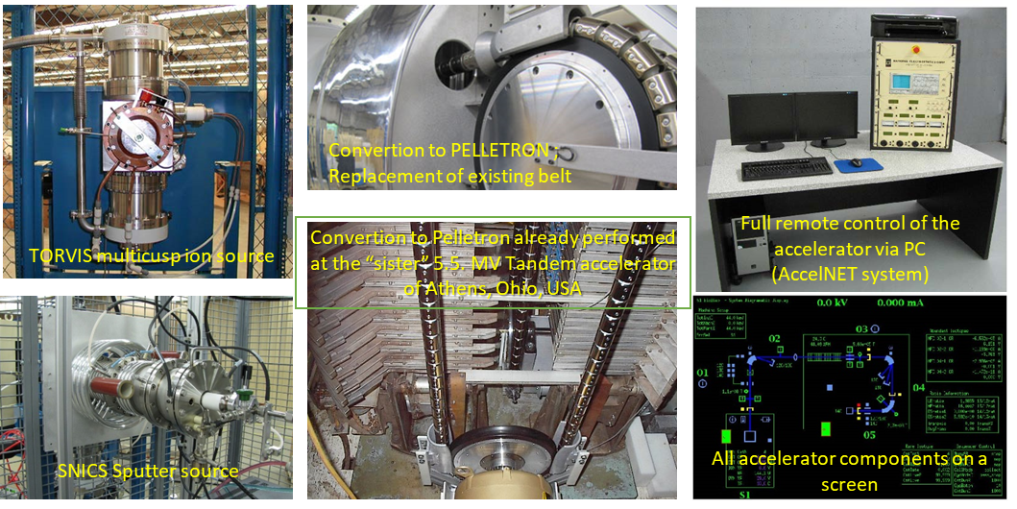
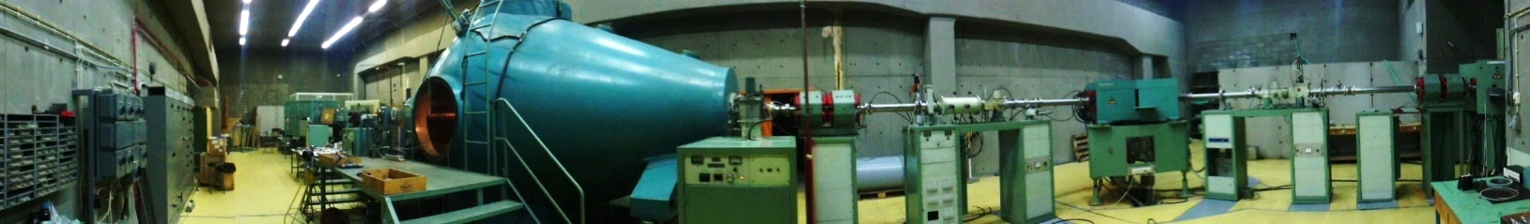
Experimental capabilities for surface analysis of plasma facing materials (1)
Ion Beam Analysis
Rutherford Backscattering Spectroscopy (RBS)
Nuclear Reaction Analysis (NRA)
Particle Induced X/Gamma-ray Emission (PIXE/PIGE) spectroscopy
Time-of-Flight Elastic Recoil Detection Analysis (ToF-ERDA) from early 2022
Milli- and micro-beam
5.5 MV Tandem Accelerator

Slide 3
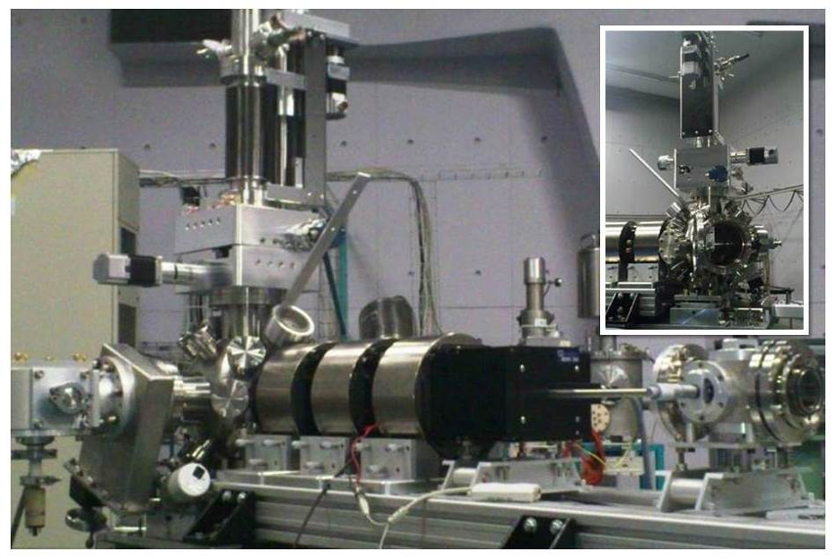
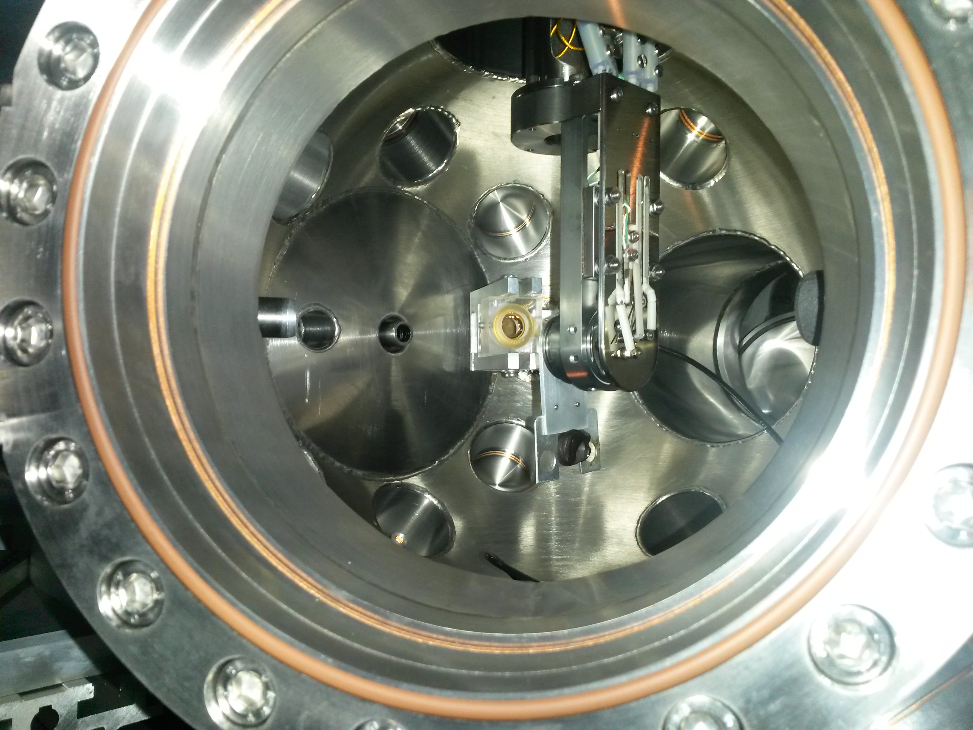
Experimental capabilities for surface analysis of plasma facing materials (2)
µ-beam facility
Spatial resolution 1.2 μm x 2 μm
Chamber’s features:
  Load – lock chamber
  X – Y - Z motorized sample holder
  Rotatable target holder
  Heating / Cooling
  Long range microscope for precision
  CCD camera for sample Monitoring
Detectors:
  PIXE SSD detector at 45º
  PIGE HPGe detector at 45º
  RBS SSB detector at 170º
  NRA SSB detector at 150º

Slide 4
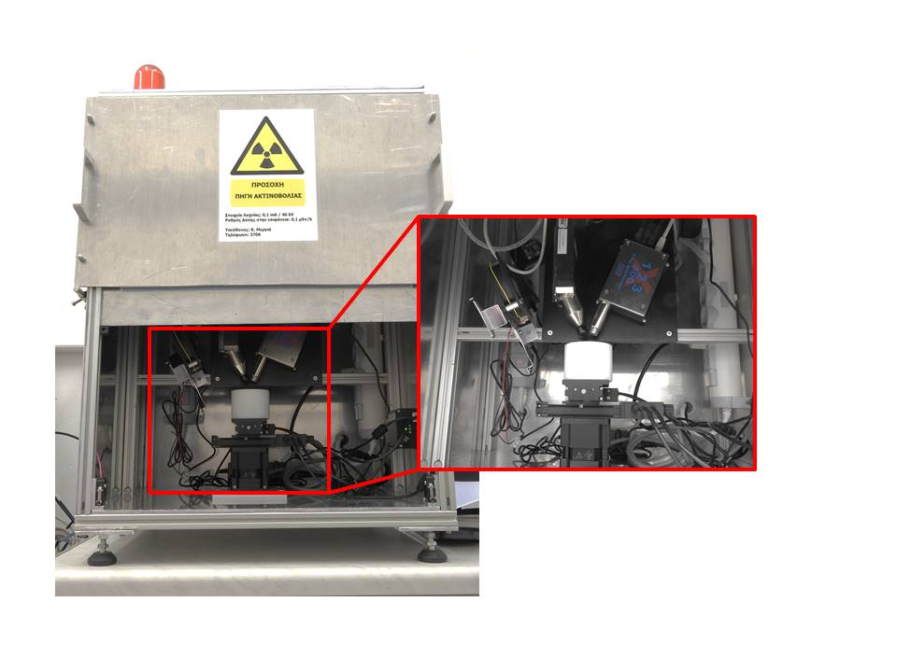
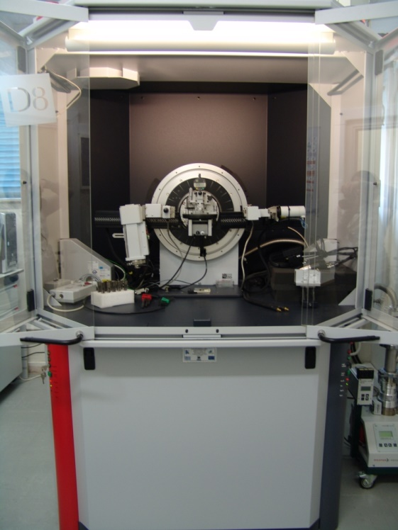
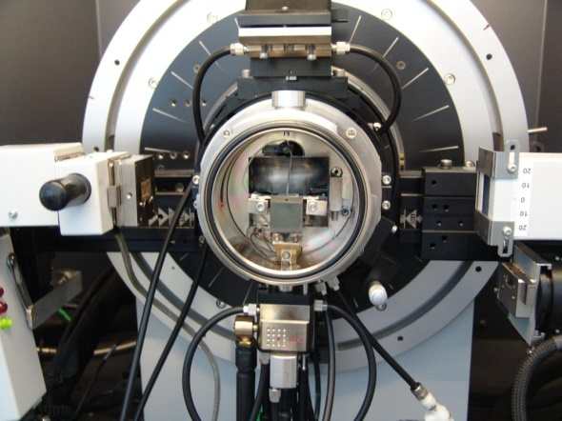
Experimental capabilities for surface analysis of plasma facing materials (3)
X-ray Fluorescence Spectroscopy (XRF)
  Elemental analysis for Z>11
X-ray Photo-electron Spectroscopy (XPS)
X-ray diffraction/reflectivity (XRD/XRR)
  Normal and incidence angle
  High speed linear position sensitive detector
  In-situ studies from LN2 up to 1500°C (XRD) or up to 800 °C (XRR)
Scanning Electron Microscopy (SEM) with EDX spectroscopy
  <1 nm resolution 0.2-30 kV
Transmission Electron Microscopy (TEM)
Atomic Force Microscopy (AFM)
XRF
XRD/XRR
XRD/XRR furnace

Slide 5
Be castellated Tiles from JET tokamak
Carbon deposition on the castellation sides – d micro-beam NRA
ILW-1 OPL (120)
ILW-2 OPL (320)
ILW-1 DP (80)
2B(C)2
DP
IWGL
Carbon amount on surface and cast. sides
ILW-1 IWGL outer (27)
ILW-1 IWGL outer (191)
OPL
4D14
2XR10
divertor
ILW-1 IWGL centre (174)
ILW-1 IWGL wing (76)

Slide 6
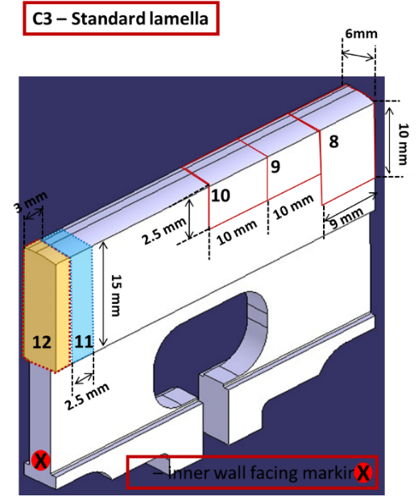
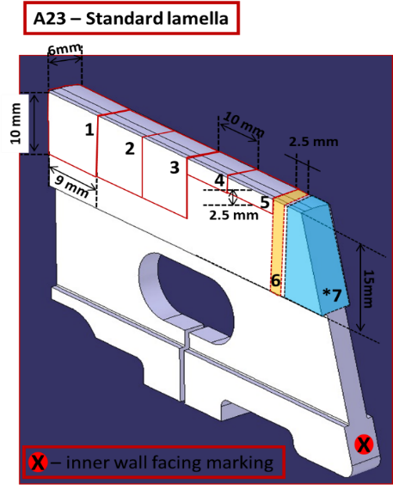
NRA results from stack A & C W lamellae – using d micro/mili-beam
Carbon depth profile and mapping
Carbon amount and deposition thickness using micro-beam
(ILW1) C3,12 (2)
ILW1
Measured surface
Exp. Period | W Lamella | Sample No | C Amount (10¹⁷ at/cm²) | Deposition Thickness (10¹⁸ at/cm²)
ILW1 | C3 | 12 (area 2) | 24.8 | 10.7
ILW1 | C3 | 12 (area 1) | 166 | 33
ILW1 | A23 | 7 | 2.21 | 10
(ILW1) C3, 12 (1)
Beryllium and Carbon amount using mili-beam
ILW1
Measured surface
(ILW1) A23, 7

Slide 7
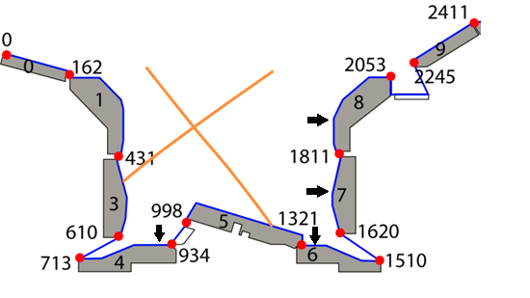
NRA and XRD results from W/CFC Tiles from the JET divertor
JET divertor
Elemental Quantification
 | Atomic surface density (10¹⁸ at/cm²)
Element | Tile 4 | Tile 6 | Tile 7 | Tile 8
C | 0.36 | 3.46 | 0.36 | 0.30
Be | 0.90 | 9.00 | 0.80 | 0.74
D | 1.0 | 2.25 | 0.70 | 1.02
O | 0.40 | 1.13 | 0.20 | 0
N | 0 (0.023) | 0.23 | 0 (0.092) | 0 (0.058)
A. Lagoyannis et al, Nucl. Fusion (2017) 076027 (7pp)

Slide 8
2026 workplan
Post-mortem analysis of PFC and diagnostic components from JET
Ion beam analysis using RBS/NRA, TOF-ERDA and μ-NRA measurements.
Note: we are licensed from GAEC to handle activated samples

Slide 9

Thank You!

